Slide 1
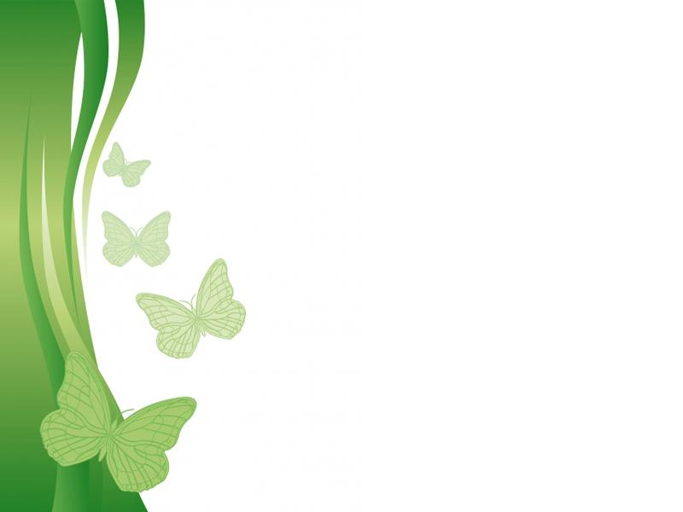
بسم الله الرحمن الرحیم
Free Powerpoint Templates

Slide 2
دکتر فاطمه نجات بخش
متخصص طب سنتی ایرانی
عضو هیئت علمی دانشکده طب سنتی
دانشگاه علوم پزشکی تهران

Slide 3
Treatment of male infertility with “Loboob”; an Iranian traditional medicament

Slide 4
Background:
Infertility is defined as the inability to conceive after 12 or more months of regular intercourse without contraception.
Infertility is a common condition with a prevalence of 10-15% in different societies.

Slide 5
Background:
Sperm abnormalities are introduced as 20-47 % of infertility etiology.
Idiopathic male subfertility is common (40-50%).

Slide 6
Background:
many different treatments have been used include androgens, gonadotropins, and antiestrogens.
androgen therapy in a study showed no significant improvement on semen parameters.

Slide 7
Background:
Gonadotropins especially FSH have been conflicting, and Pure FSH has been 49% effective.
GnRh, has lower success in comparison with gonadotropines.
Antiestrogens like clomiphene can be useful only in 10-28% of cases.

Slide 8
Background:
Unfortunately, up to now no definite medical treatments have been found to improve semen parameters or fertilization rate in men with idiopathic subfertility.

Slide 9
Background:
Fertilization rate with assisted reproductive techniques (ART) which are very expensive, invasive, with both low conception rates per cycle and potential risks is about
7-40% in literatures.

Slide 10
Background:
In Iranian traditional medicine, various treatment modalities for male infertility are available with “Loboob electuary” being one highly recommended.

Slide 11
Method:
retrospective case series study
“Loboob” effectiveness was evaluated on 13 infertile men suffering from idiopathic oligoasthenoteratospermia who were treated with 10g twice daily for at least 100 days.

Slide 12
Ingredients of Loboob electuary
Name of drugs | Ratio (unit)
Pistachio | 5
Cocos nucifera | 5
Corylus avellana L. | 5
Pinus gerardiana | 5
Prunus species | 10
Sesamum orientale | 10
Sugar | 10
Myristica fragrans | 1
Lepidium sativum | 1
Piper elongatum | 1

Slide 13
Ingredients of Loboob electuary
Name of drugs | Ratio (unit)
Medicago sativa L. | 1
Zingiber officinale | 2
Piper cubeba | 2
Boswellia carteri | 2
Statice limonium L. | 3
Centaurea behen | 3
Alyssum minus L. | 6
Skink | 1
Urtica dioica L. | 1
Honey | 140

Slide 14
Cases report:
Meanwhile no other drugs except the Loboob electuary were given to the patients.
All patients reported improvement of libido and erectile function, post electuary use.

Slide 15
Cases report:
There was no report of drug intolerance.
Wives of 11 cases (84/6%) became pregnant after a mean of 4/8±2 months (with a range of 3/3 and 10/6 months).

Slide 16
Cases report:
All the 11 wives who became pregnant had a normal term pregnancy and gave birth to normal babies.

Slide 17
Cases report:
In two other cases with very low sperm count (0.1×10⁶/ml) , follow up tests after 4 months in one and 5 months in another didn't show any changes in sperm count.

Slide 18
Summary of patients’ information
No | Age (yr) | Infertility duration (yr) | Sperm count (×10⁶/ml) | Sperm Motility (%) | Sperm normal Morphology (%) | Past history | Pregnancy in wives | Tx duration (month)
1 | 27 | 5 | 17.6 | 50 | 52 | Varicocele with surgery 3 years ago | + | 10.6
2 | 25 | 2 | 12 | 70 | 70 | - | + | 3.3
3 | 23 | 3 | 15 | 70 | 40 | - | + | 5.3
4 | 35 | 10 | 19 | 30 | 18 | 1 Abortion 1 year ago | + | 4.2
5 | 26 | 4 | 0.5 | 40 | 25 | - | + | 4
6 | 26 | 3 | 11 | 40 | 30 | - | + | 3.6
7 | 34 | 9 | 18 | 35 | 23 | Abortion 3 years ago | + | 5
8 | 37 | 6 | 8 | 40 | 4 | IUI with pregnancy | + | 4.4
9 | 37 | 10 | 4 | 1 | 15 | IUI and IVF without any result | + | 7
10 | 37 | 2 | 16 | 40 | 20 | - | + | 4.6
11 | 32 | 1 | 13 | 40 | 5 | - | + | 5
12 | 35 | 8 | 0.1 | 0 | 1 | IVF without any result | - | 5
13 | 29 | 4 | 0.1 | 0 | 1 | - | - | 4

Slide 19
Discussion:
it seems that Loboob electuary is effective in patients with sperm counts of ≥ 0/5×10⁶/ml and in those with lower sperm counts, the treatment would not be useful.

Slide 20
Discussion:
It might be that an extended duration of treatment can lead to different results and also having the semen analysis repeated during the treatment can yield evidence of its effects.

Slide 21
Discussion:
Since successful pregnancy rate in healthy couples is 20% in a normal cycle, an average of 4/8 months for successful fertility with Loboob electuary would be very remarkable.

Slide 22
Discussion:
Since spermatogenesis takes 70 days and sperm transfer from epididymis to ejaculatory duct lasts 12-21 days, it seems that Loboob electuary could resolve sperm abnormalities in the first 90 days required for sperm formation and transfer, and lead to successful fertilization.

Slide 23
Discussion:
However, more studies should be made to clarify its efficiency on sperm count, motility and dysfunction.

Slide 24
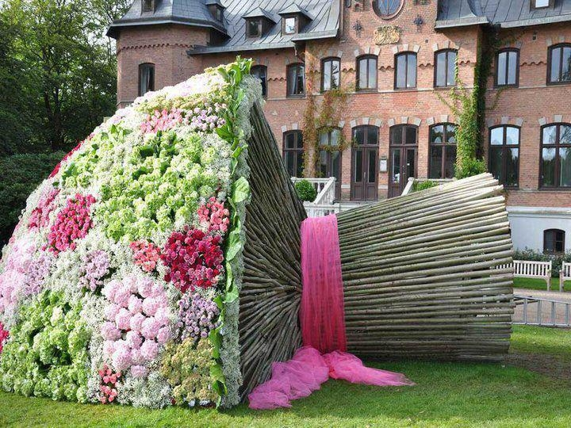
تقدیم به شما

