Slide 1
Cellular Mechanisms of arterial hypertension
Prof. Nader Gordjani MD Ph D
Children´s Hospital Offenbach
University of Frankfurt
University of Freiburg

Slide 2
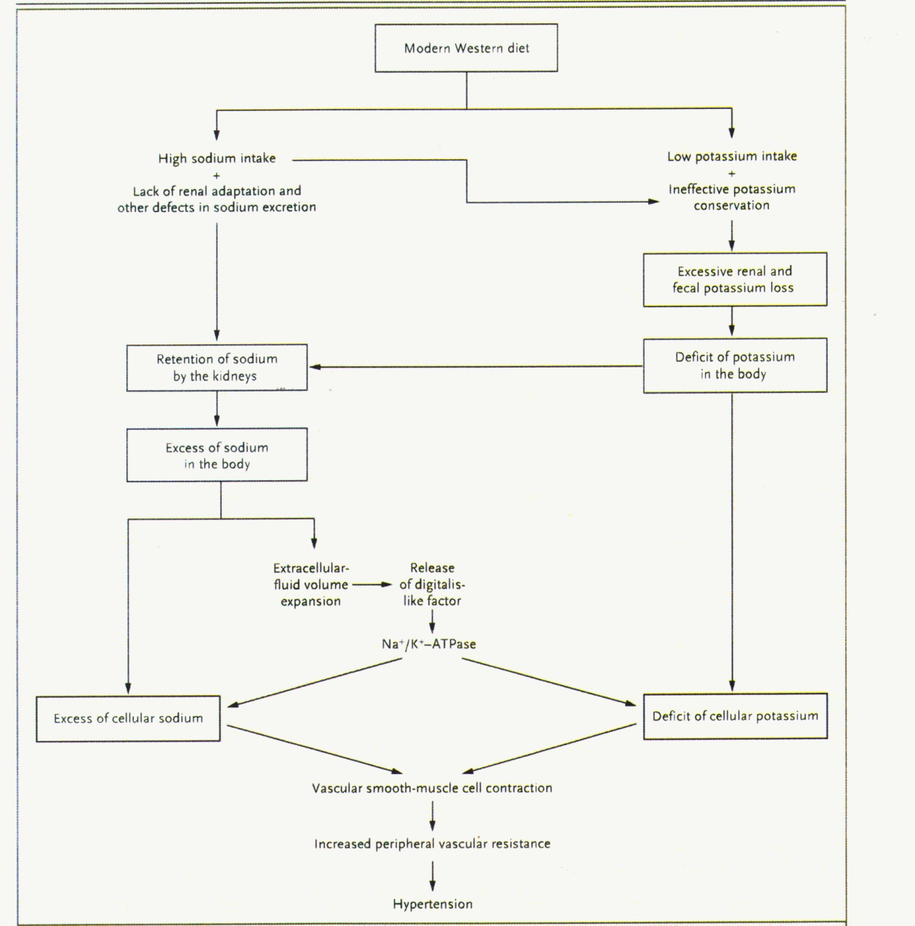
Arterial Hypertension and Salt
General considerations
Adrogue et al. New Engl J Med 2007

Slide 3
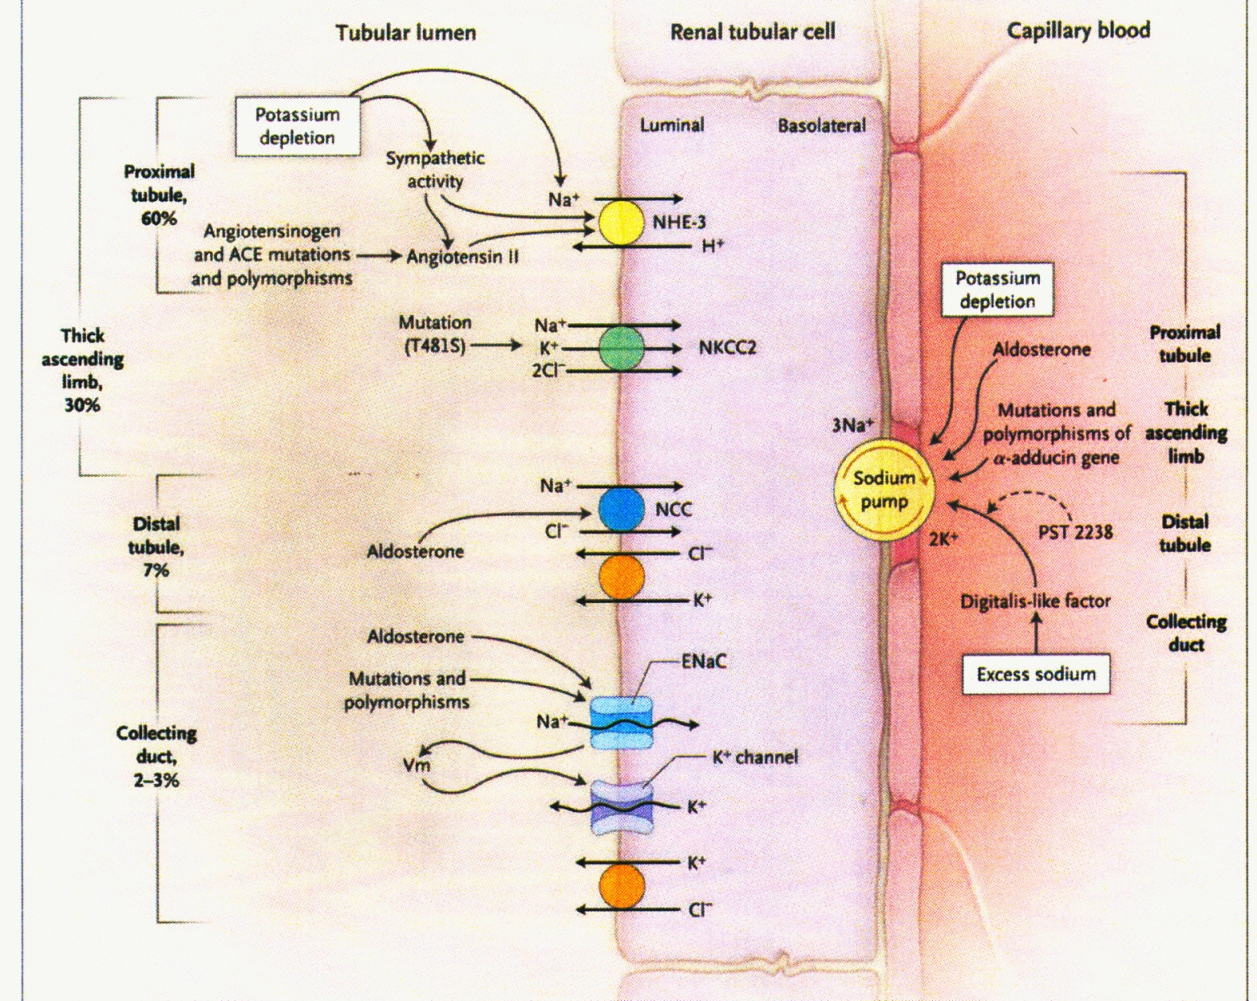
Arterial Hypertension and Salt
General considerations
Adrogue et al. New Engl J Med 2007

Slide 4
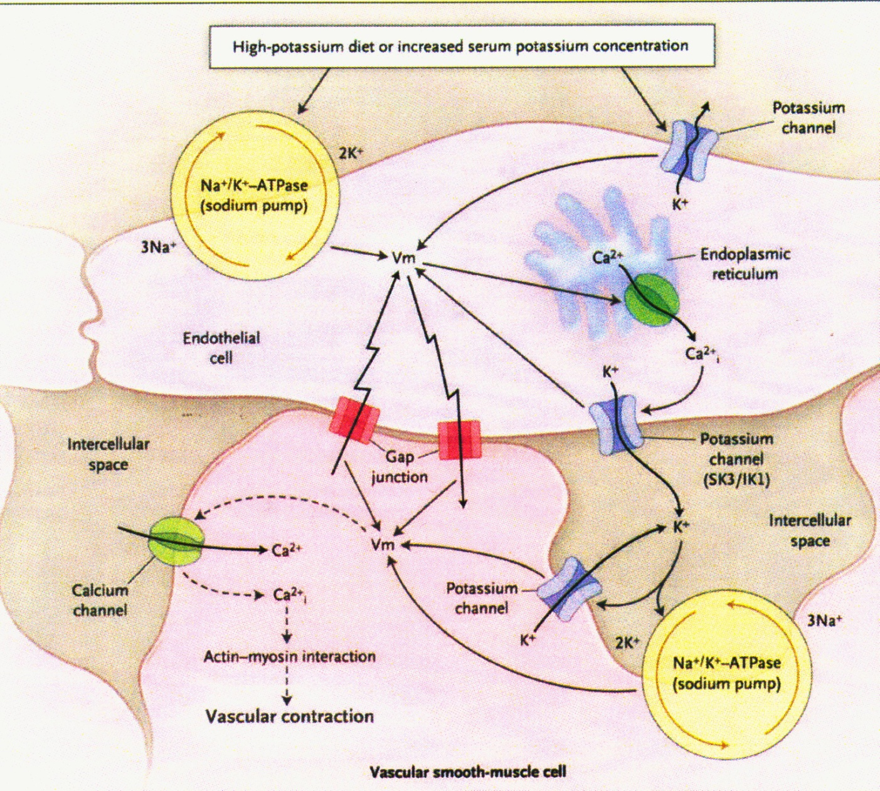
Arterial Hypertension and Salt
General considerations
Adrogue et al. New Engl J Med 2007

Slide 5
Arterial Hypertension and Salt
General considerations
Gordjani et al. 1987

Slide 6
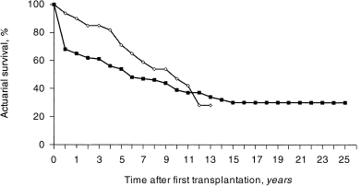
Arterial Hypertension and Salt
Transplantat Überlebensrate [%]
AZA (n=79)
CyA
CyA (n=79)
General considerations
Jahre nach Transplantation
Offner et al. 1997

Slide 7
CyA-induced hypertension is salt-sensitive
General considerations
Curtis J. Am J Med 85:134-138 (1988)

Slide 8
Arterial Hypertension cellular mechanisms
Cyclosporin A
Renin
Sympathikotonus
Angiotensin II
zytosol. Ca²⁺
Endothelin
Vasokonstriktion
Tubulusepithel ?
Hypertonus
General considerations
Ischämie
Na⁺/Cl⁻ Retention
TGF-ß
Int.Fibrose

Slide 9
Mechanisms of Volume expansion
Na⁺
K⁺,H₂O
Cl⁻
Volumenexpansion
Na⁺
Na⁺
3
ATP
H⁺
K⁺
Arterielle
Hypertonie
Ca2+
c AMP
H⁺
Amilorid
EIPA
HOE 694
1
Na⁺
Tubulus-Lumen
Blut

Slide 10
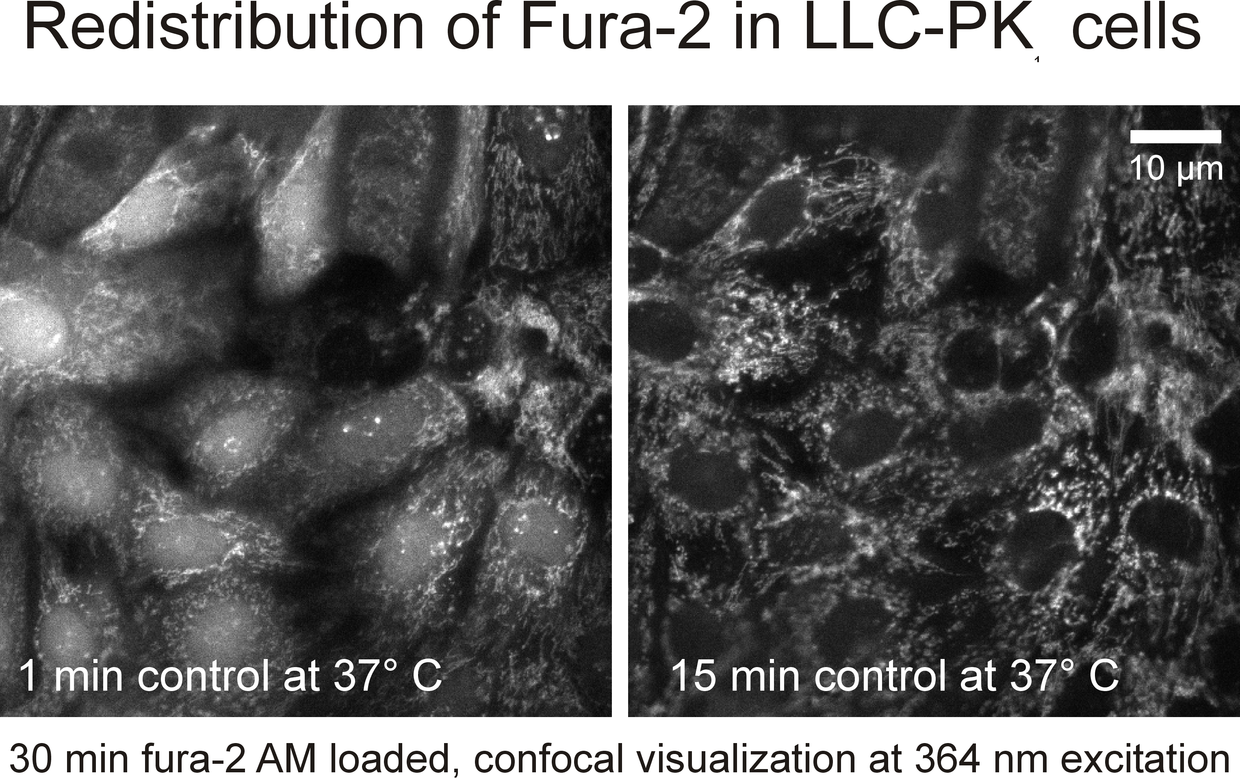
Methods
Fluoreszenzmikroskopie:
Intrazelluläre Ca²⁺-Konzentration: Fura 2
Intrazellulärer pH: BCECF (NHE3-activity)
Zellkultur:
LLC-PK₁/PKE₂₀

Slide 11
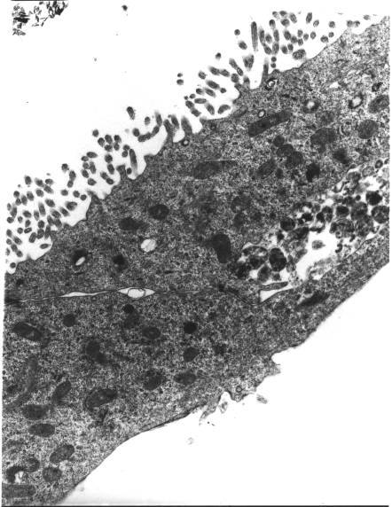
LLC-PK₁/PKE₂₀ proximal Tubular cells

Slide 12
Arterial Hypertension and Salt
General considerations
Adrogue et al. New Engl J Med 2007

Slide 13
CyA induces Increase of cellular Ca²⁺- activity of proximal Tubuls of the rabbit

Slide 14
Arterial Hypertension and Salt
General considerations
Adrogue et al. New Engl J Med 2007

Slide 15
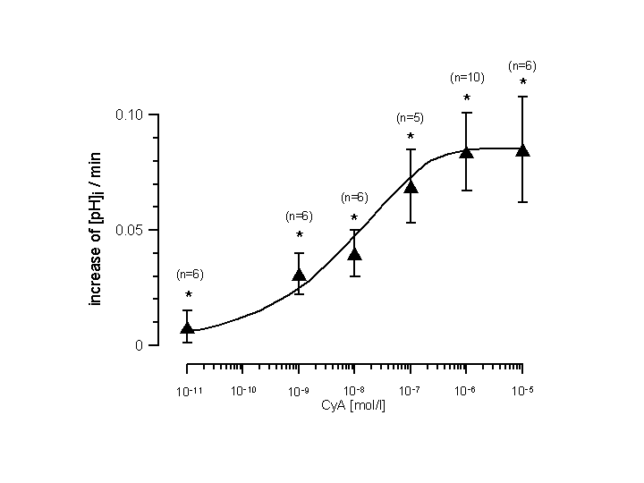
CyA activates Na⁺/H⁺-Exchange in dose dependant manner

Slide 16
CyA activates apical Na⁺/H⁺-Exchange
Δ
Δ

Slide 17
Apical NHE3 of LLC-PK₁/PKE₂₀ cells can be inhibited specifically
∆-

Slide 18
24 h-exposure stimulates NHE3

Slide 19
Stimulation of Na⁺/H⁺-Exchange depends on cellular Ca²⁺-stores
Δ

Slide 20
Activation of Na⁺/H⁺-Exchange by Angiotensin II via AT-1 Rezeptor
*
*
Δ-
Δ-

Slide 21
Proximal Na⁺-Reabsorbtion
Na⁺
K⁺,H₂O
Cl⁻
Na⁺
Na⁺
3
ATP
H⁺
K⁺
Angio II
AT1
Ca²⁺
H⁺
CyA
1
Na⁺
Tubulus-Lumen
Blut

Slide 22
Summary of results
Cyclosporin A activates apical Na⁺ /H⁺ Exchange (NHE3) on the apical membrane of proximal tubular cells.
This can cause Na⁺ /Cl—Retention and secondary arterial hypertension.
NHE3-activation is mediated by Ca²⁺ release from internal cellular stores:
directly via stimulation by Cy A
Through store release by Cy A
CyA may also act via sensitization of AT1 Receptors exagerating the NHE3 response to Angiotensin effect.

Slide 23
Conclusions
Sodium restriction seems justified.
As monotherapy an Angiotensin-Converting-Enzyme Inhibitor seems appropriate.
If necessary saluretic therapy can be added.

Slide 24
Matthias Brandis
Thomas Epting
Philipp Fischer-Riepe
Rainer Greger
Kathrin Hartmann
Karl Kunzelmann
Jens Leipziger
Viktoria Müller
Roland Nitschke
Beth Padden
Anne Catherine Passaquin
Hermann Pavenstädt
Urs Ruegg
Anna Sandqvist
Barbara Schönfeld

Slide 25
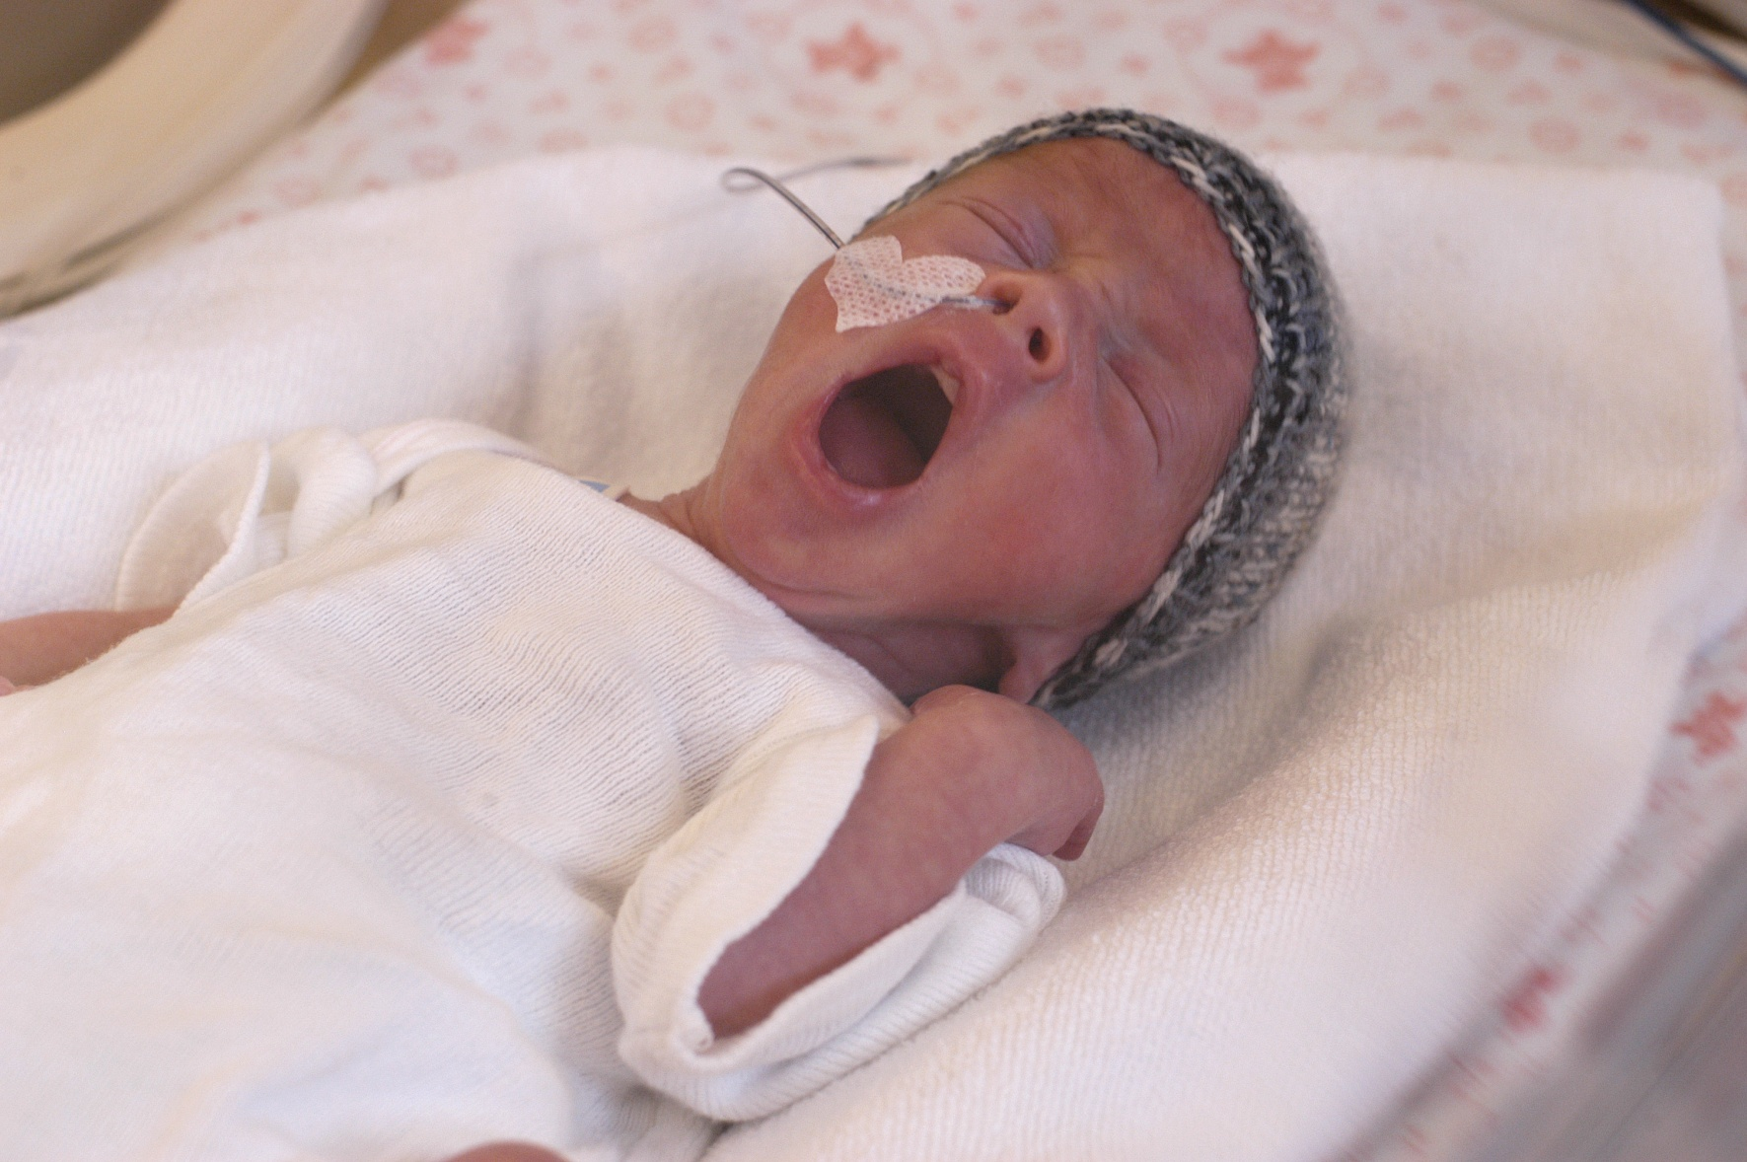
Danke für Ihre Aufmerksamkeit!
General considerations

Slide 26
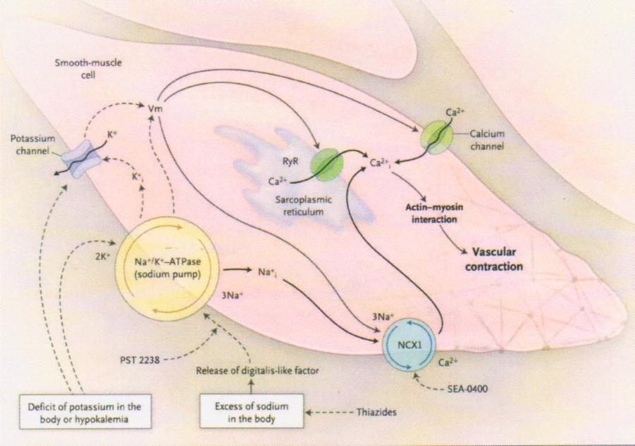
Arterial Hypertension and Salt
General considerations
Adrogue et al. New Engl J Med 2007

