Slide 1
Notes:
It may be very difficult to find a logical relationship among all these components.
But evidence-based medicine-which is commonly known as EBM-will help us to find the answer.

Slide 2
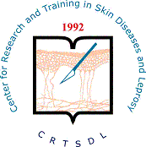
Update on Cutaneous Leishmaniasis
Alireza Firooz, MD
Professor of Dermatology
Center for Research and Training in Skin Diseases and Leprosy
Tehran University of Medical Sciences
Notes:
In the name of god, in-compassionate, the merciful.
Dear chair persons, dear colleagues:
I am going to talk about an evidence-based approach to treatment of acute Old World cutaneous leishmaniasis.

Slide 3
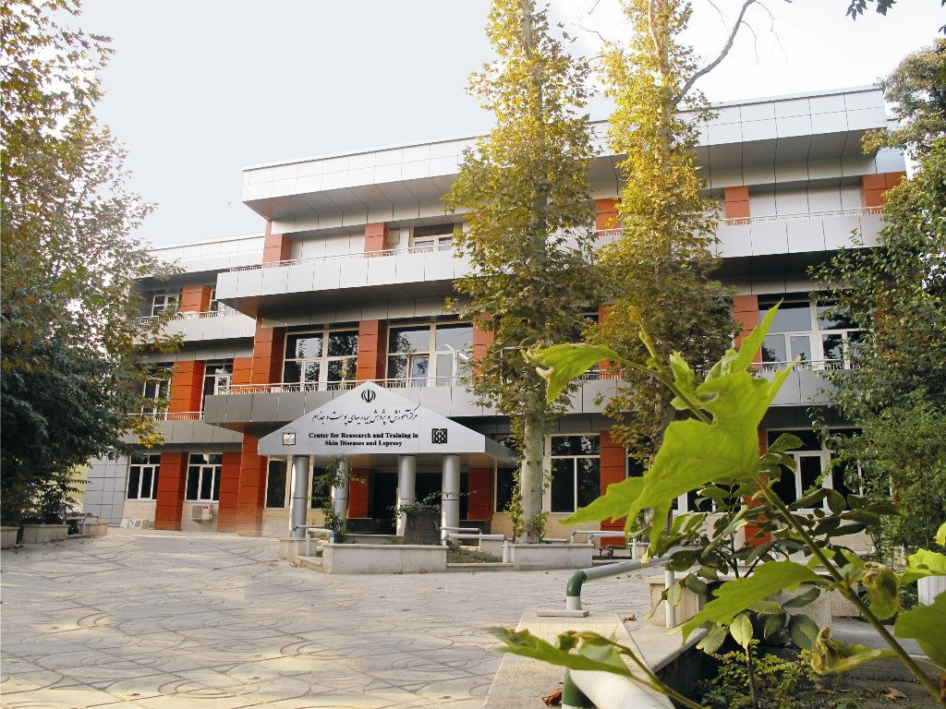

Slide 4
Outline of the Presentation
Background
Classification and terminology
Epidemiology
Clinical manifestations
Differential diagnosis
Diagnosis
Treatment
Prevention

Slide 5
Background
Leishmaniases are a group of diseases caused by several specious of protozoa of the genus Leishmania which can result in a wide spectrum of clinical syndromes ranging from single cutaneous ulceration to systemic infections.
The protozoa are transmitted to mammals via the bite of the female sandfly.

Slide 6
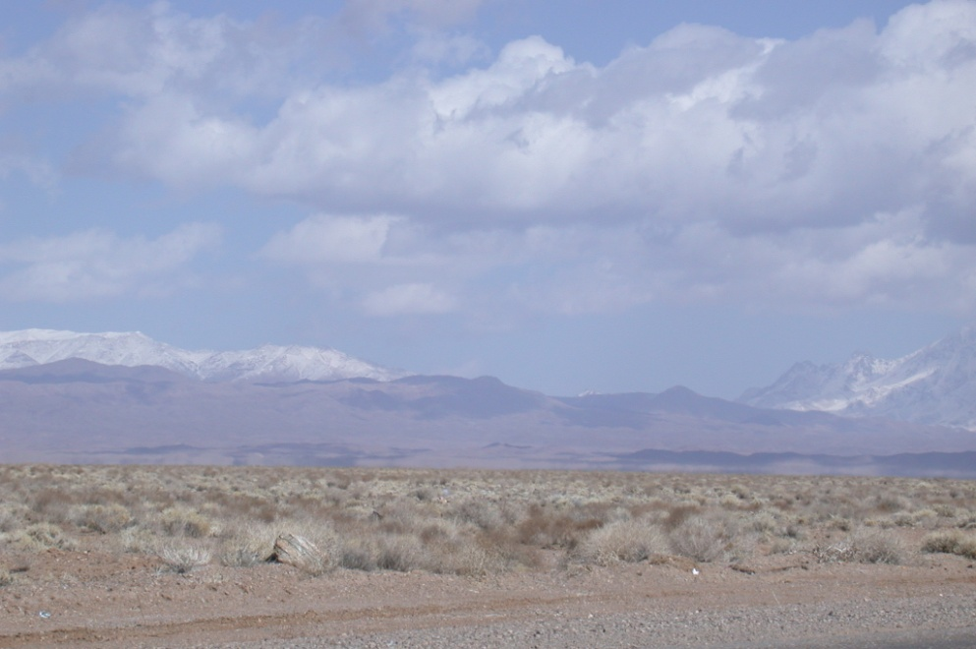
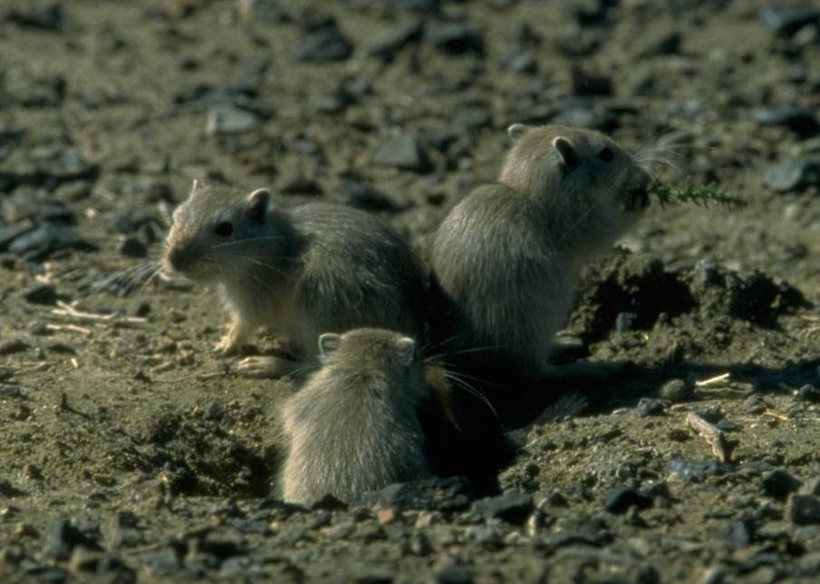
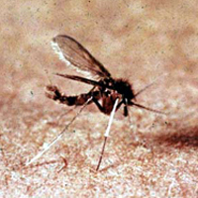
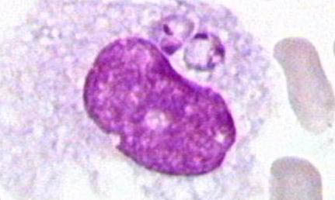
Environment, reservoir, vector, parasite

Slide 7
Leishmaniases: Classification
Leishmaniases
Visceral Leishmaniasis
Cutaneous Leishmaniasis (CL)
Mucocutaneous Leishmaniasis
Old World CL
New World CL
Post-Kala-Azar Dermal Leishmaniasis
Diffuse Cutaneous Leishmaniasis
Leishmania Recidivans
Localized Cutaneous Leishmaniasis (LCL)

Slide 8
Old-World CL: Terminology
Synonyms:
Oriental sore
Bouton d’orient
Delhi boil
Aleppo boil (evil)
Baghdad sore
Sa’lak (Iran)
Sa’ldaneh (Afghanistan)

Slide 9
Epidemiology

Slide 10
Epidemiology
90 countries affected (77 developing ones)
350 millions at risk
Prevalence: 12 millions
Incidence 1.5-2 millions
¾ CL
¼ VL (mostly children)
Major health problem:
5 countries visceral
14 countries cutaneous leishmaniasis (CL)
90% of VL in 7 countries
80% of CL in 7 countries

Slide 11
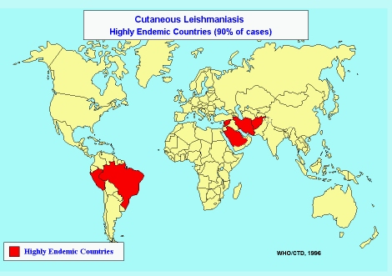
Notes:
EBM is a stepwise method:
The first step is to formulate a well built clinical question.
This is followed by searching for finding the best current evidence.
The third step is to critically appraise the found evidence.
The forth step is composed of integrating the data with patient values and clinical expertise.
Appropriate storage of the gathered data makes the last step.

Slide 12
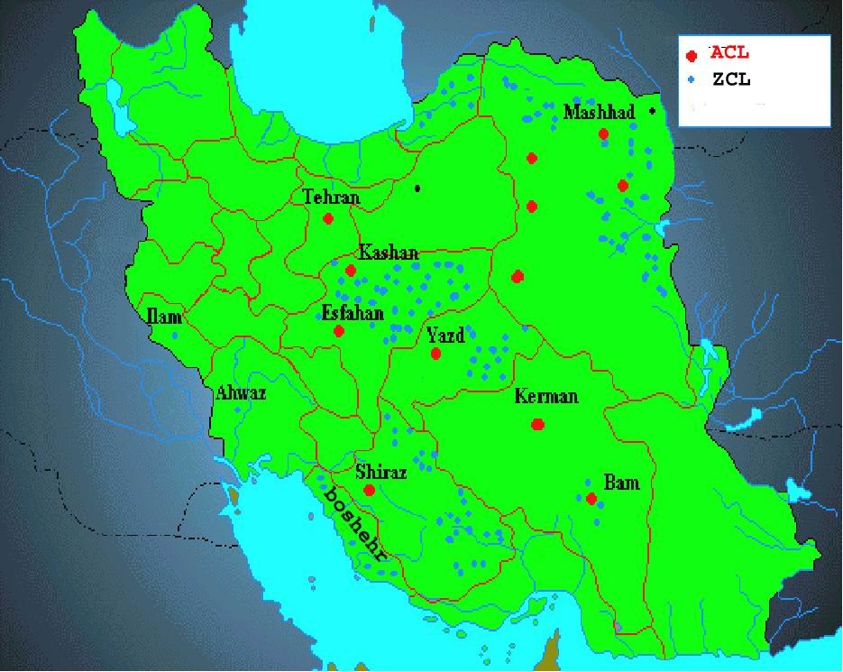
Notes:
It may be very difficult to find a logical relationship among all these components.
But evidence-based medicine-which is commonly known as EBM-will help us to find the answer.

Slide 13
Etiology and Pathogenesis

Slide 14
Old World Cutaneous Leishmaniasis (CL)
Caused by:
Leishmania major
L. tropica
L. aethiopica
L. donovani infantum

Slide 15
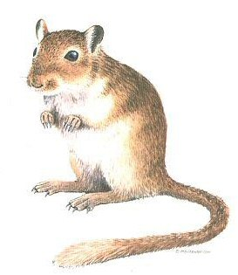
Life Cycle of Leishmania major (Zoonotic CL)

Slide 16
Life Cycle of Leishmania tropica Anthroponotic CL
Notes:
The hierarchy of the evidences concerning treatment, is demonstrated in this table.
As will be discussed later, only levels 1b and 2b evidences were found during this review.

Slide 17
Determinants of clinical manifestations
Parasite spp.
Host response (immune system condition)
Size of inoculation

Slide 18
Immunology
Th1 response (g-INF, IL-2, IL-12) leads to localized cutaneous leishmaniasis with high CMI (+ leishmanin test) and low HI (no antibody)
Th2 response (IL-4, IL-5, IL-10) leads to diffuse cutaneous and visceral leishmaniasis with low CMI (- leishmanin test) and high HI (high antibody titre)
This paradigm is quite similar to leprosy: Th1 response leads to tuberculoid leprosy and Th2 response leads to lepromatous leprosy

Slide 19
Common Clinical Manifestations

Slide 20
CL Due to L. major
Also known as: wet, rural, zoonotic CL (ZCL)
Acquired in rural areas
Infecting organisms are also rodent parasites (and are poorly adapted to humans)
Hosts: gerbils esp. Rhombomys, Meriones (Asia, north Africa, Sudan); rodents esp. Avicanthus, Tatera
Vectors: Phlebotomus papatasii (Asia, north Africa, Sudan); P. duboscqi (Sub-Saharan savanna, Sudan)
Notes:
For each article a CAT was developed, which included:
Citation
Research question
Clinical bottom line
Study design (e.g.: RCT, double-blinded RCT, etc)
Control group
Experimental group
Validity criteria (randomization, concealment of randomization list, patient allocation, blinding, etc)
Importance criteria (RRR, ARR, NNT)
Applicability
Abstract

Slide 21
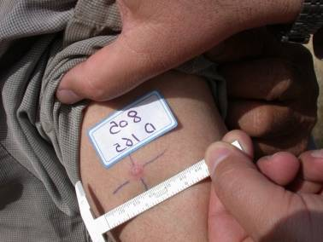
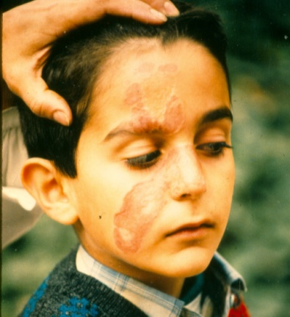
CL due to L. major: clinical course
< 2 months
After 2 weeks
2-3 months
2-6 months

Slide 22
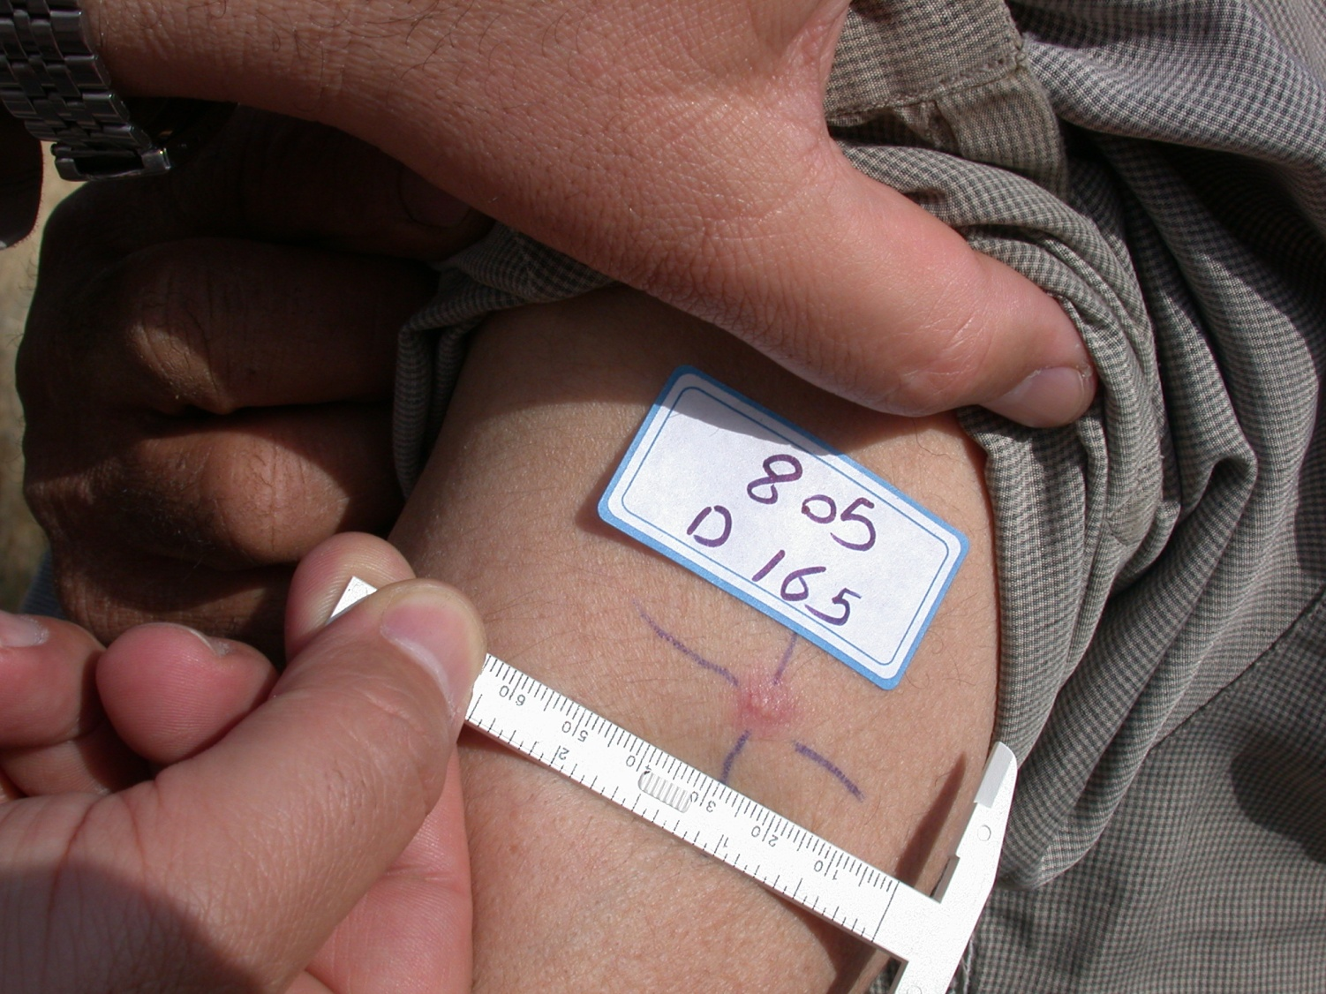
CL due to L. major: early lesion

Slide 23
CL due to L. major: crust formation

Slide 24
CL due to L. major: ulcerative lesion

Slide 25
CL due to L. major: healing and scar formation

Slide 26
CL due to L. tropica
Also known as: dry, urban, anthroponotic CL (ACL)
Towns in Middle East, Mediterranean basin, Central Asia
Reservoir: Humans, ?dogs
Vector: P. sergenti
Notes:
For each article a CAT was developed, which included:
Citation
Research question
Clinical bottom line
Study design (e.g.: RCT, double-blinded RCT, etc)
Control group
Experimental group
Validity criteria (randomization, concealment of randomization list, patient allocation, blinding, etc)
Importance criteria (RRR, ARR, NNT)
Applicability
Abstract

Slide 27
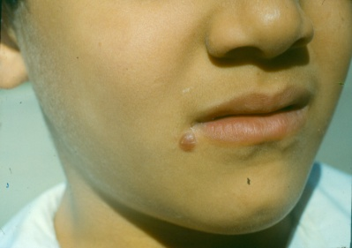
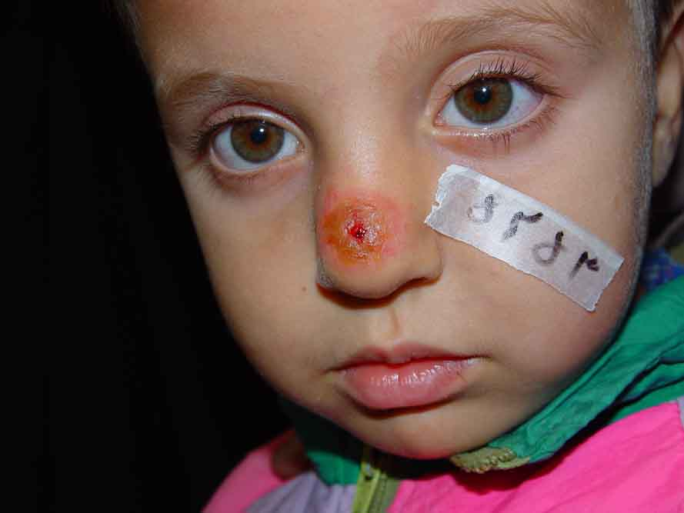
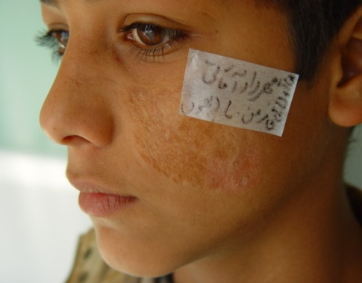
CL due to L. tropica: clinical course
>2 months
Over 6 months
The same stage
8-12 months

Slide 28
CL due to L. tropica: early lesion

Slide 29
CL due to L. tropica: plaque stage

Slide 30
CL due to L. tropica: ulcerative lesion

Slide 31
CL due to L. tropica

Slide 32
Leishmaniasis recidivans
Also known as: lupoid leishmaniasis
In one of our recent studies from Bam (Iran), 18.7% of ACL cases in school children had leishmaniasis recidivans.
Brown-red or brown-yellow papules appear, usually close to a scar of an old lesion of CL or actually in the scar.
They coalesce and form a plaque closely resembling lupus vulgaris, even to the formation of apple-jelly nodules

Slide 33
Leishmaniasis recidivans
The recidivans lesion is the result of a peculiar host reaction in which cellular immunity fails to sterilize the lesion, despite the presence of exaggerated hypersensitivity.
Although not as destructive as lupus vulgaris, lupoid leishmaniasis may persist and spread slowly for many years.

Slide 34
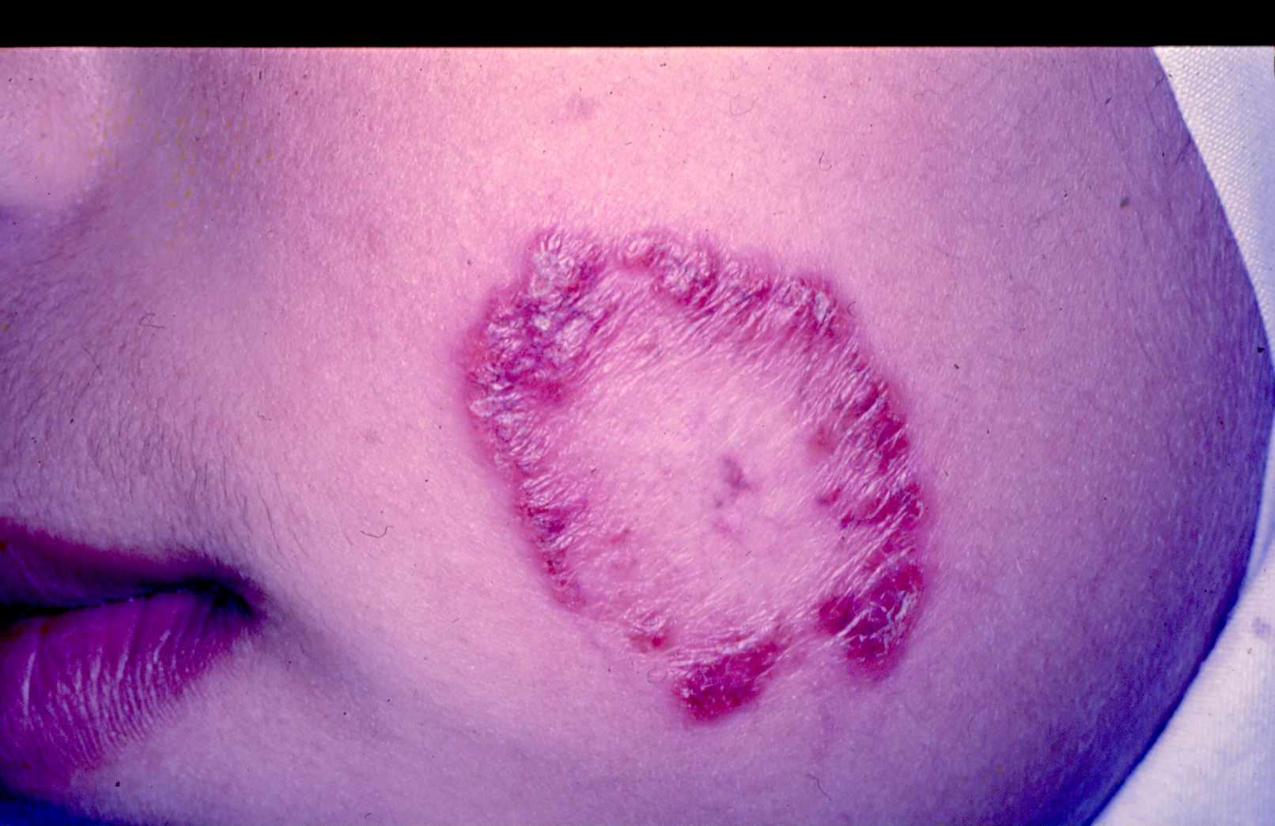
Leishmaniasis recidivans

Slide 35
Post-kala-azar dermal leishmaniasis (PKDL)
Generally occurs 1-3 years after recovery of VL
L. donovani
India and Bangladesh
Dermatologic manifestations:
Small hypopigmented macules: 1st appeared lesions enlarge to large irregular patches; develop on the chest, back, anterior thighs, arms and neck.
Erythematous macules: 2nd appeared lesions; esp. on the face (with a malar distribution) and areas of hypopigmented patches).
Nodules: last developed lesions soft, painless, non-ulcerative, yellowish-pink nodules; may appear on previous lesions or de novo; most commonly involve face and earlobs, trunk and genitalia.

Slide 36
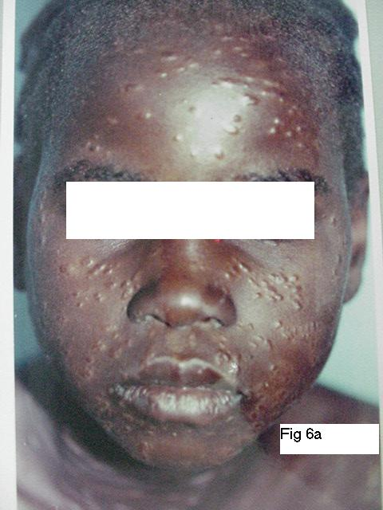
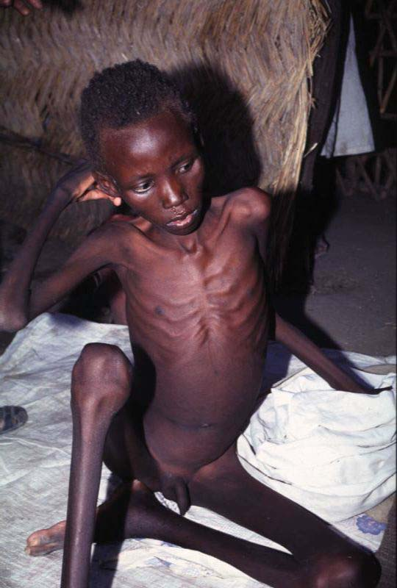
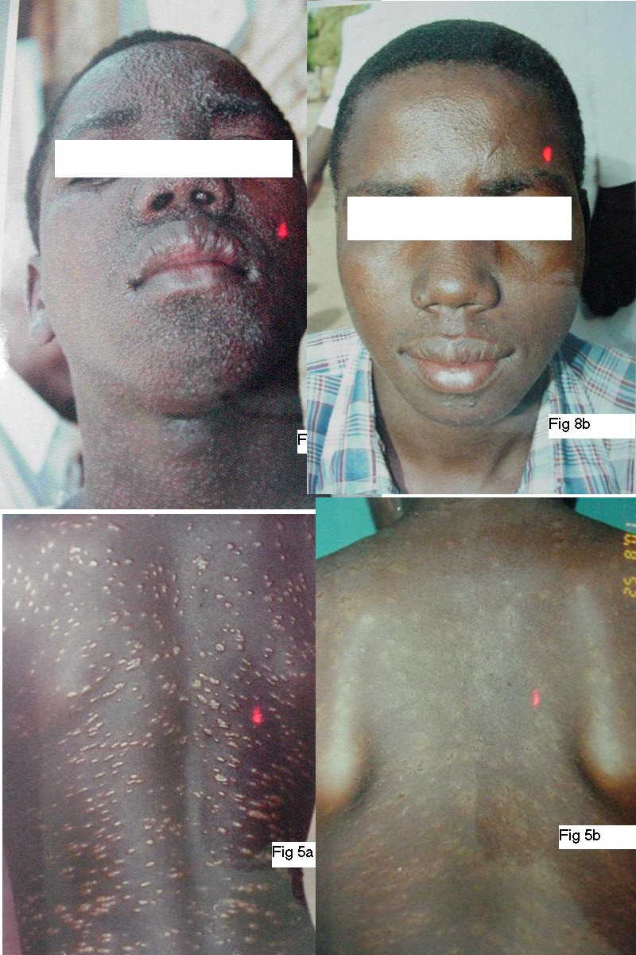
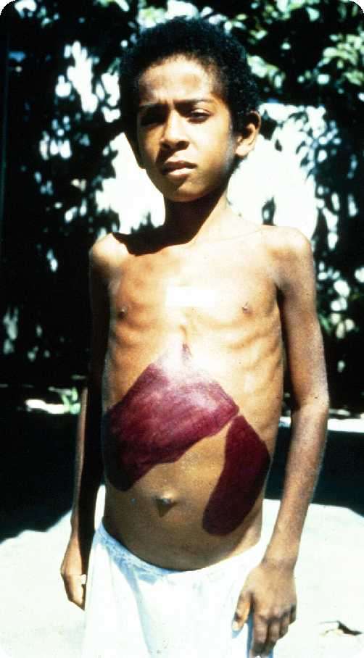
Post-kala-azar dermal leishmaniasis (PKDL)
PKDL
Kala azar

Slide 37
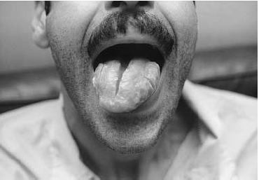
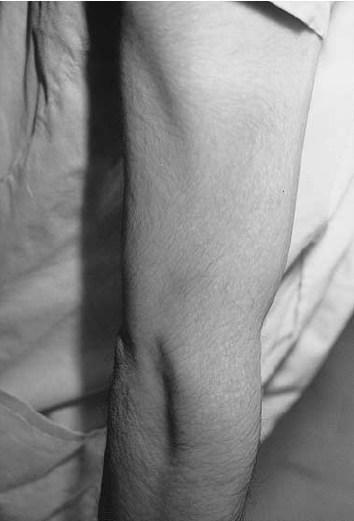
PKDL: A rare presentation
1
1. Macroglosia with scrotal tongue
2. Hypopigmented macules on the arm
2
Source: Nikzad et al. Int J Dermatol 2005

Slide 38
Less Common Clinical Manifestations

Slide 39
Sporotrichoid type

Slide 40
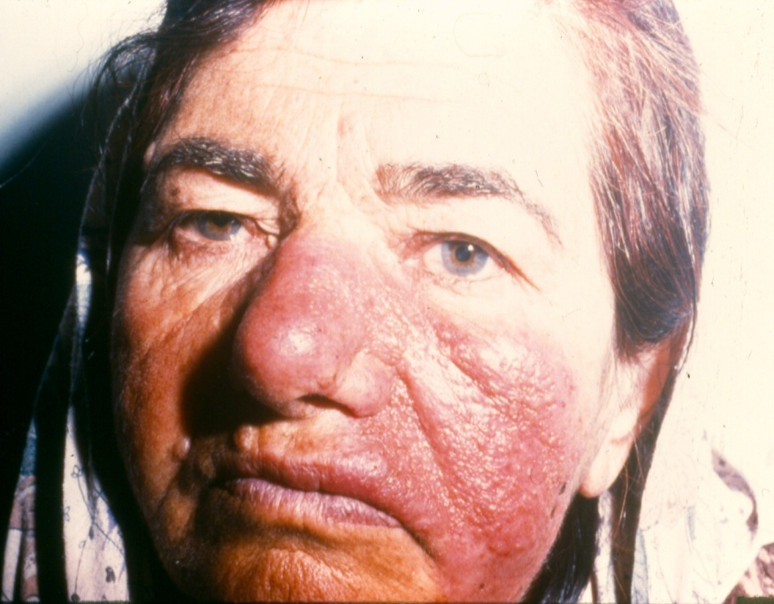
Erysipeloid CL

Slide 41
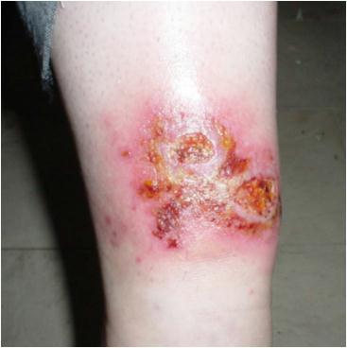
Impetigenized type

Slide 42
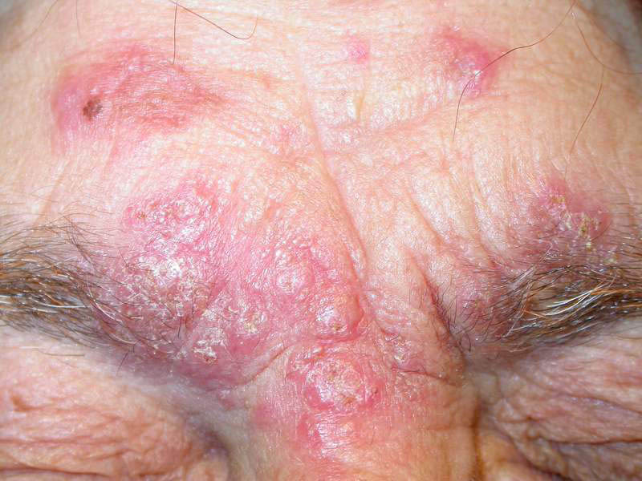
Psoriasiform CL

Slide 43
Verruciform CL

Slide 44
CL lesions due to auto-inoculation

Slide 45
CL lesion on the scalp

Slide 46
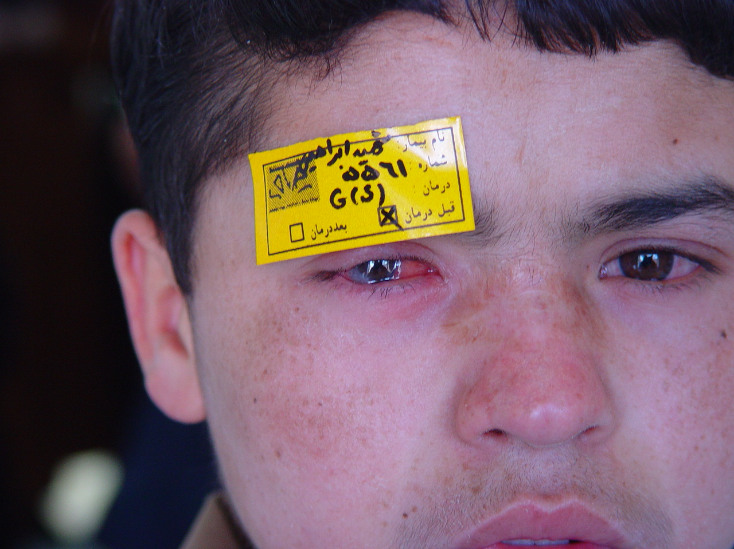
Eye involvement

Slide 47
CL: Differential Diagnosis
Infections
Fungal
Sporotricosis, chromoblastomycosis, etc
Bacterial
Mycobacterioses
Leprosy, lupus vulgaris, etc
Staphylococcal/ streptococcal pyodermas
Ecthyma, impetigo, etc
Viral
Orf, warts, etc
Inflammatory
Psoriasis, lichen planus, DLE, sarcoidosis, etc
Neoplastic
BCC, SCC, CTCL, keratoacanthoma

Slide 48
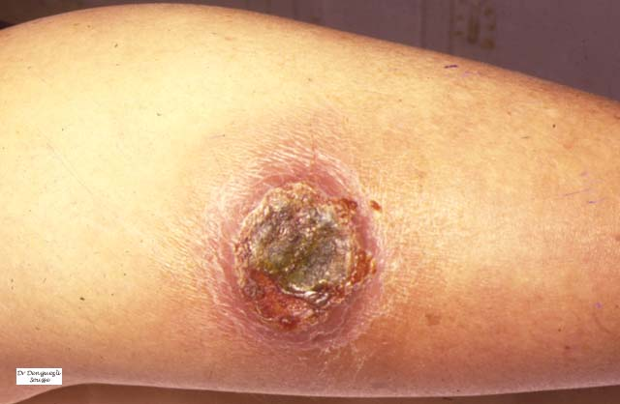
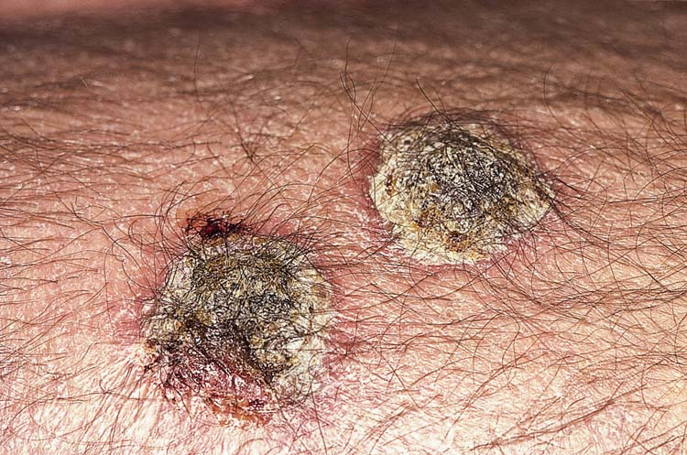
CL: Differential Diagnosis
Ecthyma
Cutaneous Leishmaniasis

Slide 49
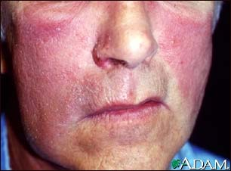
CL: Differential Diagnosis
Erysipelas
Cutaneous Leishmaniasis

Slide 50
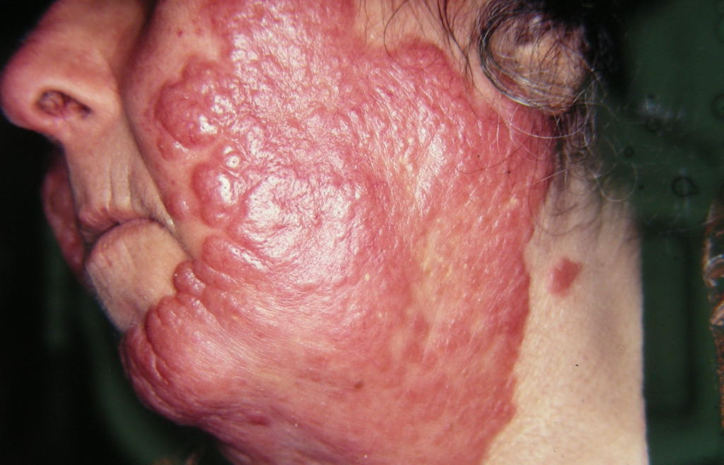
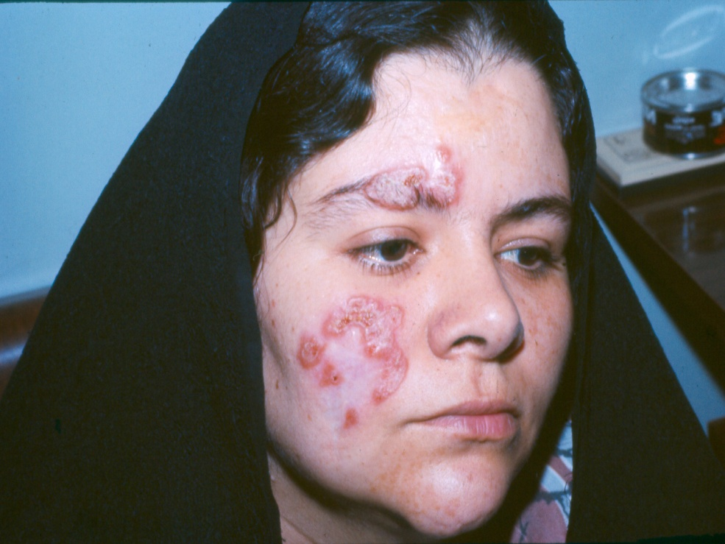
CL: Differential Diagnosis
Lupus Vulgaris
Cutaneous Leishmaniasis

Slide 51
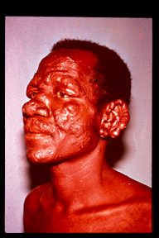
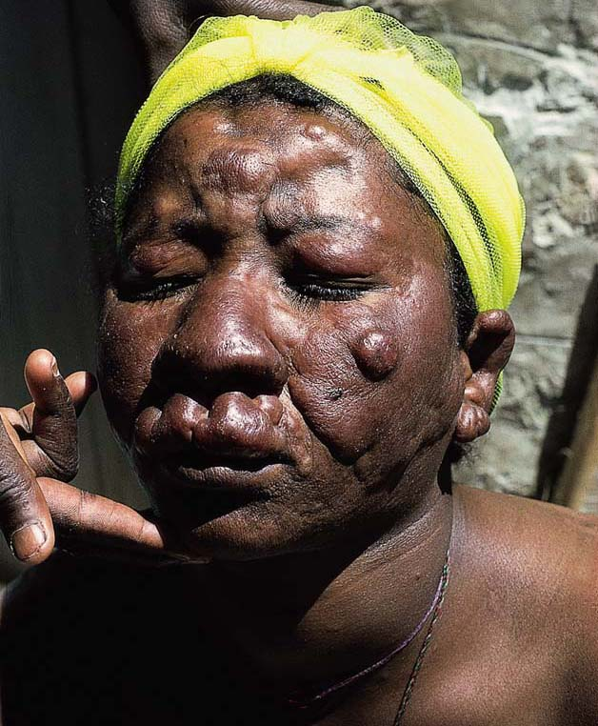
CL: Differential Diagnosis
Lepromatous Leprosy
Cutaneous Leishmaniasis

Slide 52
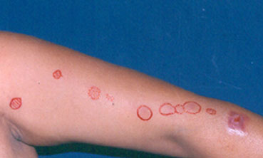
CL: Differential Diagnosis
Sporotrichosis
Cutaneous Leishmaniasis

Slide 53
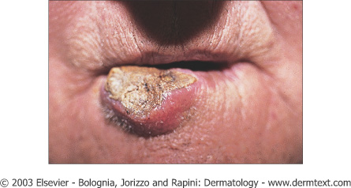
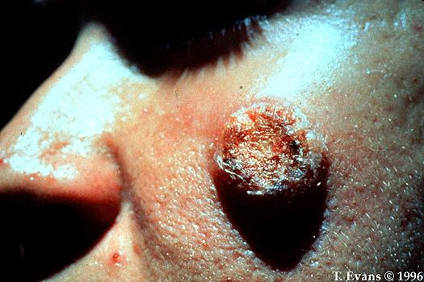
CL: Differential Diagnosis
Squamous cell carcinoma
Cutaneous Leishmaniasis

Slide 54
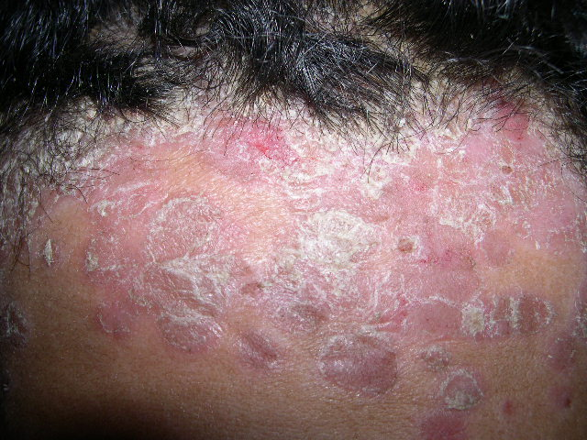
CL: Differential Diagnosis
Psoriasis
Cutaneous Leishmaniasis

Slide 55
CL: Diagnosis
Clinical
History: residence in or history of travel to endemic areas, painless lesions, clinical course, similar cases in other family members
Physical examination: esp. induration, exposed sites
Direct smear
Culture on Nicolle-Novy-Mac Neal (NNN) medium
Leishmanin Skin Test (LST)
Histopathology
Iso-enzyme electrophoresis (ISE)
Monoclonal antibodies(mAb)
Polymerase Chain Reaction (PCR)
Can be used for species identification

Slide 56
Treatment

Slide 58
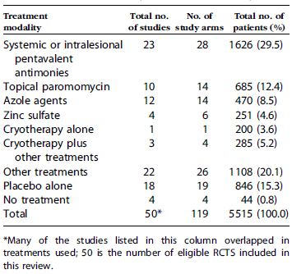
Source: Khatami et al. J Am Acad Dermatol 2007
Overview of 50 qualified RCTs for inclusion
in a systematic review published in 2007

Slide 59
CL Treatment: Indications
Ulcer(s) that are located close to vital organs or are cosmetically important, such as on the face.
Lesions that show no evidence of healing for several months after the onset.
Special forms of CL, such as sporotrichoid or lymphangietic with satellite lesions, which indicates spreading.
CL due to L. tropica, which could subsequent systemic involvement or be the reservoir of infection.
PKDL requires high doses of systemic medications.

Slide 60
CL treatment: general considerations
Systemic treatments
Topical treatments (including intralesional injections)
Physical treatments (including surgery)

Slide 61
Systemic treatments
Pentavalent antimonies
Meglumine antimoniate (Glucantime®)
Sodium stibogluconate (Pentostam ®)
Azole drugs
Itraconzaole, fluconazole, ketaconazole
Other treatments:
Combination of pentavalent antimonies to other drugs e.g. oral allopurinol
Dapsone, rifampicin, isoniazide, allopurinol, pentamidine, terbinafine, zinc sulfate, oral miltefosine

Slide 62
Treatments: Topical and intralesional
Intralesional pentavalent antimonies injections
Meglumine antimoniate (Glucantime®)
Sodium stibogluconate (Pentostam ®)
Paromomycin ointment

Slide 63
Treatment: Physical methods
Cryotherapy
Alone
Combined to other treatments e.g. i.l. pentavalent antimonies
Thermotherapy
CO₂ laser
Photodynamic therapy (PDT)
Curettage
Surgery

Slide 64
National Guideline for Treatment of CL in Iran
Zoonotic Cutaneous Leishmaniasis (ZCL) can be left untreated if patient accepts unless:
Diameter larger than 3 cm
Number of lesions more than 3
Location on face or joints
Sporotrichoid lesions
All cases of Anthroponotic Cutaneous Leishmaniasis (ACL) should be treated.

Slide 65
Local Treatment National Guideline for Treatment of CL in Iran
Local treatment can be used except:
Lesions around vital organs (eye, ear, mouth)
Lesions on joints
Lesions larger than 3 cm
Number of lesions more than 5
Sporotrichoid lesions

Slide 66
Local treatment National Guideline for Treatment of CL in Iran
Cont’d
Combination of intralesional injection of antimonial weekly and cryotherapy with liquid nitrogen biweekly for a maximum of 12 weeks
Cryotherapy should always be done prior to injection.
In certain cases each traetment modality can be used alone (for example cryotherapy alone in pregnant women)

Slide 67
Systemic Treatment National Guideline for Treatment of CL in Iran
Indications:
Lesions around vital organs (eye, ear, mouth)
Lesions on joints
Lesions larger than 3 cm
Number of lesions more than 5
Sporotrichoid lesions
Lesions not responded to local treatment

Slide 68
Systemic Treatment National Guideline for Treatment of CL in Iran
Cont’d
Dosage: 20 mg/kg/day Sb⁺⁵ (equal to 75 mg/kg/day of meglumine antimoniate or Glucantim) for a maximum of 3 vials daily
Preparations:
Glucantim: 405-415 mg Sb+5 equivalent to 1500 mg Glucantim in each 5 mL vial for IM injection
Pentostam: 600 mg Sb+5 in each 6 mL vial for IM or IV injection
Duration: 2 weeks for ZCL and 3 weeks for ACL, which can be repeated if necessary after 4-6 weeks of rest

Slide 69
Side effects National Guideline for Treatment of CL in Iran
Common but rarely severe
Pain
GI complaints
Myalgia
Headache
Skin rash
Hepatotoxicity
Nephrotoxocity
Arrythmia
Pnacreatitis

Slide 70
Contraindications National Guideline for Treatment of CL in Iran
Hepatitis
Pancreatitis
Myocarditis
Renal failure
Pregnancy
Lactation

Slide 71
Work up National Guideline for Treatment of CL in Iran
CBC, LFT, RFT, ECG if:
Age over 60 years
History of underlying systemic disease
Concomitant drug use

Slide 72
Prevention

Slide 73
CL: Prevention
Drugs unsatisfactory or too expensive
Environmental changes
Vector control impractical, unsafe for environment
Reservoir control: impossible or impractical (short term success in China, S. Arabia, India)
Leishmanization
Vaccines
First generation
Second generation
Third generation

Slide 74
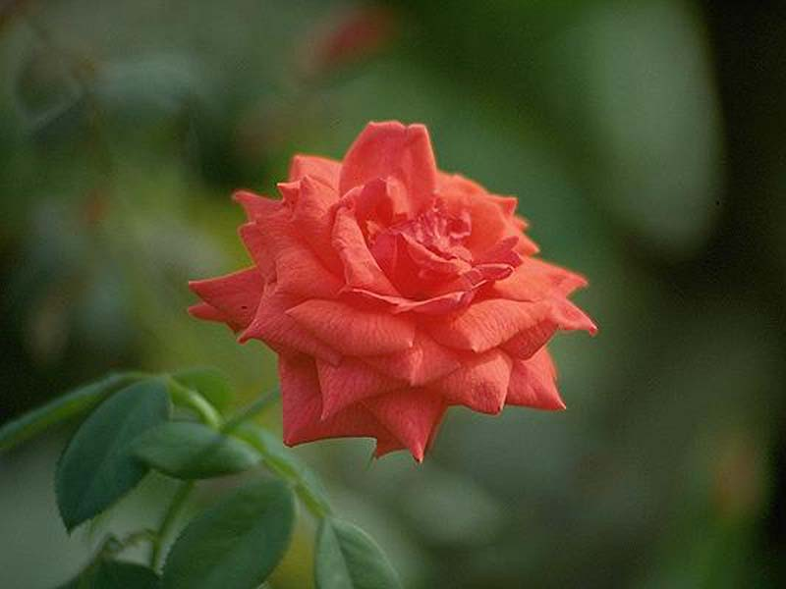
Thank you for your attention!

