Slide 2

Tehran University of Medical Sciences
Clinical and Molecular Features of
Prostate Cancer in Iran
G. Pourmand MD.
Professor of Urology
Urology Research Center, Sina Hospital
Tehran University of Medical Sciences, Iran

Slide 3
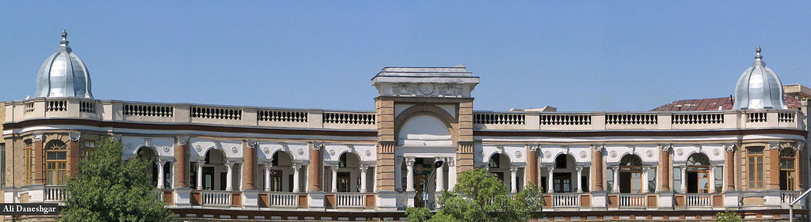
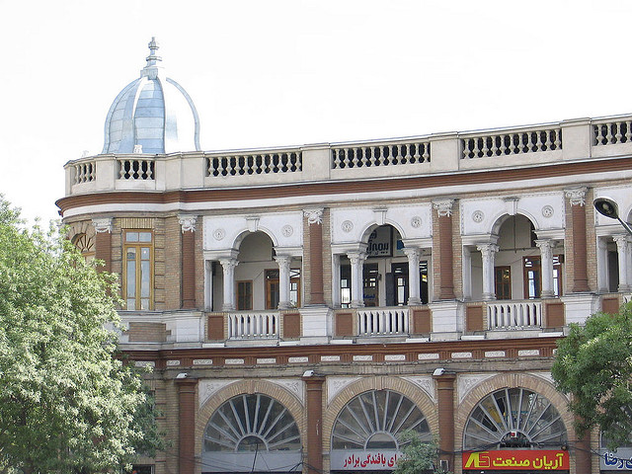
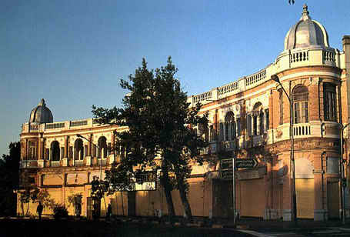
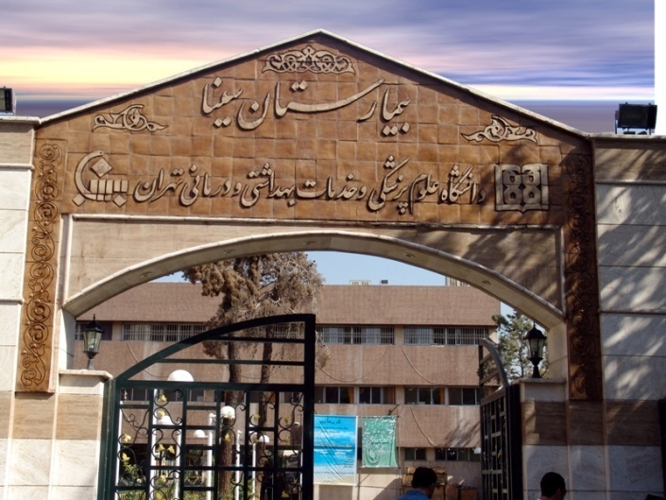

Slide 4
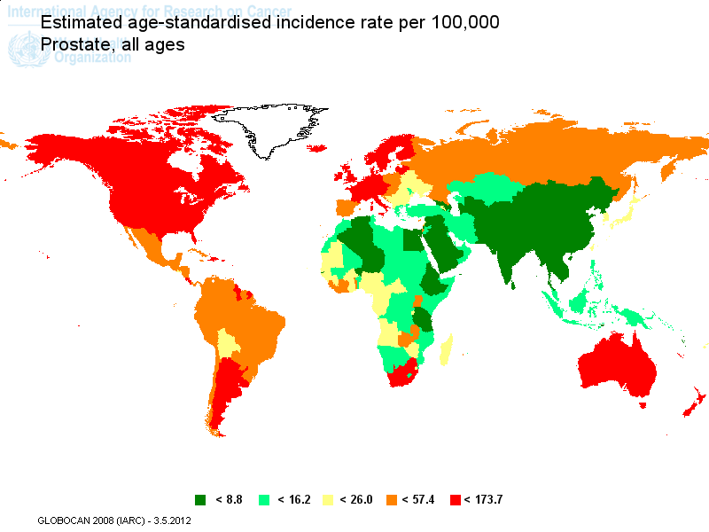
Sweden
95.4
Russia
26.1
England
64
USA
83.8
Iran
11.55
China
4.3
SA
7.7
Brazil
50.3
AUS
105

Slide 5
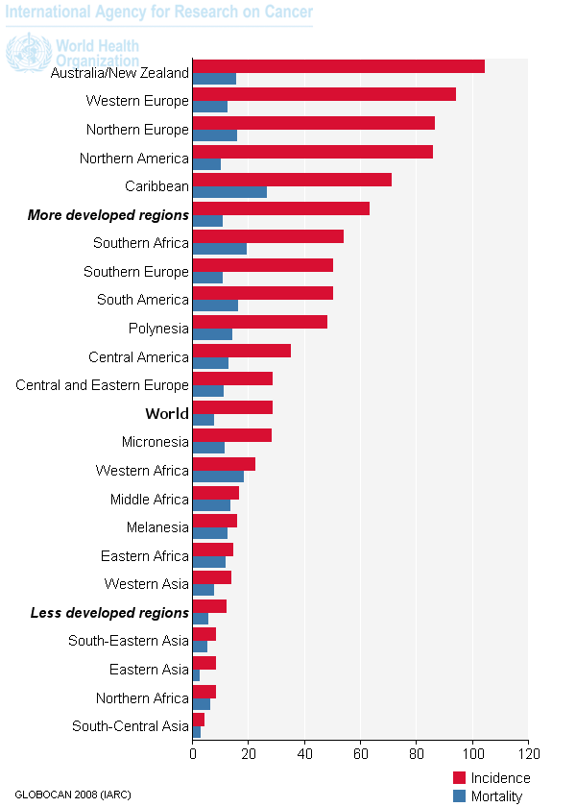
Prostate Cancer Incidence & Mortality Worldwide in 2008
Estimated age-standardised rates (World) per 100,000

Slide 6
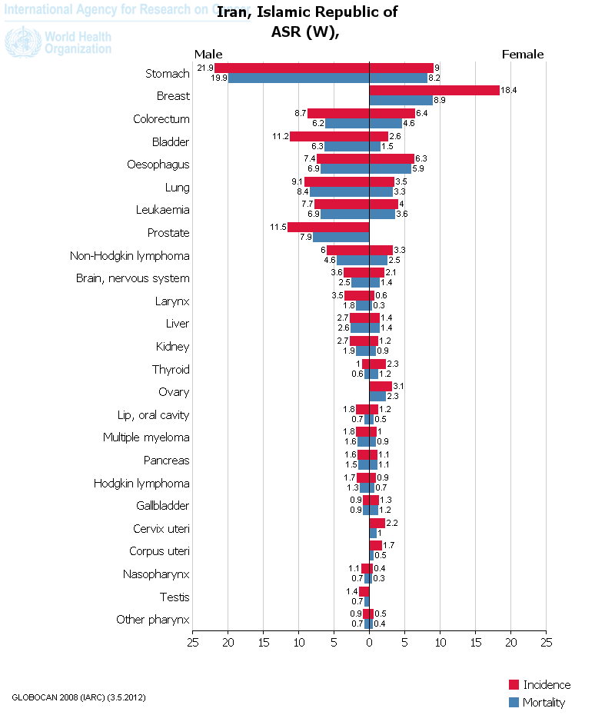
Cancer Incidence & Mortality (Iran)

Slide 7
The 3rd International Congress of the International Prof. Dr. Alireza Yalda Academic Foundation in Medical Sciences
November 2012

Slide 8
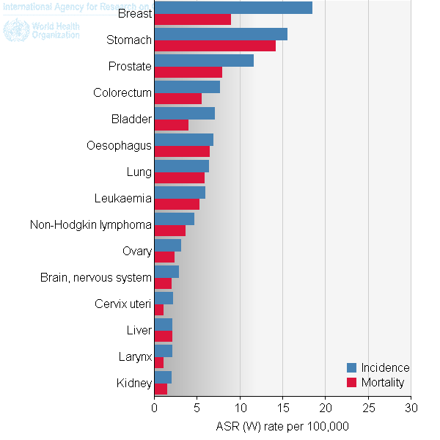
Iran Incidence & Mortality (ASR)
GLOBOCAN 2008 (IARC)(3.5.2012)

Slide 9
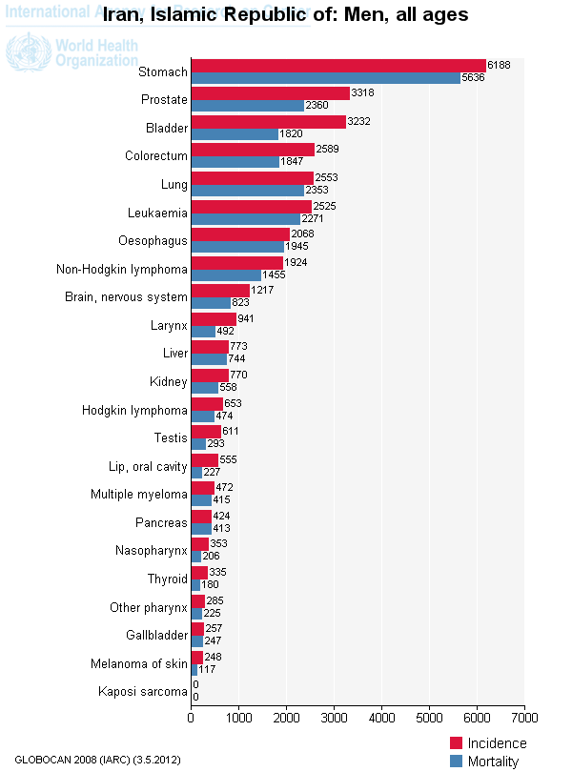
Common cancers in Iranian men

Slide 10
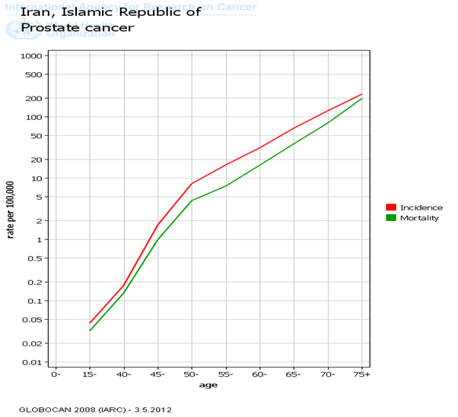
Prostate Cancer & Age (Iran)

Slide 11
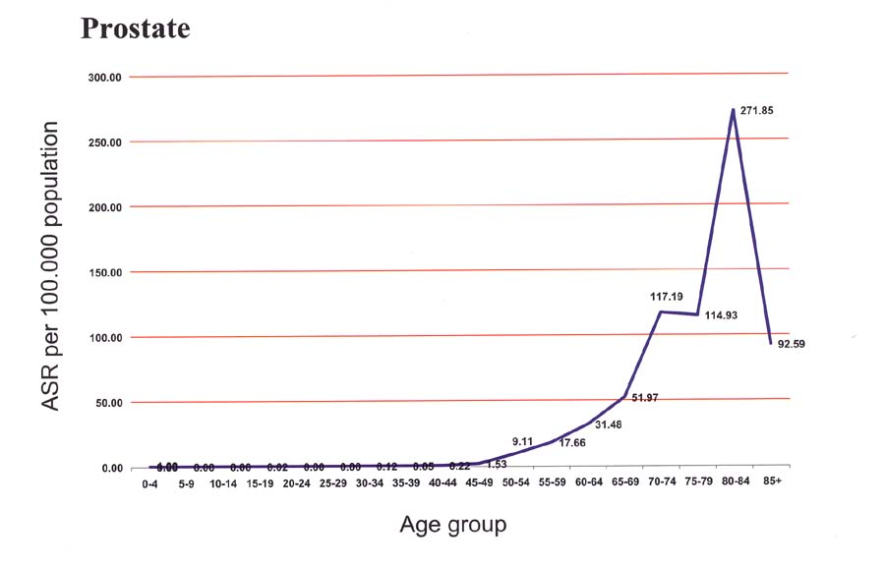
ASR, Prostate cancer 2005-2006

Slide 12
Prostate cancer in Iran (Cont.)
Number and ASR of Prostate Cancer
Year | 2003 | 2004 | 2005 | 2006 | 2007 | 2008
Crude Number | 733 | 1333 | 1891 | 2604 | 2814 | 3318
ASR | 2.47 | 4.42 | 6.4 | 8.86 | 9.57 | 11.6
Mortality | 3.85 | 4.521 | – | – | –

Slide 13
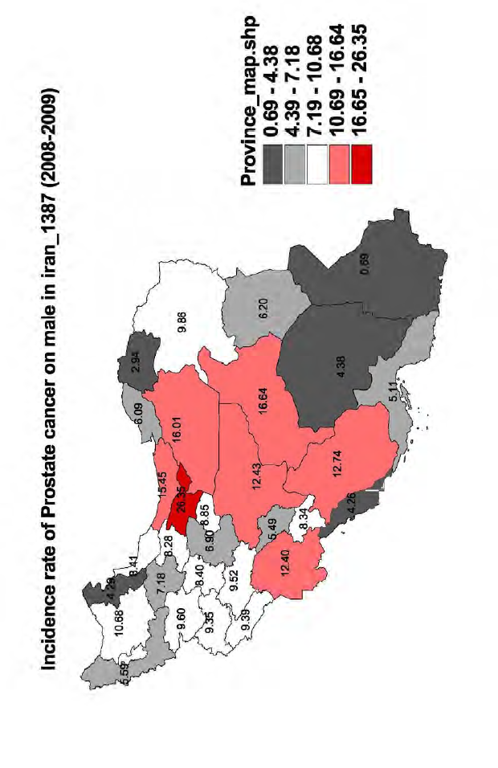

Slide 14
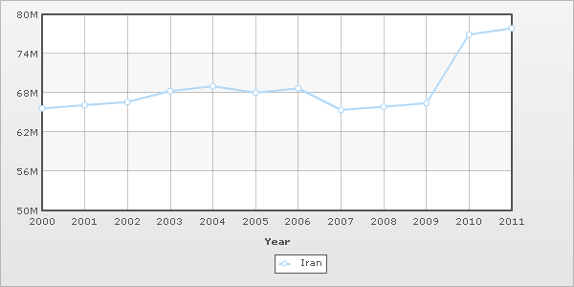
Population Of Iran
2011 IndexMundi

Slide 15
Percentage of total population aged 60 years or older in Iran(2006)
percent | number | years
7.41 | 2.654.833 | 60 years or older
Statistical Center of Iran

Slide 16
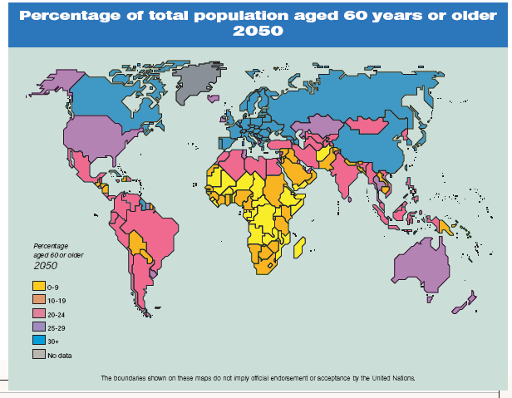
Russia
USA

Slide 17
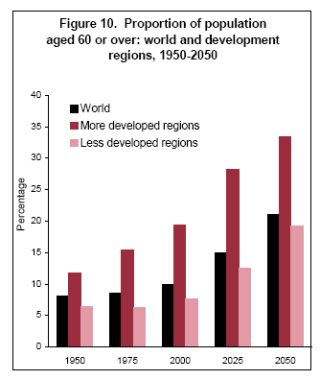
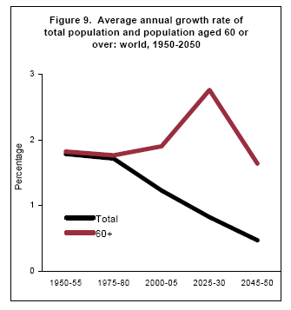
World Population Ageing 1950-2050, Population Division, DESA, United Nations

Slide 18
Clinical and Molecular

Slide 19
Normal Serum PSA Levels in Iranian Men
Mean PSA (ng/ml)
Age group (years) | Yasuj:650 Men (2003-2004) ¹ | Tehran:3670 men (1996-2004)²
40-49 | 0.7 | 1.2
50–59 | 0.9 | 1.3
60–69 | 1.6 | 1.8
≥70 | 2.3 | 2.1
¹ Mehrabi et al,East Mediterr Health J. 2007 Sep-Oct;13(5):1190-4
² Safarinejad,Annals of Oncology 17: 1166–1171, 2006

Slide 20
Serum prostate-specific antigen as a function of age
Population-based screening for prostate cancer in Iran: (1996-2004)
Age group (years) | No. of volunteers n (%) | PSA (ng/ml) mean (range) | No. of volunteers with PSA ≥2.1 ng/ml n (%)
40–49 | 954 (26) | 1.2 (0.2–11.0) | 43 (10)
50–59 | 1101 (30) | 1.3 (0.2–27.5) | 95 (22)
60–69 | 918 (25) | 1.8 (0.3–31.8) | 130 (30)
≥70 | 697 (19) | 2.1 (0.5–37.7) | 165 (38)
Totals | 3670 (100) | – | 433 (100)
PSA, prostate-secific antigen.
M. R. Safarinejad , Annals of Oncology 17: 1166–1171, 2006
doi:10.1093/annonc/mdl087
Published online 9 May 2006

Slide 21
Our Experience (2008)
Age group (years) | Control group |  | Case group
 | Number (%) | PSA (ng/ml) mean (range) | Number (%) | PSA (ng/ml) mean (range)
40-49 | 3 (5) | 0.8 (0.2–1.6) | – | –
50–59 | 21 (32) | 2.05 (0.2–8) | 21(21) | 19.74 (4.1–91)
60–69 | 26 (39) | 2.84 (0.3–26) | 35(35) | 22.91(4–188)
≥70 | 16 (24) | 3.32 (0.1–17) | 44(44) | 37.60(4.7–379)
Totals | 66 (100) | 2.61(0.1-26) | 100(100) | 28.71(4–379)

Slide 22
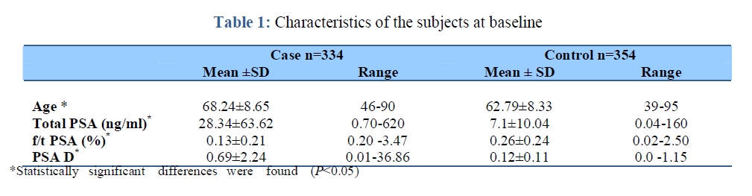


Preventing Unnecessary Invasive Cancer-Diagnostic Tests:
Changing the Cut-off Points
Among 688 men 334, 48.5% had PCa and 354, 51.5% had benign prostate disease.
2009 – 2012
        Methods: f/t PSA , DRE, TRUS+ PSAD, TRUS+ Prostate Biopsy
G Pourmand et al Iranian J Publ Health, Vol. 41, No.2, Feb 2012, pp. 47-52

Slide 23
Results
Results
tPSA 7.85ng/ml 71%
PSAD 15% 76%
f/tPSA ratio 0.13 81.4%
European and American values!
G Pourmand et al Iranian J Publ Health, Vol. 41, No.2, Feb 2012, pp. 47-52

Slide 24
Prostate Cancer Predicting Factors
case control study
160 case with 190 controls.
Hospital based
2005- 2008
Accepted for publication in Urology Journal.

Slide 25

Results
the probability of developing PCa increases by 90% for every decade after the fifties (OR_{adj}= 1.90, p.v=0.000).
 | Prostate cancer (Case) | BPH (Controls) | OR_{crude} (P.value)
=<50 | 6(1.6%) | 16(8.4%) | 1.95(0.00)
50-59 | 80(21.4%) | 70(36.8%)
60-69 | 135(36.1%) | 69(36.3%)
=>70 | 153(40.9%) | 35(18.4%)
Variables
Age

Slide 26


Comparing lab tests accuracy in diagnosing PCa & BPH patients
 | Prostate cancer (Case) | BPH (Controls) | Mean Difference ( 95%CI)
Total PSA | 28.04±60.82 | 6.08±5.99 | -21.95 (-28.19 - -15.71)
Free PSA | 2.97±9.32 | 1.30±1.59 | -1.67 (-2.77 - -0.57)
FreeTotal (%) | 11.63±6.40 | 19.60±18.01 | 7.97 (4.52-11.42)
Prostate Volume | 48.84±25.21 | 57.49±35.91 | 8.65 (2.81 -14.48)

Slide 27

Figure 1. Mean (95% CI) of free/total PSA serum level in different age groups of PCa & BPH patients
Figure 2. Mean (95% CI) of total PSA in different age groups of PCa & BPH patients

Slide 28
Figure 3. Mean (95% CI) of free PSA serum level in different age groups of PCa & BPH patients
Figure 4. ROC Curve, comparing total PSA, free PSA, free/total PSA sensitivity and specificity

Slide 29
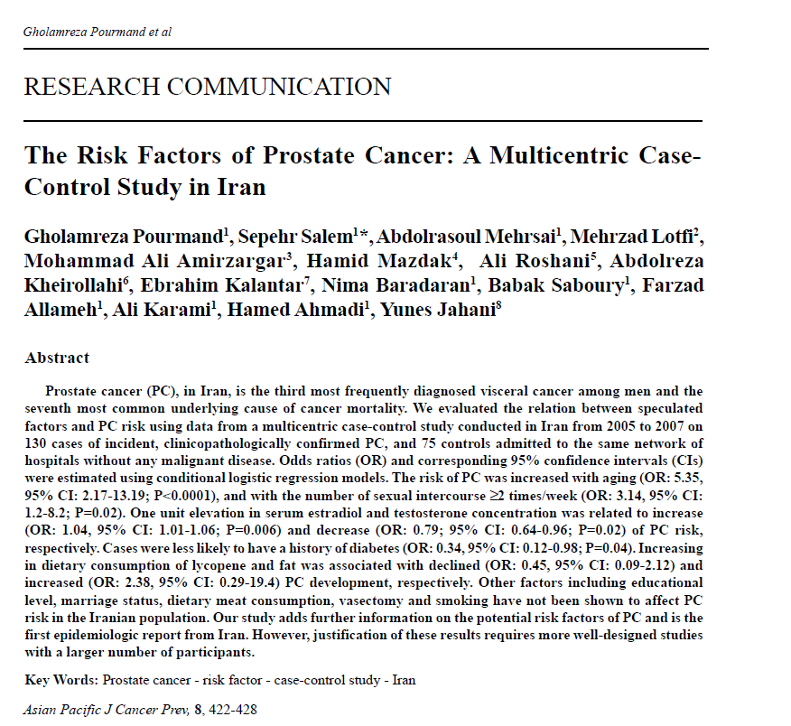

Slide 30
Dietary factors
 Dietary fat
 Lycopene
Red meat
Dietary fat
Garlic
Micronutrients
Selenium

Slide 31
Lycopene
A multicentric case-control study conducted in Iran from 2005 to 2007
130 cases with prostate cancer, and 75 controls
Increasing in dietary consumption of lycopene and was associated with declined (OR: 0.45, 95% CI: 0.09-2.12) prostate cancer development.*
Tomato Consumption (gr/week) | Control group [n=75] (%) | Cancer group [n=130] (%)
≤ 10 | 33 (44.0) | 47 (36.2)
11-100 | 17 (22.7) | 52 (40.0)
> 100 | 25 (33.3) | 31 (23.8)
P value = 0.03
*Pourmand G. et al,Asian Pacific J Cancer Prev 2007, 8, 422-428

Slide 32
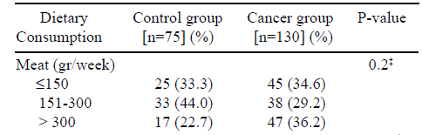
Dietary Meat
0.2
*Pourmand G. et al,Asian Pacific J Cancer Prev 2007, 8, 422-428

Slide 33
Fat
along with the dietary consumption of lipid, the PC risk increased, but it was not statistically significant (OR: 2.38, 95% CI: 0.29-19.4; P=0.42).
Lipid Consumption | Control group [n=75] (%) | Cancer group [n=130] (%) | P-value
≤ 50 | 27 (36.0) | 44 (33.9) | 0.08‡
51-200 | 34 (45.3) | 41 (31.5)
> 200 | 14 (18.7) | 45 (34.6)
‡ Chi-square test.
*Pourmand G. et al,Asian Pacific J Cancer Prev 2007, 8, 422-428

Slide 34
Garlic
GARLIC Consumption | Control group | Cancer group | P-value
No | 36 (48.0) | 73 (56.2) | 0.24†
Yes | 39 (52.0) | 57 (43.8)
† Fisher’s Exact test
*Pourmand G. et al,Asian Pacific J Cancer Prev 2007, 8, 422-428

Slide 35
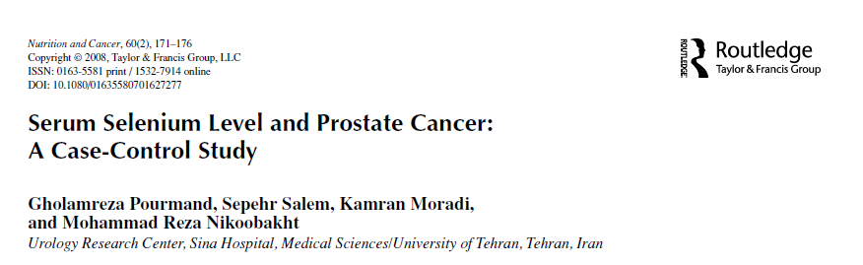
Selenium
Between 2005 and 2006
A prospective case-control study
62 men with prostate cancer (Case group)
68 men with no prostate cancer (Control group)

Slide 36
Selenium
(Results)
Serum Selenium level: (Normal:95-165 µg/l)
- Case group → 66.3 ± 17.7 μg/l
- Control group → 77.5 ± 22.5 μg/l Pvalue < 0.002
Serum selenium level Risk of prostate cancer
Pourmand G. et al,Nutrition and Cancer,2008, 60(2), 171–176

Slide 37

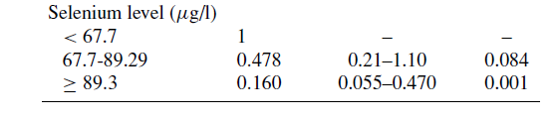

Selenium
(Results)
An increase of 10 μg/l in serum selenium concentration was associated with a significant decrease in risk of prostate cancer (OR = 0.29; 95% CI = 0.10–0.47).
Pourmand G. et al,Nutrition and Cancer,2008, 60(2), 171–176

Slide 38
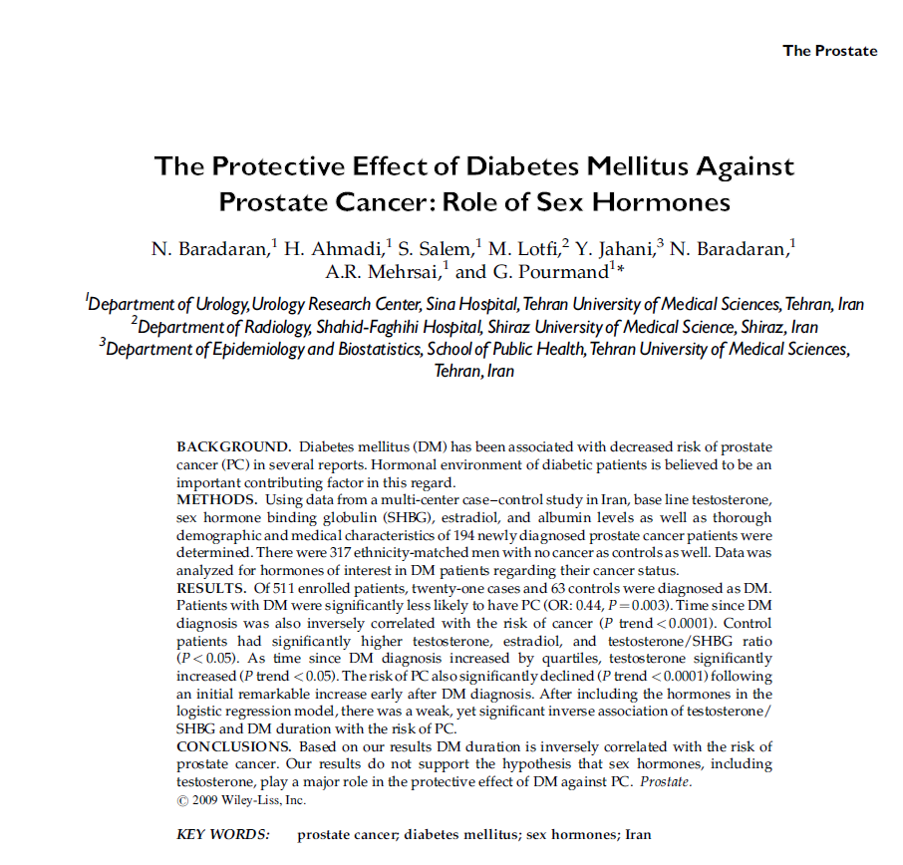

Slide 39

The Protective Effect of Diabetes Mellitus Against
Prostate Cancer: Role of Sex Hormones
multi-center case–control study conducted from 2005 to 2008
194 case ( with PCa) and 317 control (-ve for malignancy).

Slide 40
Diabetes Mellitus
(Results)
Patients with DM were significantly less likely to have PCa
(OR: 0.46, 95% CI: 0.27–0.79, P¼0.004).
Variable | Case (n=194) | Control (n=317) | P-value
DM, Positive, n(%) | 21(11.3) | 63 (19.8) | 0.004
PSA (ng/ml)b | 18.1 | 1.7 | <0.0001
N. Baradaran, et al the prostate July 2009

Slide 41

Diabetes Mellitus
(Results)
Patients with DM for more than 20 years were significantly less likely to have cancer (P value<0.0001).
Variable |  | Case (n=194) | Control (n=317) | P-value
DM (years) | <10 | 14 (66.7) | 9 (14.3) | <0.0001
 | 10–15 | 4 (19) | 14 (22.2)
 | 16–20 | 2 (9.5) | 22 (34.9)
 | >20 | 1 (4.8) | 18 (28.6)
PSA (ng/ml)b |  | 18.1 | 1.7 | <0.0001
N. Baradaran, et al the prostate July 2009

Slide 42

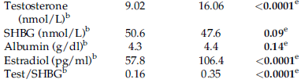
Diabetes Mellitus
(Results)
Our results do not support the hypothesis that sex hormones, including testosterone, play a major role in the protective effect of DM against PCa.
N. Baradaran, et al the prostate July 2009.

Slide 43
Hormones
Association between Different Factors and Risk of Prostate Cancer in Conditional Logistic Regression Model
P Value | 95% Confidence Internal | Odds Ratio | Control group N=75 | Cancer group N: 130 | Variable
0.006 | 1.01-1.06 | 1.04 | 17.5±17.52 | 22.8±20.76 | Serum estradiol Level (pg/ml)
0.02 | 0.64-0.96 | 0.79 | 2.9±2.53 | 2.5±2.45 | Serum testosterone Level (ng/ml)
An increase of one unit in the Serum Estradiol concentration was associated with a significant increase in the risk of PC (OR: 1.04, 95% CI: 1.01-1.06; P=0.006).
An increase of one unit in Serum Testosterone concentration was related to a significant decrease in PC risk (OR: 0.79; 95% CI: 0.64-0.96; P=0.02).
*Pourmand G. et al,Asian Pacific J Cancer Prev 2007, 8, 422-428

Slide 44
Calcium
Comparison of demographic & baseline characteristics of patients in both study groups.
characteristic |  | cancer group [n=194] % | control group [n=317] % | P value
Mean Age ± SD |  | 71.1±7.84 | 66.5±10.2 | < 0.0001
PSA | <4 | 24(15.7) | 198(67.8) | < 0.0001
 | 4-10 | 21(13.7) | 44(15.1)
 | >10 | 108(70.6) | 50(17.1)
Mean Total Calcium ±SD (mg/dl) |  | 9.22±0.46 | 9.48±0.51 | < 0.0001

Slide 45
Serum Calcium as a Protective Marker Against Prostate Cancer: Role of Associated Factors
multi-center case-control study.
194 cases with PCa and 317 controls.
serum calcium case control
mg/dl 9.22 (±0.46) 9.48 (±0.51)
(OR: 0.52; 95% CI: 0.34-0.76).
P value <0.0001
An increase of 1 mg/dl in serum calcium ~ significant decrease in risk of PC

Slide 46
Results
No Significant
Marriage, Familial History of Pca, Vasectomy, Smoking,Garlic & Fatty Diet, Red Meat , ethnicity, educational level, occupation, alcohol consumption, prostatitis or any other sexually transmitted diseases, years of having sexual activity, and blood tests such as serum SHBG level, TG, and Alb.
Ketchup OR_{crude} (P.value) (0.000)

Slide 47
Genetic Markers

Slide 48
Genetic Markers
High Risk
Screening techniques
Prediction of Response to treatment
Therapeutic Strategies in advanced disease
Indolent Vs Aggressive
Disease

Slide 49
Androgen receptor
expression

Slide 50
PCa is the most
Common cause of cancer
Death for men in the
Western World

Slide 51
PSA Indolent cancers
Aggressive Treatment
Significant Morbidity
Without
Clinical Benefit!

Slide 52
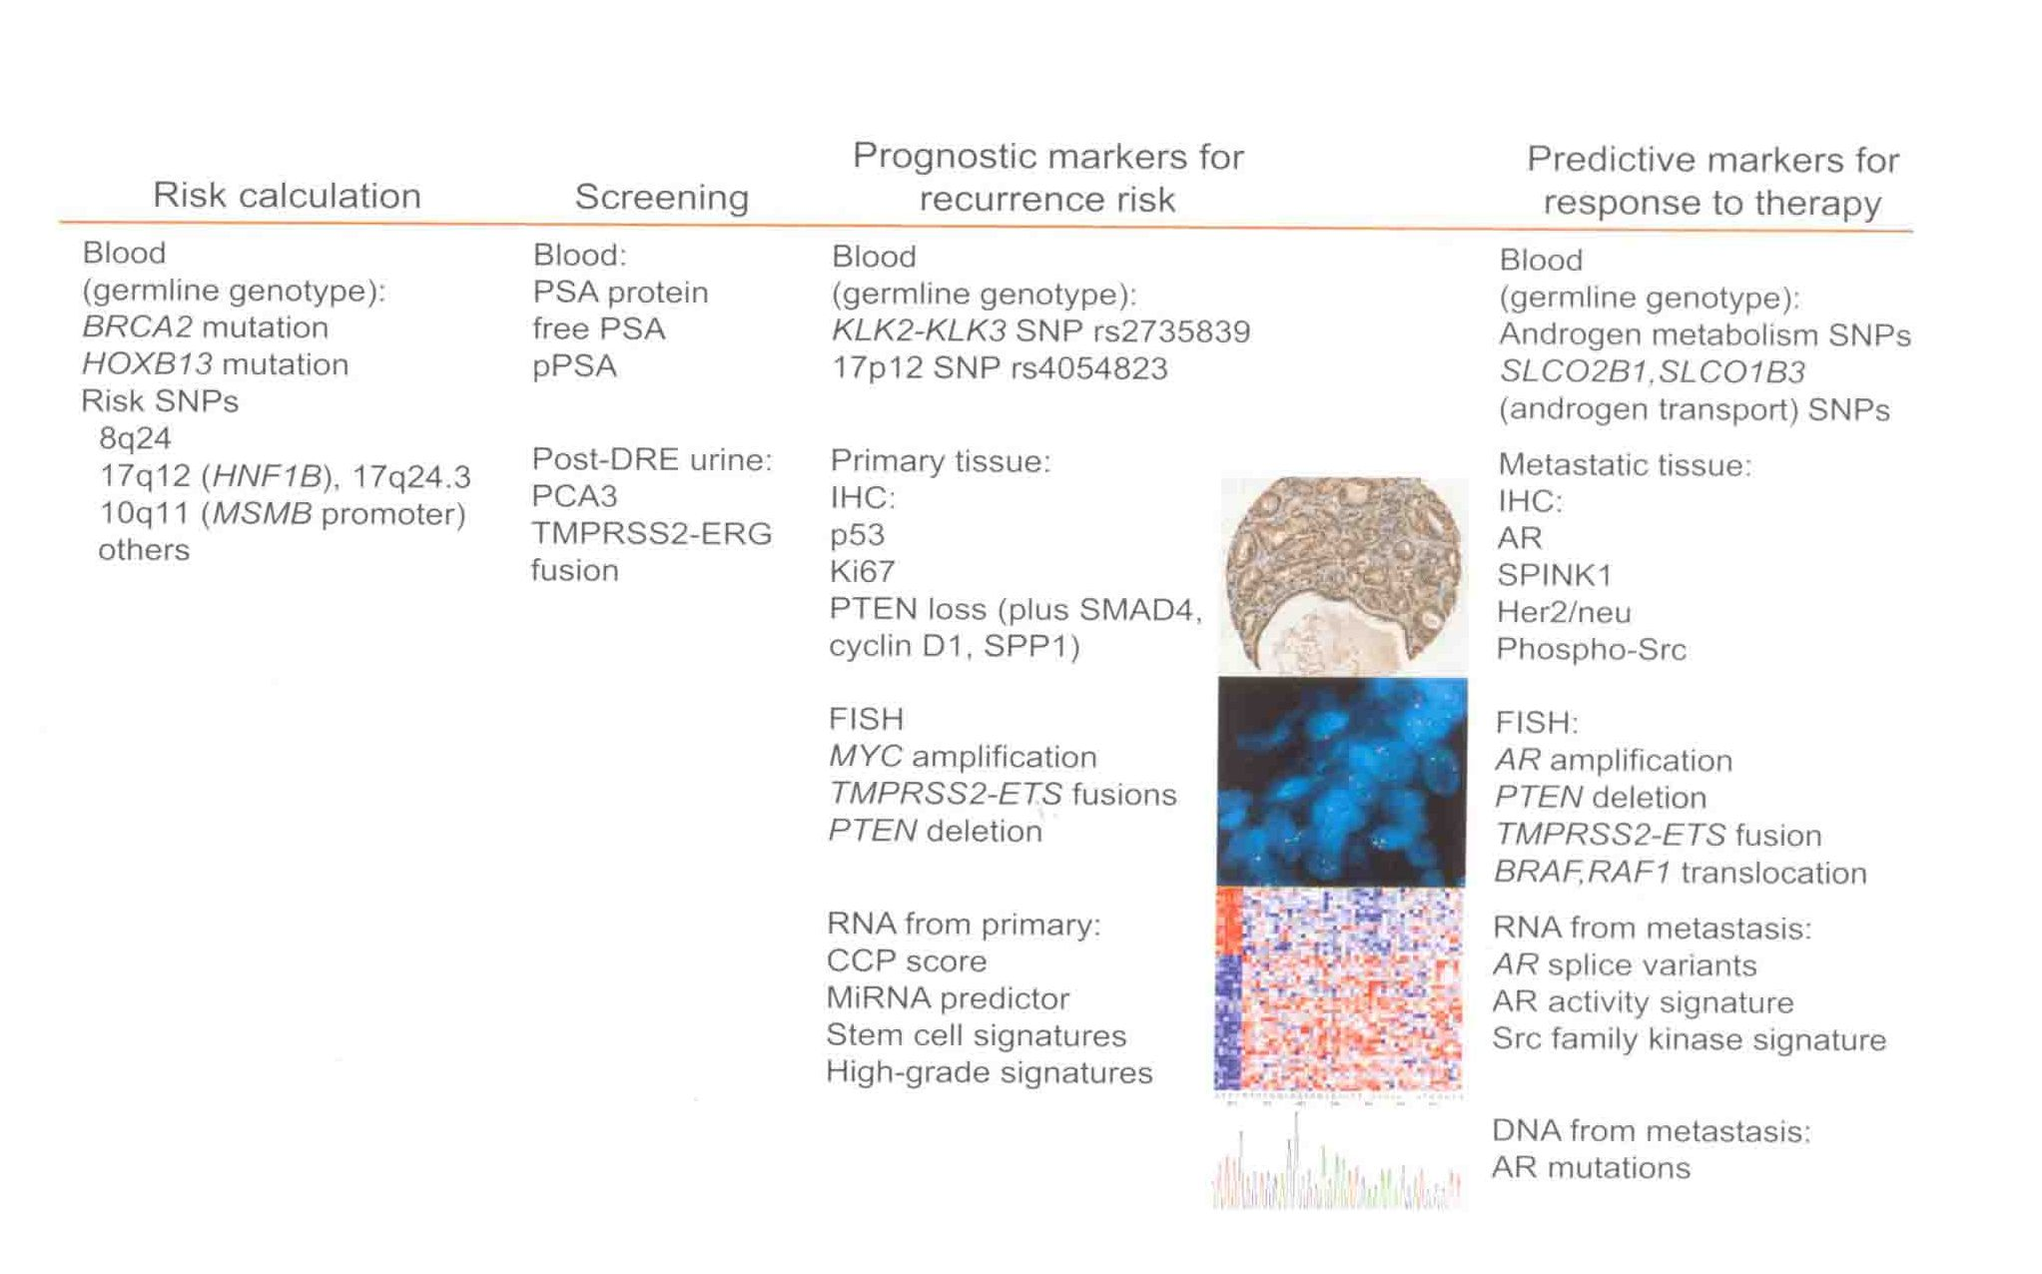

Slide 53
PSA & PCA3
Sensitivity Specificity
PSA 65% 47%
PCA3 66% 76%
PCA3 SCORE>35

Slide 54
AR mutations in PCa are most frequently somatic and may be induced by currently
Nonandrogenic steroids
Adrenal androgens
Product of dihydrotestosteree metabolism
Nonsteroidal antiandrogens

Slide 55
There are so many
Open Questions ??

Slide 56
Tyrosine kinase
Inhibitors

Slide 57
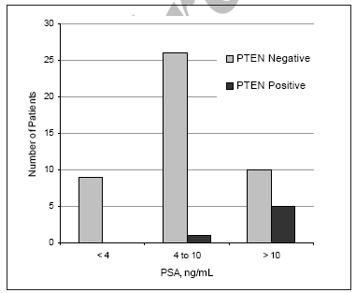
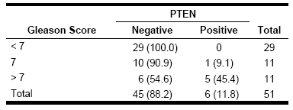
Genetic polymorphism
Role of PTEN Gene in Progression of Prostate Cancer: *
6 of 51 patients (11.8%) with prostate cancer had PTEN mutations
PTEN gene mutation and PSA level
PTEN Gene Mutation and Gleason Score
*Pourmand G. et al. Urol J. 2007;4:95-100.

Slide 58
New Researches
Serum level of early prostate cancer antigen 2- (EPCA-2) in patients with PCa and BPH
Evaluation of PTEN gene mutation and its effects on progression and prognosis of urothelial carcinoma

Slide 59
Conclusions
The Incidence of PCa was 2.47 in 2003 ,…, 11.6 in 2008.
Mortality of PCa is higher than other countries.
PCa is the second most common cancer in Iranian men.
The Incidence of PCa diagnosis is about 271 in 80 years Vs 50 in 60 years.
Life expectancy as other countries is going up, so, the chance of PCa diagnosis will be increased.

Slide 60
Conclusions
In two studies, the maximum normal serum PSA level was 2.3 ng/ml. It seems that PSA above 2.3 should be considered.
Age, the increased sexual activity and serum estradiol level should be considered as potential risk factors for developing PC in Iranian men.
having diabetes mellitus and increased level of serum testosterone were found to have protective effects in the incidence of this disease.
higher intake of dietary lycopene is encouraged.

Slide 61
Conclusions
Higher serum calcium should be considered as a protective biomarker against PCa development.
Lower serum selenium level was associated with the higher risk of prostate cancer.
Higher level of PSA in the elderly can be a good predictor for PCa probability and the necessity of biopsy.

Slide 62
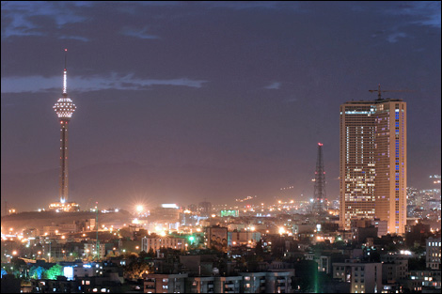
Thanks for your kind attention

Slide 63
Nomogram
669 TRUS Biopsies were done.
223 (33%) had PCa.
Accuracy of the nomogram (AUC) was about 79.1% compared to 62.4% with PSA alone.
Finally, by using this model, if we considered that only those patients with greater than 15% predicted probability of PCa will undergo biopsy, my model would capture 90% of all patients with PCa (sensitivity), and sparing of 35% of patients without Pca from undergoning unnecessary procedures (specificity)

Slide 64
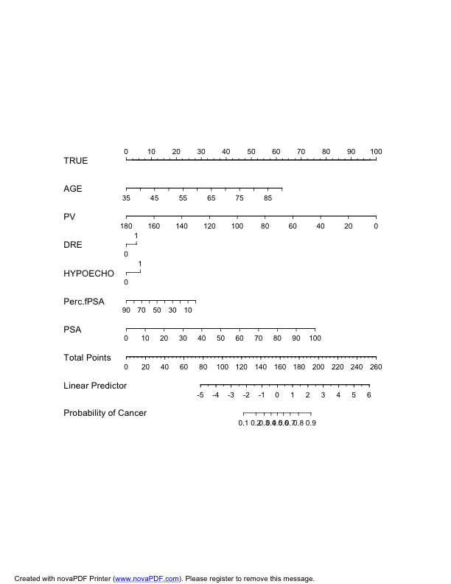
Score
f/t PSA
=40%

