Slide 1
بسم الله الرحمن الرحيم

Slide 2

Colon Cancer metastasis diagnosis by vertically aligned carbon nanotube based biosensor
By:
Mohammad Abdolahad
Nanoelectronic Lab.
School of Electrical and Computer Eng.
University of Tehran
Nov.2012

Slide 3
Outline:
Changes in cell Physical properties during cancerous transformation
Cytoskeletal changes
Mechanical (deformability and elasticity) properties of healthy & cancer cells
2. Cancer cell entrapment by MWCNT
Growth of vertically aligned MWCNT
Higher metastatic transformation effect on cell entrapment
Selective entrapment of Colon and RC Cells on MWCNT arrays
3. CNT-ECIS : High sensitive cancer cell biosensor
Mechanical and electrical interaction of cancer cells with CNT arrays
Metastasis diagnosis of colon cancer cells by CNT-ECIS
CEF & TEF parameters of CNT-ECIS
4. CNT based single cell electrical endoscopy for metastasis diagnosis and EDR assay
Electrical properties of cell membrane
CNT endoscopy for single cell cancer metastasis diagnosis
Single cell EDR Assay by CNT electrical endoscope

Slide 4
Changes in cell Physical properties during cancerous transformation [1]
1. Cytoskeletal changes
2. Cell adhesion and motility changes
3. Nuclei changes
4. Enzyme production
Two first changes are directly returned to cell mechanical properties
The altered cytoskeleton enhances the ability of cancer cells to contract or stretch. As a result, tumor cells exhibit lower resistance to deformation in comparison with normal ones; even they are more deformable than non-metastatic cells
1. Adami, etal,. "Textbook of Cancer Epidemiology."Oxford University Press, 2002

Slide 5
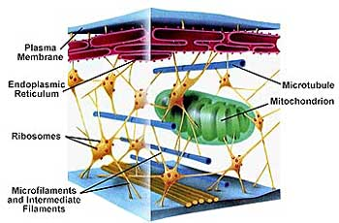
Cytoskeletal changes
The distribution and activity of the microfilaments and microtubules may change. These alterations change the ways in which the cell interacts with neighboring cells and alter the appearance of the cells. Changes in the cytoskeleton also affect cell adhesion and movement (motility) [1].
Changes in cell cytoskeletal properties have a key role in cancerous transformation of the cell
1: Bruce Alberts etal, Molecular biology of the cell (Fifth Edition), New York: Garland Science 2008,

Slide 6
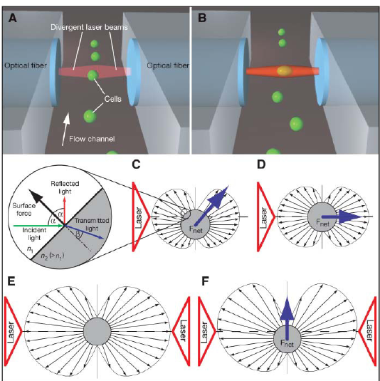
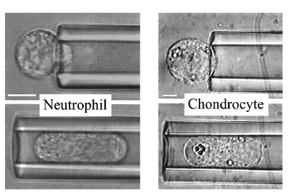
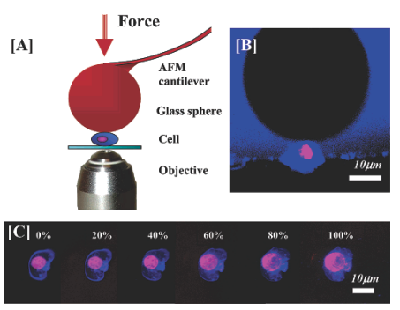
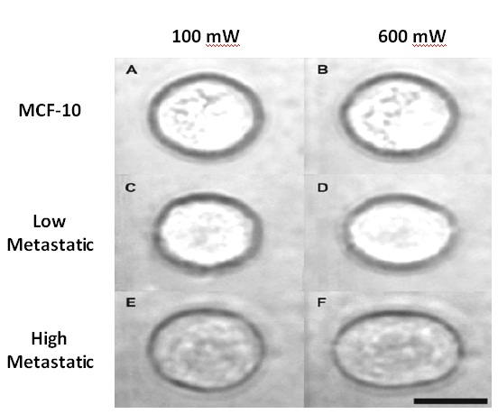
AFM indentation method
2. Optical stretching
3. Micro pipette aspiration
Mechanical (deformability and elasticity) properties of healthy & cancer cells investigation
AFM indentation method
Optical stretching
Micro pipette aspiration
1. Langmuir 2006, 22, 8151-8155
2. Biophysical Journal, 88(2005) 3689–98
3. J Biomechanics 33 (2000) 15-22

Slide 7
Cancer cell entrapment by MWCNT
(due to cell’s deformability)

Slide 8
Our main trends
Investigate a new nanotechnological method based on mechanical & electrical properties of cells for cancer diagnosis
By
Vertically aligned carbon nanotube arrays

Slide 9
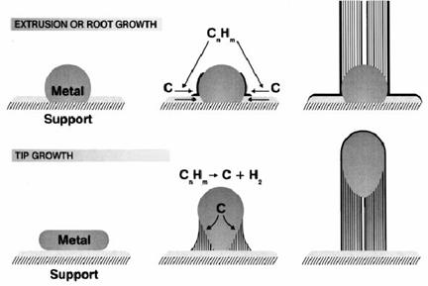
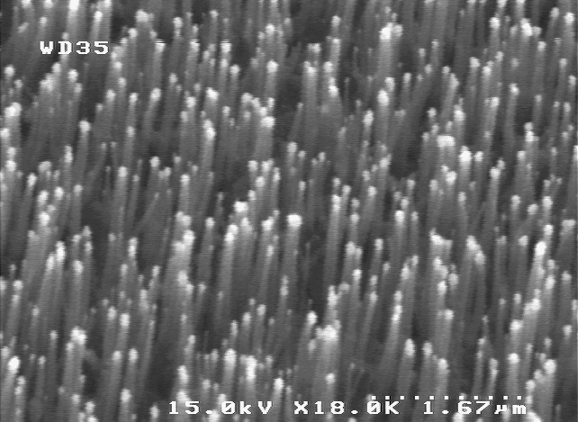
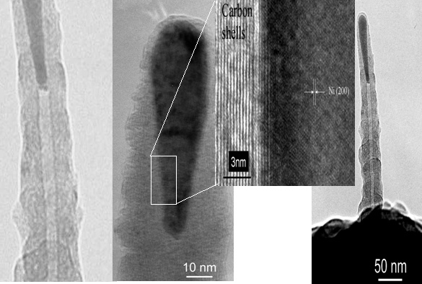
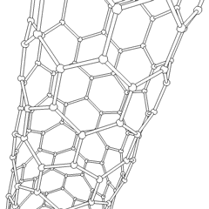
Growth of vertically aligned MWCNT
SEM image of vertically aligned MWCNT
Growth mechanism of CNT , Root growth (up), Tip growth (down) [1]
TEM image of a MWCNT beam [1]
1. PhD Thesis, Javad Koohsorkhi, Tehran University, 2010

Slide 10
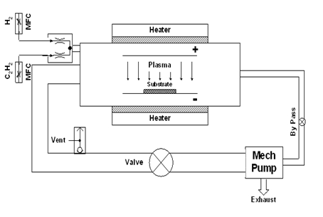
Growth of vertically aligned MWCNT
DC PECVD for growth of vertically aligned MWCNT [1]
Important parameters:
Ni thickness
C2H2, H2 and O2 flow
Plasma power
Thermal evaporation fot Ni coating as catalyst for CNT growth [1]
1. PhD Thesis, Javad Koohsorkhi, Tehran University, 2010

Slide 11
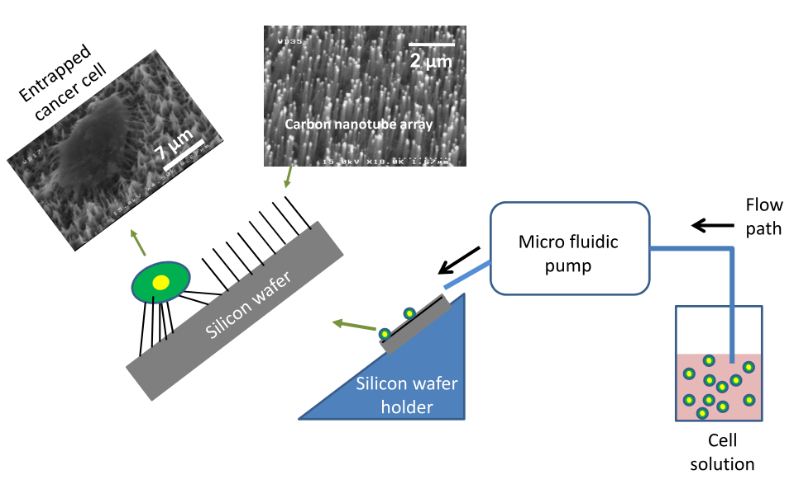
Cancer cell entrapment by MWCNT arrays
A diagram of cancer cell entrapment process on CNT arrays. The cell solution is flown onto the CNT arrays by a microfluidic pump. The time duration of the experiment was of the order of few seconds[1]
[1] M.Abdolahad, etal, Carbon 50, (2012), 2010

Slide 12
Further entrapment of higher metastatic cancer cells (SW48 Vs. HT29)
SEM images of trapped (a) SW-48 and (b) HT29 cells with the same primary solution concentration and flow rate on CNT arrays The solution flow rate was 2.5 cc/min [1]
[1] M.Abdolahad, etal, Carbon 50, (2012), 2010

Slide 13
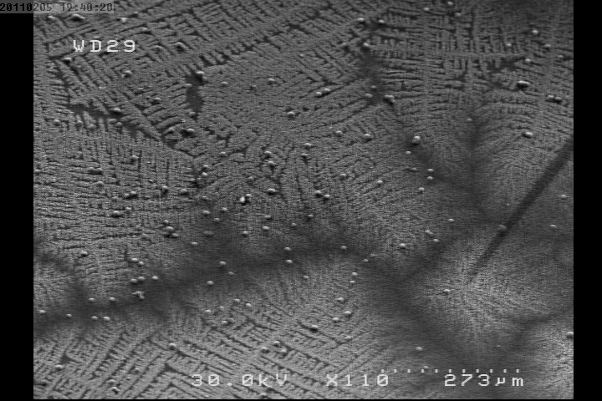
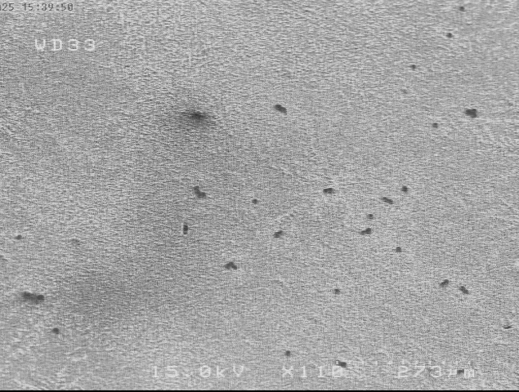
(a)
Stiffness measurement by AFM:
SW48 : 470 kPa
HT29: 570 kPa
270 µm
(b)
SEM images of entrapped (a) SW48 and (b) HT29 cells on CNT arrays in large scales
270 µm

Slide 14
Entrapment of fixed Vs. live cells
FESEM images of entrapped fixed (a) and live (b) HT-29 cells on vertically aligned CNT arrays. (c) SEM image of comparative entrapment from live and fixed HT-29 cells on CNT array.

Slide 15
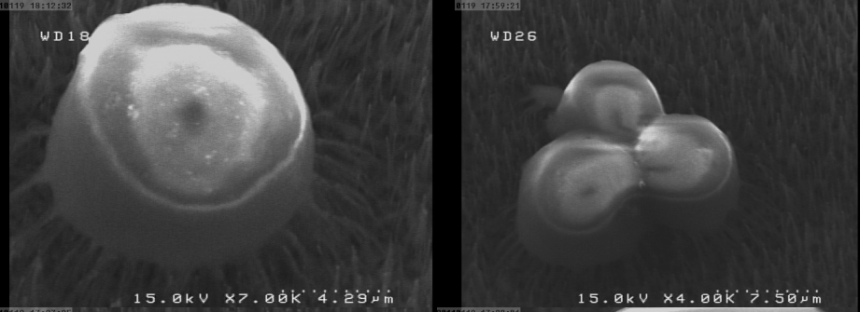
Entrapment of fixed cells
Fixed HT29 cells entrapment on CNT arrays
Fixation
cell rigidity increment (20 time )
Observable decrease in the fraction of cells entrapment on CNT arrays

Slide 16
an observable increase in the fraction of cell entrapment from 5% for fixed lower metastatic cell to about 75% for higher metastatic ‘‘live’’ ones.

Slide 17
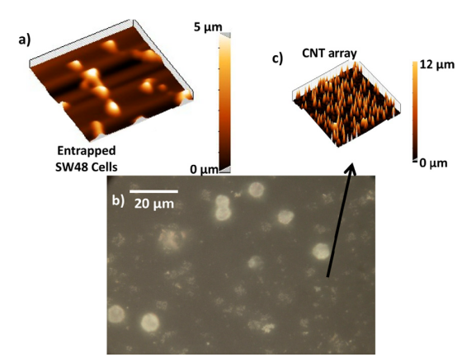
AFM image from entrapped cells
(a) AFM images of live entrapped SW-48 cells on CNT arrays immediately after cell solution flowing. (b) Optical microscope image of entrapped SW-48 cells. (c) AFM image of CNT arrays after cell solution flowing process.

Slide 18
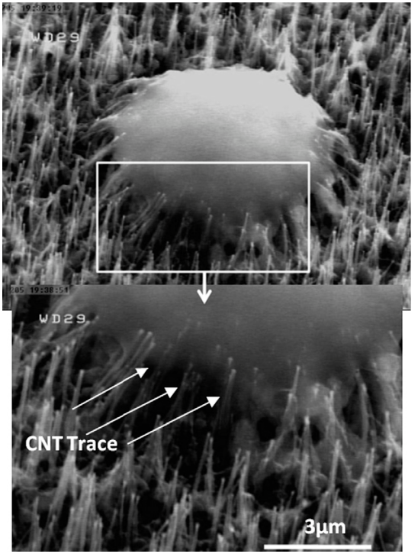
Probable mechanisms for high fraction of metastatic cancer cell entrapment
Cell adhesion
RGD domain protein secreting
Hydrophilic interaction
Cell deformability and mechanical interactions
CNT beam: stopping agent
High resolution SEM image from the membrane of entrapped SW48 cells on CNT surface.

Slide 19
Renal carcinoma & healthy cells entrapment on CNT arrays
Cell separation process from cancer and healthy tissue
kidney cancer ( Renal Carcinoma) & healthy cells:
Nephrectomy
Fixation by 10% formaldehyde
Ultrasonic bath (80 kHz) for about 7 hours
Centrifuge (2500 rpm) for 5 min

Slide 20
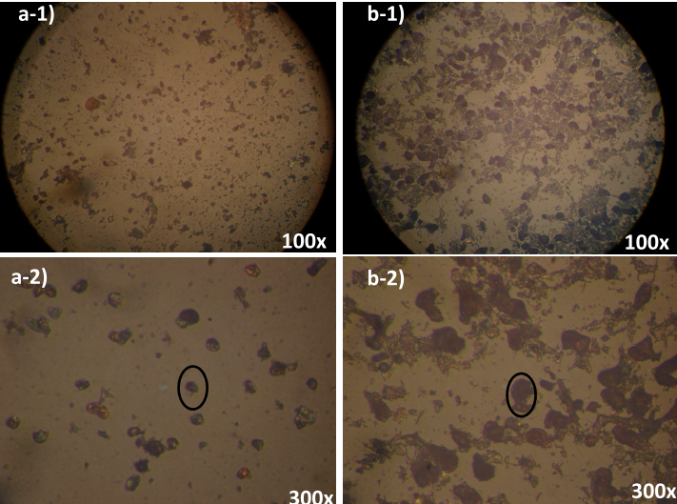
Cell separation process from cancer and healthy tissue
The optical microscopy images of separated (a) renal healthy and (b) carcinoma cells stained by papanicolaous-staining method

Slide 21
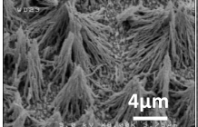
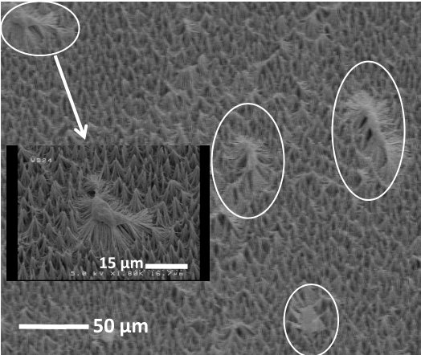
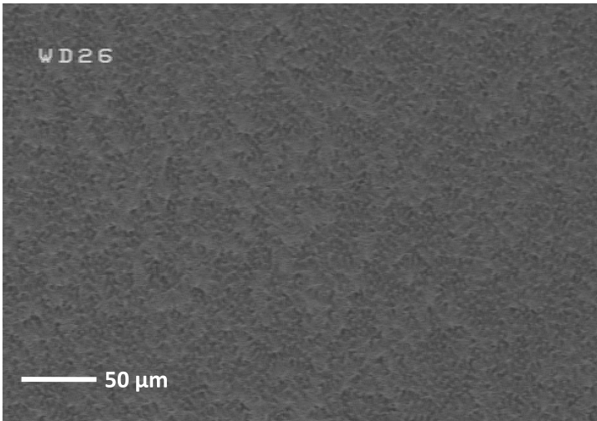
Selective entrapment of RC Cells on MWCNT arrays
SEM image from the entrapment of renal cancer cell on MWCNT arrays (right figure). No entrapment of benign renal cell was observed (left figure).

Slide 22
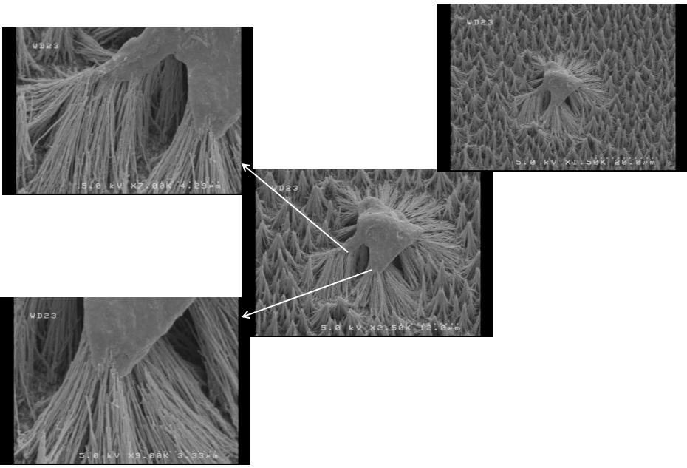
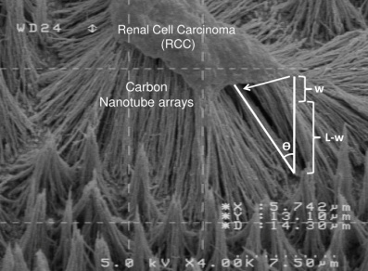
Cell traction force measurement by their entrapment on CNT arrays
SEM images of the arrangement of CNT beams after deflection by the traction force of RC Cells, applied on them. Apart from CNT deflection, the deformation of the cell after entrapment is noticeable.
Cell traction force measurement by this method

Slide 23
CNT-ECIS :
High sensitive cancer cell biosensor

Slide 24
Fabrication process of CNT-ECIS
RCA Silicon substrate
Dry oxide 100 nm
Ni coating
by e-beam system
9 nm
Photolithogrphy
of Ni
CNT growth on Ni catalyst by
DC-PECVD

Slide 25
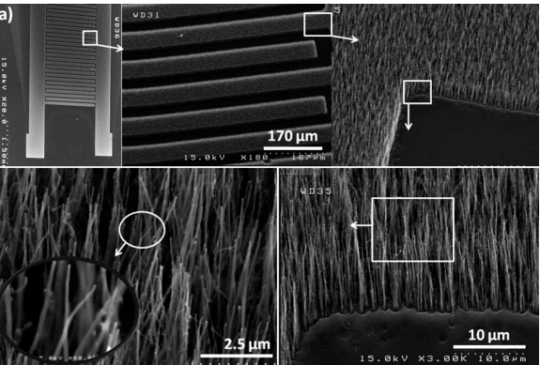
Cancer cell detection by CNT-ECIS
SEM images of a CNT-ECIS biosensor, indicating the evolution of vertical CNTs with desired patterns.

Slide 26
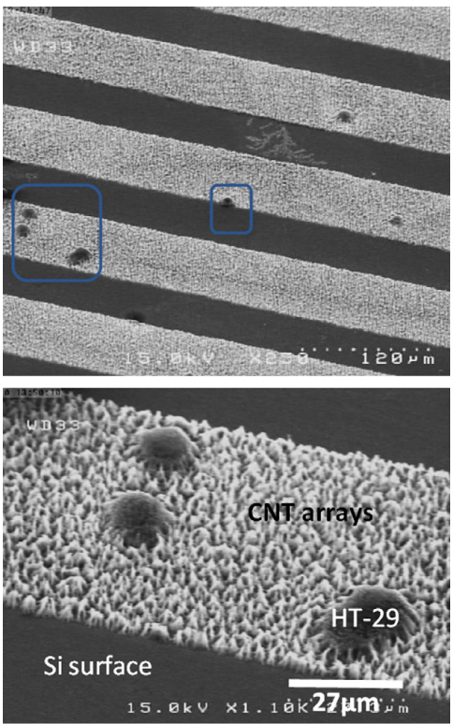
Cancer cell detection by CNT-ECIS
Cancer cells were flown on CNT-ECIS
Mechanical interaction of cell & CNT
Cancer Cell entrapment
Electrical interaction of CNT tip & cell membrane
Signal extraction & Cell electrical detection
SEM image of HT29 cells entrapmen
t on CNT covered arrays.

Slide 27
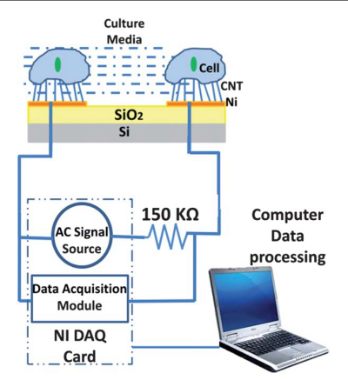
Signal extraction
A schematic diagram of the setup used for CNT-ECIS. The arrows coming from one electrode to the other represent the AC probe signal. The dashed box represents the computer controlled DAQ Card NI PCI-6110 (National Instruments) which could not only provide an AC potential to the sensing device producing a weak AC probe signal, but also acquire the feedback voltage drops across the two electrodes using data acquisition module. The data processing is carried out by computer which also takes charge of real-time display of the impedance curve.

Slide 28
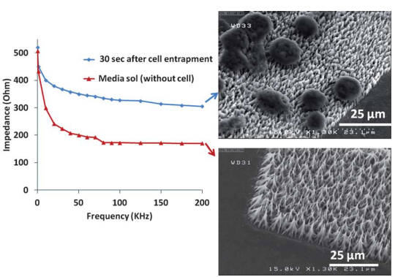
Cancer cell detection by CNT-ECIS
The impedance spectrum of a CNT-ECIS sensor measured at different probe frequencies.
Mechanical entrapment & electrical detection (signal extraction) [1]
[1] M.Abdolahad, etal, Lab on chip 2012, 12, 1183–1190

Slide 29
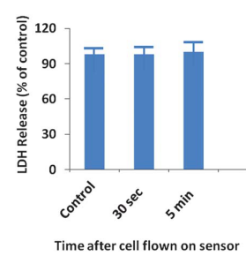
cell viability test during signal extraction
(b)
LDH assay
GFP expression
(a)
CNT array
100µm
Cancer Cell
(c)
CNT
10µm

Slide 30
Sensitivity diagram
(A)
The sensitivity of the CNT-ECIS sensor
versus probe signal frequency
Sensitivity (f ) = (|Z_{cell-covered-total} (f )| _ |Z_{cell-free-total}(f )|)Q_{cell}⁻¹
Observable mechanical and electrical interaction of CNT arrays and cancer cells

Slide 31
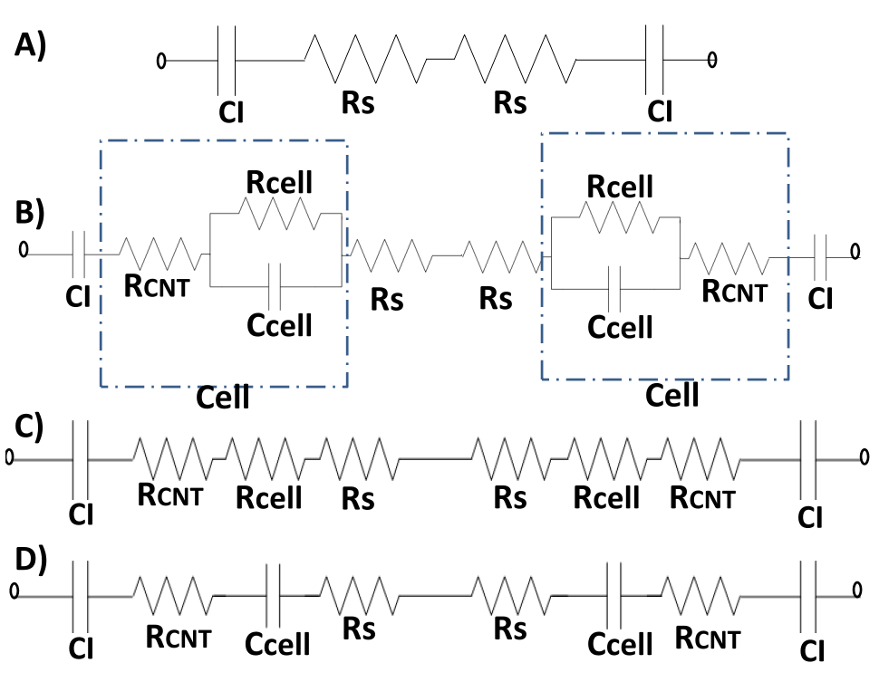
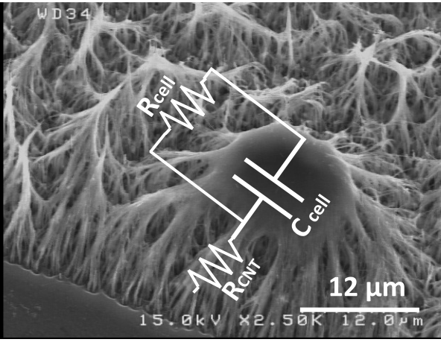
Equal circuit model of the device
Z_{cell-free} (f ) = 2R_{s}+2(j 2πf CI)⁻¹
Z_{cell-free-total} (f) = (2R_{s}+2(2jπf CI)⁻¹)n⁻¹
Z_{cell-entrapped-total} (f) = (Z_{cell-free} (f) +2[R_{cell}⁻¹+ (j2πfC_{cell}⁻¹)]⁻¹+ 2[R_{CNT}])n⁻¹

Slide 32
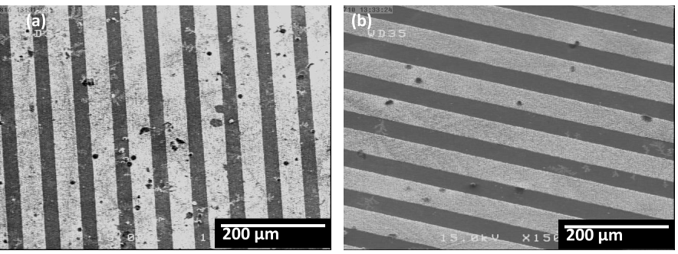
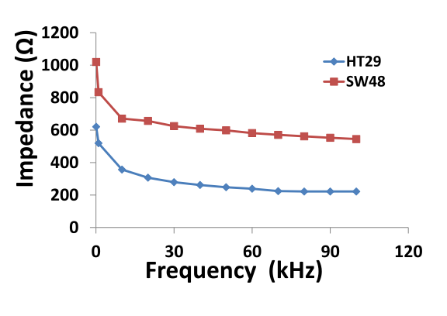
Metastasis diagnosis of colon cancer cells by CNT-ECIS
SW48
HT29

Slide 33
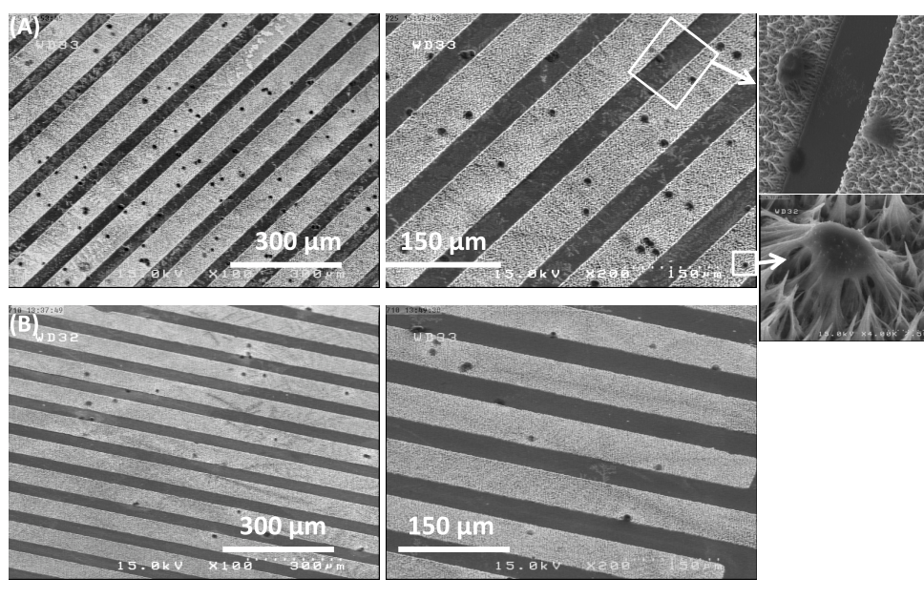
Cells concentration detection
SEM images of SW48 entrapped cells with (A) Higher (10 000 cells ml1) and (B) lower (4000 cells ml1) populations on CNT-ECIS.

Slide 34
The variation in impedance against frequency for different populations of cells

Slide 35
CNT-ECIS comparison with other cell biosensors

Slide 36
Cell & Time efficiency factors of CNT-ECIS
For comparison with other impedance based cell biosensors we deﬁned TEF and CEF parameters which describe the rapidness and resolution of biosensors.
Time efﬁciency factor (TEF) of the sensor corresponds to the best sensitivity of the sensor (S) per time duration for cell attachment on the electrodes (T) and is formulated as:
TEF = S/T
Cell efﬁciency factor (CEF) which describes the best sensitivity of the sensor (S) per density of attached cells (D), formulated as:
CEF = S/D

Slide 37
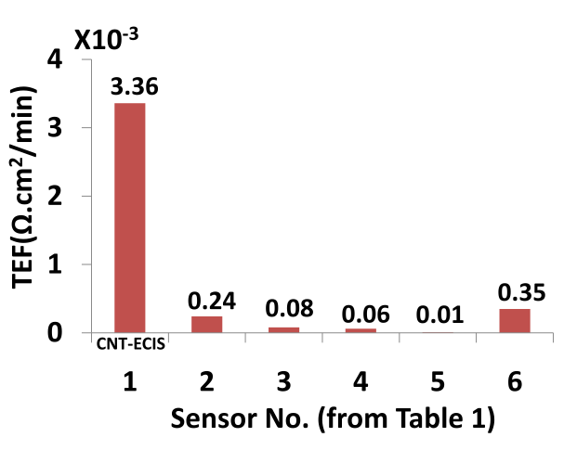
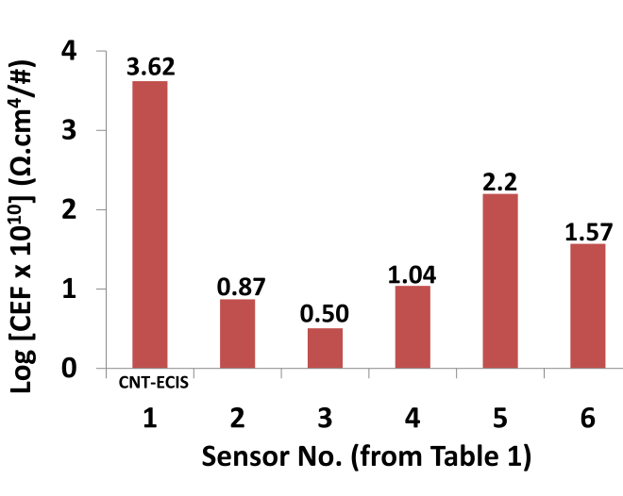
Cell & Time efficiency factors of CNT-ECIS
(A)
(B)
Comparative diagram of (A) TEF and (B) CEF parameters between CNT-ECIS and other impedance based cell biosensors. The CEF of CNT-ECIS is observably higher than the others.

Slide 38
In breif:
Vertically aligned CNT arrays, promising candidate for detection of higher grades of cancer cells by their rapid mechanical entrapment .
CNT-ECIS, high sensitive biosensor for metastasis diagnosis of cancer cells
CNT nanobeams play the key role in both Mechanical entrapment and electrical detection procedures
Sensitivity and rapidness of CNT-ECIS is more than other cell biosensors.
Many applications could be suggested for CNT-ECIS such as cell monitoring and EDR assay.
Single cell electrical endoscopy based on CNT could be used for single cell metastasis diagnosis as well as a power full EDR assay for cancer therapy

Slide 39
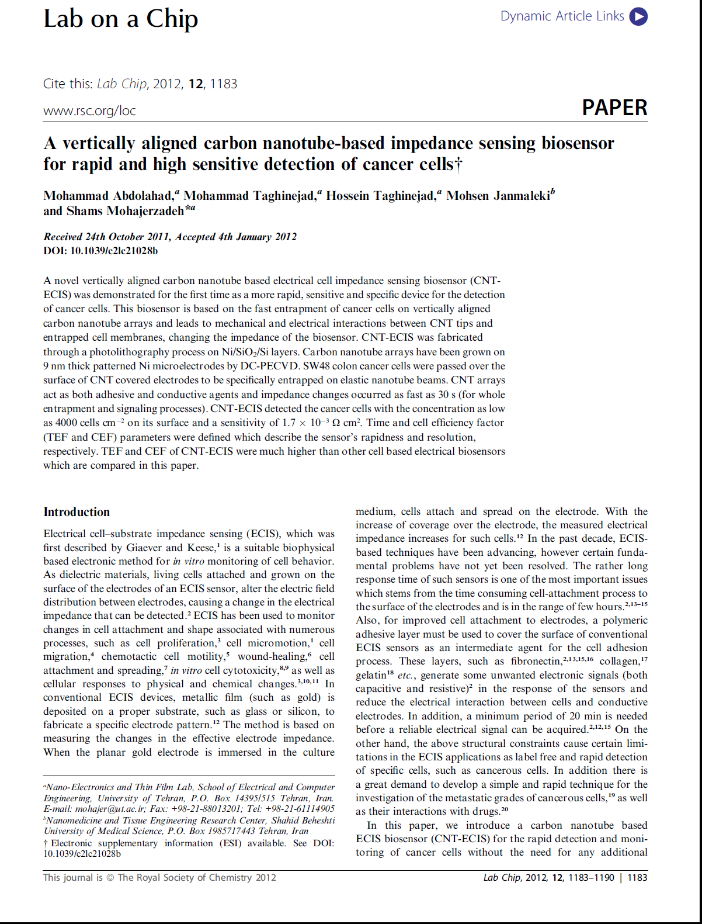
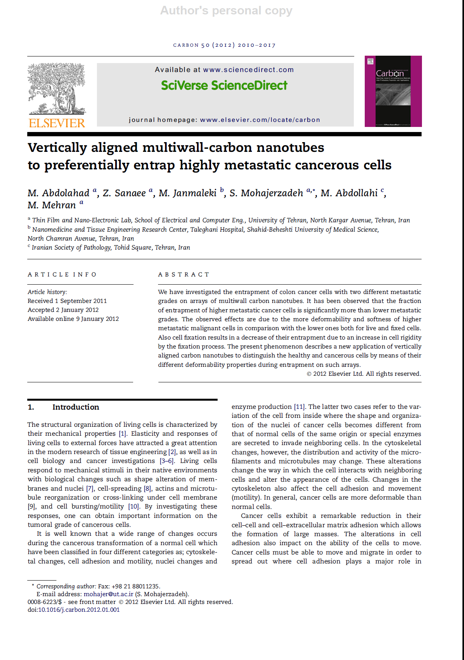

Slide 40


Slide 41
By full of thanks from:
Prof mohajerzadeh (my supervisor)
Prof. peirovi (Shahid Beheshti Med.Univ)
Dr. Abodollahi (MD. Pathologist)
Mr. Janmaleki (Taleghani Hospital)

Slide 42
Thanks for your attention

Slide 43
Monitoring of cell vital signals by CNT-ECIS

Slide 44
CNT based single cell electrical endoscopy for metastasis diagnosis and EDR assay

Slide 45
Electrical properties of cancer cells
Cell membrane: phospholipids bilayer (dielectric) & ion channels (conductor)
Cancer cell: membrane deterioration
Impedance disruption of cell membrane during cancerous transformation

Slide 46
CNT based single cancer cell electrical endoscope

Slide 47
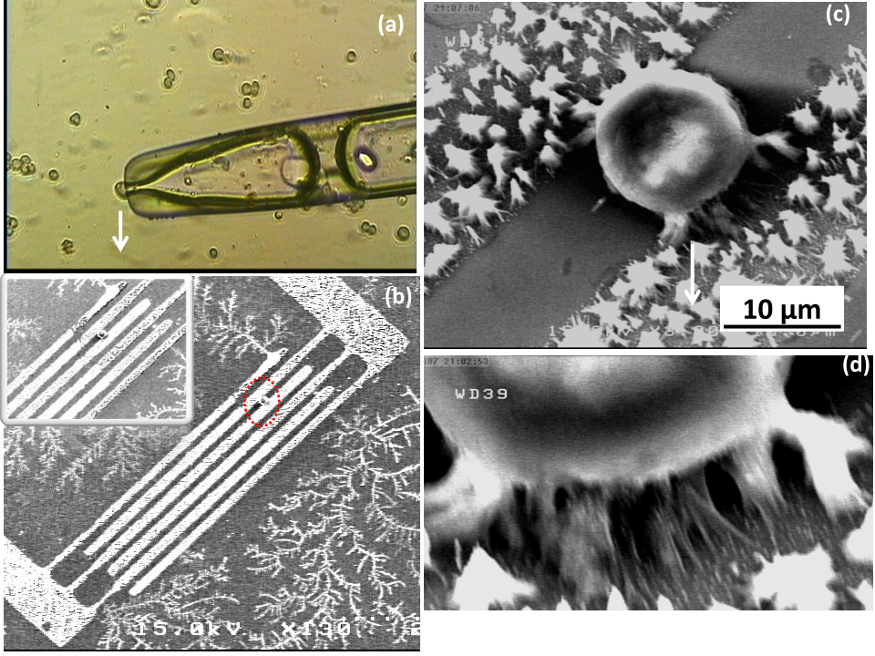
CNT based single cancer cell electrical endoscope
(a) Optical microscope image from HT29 cells being evacuated through an micro pipette system. (b) SEM image from CNT probes used as a cancer electrical endoscope system. (c) Higher resolution SEM micrograph from HT29 cancer cell located between CNT probe electrodes. (d) SEM micrograph from the geometry of deflected nanotubes and their entrance to cell membrane .

Slide 48
GFP tag for cell viability testing
(a)
100µm
(b)
Cancer Cell
(c)
CNT
CNT array
10µm
(a,b) A fluorescent image of a living HT29 cell trapped on CNT arrays expressing a GFP-tagged nuclear body protein (green). (c) The cell dribbled between CNT cancer endoscope nano-electrodes during signal extraction.

Slide 49
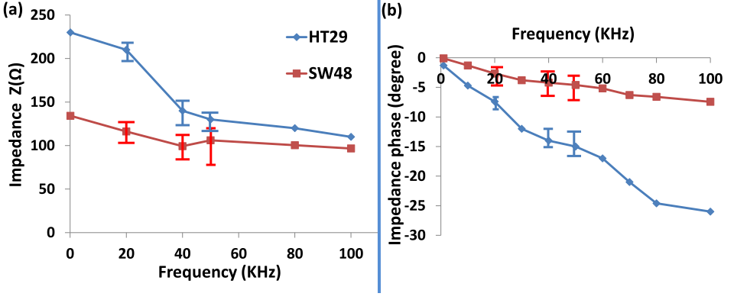
Impedance diagram of CNT endoscopy for HT29 & SW48 single cells
Phospholipids
deterioration
(a) The impedance intensity and (b) impedance phase results of low and high metastatic stages of colon cancer measured by CNT based electrical cancer endoscope at different probe frequencies. The impedance of HT29 cell is more than SW48 one, which is related to the metastatic progression of the latter cancer cell.

Slide 50
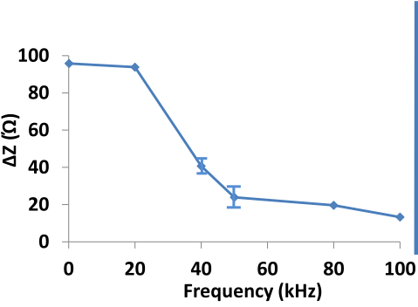
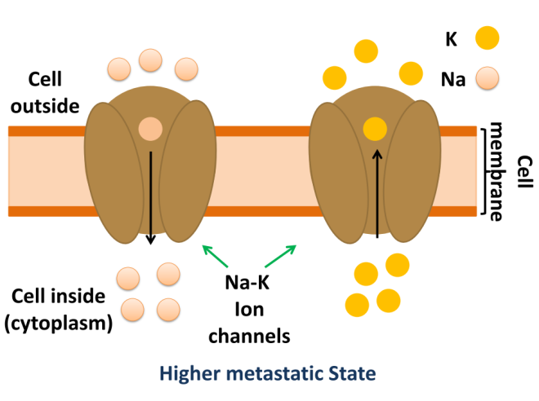
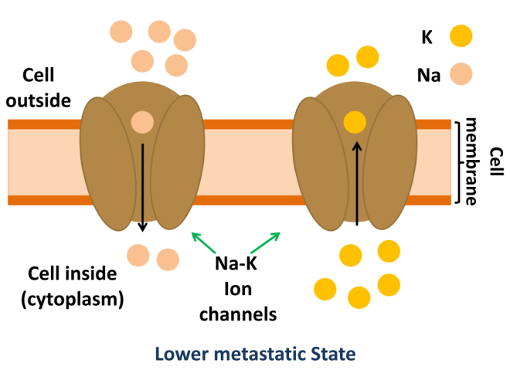
(a)
(b)
(c)
The diagram of (a) impedance difference between HT29 and SW48 cells at frequencies ranged from 100 Hz to 100 kHz. This difference initiates from cell membrane ion permeability increment after metastatic progression, which relates to Na accumulation inside and K penetration outside the cell membrane as described in the schematic drawings of (b) and (c).

Slide 51
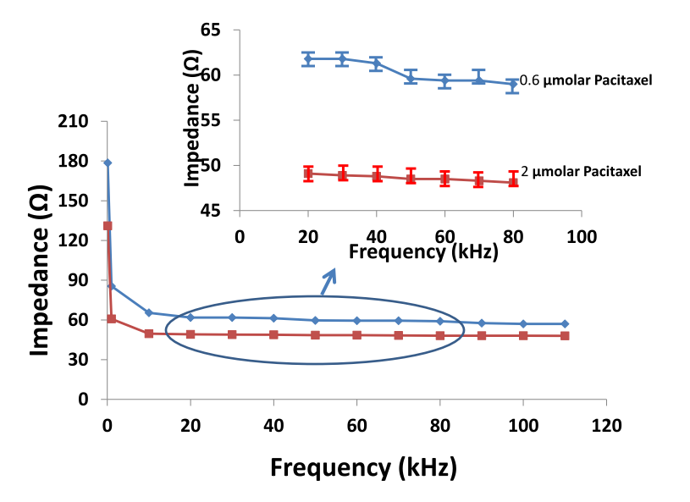
Single cell EDR Assay by CNT electrical endoscope
Triton
Paclitaxel
impedance diagram of HT29 single cell treated with 1%, 5% and 25% of triton at different frequencies measured by CNT based cancer endoscopy.
Impedance diagram of HT29 single cell treated with 0.6 and 2.0 µmolar of paclitaxel at different frequencies measured by CNT based cancer endoscopy of single cell resolution EDR assay.

Slide 52
Equivalent Circuit Model
The equivalent circuit of CNT cancer cell electrical endoscopy.

Slide 53
Chapter 5
Silicon Micro/Nano structures interaction with cancer cells

Slide 54
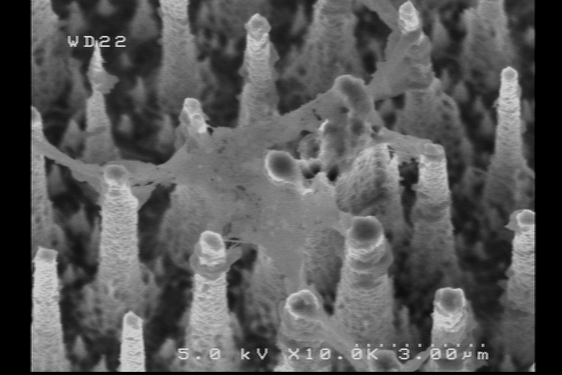
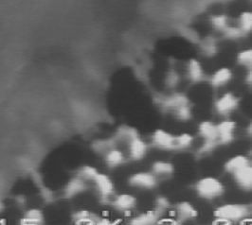
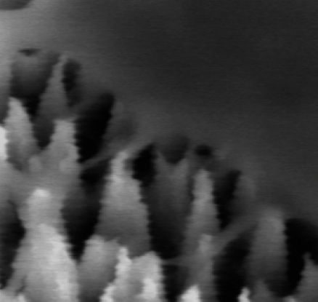
cells entrapment
on Silicon nanograss
cell entrapment
on Si micro rods
a)
b)
a-1
b-1
a-2
b-2
3 µm
Renal cancer cell
Renal Healthy cell
Both healthy and cancer cells
were entrapped: No selectivity
Cell extension on the rods:
no entrapment regime

Slide 55
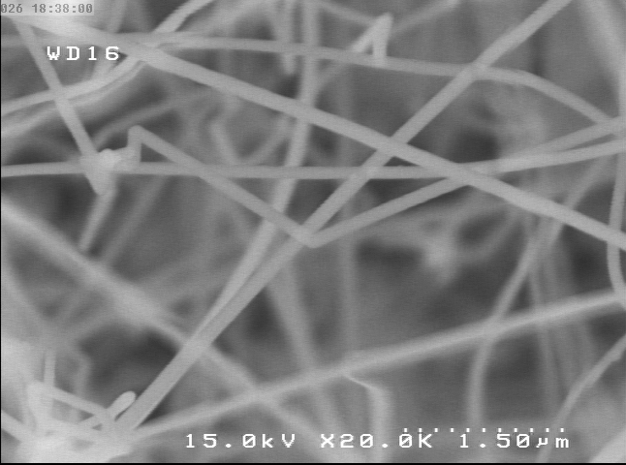
Skein based silicon nanowires
grown by
LPCVD with
Au & Ni catalysts
With
diamaeter < 150 nm
and length > 500 um
MTT ASSAY
Biocompatible structure
Good substrate for cell seeding and growth

Slide 56
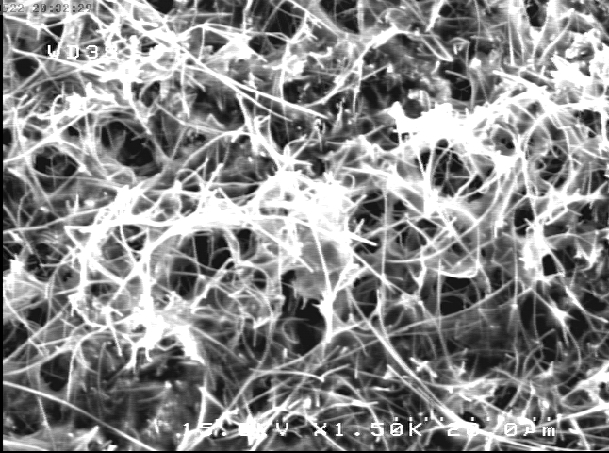
GFP Tag for cells viability on SiNW
20 µm
SW48 cell
NO Cancer cell entrapped
on SiNW after cell solution flown
Silicon Nanowires
10 µm

Slide 57
Colon cancer metastasis diagnosis based on SiNW capacitive biosensor
Diagnosis based on further mitosis of higher metastatic cells
SW48
HT29

Slide 58
Time consuming biosensor in comparison with CNT-ECIS (24 hrs Vs. 30 sec)
High population of cells required for changing the impedance & metastasis diagnosis

Slide 59
Chapter 6
Graphene nanosheets interaction with cancer cells

Slide 60
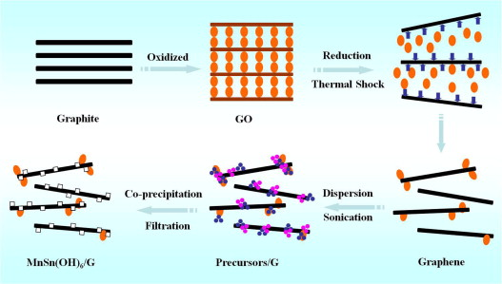
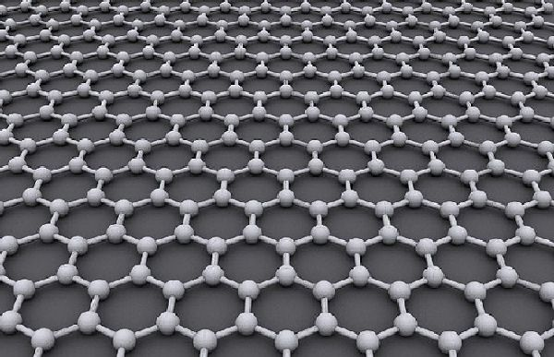
Graphene definition and its application in cancer therapy
Graphene: a new carbon based nanostructure
Dose dependent biocompatibility
Achieved : Hummers method and thermal exafolation
Our method: reduction of GO by green tea
Applied in cancer photothermal therapy with NIR
Polyphneol attached GT-rGO may have selective attachment to cancer cell wall

Slide 61
Structural analysis of GT-rGO
AFM
Raman
AFM image of rGO layer. The hight of one layer is about 1 nm
Raman spectra of a) as prepared GO layers and b) rGO sheets

Slide 62
XPS
GO
GT-rGO
UV–visible spectra
. a) GO, b) GT, and c) GT-rGO suspensions with 0.01 mg/mL concentration of GO.

Slide 63
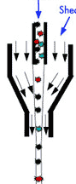
Biocompatibility testing by FLOWCYTOMETRY
sample
Sheath
Flow
chamber
Single Cell
Laser
Scatter

Slide 64

Flow cytometry diagram
(a) rGO treated and (b) untreated SW48 cell solution which exhibited 20% and 22% in PI binding respectively
Just 2% difference in cell biocompatibilty from control sample

Slide 65

Photothermal destruction results
Testing procedure

Slide 66

Optical microscopy image of treated cells
HT29
SW48
Control samples
15 min NIR ablation
to cell solution
10 min NIR ablation
to rGO added
cell solutions

Slide 67

Granularity Diagram
GT-rGO Treated
Control Sample
Observable increment in photothermal therapy efficiency
Polyphenol attached rGO

Slide 68
A comparative table for the PEF of the GT-rGO & other materials
 | Number of cells under irradiation | Percentage of destructed cells | rGO concentration (mg/L) | Irradiation time (min) | Laser power density W/cm² | PEF ((mg/L)(Wcm²))⁻¹
1.This work (GT-rGO) | 30000 | 80 | 3 | 20 | 0.25 | 1600
2.Robinson, et al. [169] (nano-r-GO) | 4000 | 86 | 6.6 | 8 | 15 | 4
3.Chakravarty, et al. [158] (RFT5-CNT) | 100000 | 95 | 300 | 7 | 5 | 9
4. Zhou et al. [178] (FA-SWNT) | 500 | 85 | 3.5 | 5 | 1 | 24

Slide 69
Chapter 7
Interactions of MWCNTs with bacteria
micro organism

Slide 70


MWCNT application in interaction with microorganism (bacteria)
SEM images of the CNT arrays grown on Ni/Si(0 0 1) thin ﬁlm at 650 C. The inset shows the CNTs in a greater
magniﬁcation.
XRD patterns of (a) the grown MWNTs/Si(0 0 1) and the TiO₂ (100 nm)/MWNTs/Si(0 0 1) ﬁlms annealed at (b) 100 and (c) 400 C.

Slide 71


TiO₂/MWCNT Heterojunction for antibacterial application
TEM image of a TiO2/MWNT heterojunction nanotube at tip of the CNT, after removing the Ni seed from tip of the CNT.
Peak deconvolution of C(1s) XPS core level of the polished TiO2/MWNTs/Si ﬁlms post annealed at (a) 100 and (b) 400 C. The inset of (b) shows Ti(2p) core level of that ﬁlm.

Slide 72


TiO₂/MWCNT Heterojunction for antibacterial application
(a) Normalized ratio of the killed bacteria on surface of the Si substrate as a control sample, (b) ratio of the viable bacteria on surface of the bare MWNT arrays and (c) normalized ratio of the killed bacteria on surface of the pure TiO2 thin ﬁlm annealed at 400 C.
Normalized ratio of the killed bacteria on surface of the TiO2/MWNT samples annealed at 100 C; (a) in dark and (b) under visible light irradiation.

Slide 73


MWCNT application in interaction with microorganism (bacteria)
HRTEM image of a Ni-removed Ag–CN
Peak deconvolution of the Ag(3d) XPS core level of a) the Ag–
Ni/CNTs and b) the Ni-removed Ag–CNTs with the open tips.

Slide 74


The silver ion release curves of a) the Ag–Ni/CNTs after two
sequential measurements (the dotted curves) and b) the Ni-removed Ag–
CNTs after three sequential measurements (the solid curves), in the
HNO3 solution.
Percent of the inactivated bacteria on the surface of a) the Ag–
Ni/CNTs, b) the Ni-removed CNTs, c) the Ni-removed Ag–CNTs, and d)
the Si substrate (as a control sample) and e) ratio of the viable bacteria on
the surface of the unpurified Ni/CNT arrays.

Slide 75



Slide 76
Conclusion
High metastatic cancer cell diagnosis by their entrapment on vertically aligned CNT arrays
Cell traction force (CTF)measurement after entrapment on CNT arrays by large deflection mode
CNT-ECIS, high sensitive biosensor for rapid detection of metastatic cancer cells: mechanical & electrical intearction of cell-CNT
Single cell metastatic diagnosis by CNT electrical endoscopy: EDR assay for cancer therapy assistance
Si micro/nano structure in interaction with cancer cells : SiNW capacitive biosensor not as well as CNT-ECIS
GT-rGO as an effeicent material for NIR mediated cancer photothermal therapy
CNT based controlled antibacterial structures

Slide 77
Suggestions
Make a diagnostic profile from cancer cells based on their entrapment on CNT arrays
Test and calibation of CNT-ECIS for on different kinds of epithelial cancers to make a clinical application for it.
CTC detection in blood samples by CNT-ECIS
Would it become a lab on chip for metastasis diagnosis in hospitals?
Investigation of cell membrane electrical variations by CNT electrical endoscopy
Would it be an assisted diagnostic device for EDR assay in cancer therapy?
Developing Si nanostructures for Si-ECIS fabrication
In vivo cancer photothermal therapy by GT-rGO

Slide 78
Thanks for your attention

