Slide 1
Biotechnology and Medicine
Esmaeil Sadroddiny, PhD
Medical Biotechnology

Slide 2
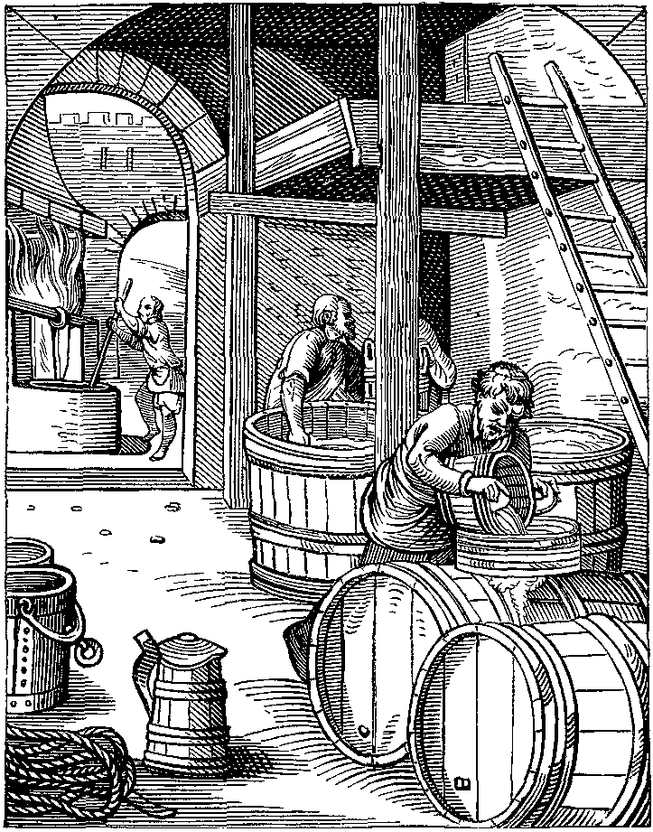
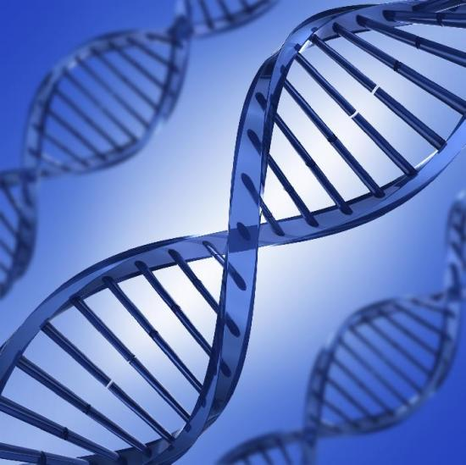
Biotechnology: An ancient job, a novel concept

Slide 3
Biotechnology
Blue biotechnology
Marine
Green biotechnology
Agricultural
Red Biotechnology
White biotechnology
Medical
Industrial

Slide 4
Medical Biotechnology
Public Health
Diagnosis
BioPharmaciutics
Treatment

Slide 5
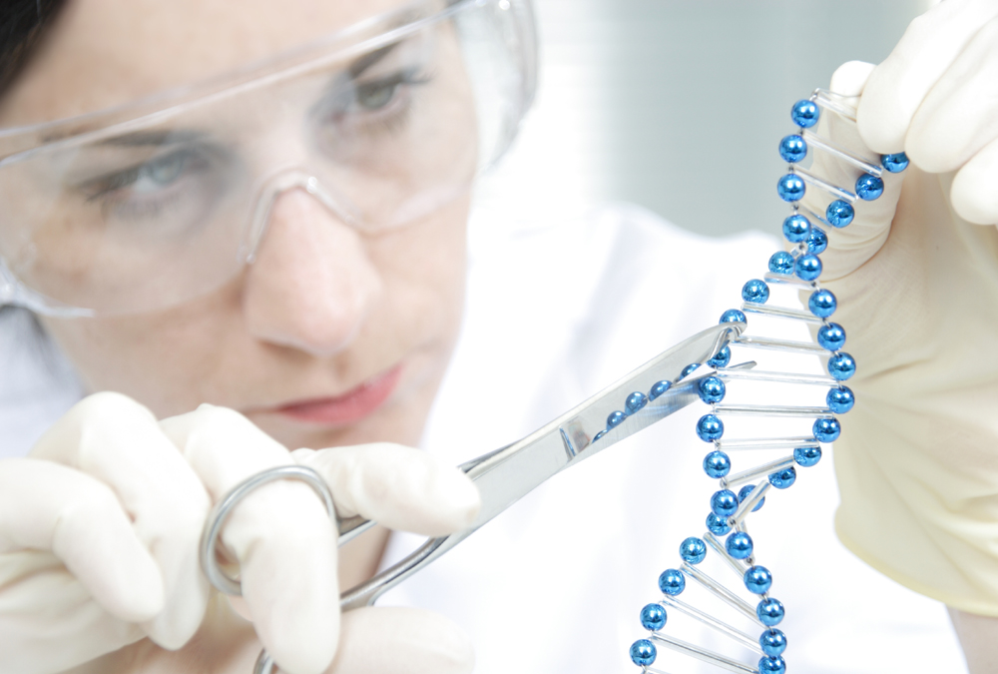
Biotechnological tools
Genetic engineering and recombination

Slide 6
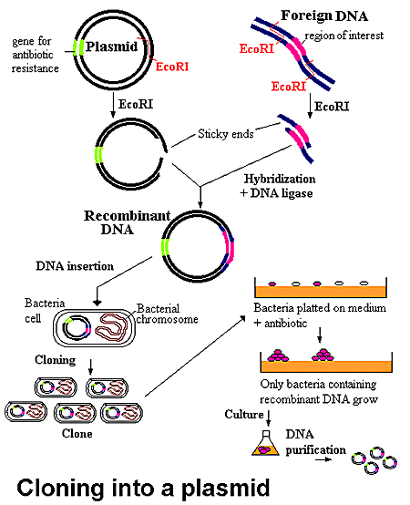
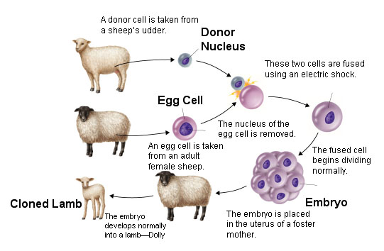
Biotechnological tools
Cloning
Molecular pharming

Slide 7
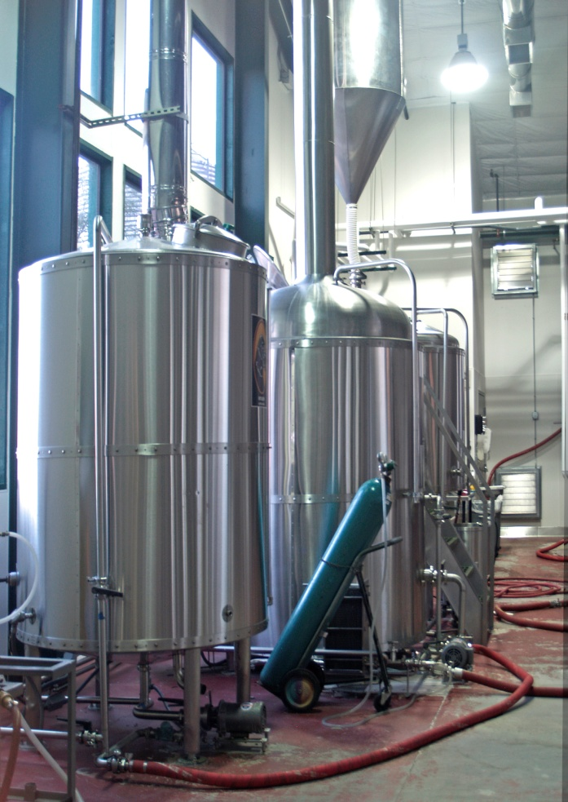
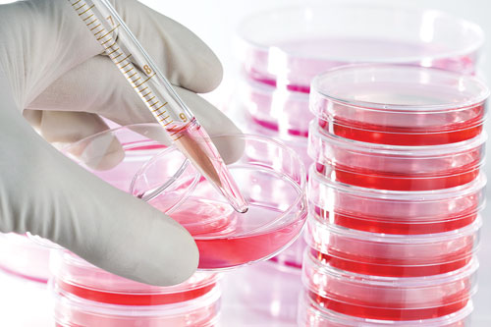
Purification
Cell culture
Fermentation
Purification

Slide 8
Biotechnology and public health
Vaccines
Genetically modified plants/animals
Improved nutrition
Improved shelf life and resistance to stress, herbicide, pathogens
Molecular Pharming
Environmental pollution
Biofuels: 10% of transport energy, UK, by 2020 =4.3 m tones of fossil oil each year
Biological pest control

Slide 9
Vaccines
Recombinant vaccines
DNA vaccines

Slide 10
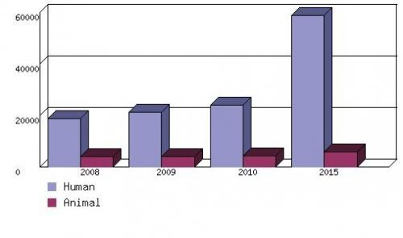
Vaccines: Global Market
$32b, 2013
$56b, 2016
$ MILLIONS
GLOBAL REVENUE OF HUMAN AND ANIMAL VACCINES, 2008-2015
Ref: bcc research

Slide 11
Recombinant vaccines
Hepatitis B, 1986
HPV vaccine, 2006

Slide 12
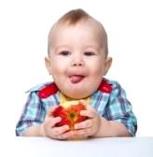
Vaccine in our food
Potatoes and tobacco: toxin from E.coli
Alfalfa plants: cholera toxin
Tomatoes and lettuce: hepatitis B surface protein

Slide 13
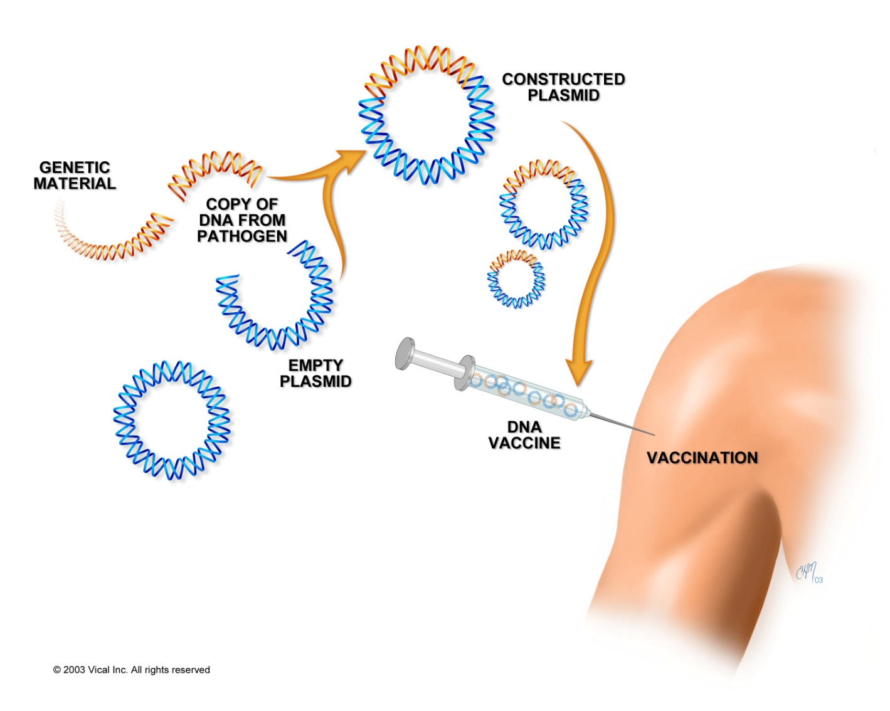
DNA vaccines

Slide 14
Biotechnology and Diagnosis
In vitro diagnosis, IVD and home testing
Immunodetections
Molecular diagnosis
Biosensors: global market (2012); $8.5b
Forensic medicine

Slide 15
IVDs: Global market
$46b 2012
$65b 2017
Share of recombinant market: 30%

Slide 16
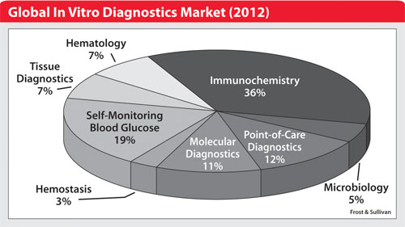
Ref: Darkdaily.com

Slide 17
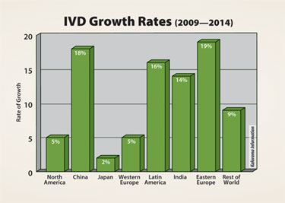
Ref: BioMarketTrends

Slide 18
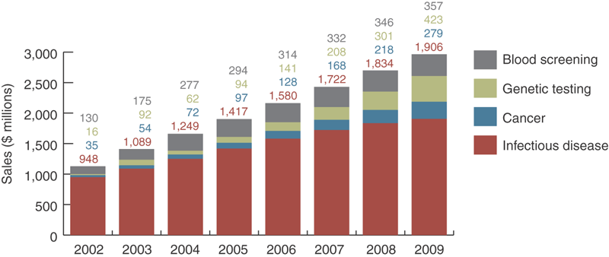
IVD market according to disease

Slide 19
Biopharmacioticals
Purified therapeutics
Recombinant drugs
Pharmed products

Slide 20
Protein purification from plasma
289 proteins documented
About 100 are used in diagnostic assays
Fewer than 20 as plasma therapeutics
Three proteins accounting for 70% of the revenue, Alb, IVIG, VIII

Slide 21
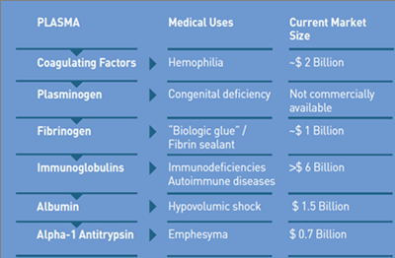
Global market: Purified therapeutics
Ref: http://www.prometic.com/en/protein-technologies/plasma-derived.php

Slide 22
 | Iran
The number of annual donation | 1,735,000
Amount of plasma | 300,000 L
Plasma used for fractionation | 150,000 L
Total Alb Derived (30g/L) | 4.5 tones
Recombinant Human Albumin in rice | 2.75 g/kg
Total rice required | 1636 tones

Slide 23
Recombinant Drugs
1982: Insulin
> 170 FDA approved recombinant therapeutic protein: 2012
Iran market: 28
Global market: $90 b, 13.8% share of the global pharmaceotical market, 2010

Slide 24
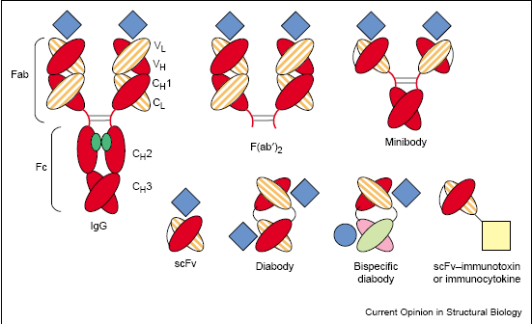
Recombination for multi-functionality

Slide 25
Biopharmaceoticals
Biopharmaceuticals produced with animal cell technology (status 2012): 80 trade marks
Monoclonal Antibodies Approved by the FDA for Therapeutic Use (status 2013): 29 trade marks
Biopharmaceuticals produced from tissues & organs (status 2010): 26 trade marks

Slide 26
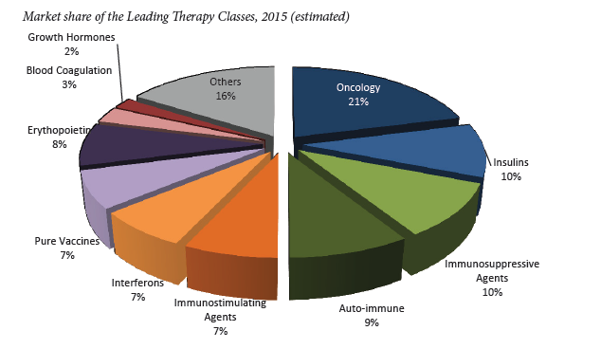
Ref: Bartłomiej Żerek, Piotr Rózga, Adamed Sp. z o.o.

Slide 27
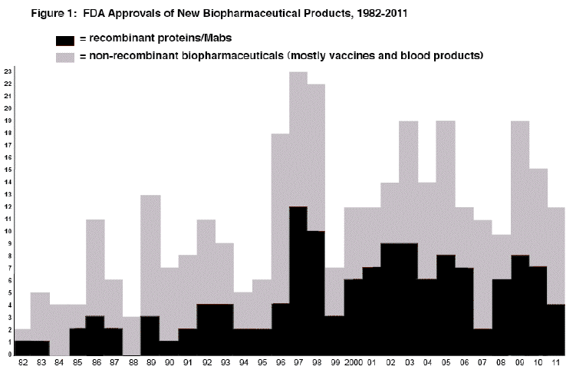
Ref: http://biopharma.com/approvals_2011.html

Slide 28
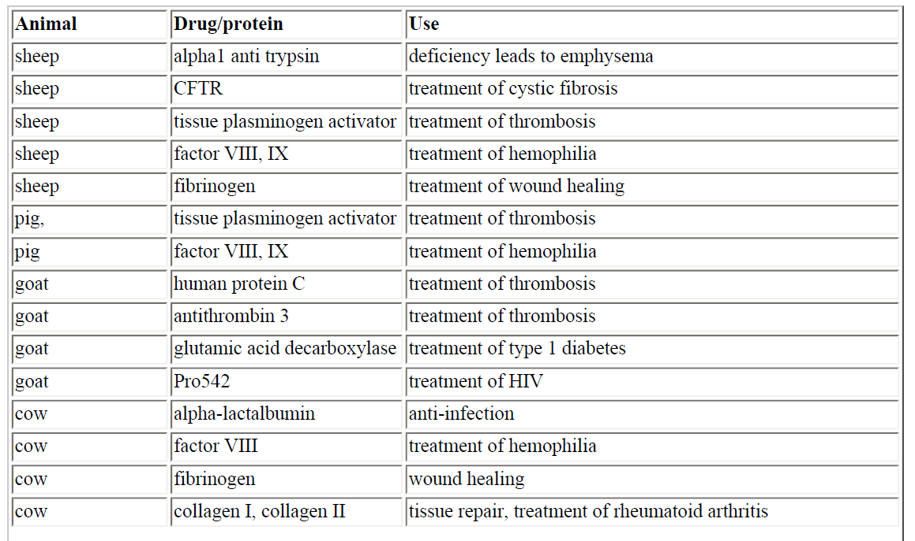
Animal pharming

Slide 29
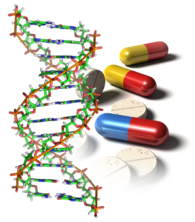
Pharmacogenomics
Personalized medicine

Slide 30
Biotechnology and Treatment
Gene therapy
Stem cell therapy

Slide 31
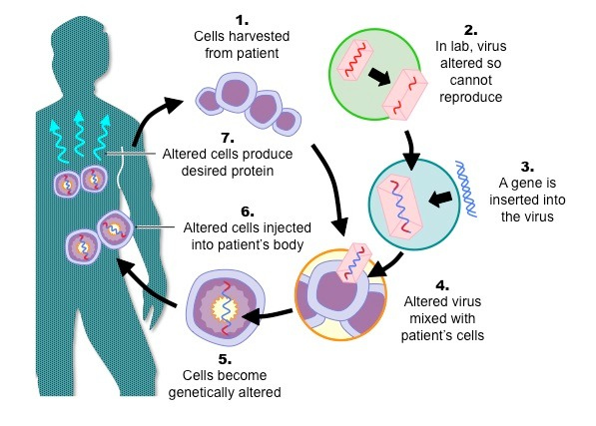
Gene therapy
SCID: 1990
LPLD: Glybera 2012
Disease targets
severe combined immunodeficiencies,
lipoprotein lipase deficiency
cancer
AIDS
cystic fibrosis
muscular dystrophy
cardiovascular diseases
obesity
high blood pressure
alpha1-antitrypsin deficiency
peripheral artery disease)
various ocular diseases
Gaucher disease
rheumatoid arthritis
hemophilia A and B
familial hypercholesterolemia

Slide 32
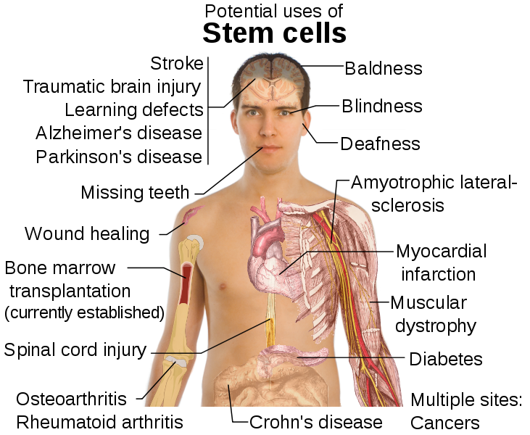

Slide 33
BM transplantation: a successful cell therapy
First clinical trial: GRNOPC1, 2009
FDA approved products ( 2013): 9
Engineered stem cell therapy

Slide 34
Medical biotechnology: Current state and future
Vaccine market: 7 out of 78 marketed vaccine
IVD market: 30%
Biopharmacioticals: 13.8% recombinants
Gene therapy: only one case
Cell therapy (FDA product and devices): 9
Major challenges:
Economics of development
Ethics and public concern

Slide 35
Thank you

