Slide 1
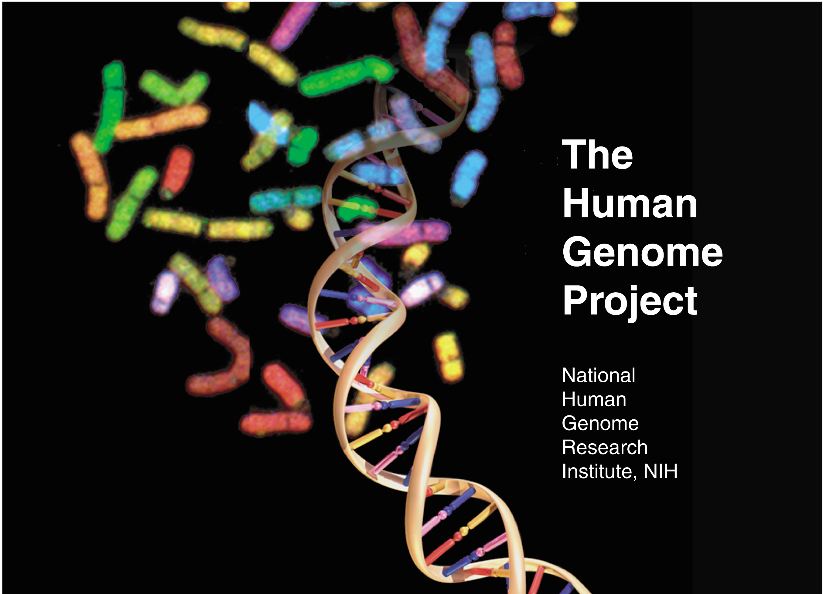
Genomic Medicine:
The Infrastructure for Future Medicine
TUMS
Javad Tavakkoly Bazzaz MD, PhD
Department of Medical Genetics,
School of Medicine,
Tehran University of Medical Sciences

Slide 2
Genomic Medicine Vs. Medical Genetics
Genetics > Human Genetics > Medical Genetics
Genomic Medicine: Understanding variability between individuals allows for more targeted or personalized healthcare based on genetic differences.
To link, on a genomic scale, the resources and tools of the Genome Project to major biological processes and systems involved in different diseases.

Slide 3
Systems/Translational Medicine
Systems Biology: Understanding the manner in which the parts of an organism interact in complex networks.
Systems Medicine: Translation of systems biology into medicine.
Translational Genomics: The part of systems medicine that deals with genome-based systems engineering.

Slide 4
Translational Medicine
Translation of evidence based research findings into practice.
Findings have not been implemented into practice in widespread settings.
May take 10 -20 years for original research to translate to routine medical practice.

Slide 5
Goals of Translational Genomics
Screen for key genes and gene families that explain specific cellular phenotypes (disease).
Use genomic signals to classify/subclassify diseases on a molecular level.
Build model networks to study dynamical genome behavior and derive intervention strategies to alter undesirable behavior.

Slide 6
Epigenetics Mechanisms
Stable & Dynamic Genomics
RNA Interference
Gene Expression
Histone Modifications
DNA Methylation

Slide 7
Nature, June 12, 2008
Translational Research: Bridging the gap between bench and bedside

Slide 8
Basic & Applied Sciences!
“ There does not exist a category of science to which one can give the name ‘applied science.’ There are science and the applications of science, bound together as the fruit of the tree which bears it.”
Louis Pasteur

Slide 9
Paradigm Shift in
Genetic Research in Post-Genomic Era
Modified From Peltonen and McKusick, 2001

Slide 10
Because we know
More Specific Information,
we can…
Diagnose more precisely | Provide more effective treatment.
Select specific treatment that best fits disease | Target the medication to the disorder. Avoid adverse drug reactions. Avoid delay from false starts.
Predict risk before symptoms occur | Provide earlier treatment. Take preventive action.
Manage disease more effectively | Eliminate unnecessary treatment. Provide better timing. Adjust treatment as disease changes.
AND…
AND…
AND…
AND…
Notes:
Here is what that powerful new individualized knowledge lets us do….
We can diagnose disease much more precisely, which lets us provide more effective treatment.
We can select a specific treatment that fits the specific disease of the individual. This allows us to begin treatment promptly, without the false starts of trial and error medicine. It also means we can avoid the adverse drug reactions that drive up deadly complications for patients—along with health costs.
We can predict the risk of a disease well before symptoms occur, which lets us take preventive and therapeutic action earlier.
And we are better able to manage the condition over time, as it changes and as the patient’s needs change.
Today, we will look at examples of all of these.

Slide 11
Tools Needed for Prediction & Personalized Care
Decision Support Tools:
Monitor Progression
Predict Events
Inform Therapeutics
Assess Risk
Refine Assessment
Predict/Diagnose
Baseline Risk
Initiating Events
Earliest Molecular Detection
Earliest Clinical Detection
Typical Current Intervention
Cost
1/reversibility
Disease Burden
Time
Baseline Risk
Preclinical Progression
Disease Initiation and Progression
Stable Genomics: (SNPs) Haplotype Mapping , Gene Sequencing
Sources of New Biomarkers:
Dynamic Genomics: Gene Expression
Proteomics Metabolomics Molecular Imaging
Therapeutic Decision Support

Slide 12
Preparing for the Age of Genomic Medicine
Genetics is becoming a driving force
in medical decision making

Slide 13
Uses of Genetic Information
Development of gene therapy
Genetic testing for risk stratification
Use of genetic information for treatment decisions & drug development

Slide 14
Medicine of the past could be called “trial-and-error” medicine
Observe
Diagnose
Treat
Monitor
response
Adjust
Notes:
Let’s begin by examining what medicine has looked like in the past. Think of it as trial-and-error medicine.
A physician observes the patient’s condition through a physical exam, asks about medical history, and makes a “most likely” diagnosis based on the knowledge and evidence that is available.
The physician then decides upon the treatment that he or she believes is most appropriate.
Then the physician monitors the response to decide whether to stay the course or try an alternative.
Trial-and-error medicine represents a vast improvement over what came before—largely the “guesswork” of the 19th and early 20th centuries. And it often works.

Slide 15
Interindividual Variability in Drug Response
Disease Drug Class Rate of Poor Response
Asthma Beta-agonists 40-75%
Hypertension Various 30%
Solid Cancers Various 70%
Depression SSRIs, tricyclics 20-40%
Diabetes Sulfonylureas, others 50%
Arthritis NSAIDs, COX-2 inhibitors 30-60%
Schizophrenia Various 25-75%

Slide 16
Factors Contributing to Interindividual Variability in Drug Disposition and Action
Age
Race/ethnicity
Weight
Gender
Concomitant Diseases
Concomitant Drugs
Social factors
GENETICS
PERSONALIZED
MEDICINE

Slide 17
Diagnose more precisely
Genetic tests identify DNA mutations of childhood leukemia, enabling physicians to choose the treatment that fits it precisely.
The impact of genetic tests and genome-based cancer drugs on survival of childhood leukemia
Acute lymphoblastic leukemia is most common form of childhood leukemia
Genetic tests identify subtypes; allow precise treatment and timing
Today’s cure-rate exceeds 80% vs. 4% in the 1960s
Source: New England Journal of Medicine, 2006, 200l; Personalized Medicine Coalition, 2006.
Notes:
One of the best examples of diagnosing disease more effectively involves the most common form of childhood leukemia—acute lymphoblastic leukemia.
Genetic tests are able to determine the exact chromosomal structure of the individual child’s disease. That allows physicians to select the optimal drug and dosage for each child.
You can see some of the results: In 1962, about 4 percent of children were cured. Now that is over 80 percent.

Slide 18
Today, Cancer is experiencing a shift toward precision medicine
Farber develops 1st chemotherapy for leukemia
Novartis launches Gleevec, the 1st molecular targeted drug, to treat myeloid leukemia
2 types: leukemia & lymphoma
1920
1930
1940
1950
1960
1970
1980
1990
2000
2010
Disease of the blood
38 types of leukemia; 51 types of lymphoma
3 types of leukemia (acute, chronic, preleukemia) and 2 types of lymphoma (indolent, aggressive)
Source: Mara Aspinall, Genzyme
Notes:
18
A deeper understanding of molecular biology and the human genome is enabling scientists and clinicians to begin diagnosing and treating cancers based on their molecular characteristics rather than just gross anatomical observations

Slide 19
Main health-related challenges
Cardiovascular
Cancer
Diabetes-obesity
Undernutrition/malnutrition
Infectious diseases
Allergies
Ageing process
Complex biological problems!
Polygenic + environmental effects!

Slide 20
NCRR Strategic Plan 2009–2013
Translating Research from Basic Discovery to Improved Patient Care

Slide 21
NIH Roadmap
Approach to accelerate fundamental discovery and translation of research knowledge into effective prevention strategies and new treatments.
Strategic initiatives will address critical roadblocks and knowledge gaps that currently constrain rapid progress in biomedical research.
Synergize the work of many NIH Institutes and Centers.
http://nihroadmap.nih.gov

Slide 22
7 common barriers to translation
Basic research not clinically relevant ( generated for its own sake!)
Clinical practice guidelines in literature insufficient for translation.
Comparisons among programs hampered by competition, conflict of interest.
Perception that translation will be lengthy and expensive
Time necessary to train researchers to communicate and share across fields
Practitioners unable to utilize an innovation
Researchers don’t interpret findings so that they can’t be easily disseminated

Slide 23
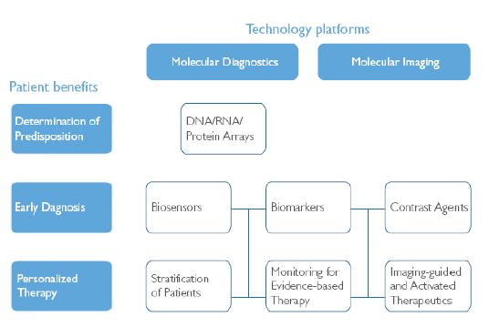
Technology Platforms
Patient Benefits

Slide 24
Biomarker
A biomarker, or biological marker, is in general a substance used as an indicator of a biological state. It is a characteristic that is objectively measured and evaluated as an indicator of normal biological processes, pathogenic processes, or pharmacologic responses to a therapeutic intervention. It is used in many scientific fields.
In medicine, a biomarker can be a traceable substance that is introduced into an organism as a means to examine organ function or other aspects of health.. It can also be a substance whose detection indicates a particular disease state, for example, the presence of an antibody may indicate an infection. More specifically, a biomarker indicates a change in expression or state of a protein that correlates with the risk or progression of a disease, or with the susceptibility of the disease to a given treatment.
A useful way of finding genetic causes for diseases such as schizophrenia has been the use of a special kind of biomarker called an endophenotype.

Slide 25
Biosensor
A biosensor is an analytical device for the detection of an analyte that combines a biological component with a physicochemical detector component.
An analyte is a substance or chemical constituent that is determined in an analytical procedure, such as a titration. For instance, in an immunoassay, the analyte may be the ligand or the binder, while in blood glucose testing, the analyte is glucose. In medicine, analyte often refers to the type of test being run on a patient, as the test is usually determining a chemical substance in the human body.
An analyte itself cannot be measured, but a measurable property of the analyte can. For instance, one cannot measure a table (analyte-component) but, the height, width, etc. of a table can be measured. Likewise, one cannot measure glucose but can measure the glucose concentration. In this example "glucose" is the component and "concentration" is the kind-of-property.
Analyte

Slide 26
Biosensor
A biosensor consists of 3 parts:
the sensitive biological element (biological material -e.g. tissue, microorganisms, organelles, cell receptors, enzymes, antibodies, nucleic acids, etc.-, a biologically derived material or biomimic).
the transducer or the detector element (works in a physicochemical way; optical, piezoelectric, electrochemical, etc.) that transforms the signal resulting from the interaction of the analyte with the biological element into another signal (i.e., transducers) that can be more easily measured and quantified;
Associated electronics or signal processors that are primarily responsible for the display of the results in a user-friendly way.
A common example of a commercial biosensor is the blood glucose biosensor, which uses the enzyme glucose oxidase to break blood glucose down. In doing so it first oxidizes glucose and uses two electrons to reduce the FAD (a component of the enzyme) to FADH2. This in turn is oxidized by the electrode (accepting two electrons from the electrode) in a number of steps. The resulting current is a measure of the concentration of glucose. In this case, the electrode is the transducer and the enzyme is the biologically active component.

Slide 27
Genetic tests identify variations in the BRCA 1 and BRCA 2 genes that increase risks for breast and ovarian cancer.
Predict Risk of Disease Before Symptoms
Genetic tests identify greatly increased hereditary risk for breast and ovarian cancer
Knowledge of increased risk allows preventive measures, such as closer monitoring, risk avoidance, and preventive surgery or chemotherapy.
Lifetime risk of developing breast cancer…
…with BRCA 1 and 2 = 50% - 85%
….without = 13%
Lifetime risk of developing ovarian cancer…
…with BRCA 1 and 2 = 10% - 45%
…without = 1.7%
Notes:
Genetic tests are also able to predict a patient’s risk well before symptoms appear.
This is illustrated well in the case of the BRCA1 and BRCA2 genes that increase a patient’s risk for breast and ovarian cancer. According to estimates of lifetime risk, about 13.2 percent of women in the general population will develop breast cancer, compared with estimates of 36 – 85 percent of women with an altered BRCA1 or BRCA2 gene.
In other words, women with these gene alterations are 3 – 7 times more likely to develop breast cancer than women without.
You can also see that these genes dramatically increase the risks of developing ovarian cancer as well.
This information empowers patients and physicians by knowing what they are facining and having the option to take action that can lessen the risk.
Closer monitoring
Earlier treatment through surgery or preventive chemotherapy
Greater risk-avoidance

Slide 28
Managing Warfarine Dosing
Warfarin is metabolized primarily via oxidation in the liver by CYP2C9, and exerts its anticoagulant effect by inhibiting the protein vitamin K epoxide reductase complex, subunit 1 (VKORC1).
Three single nucleotide polymorphisms (SNPs), two in the CYP2C9 gene and one in the VKORC1 gene, have been found to play key roles in determining the effect of warfarin therapy on coagulation.
Variants of two genes, CYP2C9 and VKORC1 account for 30-50% of the variability.

Slide 29
Predicted economic benefit of CYP2C9 testing for warfarin dosing
Predict 1 major bleed prevented for every 44 patients screened ($135/assay)
$6,000 testing costs ~ cost of 1 major bleed
Neutral economic result, but significant improvement in patient outcome
Prospective trial needed
Higashi and Veenstra, Am J Manag Care 2003; 9: 493-500

Slide 30
Using Genetic Information to Predict Drug Metabolism: The AmpliChip CYP450
A range of drug metabolism phenotypes is observed for individuals based upon the particular cytochrome P-450 genes they possess.
Many drugs metabolized through cytochrome P-450 pathway.
Individual variability in CYP450 isoforms contributes to observed range of metabolic phenotypes.
Analyzes genetic variation in CYP450-CYP2D6 and CYP450-CYP2D19 genes
approved for use in U.S. and Europe
Source: Caraco, Y., N Engl J Med, 2004
Notes:
Many drugs metabolized through cytochrome P-450 pathway
Individual variability in CYP450 isoforms contributes to observed range of metabolic phenotypes.
Analyzes genetic variation in CYP450-CYP2D6 and CYP450-CYP2D19 genes
Approved for use in U.S. and Europe

Slide 31
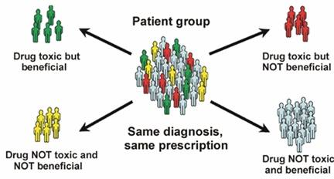
Genomic medicine implies personalization and all its benefits
Diagnosis/ predicting risk of disease
Determining whether a treatment is working
Monitoring healthy people to detect early signs of disease
Producing safer drugs by predicting potential for adverse effects earlier
Producing better medical products
Ready access to information
Decreasing health care costs
Notes:
31
Producing better medical products: Producing new classes of structural materials that are expected to bring about lighter, stronger, smarter, cheaper, cleaner, and more precise medical products

Slide 32
Genetic Testing Where will it be used?
Diagnosis
Prognosis
Pharmaceutical Development
Therapeutic Selection & Monitoring
Screening & Risk Assessment
Prevention
Genetic testing will impact nearly every clinical decision health care providers make

Slide 33
Genetic Testing Market
Number of Available Tests*
est.
1000
1000
862
945
811
800
667
625
600
485
420
400
303
200
0
1995
1996
1997
1998
1999
2000
2001
2002
2003
* Excludes genetic tests for hereditary cancers and infectious diseases Source: GeneTests.org
Notes:
Major Point
Graph does not include tests for hereditary cancer and infectious disease. This is important because most of the audience members will think of genetic testing as that class of tests for the rare single gene disorders. The point here is to open their eyes to the fact that genetics is becoming a greater part of everyday medicine.
The number of tests reported to GeneTests as of 7/31/02 was 943. We are using 1,000 as an estimate of all of 2002. GeneTests is dependent upon self-reporting by the laboratories; therefore, does not capture all the genetic tests actually available.

Slide 34
Genetic Testing Market
Growth in Annual Dollars
Largest dollar growth in cancer tests
(41% of Total by 2006)
1000
Cancer (257% growth)
800
Prenatal (46% growth)
Predisposition (254%
growth)
600
Million $
Total (134% growth)
400
200
0
2001
2002
2003
2004
2005
2006
Source: Frost and Sullivan, IVD Technology Nov/Dec 2001
Notes:
Additional Information
Total genetic testing industry projected to grow from $374.9M to $877.2M
Cancer projected to grow from $101.3 to $361.3
Prenatal projected to grow from $217.5 to $316.7
Predisposition (e.g. Huntington’s, Alzheimer projected to grow from $56.2 to $199.2
These numbers do not include genetic testing for infectious disease.

Slide 35
Why Do Health Professionals Need to Prepare for Genomic Medicine?
Need to learn to “think genetically” - to:
realize when genetic factors play a role
effectively use family hx & genetic tests
be able to explain genetics concepts
deal with “risk” & genetic predisposition
realize personal and societal impact of genetic information
protect genetic privacy
use genetics to individualize patient care
use genetics to preserve health

Slide 36
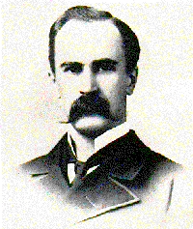
“If it were not for the great variability among individuals, medicine might as well be a science and not an art”
Sir William Osler, 1892
Notes:
36

Slide 37
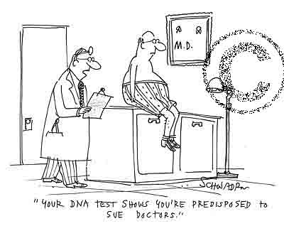
Thank You!

