Slide 1


Nano carriers for drug
delivery into brain tumors
Masood Khosravani , MD,PhD
School of advanced Technologies in Medicine
Tehran University of Medical sciences
Drkhosravani@tums.ac.ir

Slide 2
In 2008 approximately 12.7 million cancers were diagnosed (excluding non-melanoma skin cancers and other non-invasive cancers) and 7.6 million people died of cancer worldwide.
Cancers as a group account for approximately 13% of all deaths each year with the most common being:
lung cancer (1.4 million deaths)
stomach cancer (740,000 deaths)
liver cancer (700,000 deaths)
colorectal cancer (610,000 deaths)
breast cancer (460,000 deaths)
This makes invasive cancer the leading cause of death in the developed world and the second leading cause of death in the developing world

Slide 3
In the United States in the year 2005, it was estimated there were 43,800 new cases of brain tumors (Central Brain Tumor Registry of the United States, Primary Brain Tumors in the United States, Statistical Report, 2005–2006),
1 percent of all cancers
2.4 percent of all cancer deaths,
[20–25 percent of pediatric cancers.
Ultimately, it is estimated there are 13,000 deaths per year in the United States alone as a result of brain tumors

Slide 4
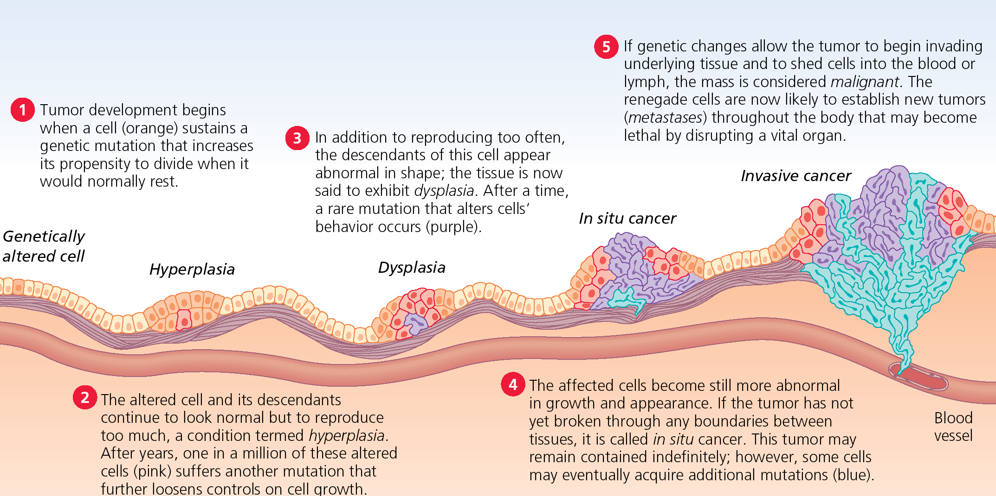
Neoplastic cells usually exhibit chromosomal abnormalities and the loss of their differentiated properties.
These changes lead to uncontrolled cell division and many result in the invasion of previously unaffected organs, a process called metastasis.

Slide 5
Its threat level depends on the combination of factors like the type of tumor, its location, its size and its state of development.
The most common primary brain tumors are:
Gliomas (50.3%)
Meningiomas (20.9%)
Pituitary adenomas (15%)
Nerve sheath tumors (8%)

Slide 6
These areas are composed of two broad classes of cells: neurons and glia.
These two types are equally numerous in the brain as a whole, although glial cells outnumber neurons roughly 4 to 1 in the cerebral cortex.
Glia come in several types, which perform a number of critical functions, including structural support, metabolic support, insulation, and guidance of development.
Primary tumors of the glial cells are called Glioma and often are malignant by the time they are diagnosed.

Slide 7
Brain tumors include all tumors inside the cranium or in the central spinal canal. They are created by an abnormal and uncontrolled cell division, usually in the brain itself.
Within the brain itself, the involved cells may be neurons or glial cells (which include astrocytes, oligodendrocytes, and ependymal cells). Brain tumors may also spread from cancers primarily located in other organs (metastatic tumors).
Brain tumors or intracranial neoplasms can be cancerous (malignant) or non-cancerous (benign).

Slide 8
WHO classification of the tumors of the central nervous system
1 Tumours of neuroepithelial tissue
2. Tumours of cranial and paraspinal nerves
3. Tumours of the meninges
4. Tumors of the haematopoietic system
5. Germ cell tumours
6. Tumours of the sellar region
7. Metastatic Tumours

Slide 9
1. Tumours of neuroepithelial tissue
1.1. Astrocytic tumours 1.1.1 Pilocytic astrocytoma (ICD-O 9421/1, WHO grade I) 1.1.1a Pilomyxoid astrocytoma (ICD-O 9425/3, WHO grade II) 1.1.2 Subependymal giant cell astrocytoma (ICD-O 9384/1, WHO grade I) 1.1.3 Pleomorphic xanthoastrocytoma (ICD-O 9424/3, WHO grade II) 1.1.4 Diffuse astrocytoma (ICD-O 9400/3, WHO grade II) 1.1.5 Anaplastic astrocytoma (ICD-O 9401/3, WHO grade III) 1.1.6.Glioblastoma(ICD-O 9440/3, WHO grade IV) 1.1.6a Giant cell glioblastoma (ICD-O 9441/3, WHO grade IV) 1.1.6b Gliosarcoma (ICD-O 9442/3, WHO grade IV) 1.1.7 Gliomatosis cerebri (ICD-O 9381/3, WHO grade III)
1.2. Oligodendroglial tumours 1.2.1 Oligodendroglioma (ICD-O 9450/3, WHO grade II) 1.2.2 Anaplastic oligodendroglioma (ICD-O 9451/3, WHO grade III)
1.3. Oligoastrocytic tumours 1.3.1 Oligoastrocytoma (ICD-O 9382/3, WHO grade II) 1.3.2 Anaplastic oligoastrocytoma (ICD-O 9382/3, WHO grade III)
1.4. Ependymal tumours 1.4.1 Subependymoma (ICD-O 9383/1, WHO grade I) 1.4.2 Myxopapillary ependymoma (ICD-O 9394/1, WHO grade I) 1.4.3 Ependymoma (ICD-O 9391/3, WHO grade II) 1.4.4 Anaplastic ependymoma (ICD-O 9392/3, WHO grade III)
1.5. Choroid plexus tumours 1.5.1 Choroid plexus papilloma (ICD-O 9390/0, WHO grade I) 1.5.2 Atypical choroid plexus papilloma ( ICD-O 9390/1, WHO grade II) 1.5.3 Choroid plexus carcinoma (ICD-O 9390/3, WHO grade III)
1.6. Other neuroepithelial tumours 1.6.1 Astroblastoma (ICD-O 9430/3, WHO grade I) 1.6.2 Chordoid glioma of the third ventricle (ICD-O 9444/1, WHO grade II) 1.6.3 Angiocentric glioma (ICD-O 9431/1, WHO grade I)
1.7. Neuronal and mixed neuronal-glial tumours 1.7.1 Dysplastic gangliocytoma of cerebellum (Lhermitte-Duclos) (ICD-O 9493/0) 1.7.2 Desmoplastic infantile astrocytoma/ganglioglioma (ICD-O 9412/1, WHO grade I) 1.7.3 Dysembryoplastic neuroepithelial tumour (ICD-O 9413/0, WHO grade I) 1.7.4 Gangliocytoma (ICD-O 9492/0, WHO grade I) 1.7.5 Ganglioglioma (ICD-O 9505/1, WHO grade I) 1.7.6 Anaplastic ganglioglioma (ICD-O 9505/3, WHO grade III) 1.7.7 Central neurocytoma (ICD-O 9506/1, WHO grade II) 1.7.8 Extraventricular neurocytoma (ICD-O 9506/1, WHO grade II) 1.7.9 Cerebellar liponeurocytoma (ICD-O 9506/1, WHO grade II) 1.7.10 Papillary glioneuronal tumour (ICD-O 9509/1, WHO grade I) 1.7.11 Rosette-forming glioneuronal tumour of the fourth ventricle (ICD-O 9509/1, WHO grade I) 1.7.12 Paraganglioma (ICD-O 8680/1, WHO grade I)
1.8. Tumours of the pineal region 1.8.1 Pineocytoma (ICD-O 9361/1, WHO grade I) 1.8.2 Pineal parenchymal tumour of intermediate differentiation (ICD-O 9362/3, WHO grade II, III) 1.8.3 Pineoblastoma (ICD-O 9362/3, WHO grade IV) 1.8.4 Papillary tumors of the pineal region (ICD-O 9395/3, WHO grade II, III)
1.9. Embryonal tumours 1.9.1 Medulloblastoma (ICD-O 9470/3, WHO grade IV) 1.9.1b Medulloblastoma with extensive nodularity (ICD-O 9471/3, WHO grade IV) 1.9.1c Anaplastic medulloblastoma (ICD-O 9474/3, WHO grade IV) 1.9.2. CNS Primitive neuroectodermal tumour (ICD-O 9473/3, WHO grade IV) 1.9.2a CNS Neuroblastoma (ICD-O 9500/3, WHO grade IV) 1.9.3 Atypical teratoid/rhabdoid tumour (ICD-O 9508/3, WHO grade IV)

Slide 10
The glioblastoma
Low-grade gliomas are slowly growing, and are assigned either a I or II grade ( pilocytic astrocytoma).
High grade(malignant) gliomas grow much more quickly, and are assigned either a II(anaplastic) or IV(glioblastoma multiforme) grade.

Slide 11
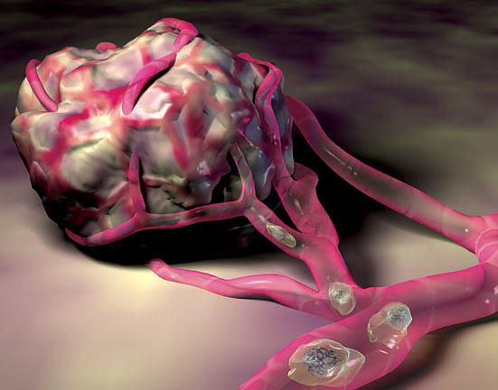
Treatment options of cancer
Surgery:before 1955
Radiotherapy:1955~1965
Chemotherapy:after 1965
Immunotherapy
Gene therapy
All three methods risk damage to normal tissues or incomplete eradication of the cancer.

Slide 12
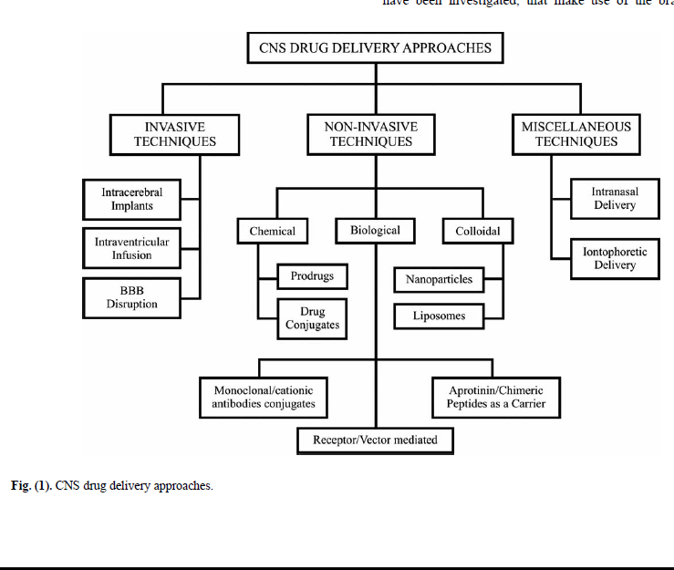

Slide 13
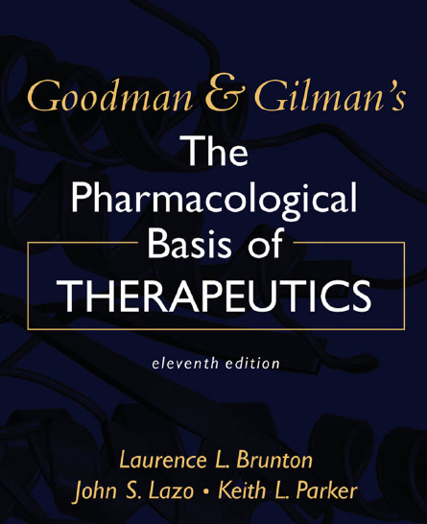
Antineoplastic agent
Alkylating agent
Natural product
Miscellaneous agent
Hormons & Antagonists
Antimetabolites

Slide 14
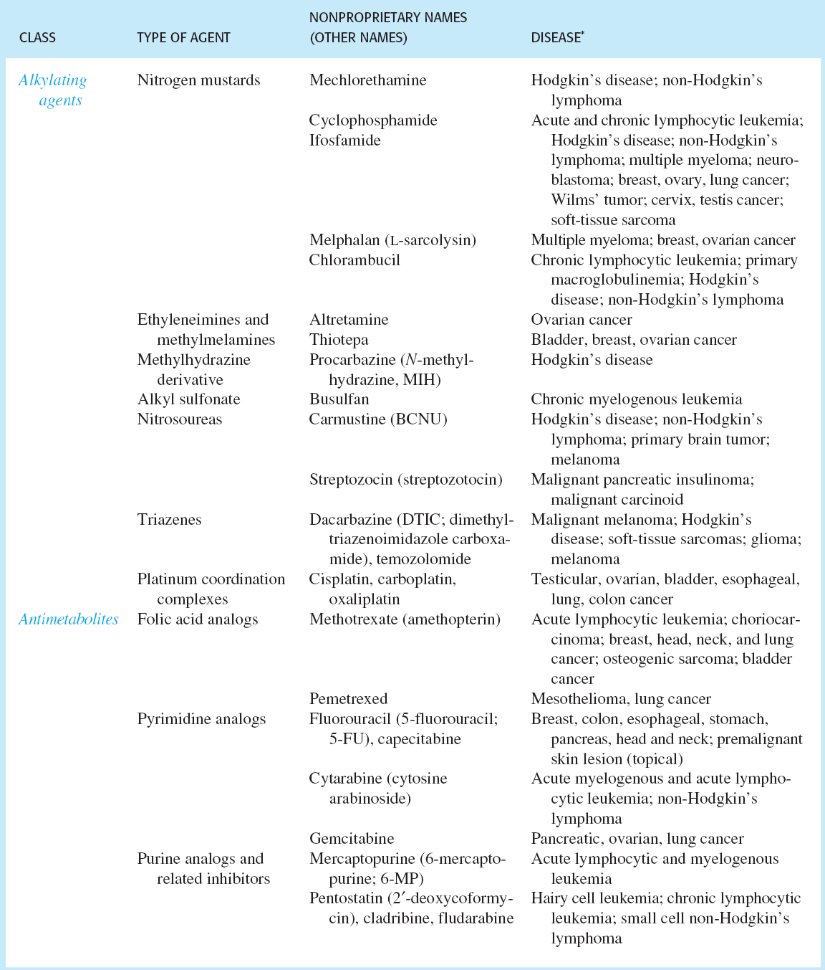

Slide 15
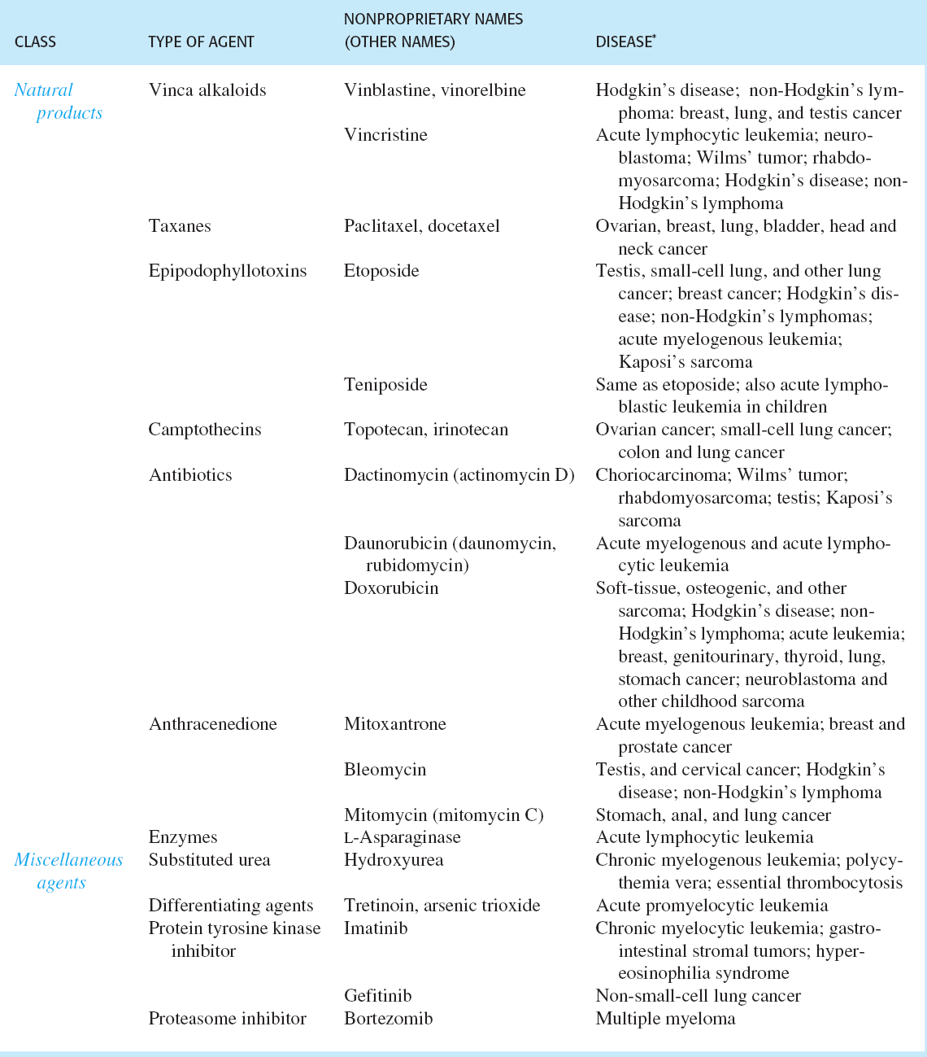

Slide 16
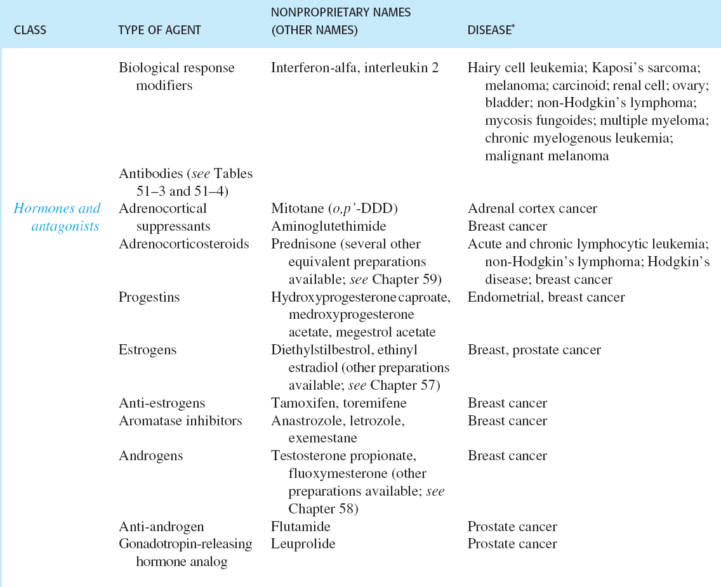

Slide 17
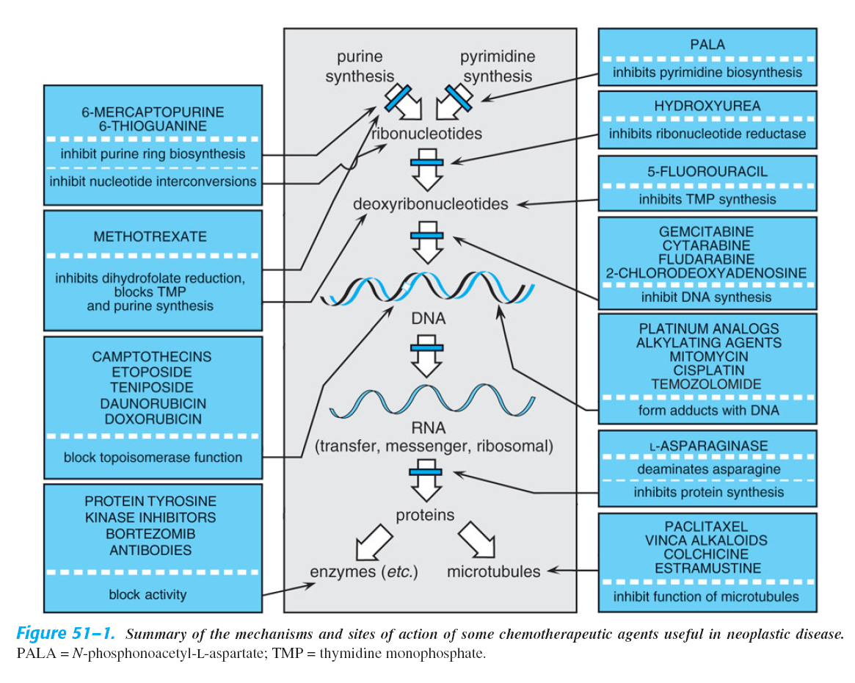

Slide 18
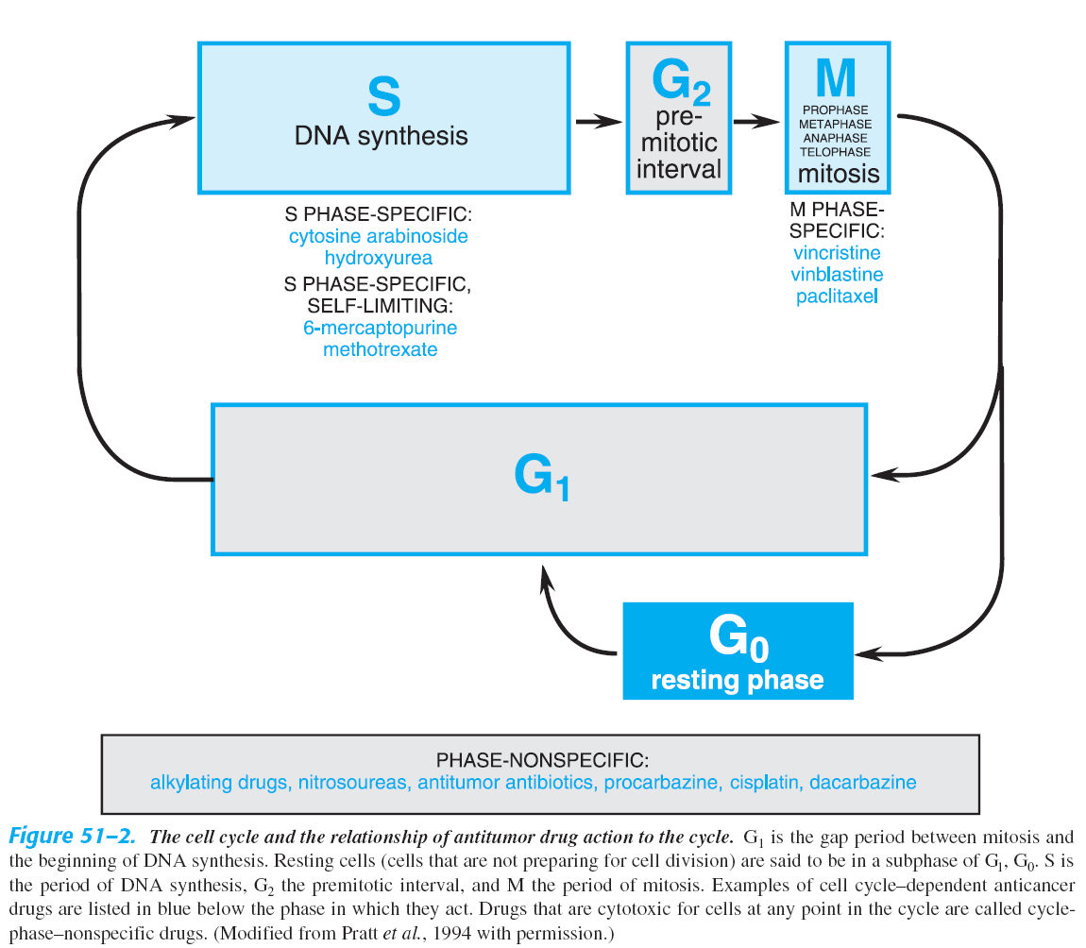

Slide 19
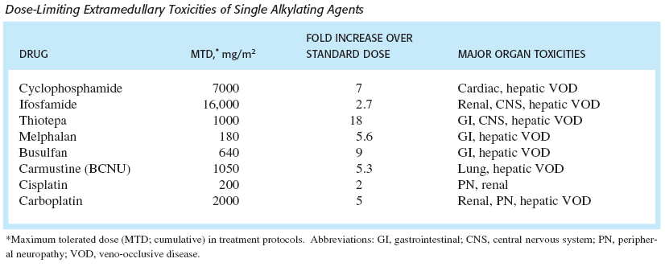

Slide 20
Chemotherapy drugs for brain tumours
Procarbazine
Carmustine (BCNU): (bis-chloroethylnitrosourea)
Lomustine (CCNU): 1-(2-chloro-ethyl)-3-cyclohexyl-1-nitrosourea
Irinotecan
Temozolomide
Cisplatin
Carboplatin
Methotrexate
Etoposide
Cyclophosphamide
Ifosfamide
Vincristine
Other

Slide 21
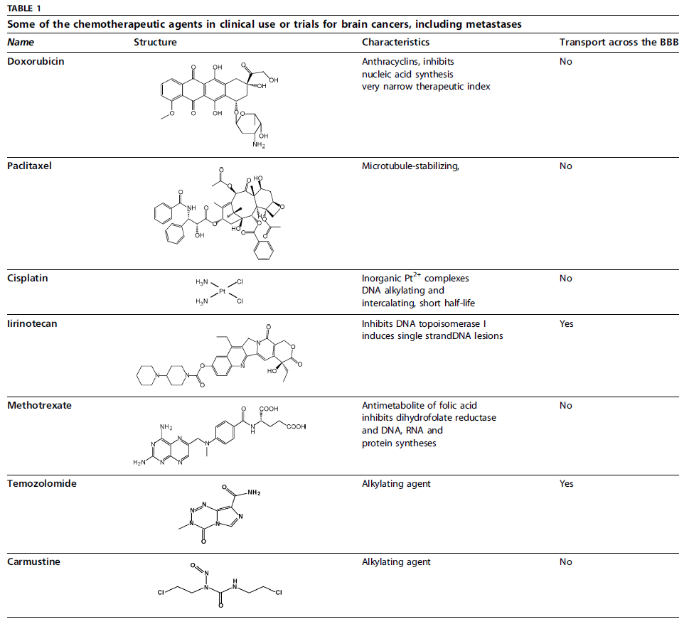

Slide 22
Anticancer agents can have several limitations in vivo:
slow absorption by tumor cells
non-specific adsorption by normal cells,
reduced lifetimes due to rapid clearance by the human body due to the poor solubility and stability in vivo
high cytotoxicity and side effects.

Slide 23
BBB

Slide 24
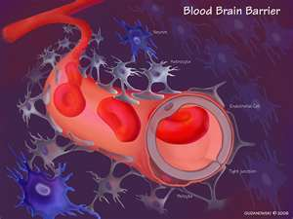
BBB
neurovascular unit: endothelial cell & astrocytes & pericytes & neurons & the extracellular matrix

Slide 25
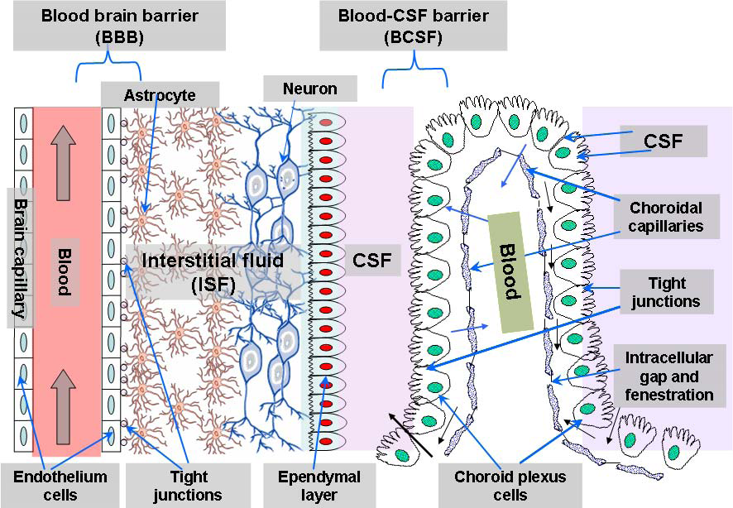

Slide 26
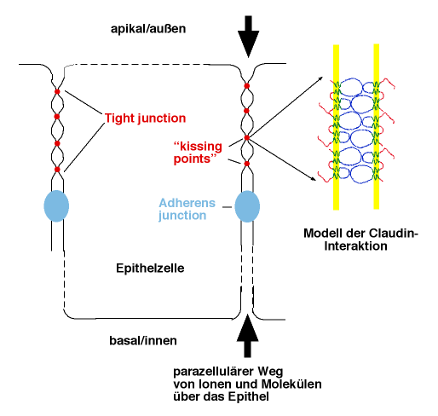

Slide 27
Mechanisms conferring drug resistance in glioma treatment
1. The Blood-Brain Barrier
One of the most important fields studied in drug targeting is the targeting to the brain due to its complexity, and only very few approaches are successful.The Blood-brain barrier (BBB), which is formed by the tight junctions within the capillary endothelium of the brain, forms a formidable barrier to the CNS inhibiting the delivery of therapeutic agents (mostly with high molecular weight and/or hydrophilic drug).

Slide 28
Principal mechanisms involved in the restriction of brain drug uptake by the BBB include:
(1) The absence of paracellular openings
(2)The lack of pinocytosis
(3) The presence of significant protein efflux pumps

Slide 29
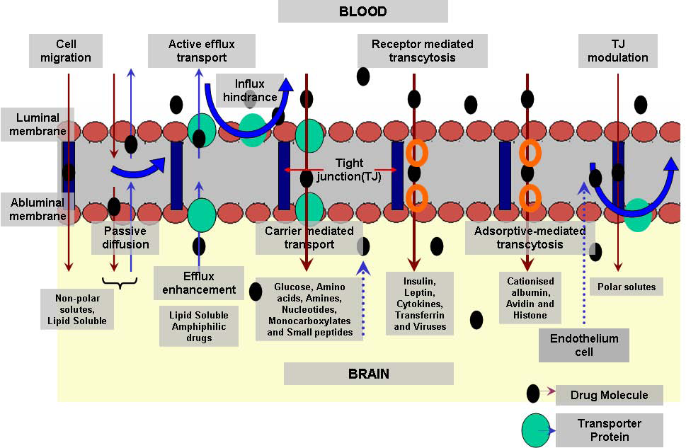

Slide 30
In order to overcome the limited access of drugs through the BBB to the brain, different delivery methods have been developed.
The manipulation of the BBB by temporary disruption of tight junctions to allow paracellular movement by way of osmotic opening or by the use of biologically active agents (e.g. histamine, serotonin,free oxygen radicals, calcium entry blockers, etc.).
The problem with this method is that it is very invasive because it also allows the free passage of non-desired drug,resulting in a high toxicity of the brain.

Slide 31
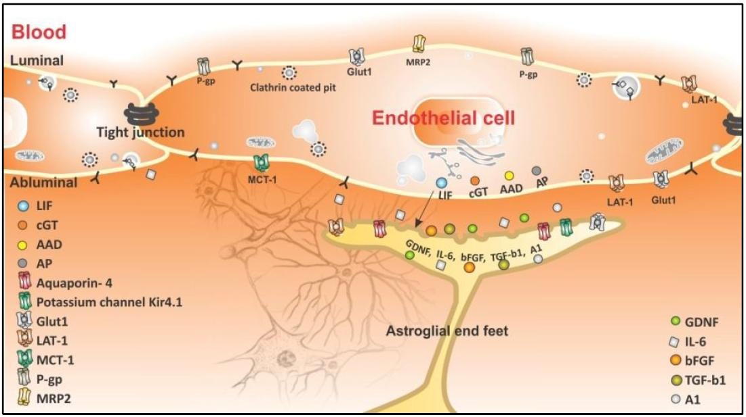
The blood brain barrier (BBB)

Slide 32
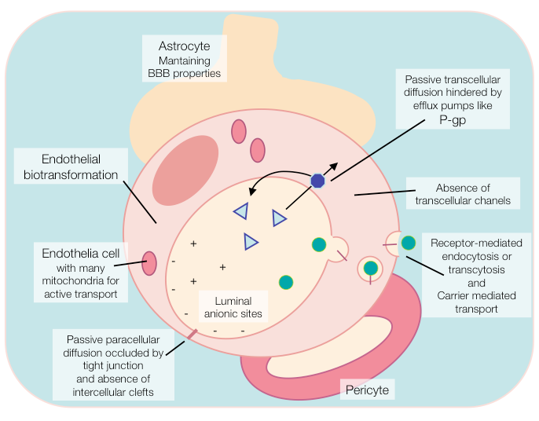

Slide 33
P-gp is an active drug efflux transporter protein, which is in the luminal membranes of the cerebral capillary endothelium.This efflux transporter actively removes a broad range of drug molecules from the endothelium cell cytoplasm before they cross into the brain.
The presence of P-gp in tumours causes multidrug resistance (MDR), and P-gp in the BBB is also responsible for multidrug resistance (MDR) in the case of brain tumours.

Slide 34
Table 1. P-gp substrates and inhibitors
Cancer drugs :
Doxorubicin
Daunorubicin
Vinblastine
Vincristine
Actinomycin D
Paclitaxel
Teniposide
Etoposide
Immunosuppressive drugs:
Cyclosporin A
Lipid-lowering agent:
Lovastatin
Antihistamine:
Terfendine
Steroids:
Aldosterone
Hydrocortisone

Slide 35
Cortisol
Corticosterone
Dexamethasone
Dopamine antagonist:
Domperidone
HIV protease inhibitors:
Amprenavir
Indinavir
Nelfinavir
Ritonavir
Saquinavir
Cardiac drugs:
Digoxin
Quinidine
Antiemetic:
Ondansetron
Anti-diarrheal agent:
Loperamide
Anti-gout agent;
Colchicine
Antibiotic:
Erythromycin
Anti-helminthic agent:
Ivermectin
Anti-tuberculuos agent:
Rifampin
Florescent dye:
Rhodamine-123

Slide 36
2.The Tumour resistance
 Non-cellular drug resistance mechanisms could be due to poorly vascularized tumour regions,
The acidic environment in tumours can also confer a resistance mechanism against basic drugs. These compounds would be ionized, preventing their internalization across the membrane cellular.
 Cellular drug resistance mechanisms compromise altered activity of specific enzyme systems,transport based mechanisms, like P-glycoprotein efflux system,responsible for the multidrug resistance (MDR), or the multidrug resistance associated protein(MRP).

Slide 37
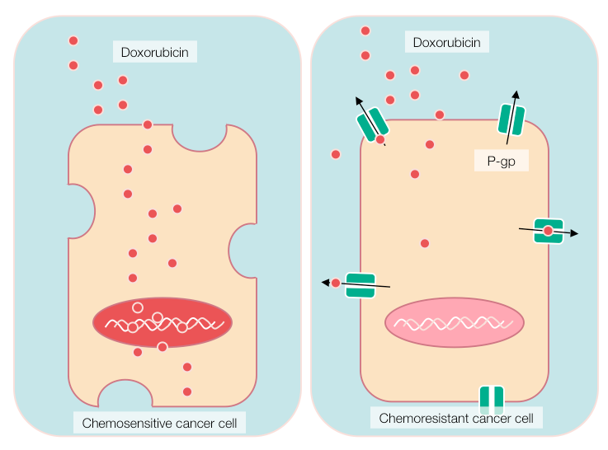

Slide 38
Nanotechnology Benefits for Treatment and Clinical Outcomes
Nanotechnology offers the means
to aim therapies directly and selectively
at cancerous cells.
  Nanocarriers
  Passive Targeting
  Active Targeting

Slide 39
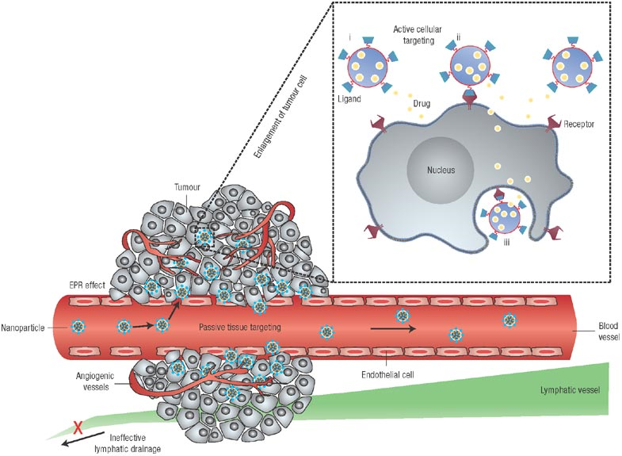
Mechanisms by which Nanocarriers Can Deliver Drugs to Tumors
NANO

Slide 40
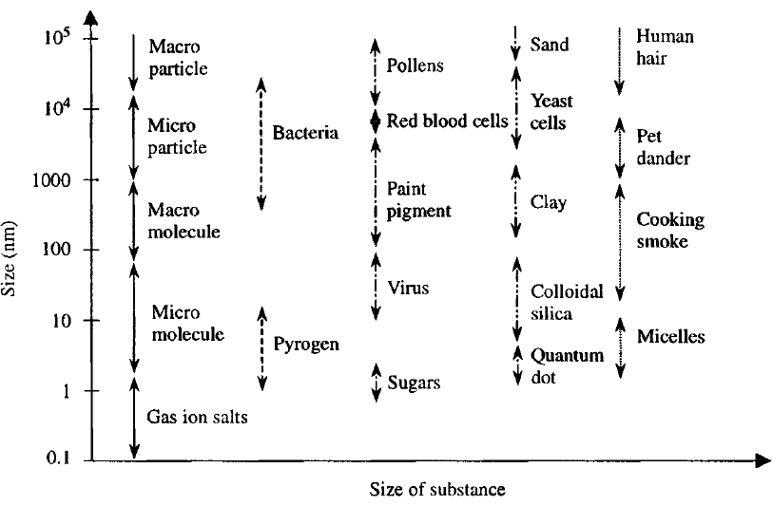
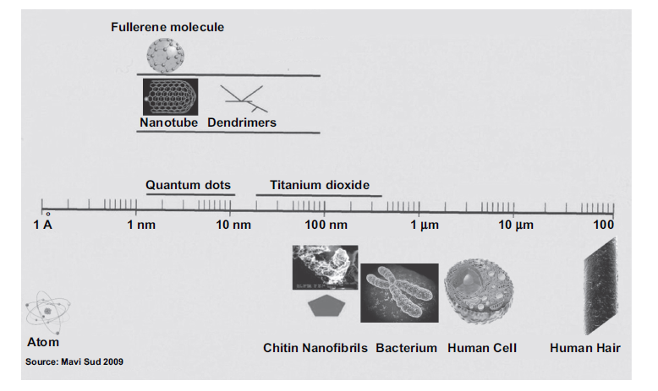
Nanoscale Materials
One nanometer is approximately the length equivalent to 10 hydrogen or 5 silicon atoms aligned in a line.

Slide 41
Definitions of Nanotechnology adopted by FDA
FDA has not established its own formal definition ..Our understanding is that the FDA currently relies on the NNI definition.
National Nanotechnology Initiative (NNI):
  Nanotechnology is the understanding and control of matter at dimensions of roughly 1 to 100 nanometers, where unique phenomena enable novel applications. …. At the nanoscale, the physical, chemical, and biological properties of materials differ in fundamental and valuable ways from the properties of individual atoms and molecules or bulk matter.
NCI Cancer Nanotechnology Plan (July 2004):
  Nanotechnology refers to the interactions of cellular and molecular components and engineered materials - typically clusters of atoms, molecules, and molecular fragments - at the most elemental level of biology. Such nanoscale objects - typically, though not exclusively, with dimensions smaller than 100 nanometers - can be useful by themselves or as part of larger devices containing multiple nanoscale objects.
ubraxane

Slide 42
Nanoparticles are nanosized polymeric colloidal particles with a therapeutic agent encapsulated within the polymeric matrix, or adsorbed, or conjugated onto the surface of the nanoparticle. They are made of natural or synthetic polymer ranging in size between 10-1000 nm. Nanoparticles can be prepared from synthetic biodegradable polymers by polymerization techniques of suspension, emulsion, or micelle polymerization.

Slide 43
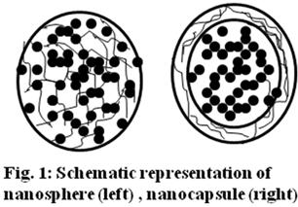
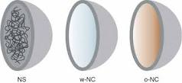
Nanoparticles as a drug delivery system

Slide 44

Nanotechnology Based Drug Delivery Systems for Cancer Therapy
Nanoparticle | Description | Recent applications
Nanocapsules | Vesicular systems in which the drug is surrounded by a polymeric membrane | Stability of the cisplatin nanocapsules has been optimized by varying the lipid composition of the bilayer coat
Nanospheres | Matrix systems in which the drug is physically and uniformly dispersed | Bovine serum albumin nanospheres containing 5-fluorouracil show higher tumour inhibition than the free drug
Micelles | Amphiphilic block copolymers that can self-associate in aqueous solution | Micelle delivery of doxorubicin increases cytotoxicity to prostate carcinoma cells
Ceramic nanoparticles | Nanoparticles fabricated using inorganic compounds including silica, titania… | Ultra fine silica based nanoparticles releasing water insoluble anticancer drug
Liposomes | Artificial spherical vesicles produced from natural phospholipids and cholesterol | Radiation-guided drug delivery of liposomal cisplatin to tumor blood vessels results in improved tumour growth delay
Dendrimers | Macromolecular compound that comprise a series of branches around an inner core | Targeted delivery within dendrimers improved the cytotoxic response of the cells to methotrexate 100-fold over free drug
SLN particles | Nanoparticles made from solid lipids | SLN powder formulation of all-trans retinoic acid may have potential in cancer chemoprevention and therapeutics.

Slide 45
NANOsPHERES
1) Polymerization
Polyacrilamide nanosphers
poly alkyl methacrylate
Polyalkylcyanoakrylate nanospheres
polybutylcyanoakrylate
Polyglutaraldehyde nanosphers
2) Prepared Polymers
Natural polymers (macromolecules)
    Human serum albumin
    Alginates
synthetic polymers
    Poly lactic acid PLA
    Poly lactic-co-glycolic acid PLGA
    Cellulose acetate phthalate CAP

Slide 46
Increasing the efficiency of targeting and the therapeutic index is thus a priority in the pharmaceutical industry. For these challenging tasks, nanoparticles have emerged as promising candidates.
This is because their biological function, including distribution and elimination patterns in the body, is dictated mainly by their controllable physicochemical properties such as size, shape, hydrophobicity, and surface charge.

Slide 47
Ideal nanocarrier
A suitable nanocarrier must be
Biodegradable and stable in body fluids
Not causing systemic toxicity, embolism and immune response
biocompatible
BBB-targeted
secretion from the biological systems, i.e., the kidney or liver
In the ideal case,
particle diameter less than 100 nanometers
These nanocarriers can be loaded with various drugs and targeted to a pathological location in the body
Providing increased bioavailability of drugs
Decreased effective dose
Protection of unstable drugs
Achieving high drug concentration in infected or abnormal cells
and low concentration in normal cells thus decreasing the drug toxicity and undesirable side effects

Slide 48
Surfactants as surface modifications of nanoparticles
one of the major problems in targeted drug delivery is the rapid opsonization and uptake of the nanoparticles by the mononuclear phagocytes system (MPS).
The ability of cells of the MPS to capture the nanoparticles depends on the characteristics of the nanoparticle surface, such as charge and hydrophobicity surfaces.In modified nanoparticles, the surface characteristics and the size of the nanoparticles are the key for their biological fate. Larger particles are filtered out by the first capillary bed. A small size seems to improve the reduction in opsonization reactions and subsequent removal by macrophages.

Slide 49
The use of hydrophilic surfactants to coat the surface creates a hydrophilic surface around the nanoparticles and avoids the capture of nanoparticles by macrophages, giving long-circulating properties. The long-circulating carriers thereby also increase the possibility of the nanoparticles to reach the brain.Thus, the coating of the nanoparticles surface with non-ionic surfactants promotes an enhancement of the internalization of the nanoparticles into cells.

Slide 50
A hydrophilic surface can be obtained by adsorbing hydrophilic surfactants, such as polysorbate 80 on the nanoparticles surface or using block/branched copolymers, such as poloxamines and poloxamers. Polyethylene oxide (PEO) or poly ethylene glycol (PEG) are the most successful non-ionic hydrophilic polymer moiety employed for this purpose.
Poloxamers consist of two ethylene oxide (EO) polymers attached to the ends of one propylene oxide (PO) polymer. Poloxamines consist of four EO polymers attached to four PO polymer and all four are coupled to an ethylene diamine core.

Slide 51
the chemical nature of the coating surfactant is of importance,because poloxamine 908-coated nanoparticles showed long-circulating characteristics but failed to increase nanoparticle brain concentration, whereas doxorubicin adsorbed onto polysorbate 80-coated nanoparticles was successfully delivered into the brain.
Others authors, indicated polysorbate 80 as a surfactant able to inhibit the efflux pump protein, Pglycoprotein(P-gp), mainly localized in the endothelial cells, and consequently it would allow the internalization of the nanoparticles and/or the drug by blocking its P-gp-mediated transport.

Slide 52

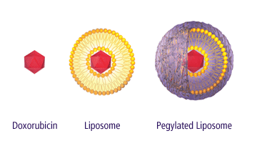
Nanotechnology in the Treatment of Cancer
NANO
Nanotechnology has generated a great deal of interest in the field of oncology due to its potential to selectively deliver and concentrate drugs to tumors while minimizing damage to healthy cells.
Two FDA approved nanoparticle formulations for the treatment of cancer:
Abraxane®: a suspension of albumin-bound paclitaxel (130 nm). FDA approved in January, 2005.
Doxil®: liposomal formulation of doxorubicin (100 nm). Approved in February, 2005.
http://www.doxil.com/images/clientChart.gif

Slide 53
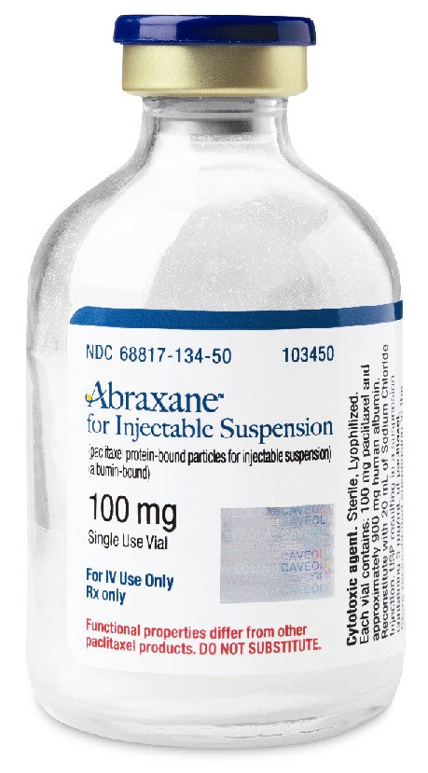
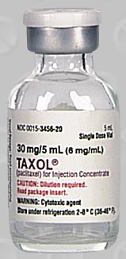
Abraxane
Taxol
ubraxane
Abraxane received FDA
Approval
January, 2005
for metastatic breast cancer
Contents:
100 mg paclitaxel
900 mg albumin
No Surfactants/Solvents
Contents:
Paclitaxel 6 mg/ml
Cremophor 537 mg/ml
Ethanol 396 mg/ml
Notes:
This slide clearly delineates the differences between the two paclitaxel formulations. While Abraxane contains only paclitaxel and albumin, Taxol contains almost 100 mg of Cremophor for every 1 mg of paclitaxel, plus a strong shot of ethanol.

Slide 54
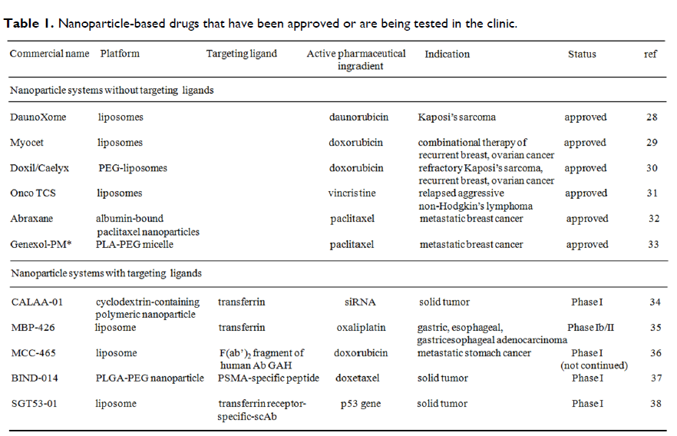

Slide 55
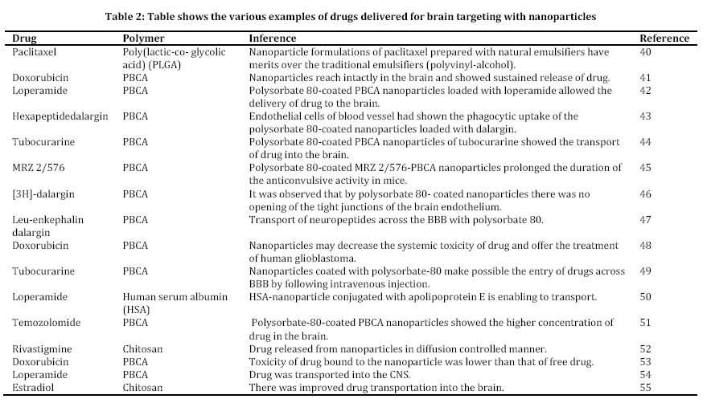

Slide 56
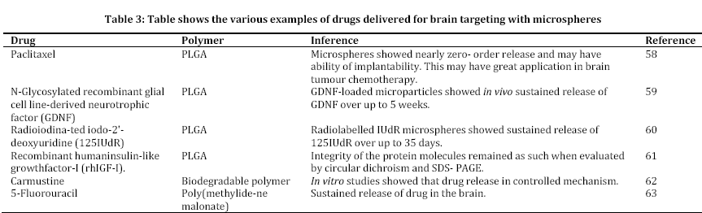

Slide 57
Drug 1 + nanospher PLGA
Drug 2 + nanospher PLGA
Drug 3 + Albumin
Drug 4 + Albumin
Drug 5 + Albumin
Druge6 + SLN

Slide 58
Drug1 + PLGA
80 mg PLGA + 5ml chloroform
mixed
+ 4mg Drug1
+20 ml PVA(dropwise)
2 min sounication(emulsion formed)
emulsion +(PVA +Water)
magnetic stirr for 8-10h
centrifugation & freeze dried

Slide 59
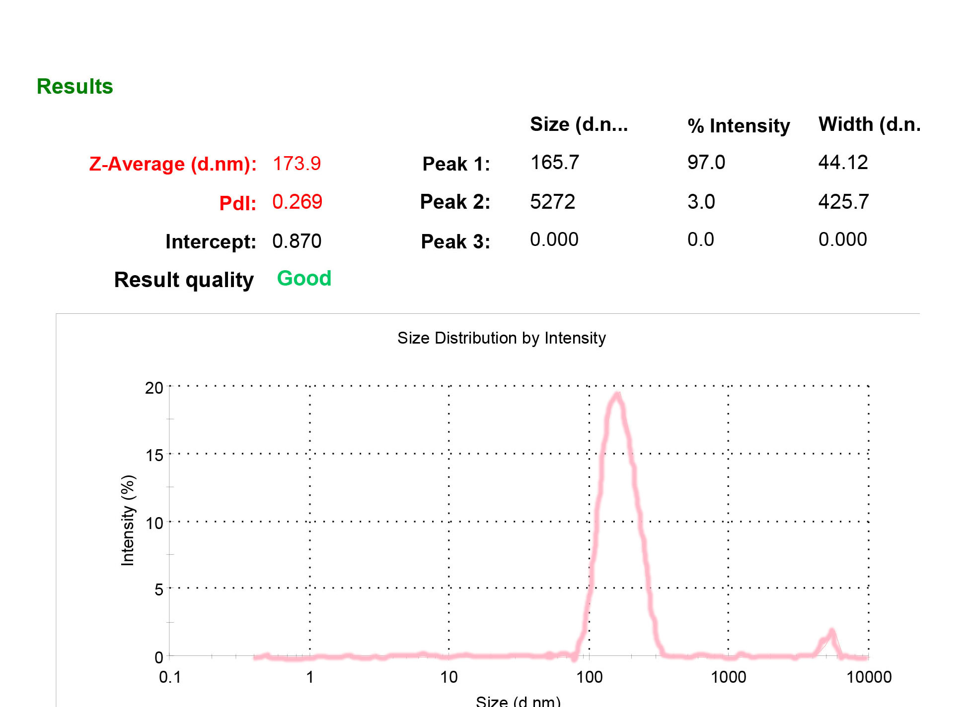
Drug1 + PLGA

Slide 60
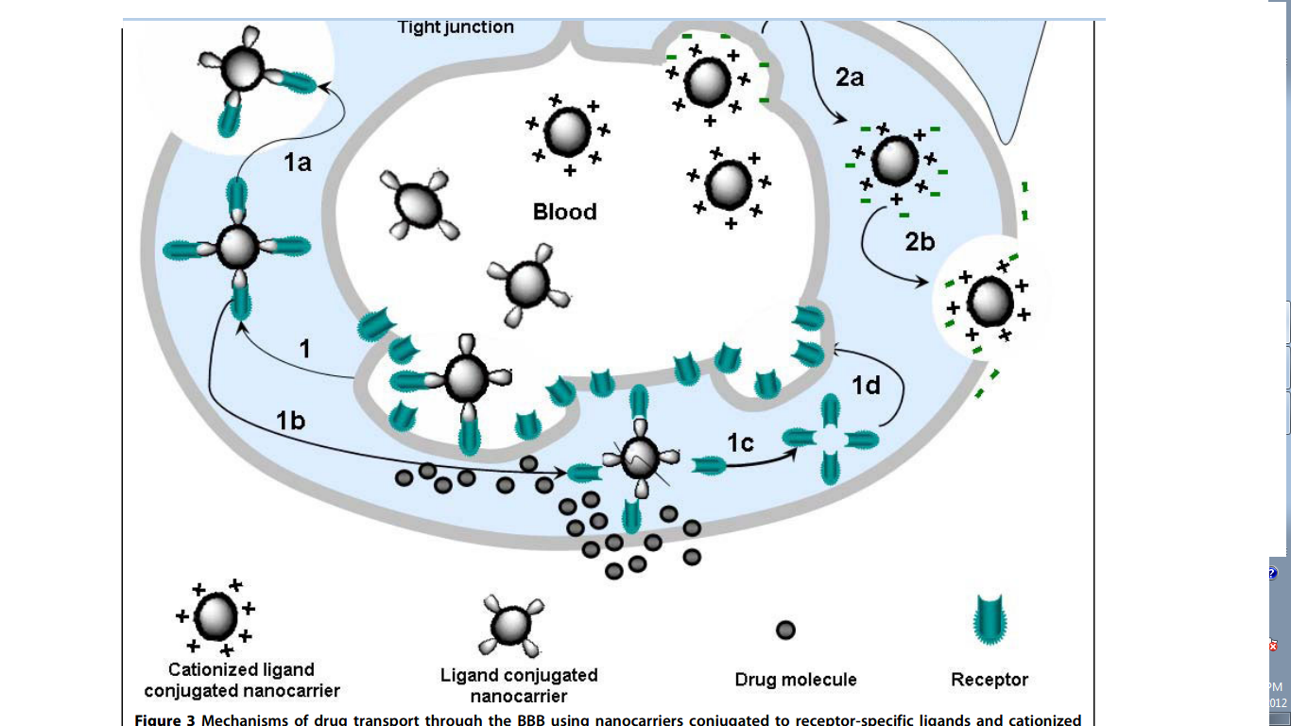

Slide 61
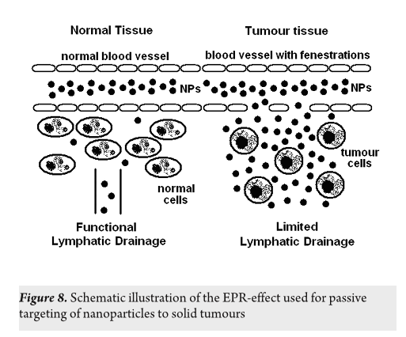
Passive targeting

Slide 62
Active targeting
The nanoparticle surface can be modified with targeting ligands, that recognize a specific target thus achieving active targeting of the nanoparticle carrier system to cancer cells.
Recently developed highly functionalized PACA-based nanoparticles make it possible to decorate the particle surface with various desirable targeting ligands via azide-alkyne “.

Slide 63
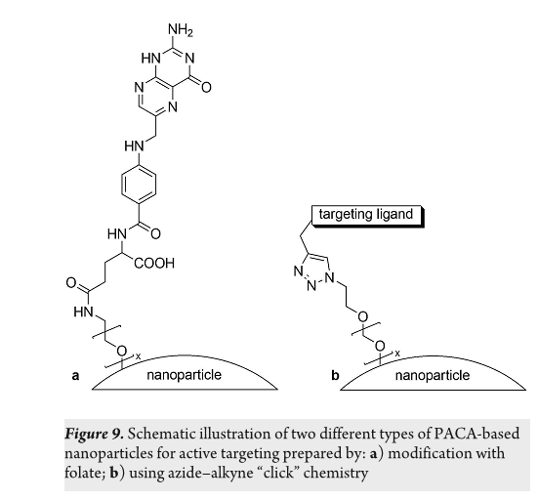

Slide 64
Mechanisms of drug release
There are different mechanisms of drug release depending on the type of drug loading in nanoparticles . Drugs that are adsorbed on the surface of pre-synthesized nanoparticles are released by desorption.
Entrapped drugs, which are weakly bound to the polymer material, are released by diffusion.
Drugs, which have high affinity to the polymer are released very slowly by diffusion and can be released during the bioerosion of the polymer.

Slide 65
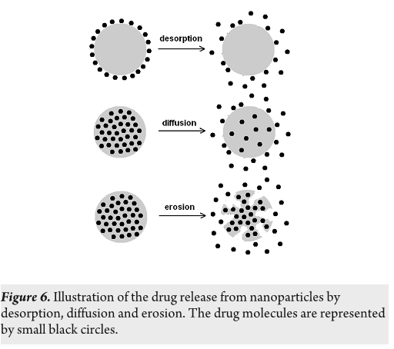

Slide 66
Albumin: Facts
Albumin
Major plasma protein made by the liver
Major determinant of intravascular volume
responsible for 70% of colloidal osmotic pressure.
Necessary for blood & oxygen delivery to tissues and removal of wastes.
Is a storage protein that the body uses to build other proteins
A high albumin level indicates dehydration.
A low albumin level can by associated with liver, kidney disease & gastrointestinal disease, or severe dermatitis
Many drugs are bound chemically to albumin
Normal A/G (albumin to globulin) ratio is 1½ to 2
Albumin level is strongly influenced by hydration status
(levels drop with edema and increase with dehydration)

Slide 67
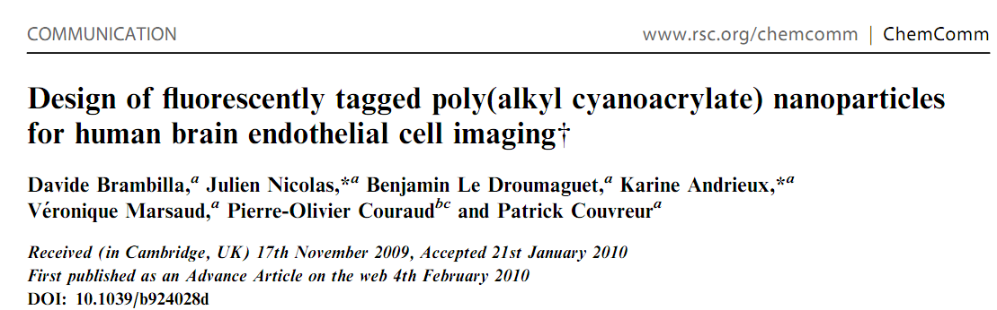

Slide 68
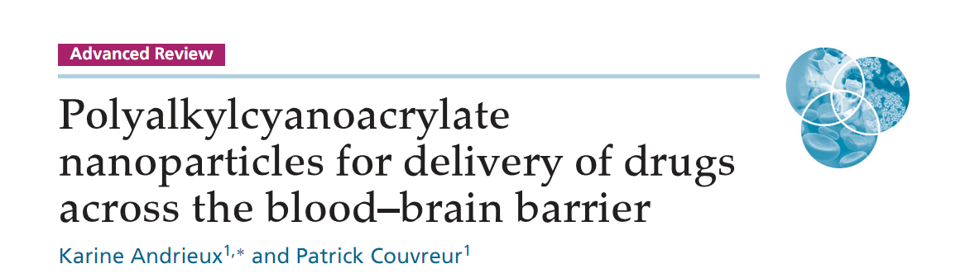

Slide 69
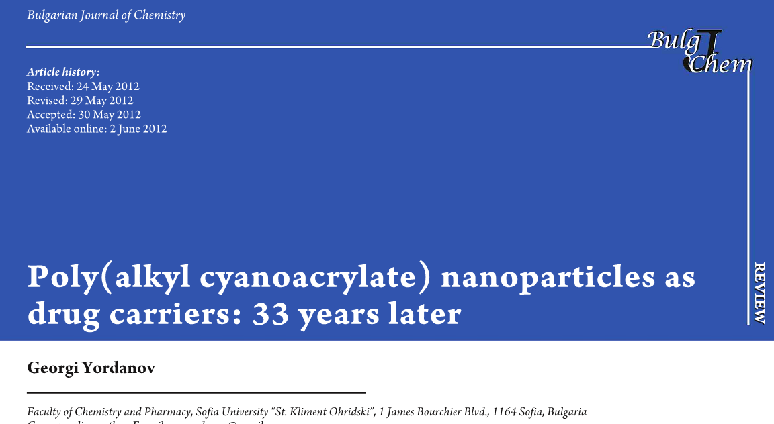

Slide 70
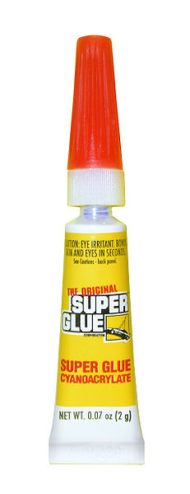
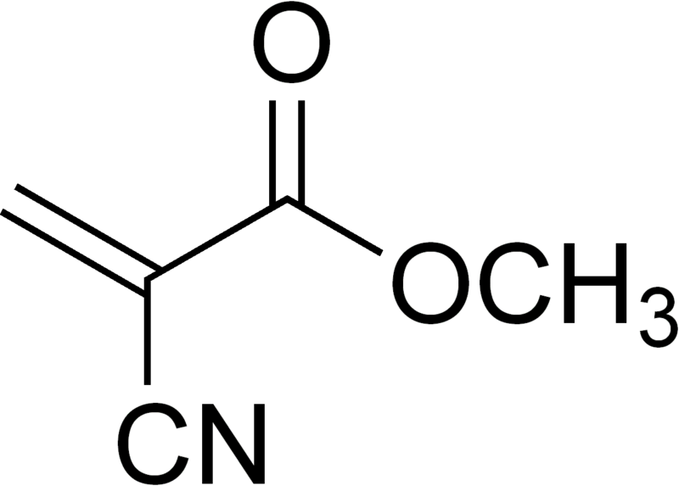
Polyalkylcyanoakrylate nanospheres
(PACA)

Slide 71
Poly(butyl cyanoacrylate) nanoparticles meet ideal requirements for targeting, it is for instance biodegradable, has the ability to alter the biodistribution of drugs and is easy to synthesize and purify. Furthermore, the use of biodegradable polymeric nanoparticles for controlled release of anticancer drugs has the advantages of enhancing the drug therapeutic efficacy and reducing drug systemic side effects.

Slide 72
It has been found that drug-loaded PACA nanoparticles can be targeted to the brain by modifying their surface with the surfactant polysorbate80.
This particles very significantly increased the survival time of rats with intracranial transplanted glioblastoma 101/8 and even led to long-term remission in 25% of the animals . Consequently, poly(butyl cyanoacrylate) nanoparticles were successful in enabling the treatment of glioma tumours, as also shown in vivo experiments by Kreuter et al.
Doxorubicin-loaded nanoparticles with polysorbate 80-modif ied surface, when administered intravenously resulted in 40% cure in rats with intracranial transplanted glioblastoma.

Slide 73
It has been shown that PACA nanoparticle carriers can be highly efficient for the treatment of multidrug-resistant cancer cells .
The mechanism may involve enhanced drug penetration into cells as well as inhibiting efflux of drug molecules from the resistant cells, although the exact mechanism is not completely clarified.
For example, the utilization of doxorubicin-loaded PACA nanoparticles for treatment of resistant breast cancer cells resulted in drug 130-fold increase of the efficiency.

Slide 74
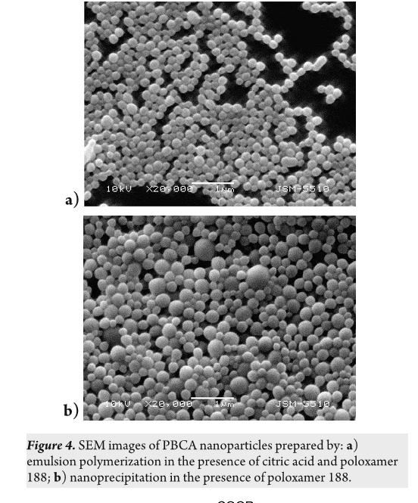

Slide 75
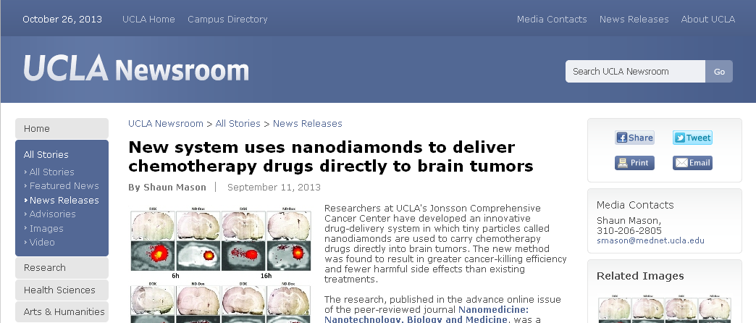

Slide 76


