Slide 1

بسم الله الرحمن الرحيم

Slide 2
Organ Transplantation in Iran
Ancient Era
Avicenna ( 980-1037 )
Jordjani ( 1042-1136 )

Slide 3
ORGAN TRANSPLANTATION IN IRAN
First Corneal Transplantation
1935
By
Professor. Shams
Tehran University

Slide 4
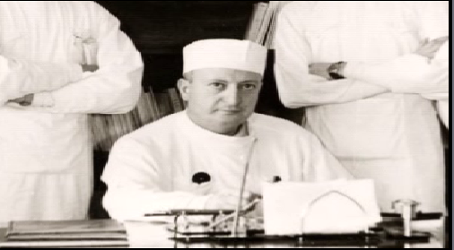

Slide 5
Organ Transplantation in Iran
Corneal Transplantation
Pioneering Role of
Dr. Khodadoust
1969-1978
Shiraz University

Slide 6
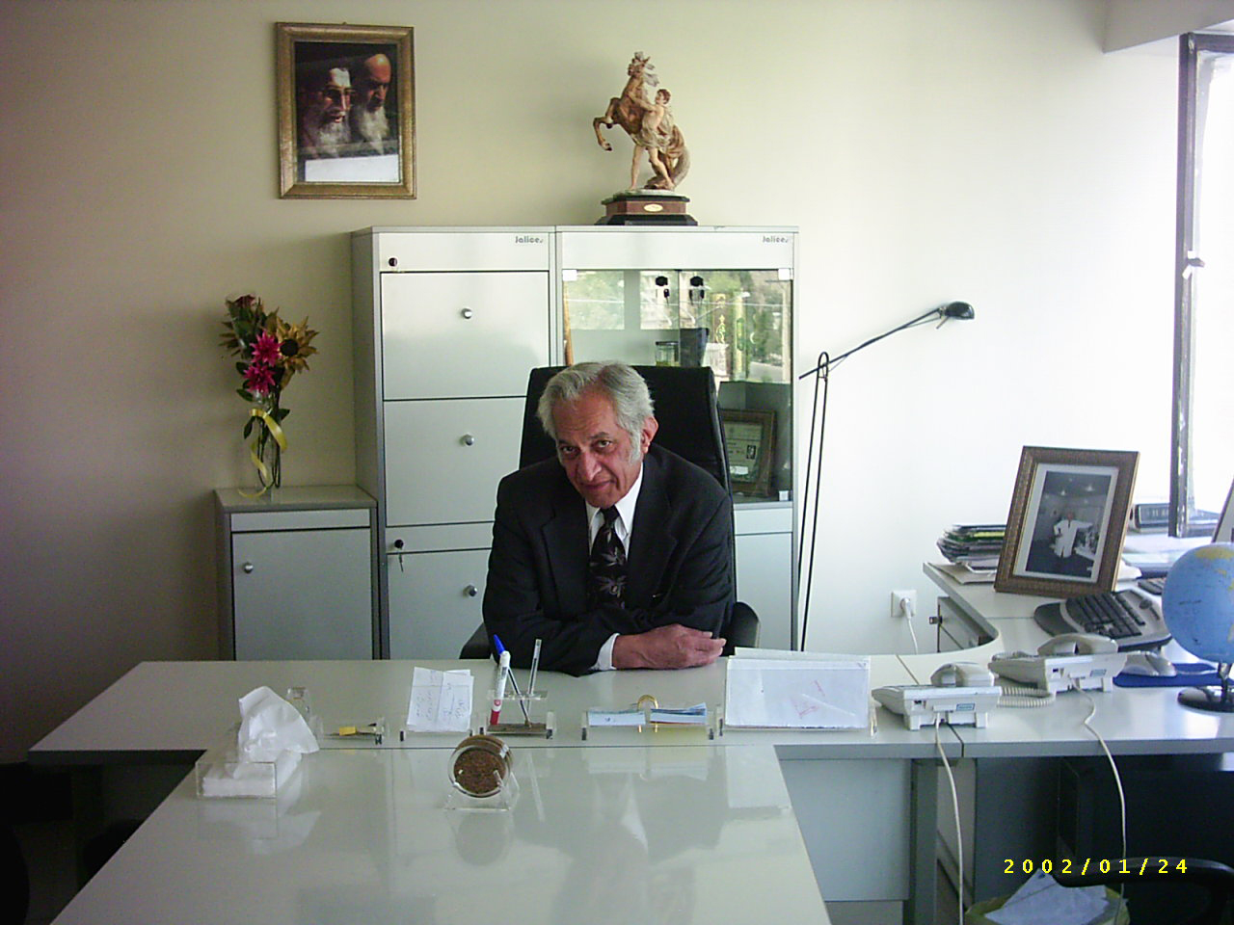

Slide 7
Organ Transplantation in Iran
Corneal Transplantation
Dr. Hamid Sajjadi
Post Revolution Ophtalmology
Training Program 1981
Shahid Beheshty University, Tehran

Slide 8
Organ Transplantation in Iran
Corneal Transplantation
Currently over
100 Eye Care Centers
Number of Transplanted Patients: 33638

Slide 9
Organ Transplantation in Iran
First Kidney Transplantation
1968
Dr.Sanadi Zadeh
Shiraz University

Slide 10
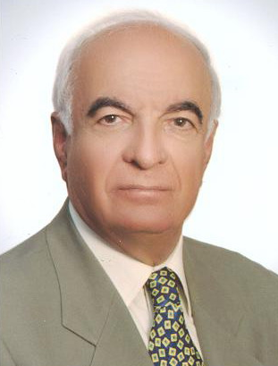

Slide 11
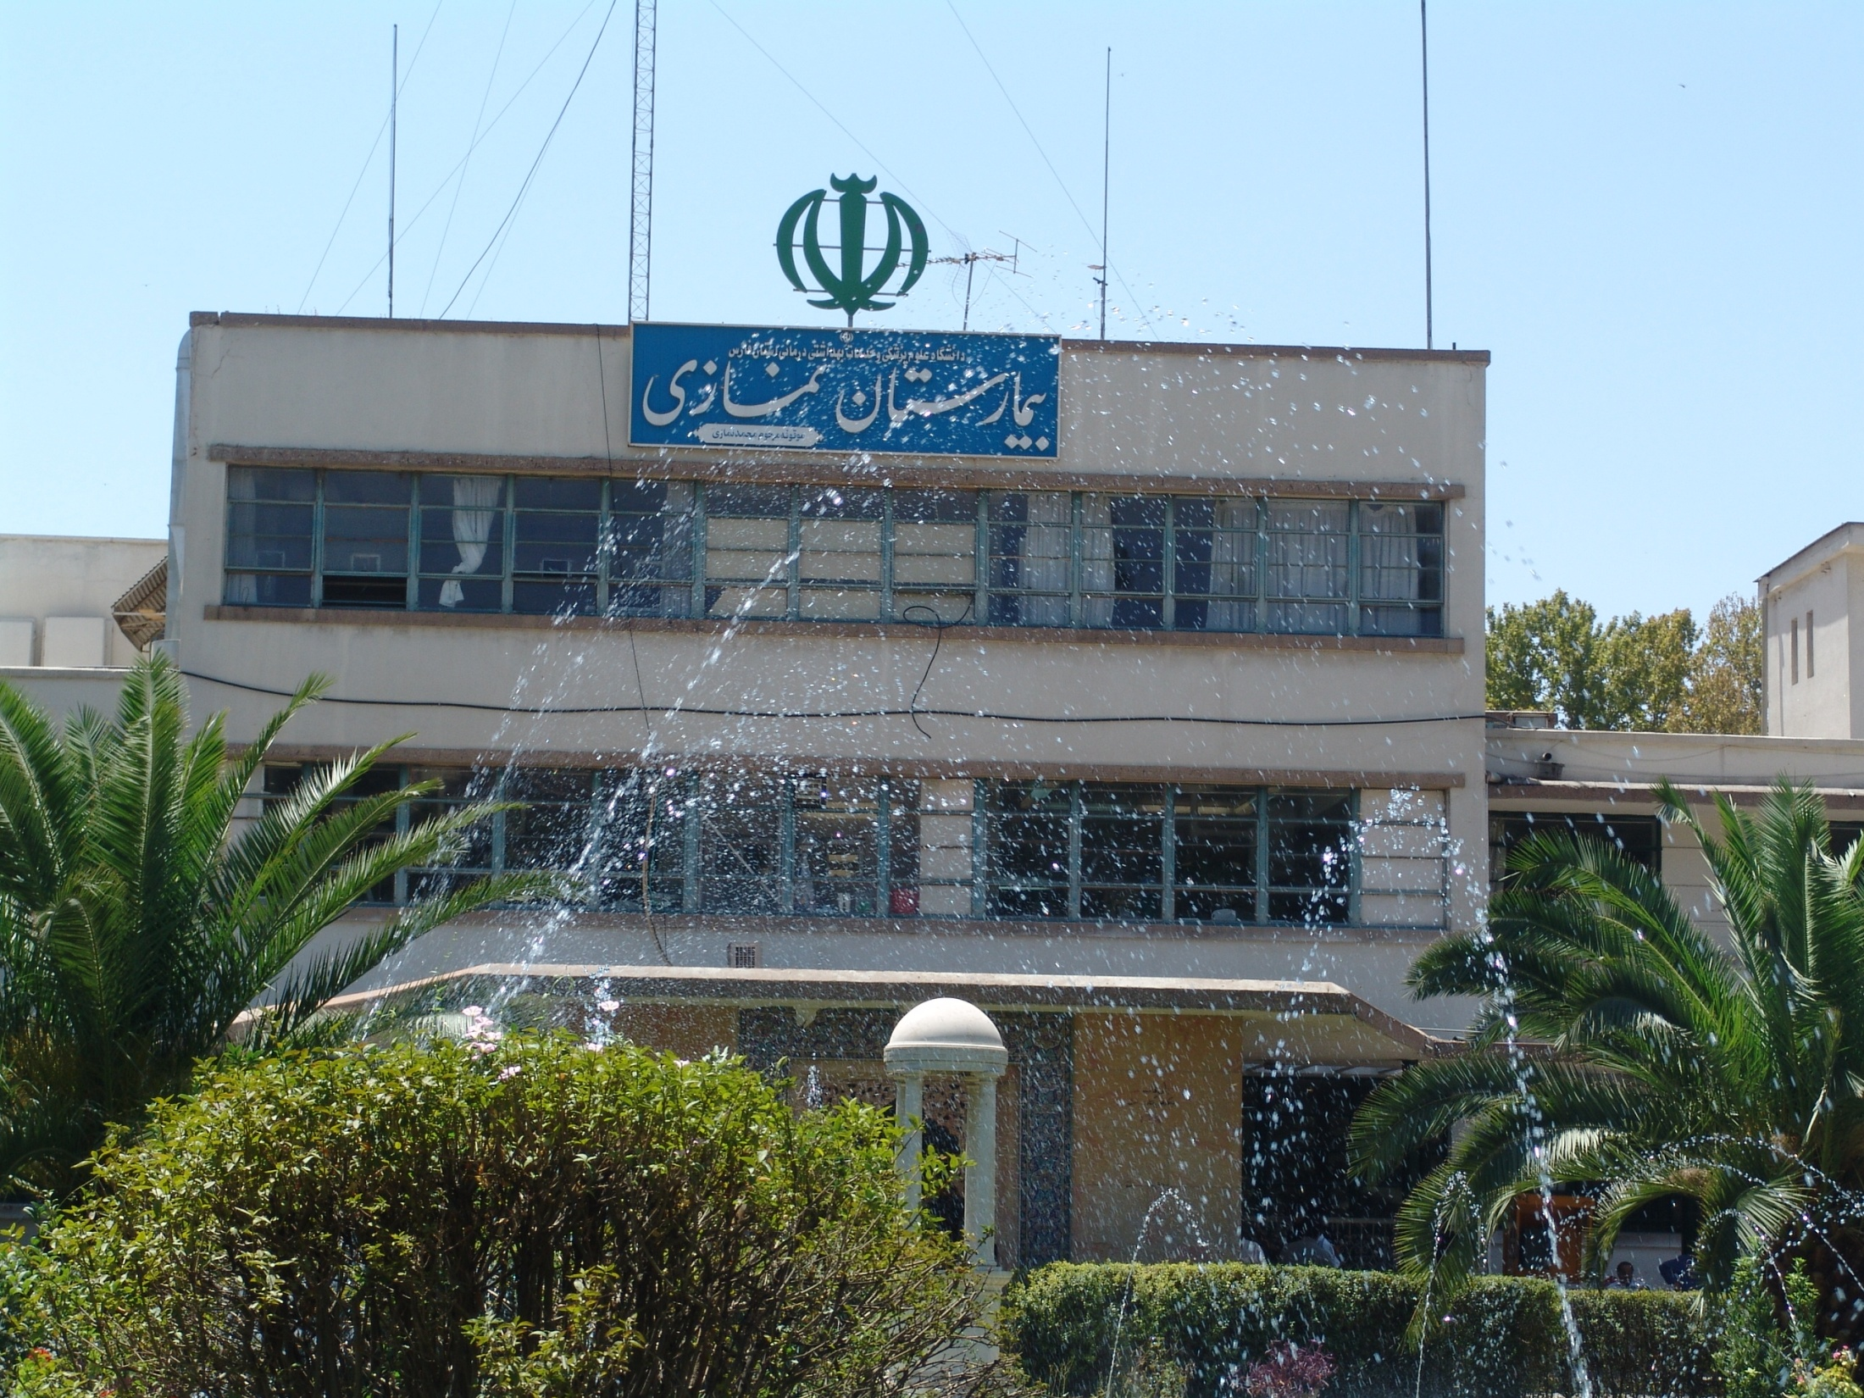

Slide 12
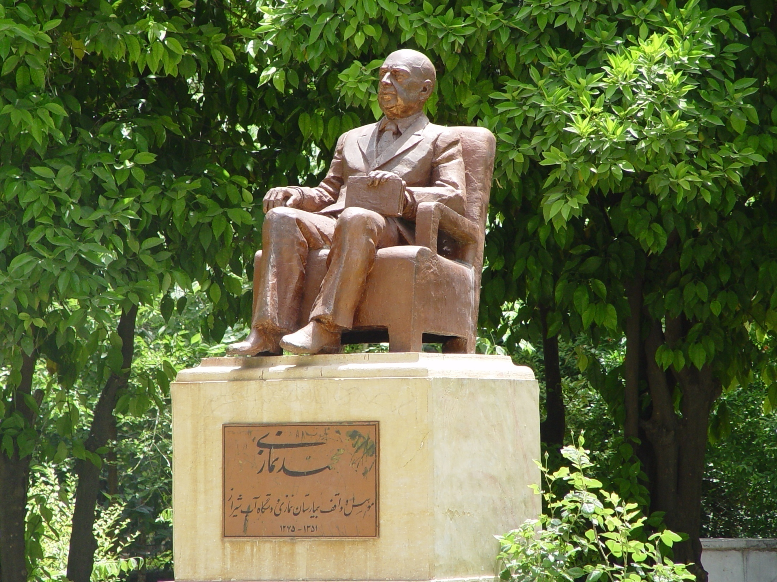

Slide 13
Organ Transplantation in Iran
Kidney Transplantation
1968-1978
80 Cases
1978-1982
None

Slide 14
Organ Transplantation in Iran
1978-1982
* Post Revolution period
* Imposed War
* Different Embargos
* War Casualties

Slide 15
Organ Transplantation in Iran
Pilot Study
1982-1984
Renal Transplantation Program
50 Cases from LRDs
Iradj Fazel

Slide 16
Organ Transplantation in Iran
Pilot Study
Multi disciplinary Responsibility
* University Hospital Based
Team Work
Living Related Donor
Training new Teams

Slide 17
Organ Transplantation in Iran
Pilot Study and
Establishment of National
Renal Transplantation Program
1984
Iradj Fazel

Slide 18
ORGAN TRANSPLAN TATION IN IRAN
Establishment of 2nd Renal Transplantation Center 1985
First Unrelated Live Kidney Donor
1986
Dr. Simforoush
Shahid Beheshty University, Tehran

Slide 19
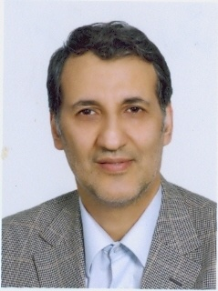

Slide 20
Organ Transplantation in Iran
Kidney Transplantation
Number of Centers
26
Number of Cases
23270

Slide 21
Organ Transplantation in Iran
Brain Death Concept
Approved by Religious Authorities
( FATWA )
IMAM KHOMEINI
20 May 1989

Slide 22
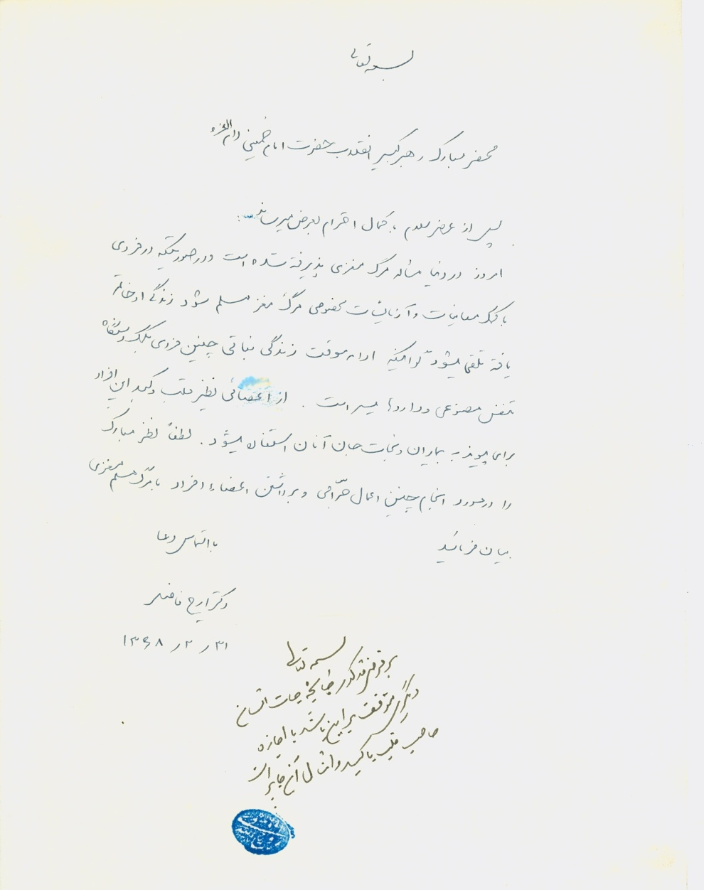

Slide 23
Organ Transplantation in Iran
Brain Death Law
Approved by National Assembly
2001

Slide 24
HISTORY OF ORGAN TRANSPLAN TATION IN IRAN
Stem Cell Transplantation
Established in
1991
Dr. Ghavamzadeh
Tehran University

Slide 25
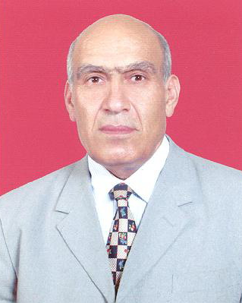

Slide 26


Slide 27
Organ Transplantation in Iran
First Small Bowel Transplantation
4 April 1992
Dr. Iradj Fazel
Shahid Beheshty University
Tehran

Slide 28
Organ Transplantation in Iran
First Liver Transplantation
Was Performed By
Dr.Malekhoseini
4 May 1993
Shiraz University

Slide 29
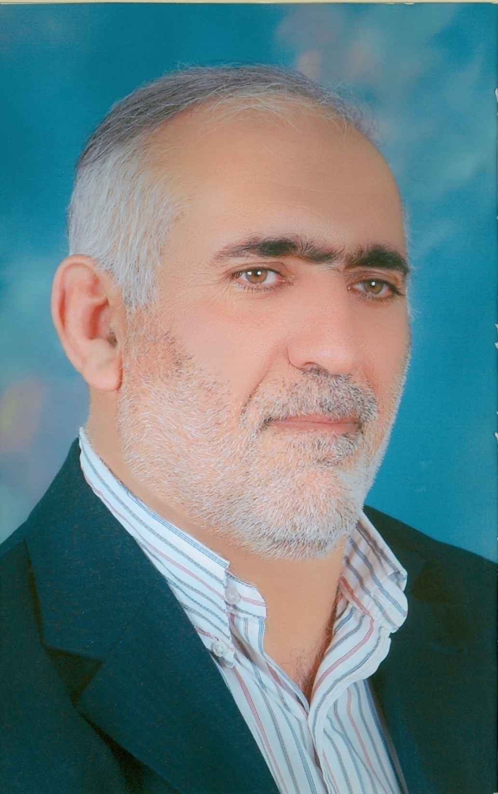

Slide 30
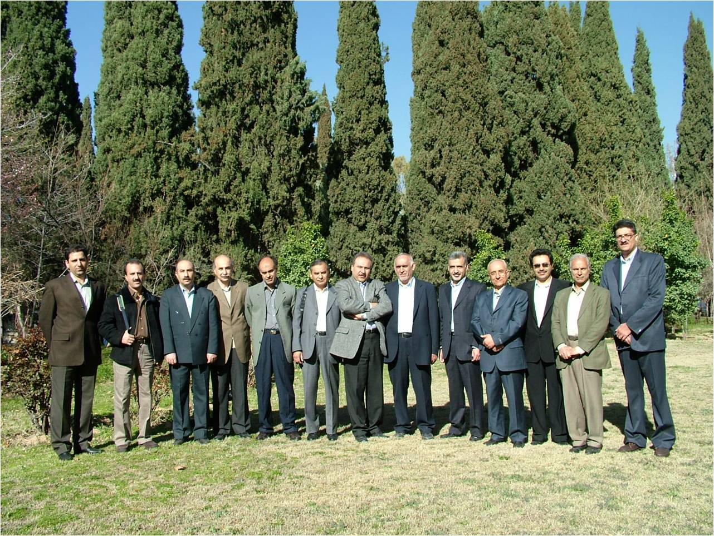

Slide 31
Organ Transplantation in Iran
First Successful Heart Transplantation
July 1993
Dr. Mandegar
Shariati Hospital
Tehran University

Slide 32


Slide 33
Organ Transplantation in Iran
Iranian Society of Organ
Transplantation
ESTABLISHED By
IRADJ FAZEL
in
1995

Slide 34


Slide 35
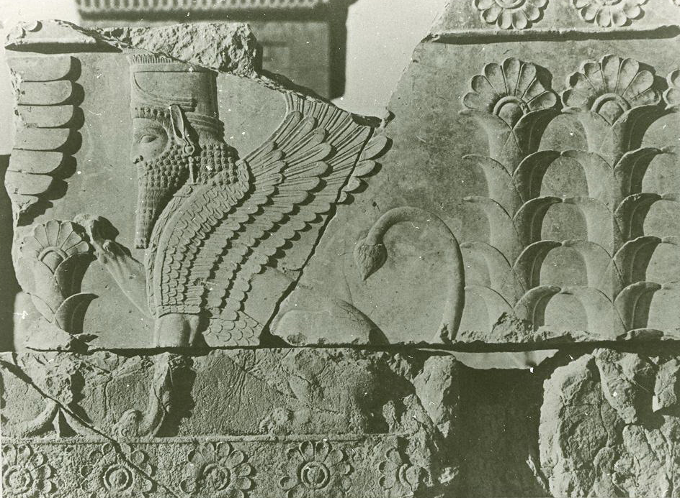

Slide 36
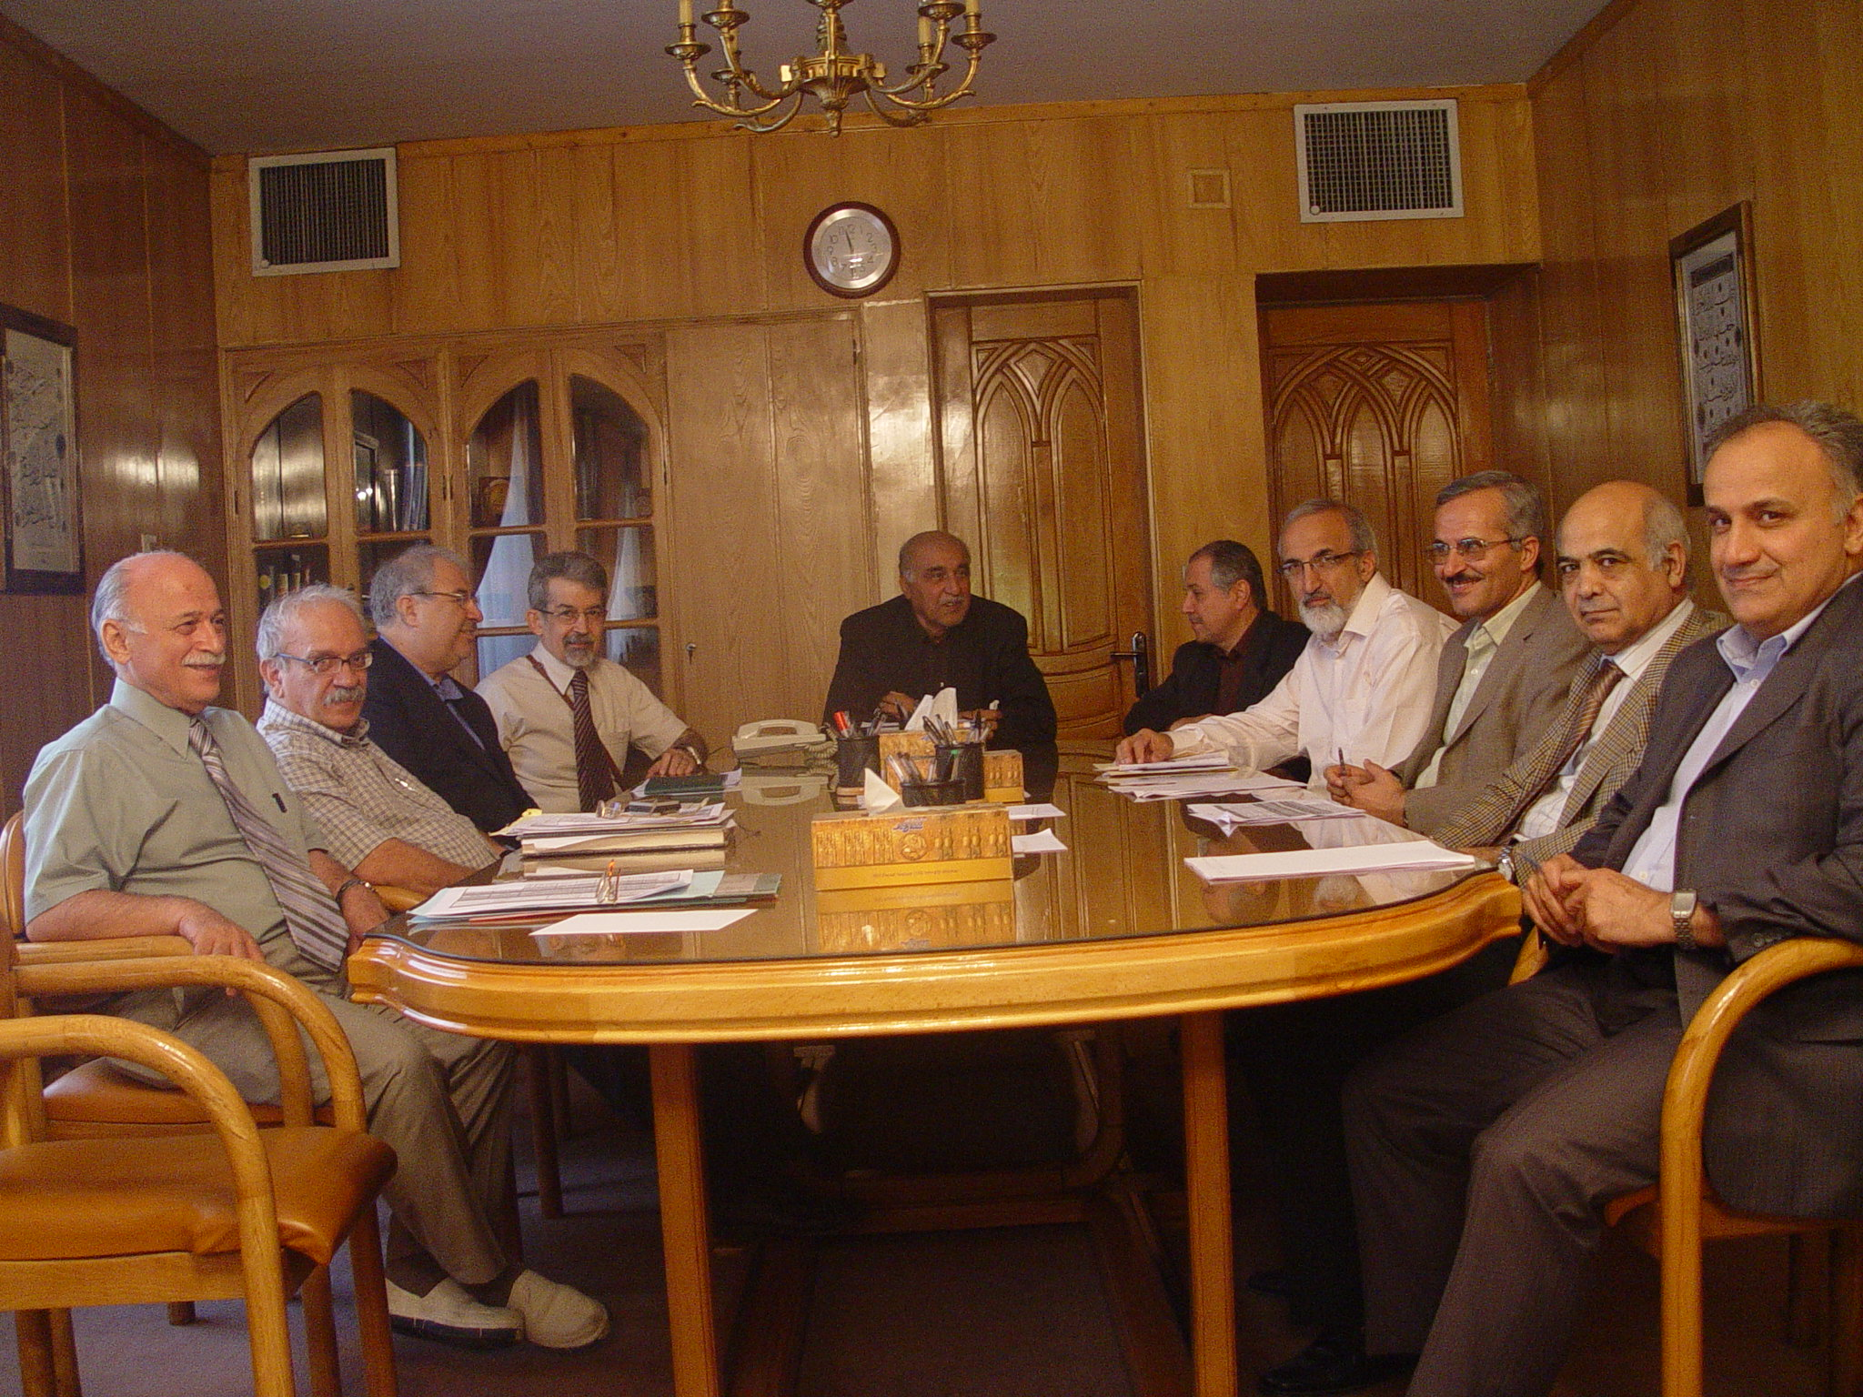

Slide 37
Organ Transplantation in Iran
First Successful Lung Transplantation
2000
Dr. H. Ahmadi
Imam Khomeini Hospital
Tehran University

Slide 38
Organ Transplantation in Iran
Lung Transplantation
Pioneering Role of
Dr. A. Abbasi
Masih Daneshvary Hospital
Shahid Beheshty University
Tehran

Slide 39
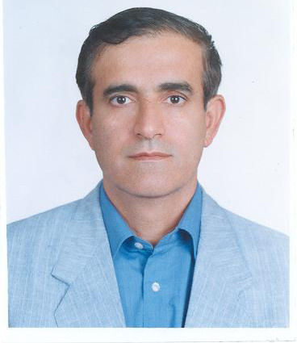

Slide 40
Organ Transplantation in Iran
First Pancreatic Transplantation
April 2006
By
Dr. Nikeghbalian
Shiraz University

Slide 41

Notes:
41

Slide 42
Nationwide Transplant Centers
Kidney : 26
Heart : 5
Lung : 3
Liver : 6
Pancreas : 1
Bone Marrow : 4
Cornea : 61

Slide 43
Historical Background
First Corneal Transplant : 1935
First Kidney Transplant : 1968
First Bone Marrow Transplant : 1991
First Small Bowel Transplant : 1992
First Liver Transplant : 1993
First Heart Transplant : 1993
First Lung Transplant : 2000
First Pancreas Transplant : 2006

Slide 44
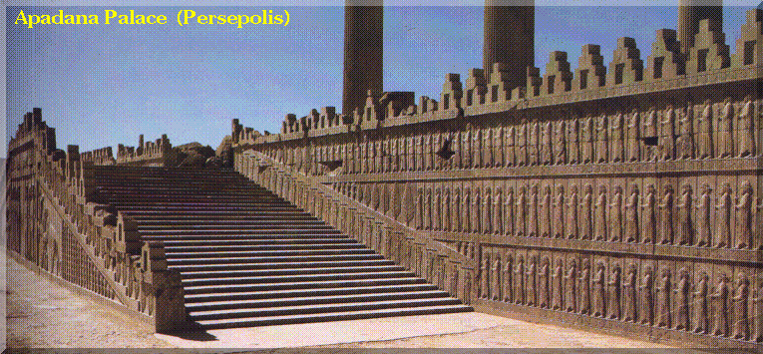

Slide 45
KIDNEY TRANSPLANTATION
THE STORY SO FAR
Legislation for Rewarding Living Donation
Legislation for Cadaver Tx
23270 Kidney Transplant from the Beginning(1968) Up to 2007

Slide 46
Cadaveric Organ Transplantation
8-Year activities
Since Legislation(2000)

Slide 47
Transplantation Activities
Beginning to 2007
Kidney : 23270
Liver : 500
Heart : 159
Pancreas : 38
Lung : 23
Cornea : 33638
Bone Marrow : 2378
Heart Valve : 1470
Bone : 1553

Slide 48
Historical Background
First Corneal Transplant : 1935
First Kidney Transplant : 1968
First Bone Marrow Transplant : 1991
First Small Bowel Transplant : 1992
First Liver Transplant : 1993
First Heart Transplant : 1993
First Lung Transplant : 2000
First Pancreas Transplant : 2006

Slide 50


