Slide 1
PULMONARY INFECTIONS AND IMMUNE DEFICIENCY
Davood Mansouri MD, MPH, AFSA, Du
Professor of Medicine
Chief Department of Clinical Immunology and Infectious diseases, NRITLD, Tehran, Iran
October 2013

Slide 2
Pneumonia is the most prevalent and important complication among immune deficient patients.

Slide 3
Immune deficiency, particularly the secondary type, is not uncommon.
Primary immune deficiencies (PID) are not as common as the secondary types but are important due to diagnosis and treatment issues.

Slide 4
Different types of pneumonia presenting in immune deficient host:
1- Pulmonary infections with undetermined etiology in a patient with recognized immune deficiency
2- Recognized etiology of pulmonary infection in a patient with unknown immune deficiency
3- Unknown etiology of pulmonary infection and unknown underlying immune deficiency
4- Pulmonary infection, leading to recognition of new genetic defect and even new immunologic pathway
5- Recognized etiology of pulmonary infection not attributable to known underlying immune deficiency
6- Multiple infections in a patient with recognized immune deficiency
7- An opportunistic infection resulting in emerging other opportunistic infections in a patient with recognized immune deficiency

Slide 5
- Pulmonary infections with undetermined etiology in a patient with recognized immune deficiency
Empirical treatment is problematic and increases the morbidity and mortality due to frequent and irrational use of antimicrobial agents.
The principle is early non-invasive and invasive diagnostic evaluation and straight forward treatment based on opportunistic and common microorganisms.

Slide 6
Consider possible etiologies based on underlying immune deficiency:
1. Phagocytic
2. Humoral
3. Cellular
4. Mixed

Slide 7
A 46 year-old woman with diabetes since 16 years ago

Slide 8
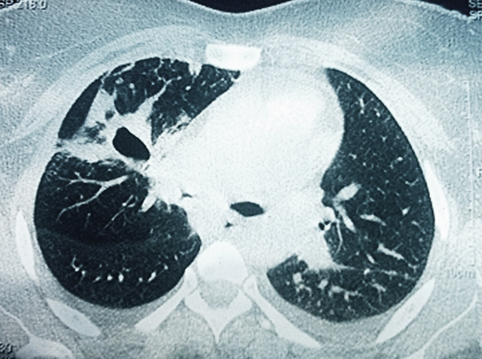

Slide 9
Final diagnosis: Pulmonary Aspergillosis

Slide 10
A 15 years-old boy with renal transplant presenting with fever and multiple pulmonary nodules since three years ago.

Slide 11
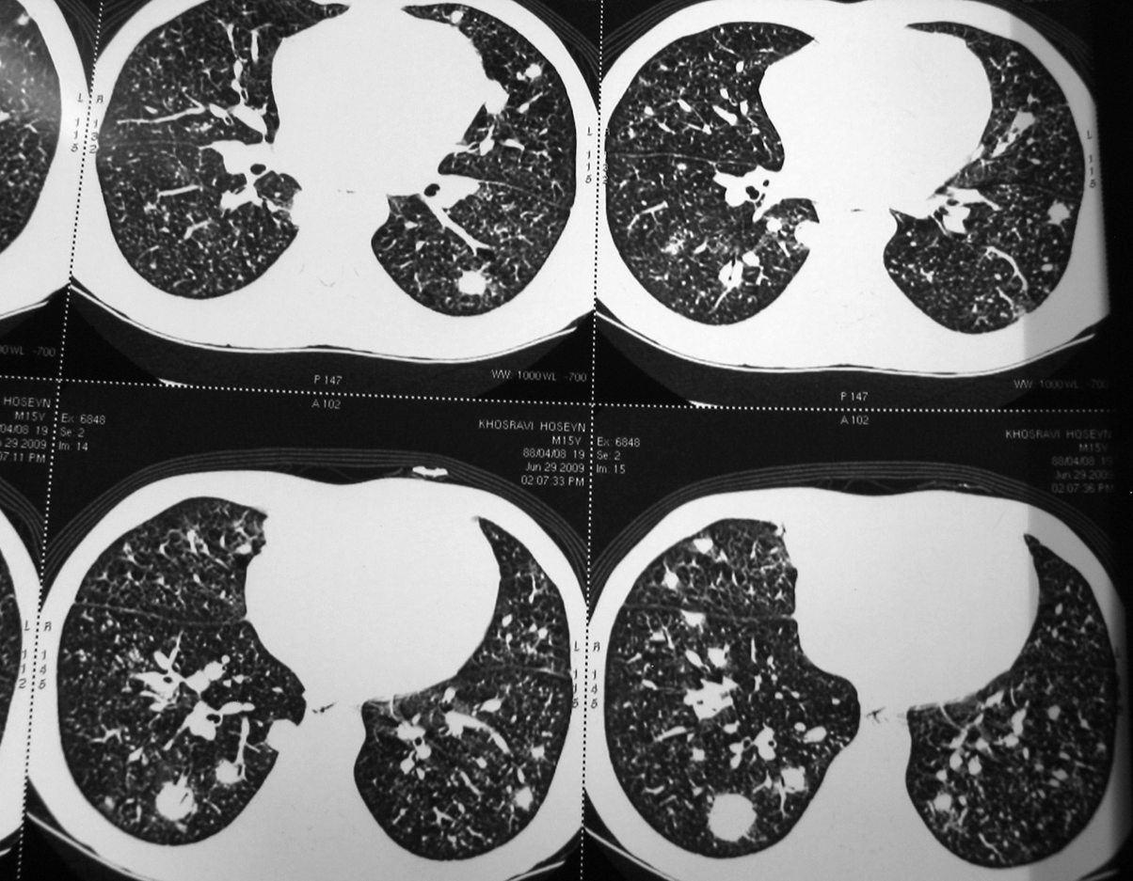

Slide 12
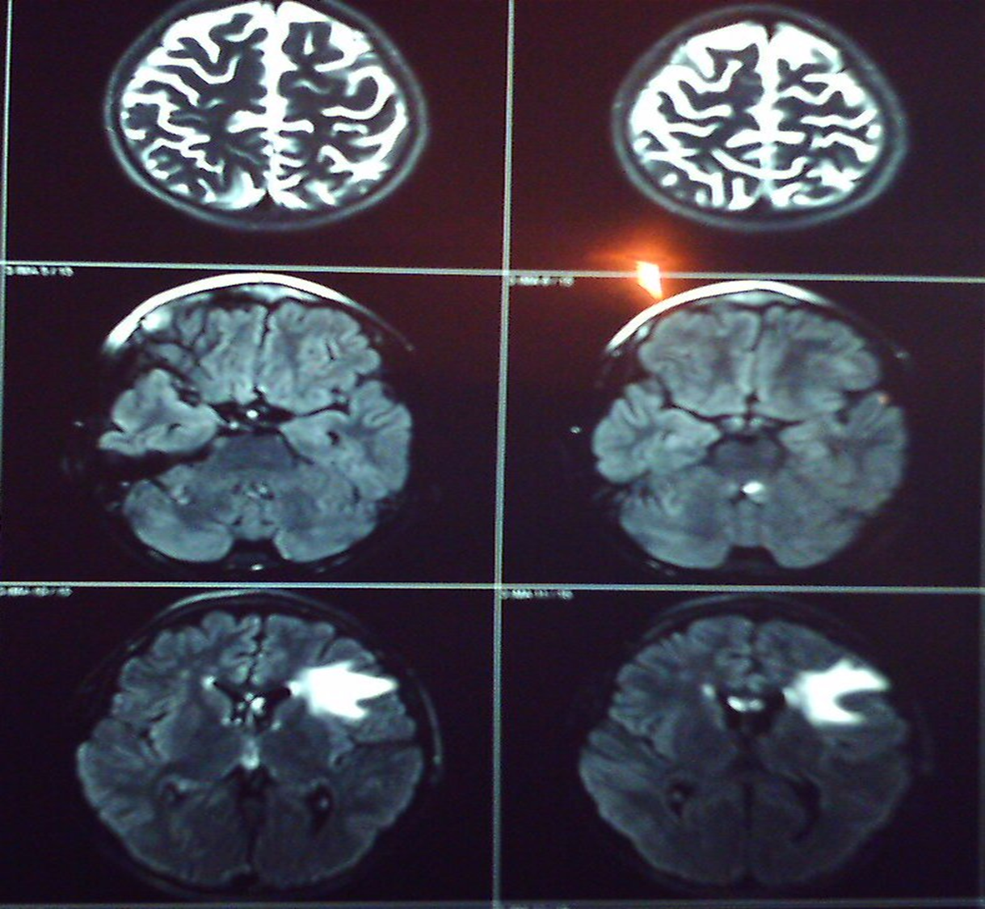

Slide 13
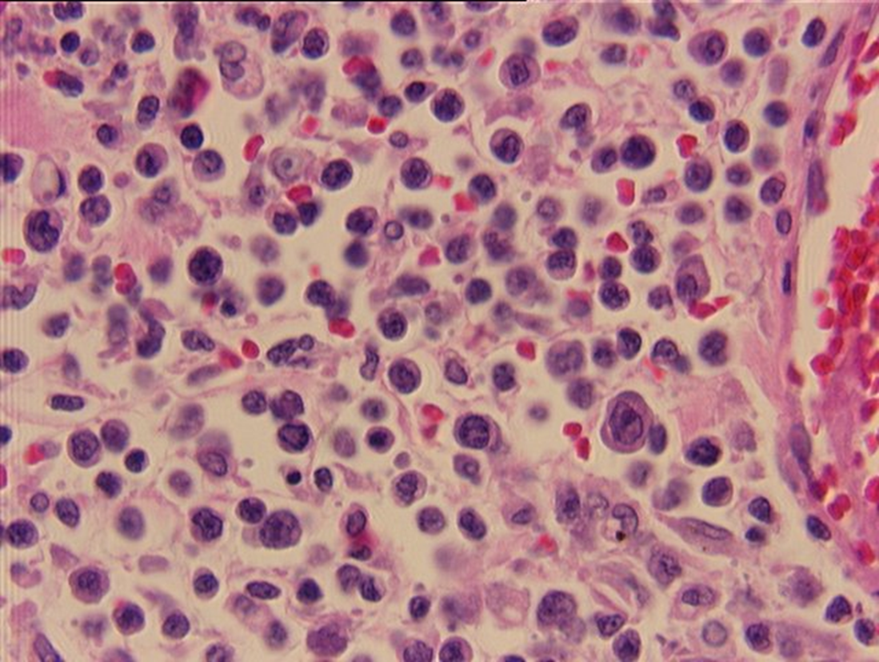

Slide 14
Extensive work up resulted in diagnosis of EBV induced PTLD, treated with Rituximub.

Slide 15
A 20 year old man with Job’s syndrome

Slide 16
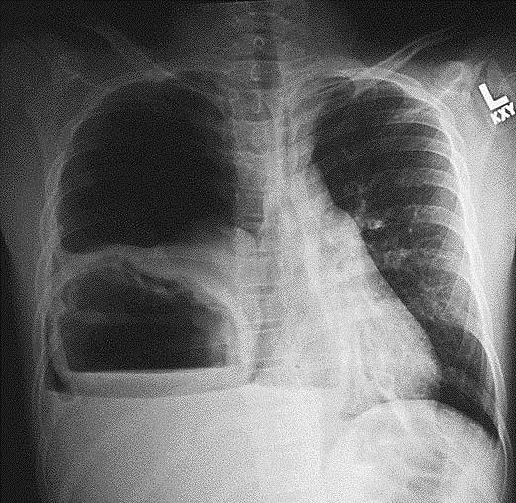

Slide 17
Staphylococcal lung abscess and destructive lung

Slide 18
A lung transplant patient

Slide 19
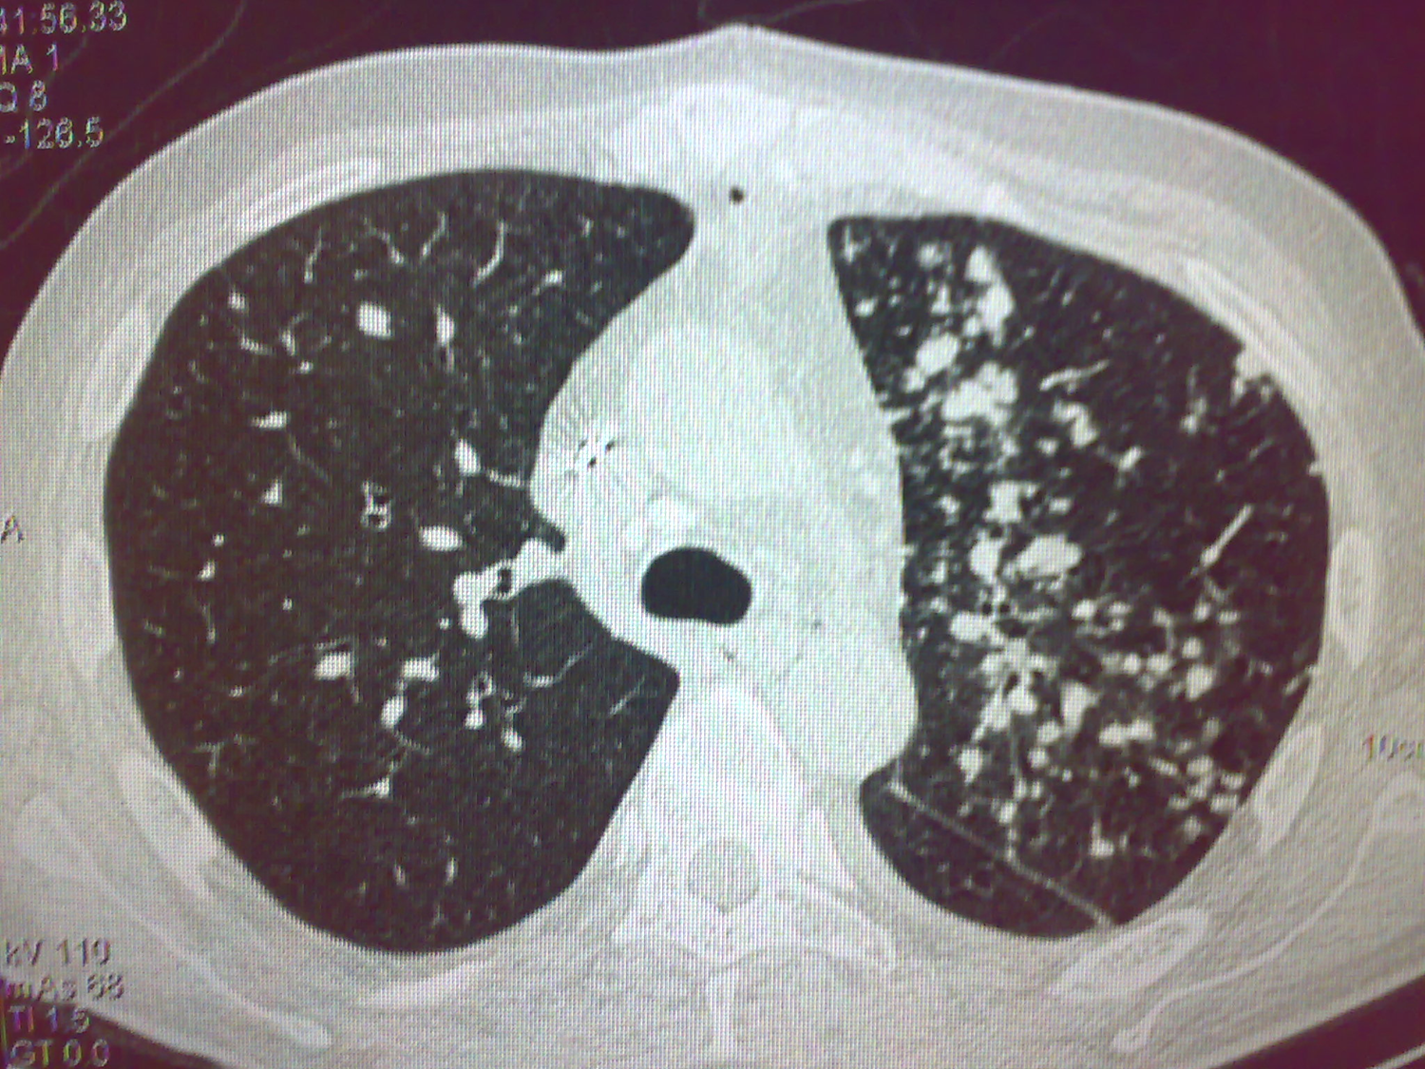

Slide 20
Pulmonary Aspergillosis

Slide 21
A heart transplant patient

Slide 22
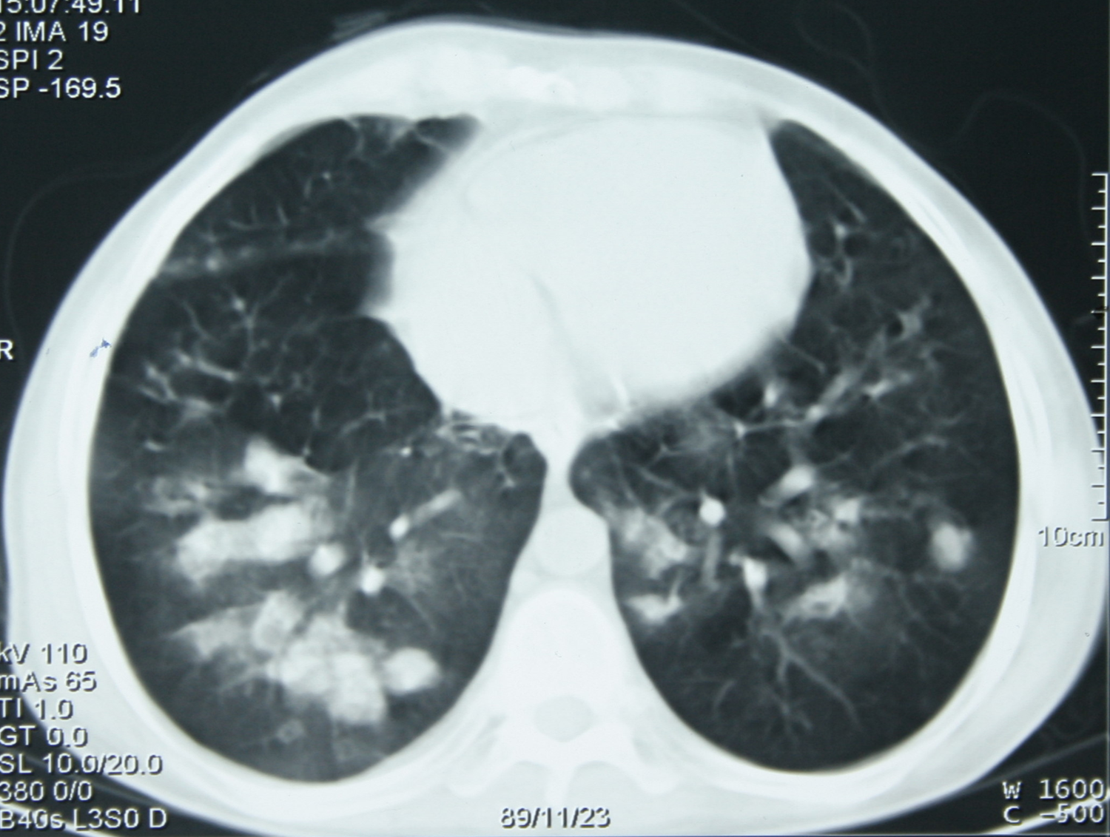

Slide 23
Pulmonary Aspergillosis

Slide 24
A case of CGD

Slide 25
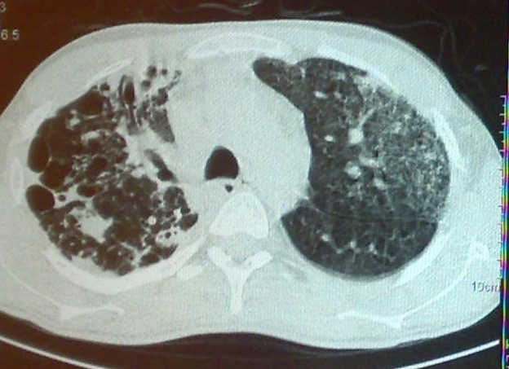

Slide 26
Pulmonary Tuberculosis (unusual in CGD)

Slide 27
A case of HIV infected patient

Slide 28
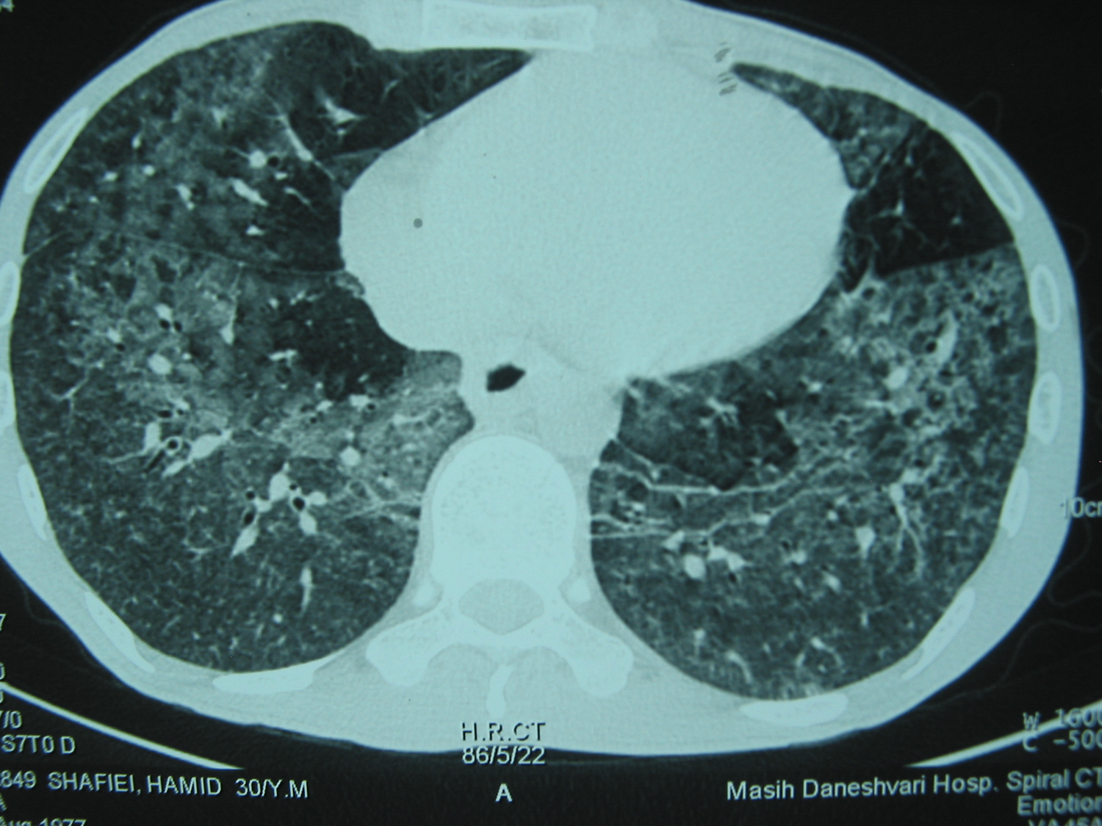

Slide 29
PCP

Slide 30
A twenty year-old diabetic woman with hemoptysis

Slide 31
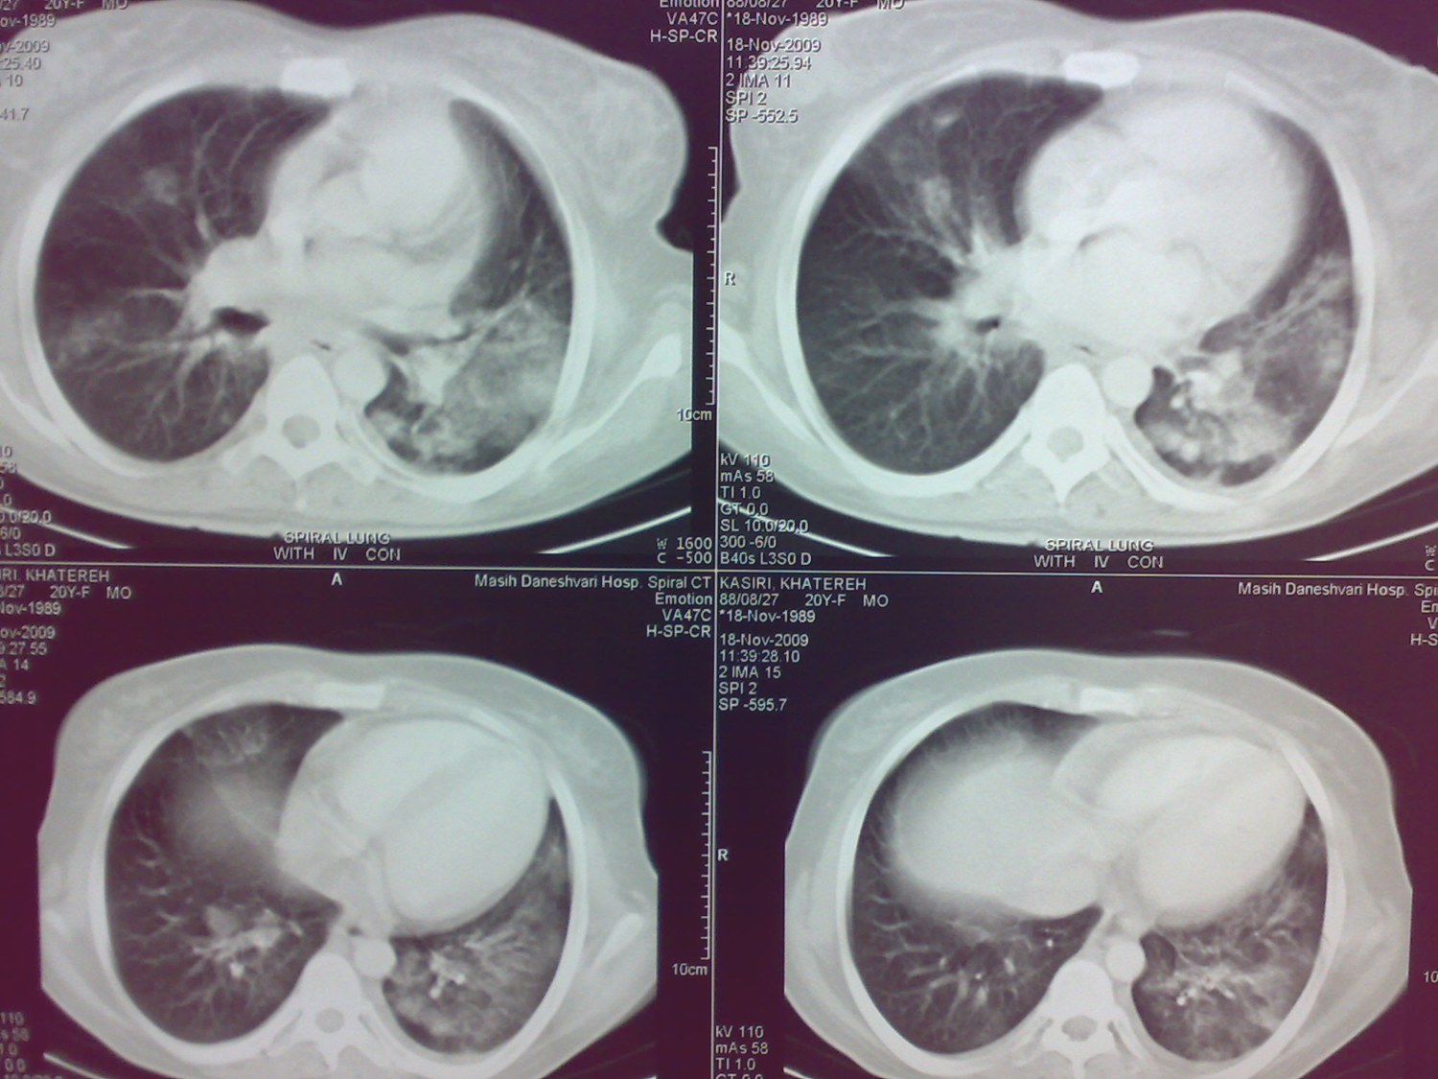

Slide 32
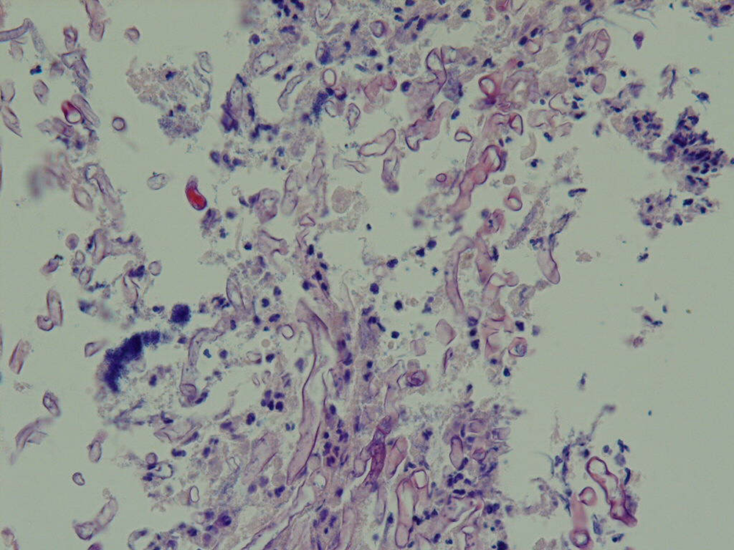

Slide 33
Mucormycosis

Slide 34
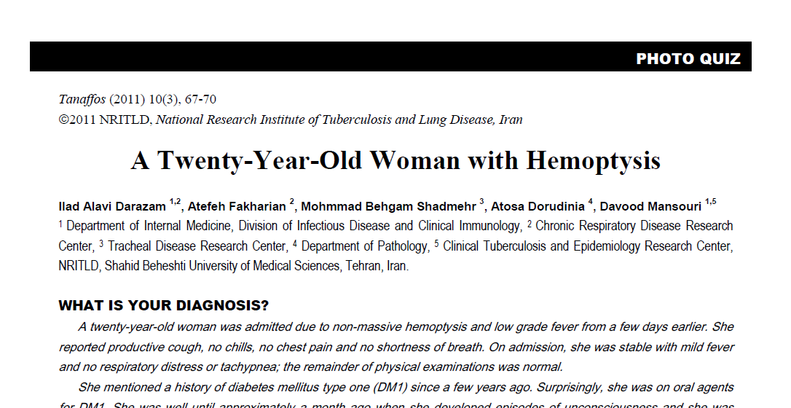

Slide 35
An uncontrolled diabetic patient returning from southeast Asia presenting with sepsis, pneumonia and myocarditis

Slide 36
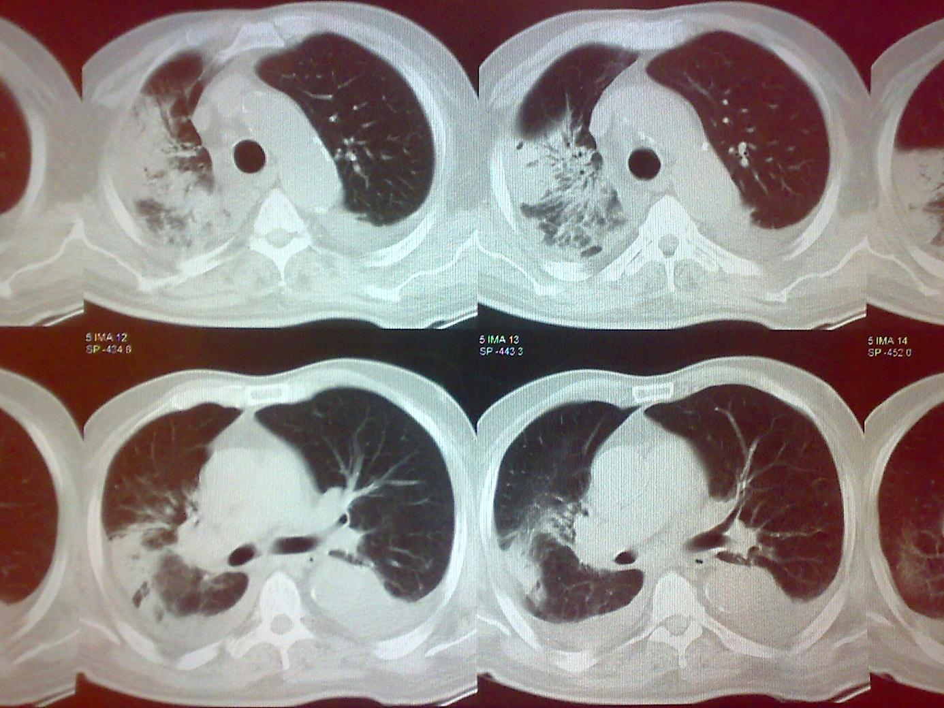

Slide 37
Melioidosis

Slide 38
A 37 year old man with productive cough, dyspnea and purple papular lesion in lower extremity, 6 months after heart transplantation.

Slide 39
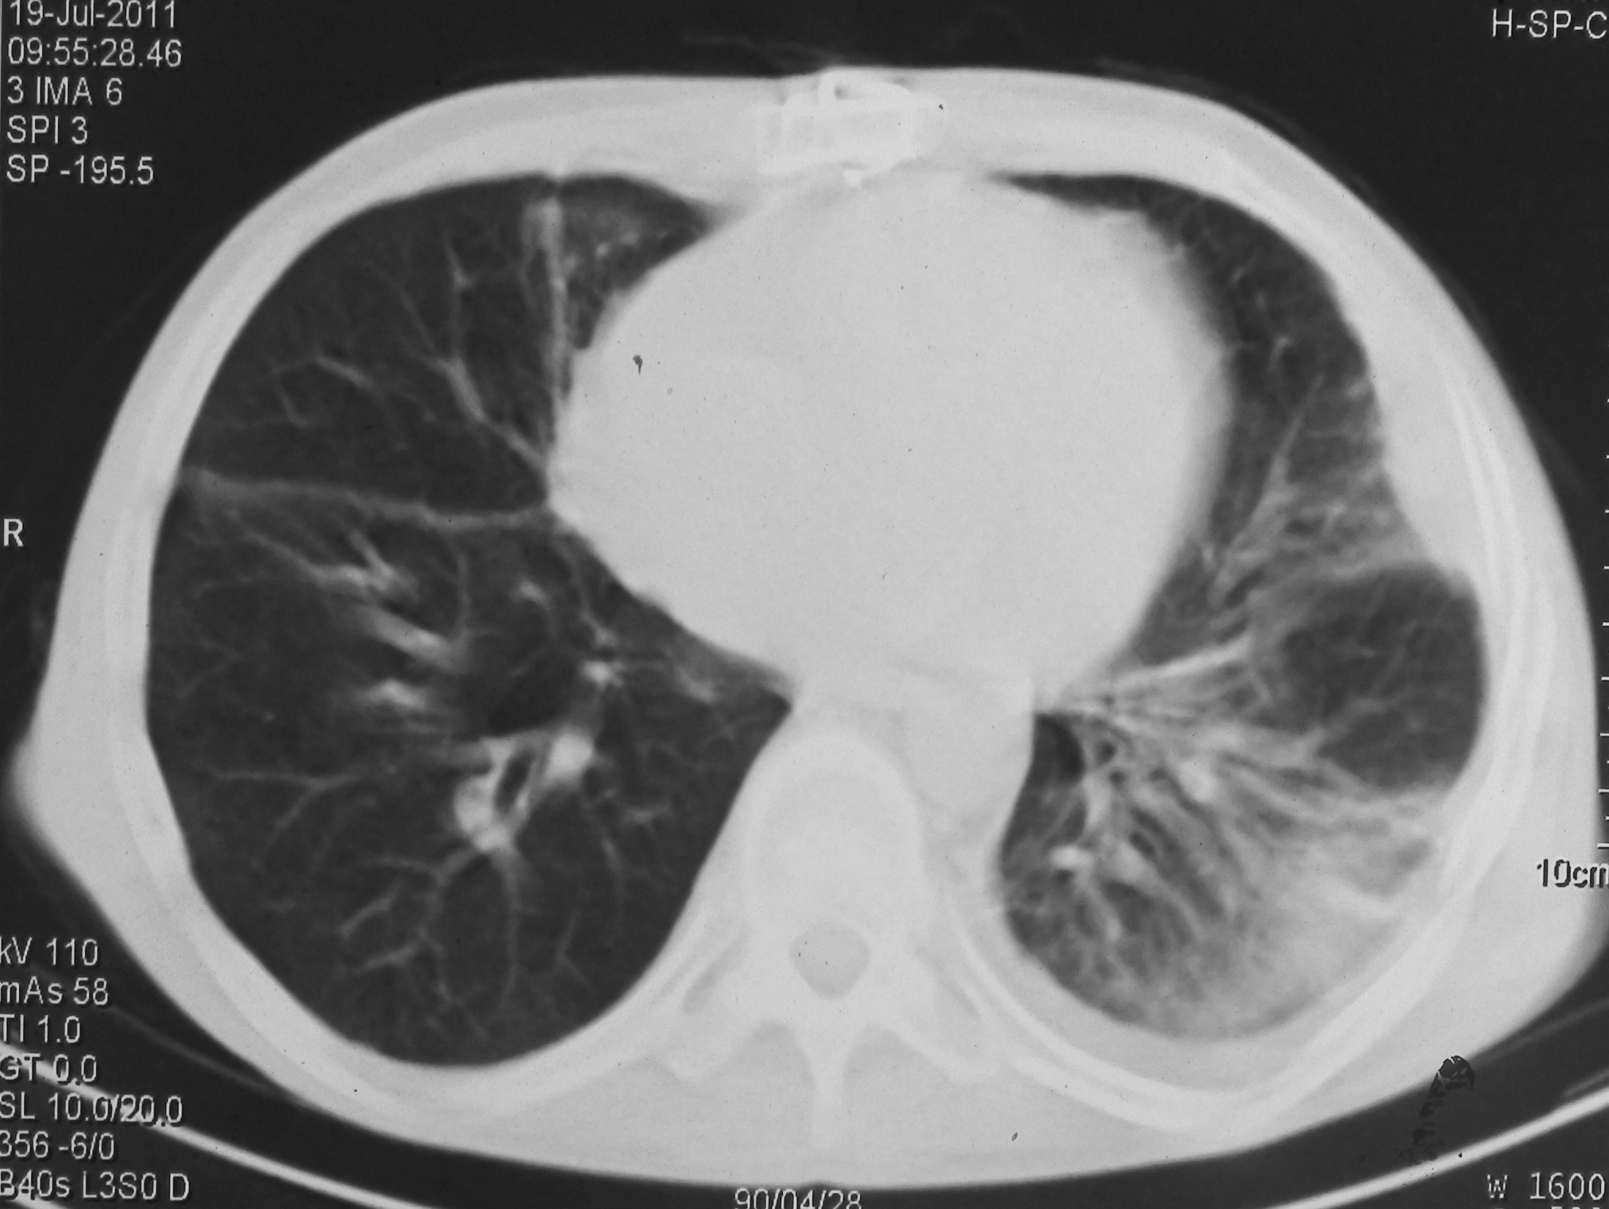

Slide 40
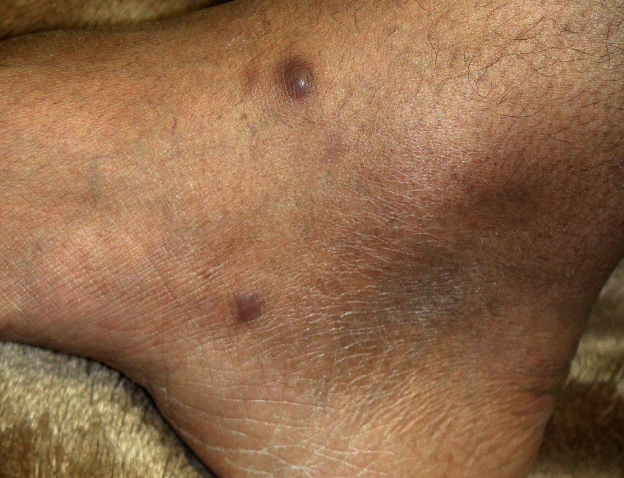

Slide 41
Final diagnosis according to BAL, TBLB and skin biopsy: Alternariasis

Slide 42
- Recognized etiology of pulmonary infection in a patient with unknown immune deficiency
Sometimes pulmonary involvement, particularly in PID, is the earliest manifestation, likewise in adulthood.

Slide 43
A Young Woman with Diffuse Skin Lesions and bronchiectasis

Slide 45
Final diagnosis: CVID

Slide 46
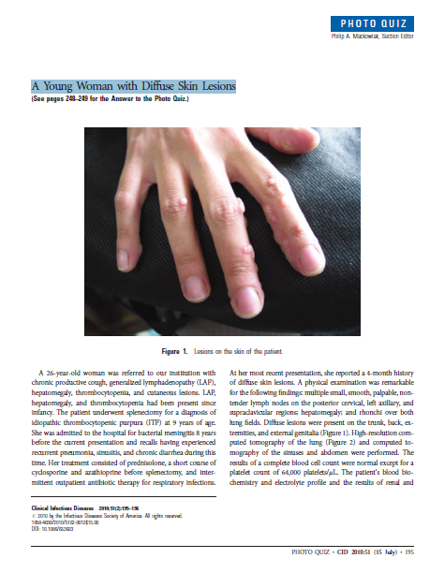

Slide 47
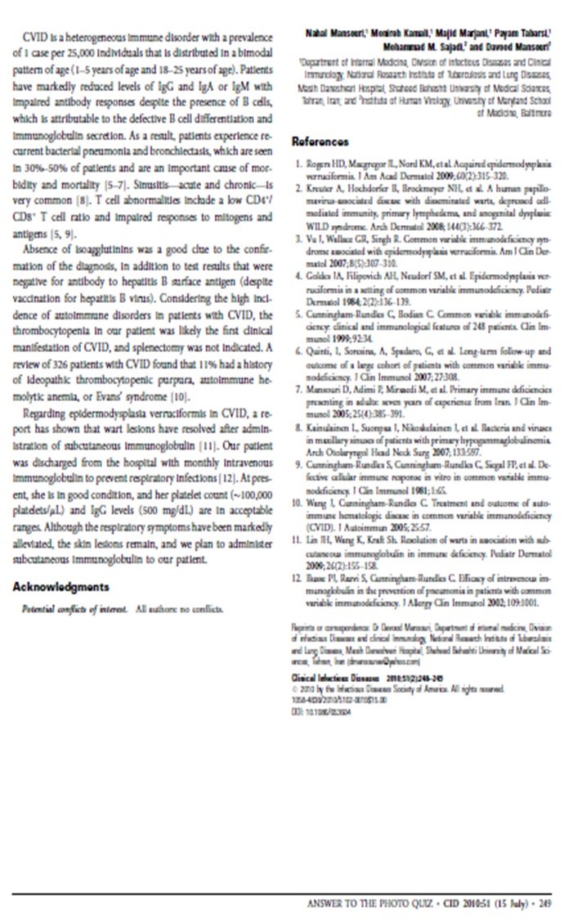

Slide 48
Acute Necrotizing Pneumonia due to nocardiosis in a Previously Healthy Young Adult

Slide 49
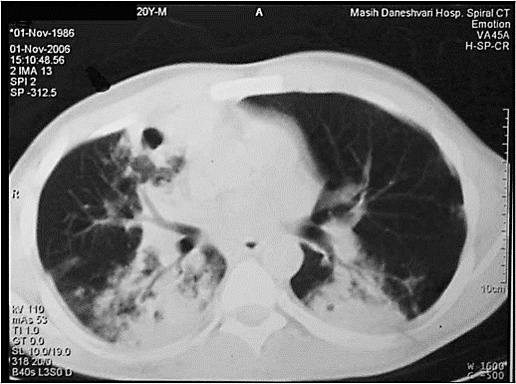

Slide 50
Final diagnosis : CGD

Slide 51
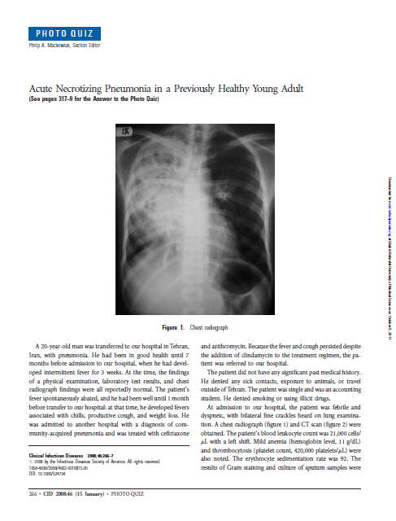

Slide 52
A case of PCP

Slide 53
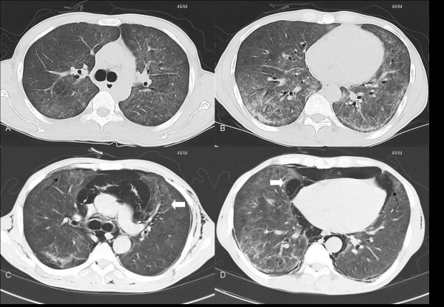

Slide 54
Final diagnosis: HIV infection

Slide 55
Unknown etiology of pulmonary infection and unknown underlying immune deficiency

Slide 56
Pulmonary mass and disseminated abscess formation in previously healthy young woman

Slide 57
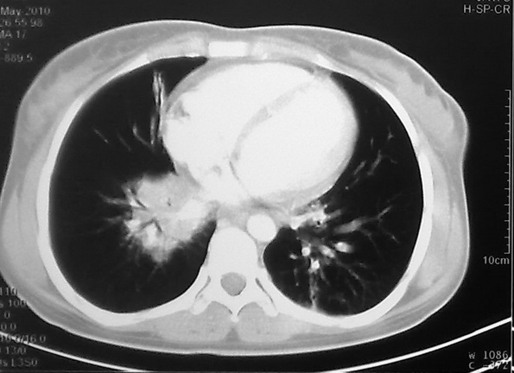

Slide 58
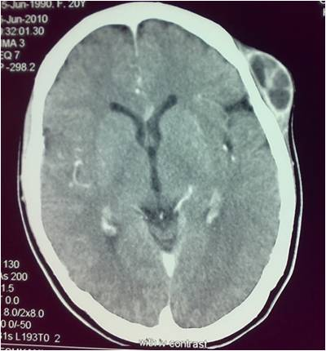

Slide 59
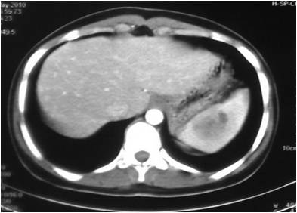

Slide 60
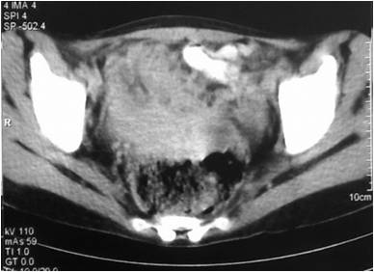

Slide 61
Finally diagnosed as : Diss. Aspergillosis in the setting of unknown CGD

Slide 62
A 33-year-old man referred as disseminated M. avium infection

Slide 63
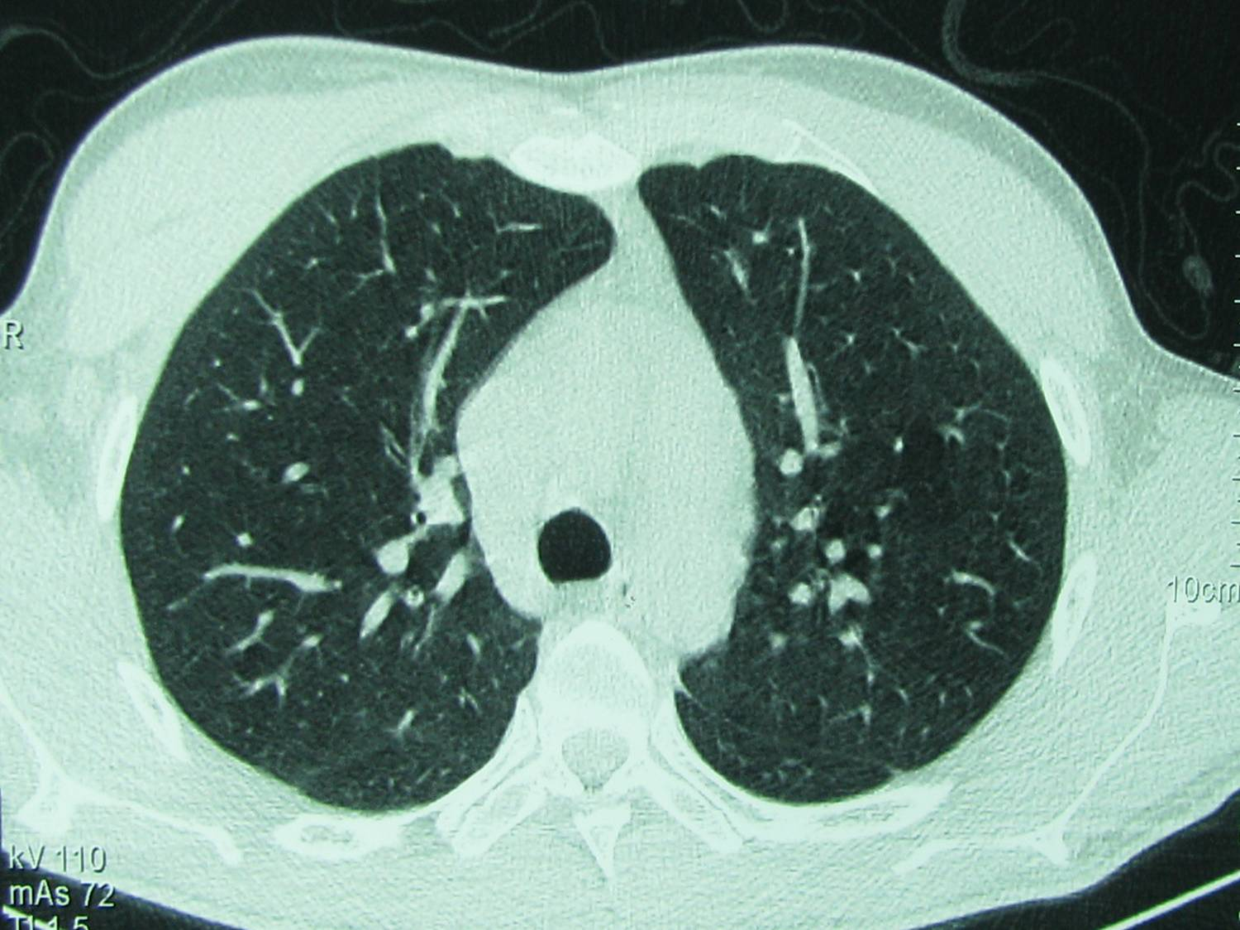

Slide 64
Finally diagnosed as : disseminated MDR TB in the setting of IL12R deficiency

Slide 65
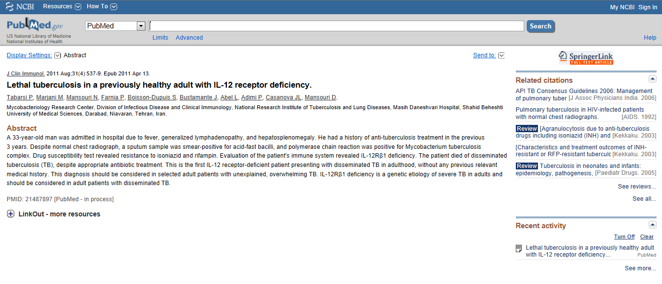

Slide 66
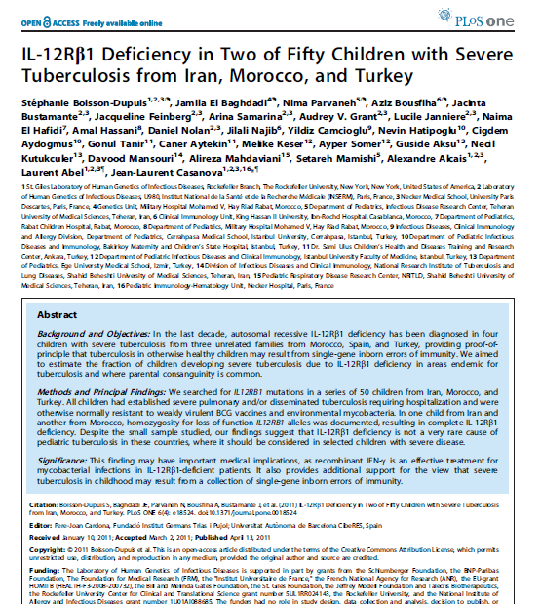

Slide 67
A 14 year-old girl with chronic diffused bilteral pulomanry nodules treated with different types of antibiotics regimens without any response.

Slide 68
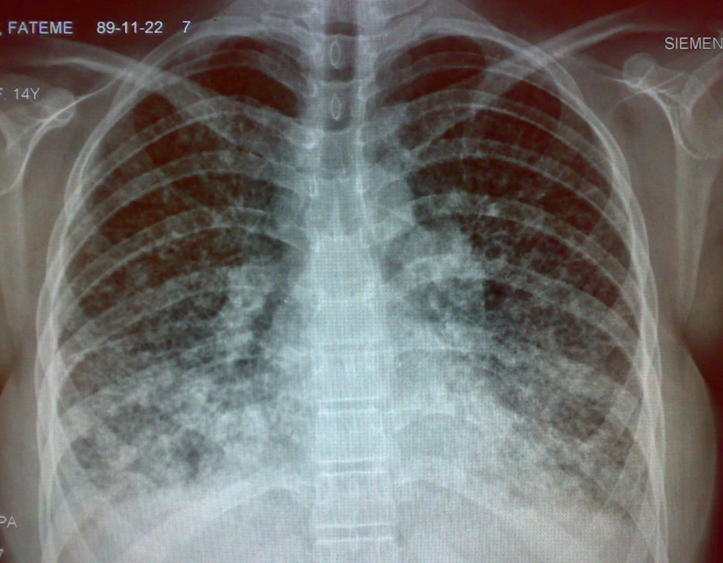

Slide 69
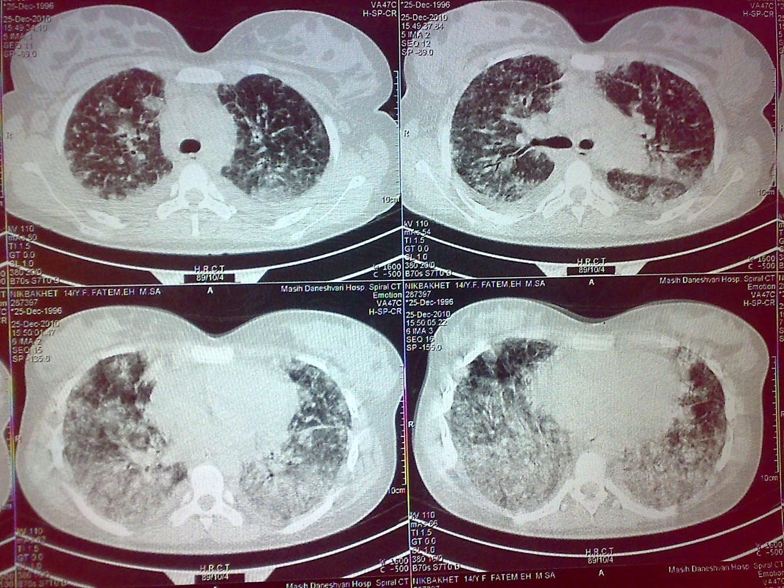

Slide 70
Chronic pulmonary EBV infection was confirmed which resulted in recognition of a newly described genetic disorder: ITK deficiency (IL-2–inducible T cell Kinase (ITK) Deficiency), a syndrome mimicking XLP

Slide 71
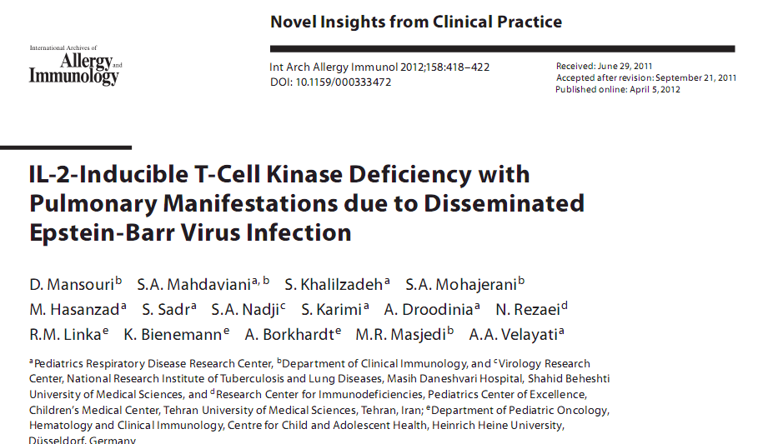

Slide 72
A 20 year-old woman with hemoptysis diagnosed as Wegener’s granulomatosis.

Slide 73
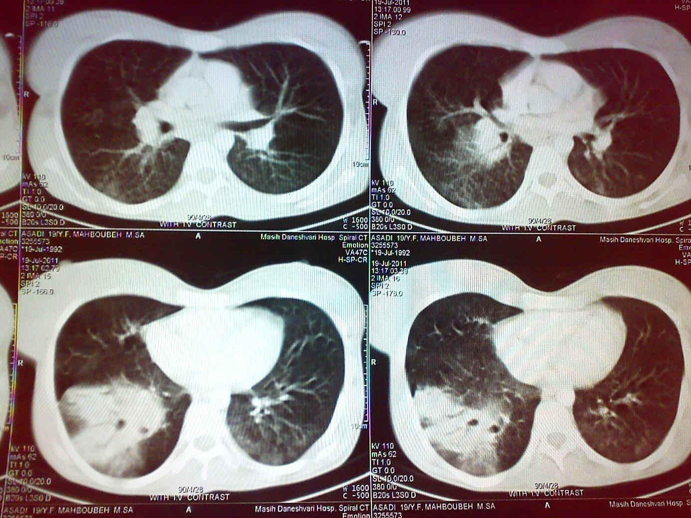


Slide 74
Finally diagnosed as invasive pulmonary & intrabronchial Aspergillosis associated with underlying CGD.

Slide 75
Pulmonary infection, leading to recognition of new genetic defect and even new immunologic pathway

Slide 76
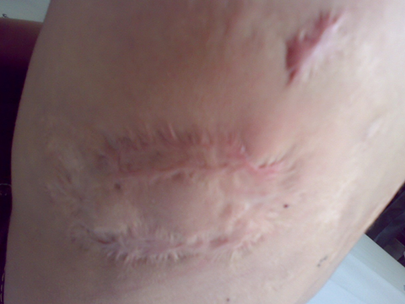

Slide 77
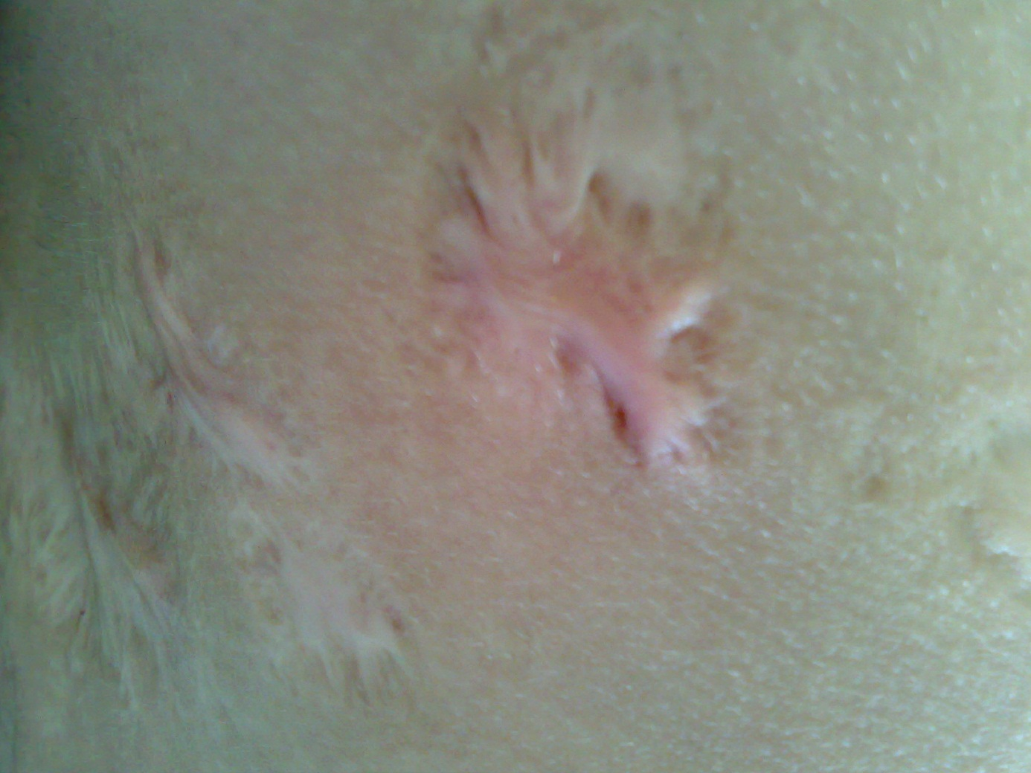

Slide 78
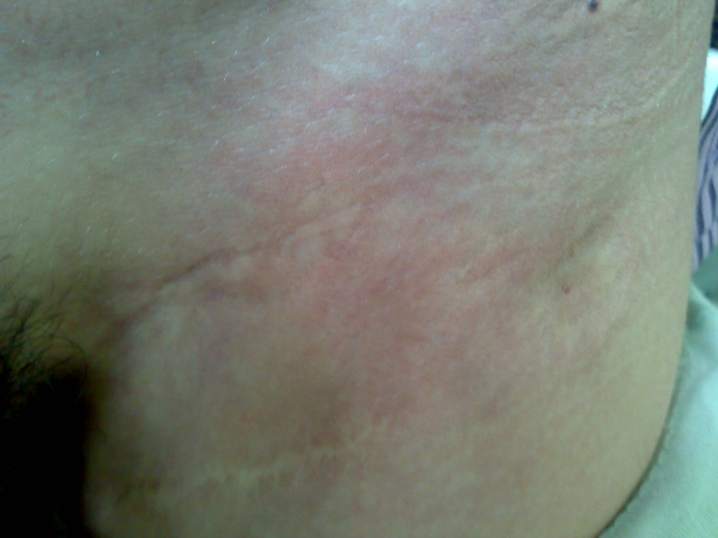

Slide 79
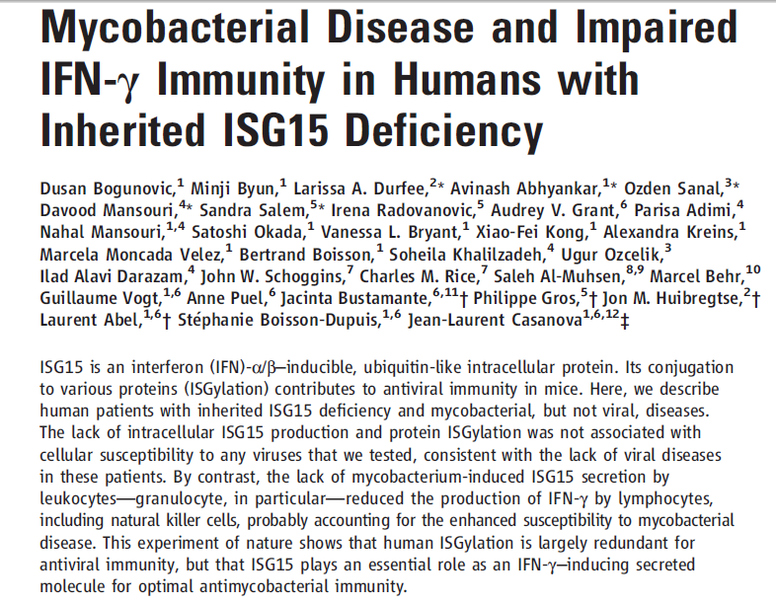


Slide 80
Recognized etiology of pulmonary infection not attributable to known underlying immune deficiency

Slide 81
A case of CGD with pseudomonas pulmonary infection, sinusitis and bronchiectasis.

Slide 82
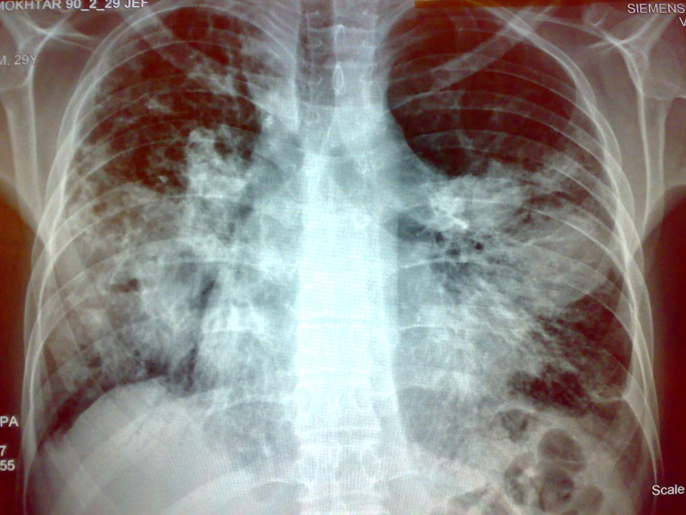

Slide 83


Slide 84
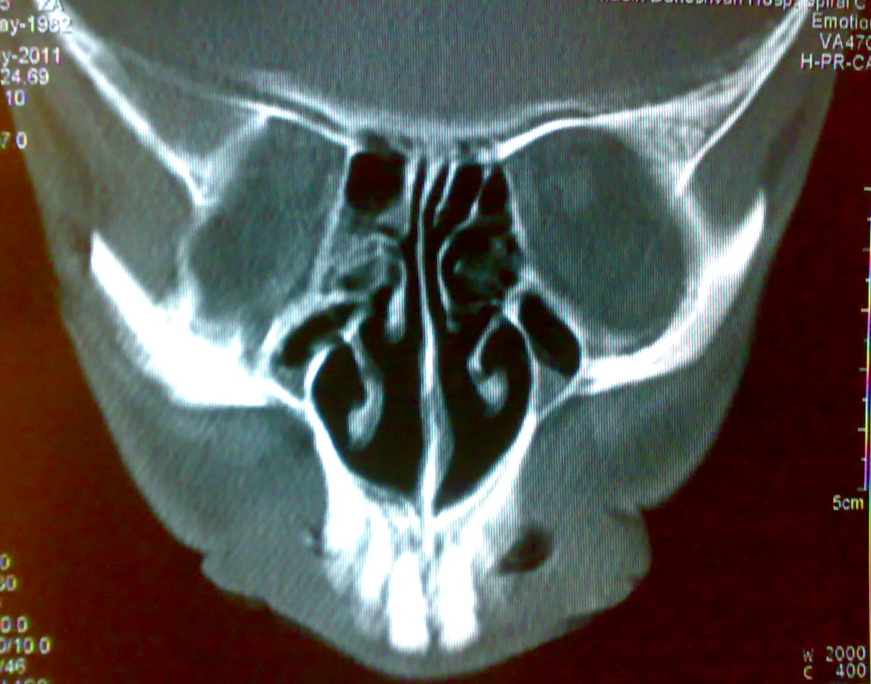

Slide 85
Immotile cilia syndrome
Two genetic abnormalities existing in a patient with different types of infections (CGD + immotile cilia syndrome)

Slide 86
Very rare organisms found in PID

Slide 87


Slide 88
Cutaneous leishmaniasis in a CGD patient

Slide 89
Chronic fistulizing hand lesion in a 53 years old woman due to Fusarium solani infection

Slide 90
Leading to diagnosis of CGD

Slide 91
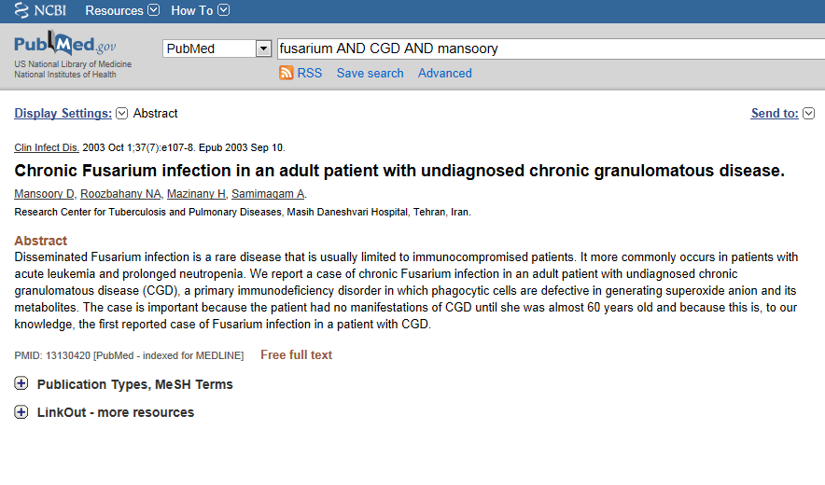

Slide 92
Conclusion:
Consider immune deficiency in pulmonary infections due to unusual, severe and opportunistic microorganisms.
Consider unusual or opportunistic pulmonary infections in the setting of recognized immune deficiencies.
Take into account the possibility of unknown immune deficiency presenting with an unknown opportunistic microorganism causing pulmonary infection for the first time.
Think about the possibility of undiscovered immune deficiency and advanced genetic workup in some opportunistic infections presenting in an apparently immunocompetent host.

Slide 93
Consider multiple opportunistic pulmonary infections in profoundly immune suppressed hosts ( PCP + CMV or PCP + TB in advanced HIV)
Consider the possibility of further opp. infections following the current opp. infection( CMV pneumonia in transplant followed by bacterial or fungal infections).

Slide 94
Approach to Infection in Immunecompromised Host

Slide 95
Infection is the major cause of mortality and morbidity in immunecompromised patients.
Diagnosis and management of infection in these patients is a big deal.

Slide 96
A 17 year-old man had been admitted due to progressive and general weakness, seizure and unilateral hemiparesis during a week (9 years ago). Imaging studies showed brain abscess and he was treated with combination of antibiotics with no response after one month. Finally, neurosurgical intervention was done. According to his medical documents, the diagnosis was candidial abscess and he was discharged with fluconazole without further investigations. Echocardiography was normal.

Slide 97
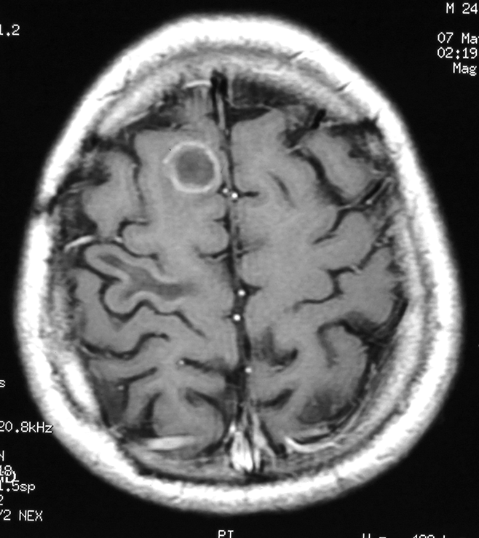

Slide 98
Three years later (6 years ago), he experienced progressive unilateral ptosis. Sinus surgery was performed and the histopathologic report was compatible with invasive candidial sinusitis. He received itraconazole for six months.

Slide 99
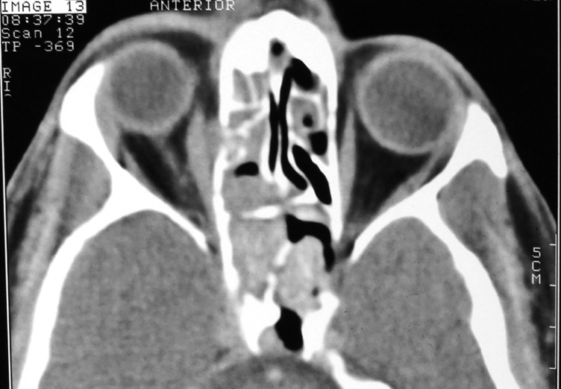

Slide 100
One year later (5 years ago), he experienced bloody colitis-shape diarrhea. One year multiple courses of oral antibiotics had no benefit. The colonoscopy revealed diffuse ulceration and pseudo-polyposis. Mesalazine was initiated with the diagnosis of ulcerative colitis.

Slide 101
The colitis progressed despite of three years treatment with mesalazine. Several colonoscopic examinations demonstrated the similar aforementioned findings. Pancolectomy was offered due to intractable colitis. Finally, before colonic surgery, he was referred to this center, two years ago. According to his past medical history and ongoing intractable colitis, immunologic investigation was performed. (Table)

Slide 103
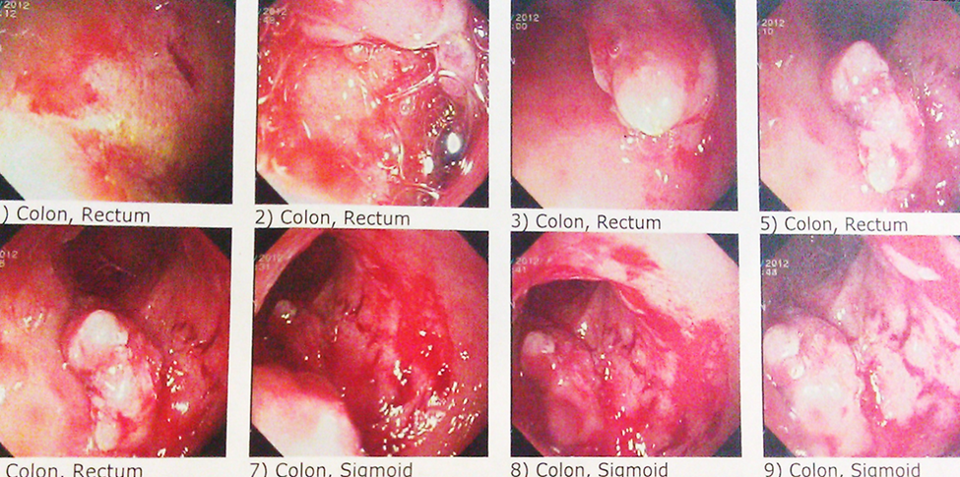

Slide 104
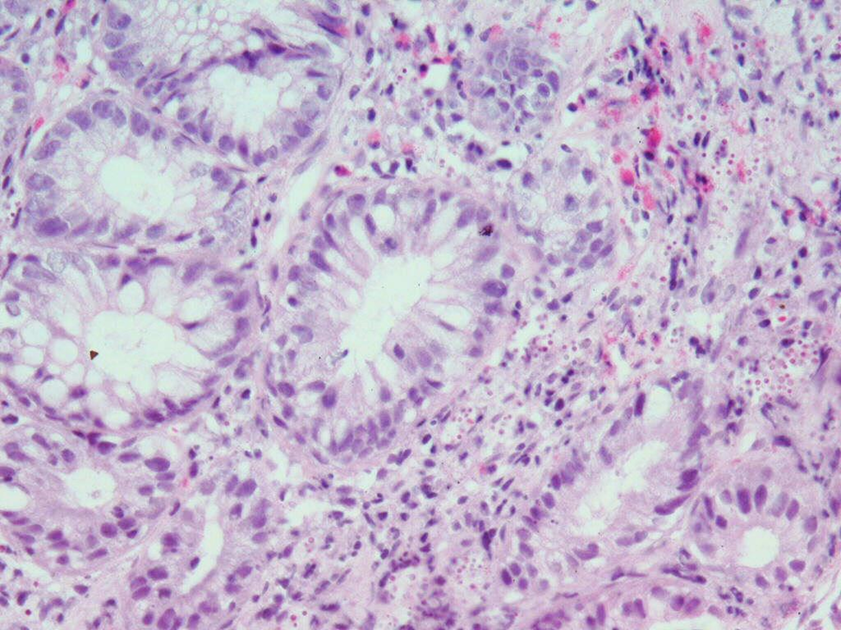

Slide 105
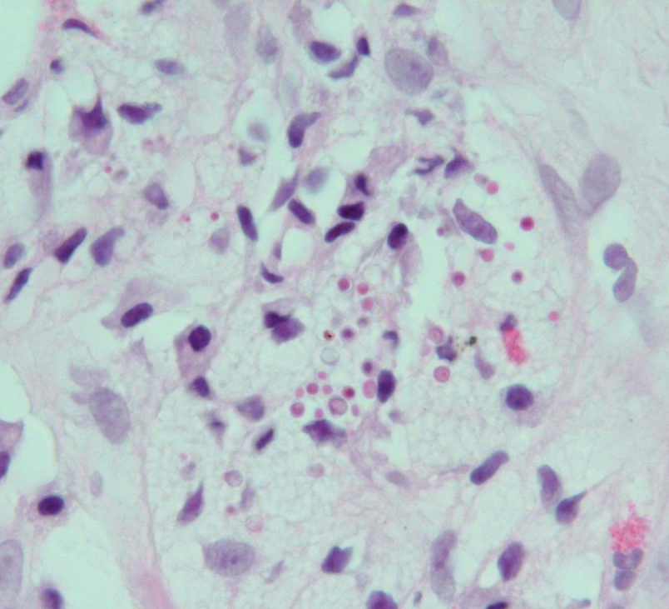

Slide 106
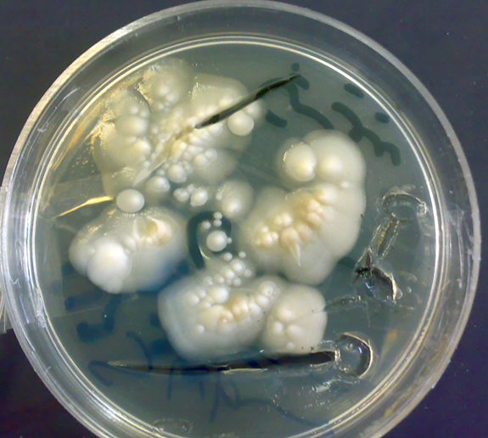

Slide 107
He has eight healthy siblings and his parents are consanguinous. Childhood vaccination was complete without any adverse reactions. Allergy history was unremarkable.
Tissue biopsy during colonoscopy was evaluated for other probable diagnosis including unusual infective causes. The histopathologic study and culture were compatible with colitis and invasive candida infection.

Slide 108
Genetic analysis revealed a:
homozygous mutation (R35Q) of CARD 9 (caspase recruitment domain family member 9)

Slide 109
Itraconazole was initiated for invasive colitis due to Candida albicans and mesalazine was discontinued.

Slide 110
His condition was relatively better with itraconazole. During two years of treatment, due to profound anemia, he required blood transfusion monthly. The mean level of hemoglobin was 4-5 mg/dl, as well as, intermittent deteriorations of general status and hematochezia. Finally, intractable colitis urged to colectomy. However, before surgery, another colonoscopy was performed.

Slide 111
This time, the tissue culture reported to be Candida glabrata, so caspofungin was initiated and after two weeks complete recovery was observed. After one month of maintenance regimen with itraconazole, the final colonoscopy revealed only pseudo-polyps without any ulcerative lesion and colitis.

Slide 112
After a year, he never needs blood transfusion and has twelve kilograms body weight gaining. The last Hemoglobin level is 11 mg/dl.

Slide 113
A Challenging Case of CD4+ T Lymphocytopenia

Slide 114
A 53 year old man, admitted in hospital with dyspnea 3 months ago.
Married, five children, employee,
Non-smoker,
No significant medical or surgical history or transfusion,

Slide 115
He was in normal status until 5 months ago when fever and chills occurred associated with dry cough then dyspnea. He had been treated symptomatically as outpatient but dyspnea aggravated and he had been admitted in hospital.
On admission he had fever, severe dyspnea and oral ulcers.

Slide 116
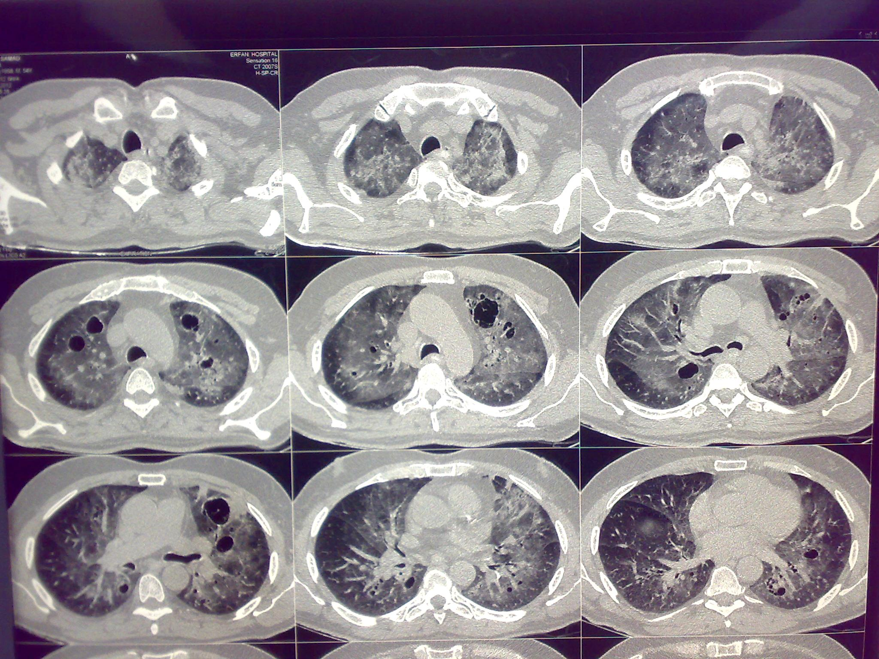

Slide 117
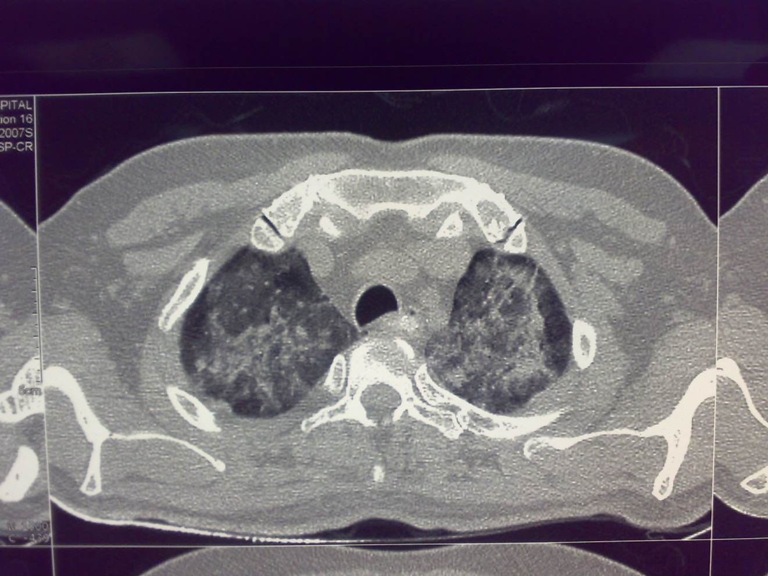

Slide 118
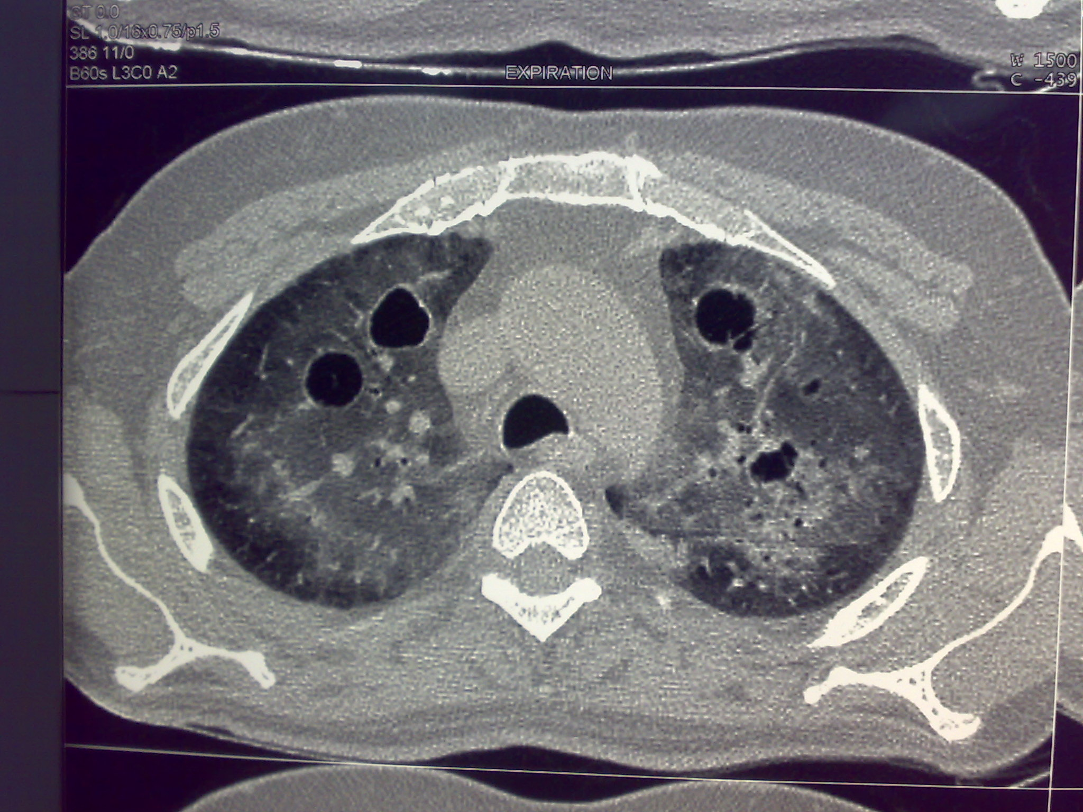

Slide 119
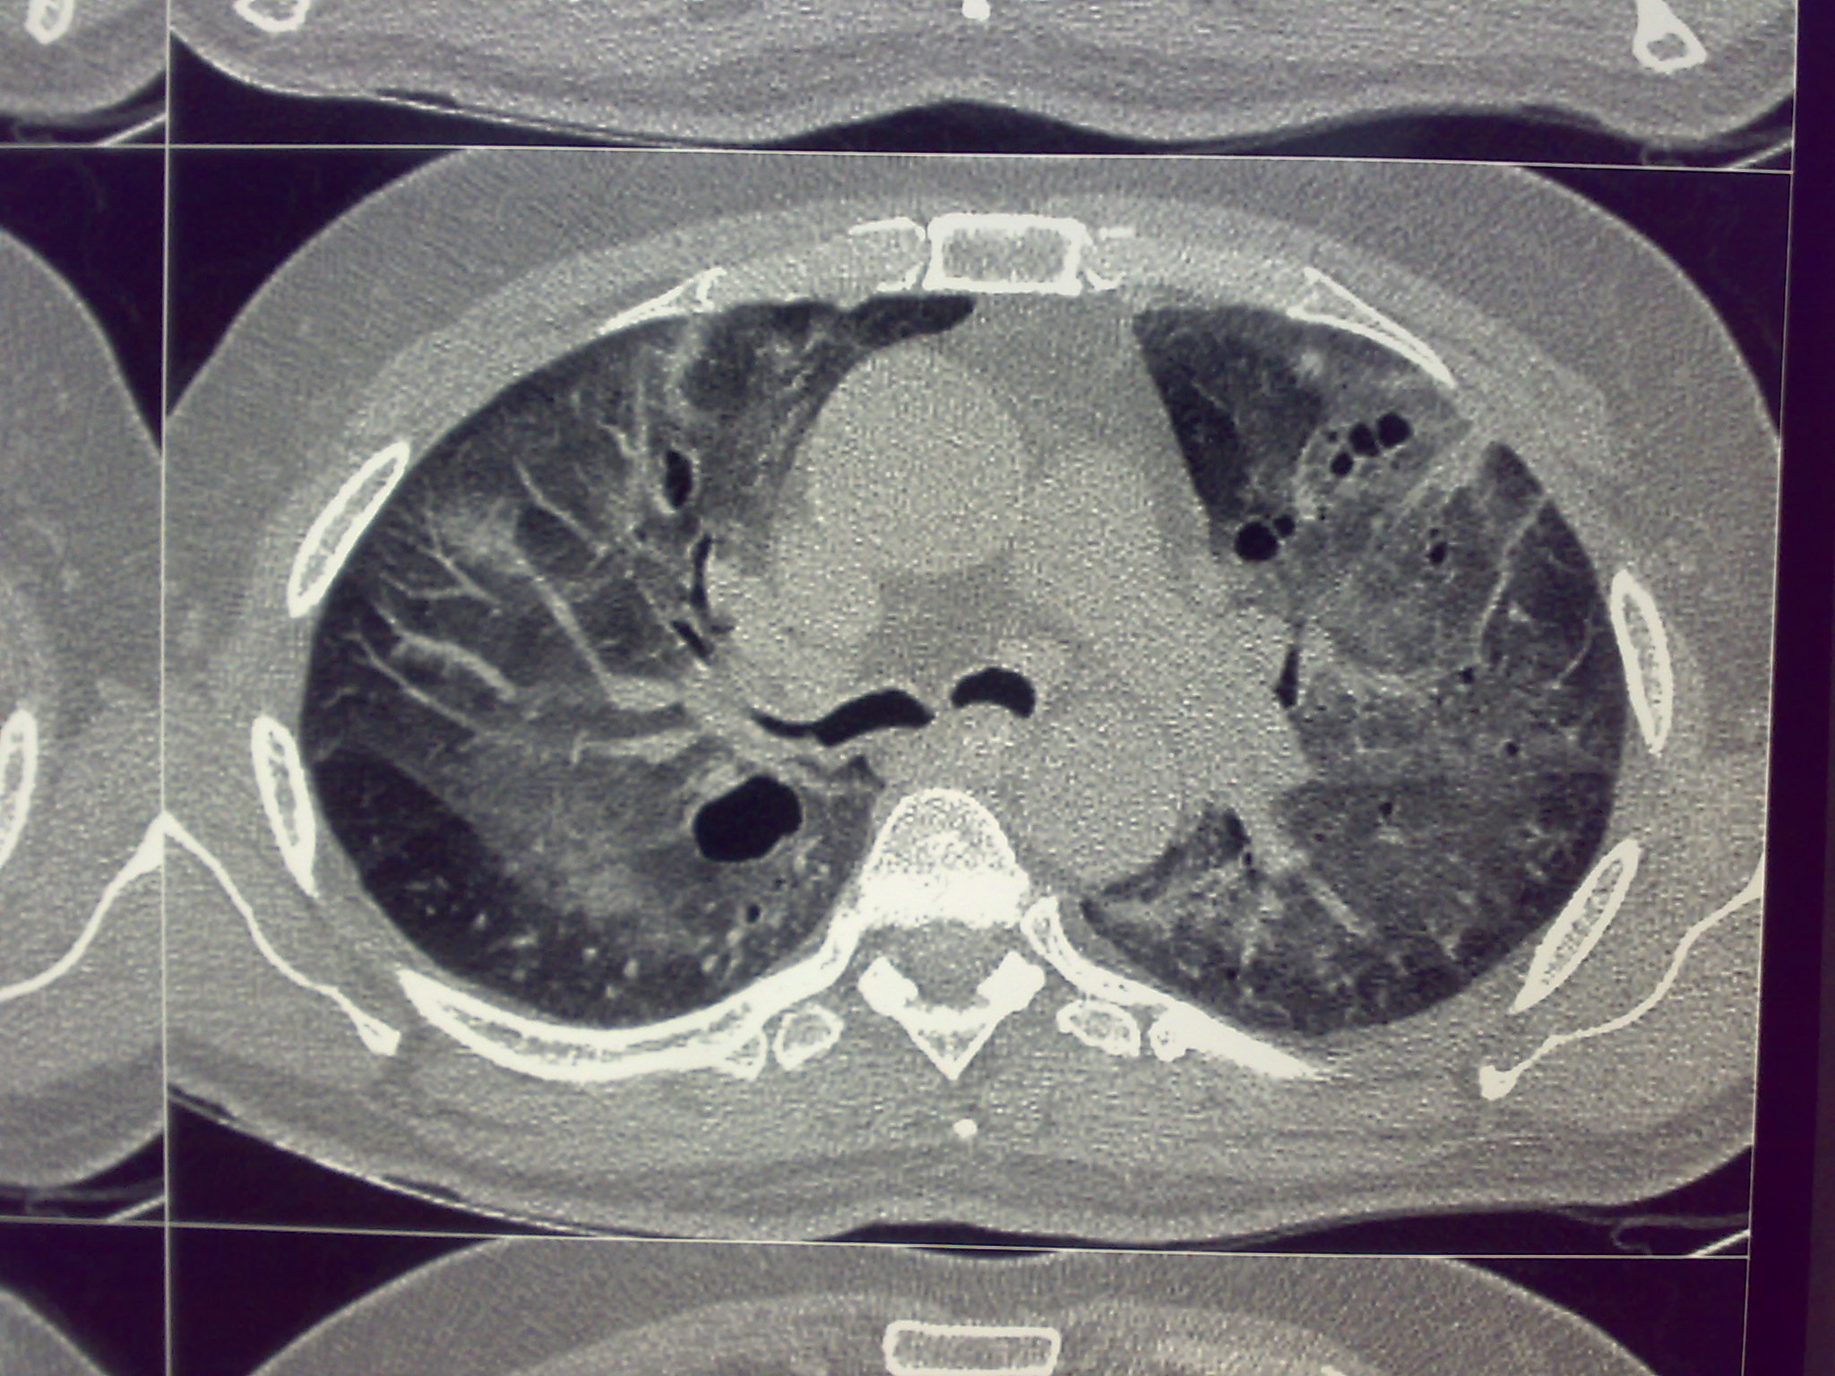

Slide 120
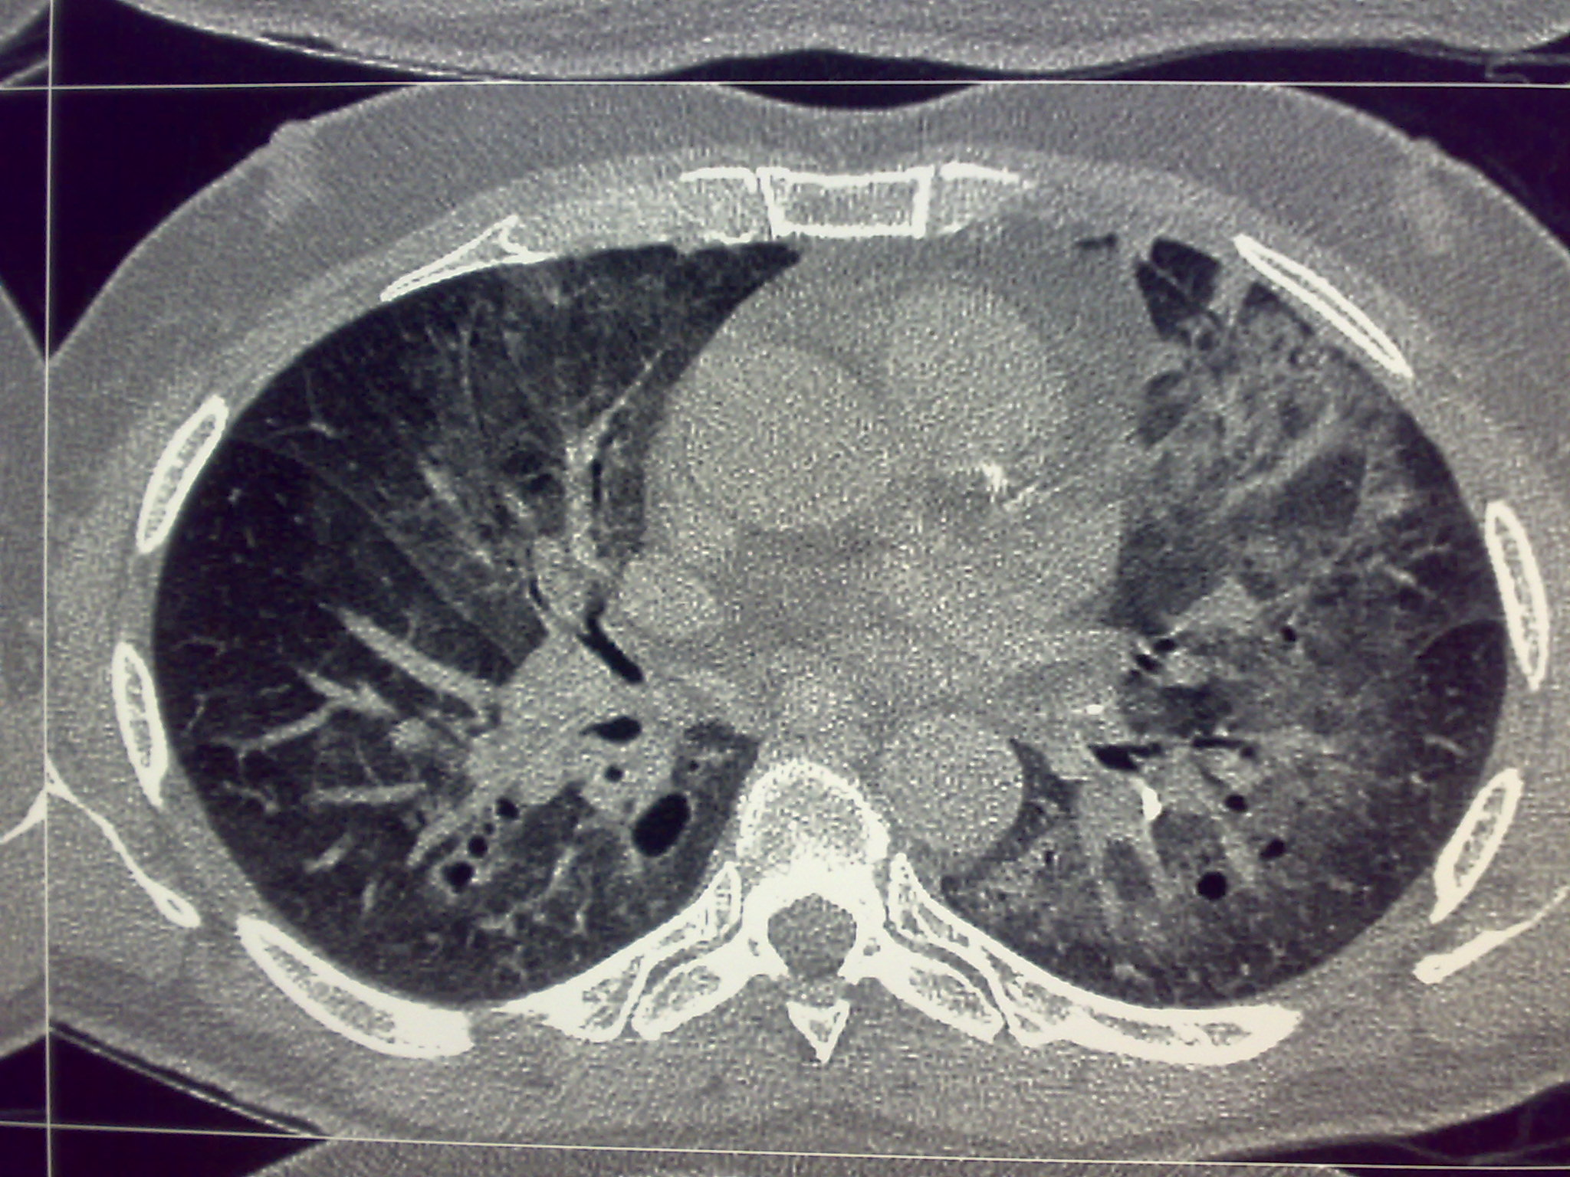

Slide 121
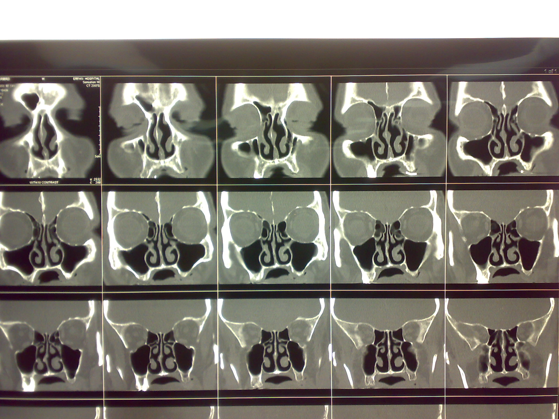

Slide 122


Slide 123
Lung HRCT demonstrated bilaterally diffuse ground glass opacities with multiple cystic lesions.
Sinus CT and abdominopelvic CT: normal

Slide 124
WBC: 10700 (P83%, L12%)
Hb: 12.3mg/dl with normal indices
Plt: 210000
CD3 89%
CD4: 1%
CD8 88%
CD19: 0%
CD20: 0%
Absolute CD4 count: 12

Slide 125
What is your diagnosis?

Slide 126
BAL positive for Pneumocystis jiroveci
PCR of the oral lesion positive for HSV 1
The patient had been treated for a duration of six weeks with high dose TMP-SMX as well as prednisolone 60 mg tapered in three weeks.
All biochemistry tests, electrolytes, LFT, U/A: normal
PPD: Negative
Serology of HIV (two times) and HIV RT-PCR: negative
ESR: 13

Slide 127
What is your diagnosis?

Slide 128
The patient completed the treatment course (two weeks at hospital and four weeks at home) with rapid recovery.

Slide 129
Lung HRCT after six weeks:

Slide 130


Slide 131


Slide 132


Slide 133
The LAB exams at the first day after discharge:
WBC: 5000 P62% L 34%
Hb: 16
Plt: 133000
BG: A + , Anti-B : 1/32
All biochemistry: Normal
U/A: Normal
Ferritin: 785 (30-400)
CRP: 3+
ESR: 12
ANA, Anti DNA, ANCA (c,P) : neg
ACE: 69 (8—65)
HbsAg: Neg
Anti HBs: 20
Anti HCV: Neg
IgG: 629 (700-1600)
IgM: 97 (40 -230)
IgA : 103 (70-400)
CH50, C3,C4: Normal
IgE: Normal
NBT: 100%
IgG subclasses: normal except for IgG4=2 (11-157)
Anti-HIV, Anti HTLV1, Anti HTLV2: Neg

Slide 134
What is your diagnosis?

Slide 135
Serum PCR for EBV, HTLV1,2, HSV1,2,: All Neg.
IgM EBV: NEG
IgG EBV: NEG
CD3:97%, CD4:8%, CD8: 86%, CD56:6%, CD19:1%, CD3/HLADR: 54%
Absolute CD4 count: 136

Slide 136
What is your diagnosis?

Slide 137

CMV EVERYWHERE !!!!
IgM CMV: highly positive = 4.2 (up to 1.1)
IgG CMV: 51.7 ( up to 30)
Serum CMV PCR: positive
CMV viral load: 8600 copies/ml
Retrospective revision of BAL result at the third day of hospitalization: BAL PCR for CMV positive

Slide 138
Final diagnosis:
ACUTE CMV INFECTION
in a 53 years old man leading to transient severe
CD4 POSITIVE T and B LYMPHOCYTOPENIA
presenting with severe dyspnea due to
PCP

Slide 139
After completion of PCP therapy, the patient is doing well, PFT normal, and the last LAB results after 3 months of admission:
WBC: 8700 (P42%, L46%)
HB: 16.6
PLT: 158000
ESR:7
CD3:89%, CD4:12%, CD8: 75%, CD19: 3%,
Absolute CD4 T cell: 440
IgM, IgG, IgA: All normal
IgM anti CMV: borderline, 1.1 (>1.1 = positive)
IgG anti CMV >500 (>30= positive)
CMV viral load: 1500 copies/ml

Slide 140
The planning:
CMV viral load, flowcytometery, and Lung HRCT three months later

Slide 141
A 46 Years-old Man Persistent Fever and Weight-loss

Slide 142
A 46 years old man was admitted to hospital due to persistent fever and weight loss.
His symptoms has begun since 5 years ago with recurrent genital ulcers which was responsive to acyclovir.
Intermittent fever has begun 6 months ago which gradually became persistent.

Slide 143
A chest wall mass appeared in anterior chest wall which was resected completely.
A nodular mass in thyroid was also detected and was biopsied.
Due to prolonged fever, Bone marrow biopsy was also performed in shiraz.
Pathologic report of all specimens was granulomatous inflammation without AFB.

Slide 144
Due to inconclusive data, the patient was referred to this center with impression of primary immunodeficiency most probably MSMD.
He was still febrile and had abdominal pain.
He had 10 Kg weight loss since 6 months ago.
He had also low back pain.
He had no cough,sputum,dyspnea or hemoptysis.

Slide 145
He also had diarrhea since 3 days before admission.
He had no history of diabetes, hypertension, IHD or immunosuppressive condition.
He was non-smoker and hadn't history of IVDU.
He was a food seller in shiraz.

Slide 146
On physical examination He was febrile(T:38)without hemodynamic instability.
He was alert and oriented.
He had no peripheral lymphadenopathy.
Auscultation of lung and heart were normal.
Abdomen was distended most probably to ascitis.
No skin abnormality was detected
Two days later erythema nodosum appeared in anterior right leg

Slide 147


Slide 148


Slide 149


Slide 150


Slide 151


Slide 152


Slide 153


Slide 154


Slide 155


Slide 156


Slide 157


Slide 158
Lab data in Shiraz
Anti-HIV:Non-reactive
HbsAg: Non-reactive
Anti-HCV: Non-reactive
Sputum smear for AFB: Neg
Sputum PCR for AFB: Neg
Bone scan: multiple uptake suggestive of metastasis

Slide 159
Lab data in this center
WBC:5.9
Hg:8.2
Plt:232000
ESR:130
Urea:64
Cr:1.5
SGOT:23
SGPT:18
ALP:572
LDH:566
CPK:46
FBS:93
Na:138
K:5.1
Albumin:3.2

Slide 160
Lab Data
Sputum smear for AFB:Neg
Ascitis smear for AFB:Neg
Ascitis Fluid:Exudative
NBT:99%
Blood culture:Neg
Stool exam for parasite:Neg
Stool exam with acid fast:Neg
P-ANCA:neg
C-ANCA:Neg
ANA:Neg
Anti-dsDNA:Neg
Anti-cardiolipin(IgG&IgM):Neg

Slide 161
Lab data
Anti HIV: Reactive
Western Blot: Positive
CD4:12
HIV viral load: 18918
EBV PCR: Neg
CMV PCR: Positive
Toxo-IgG: Positive
TEE: Mass on RV

Slide 162


Slide 163


Slide 164


Slide 165


Slide 166


Slide 167


Slide 168


Slide 169
What is your diagnosis?

Slide 170
Aspiration of spleen and CT-guided biopsy of vertebra was performed.
Biopsy of anterior chest wall mass was re-evaluated.
All samples were negative for AFB.
Culture of samples were negative for bacteria and fungi.

Slide 174
Pathology Report
Many foamy histiocytes some of them with foamy cytoplasm and blue dots in a markedly hemorrhagic background containing branching vascular cores

Slide 175
PCR for HHV-8:Negative(Blood and samples)

Slide 176


Slide 177
IHC for P. jiroveci strongly positive on three samples: Anterior mass, Spleen and Bone

Slide 178
Diagnosis
Disseminated Extra pulmonary P. jiroveci

Slide 179
The question still remains ?
Multiple extra-pulmonary lesions caused by P. jiroveci without pulmonary involvement?
Such a disseminated presentation with low HIV viral count?
Is there possibility of genetic diversity even in immunecompromised patients presenting with unusual types of common opportunistic infections?

