Slide 1
The proximal open wedge osteotomy with an Interlocking Plate for the correction of moderate to severe Hallux valgus

Slide 2
Interlocking Plate and screw

Slide 3
Indication
Hallux valgus
conservative to uncontrollable complaints
Intermetatarsal angle> 15 °
no arthritis in the Metatarsophlangal joint
TMT stable
MT I shorter MT II

Slide 4
1.) Measurement of the hallux valgus angle and intermetatarsal angle
2.) Determination of the degree and position of the osteotomy

Slide 5
Operative technique Mobilisation MTP 1
Intermetatarsaler incission I / II level MTP 1
Mobilization of the Sesammoid
Cutting of Tendon M. adduktor hallucis
Incision of lateral capsule MTP 1
„lateral release“

Slide 6
OP-Technique: surgical access
Mediodorsal Incission of TMT 1 till basic of proximal phalanges

Slide 7
Surgical technique
Osteotomy and add the plate

Slide 8
Insertion of the plate
Fill the osteotomy with the spongiosa

Slide 9
Pre- and postoperatively X-ray

Slide 10
Postoperative treatment
forefoot relieving shoe for 6 weeks
suitable bandage
Removing of suture after 12-14 days
Final X-ray controll after operation 6 weeks
Start of complete burden

Slide 11
Pre- and postoperatively

Slide 12
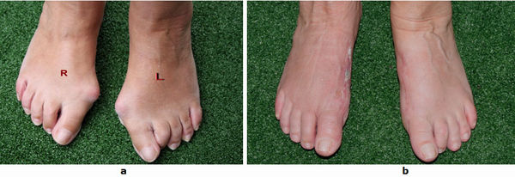
Pre- and postoperatively
Condition before (a) and after surgery (b)

Slide 13
Summary
simple technique
Reproducible
controlled, complete correction of the IMA
stable after surgery
Prevention of elevation and shortening MT 1
No Transfermetatarsalgia

Slide 14
Advantage
good three-dimensional correction possibilities
Combinations with distal operation
no shortening of the MT I
lower risk of postoperative Transfermetatarsalgia
comparatively shorter learning curve

Slide 16
Thank you so much for your attention Prof.Dr.med.Y.M-Goudarzi

