Slide 1
Renovascular Hypertension
S M Reza Khatami MD
Associate professor
Tehran University of Medical Sciences
Tehran 1392

Slide 2
Renal Artery Stenosis Vs Renovascular Hypertension
Renovascular hypertension is diagnosed when the
rising of blood pressure is due to REDUCED RENAL
PERFUSION
It is established only in RETROSPECT after successful
reversal of hypertension with revascularisation
A pressure gradient of at least 10-20 mm Hg
between the aorta and post-stenotic renal artery is
required before measurable release of renin
develops

Slide 3
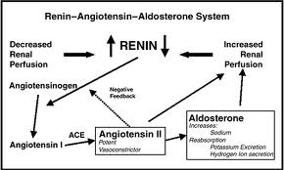
pathophysiology

Slide 4
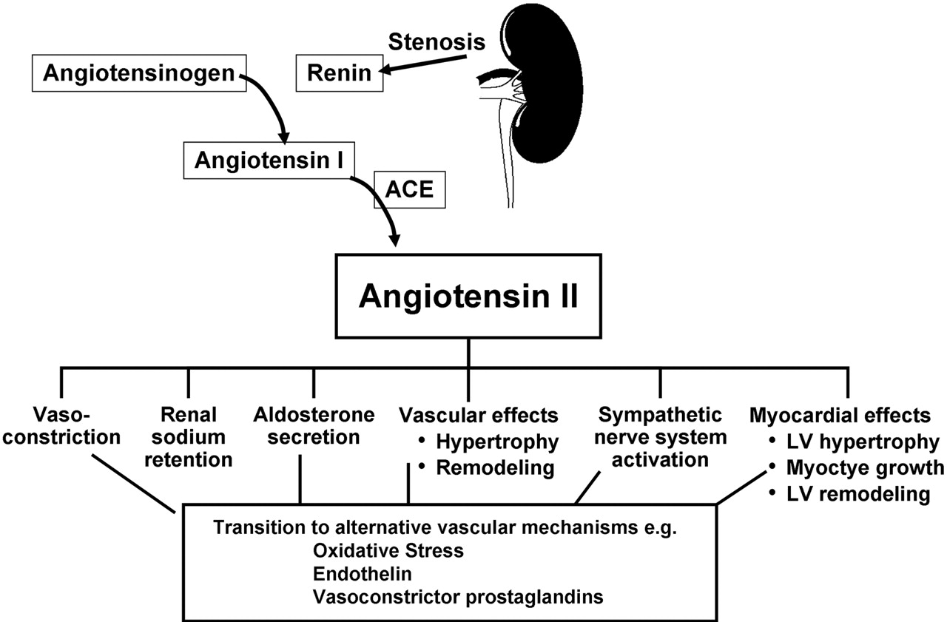

Pathophysiology
Schematic of pressor mechanisms identified in
renovascular hypertension.
Garovic V D , and Textor S C Circulation 2005;112:1362-1374
Copyright © American Heart Association
Notes:
Figure 3. Schematic of pressor mechanisms identified in renovascular hypertension. Reduced perfusion to the kidney activates release of renin, which ultimately amplifies systemic signals to restore renal artery pressures. These signals include sodium retention and recruitment of additional vasoconstrictor pathways (see text). Blockade of angiotensin generation or genetic knockout of angiotensin receptors can prevent this sequence, although some of the later signals no longer depend entirely on the renin-angiotensin system.

Slide 5
Stages
Immediate
  Hyper-reninemia
Days to weeks
  BP elevated
  Contralateral kidney +/-
Long term
  With other kidney
  Without other kidney

Slide 6
Pathophysiology
One kidney model (diseased)
  Volume is handled properly
  Non-stenotic kidney
  Vasoconstriction
Two kidney model (both diseased)
  Volume is not handled properly

Slide 7
With other kidney….
Volume expansion avoided
Renin remains high
Stenotic kidney retains sodium/produces renin
Non-stenotic dumps sodium/water/ decreases renin
Once long term defect reached – benefit of flow reversal less

Slide 8
Without other kidney…
Sodium and water retention
Vasopressor effects of angiotensin II
Renal perfusion maintained
Renin levels fall
HTN more dependent upon volume expansion

Slide 9
…third stage
HTN is unremitting
Persists after removal of stenosis
Ischemic nephropathy

Slide 10
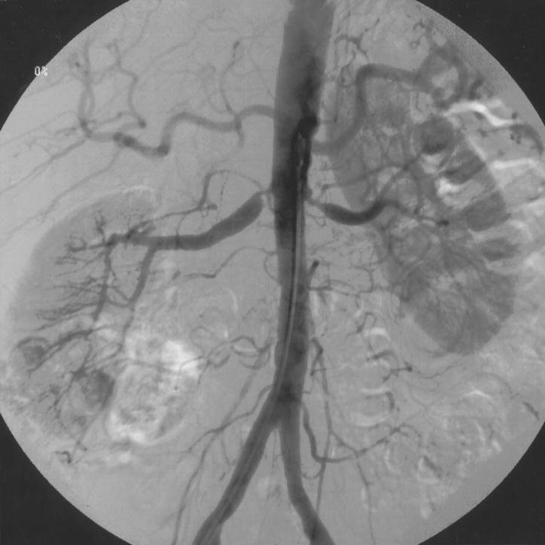
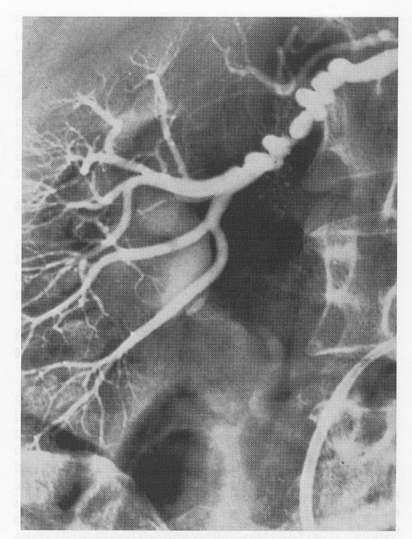
Renal Artery Stenosis
Atherosclerotic (90%)
Fibromuscular dysplasia (10%)
  Medial fibroplasia (90%)
    classic "string of beads" appearance
    middle-to-distal portion of the artery
  Perimedial fibroplasia
    focal stenoses
  Intimal/Medial fibroplasia
    a focal, concentric stenosis
Aortorenal dissection
Vasculitis involving the renal artery (i.e. PAN)
AVMs involving the renal artery
Irradiation of the renal artery
Scleroderma

Slide 11
Incidence
Older males – proximal aortic disease
Younger females – distal FMD
Less common in African - Americans
US
  1-5% of HTN in unselected populations
  30% of HTN in atheropaths
  <1% of all HTN
International
  Possibly less prevalent

Slide 12
Presentation
HTN with azotemia (>1.5 mg/dl) and modest proteinuria (< 1.5 g/dl)
HTN with progressive renal failure
Severe HTN (diastolic > 120 mmHg)
HTN with asymmetric kidney
Paradoxical worsening of HTN with diuresis / ACEI

Slide 13
Presentation
Onset of HTN < 30 y.o., w/o risk factors
Abrupt onset severe HTN (>160/100)
HTN resistant to > 3 agents
Abrupt increase in BP
HX of smoking, No family Hx
Systemic PAD with moderate to severe HTN >50 yo

Slide 14
Presentation
Recurrent pulmonary edema with mod-sever HTN
Mod to sever HTN in a patient with an atrophic kidney

Slide 15
Physical Exam
Abdominal bruit
  46% of pts with RVHT
  9% of pts with essential HTN
Advanced fundoscopic changes
Recurrent flash pulmonary edema

Slide 16
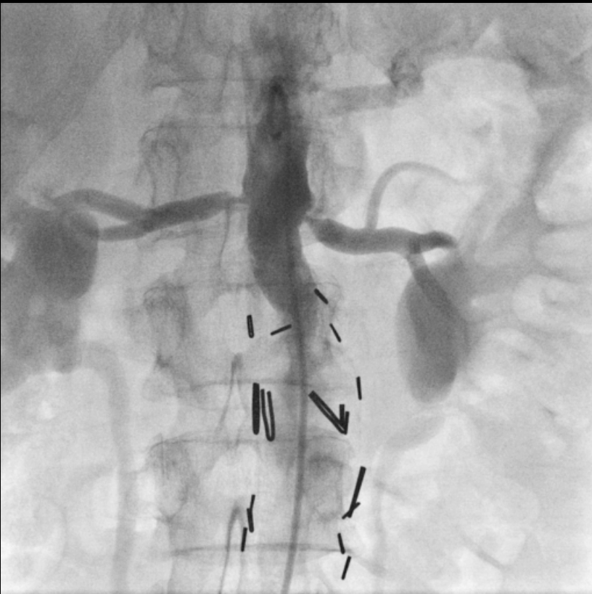
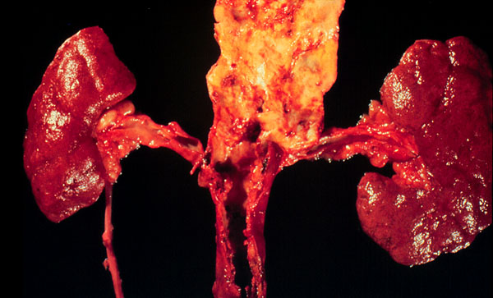
Atherosclerotic RAS
Usually ostial
Associated with diseased aorta
Can be unilateral or bilateral

Slide 17
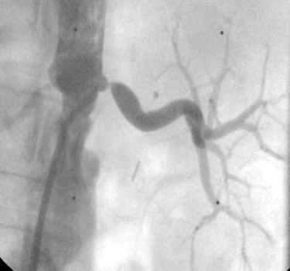
RAS is a marker of a poor prognosis

Slide 18
Prevalence of Atherosclerotic RAS
Unselected autopsies 4-27%
  healthy adults > 65 years old 6.8%
Hypertensives 1-4%
Aged 65 years and older 6.8%
Diabetics 8%
  J Vasc Surg. 2002;36:443–51).

Slide 19
RAS is common in patients with vascular disease
Prevalence of RAS
  Proven MI 12%
  Undergoing cardiac catheterization 6-19%
  Lower extremity PVD 22-59%
Predictors of RAS in patients undergoing cardiac catheterization
  CAD; Age; PVD; serum creatinine; hypertension

Slide 20
Traditional Paradigm of
Renal Artery Stenosis
Severe HTN
Physiologic testing for RAS
Renal Angio
(anatomic)
Revascularization

Slide 21
The Changing Paradigm of
Renal Artery Stenosis
Chest pain, dyspnea, etc
Severe HTN
Evaluation for Vascular Disease (usually CAD)
Physiologic testing for RAS
Renal Angio
(anatomic)
Revascularization

Slide 22
Screening
Only if intervention would be offered
American College of Cardiology and the AHA guideline

Slide 23
Imaging Studies
MRA
  96-100% sensitivity, 71-96% specificity
  Not useful in distal disease, FMD
Spiral CT
  Sensitivity 98%, specificity 94%
  If Cr >1.7 mg/dL 93% and 81%
U/S
  Seensitivity 72-92%

Slide 24
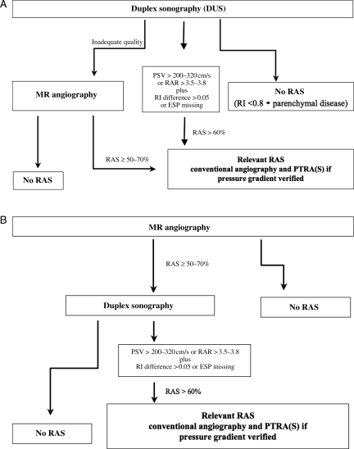
Flow chart of primary renal artery assessment using duplex sonography (A) or magnetic resonance (MR) angiography (B). RAS, renal artery stenosis; PSV, peak systolic velocity; ESP, early systolic peak; RAR, renal aortic ratio; RI, resistance index; RI difference, side to side; PTRA(S), percutaneous transluminal renal angioplasty (with stenting).
Eur Heart J. 2011 July; 32(13): 1590–1598.

Slide 25
Treatment
Appropriate anti-HTN
Smoking cessation
Antidyslipidemic agents
Superiority of surgical intervention vs medical intervention - unproven

Slide 26
Management of Renovascular Hypertension
Medical management
Antihypertensive drug therapy
ACE inhibitors
Angiotensin receptor blockers
Calcium channel blockers
β-Blockers
Central sympathetic agents
α-Blocking agents
Diuretics
Vasodilators
Lipid-reducing agents
Statins
All others cardiovascular risk factor reduction
Withholding smoking

Slide 27
Management of Renovascular Hypertension
Renal revascularization
Endovascular procedures
PTRA
PTRA with stenting
Surgical procedures
Renal artery reconstruction (require aortic approach)
Renal endarterectomy
Transaortic endarterectomy
Resection and reanastomosis, suitable for focal lesions
Aortorenal bypass graft
Extra-anatomic procedures (may avoid direct manipulation of the aorta)
Splenorenal bypass graft
Hepatorenal bypass graft
Gastroduodenal, superior mesenteric, iliac-to-renal bypass grafts
Renal ablative surgery, removal of a “pressor” kidney
Nephrectomy, direct or laparascopic
Partial nephrectomy

Slide 28

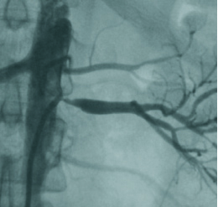
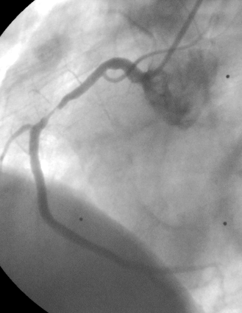
Optimal Medical Treatment
ARB + diuretic to get BP to target
  <140/90 mm Hg
  <130/80 mm Hg with DM
LDL to goal
  Currently <100 (or 70) mg/dl
Diabetes Management
  HbA1c to target (<7%)
Smoking Cessation
Anti-platelet therapy (aspirin +/- clopidogrel/prasugrel)

Slide 29
Evidence-based Medicine revascularization
Reviewed 55 studies
“Almost two thirds of the studies were of poor methodologic quality; none was deemed to be of good quality.”
“More than half of the studies had limited applicability to patients commonly seen in practice or to modern management strategies.”
“No study directly compared angioplasty with stent placement and "aggressive" medical treatment with currently available antihypertensive, antiplatelet, and lipid-lowering agents.”

Slide 30
Angioplasty and STent for
Renal Artery Lesions
NEJM 2009;361:1953-1962

Slide 31
ASTRAL Trial
Substantial atherosclerotic RAS
Suitable for endovascular revascularization
Patient's doctor was uncertain that the patient would benefit from revascularization
Revascularisation
(n = 403)
with angioplasty and/or stent
(and medical treatment)
No revascularisation
(n = 403)
Medical treatment according to local protocol
Notes:
31

Slide 32
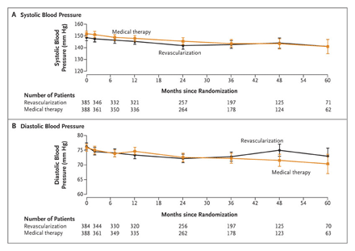
Blood Pressure

Slide 33
Serum Creatinine

Slide 34
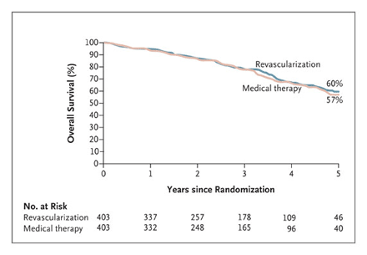
Survival

Slide 35
Procedural Complications
38 periprocedural complications in 31 of the 359 patients (9%) who underwent revascularization (including 1 of the 24 patients in the medical-therapy group who crossed over to revascularization)
Nineteen of these events (in 17 patients) were considered to be serious complications
  Pulmonary edema (1) and Myocardial infarction (1)
  Renal embolizations (5), Renal arterial occlusions (4) and Renal-artery perforations (4)
  Femoral-artery aneurysm (1)
  Cholesterol embolism leading to peripheral gangrene and amputation of toes or limbs (3)

Slide 36
“An important limitation of our trial concerns the population that we studied. As noted, patients were enrolled in the trial only if their own physician was uncertain as to whether revascularization would provide a worthwhile clinical benefit.”
Patient selection (single center)
  508 patients with atherosclerotic renovascular disease
  Of these, 283 patients had renal-artery stenosis of more than 60%
  71 underwent randomization
  24 underwent revascularization outside the trial
    poorly controlled hypertension
    rapidly declining renal function,
  188 received medical treatment only.

Slide 37

RAS and stenting – has the question been answered?

Slide 38
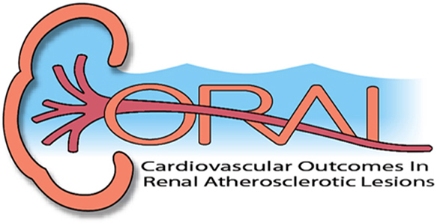
NIH Funded Trial
Prospective, multi-center, two armed, randomized, unblinded survival (time to event) clinical trial
To test the hypothesis that optimal medical therapy + stenting reduces the incidence of cardiovascular and renal events compared to optimal medical therapy alone in patients with systolic hypertension
>100 centers participating
1080 patients

Slide 39
Documented history of systolic hypertension (>155 mm Hg) on 2 or more antihypertensive medications
One or more renal artery stenosis (> 60% stenosis)
All patients receive OMT - Randomization to stent vs no stent
Large and with long term follow-up
Clinically important outcomes
  Cardiovascular or Renal Death
  Stroke
  Myocardial Infarction
  Hospitalization from CHF
  Progressive Renal Insufficiency
  Renal Replacement Therapy
All patients receive ‘optimal medical therapy’

Slide 40
Where do we stand now?
In the absence of trials showing benefit from revascularisation over conventional therapy and the significant risk of complications it seems reasonable to restrict procedures to patients who fail medical therapy with:
  resistant or poorly-controlled hypertension
  recurrent flash pulmonary edema
  dialysis-dependent kidney failure resulting from renal artery stenosis
  chronic renal insufficiency and bilateral renal artery stenosis
  renal artery stenosis to a solitary functioning kidney.
Agency for Healthcare Research and Quality (AHRQ)
Available at www.guideline.gov

Slide 41
Are we asking the wrong question?
Does RAS contribute to progression of vascular disease?
Are there different phases of RAS with potentially different treatments?
Will optimal treatment differ based on patient characteristics?
What constitutes optimal medical therapy?
What outcomes should we measure?
Is the disease more than just BP and A-II?

Slide 42
Summary
RAS is an unusual cause of hypertension but a common finding in patients with vascular disease
RAS identifies patients with very poor prognosis and a high risk of cardiovascular events
Revascularization will benefit selected patients,but convincing evidence of improved cardiovascular outcomes in most patients is lacking
A better understanding of the pathophysiology of RAS is needed in order to design more effective therapies

Slide 43


