Slide 1



Slide 2


Tehran University
of Medical Sciences
Tissue Engineering
The art of producing body parts
Jafar Ai, PhD
Nasrin Lotfibakhshaiesh, MD, PhD
Department of Tissue Engineering
School of Advanced Technologies in Medicine
The 4th International Congress on Recent Advances in Molecular, Cellular and Clinical Medicine
27th October 2013

Slide 4
Tissue Engineering
TE is an interdisciplinary field that applies the principles of engineering and the life sciences towards the development of biological substitutes that restore, maintain, or improve tissue function
Developing living tissue using cells, biomaterials, and signaling molecules
Notes:
Therefore, it is difficult to define or to describe the scope of “tissue engineering" in one sentence. Tissue engineering is a multidisciplinary/interdisciplinary approach to a critical problem in modern medicine – the supply of organs and tissues for transplant. One of the goals of tissue engineering is to develop methods to construct organs in the laboratory that can subsequently be used in medical applications. Another goal is to produce organs or tissues that can be used for research purposes. Such research might include testing new drugs, simulating diseases in order to develop better treatments and reducing the use of animal tissues and organs in biological research in general. incurable genetic defects.
We would recommend that you do Biology, Chemistry, Physics, Anatomy, Biochemistry, Pharmacology, Immunology, Physiology, Surgery, genetic, cellular and molecular, Mathematics, Engineers. Of course, as we are in the anatomy department we would strongly recommend that anatomy should be one of the subjects you should study.

Slide 5
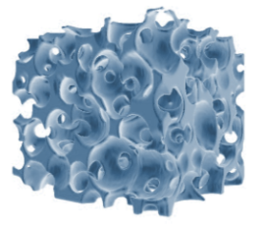
Tissue Engineering consists of
Cells
Living part of tissue
Produces protein
Gives tissue reparative properties
Scaffold
Provides structural support
Provides place for cell attachment and growth
Usually biodegradable and biocompatible
Cell Signaling
Signals that tell the cell what to do
Proteins or mechanical stimulation
Makes use of:
Cell
Growth factors
Scaffold
Proper nutrient supply and waste removal from constructs
(blood vessels) is important part of TE.

Slide 6
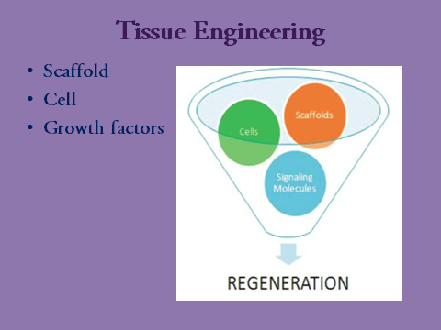
Tissue Engineering

Slide 7
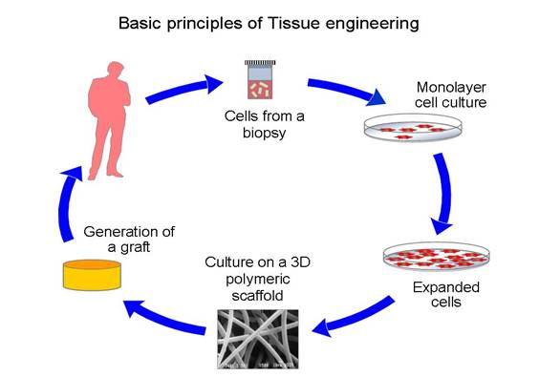
Tissue Engineering

Slide 8
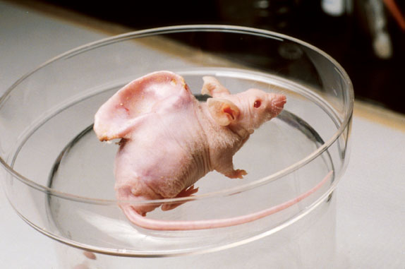
Combination of tools
Cells alone
Carticel - commercially available product
Purified Signaling molecules
Bone Morphogenic Protein for osteoblasts
Inject into tissue to encourage new tissue growth
Cells in Scaffold
Chondrocytes (cartilage cells) in alginate hydrogel
Notes:
Explain carticel - Carticel is a procedure where they remove a piece of cartilage from the knee from a non-load bearing section and send it to a lab where the isolate and expand the cells. Then the company sends the cells back and their placed in a defect in the knee and sew a flap over the defect from the outside of the bone called the periosteum. The cells cost $15,000 and the surgery costs $15,000.
The vacanti mouse was made by taking a scaffold and molding it into the shape of an ear. Then pipetting cartilage cells onto the scaffold and implanting it under the skin of the mouse. The mouse provides the nutrition to the cells and the signaling molecules to help the tissue to grow. What resulted was ear shaped cartilage that could be used to replace an ear that someone lost due to trauma.

Slide 9
Cell sources for tissue engineering applications
Autologous cells
Embryonic stem (ES) cells
Adult stem cells
Notes:
Autologous cells are the ideal choice, as their use circumvents many of the inflammatory and rejection issues associated with a non-self
donor. In the past, one of the limitations of applying cell-based regenerative medicine techniques to organ replacement was the inherent difficulty
of growing certain human cell types in large quantities.
Embryonic stem (ES) cells exhibit two remarkable properties: the ability to proliferate in an undifferentiated, but still pluripotent state
(self-renewal) and the ability to differentiate into a large number of specialized cell types. They can be isolated from the inner cell mass
of the embryo during the blastocyst stage, which occurs 5 days postfertilization. These cells have been maintained in the undifferentiated state for at least 80 passages when grown using current published protocols.
Adult stem cells, especially hematopoietic stem cells, are the best understood cell type in stem cell biology.99 Despite this, adult stem cell
research remains an area of intense study, as their potential for therapy may be applicable to a myriad of degenerative disorders. Within the
past decade, adult stem cell populations have been found in many adult tissues other than the bone marrow and the gastrointestinal tract,
including the brain,100,101 skin102 and muscle.
Research into adult stem cells has, however, progressed slowly, mainly because investigators have had difficulty in maintaining adult
non-mesenchymal stem cells in culture. Some cells, such as those of the liver, pancreas and nerve, have very low proliferative capacity in vitro,
and the functionality of some cell types is reduced after the cells are cultivated. Isolation of cells has also been problematic, because stem
cells are present in extremely low numbers in adult tissue.
The isolation of multipotent human and mouse amniotic-fluid and placental-derived stem (AFPS) cells

Slide 10
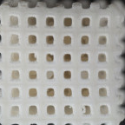
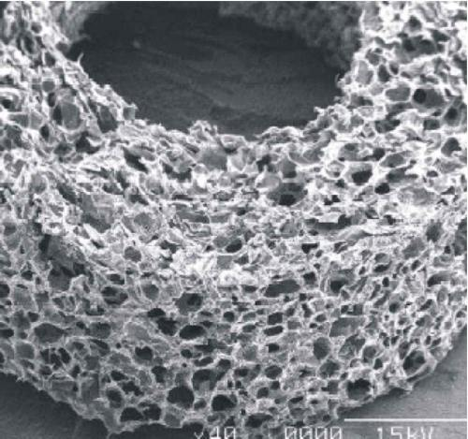
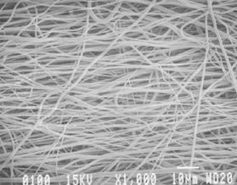
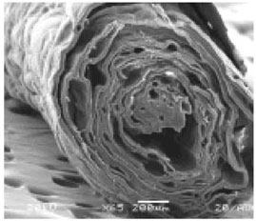
Scaffolds
Various textures and materials
Encourage cells to grow
Allow nutrients to permeate
Won’t harm the patient
Notes:
The selected biomaterial must be capable of controlling the structure and function of the engineered tissue in a predesigned manner by interacting with transplanted cells and/or host cells. In addition, it should be biocompatible, able to promote cellular interaction and tissue development, and it should possess the proper mechanical and
physical properties required for tissue support and function in the body site of interest.
Appropriate biomaterials should be biodegradable and bioresorb`able to support the reconstruction of a completely normal tissue without inflammation. Thus, the degradation rate and the concentration of
degradation products in the tissues surrounding the implant must be maintained at a tolerable level. Such behavior avoids the risk of inflammatory or foreign-body responses that is often associated with
the permanent presence of a foreign material in the body.
In addition, the biomaterial should provide appropriate regulation of cell behavior (e.g. adhesion, proliferation, migration, differentiation) in order to promote the development of functional new tissue. Cell behavior
in engineered tissues is regulated by multiple interactions with the microenvironment, including interactions with cell-adhesion ligands and with soluble growth factors.21 Cell-adhesion-promoting factors (e.g. Arg–Gly–Asp [RGD]) can be presented by the biomaterial itself or incorporated into the biomaterial in order to control cell behavior
through ligand-induced cell receptor signaling processes.
The biomaterials must provide temporary mechanical support sufficient to withstand forces exerted by the surrounding tissue and maintain a potential space for tissue development.
The chosen biomaterial must have properties that allow it to be processed into specific configurations. For example, it must be molded into a tubular shape for urethral replacement, or it must be shaped into a hollow, spherical configuration for bladder replacement. A large ratio of surface area to volume is often desirable to allow the
delivery of a high density of cells. A high porosity, interconnected pore structure with specific pore sizes promotes tissue ingrowth from the surrounding host tissue. Several techniques, such as electrospinning, have been developed, and they allow precise control of porosity, pore size and pore structure.

Slide 11
Notes:
462
Scanning electron microscope view of differently structured biodegradable materials for bone and cartilage reconstruction.
Materials can have a spongiosa-like (a–c), bulk (d–f), fibre-like (g–i) or compound (j–l) structure. From left to right:
detailed aspects of material structure and surface

Slide 12
Types of Scaffolds
Proteins
Silk
Collagen
Natural
Alginate
Chitosan
Polysaccharides
Organic polymers
PGA
PLA
Synthetic
Bioactive glass
Metals
Hydroxyapatite
Inorganic polymers

Slide 13
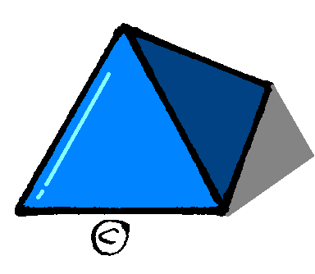
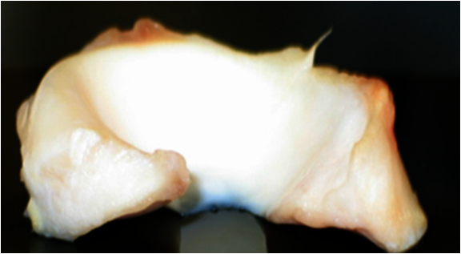
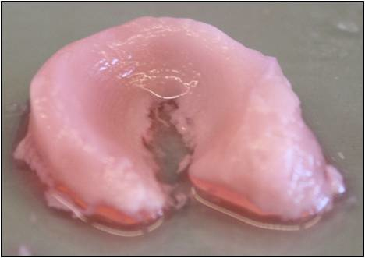
How should be the scaffolds
Biocompatible
Biodegradable
Chemical and Mechanical Properties
Proper architecture
Notes:
Architecture - a picture of a native meniscus. It has a very specific size and shape important to it’s function. Obviously you can’t replace it with something of any random shape like this pyramid. The final picture is tissue engineered meniscus made in the proper size and shape

Slide 14
  The influence of environments on cell behavior
Cell environment can dramatically
affect cell spreading/contraction
and associated intracellular signalling.
Most cells in vivo require cues
from a surrounding 3D environment
to form functional tissue.
s
Notes:
470
In vivo, cells are surrounded by a biological matrix comprising of tissue-specific combinations of insoluble
proteins (e.g. collagen and elastin), glycosaminoglycans (e.g. hyaluronan) and inorganic crystals (in
bone) that are collectively referred to as the extracellular matrix (ECM). The varied composition of the ECM components not only provides not the physical architecture and mechanical strength to the tissue, but also contains a reservoir of cell-signalling motifs (ligands) and growth factors that guide cellular anchorage and behaviour.
The influence of
two-dimensional (2D) and threedimensional
(3D) environments on
cell behaviour. 2D substrates (e.g.
cell culture plastic; (a)) and 3D
microporous tissue scaffolds (b),
have very different influences on
cell behaviour when compared to
nanostructured environments, such as
extracellular matrix (ECM) or nanofibrous
scaffolds (c). Nanostructured
environments provide, topographical,
biological and mechanical inputs in
three dimensions, which can dramatically
affect cell spreading/contraction
and associated intracellular signalling.
Most cells in vivo require cues
from a surrounding 3D environment
to form functional tissue.

Slide 15
Biological response to material surfaces
Notes:
471
Upon implantation into a biological system, water molecules interact with the material’s surface, closely
followed by protein adsorption. Material surface-bound proteins provide the recognition sites that enable cell
adhesion via specific cell receptors (e.g. integrins). The chemistry and topography of the surface affects the abundance, conformation, orientation
and distribution of the surface-bound protein. These factors are critical for cellular recognition of protein binding sites, attachment and subsequent behaviour

Slide 16
Tissue Engineering
Notes:
473
Schematic of the interaction between water molecules and surfaces. a Water molecules tightly bind onto
polar (hydrophilic) surfaces, disrupting water self-association.
The proteins in proximity of these surfaces are trapped within bound water layers. b Water molecules tend to reduce their
contact with non-polar (hydrophobic) interfaces, compelling proteins to associate with non-polar surfaces via hydrophobic
interactions

Slide 17
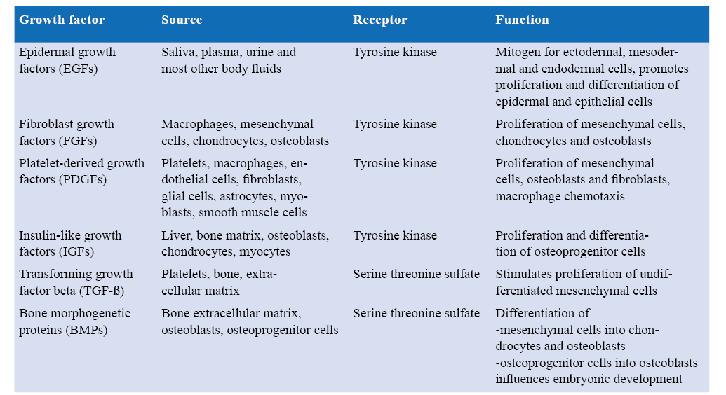
Biomolecules in tissue engineering

Slide 18
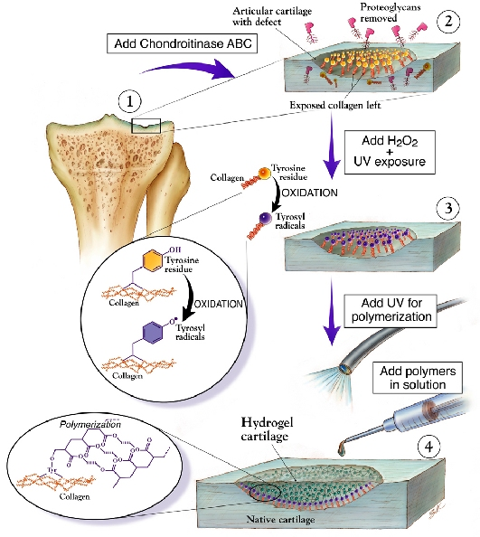
Cartilage Tissue Engineering

Slide 19
Tissue Engineering

Slide 20
Nerve conduits for regeneration of the PNS and CNS
Notes:
816
The main purpose of tissue engineering is to improve or replace the biological functions of damaged or
missing tissues or organs. In order to enhance the efficiency of tissue engineering, scaffolds with biocompatible
and biodegradable materials are normally used in combination with biological active molecules, cells or tissues

Slide 21
Regeneration of the CNS
Notes:
819
The various systems for the regeneration of the CNS. a Growth factors or proteins of interest incorporated in
biomaterials made up the scaffold that support growth and survival of the cells. b Encapsulation of cells genetically engineered
to release growth factors or proteins of interest can also avoid an immune response in vivo. c The combination of the
biomaterial scaffold and cell encapsulation approach allows more sophisticated manipulation of microenvironment that increases
the efficiency of implantation.

Slide 22
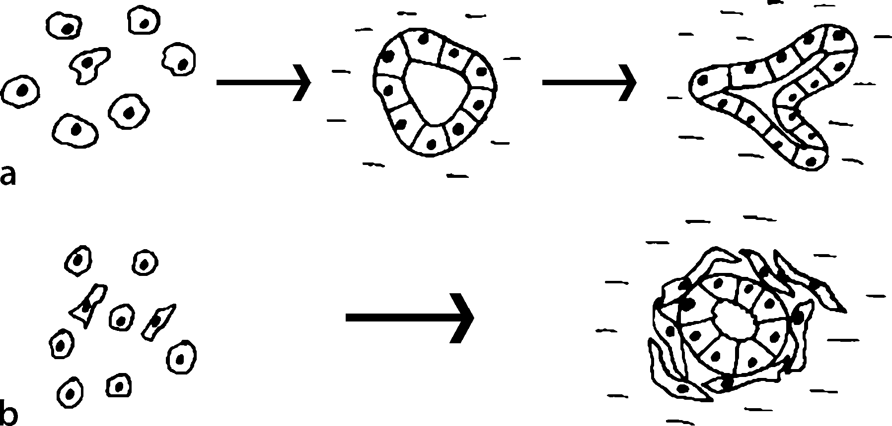
Tissue Engineering
Notes:
Page 63

Slide 23
Formation of functional renal tissue
Notes:
872
Formation of functional renal tissue in vivo. a Renal device. b Tissue-engineered renal unit shows the accumulation
of urine-like fluid. c There was a clear unidirectional continuity between the mature glomeruli, their tubules, and the
polycarbonate membrane
To determine whether renal tissue could be formed using an alternative cell source, nuclear transplantation
(therapeutic cloning) was performed to generate histocompatible tissues, and the feasibility of engineering
syngeneic renal tissues in vivo using these cloned cells was investigated [25]. Nuclear material
from bovine dermal fibroblasts was transferred into unfertilized enucleated donor bovine eggs. Renal
cells from the cloned embryos were harvested, expanded in vitro, and seeded onto three-dimensional
renal devices (Fig. 60.1a).

Slide 24
Reconstitution of kidney structures
Notes:
874

Slide 25
Tissue Engineering

Slide 26
Tissue Engineering
Part A General Aspects
- Economic Modeling and Decision Making in the Development
and Clinical Application of Tissue Engineering
- Ethical Issues in Tissue Engineering
- Sourcing Human Embryonic Tissue
- Tissue Engineering and Regenerative Medicine.
Part B Biological Considerations
- Cytokine Signaling in Tissue Engineering
-` Immune System Issues

Slide 27
Tissue Engineering
Part C Engineering Strategies Contents
Engineering at the Genetic and Molecular Level
- Biomolecule Use in Tissue Engineering
Engineering at the Cellular Level
- Embryonic Stem Cell Use
-Mesenchymal Stem Cells Use
- Stem Cell Plasticity
Engineering at the Tissue Level
- Bone Tissue Engineering
-Cartilage Engineering
- Muscle Tissue Engineering
-Tendon and Ligament Tissue Engineering
- Neural Tissue Engineering
- Adipose Tissue Engineering
- Intervertebral Disc Tissue Engineering
- Skin Tissue Engineering
- Dental Tissue Engineering
- Mucosa Tissue Engineering
- Tissue Engineering of Heart Valves
-Blood Vessels Tissue Engineering
Engineering at the Organ Level
-Breast Tissue Engineering
-Bioartificial Liver
- Pancreas Engineering
- Tissue-Engineered Urinary Bladder

Slide 28
Tissue Engineering
Part D Technical Aspects
- Biomaterials
- Biomaterial-Related Approaches: Surface Structuring
- Biomaterial and Matrix
- Hydrogels for Tissue Engineering
- Scaffold Structure and Fabrication
-Laboratory Procedures – Culture of Cells
-Bioreactors in Tissue Engineering
- The Evolution of Cell Printing
-Micro environmental Determinants of Stem Cell
- Perfusion Effects and Hydrodynamics
Part E Clinical Use
- Tissue Engineering Applications in Neurology
- Tissue Engineering in Maxillofacial Surgery
- Tissue Engineering and Its Applications in Dentistry
- Regeneration of liver Tissues
-Regeneration of Renal Tissues
- Tissue Engineering Applications in Plastic Surgery
- Tissue Engineering Applications for Cardiovascular
- Tissue Engineering Applications in Orthopedic Surgery
- Tissue Engineering Applications in Endocrinology
- Regenerative Medicine Applications in Hematology
- The Reconstructed Human Epidermis Models

Slide 29
Alejandro Amézquita Biomechanics,
Tami Brown-Brandl Bioenergy, biomaterials, | U.S. Meat Animal Research Center, Nebraska | tami.brownbrandl@ars.usda.gov
Judith Burnfield Biomechanics, biokinesiology | Madonna Rehabilitation Hospital, Lincoln, NE | jburnfield@madonna.org
Roger Eigenberg Livestock environment | U.S. Meat Animal Research Center, Nebraska | roger.eigenberg@ars.usda.gov
Qi Fang Bioprocess engineering | Banner Pharmacaps Inc. | QFang@banpharm.com
Sandun Fernando Bioenergy, biomaterials, | Mississippi State | sf99@abe.msstate.edu
Girish Ganjyal Food and bioprocess engineering | Midwest Grain Products, Inc. | girish.ganjyal@mgpingredients.com
Aristippos Gennadios Food and bioprocess engineering | Cardinal Health, Inc. | arispao@aol.com
Viswasrao Ghorpade Cereal and food processing | Kellogg Company | Viswas.Ghorpade@kellogg.com
John Gilley Livestock waste management, | 251 LWC 472-2975 | john.gilley@ars.usda.gov
Junjie Guan Food and bioprocess engineering | Watson, Inc., Connecticut | junjie.guan@watson-inc.com
G. LeRoy Hahn Livestock environment | U.S. Meat Animal Research Center, Nebraska | hahn@email.marc.usda.gov
Terry Howell Irrigation engineering | USDA-ARS, Bushland, Texas | tahowell@cprl.ars.usda.gov
Keum Taek Hwang Food processing | Seoul National University, South Korea | keum@snu.ac.kr
Daniel Miller Biomechanics | 104 LWC 402-472-0741 | dan.miller@ars.usda.gov
John Nienaber bioprocess engineering | U.S. Meat Animal Research Center, Nebraska | john.nienaber@ars.usda.gov
Lijun Wang Bioprocess engineering | North Carolina A & T State University | lwang@ncat.edu
Bryan Woodbury biomaterials | U.S. Research Center, Nebraska | bryan.woodbury@ars.usda.gov

Slide 30
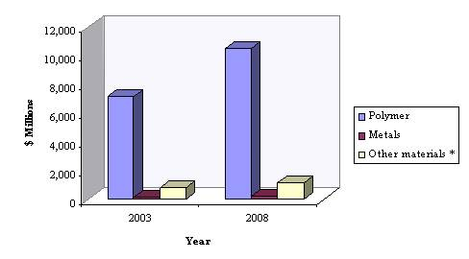
Tissue Engineering

Slide 31
Tissue Engineering
Notes:
542

Slide 32
Tissue Engineering
Notes:
654

Slide 33
Classification of publications according to clinical application
Notes:
806

Slide 34
Classification of publications according to tissue
Notes:
807

Slide 35
Classification of publications according to organs
Kidney
Pancreas
Joints
Heart
Liver
Notes:
807

Slide 36
Tissue Engineering
Growth factor Source Receptor Function
-Epidermal growth
factors (EGFs)
-plasma, urine and
most other body fluids
-Tyrosine kinase
-Mitogen for ectodermal, mesodermal
and endodermal cells, promotes
proliferation and differentiation of
epidermal and epithelial cells
-Fibroblast growth
factors (FGFs)
Macrophages, mesenchymal
cells, chondrocytes, osteoblasts
-Tyrosine kinase
Proliferation of mesenchymal cells,
chondrocytes and osteoblasts

Slide 37
Tissue Engineering
-Platelet-derived growth
factors (PDGFs)
-Platelets, macrophages, endothelial
cells, fibroblasts,
glial cells, astrocytes, myoblasts,
smooth muscle cells
-Tyrosine kinase
Proliferation of mesenchymal
cells, osteoblasts and fibroblasts,
macrophage chemotaxis
-Insulin-like growth
factors (IGFs)
-Liver, bone matrix, osteoblasts,
chondrocytes, myocytes
-Tyrosine kinase
Proliferation and differentiation
of osteoprogenitor cells

Slide 38
Tissue Engineering
-Transforming growth
factor beta (TGF-ß)
-Platelets, bone, extracellular
matrix
-Serine threonine sulfate Stimulates
proliferation of undifferentiated
mesenchymal cells
-Bone morphogenetic
proteins (BMPs)
Bone extracellular matrix,
osteoblasts, osteoprogenitor cells
-Serine threonine sulfate
-Differentiation of
-mesenchymal cells into chondrocytes
and osteoblasts
-osteoprogenitor cells into osteoblasts

Slide 39
Tissue Engineering

Slide 40
Tissue Engineering

Slide 41
Tissue Engineering
Notes:
643

Slide 42
Tissue Engineering

Slide 43
Tissue Engineering
Notes:
687

Slide 44
Tissue Engineering

Slide 45
Tissue Engineering
HPLC High-performance liquid chromatography,
ELISA enzyme-linked immunosorbent assay,
IRMA immunoradiometric assay, PCR polymerase chain reaction
Cell counter
Cell number, cell volume
Colorimetric assays
Cell viability, calcium phosphate content
Fluorescence staining
Cytoskeletal proteins, minerals
Immunostaining
Cell and matrix components
Gel electrophoresis
Proteins, nonproteinaceous components
HPLC
Proteins, nonproteinaceous components

Slide 46
Tissue Engineering
Capillary electrophoresis
Proteins, nonproteinaceous components
Western blot
Proteins components
ELISA
Proteins, nonproteinaceous components
IRMA
Proteins, nonproteinaceous components
Radioimmunassay
Proteins, nonproteinaceous components
DNA analysis (PCR)
DNA
Gene chips
Gene composition

Slide 47
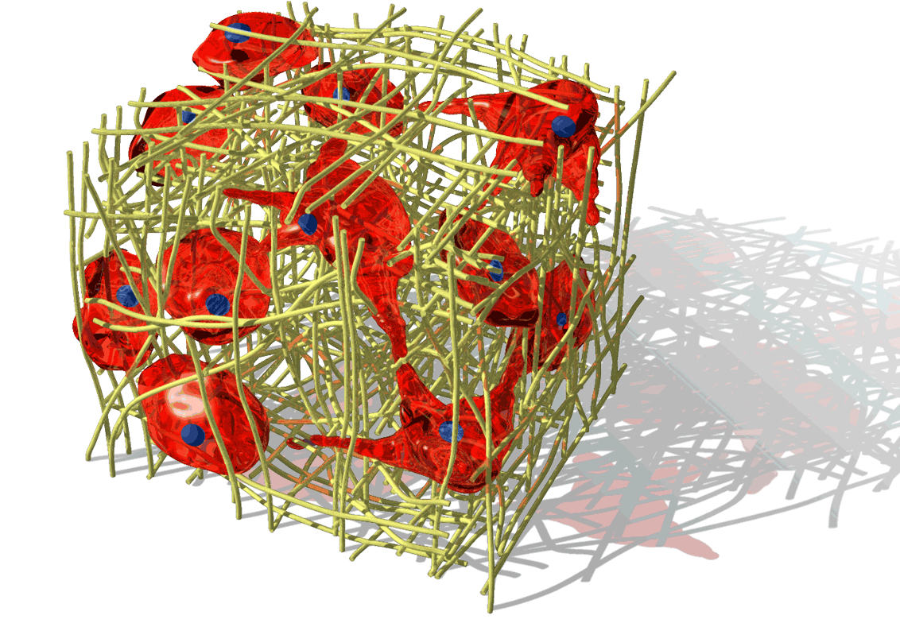
Thank you for your attention

