Slide 1
IN THE NAME OF GOD

Slide 2
Ulcerative Colitis in children Diagnosis and treatment
Dr. Gholam Reza Khatami

Slide 3
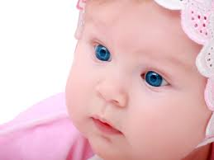
Ulcerative colitis is a chronic gastrointestinal disease
Given modern treatment, medical management is not curative

Slide 4
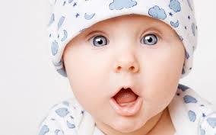
Clinical characteristics
Gastrointestinal symptoms
Extaintestinal manifestations
Hepatobiliary
PSC , AH
Joints
Knee, Wrist, Hip, Ankle, Elbow
Ankylosing spondilitis
Skin
Pyoderma gangrenosum
Erythema nodosum
Occular disorders
Episcleritis, Uveitis

Slide 5
Diagnosis
History
weight loss, amenorrhea
Abdominal pain
Underweight
Diarrhea
Rectal bleeding

Slide 6
Physical examination
Abdominal sensitivity
Perianal
skin tag, fistula
Skin lesions

Slide 7
Laboratory studies in suspected UC
CBC, ESR
Electrolytes, Protein, Albumin, LFT
Serum Iron, IBC, Ferritin
Stool for enteric pathogens
Stool for clostridium difficile toxins
Stool for ova and parasites
PANCA, ASCA, Anti-ompC
Fecal calpotectin

Slide 8
Imaging
UGI Series
Small bowel follow through
CT
MR enterography
Capsule endoscopy

Slide 9
Endoscopy
Disease starts from anal verge
Mild form
Active form

Slide 10
Management
About 20-30 % of patients have spontaneus improvement
Nutrition (Short chain fatty acid, n-3 fatty acid)
Corticosteroids
5-Aminosalicylates
Immunomodulators
Biologics
Probiotics
Leukocyte Apheresis
Surgery

Slide 11
Corticosteroids
One year
complication
Budesonide ( Oral, Enema)
Complete reaction 57%
Steroid dependant 14%
Colectomy 29%

Slide 12
5- Aminosalicylates
Sulfasalazine
G6PD
5.ASA
Mesalamin, Olsalazin, Balsalazide
Delayed – release ASA
Pentasa, Asacol

Slide 13
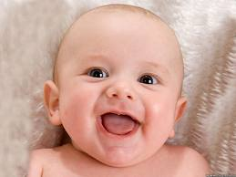
Management of proctitis or left-sided colitis
Mesalamin
Suppository better than oral
Enema better than rectal corticosteroid
Foam

Slide 14
Management of moderate to severe forms of UC
Corticosteroid
Remission
2 weeks (2 doses / day)
4 weeks (one dose / day)
Taper Mesalamin
Clinical 85%
Endoscopic 40%
Histologic 15%

Slide 15
Management of moderate to severe forms of UC (Cont)
Corticosteroid resistant or dependant
Azathioprine + Steroid
Metotrexate + Steroid
Ciclosporine delaying surgery
Infleximab

Slide 16
Probiotics, Prebiotics
Decreases the secretion of proinflammatory cytocaines
( inteferon γ , TNF – α , IL- 12 )
Increases anti inflammatory cytocaine
( Il 10 )
Saccharomyces boulardii
mild form of UC 61% remission
add to standard medical treatment 93% remission

Slide 17
Surgery
After 5 years 19% colectomy
2 stages
Subotal colectomy + ileostomy
Ilial pouch anal

Slide 18
Pouchitis
Metronidazole, Ciprofloxacin
5 - ASA
Coticosteroids
Probiotics
Antitumor necrosing factor
Resection

