Slide 1
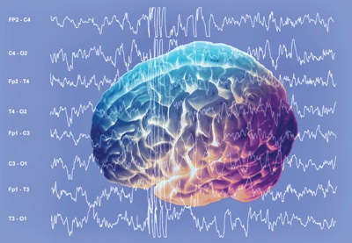
DC Potential and the Brain
Ali Gorji
Epilepsy Research Center
Münster University

Slide 2
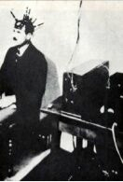
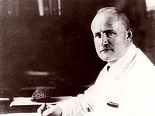
Hans Berger became the first human electroencephalographer by recording the EEG signals used non-polarizable clay cylinder electrodes and Edelmann’s small string galvanometer.
1924
Hans Berger (1873-1941)

Slide 3
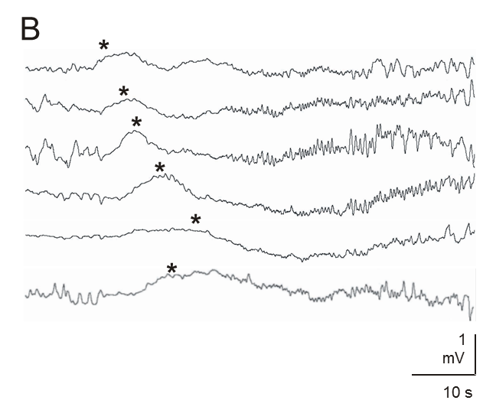
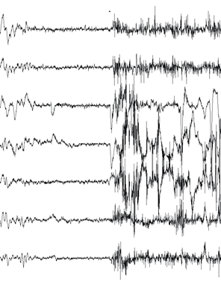
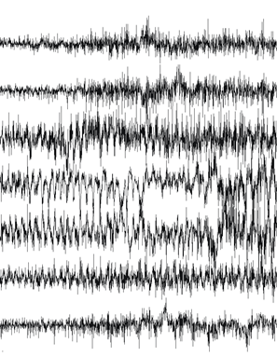
DC vs. AC Potentials
C

Slide 4
Spreading depression
Horizontal propagation
Front of excitation
Zone of depression
Vertical propagation
I
DC4
II
III
DC3
IV
DC2
V
2 mV
VI
DC1
10 s
KCl

Slide 6
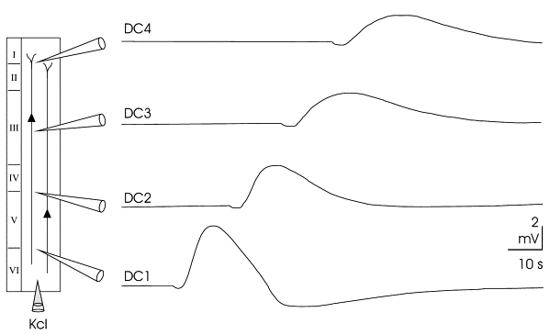
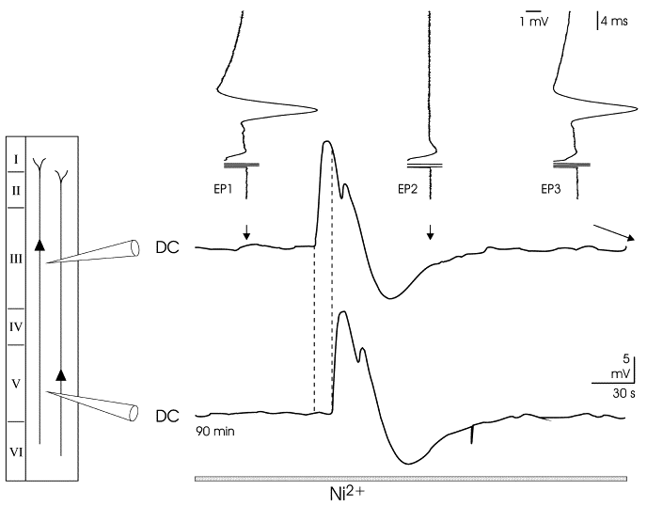
Spreading depression recordings from living human brain tissues
Gorji et al., 2001

Slide 7
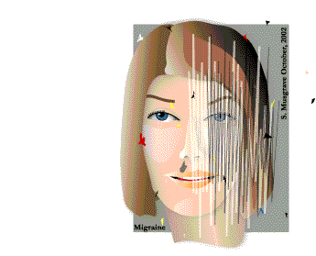
Migraine aura is the human equivalent of cortical spreading depression

Slide 8
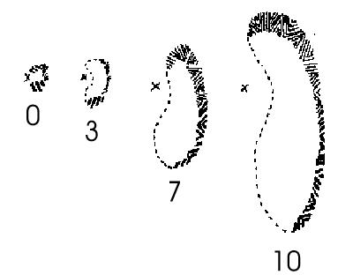
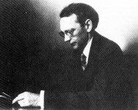
Karl Spencer Lashley (1890-1958)

Slide 10
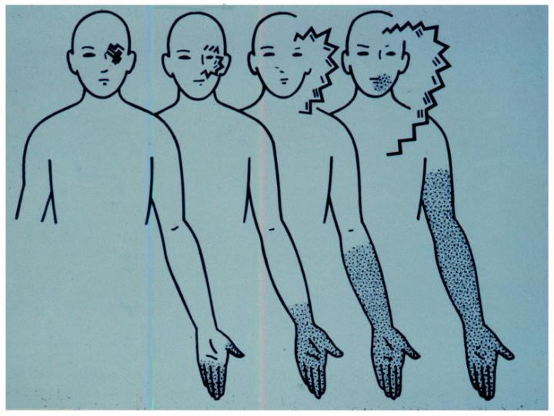

Slide 11
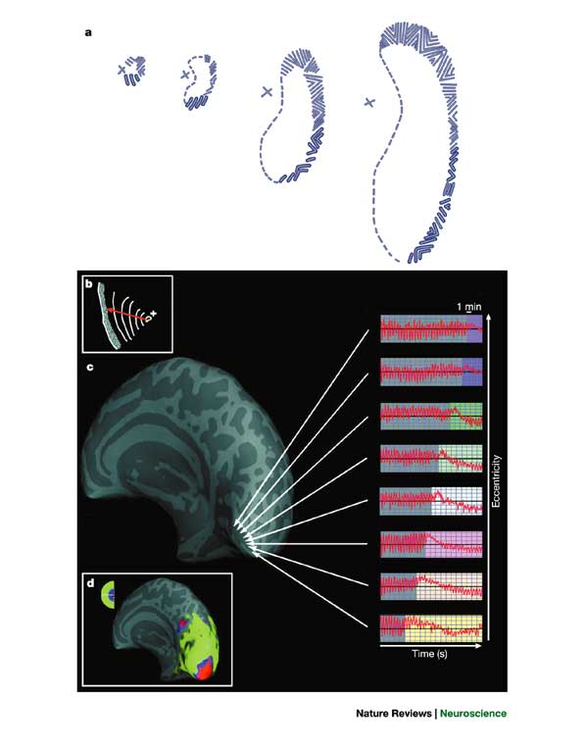
Hadjikhani et al. 2001
PNAS

Slide 12
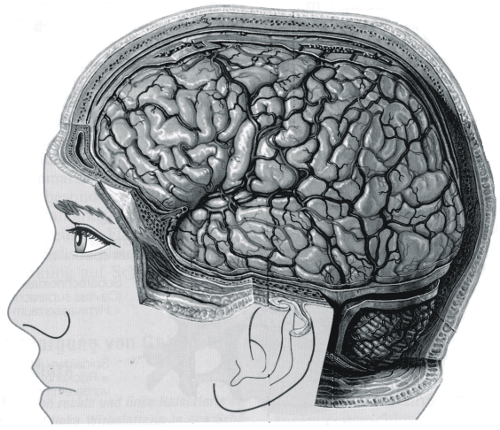
100
µV
1 s

Slide 13
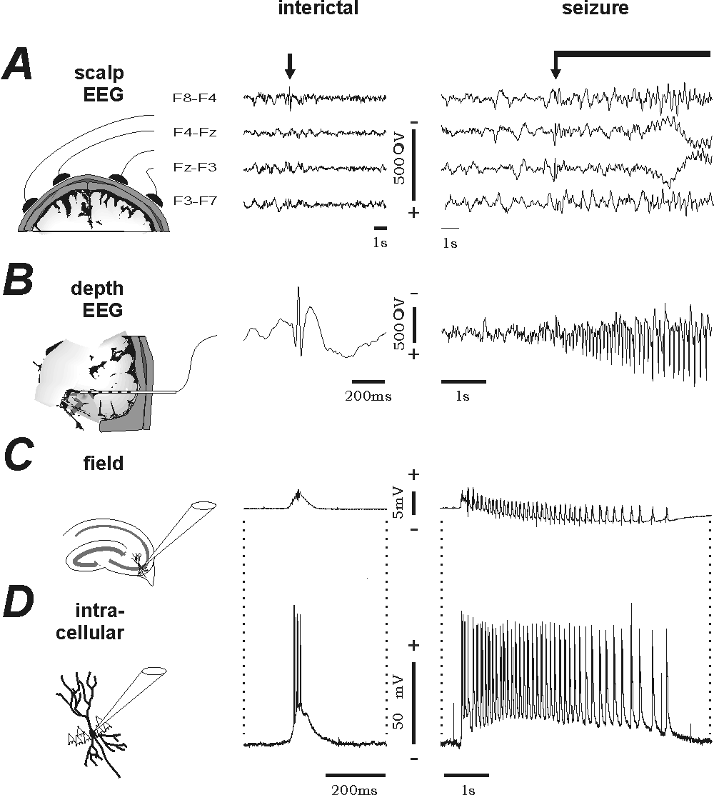

Slide 14
DC vs. AC Potentials

Slide 15
DC Potential in Acute Brain Injury

Slide 16
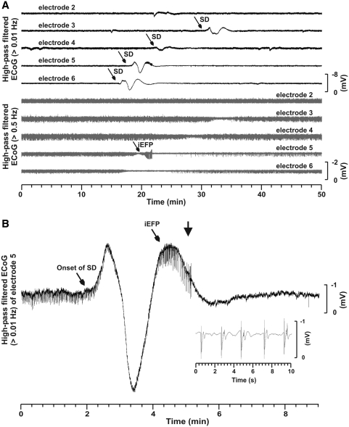
Spreading Depression and Epileptic Field Potentials in Human Brain
Dreier, et al., 2012

Slide 17
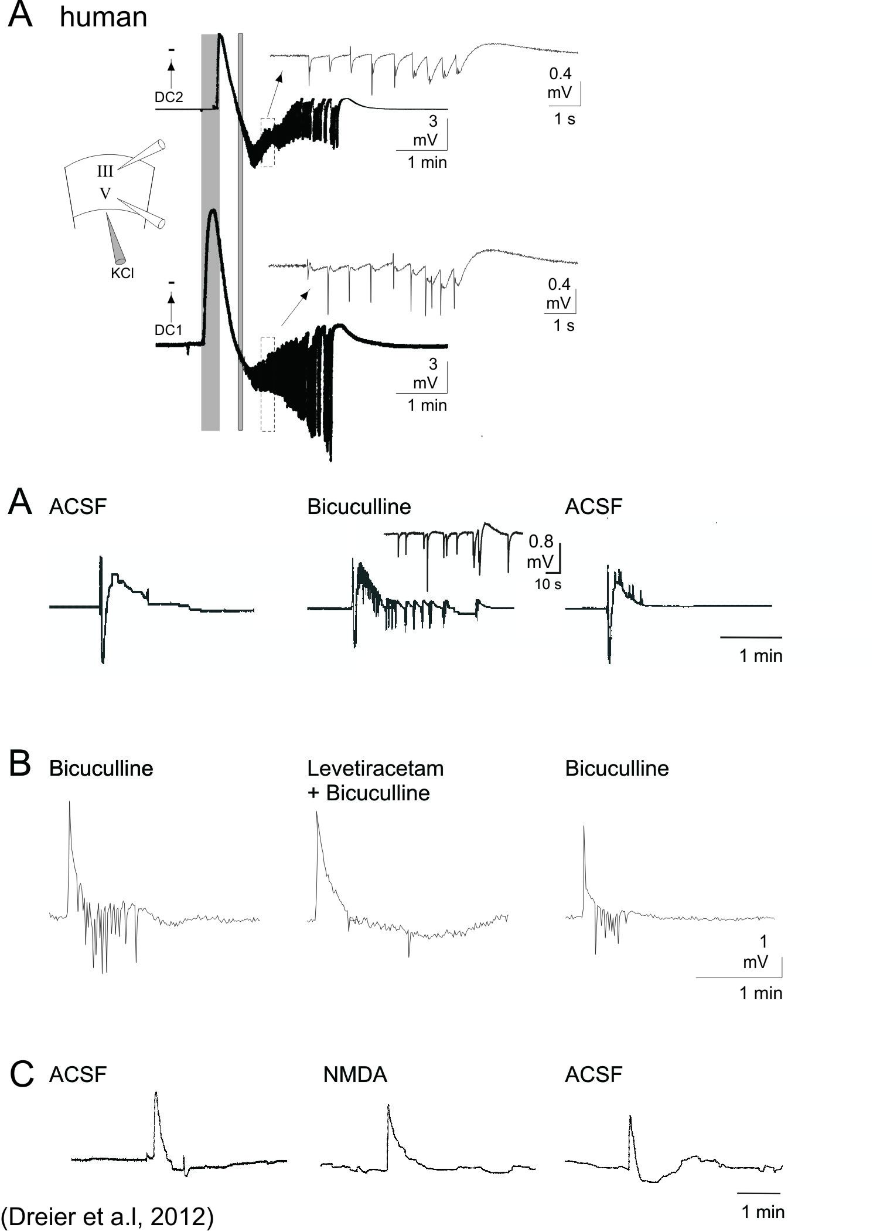

Slide 18
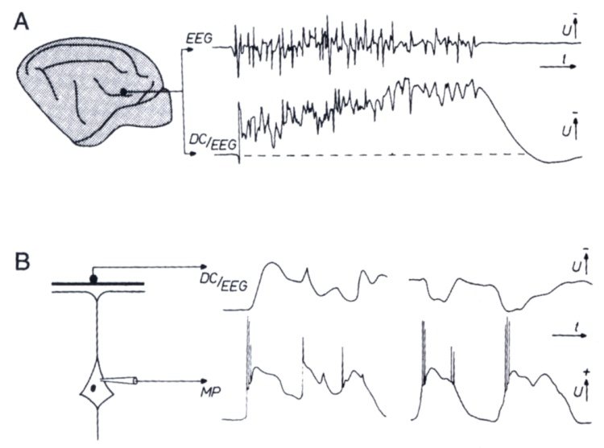
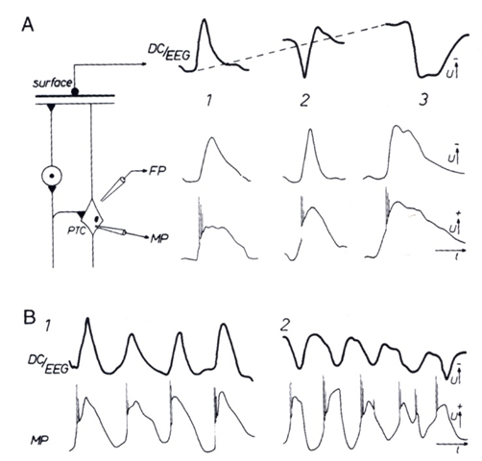
DC Potential Changes and EEG

Slide 19
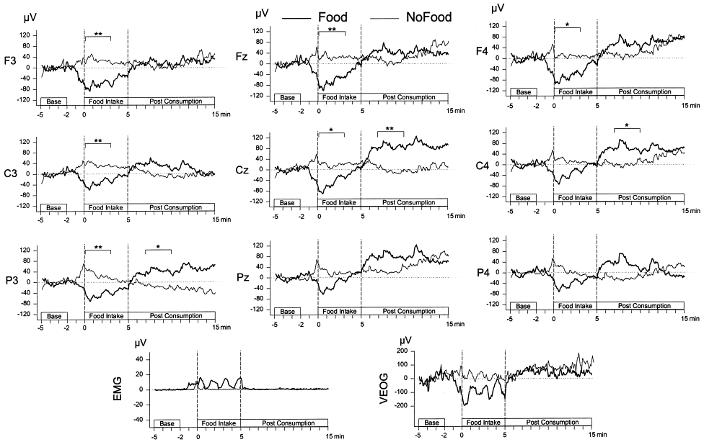
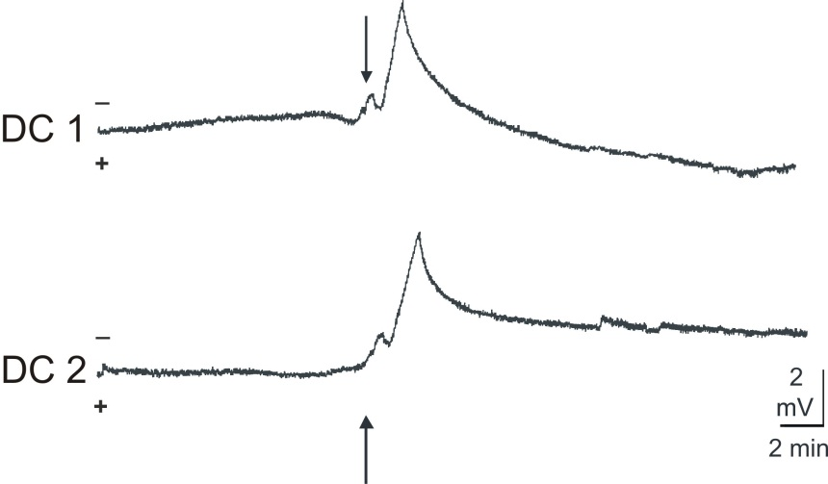
Cortical DC Potential Associated with Food Intake in Hungry humans and Rats
Rats Human
(Khaleghi et al., 2009) (Schmitt et al., 2001)

Slide 20
Conclusion
DC potentials of the brain comprise sustained displacements of the baseline as well as fluctuations between 0 Hz and 100 Hz including the frequency range of the conventional EEG.
Neurons, glial cells and blood-brain barriers forming functional units may act as a compound generator of DC potentials.
The slow components of neocortical DC potential shifts reflect changes in the level of excitation and excitability of the cortex.
Negative DC fluctuation was also observed accompanied by ictal discharges in human brain.
Negative DC deflections were reported in patients suffering from hypoxic brain injuries .
Spreading depression, a negative DC deflection, has been shown to play crucial role in aura phase of migraine with aura.
Psychophysiological studies revealed that DC potentials are highly sensitive to different information processing and to personal characteristics of the people.
It seems promising to extend DC potentials studies to provide further insights into mechanisms of brain function and dysfunction.

Slide 21
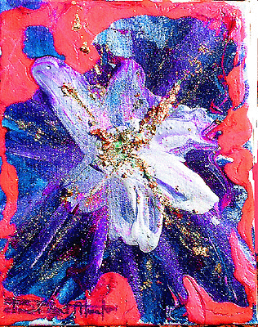
Thanks for your attention

Slide 22
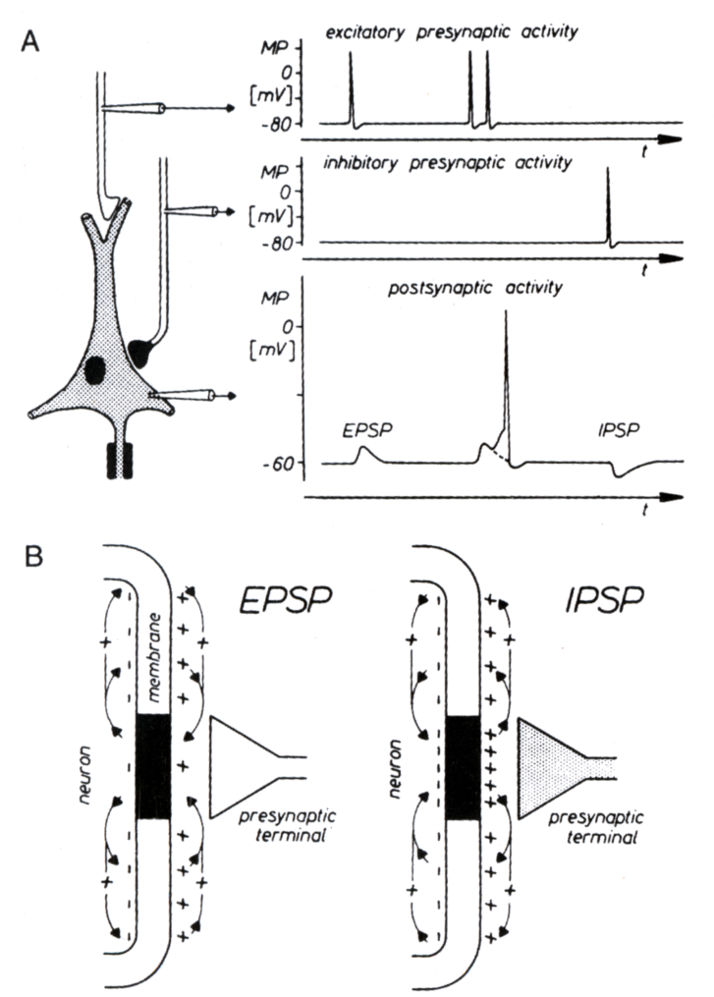
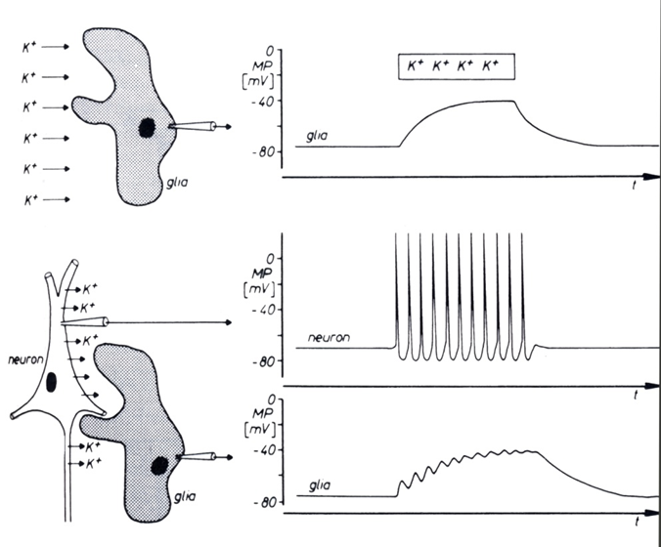
Basic Mechanisms Underlying Generation of Potentials

Slide 23
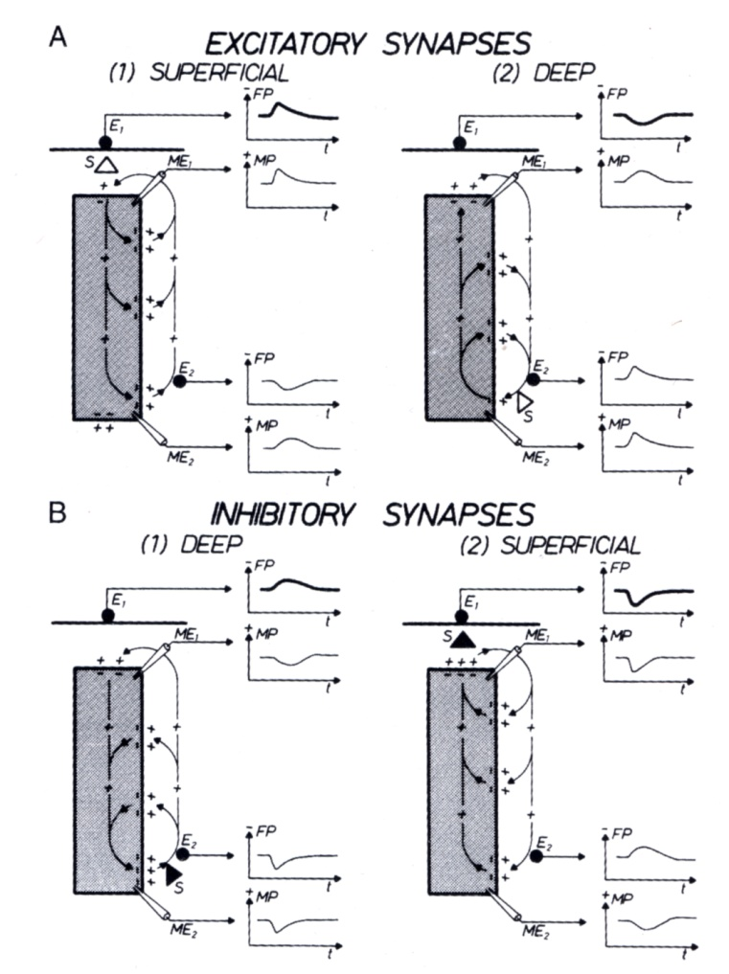
Membrane Potential Changes and Field Potentials

Slide 24
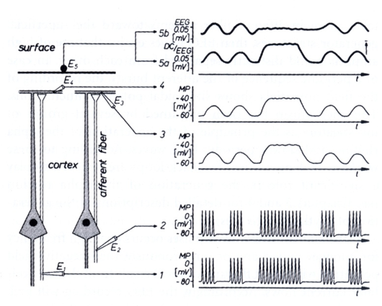
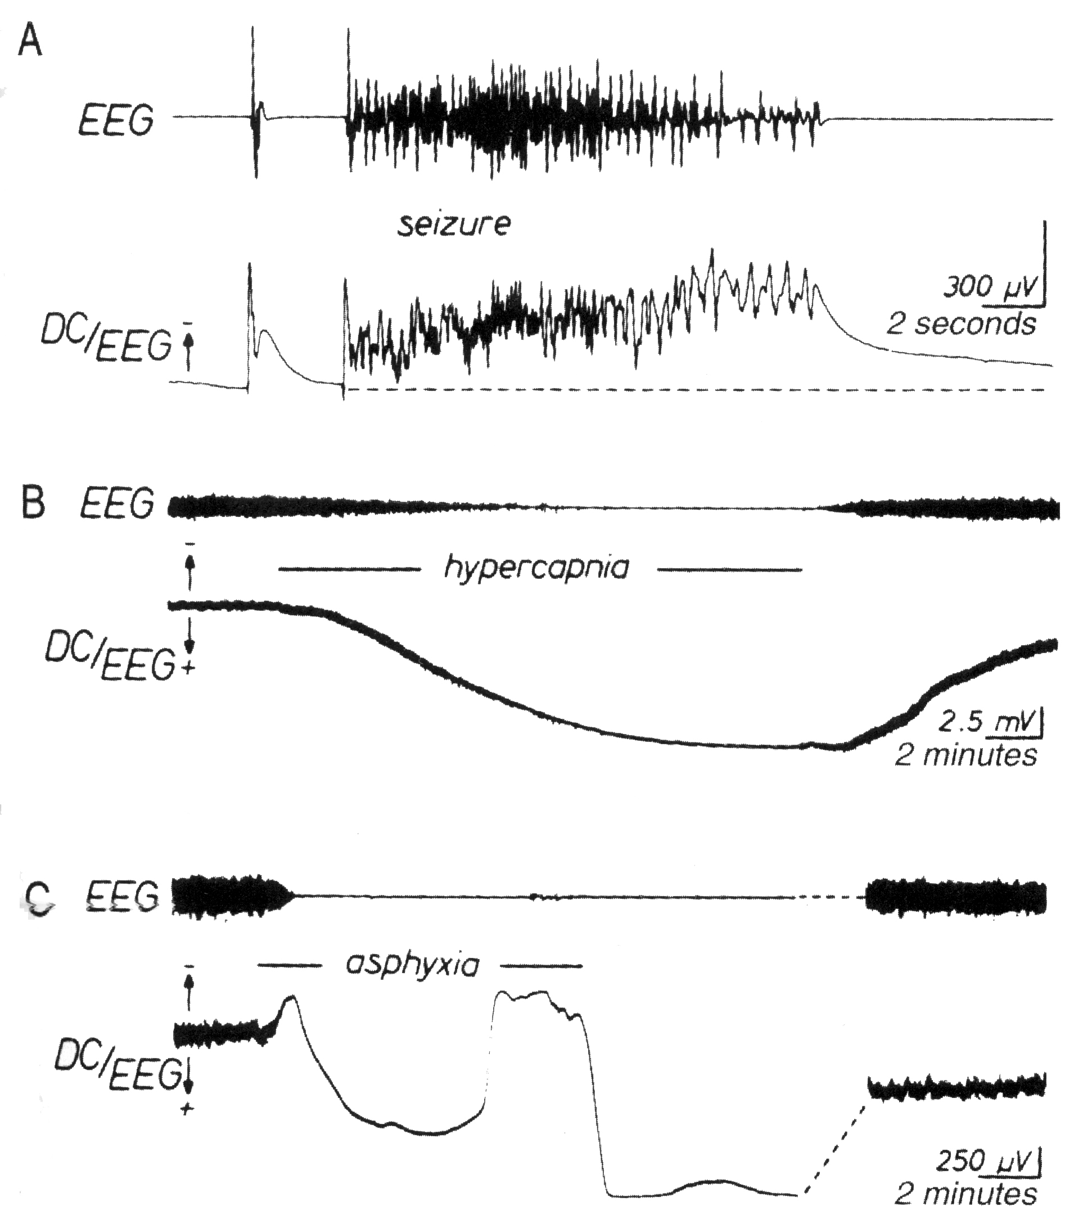
Principle of Wave Generation

Slide 25
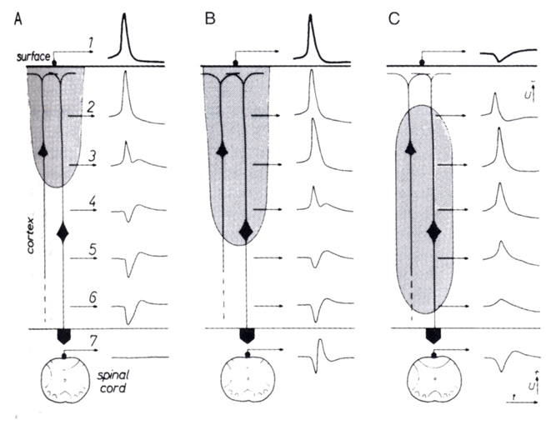
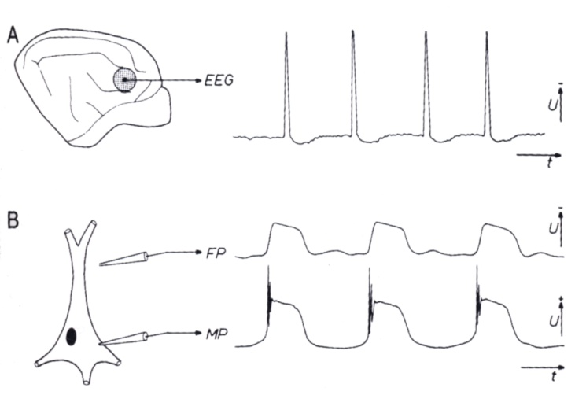
EEG and Membrane Potential Changes

Slide 26
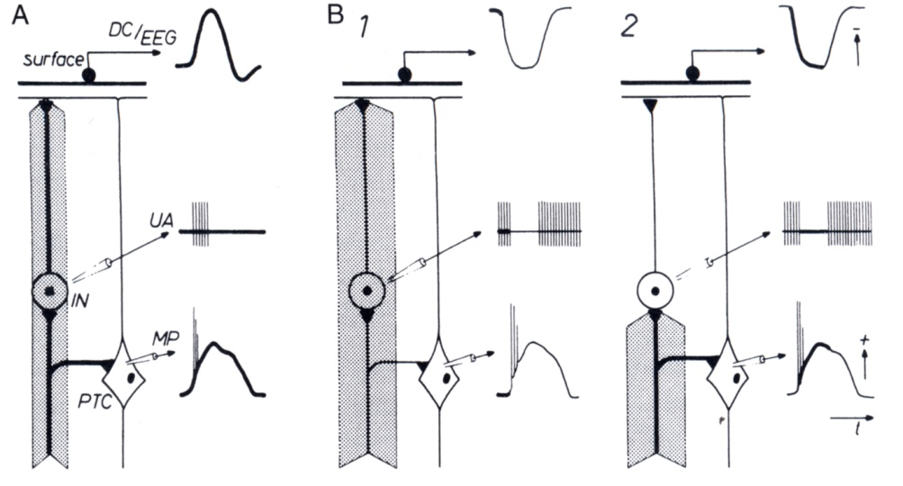

Slide 27
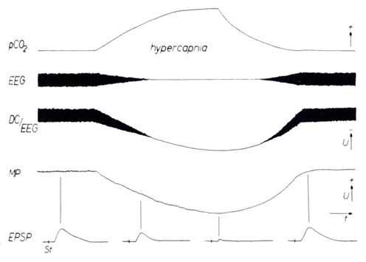
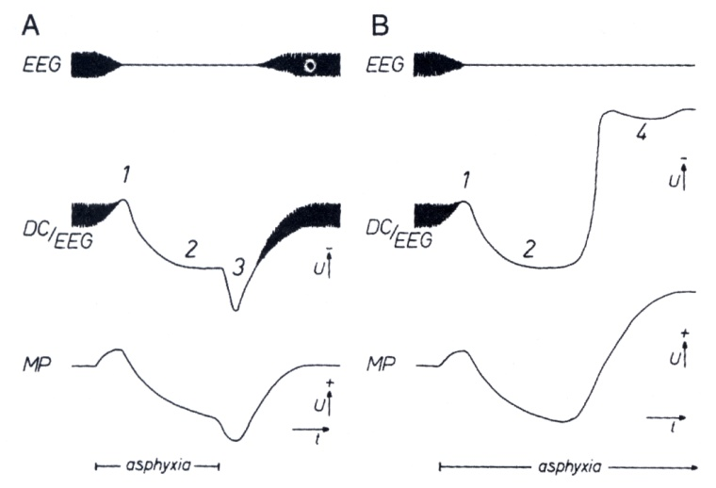
Changes of DC/EEG during Asphyxia and Hypercapnia

