Slide 1
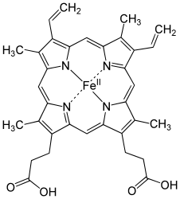
Disorders of heme biosynthesis, clinical features and laboratory findings in prophyrias Dr. Saman Hosseini 29.10.2013, Imam Khomeini University Hospital

Slide 2
Clinical aspects of the acute attack illustrated by two different cases

Slide 3
Case 1: The unknown AIP gene carrier • Stress • Lack of sleep • Alcohol At admission to emergency ward: • 2 days history of abdominal pain • Constipation • Circulatory stable • Free from fever • Laboratory workup: → CRP,Creatinine, B-Hb – within normal range → Hyponatremia 126-130 mmol/L (137-147 mmol/L) → ALT 2,0 µkat/L (<0,76); AST 3,2 µkat/L (<0,61) Sent home

Slide 4
Case 1: continued Day 2 -3 Readmission to emergency ward: ● sever abdominal pain ● CT scan “atypical appendicitis” or “Meckel’s diverticulitis” Admitted to surgical ward for observation Laparascopic appendectomy ● Anesthesia: Thiopental, Sevoflurane, fentanyl, Suxamethonium ● Patholigist assessment: No appendicitis

Slide 5
Case 1: continued Day 3 -6 Sever abdominal pain : ● Postoperative bleeding ● Reoperated (thiopental, sevoflurane) ● Hyponatremia 113 – 106 mmol/L (137-147) ● Agitation and confusion ● Hypertension and tachycardia Diagnosis??

Slide 6
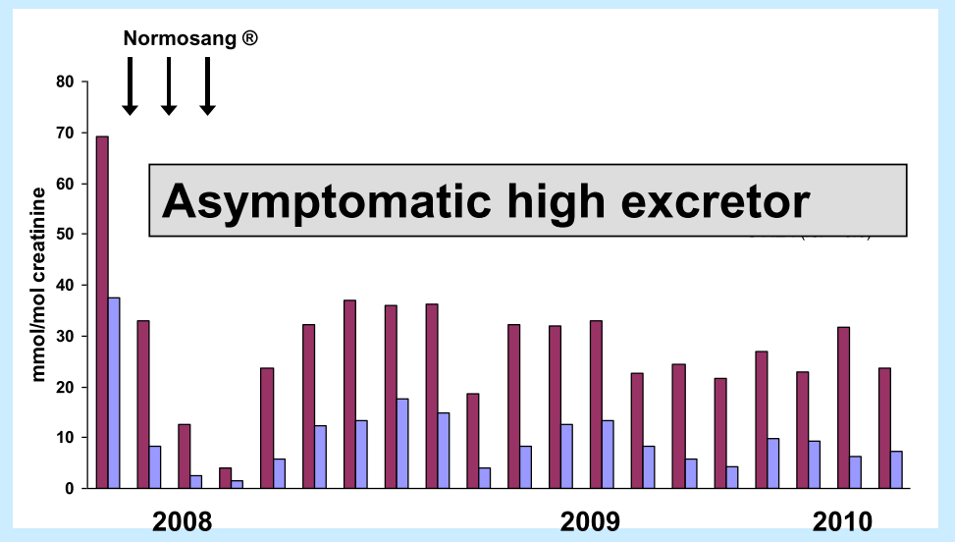
Case 1: continued Day 7

Slide 7
Case 2: the known AIP gene carrier ● two pregnancies (at age 32 and 35) ● asymptomatic high excretor since first pregnancy At admission to emergency ward: ● 3.5 days with acute abdominal pain ● constipation ● circulatory stable ● free from fever ● Laboratory workup: CRP, Creatinine, B-Hb – within normal range U-HCG neg ● CT scan: obstipation

Slide 8
Case 2: the known AIP gene carrier ● two pregnancies (at age 32 and 35) ● asymptomatic high excretor since first pregnancy At admission to emergency ward: ● color of urine? Slightly pink ● treated successfully with ketobemidon Diagnosis Obstipation Sent home

Slide 9
Case 2: continued Day 2 Readmission to emergency ward: ● severe abdominal pain ● dark urine ● circulatory stable ● fever ● laboratory workup: → Routine tests normal Referred to Internal Medicine ward: ● glucose infusion ● ketobemidon ● Acute attack discussed – no sample taken

Slide 10
Case 2: continued Day 3 - 4 Looking for differential diagnosis: ● Referred to gynecologist Diagnosis : “Abdominal pain” ● Referred to surgeon Hyponatremia is observed Diagnosis : “Obstipation” ●Urine sample taken Laboratory workup : high PBG excretion

Slide 11
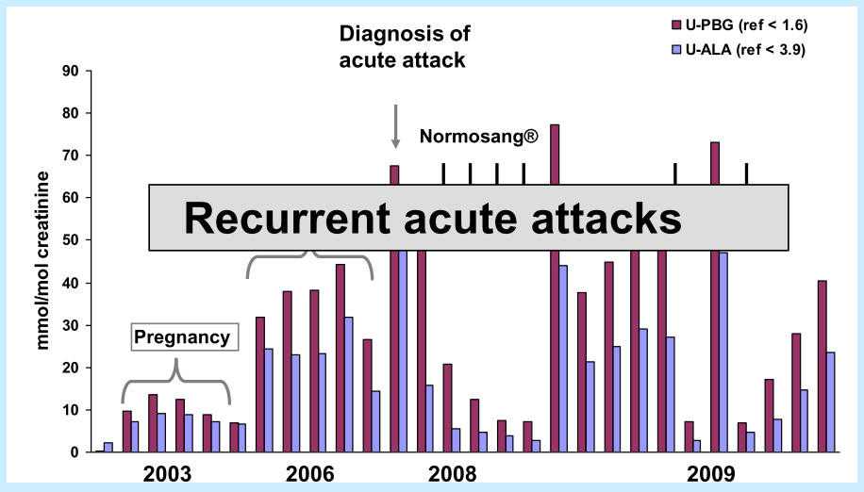
Case 2: continued Day 4 - 8

Slide 12
Case 3: the known porphyria family – undiagnosed patient ● 39 years, kidney disease since age 25 ● Stable GFR until age 36 ● At age 39 hypertension and hyperlipidemia were diagnosed ● Atorvastatin ● 1 month later admitted to hospital due to: → Abdominal pain since 2-3 days → Paratesia in lower extremities → Nausea, vomiting ● Diagnosis: Peripheral neuropaty → Amitriptylin and gabapentin → Dexofen and paracetamol Released from Hospital

Slide 13
Case 3: continued 1 – 3 months later ● Loss of weight ● Nausea, vomiting ● Readmitted to hospital →muscle numbness →CPK 176 μkat/L (<2,5 μ kat/L) →atorvastatin seponated ●MRI, neurography, myography and muscle biopsy ● Progressive abdominal and muscle pain also in upper limbs Hereditary disease in the family !

Slide 14
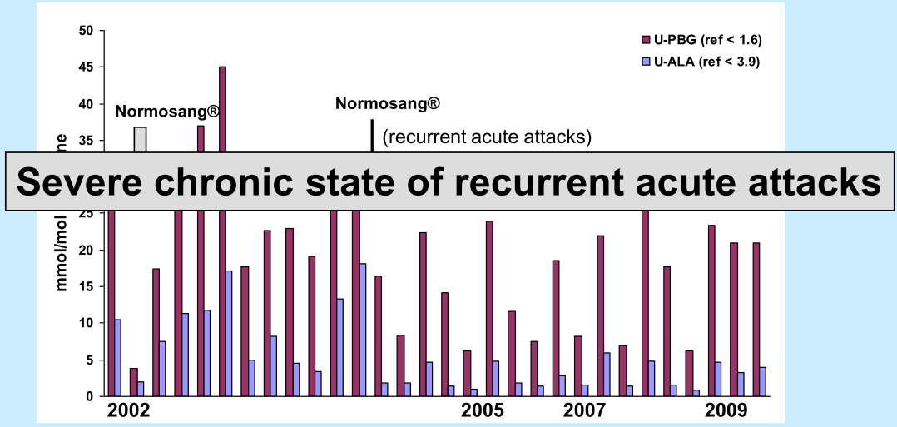
Case 3: continued 4 months

Slide 15
Human Porphyrias
“Obscure diseases with confusing names
considered only when the need for a diagnosis is desperate”
(Antony McDonagh, 1997)

Slide 16
Why are the porphyrias nevertheless important for the lab? 1) porpyhrias can be diagnosed (and excluded) by biochemical means only (the diagnosis is based on lab results exclusively).
2) clinical chemists and specialists in laboratory medicine are regularly asked for information about porphyria. Important differential diagnosis.
3) There is no clinical discipline to which the porphyrias are clearly allocated.
4) Porphyrias can run undetected while life-threatening.
5) Rare diseases ➔ usually less personal clinical experience of the individual clinician

Slide 17
Human Porphyrias:
……..from Greek: πορφυρά (porphyrá): purple colour
• 8 rare, mainly genetic diseases(prevalence ~ 1/75 000)
Due to a partial or total deficiency in one of the enzymes of the heme biosynthetic pathway caused by specific gene mutations
• Abnormal accumulation and excretion of porphyrins and precursors ALA and PBG(urine, faeces, blood, organs…)
• Acute neurovisceral attacks and/or skin lesions
• Anemia present in only 2
• red urine in most
• Pathophysiology only partially understood

Slide 18
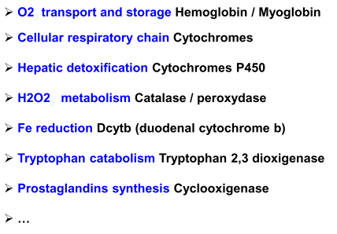
Heme
= Ferriprotoporphyrin IX

Slide 19
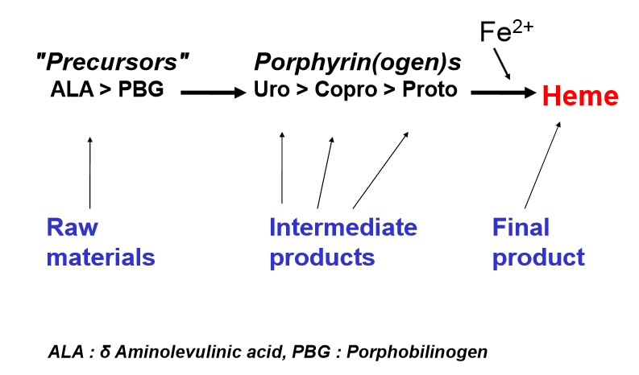
Heme-Biosynthese

Slide 20
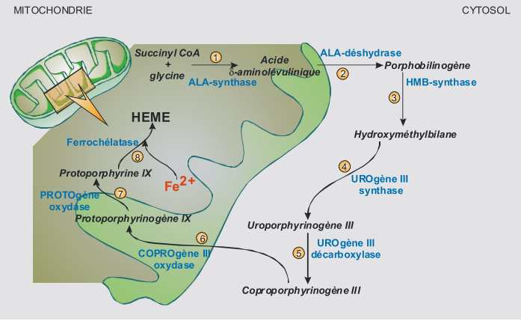
Heme Biosynthesis

Slide 21
Tissue specific heme synthesis 1. Erythroid Heme Synthesis: in Bonne Marrow 85% of body heme production ; Regulation: Fe,EPO (continuous) disregulation : Erythropoeitic porphyrias 2. Hepatic Hem Synthesis: in Liver 14% of body heme Production ; Cytochromes Liver (on demand) Regulation: Heme (feedback inhibitor ) disregulation : Hepatic porphyrias A single biosynthetic pathway that needs 2 tissue-specific regulations: At the level of the first step: ALA-Synthase Two ALAS genes : ALAS1 ubiquitous(Liver) ALAS2 erythroid specific (BM)

Slide 22
Acute attacks
→ life-threatening !
symptomatic classification
Chronic Porphyrias
→ Bullous Skin Lesionen
Photo sensitivity
VP
HC
AIP
PCT
CEP, EPP
Acute Porphyrias:
Hepatic Porphyrias (adult):
ADP - ALAD Deficiency Porphyria (Doss-porphyria)
AIP – acute Intermittent Porphyria
VP – Variegate Porphyria
HCP – Hereditary Coproporphyria
None – Acute Porphyrias:
PCT – Porphyria cutanea tarda
Erythropoietic porphyrias (child):
CEP – Congenital Erythropoietic Poprhyria
EPP – Erythropoietic Protoporphyriea
X linked Dominant Protoporphyria, XLDPP

Slide 23
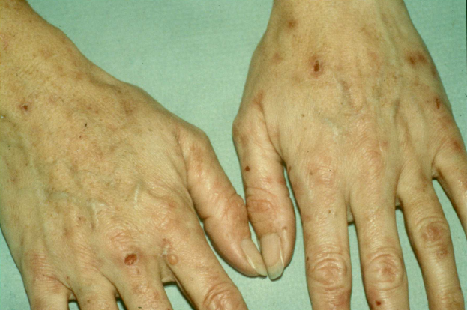
Skin lesions in Variegate Porphyria similar in PCT – bullous photodermatitis

Slide 24
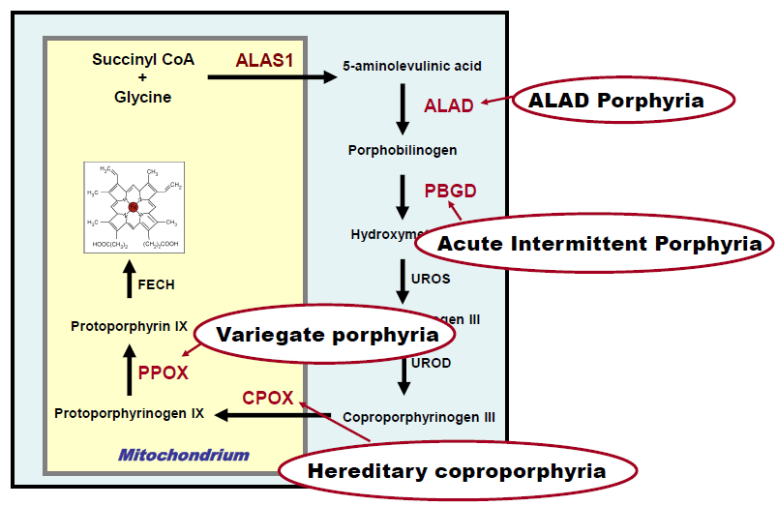
Acute Hepatic Porphyrias

Slide 25
Acute Hepatic Porpyrias ALA dehydrase Deficiency Porphyria (ADP) (Doss-porphyria) is a very rare autosomal recessive disorder that presents with acute attacks. AIP acute Intermittent Porphyria, AD common HCP Hereditary Coproporphyria, AD rare VP Variegate Porphyria, AD common The autosomal dominant acute porphyrias are low penetrant disorders that are characterised by acute neurovisceral attacks wich may be life threatening. Acute attacks affect < 10% of gene carriers.

Slide 26
Pathophysiology of acute attacks
reduced heme pool in the liver heme
Markedly increased activity of ALA-Synthase1 in the liver
Increased production, accumulation and excretion of precursors (ALA and PBG)
Specific porphyrin excretion profile depending on the location of the enzymatic defect
The release of ALA from liver results in neuronal toxicity. Neuronal damage to the autonomic, motor and central nervous system results in axonal degeneration and patchy demyelination

Slide 27
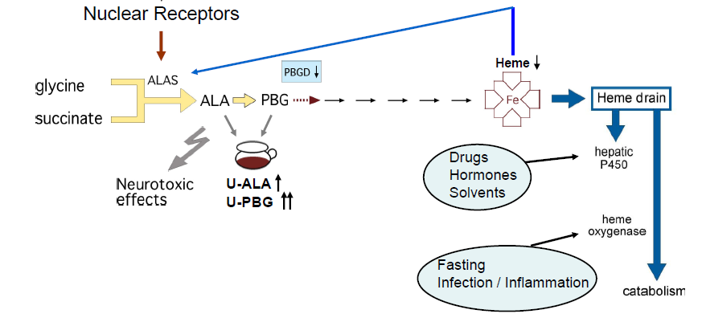
Acute porphoria
feedback inhibitor
E. Sardh

Slide 28
The Clinical Symptoms of Acute Potphyria: Autonomous Nervous System: Peripheral Nervous System: Abdominal pain (without peritoneal signs) >80% Muscle weakness Constipation Areflexia Vomiting >80% Sensory neuropathy Hypertension Respiratory paralysis Tachycardia >80% Hemi / tetraparesis Muskel pain(Back & thigh) complete paralysis Centrale Nervus System: Psychiatric symptoms : (Anxiety, Hallucinations, Agitation) 40-60% -> this does not result in chronic psychiatric illness Convulsions(Epilepsy) -> a rapid onset of profound hyponatraemia Metabolic changes: Hyponatremia >60% Hypomagnesemia

Slide 29
Acute Porphyria’s Neuropathy
• More common in females than males (5:1) • Acute attacks are very rare before puberty and less common after menopause. • The peak incidence is in the 3rd & 4th decade.
• Symptoms/signs • Severe abdominal pain mimicking acute abdomen without localizing features is almost universal.
• Vomiting, constipation • Psychiatric symptoms include anxiety, confusion, hallucinations occur during an attack but this does not result in chronic psychiatric illness
• Hypertension, tachycardia, due to autonomic dysfunction • Convulsions: may be primary or secondary to a rapid onset of profound hyponatraemia • Motor neuropathy may progress from a mild initial presentation to progressive, severe with complete paralysis

Slide 30
Precipitants (Triggers):
• Hormonal fluctuations (e.g. menstrual cycle) - particularly the pre menstrual phase correlating with progesterone levels
• Prescription Drugs (e.g. carbamazepine, barbitutates, P450 inducers..)
• Infection
• Dieting, weight loss and stress
• Alcohol (particularly binge drinking), smoking, illicit drugs
Pathophysiology of acute attacks
The release of ALA from liver results in neuronal toxicity.
Neuronal damage to the autonomic, motor and central nervous system results in axonal degeneration and patchy demyelination

Slide 32
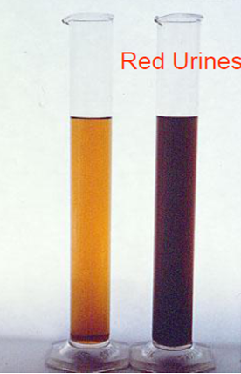
Diagnosis
First Line- Acute porphyric attack Urine porphobilinogen
protected from light, spontaneous urine
Normal is <2mg/L ~ < 2 mg/g Kreatinin
Mainly over 20 times increase in attack
Increase of ALA ( δ Aminolevulinic acid)
Hyponatraemia
CRP ?
Exception :
ADP - ALAD Deficiency Porphyria (Doss-Porphyria):
• acute Porphyric with normal PBG and increased ALA
• < 10 cases
24 hours urine collection is not required

Slide 33
Diagnosis
Second Line - Establish Type of Porphyria Total Urine and faecal porphyrin and individual porphyrins measured by HPLC as well as a plasma porphyrin scan allows an unequivocal biochemical diagnosis in symptomatic patients.

Slide 34
Management of acute porphyria attack
General: • Remove/treat precipitating factors such as drugs, infection • Symptomatic relief with analgesics (opiates), control of fluid and electrolyte balance
• Specific : • heme arginate (Normosang®) in albumin solution, is taken up by the liver and suppresses the metabolic pathway by down regulating ALA Synthase
• 3 – 4 mg/kg body weight for four consecutive days
• carbohydrates 300 – 500 g per day
• Glucose infusion 10 % in saline, 2.000 mL/day
Prevention: • Identify relatives at risk through family studies. • This requires mutation screening of the proband first and then mutation testing in relatives. • Affected relatives are then advised to avoid known precipitants

Slide 35
Genetics and epidemiology of Acute Hepatic Porphyrias
• Autosomal dominant
• Low penetrance (1-5%)
• Prevalence : 1/100 000 ?
• Mutated gene (AIP) : 1/1600
• Molecular defect : wide allelic heterogeneity
• Low rate of de novo mutation (3%)
• No phenotype – genotype relationship
• Incidence EU countries : 0.12 new case/106/year
• Sweden : 0.52 (founder effect ?)

Slide 36
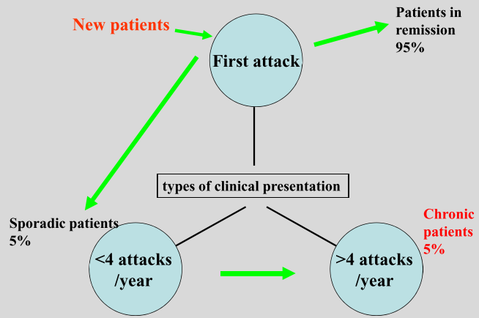
Acute Hepatic Porphyria: Natural history
In severe cases, it is necessary to proceed with liver transplantation ?

Slide 37
Cutaneous porphyrias
Non-acute porphyrias(Cutane porphyrias):
Porpyria cutanea tarda(PCT)
Erythropoietic porphyrias:
Erythropoietic protoporphyria(EPP)
Congenital erythropoietic porphyria(CEP, Günther´s disease)
->Bullous skin lesions occur in CEP also the cute hepatic porphyrias, HCP and VP
->Acute painful photosensitivity occurs in EPP
Pathophysiology: Circulating porphyrins absorb light (400-410nm) within the dermis of exposed skin and enter an energy enhanced or ‘Excited state’ . The release of this energy results in the formation of reactive oxygen species which damages proteins, lipids and DNA Lipid membrane peroxidation results in release of inflammatory mediators from mast cells, neutrophils

Slide 38
Cutaneous porphyrias
Bullous skin lesion:
Chronic damage to the dermal epidermal border by porphyrins absorbing light (energy) leading to reactive oxygen species
This results in fragile skin, blisters (bullae) which rupture, crust and heal poorly leaving permanent scarring
Hypertrichosis (excess hair) in areas exposed to the sun and non-androgen dependent skin.
Other skin features include: Milia (epidermoid cysts),
hyper/hypopigmentation, scarring alopecia and sclerodermoid plaques which can affect large areas of the skin

Slide 39
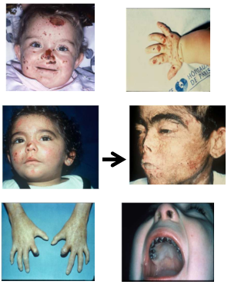
Cutaneous porphyrias
Congenital Erythropoietic Porphyria
Clinical manifestations Usually at birth, some late onset Severe mutilating bullous photosensitivity Erythrodontia Hypertrichosis Redish-coloured urine Splenomegaly Osteopenia Extreme poor quality of life Shortened life expectancy for severe cases

Slide 40
Cutaneous porphyrias
Congenital Erythropoietic Porphyria Diagnosis • Massive production and accumulation of type I porphyrins in most tissues : Bone marrow, red cells, plasma, spleen, liver, skin, teeth, bones
• Massive excretion of Uroporphyrin I and Coproporphyrin I in urine, feces (red urine, pink colored diapers)
• 80 to 99 % deficiency in UROS activity in erythrocytes
Molecular aspects
Autosomalrecessive
Marked defect in UROS activity
Compound heterozygotes- poor phenotyp-genotype correlation

Slide 41
Cutaneous porphyrias
Congenital Erythropoietic Porphyria
Therapeutic options 1. Symptomatic treatment - sunscreen lotions and skin care +++ - b-carotene, oral charcoal, hydroxyurea - splenectomy - repeated transfusions & iron chelators
2. Curative treatment - Allogenic Hematopoietic Stem Cell Transplantation, (severe case in children)

Slide 42
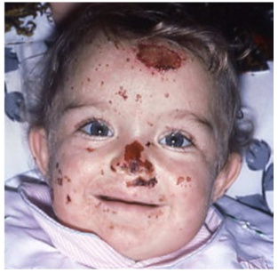
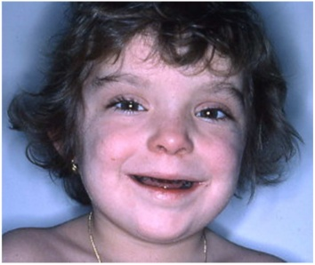
Cutaneous porphyrias
Congenital Erythropoietic Porphyria
Allogenic Hematopoietic Stem Cells Transplantation >20 patients >5 years follow-up

Slide 43
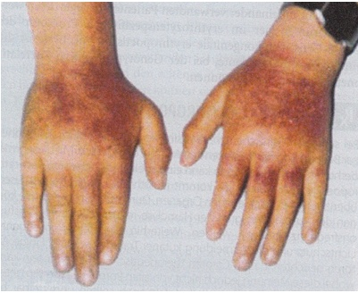
Cutaneous porphyrias
Erythropoietic ProtoPorphyria: A distressing skin pain…
Extreme intolerance to sun, wind and Temperature variation
• Early childhood
• Minutes of exposure
• Painful: needles stuck into the skin
• Relief by cold material, sleep disrupted
• Burning, itching, swelling, oedema, erythema, purpura, vesicles
• Chronic lesions : thickened waxy skin, linear scars
• Diagnosis often delayed
• Major impairment of quality of life
• Psychosocial complications

Slide 44
Cutaneous porphyrias
EPP a multi organ disease A syndrome of life-long skin photosensitivity
• Prevalence ≈ 1/100 000, incidence = 0.12/106
• Excess PPIX (Protoporphyrine IX)in bone marrow, erythrocytes, plasma, skin and liver
• Altered hematopoiesis: common mild microcytic anaemia and thrombocytopenia (30-50% cases)
• Cholelithiasis, moderate liver damage in 30% of patients
• PPIX induced chronic liver disease and cirrhosis
• Fulminant cholestatic liver failure in less than 2%

Slide 45
Cutaneous porphyrias
Molecular genetics of protoporphyria
Two distinct causes: I. Erythropoietic protoporphyria (EPP) due to deficiency of ferrochelatase
Autosomal recessive, with mutation of both alleles
II. X-linked dominant protoporphyria (XLDPP) due to gain of function mutations in ALA Synthetase 2 (ALAS2) (the erythroid specific enzyme) Deletions in the C-terminus appear to interfere with regulation of enzyme activity

Slide 46
Cave:
To recognize acute porphyria attacks
Diagnosis: PBG in Urine Sample
Recommendations:
known patients with hepatic porphyria
to carry medical alert cards.
Useful links:
http://www.porphyrie.de
http://www.drugs-porphyria.org
http://www.hgmd.cf.ac.uk/ac/index.php
http://www.porphyria-europe.com
http://www.doss-porphyrie.de

Slide 47
I would like to address my special acknowledgment to Dr. Thomas Stauch Labor PD Dr. Volkmann, Karlsruhe, Germany.
Thanks for your attention!

