Slide 1
Clinical application of rTMS in treatment of neurological disorders
Abbas Tafakhori
Assistant professor of neurology
Tehran university of Medical Sciences
Imam khomeini Hospital complex

Slide 2
Transcranial magnetic stimulation (TMS) is a safe and non-invasive method of stimulating cortical neurons.
The procedure involves a short strong electrical current that is delivered through an insulated coil of wire placed over the scalp (magnetic coil).

Slide 3
The induced electrical currents modulate neuronal excitability at the stimulated sites. Depending on stimulation parameters, transcranial magnetic stimulation can upregulate or down regulate excitability to different extents in the neural structures under the stimulating coil.
Maeda F,et alExp Brain Res 2000; 133: 425–30.

Slide 4
Motor function in stroke
Recovery of motor function after stroke is typically incomplete.
6 months after the episode, two-thirds of stroke survivors are unable to take part in activities of daily living with their paretic hand to the extent they were before and only a few are able to carry out professional work.
Kolominsky-Rabas Plet alEpidemiology of ischemic stroke subtypes according to TOAST criteria: incidence, recurrence, and long-term survival in ischemic stroke subtypes: a population-based study. Stroke 2001; 32: 2735–40.

Slide 5
It remains a desirable goal to develop strategies to improve the beneficial effects of neurorehabilitative treatments.

Slide 6
Neuroimaging studies showed increased activity of M1(intact hemisphere) with movements of the paretic hand in patients with motor impairment.
purposeful modulation of excitability in motor regions of the intact and affected hemisphere may contribute to improvements in motor function.

Slide 7
Recent studies in animals showed that motor recovery after focal lesions in the hand motor representation can improve with direct epidural cortical stimulation.
Alternative approach is the use of non-invasive cortical stimulation.
Brown JA, et al. Motor cortex stimulation for the enhancement of recovery from stroke: a prospective, multicenter safety study. Neurosurgery 2006;58: 464–73.

Slide 8
Low frequency (<=1 Hz): inhibitory effect
High frequency (>5Hz): excitability effect

Slide 9
Upregulation of excitability in the affected hemisphere
Two non invasive strategies :
Transcranial direct current stimulation
rTMS

Slide 10
In an study: repetitive transcranial magnetic stimulation daily (ten 10 s trains of 3 Hz stimulation with 50 s between each train) combined with customary rehabilitative treatment for 10 days within the first 2 weeks after stroke.

Slide 11
Results: Motor improvements with repetitive transcranial magnetic stimulation relative to sham lasting for at least 10 days.
There were no complications with either interventions and the researchers proposed that repetitive stimulation sessions could elicit longer-lasting effects than single applications.
Khedr EM, et al. Therapeutic trial of repetitive transcranial magnetic stimulation after acute ischemic stroke. Neurology 2005; 65: 466–68

Slide 12
Downregulation of excitability in the intact hemisphere
An alternative approach that could theoretically improve motor function in the paretic hand is downregulation of excitability in M1(intact hemisphere), possibly through modulation of inappropriate interhemispheric inhibition.

Slide 13
Previous studies in healthy volunteers showed that downregulation of excitability in one motor cortex results in increased excitability in the opposite motor cortex and performance improvements in motor functions of the ipsilateral hand, a mechanism proposed to rely on modulation of interhemispheric inhibition between both primary motor cortices.
Kobayashi Met al Ipsilateral motor cortex activation on functional magnetic resonance imaging during unilateral hand movements is related to interhemispheric interactions. Neuroimage 2003; 20: 2259–70.

Slide 14
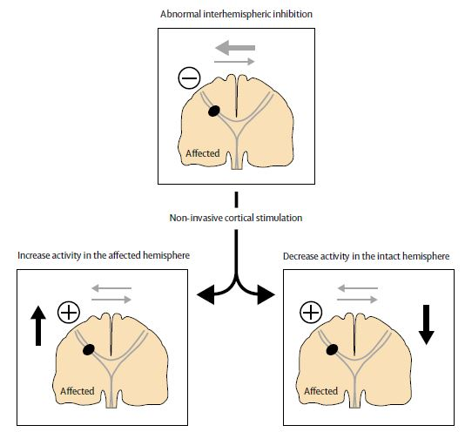

Slide 15
Chronic tinnitus
rTMS can relieve tinnitus by modulating the excitability of neurons in the auditory cortex to decrease the hyperexcitability that is associated with generating the neural activity that causes some form of tinnitus.

Slide 16
There is increasing evidence that expression of neural plasticity is involved in tinnitus.
Many forms of chronic tinnitus are auditory phantom perceptions.
That might be a result of maladaptive attempts at cortical reorganization due to distorted sensory input

Slide 17
The results of positron emission tomography (PET) have shown signs of an abnormal asymmetry in the auditory cortices of some individuals with tinnitus indicating higher levels of spontaneous activity on the left side, independent on the side to which the tinnitus is referred.

Slide 18
Since rTMS has the ability to modulate cortical activity focally, it seems likely to assume that application of rTMS to cortical auditory areas can alleviate tinnitus.

Slide 19
It has been shown that trains of high-frequency rTMS (10–20 Hz) can induce an immediate, shortlasting interruption of tinnitus perception, whereas repeated stimulations with low-frequency (1 Hz) rTMS on several consecutive days can have a lasting beneficial effect on tinnitus and thus represent a potential therapeutic method.

Slide 20
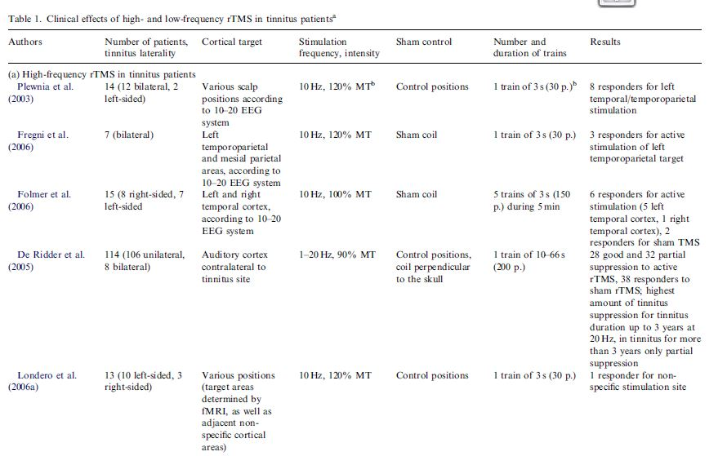

Slide 21
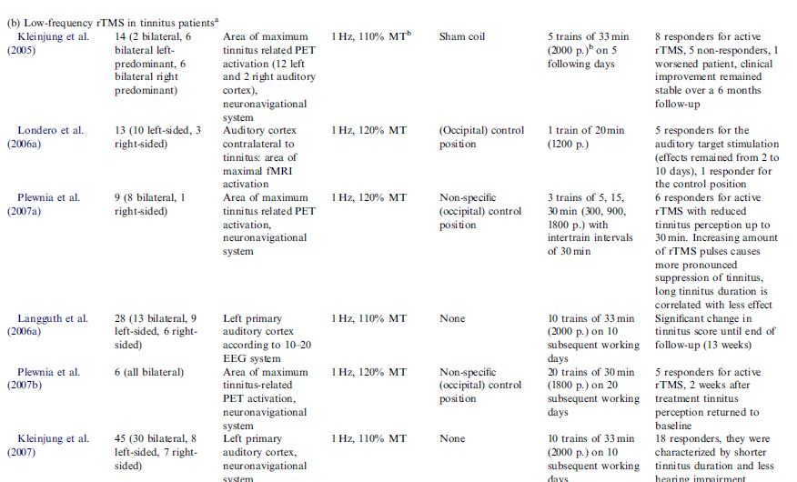

Slide 22
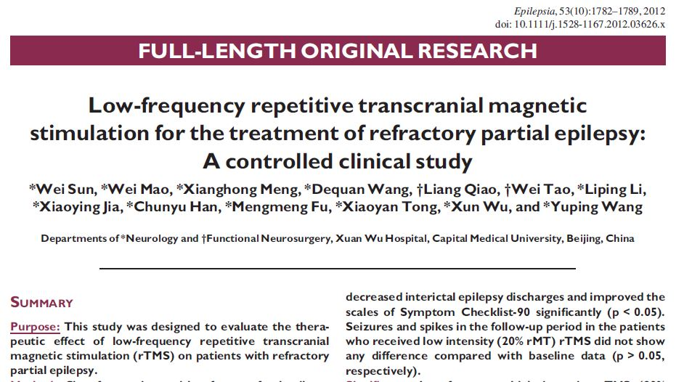

Slide 23
Sixty-four patients with refractory focal epilepsy were screened and 60 patients were randomly divided into two groups by stimulation intensity: 90% (group 1) or 20% (group 2) of resting motor threshold (rMT). Seizure frequency and interictal EEG epileptic discharges were compared between the baseline and follow-up periods.

Slide 24
Seizures significantly decreased following 2-weeks high intensity (90% rMT) rTMS treatment compared with baseline level (p < 0.05). rTMS also decreased interictal epilepsy discharges and improved the scales of Symptom Checklist-90 significantly (p < 0.05).
Seizures and spikes in the follow-up period in the patients who received low intensity (20% rMT) rTMS did not show any difference compared with baseline data (p > 0.05,respectively).

Slide 25
Low-frequency high intensity rTMS (90% rMT) delivered into the epileptogenic zone had a significant antiepileptic effect on patients with refractory partial seizures. rTMS treatment can also reduce the interictal epileptic discharge frequency and improve the sychological condition of these patients.

Slide 26
Parkinson disease
Of all the movement disorders, PD has received the most attention with regard to rTMS therapeutic studies.

Slide 27
Physiological evidence for rTMS
The pathological process that underlies PD causes widespread dysfunction of the brain and that particularly affects processing in the cortico–basal ganglial loops.
Functional imaging studies have, in general, identified hypometabolism within the supplementary motor area (SMA) and the prefrontal cortex during movement in patients with PD that are thought to be caused by the primary dysfunction in the basal ganglia.
Jahanshahi Met al. Self-initiated versus externally triggered movements. I. An investigation using measurement of regional cerebral blood fl ow with PET and movement-related potentials in normal and Parkinson’s disease subjects. Brain 1995; 118: 913–33.

Slide 28
Therapy for PD (eg, levodopa) can, to a certain extent, reverse such changes in both human beings and animals. Therefore, excitatory rTMS might have a similar effect, which might be translated into an improvement in clinical (motor) symptoms.

Slide 29
rTMS is also capable of inducing dopamine release from the basal ganglia: in healthy individuals, application of 10 Hz of rTMS over the motor cortex (M1) or the dorsolateral prefrontal cortex (DLPFC) induced ipsilateral dopamine release from the putamen and caudate, respectively.

Slide 30
There is evidence, at least in animal models of PD, that levodopa-induced dyskinesia might represent abnormal plasticity in the motor system. In light of this, some studies with rTMS have specifically looked at the potential application of brain stimulation in PD patients with dyskinesia.

Slide 31
Therapeutic trials of motor symptoms
1. single-session studies
2. multiple-session studies

Slide 32
single-session studies
Early studies of the potential therapeutic application of rTMS in PD investigated changes in parkinsonian motor symptoms during a high-frequency (5 Hz), low-intensity rTMS protocol delivered once over the M1, with the aim to increase excitability.

Slide 33
After all applications of real rTMS, a 10–30% improvement was shown in most studies for almost all outcome measures, with no effects after sham stimulation.

Slide 34
multiple-session studies
Despite the inconsistency of the single-session results, the transient clinical gains seen in some studies after a single session of rTMS have encouraged long-term treatment studies in patients with PD.

Slide 35
Despite the methodological differences, excitatory (high-frequency) rTMS can improve upper-limb bradykinesia, gait speed, and the score in the motor section of the unified Parkinson’s disease rating scale (UPDRS); these improvements range from 15% to an impressive 50% for some of the outcome measures.

Slide 36
On some occasions, improvements were shown to last for up to 1 month after the end of the stimulation regimen, but were gradually lost.
Khedr EM, Rothwell JC, Shawky OA, Ahmed MA, Hamdy A. Eff ect of daily repetitive transcranial magnetic stimulation on motor performance in Parkinson’s disease. Mov Disord 2006; 21: 2201–05.

Slide 37
Therapeutic trials of levodopa-induced dyskinesia
Three small studies have specifi cally investigated the effect of rTMS protocols on the severity of levodopa induced dyskinesia.
Koch and colleagues found that a single session of rTMS at 1 Hz to the SMA bilaterally lowered the severity of dyskinesia for 30 min after stimulation. No effect was seen after sham stimulation. Dyskinesia worsened after stimulation with 5 Hz.

Slide 38
In a follow-up paper, a transient effect of a single session of 1 Hz stimulation over the SMA was again seen, by contrast with sham stimulation.
Rektorova and colleagues assessed the effect of high frequency (10 Hz) stimulation of the DLPFC or motor cortex, given as daily sessions for 5 days, on gait and bradykinesia in patients with PD. The intervention did not show any benefit and the study was terminated early.

Slide 39
Painful diabetic neuropathy
Painful neuropathy is associated with plasticity changes in the nervous system.
Deep rTMS is a newer development that allows direct activation of deeper neuronal populations, by a unique coil design termed the H-coil.
Deep H-coil rTMS provides pain relief in patients
with diabetic neuropathy. This technique can induce a therapeutic effect on brain areas that otherwise remain difficult to target.
Onesti E, et al, H-coil repetitive transcranial magnetic stimulation for pain relief in patients
with diabetic neuropathy, Eur J Pain. 2013

Slide 40
Neuropathic pain
In an study efficacy and safety of 10 daily rTMS was evaluated in NP patients. In this randomized, double-blind, sham-controlled, crossover study at 7 centers:
The real rTMS, compared with the sham, showed significant short-term improvements in VAS. No serious adverse events were observed.
Hosomi K, et al, Daily repetitive transcranial magnetic stimulation of primary motor cortex for neuropathic pain: A randomized, multicenter, double-blind, crossover,sham-controlled trial. Pain. 2013

Slide 41
Migraine
Effect of high rate repetitive transcranial magnetic stimulation (rTMS) in migraine prophylaxis in medically refractory patients:
98% patients had more than 50% reduction of headache frequency at the end and 1 week after rTMS and the improvement persisted till the fourth week in 80.4% patients. The headache frequency, severity, functional disability, migraine index, and rescue medications significantly reduced at all time points, but the maximum benefit was observed in the first 2 weeks. There were no serious adverse events.
Misra UK, et al, Neurol Res. 2012 Jul;34(6):547-51

Slide 42
Low-frequency rTMS of the vertex in the prophylactic treatment of migraine.
The rTMS treatment was tolerated well. rTMS stimulation over vertex with 1 Hz was not effective in migraine prophylaxis when compared with placebo.
Teepker M, et al. Cephalalgia. 2010 Feb;30(2):137-44

Slide 43
Aphasia
Loss of fluency is a significant source of functional impairment in many individuals with aphasia. Repetitive transcranial magnetic stimulation (rTMS) administered to the right inferior frontal gyrus (IFG) has been shown to facilitate naming in persons with chronic left hemisphere stroke and non-fluent aphasia.
Medina J, Aphasiology. 2012 Sep 1;26(9):1153-1168

Slide 44
rTMS with or without conventional rehabilitation has positive effects on post-stroke aphasia.
Wong IS, Tsang HW, Rev Neurosci. 2013;24(1):105-14

Slide 45
