Slide 1
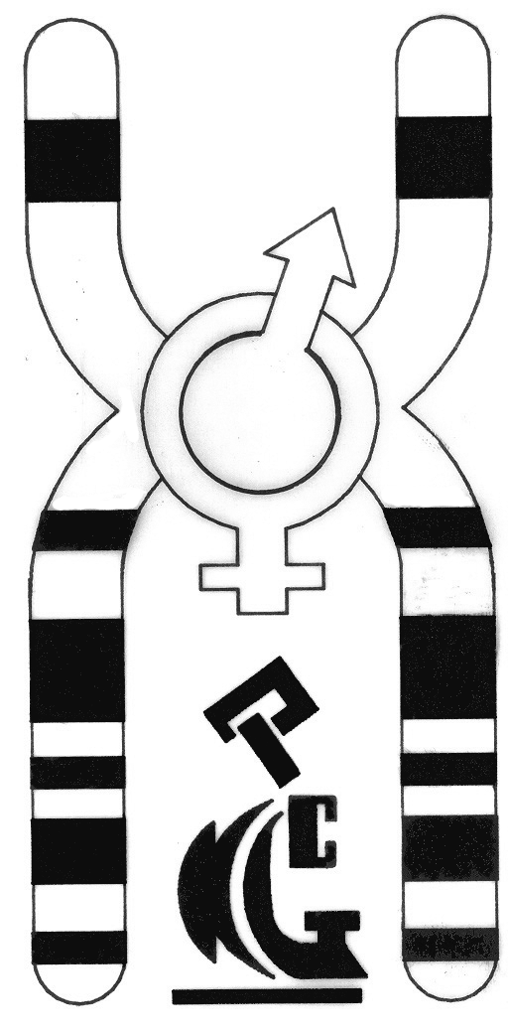
Array Comparative Genomic Hybridization by 24 SURE in PGS
Roxana Kariminejad
Kariminejad Najmabadi Pathology & Genetics Center, Tehran
مركز پاتولو‍ژي و ژنتيك كريمي نژاد – نجم آبادي

Slide 2

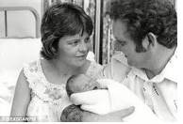
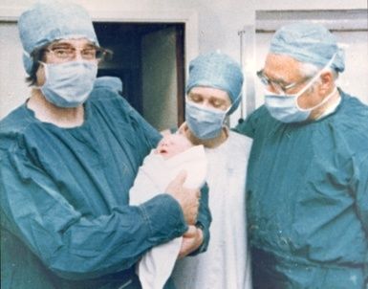
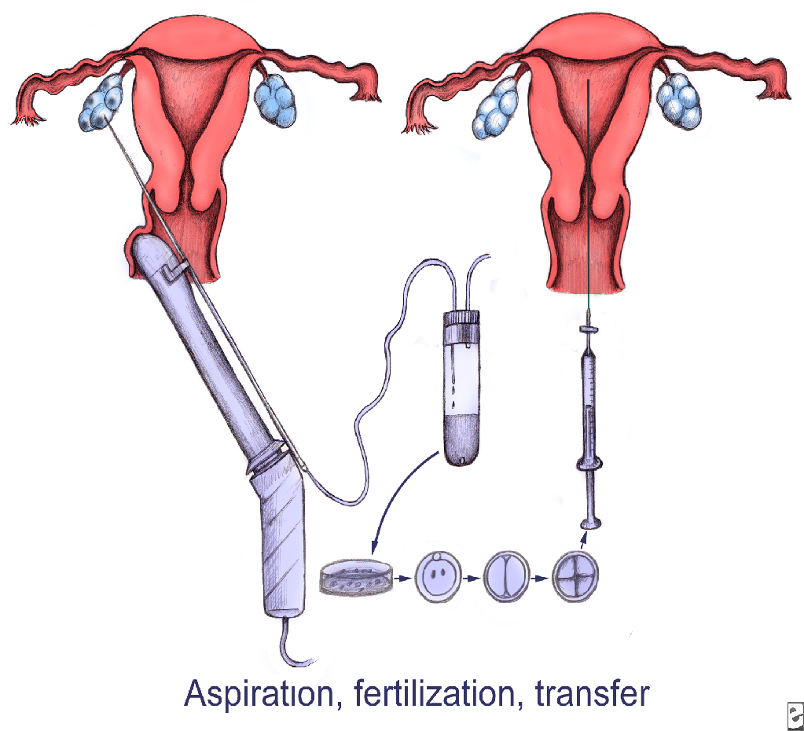

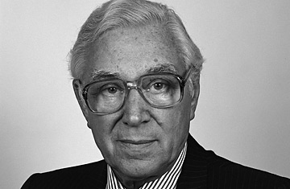
Louise Joy Brown
Born25 July 1978 (age 36)
Oldham General Hospital,Oldham, England
Sir Robert Hayes
Physiologist
Patrick Steptoe
Gynecologist/Obstetrician

Slide 3
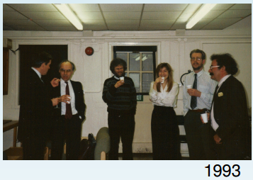

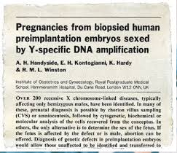
First PGD
– Richard Gardner & Robert Edwards (1967)
– Sexing rabbit blastocysts
Alan Handyside, Robert Winston, Elena Kontogianni
Amplification of Y chromosome by PCR
Two twin and one singleton pregnancy resulted

Slide 4
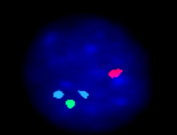
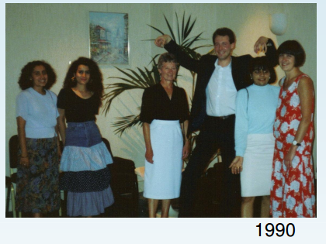
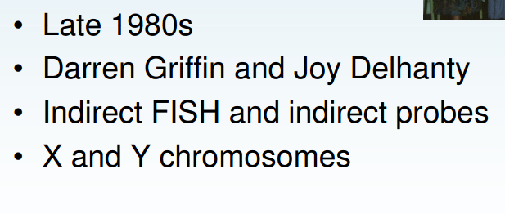

Slide 5
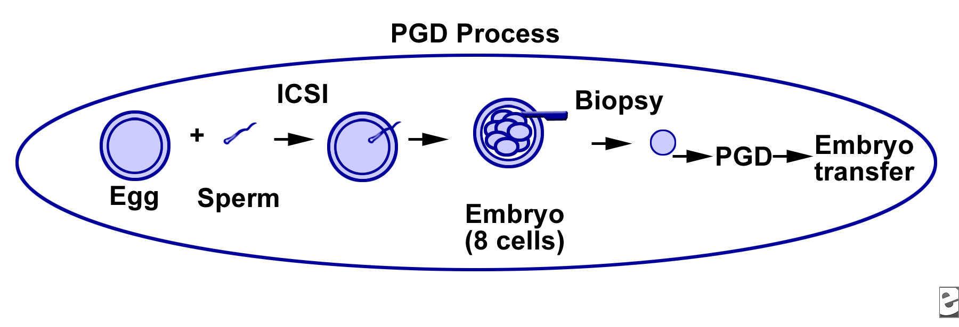
PGD: Diagnosis of known disease in embryo prior to implantation, for example b-thalassemia, connexin, DMD etc
PGS: Selection of most viable embryo for implantation
PGS/PGD: Diagnosis of known disease and selection of embryo

Slide 6
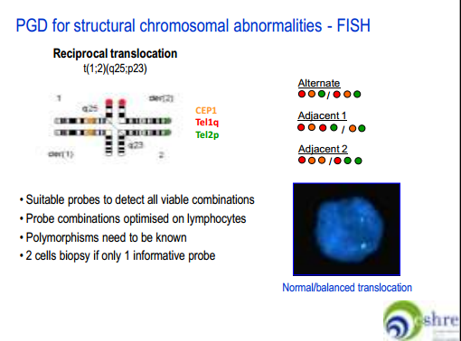
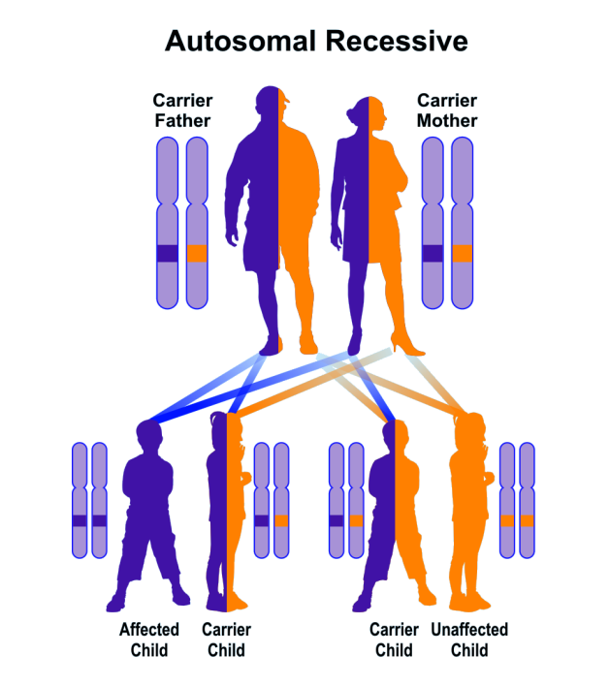
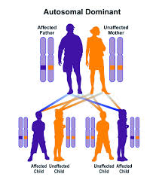
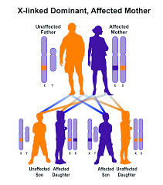
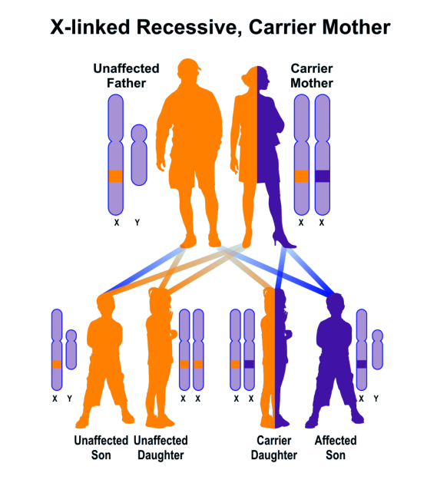
Primary candidates for PGD
25% risk of affected embryo
50% risk of affected embryo
50% risk of affected embryo
25% risk of affected embryo
50% of males

Slide 7
Human leukocyte antigen (HLA) matching
Provide a potential donor for stem cell or bone marrow transplantation
Recessive diseases, including thalassemias or acquired malignancies such as leukemia.

Slide 8
Preimplantation Genetic Screening
WHY?
30% of IVF cycles lead to babies by morphological screening
Increase rate of implantation, only 15% of transferred embryos implant
Increase pregnancy rate
Decreased rate of abortion, increased risk of abortion with advancing maternal age
Possibility of transfer of single embryo instead of multiple embryos, ¼ multiple pregnancies associated with risk to mother and child

Slide 9
Indications for Preimplantation Genetic Screening
Most early pregnancy losses attributed to aneuploidy

Slide 10
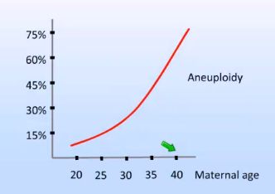

Aneuploidy in oocytes, affect on implantation
]ئحقخرث هئحمشفدشفهخد
Implantation

Slide 11
Chromosomal aneuploidies
High rate of chromosomal aberration in embryos
Nagaoka 2012 Nat Rev Genet

Slide 12
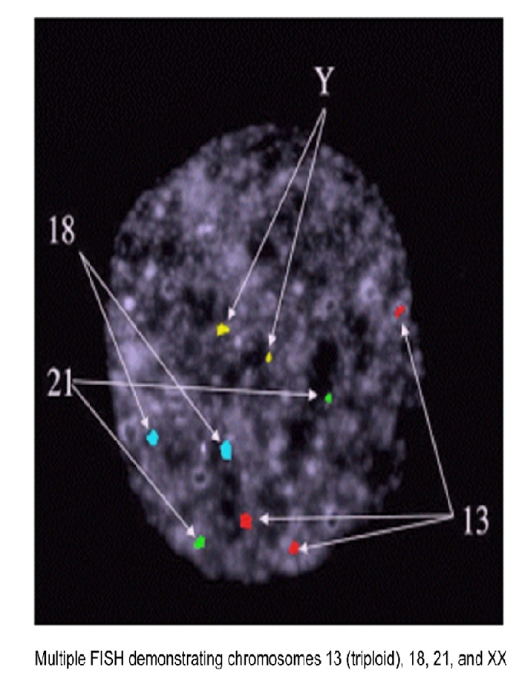
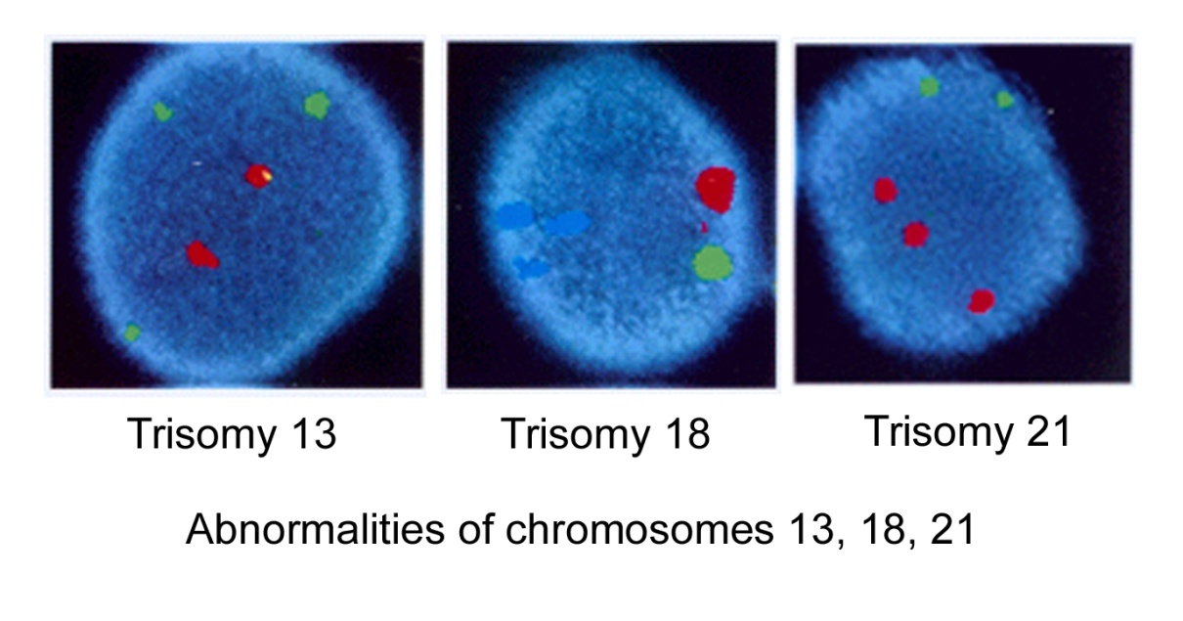
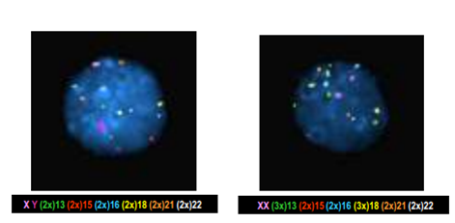

<25% of aneuploid embryos as normal because the abnormal chromosomes were not analyzed
10% of cells removed for screening yield no or inconclusive results.

Slide 13
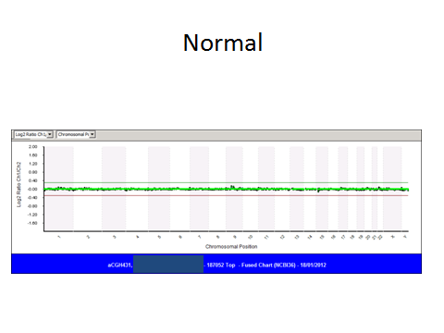
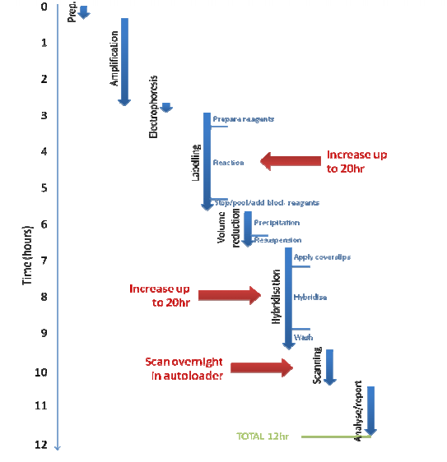
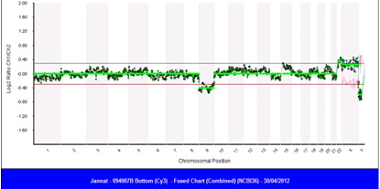
Microarray technology 24 sure
Male, -9,+22
Simultaneous screening and diagnostic testing on DNA sample

Slide 14
Results
Within 24 hours
98% of samples were successfully studied
23 cycles
1-7 embryos from each cycle
At least 1 embryo appropriate for transfer in 20/23 cycles
Transfer in 11 cycles because of embryo loss (3) or sex selection (6)
3 unsuccessful cycles: 1, 4, 5 embryos

Slide 15
Pilot study: 100 embryos

Slide 16
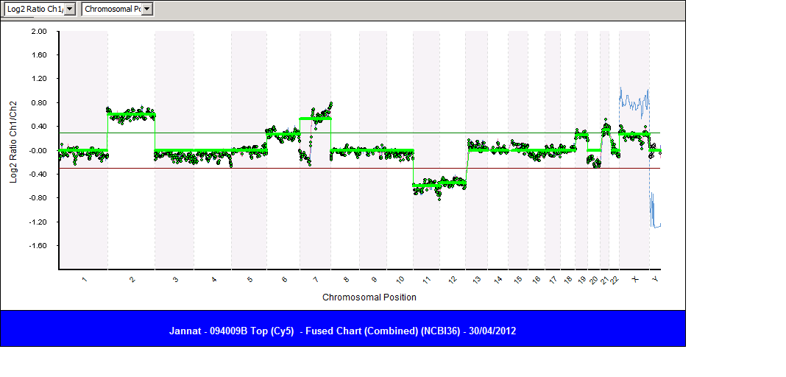
Female, +2,+9q,-11,-12,+19,+21

Slide 17
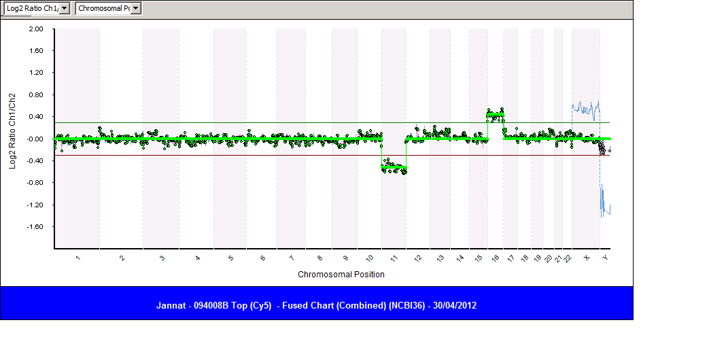
Female, -11,+16

Slide 18
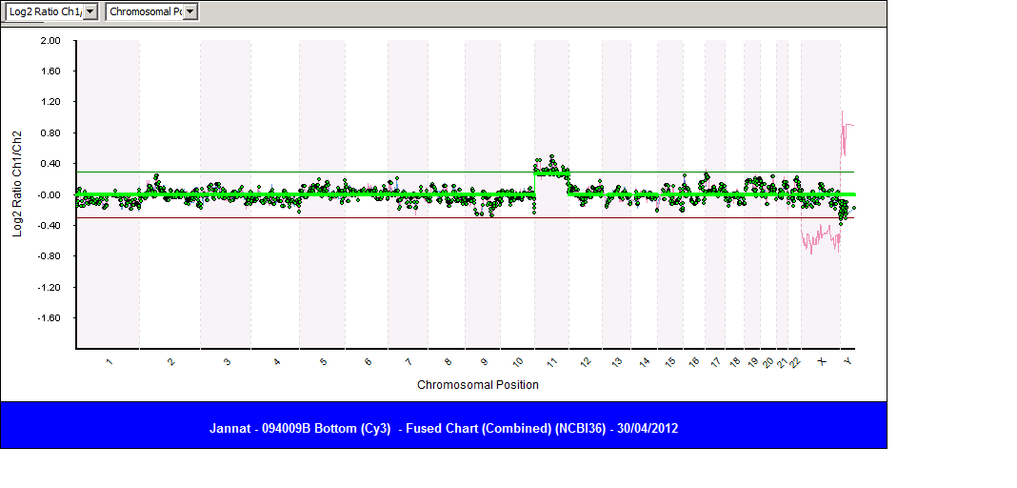
Male, +11

Slide 19
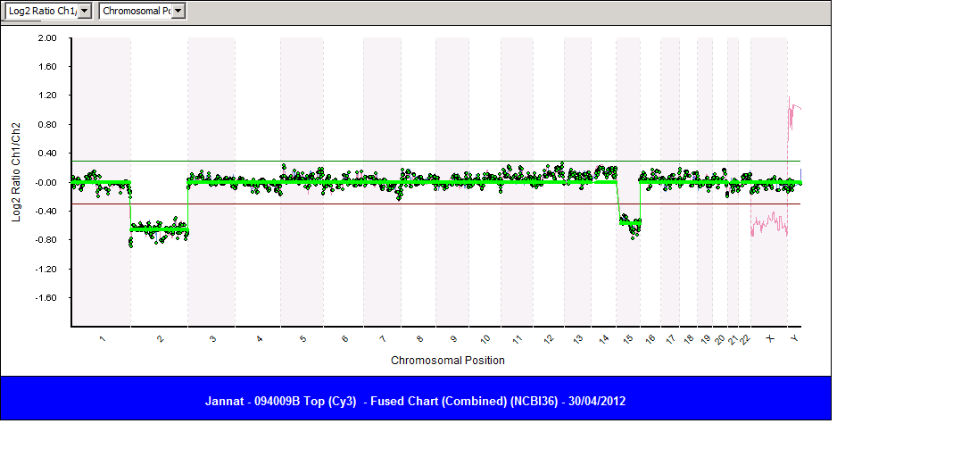
Male,-2,-15

Slide 20
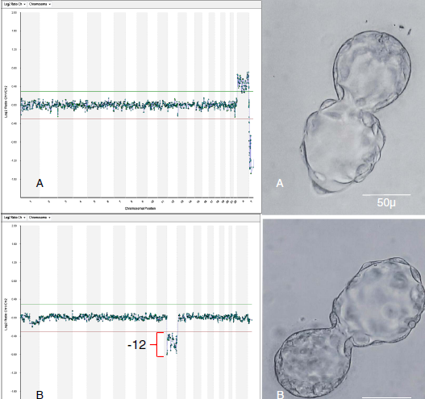
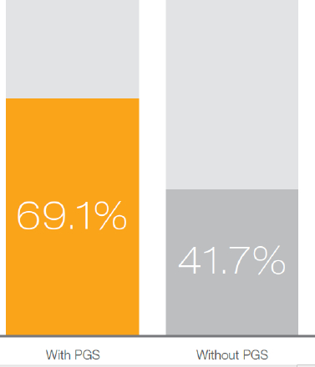
Selection of single blastocysts for transfer
Yang 2012 Mol Cytogenet

Slide 21
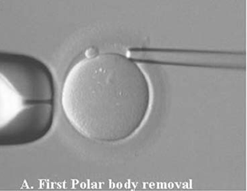
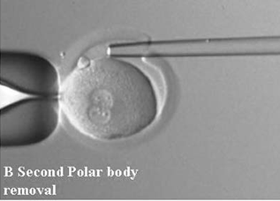
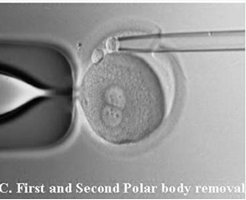
Polar body biopsy
Limited to female chromosomal disorders
No information regarding the chromosomal constitution of the subsequent embryo, 93% (Christopikou et al. 2013), 94% (Geraedts et al. 2014) concordance
Limited damage to embryo
Increased number of testing for all ova

Slide 22
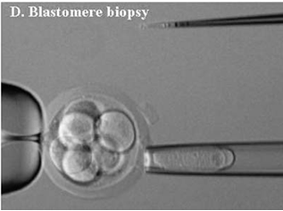
Cleavage-stage embryo biopsy
The most common approach
Single blastomere from day 3 embryos
Technically challenging procedure
May not be representative of entire embryo
Mosaicism
Self repair

Slide 23
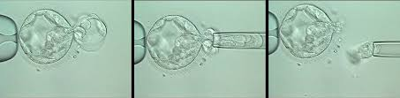
Blastocyst biopsy
Blastocyst formation begins on day 5 post-egg retrieval
Presence of an inner cell mass and the outer cell mass or trophectoderm.
More than 100 cells, up to 5 cells for testing
Mosaicism is reduced, and may be detected
Day 5 sampling , viability in vitro (≤6 d after egg retrieval)
Biopsied blastocysts day 6 transfer or frozen
Possible loss of viable embryos

Slide 24
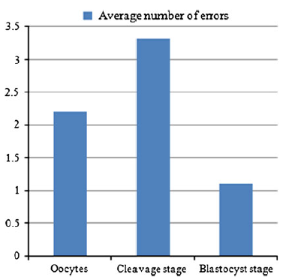
Results of comparison among different preimplantation stages
Fragouli 2013 Hum Genet

Slide 25

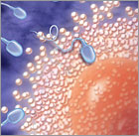
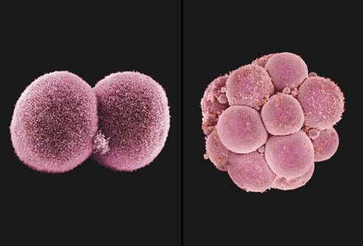
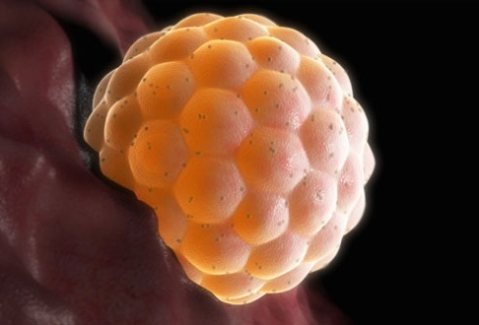
Primary candidates for PGS
Can include the following:
Women of advanced maternal age,
Couples with history of recurrent pregnancy loss
Couples with repeated IVF failure
Good prognosis patient
Male partner with severe male factor infertility

Slide 26


What can PGS offer
Achieve high efficiency embryo selection
Increase pregnancy rate per cycle
Faster time to pregnancy
Avoid unnecessary embryo transfer
Avoid cryopreservation of non viable embryos
Reduce miscarriage
Reduce Down syndrome
Prognostic information

