Slide 1
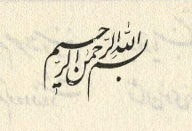
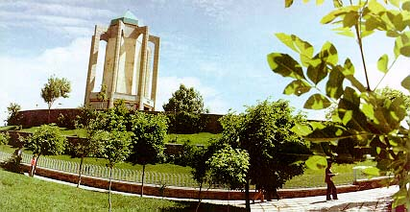
Near Hamedan, Iran
Nearly 900 years ago
Mehr 1393
9th Mehr 1388.

Slide 2
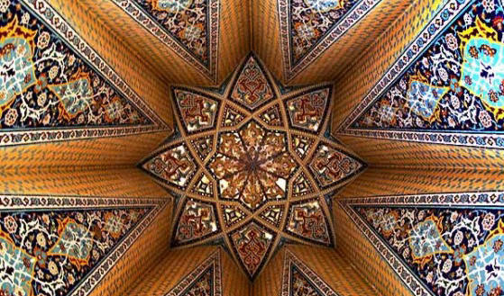

Slide 5
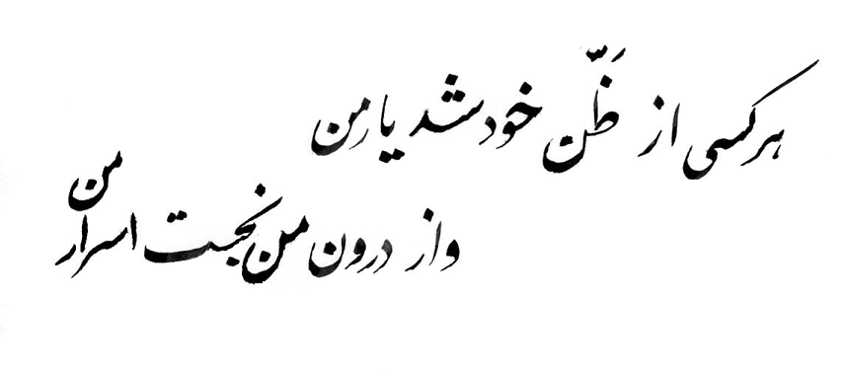

Slide 6
Types of Attention
Carlos Castaneda.

Slide 7
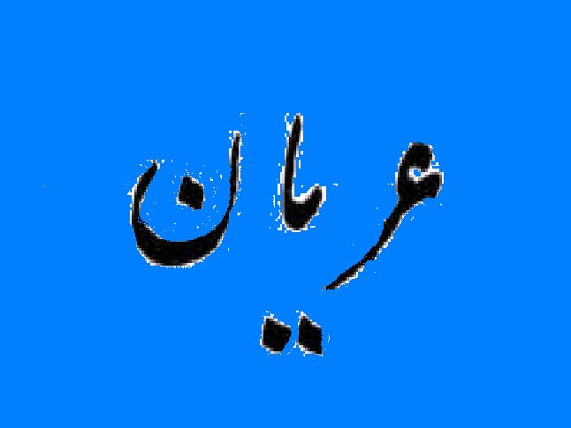
Was BaBa Taher truly orian
Was he a nudist
Was that just a nickname by which the people called him
Or was he orian of bad characters

Slide 8
Jokes about orian
Saadi, Bozorgash nakhanand ahle kherad
Ke name bozorgan be zeshti barad
Name nke rftegan zaie nakon Ta bamanad ame nkat yadegar

Slide 9
Budah:
Wants are the source of suffering
Naked of Wants

Slide 10
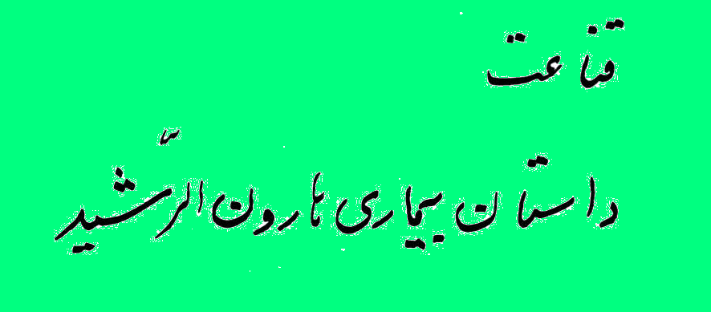

Slide 11
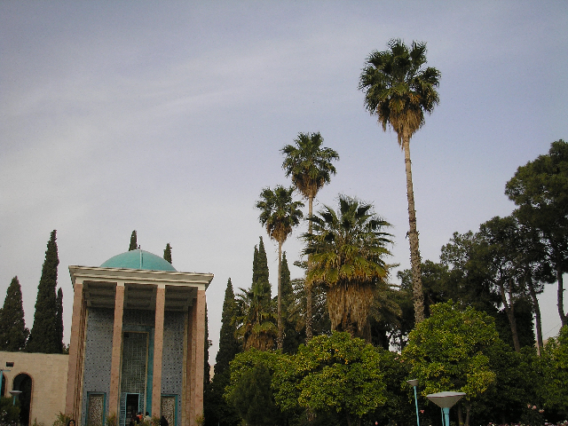
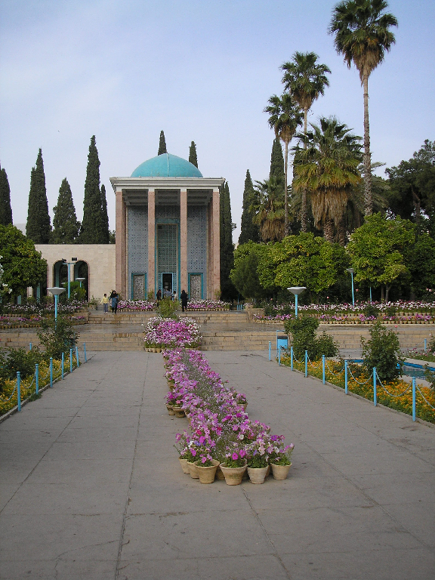
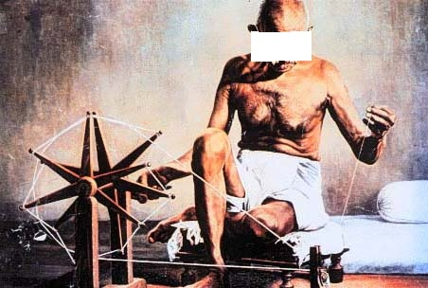

Slide 12
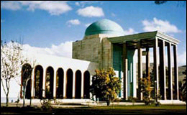

Slide 13
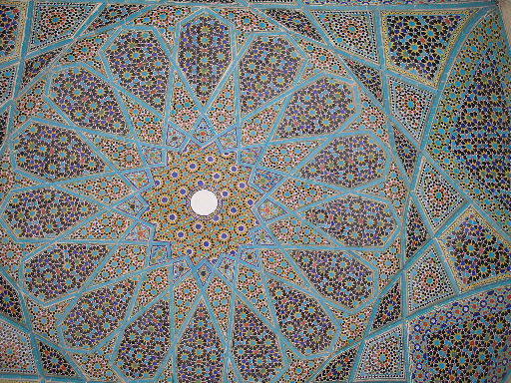
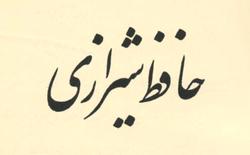

Slide 14
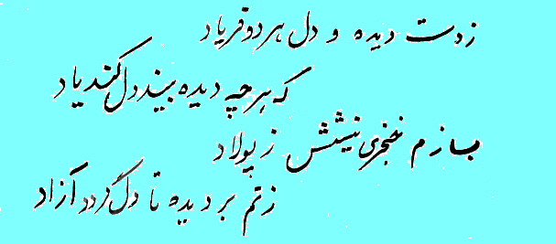

Slide 15
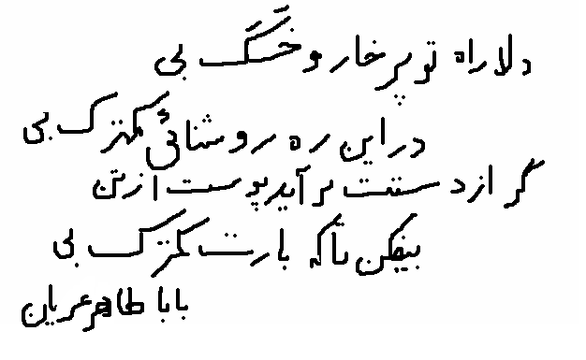
Contentment
Traveling Lightly
The One Thousand & One Night
Sindbad the Sailor & drowning of the ship

Slide 16
Orian has 2 aspects
1.. Orian as not wanting
2. Orian as being transparent before Doost

Slide 17
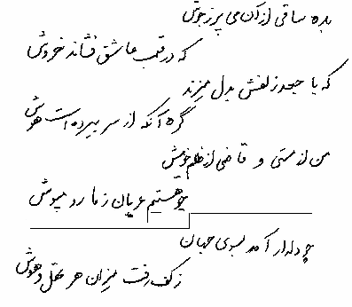

Slide 18
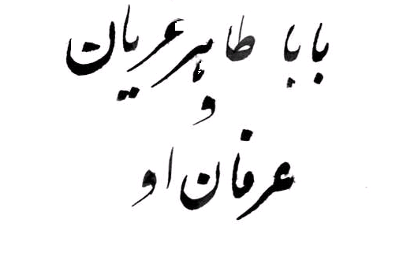
If BaBa Taher was here today:
What would he say
What would he think
What would be his advice to us

Slide 19
Metaphor, Esteareh
Metaphors were used to describe some indescribable thoughts/concepts
Tomb of BaBa Taher, Hamadan, Iran

Slide 20
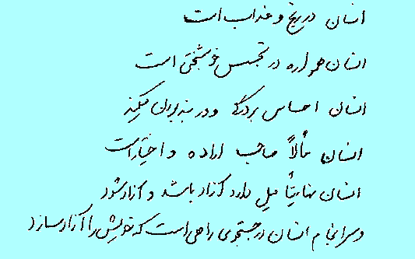
Why Do We Need Erfan?
In This World:
Man is in pain & agony
Man seeks happiness
Man feels enslaved
Man, ultimately, has a
choice
Man wants to be free
And, ultimately, Man
seeks ways to free himself

Slide 21
In This World
Man is in pain because he is separated from its origin
Man is a traveler on a path

Slide 22
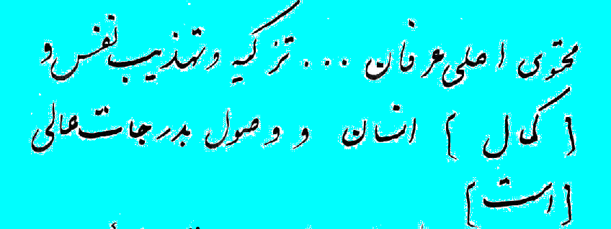
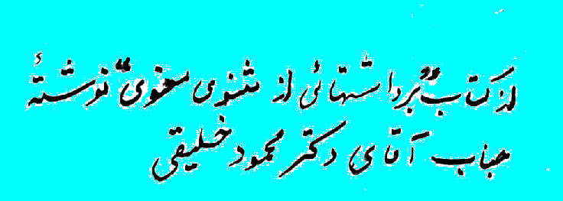

Slide 23
Mysticism

Slide 24
The Way
How to go there.
How to get there.

Slide 26
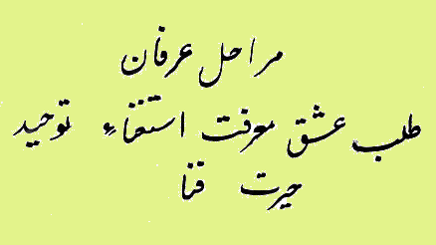
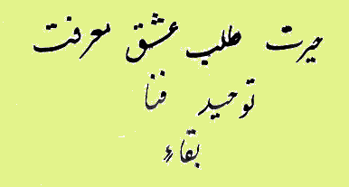
Attar, The Seven Cities of Love Variations In Mystisism

Slide 27
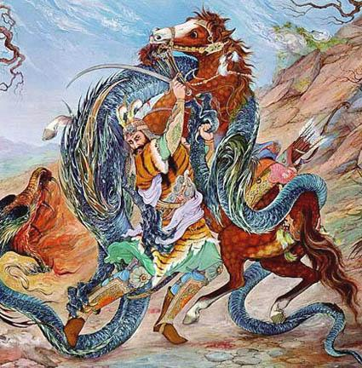
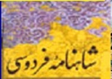
Seven
1. The one thousand and one night:
The seven journeys of Sinbad, the Sailor
2. Haft Khan Rostam.
3. Haft Gonbad Nezami Ganjavi.
4. Seven days of the week

Slide 28
First: Talab

Slide 29
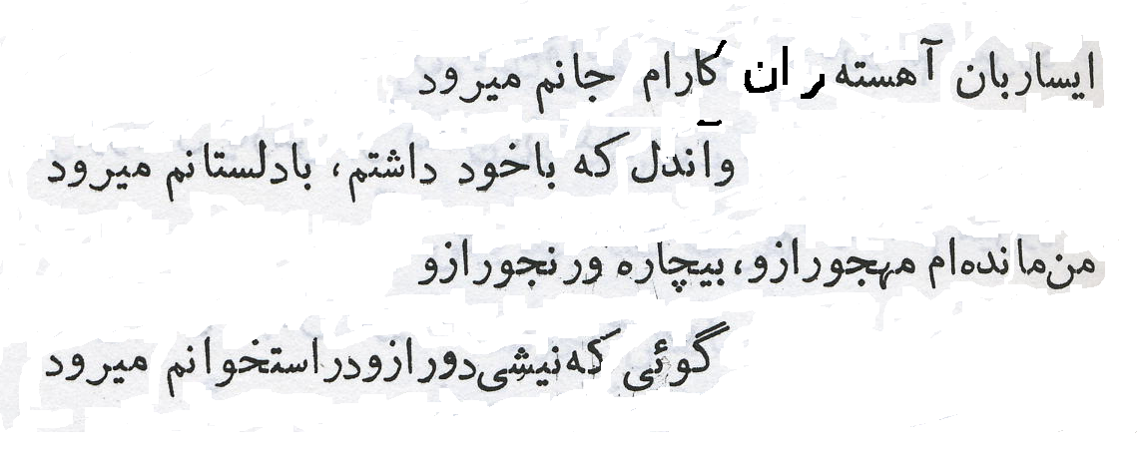
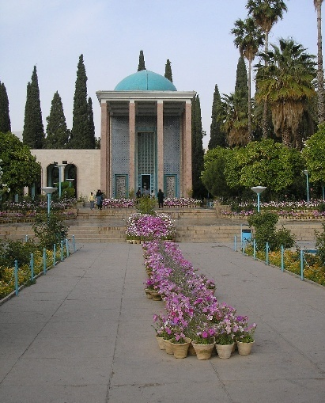

Slide 30
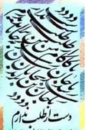

Slide 31
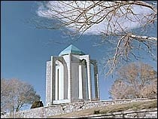

Slide 32
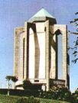
Last Updated: 12-Jul-96
Web Site Design by: Multimedia Internet Services, Inc. Send your Comments to: iranian@interport.net. Copyright © 1996 Abadan Publishing Co. All Rights Reserved. May not be duplicated or distributed in any form.

Slide 33
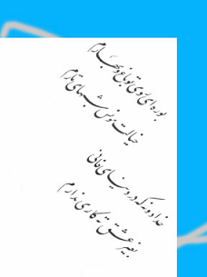

Slide 34
Life Is Not Forever

Slide 35
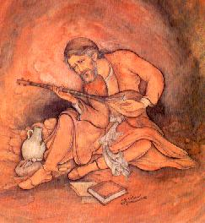
Life Is Not Forever Realization of Mortality No Permanency So true especially on a day like today.

Slide 36
The Worth of Materialistic Existence

Slide 37
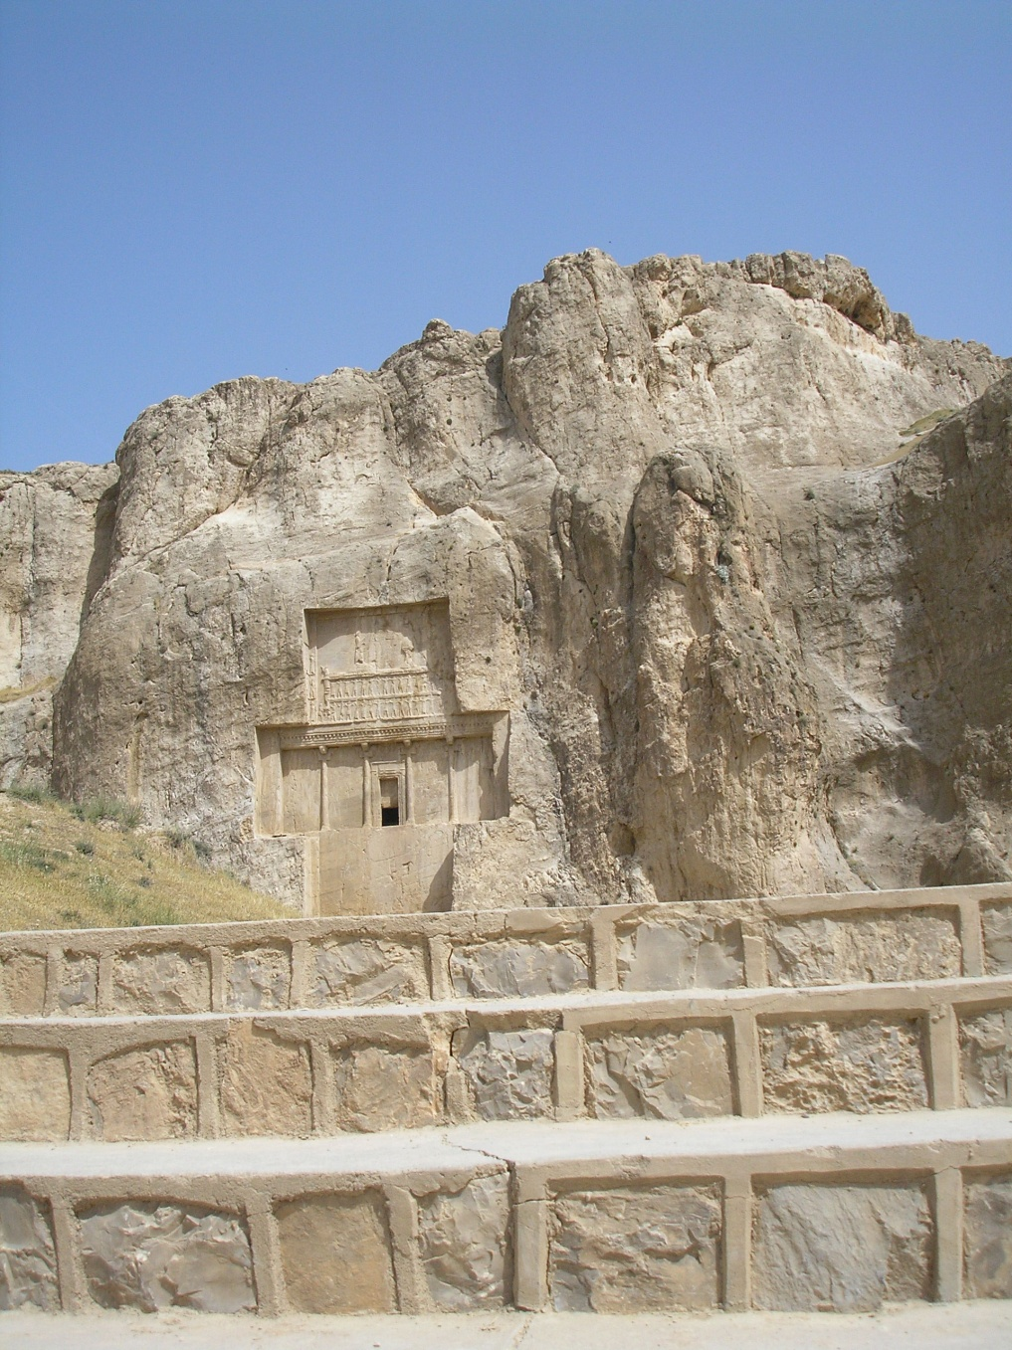
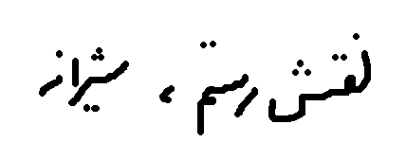
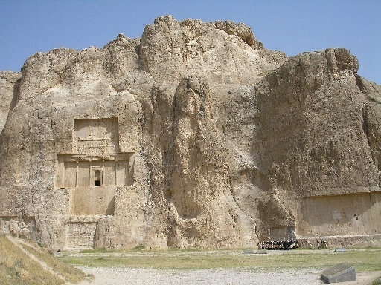
The Origins of Erfan (Mysticism)

Slide 38
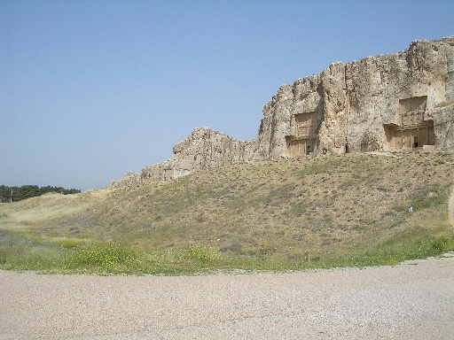

Slide 39
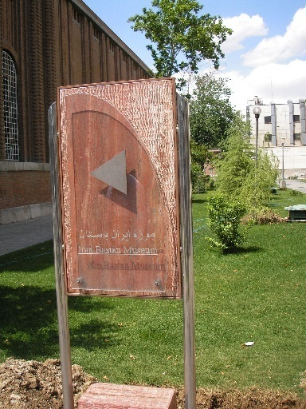
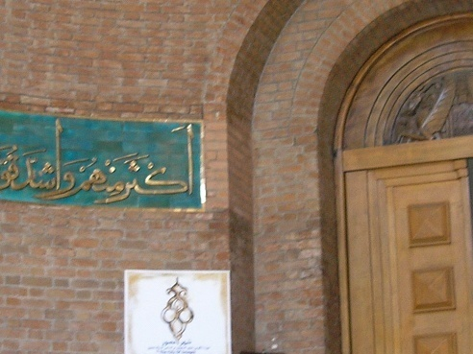
In The Name if Ahooramazda Kooroshe Kabir

Slide 40
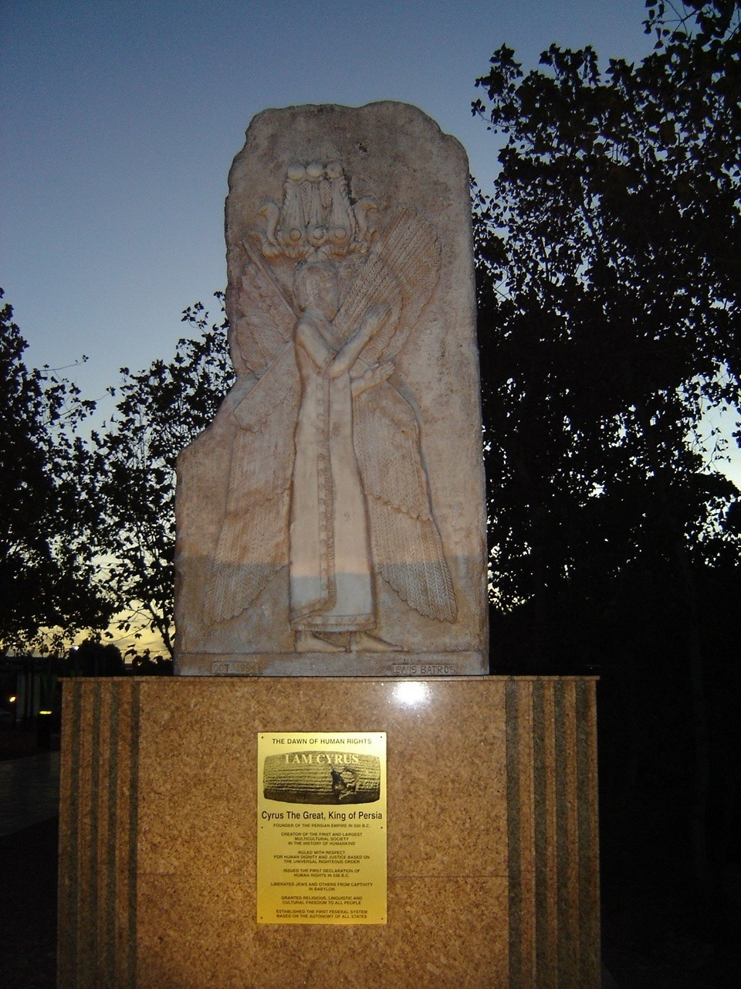
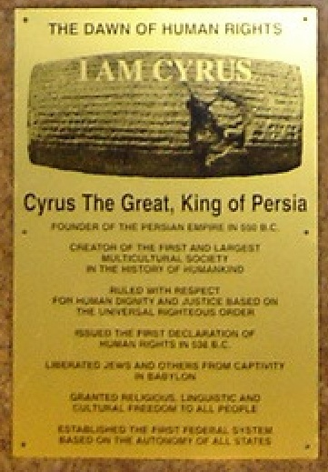
Sydney, Ausralia

Slide 41
سعدی » دیوان اشعار » غزلیات
اگر سروی به بالای تو باشد
نه چون بشن دلارای تو باشد
برای خود نشاید در تو پیوست
همی‌سازیم تا رای تو باشد
سر سعدی چو خواهد رفتن از دست
همان بهتر که در پای تو باشد
باباطاهر » دوبیتی‌ها
چه خوش بی‌مهربانی هر دو سر بی
که یکسر مهربانی دردسر بی
اگر مجنون دل شوریده‌ای داشت
دل لیلی از آن شوریده تر بی
Az sare rah chand to bardashti
Ta yar kera khahado meilash be ke bashad

Slide 42
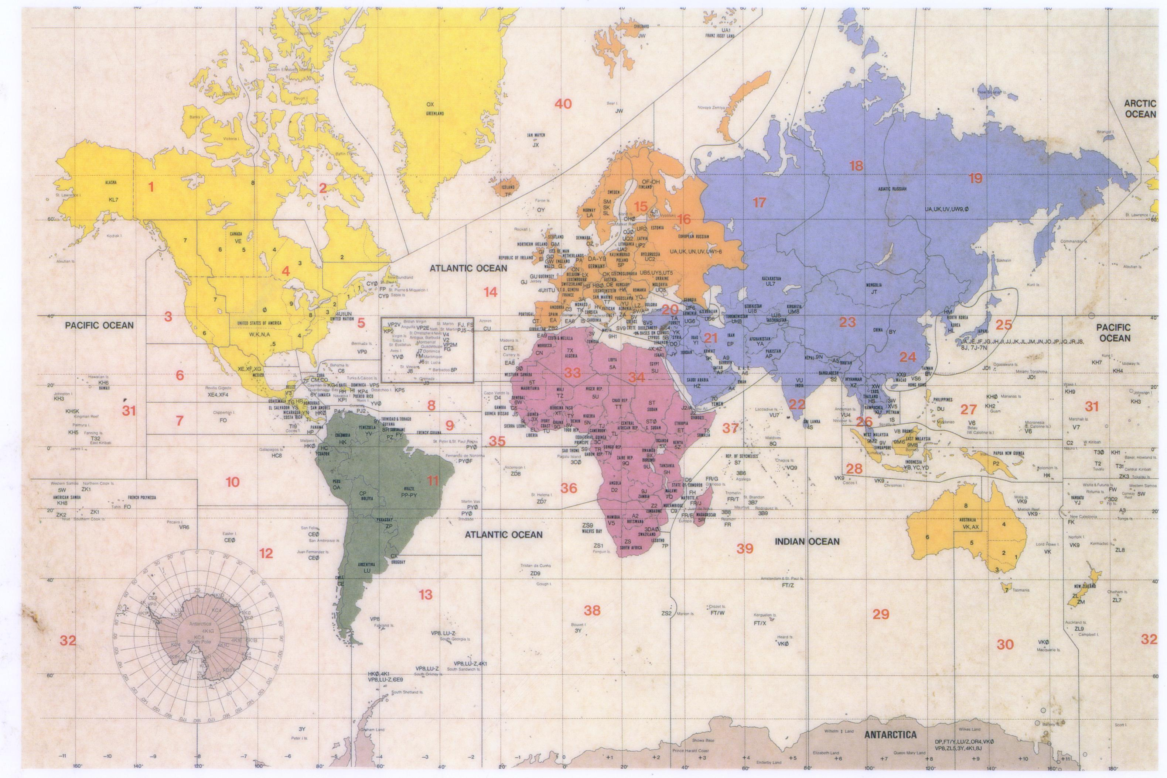
Mysticism Worldwide

Slide 43
Contributions of Iranian Mystiques
Shortcuts
A Bridge
Life as a Privilege

Slide 44
Tarighat

Slide 45
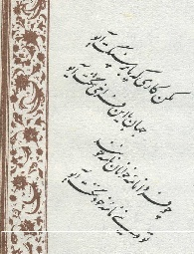
Tarighat

Slide 47
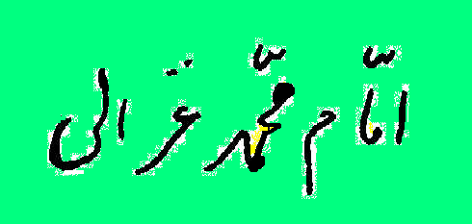
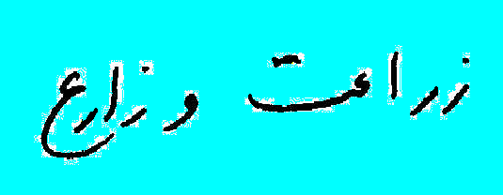

Slide 48
Permanency
Confucius: Definition of a gentleman
Saadi: Drown & drowning
صاحبدلی به مدرسه آمد ز خانقاه
بشکست عهد صحبت اهل طریق را
گفتم میان عالم و عابد چه فرق بود
تا اختیار کردی از آن این فریق را
گفت آن گلیم خویش بدر می‌برد ز موج
وین جهد می‌کند که بگیرد غریق را

Slide 50
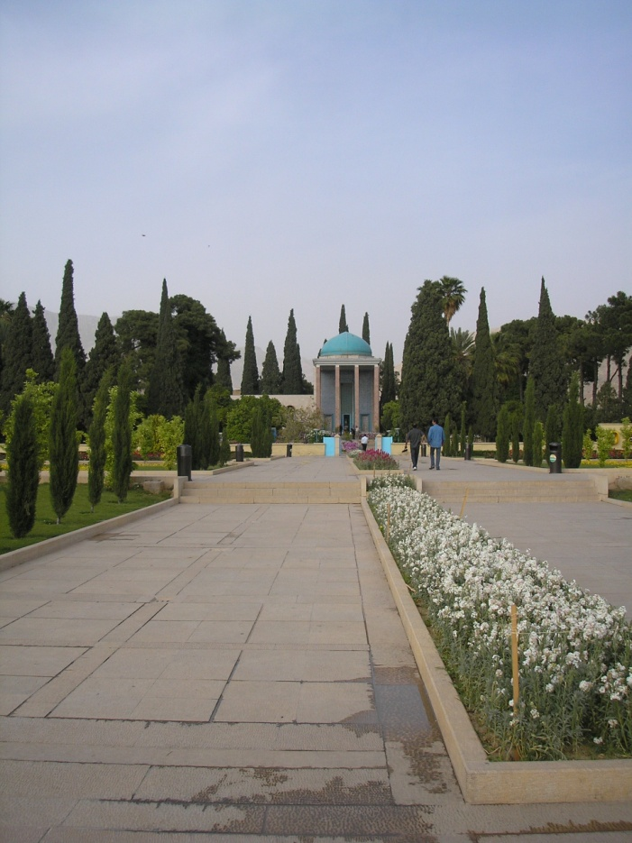

Slide 51
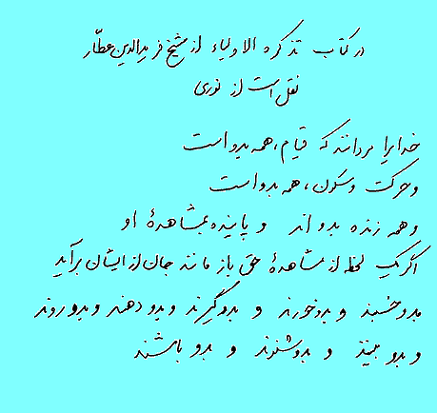

Slide 52
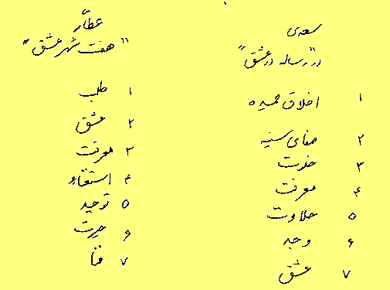
Akhlaghe Hamideh
Safaie sineh
Khalvat
Marefat
Halavat
Vajd
Eshgh

Slide 53
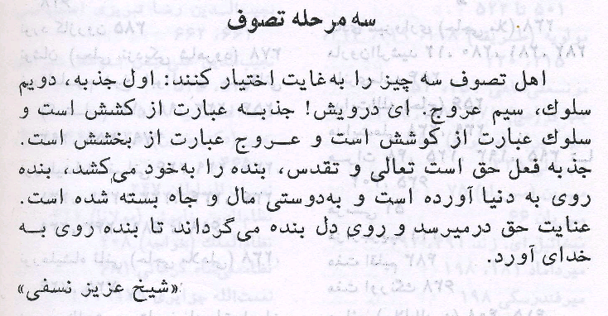

Slide 54
Torment, Anguish

Slide 55
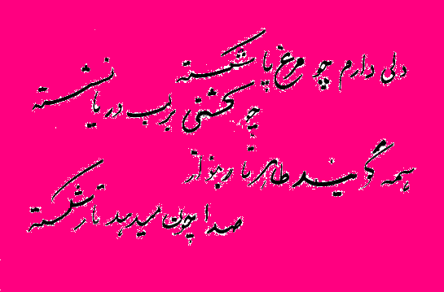
Torment, Anguish

Slide 56
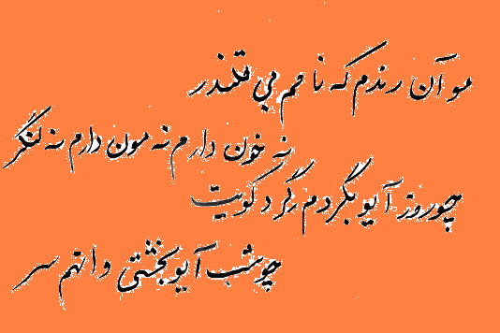
Bewilderment

Slide 57
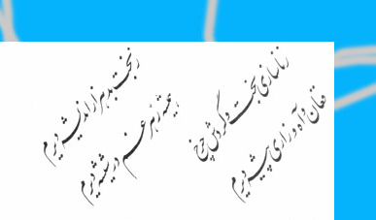
Torment, Anguish

Slide 58
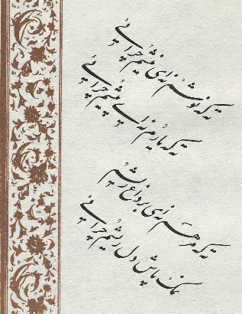
Torment, Anguish, Bewilderment, Love

Slide 59
Torment, Anguish, Bewilderment, Love

Slide 60
Torment, Anguish, Bewilderment

Slide 61
Bewilderment

Slide 62
Bewilderment

Slide 63
Tahhayor

Slide 65
Bewilderment

Slide 66
Tavakkol, Tavassol & Tasslim Faith, Acceptance & Yeilding

Slide 69
Universal Unity A Cosmic Affection Tawheed

Slide 70
Universal Unity A Cosmic Affection Tawheed

Slide 71
Universal Unity A Cosmic Affection Tawheed

Slide 72
Me or You The Same?
Molana: Story of the man who goes to the house of his beloved

Slide 73
Unification

Slide 78
Thanks For Listening
AlsoThanks to:
Dr. Osatd Moslem Bahadori
Dr. Osatd Alireza Ranjbar
Dr. Osatd Zia Norouzi
And many others.

Slide 80
Thanks For Listening
AlsoThanks to:
Dr. Khademi
Dr. Khalighi
Mr. Mahboobzadeh

