Slide 2
Development and Dosimetry of ⁴⁶Sc-HEDP as a bone-Seeker Radiopharmaceutical
Leila Moghaddam Banaem

Slide 3
In diagnosis radiopharmaceuticals produce images that enable the function and living chemistry of the body to be evaluated.
Radiopharmaceuticals are designed for internal radiotherapy, because they accumulate in tumours and eliminate cancerous cells by selective targeting, without harming healthy cells.
Bone-seeking radiopharmaceuticals are used for the palliative treatment of bone pain resulting from skeletal metastases.

Slide 4
Mechanisms of Localization
Compartmental localization and leakage
Cell sequestration
Phagocytosis
Passive diffusion
Metabolism
Active transport

Slide 5
Localization (cont.)
Capillary blockade
Perfusion
Chemotaxis
Antibody-antigen complexation
Receptor binding
Physiochemical adsorption

Slide 6
Ligand from Latin ligare “to bind”
“a molecule or anion with an unshared pair
of electrons donating a lone pair to a metal
cation to form a coordinate covalent bond”
Elements with unshared pairs of electrons capable of being ligands:
C, N, O, S, F. Cl, Br, I
Molecules acting as ligands:
:NH₃; :OH₂
Ions acting as ligands:
Cl⁻, Br⁻, I⁻,

Slide 7
Ideal Radiopharmaceuticals
Low radiation dose
High target/nontarget activity
Safety
Convenience
Cost-effectiveness

Slide 8
Therapy isotopes for bone pain palliation
Isotope | t_{1/2}(days) | E_{β (max)} (MeV) | γ Emission (keV) | Abundance %
³²P | 14.3 | 1.7
⁸⁹Sr | 50.5 | 1.46
¹⁵³Sm | 1.9 | 0.81 | 103 | 29
¹⁸⁶Re | 3.8 | 1.07 | 137 | 9
¹¹⁷Sn^{m} | 13.6 | 0.13,0.16 | 158 | 87
⁴⁷Sc | 3.35 | .441 | 159 | 7

Slide 9
Bone Seeker Carrier
H
H
H
O
R2
O
O
C
O
O⁻
P
C
P
O⁻
O⁻
P
C
P
O⁻
R1
O⁻
O⁻
OH
O⁻
O⁻
Molecular structure of HEDP
C₂H₄Na₄O₇P₂
Molecular structure of Bisphosphonate

Slide 10
Scandium
رادیونوکلئید | نیمه عمر | حالت واپاشی | انرژی گاما((keV | متوسط انرژی بتا((keV
اسکاندیوم-46 | 83/9 روز | بتا منفی | (99/98%)889/28 (99/99%)1120/55 | (99/99%)112
اسکاندیوم-47 | 3/35روز | بتا منفی | (68%)159 | (68%)142-(32%)204
اسکاندیوم-48 | 1/82روز | بتا منفی | (100%)1312-(100%)983 (97%)1037 | (100%)157-(89%)226

Slide 11
HPGe spectrum for SC-46 chloride solution used in this study

Slide 12
TLC of ScCl3 by NH4OH:CH3OH:H2O

Slide 13
TLC of ⁴⁶Sc-HEDP

Slide 14
Biodistribution of ⁴⁶Sc-HEDP

Slide 15
Biodistribution of ¹⁸⁶Re-HEDP

Slide 16
Spect of Rat 24h after Re-HEDP injection

Slide 17
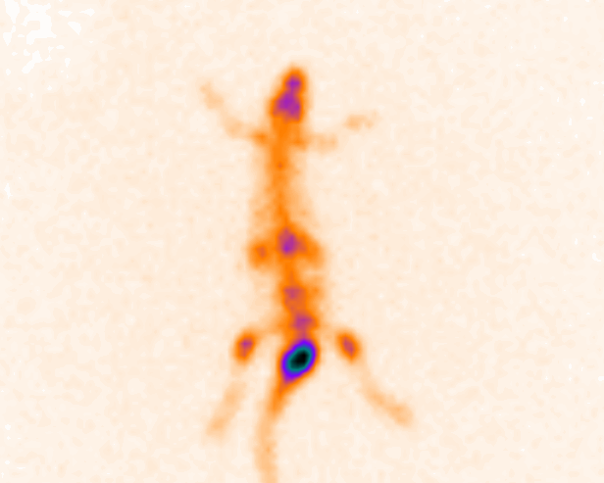
Spect of Rat 4h after ⁴⁶Sc-HEDP injection

Slide 18
¹⁸⁶Re-HEDP scintigraphy 48 h after the treatment infusion.

Slide 19
Dosimetry Methods
Types of Dosimetry
Marinelli/Quimby
ICRP
RADAR
Dose Calculation for Staff and Patients
ICRPII
ICRP30
Electronic Source
Software OLINDA/EXM
Dose Calculation for Staff and Patients
MIRD

Slide 20
Dose Calculation-MIRD method
A(t)=a₁e^{-b1t}+a₂e^{-b2t}+….
ICRP89
(International Commission on Radiological Protection)

Slide 21
Estimated human %ID

Slide 22
Estimated Human Absorbed Dose
Organ | Accumulated Acivity (µCi-h) | Absorbed Dose (mGy/MBq)
L-Intestine | 4 | 0.133
H-Intestine | 4 | 0.273
Stomach | 7 | 0.066
Kidney | 22 | 0.109
Liver | 241 | 0.168
Lung | 5 | 0.078
Spleen | 11 | 0.113
Bone-Surface | 5946 | 2.25
Red-Marrow |  | 0.758
Total Body | 2295 | 0.254

Slide 23
Conclusion
 | ¹⁸⁶Re-HEDP | ⁴⁷Sc-HEDP
Stability | 48h in room Temp. | 48h in room Temp.
Biodistribution | 4 h maximum %2.4in bone | 4h maximum & %6.31 in bone
Performing | Simple Target preparation Equal product expense With impurity | Simple Target preparation Needs separation Equal product expense Without impurity

