Slide 1
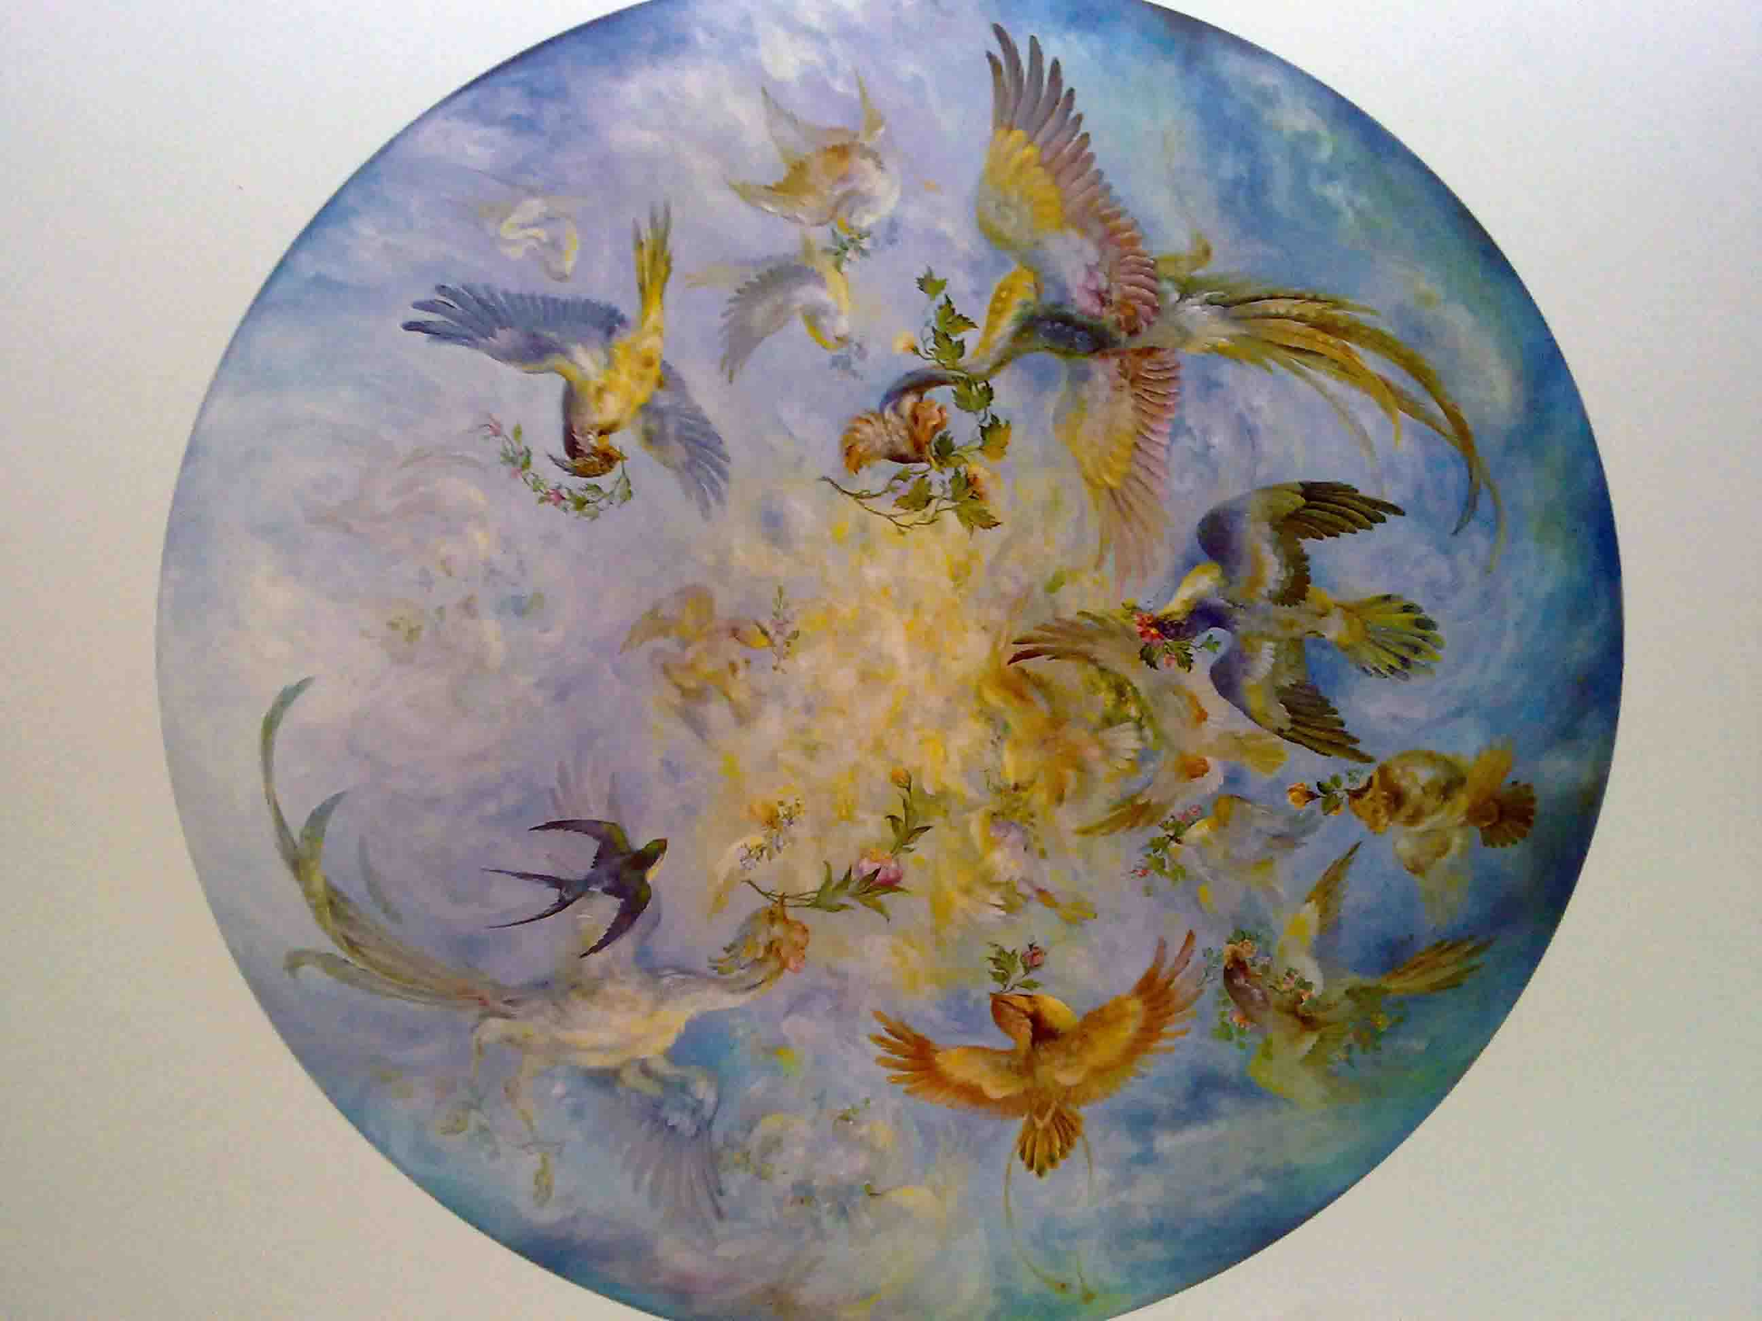
بسم الله النور

Slide 2
NON-ABLATIVE CO2 LASER THERAPY (NACLT) A NEW APPROACH TO RELIEVE PAIN IN PAINFUL ORAL MUCOSAL LESIONS
Nasrin Zand, MD
Dermatologist, Assistant Professor of Dermatology,
Iranian Center for Medical Laser (ICML),ACECR, Tehran, Iran

Slide 3
Parvin Mansouri, MD
Dermatologist, Professor of Dermatology, Imam Khomeini hospital, Tehran University of Medical Sciences
Leila Ataie-Fashtami, MD
Dermatologist, Assistant Professor of Dermatology, Iranian Center for Medical Laser (ICML)
Mohsen Fateh, MD, MPH
Research Fellow, Iranian Center for Medical Laser (ICML)
Gholamreza Esmaeeli Djavid, MD
Research Fellow, Iranian Center for Medical Laser (ICML)
Safa Najafi
Internist, Medical Oncologist, Assistant Professor of Oncology, Iranian Center for Breast Cancer (ICBC),ACECR
Mohammad-Reza Alinaghizadeh, MSc
Researcher, Medical Physicist

Slide 4
Low- Vs. High-Power Lasers
High power lasers
Photothermal effects
Used in medicine for
Surgical cutting , ablation, coagulation
Laser hair reduction
Resurfacing
Vascular lesions
Pigmented lesions, tatoo removal
etc.

Slide 5
Low- Vs. High-Power Lasers
Low power lasers
Photochemical effects
Used in medicine for:
Promoting wound healing and tissue repair and prevention of tissue death
Relief of inflammation
Pain relief

Slide 6
High power CO2 laser Has been used as ablative, coagulative and cutting device successfully.

Slide 7
NON-ABLATIVE CO2 LASER THERAPY (NACLT)
Immediate pain relief
Procedure: pain free, no need to anesthesia
No visual effects of mucosal damage

Slide 8
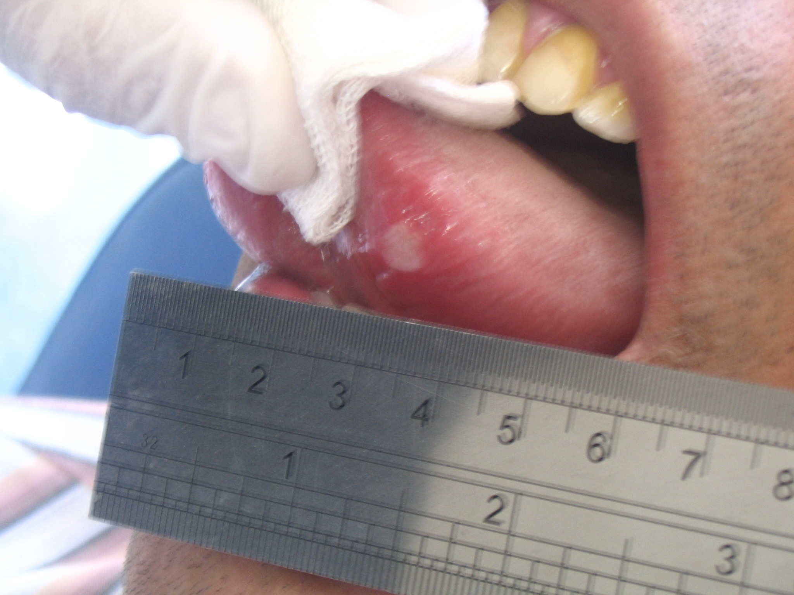

Slide 10
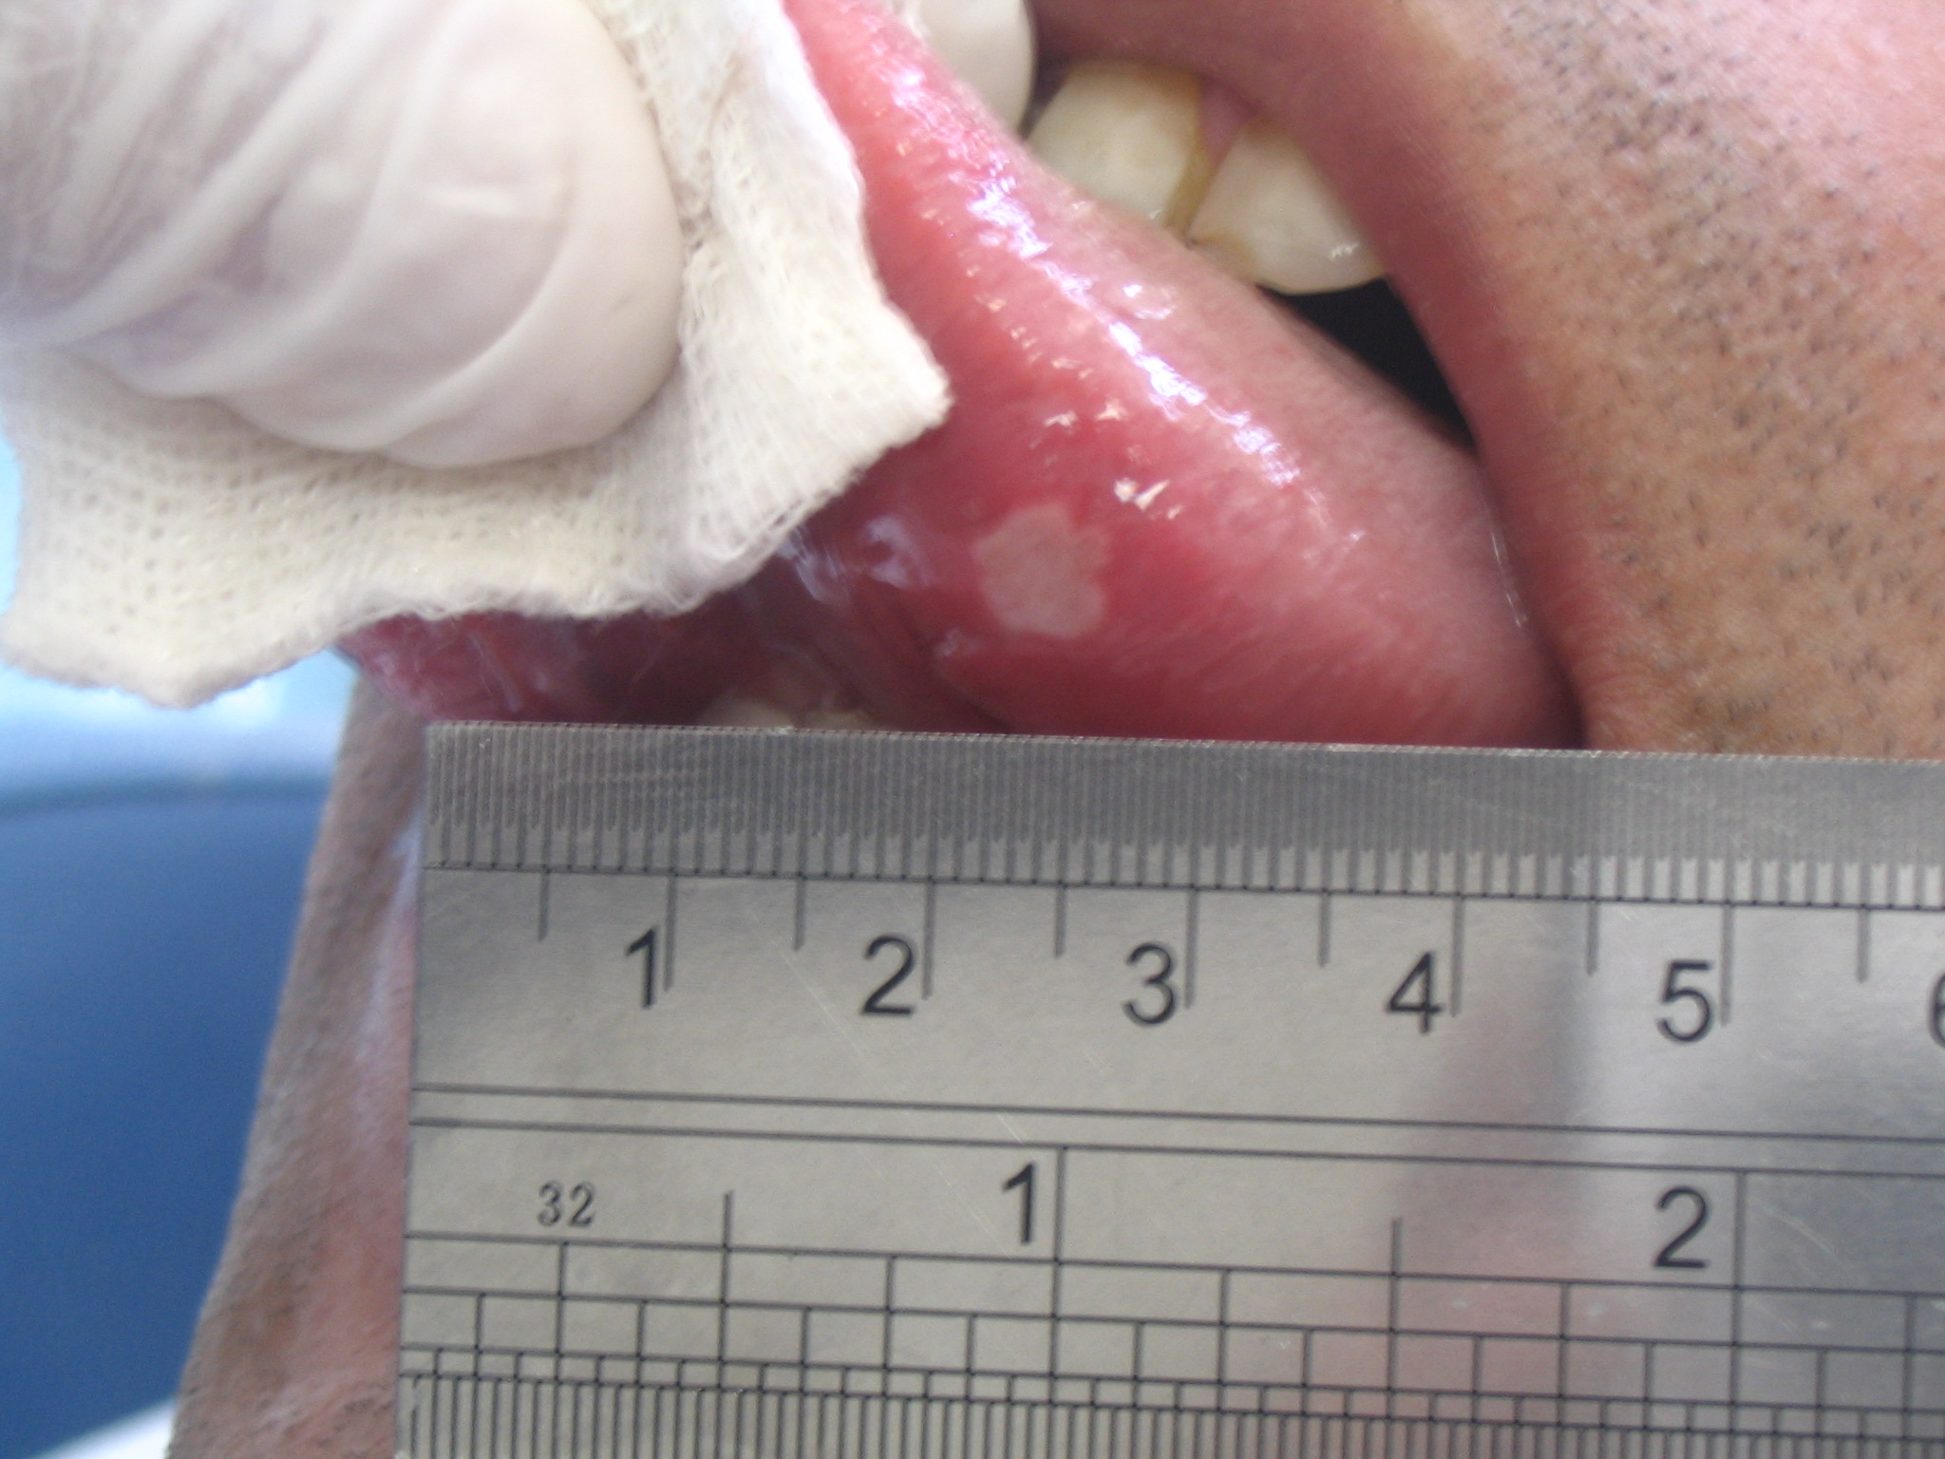

Slide 11
Case report- (Buller ,2004)
Two patients with aphthous ulcers
Before laser irradiation: Elmex gel
CO2 laser: Power out put : 1-1.5 w
Defocused hand piece
Irradiation time: 5 sec
Immediate pain relief
Procedure: pain free
No visual effects of mucosal damage

Slide 12
However,
No control group
Small sample size
So,
We designed an RCT to evaluate the effects of CO2 laser in non ablative manner in reducing pain and promoting wound healing in RAS as a prototype of painful oral mucosal lesions.

Slide 13
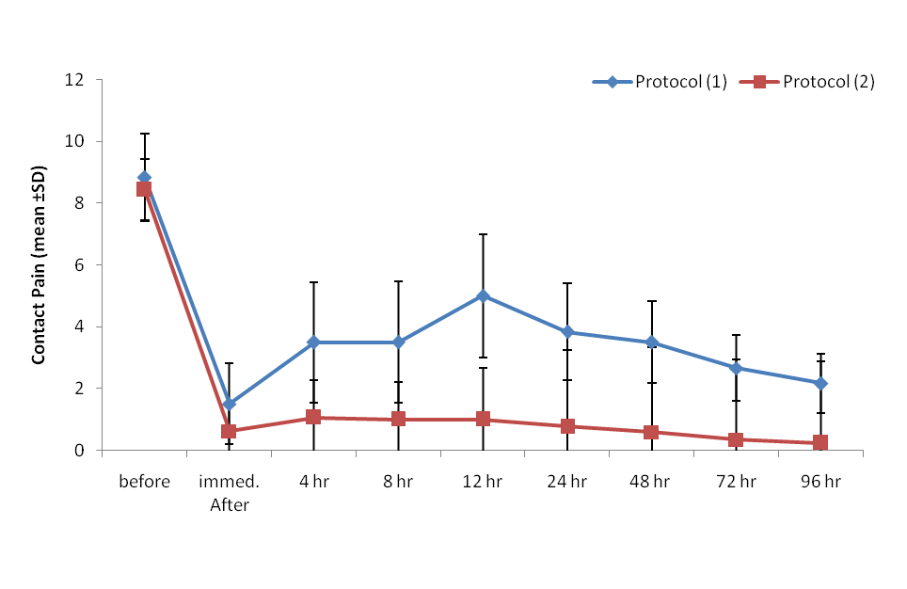

Slide 14
Recurrent Aphthous Stomititis
Randomized controlled clinical trial

Slide 15
Patient selection
Careful examination by: Dermatologist
Ophthalmologist
Pathergy test
Lab tests: CBC, ESR, CRP, serum ferritin, B12, Folic Acid, Ca, P.

Slide 16
Inclusion Criteria
Reliable history of RAS
Presence of 2 similar discrete painful aphthous ulcers at the same time
Age of the ulcers less than 3 days for miRAS and 5 days for maRAS

Slide 17
Exclusion Criteria
Age less than 18 years
Pregnancy
Lactation
Any systemic disease predisposing the patient to aphthous like lesion

Slide 18
Study procedure
Random allocation (laser/ control)
Placing gel on both the laser and control lesions.
CO2 laser: (10600nm/ lancet 2/ Russia)
Power out put: 1W
Defocused handpiece
Continuous mode
Circular motion
5-10 sec / pass
Procedure: pain free

Slide 19
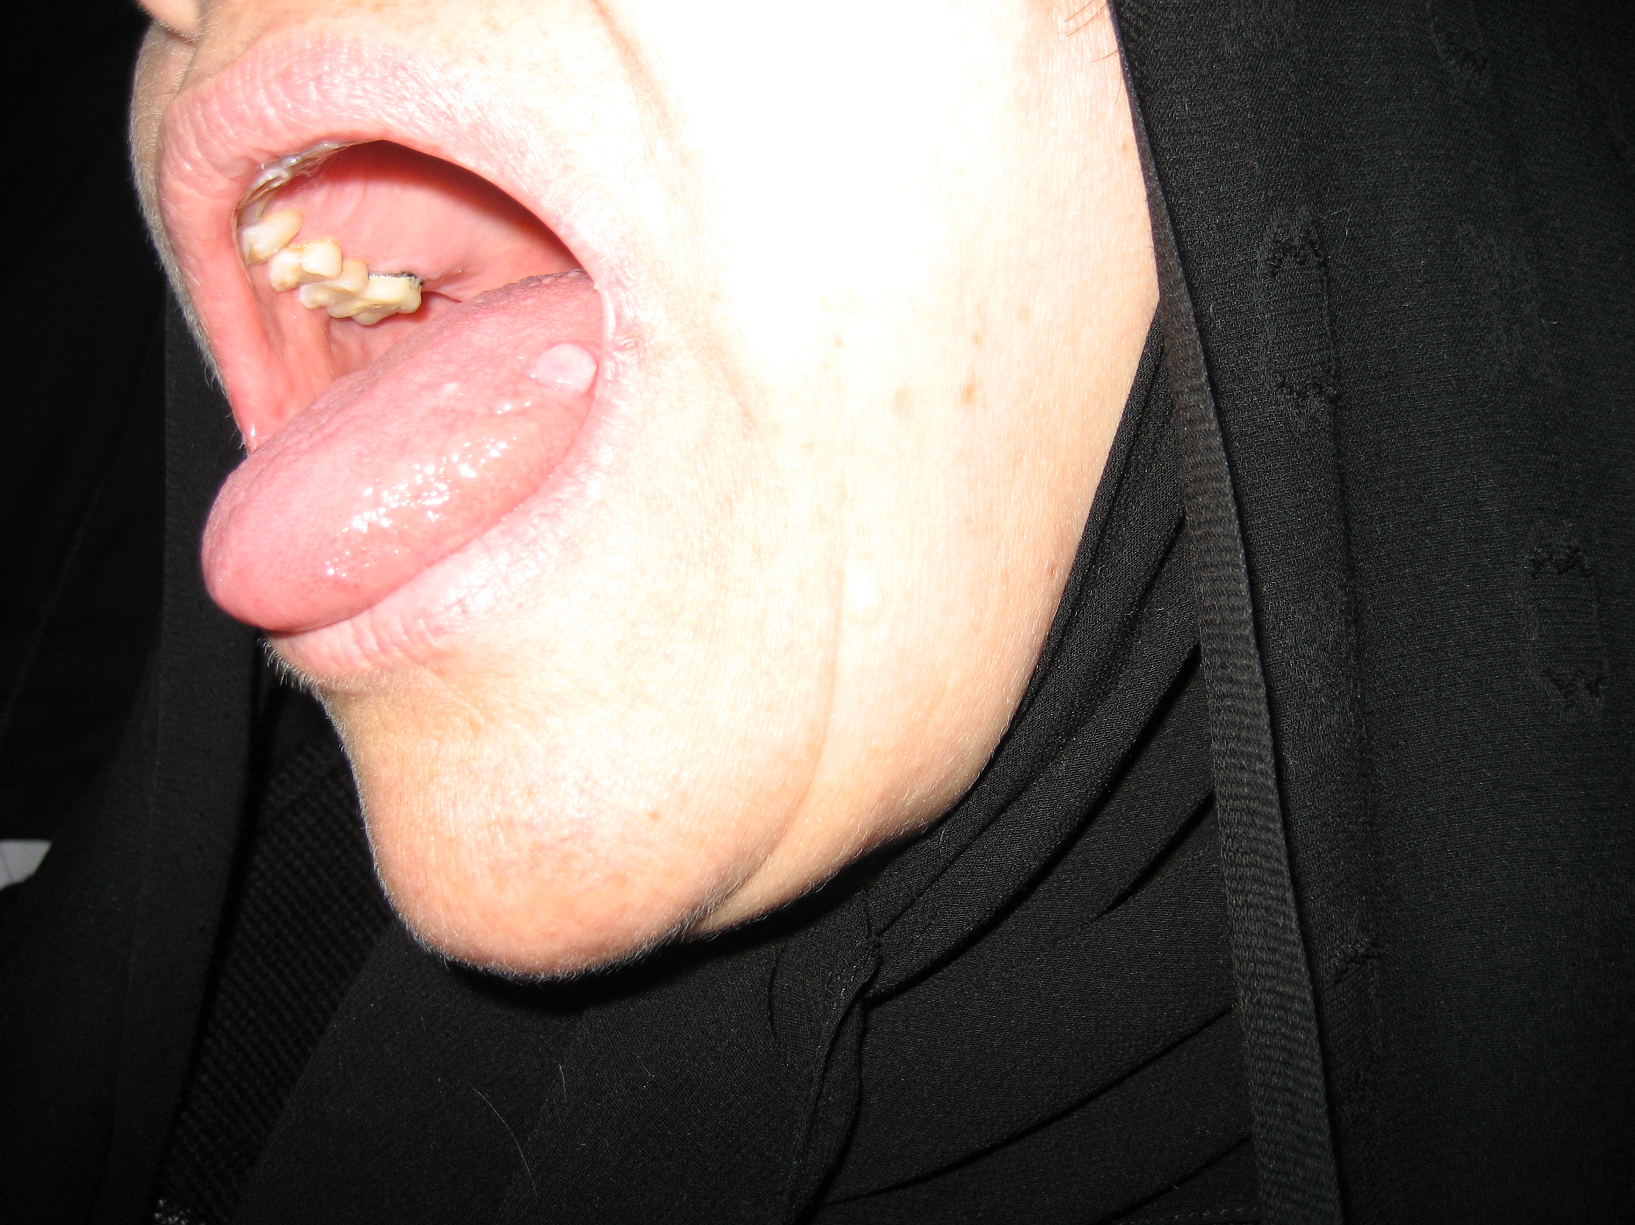
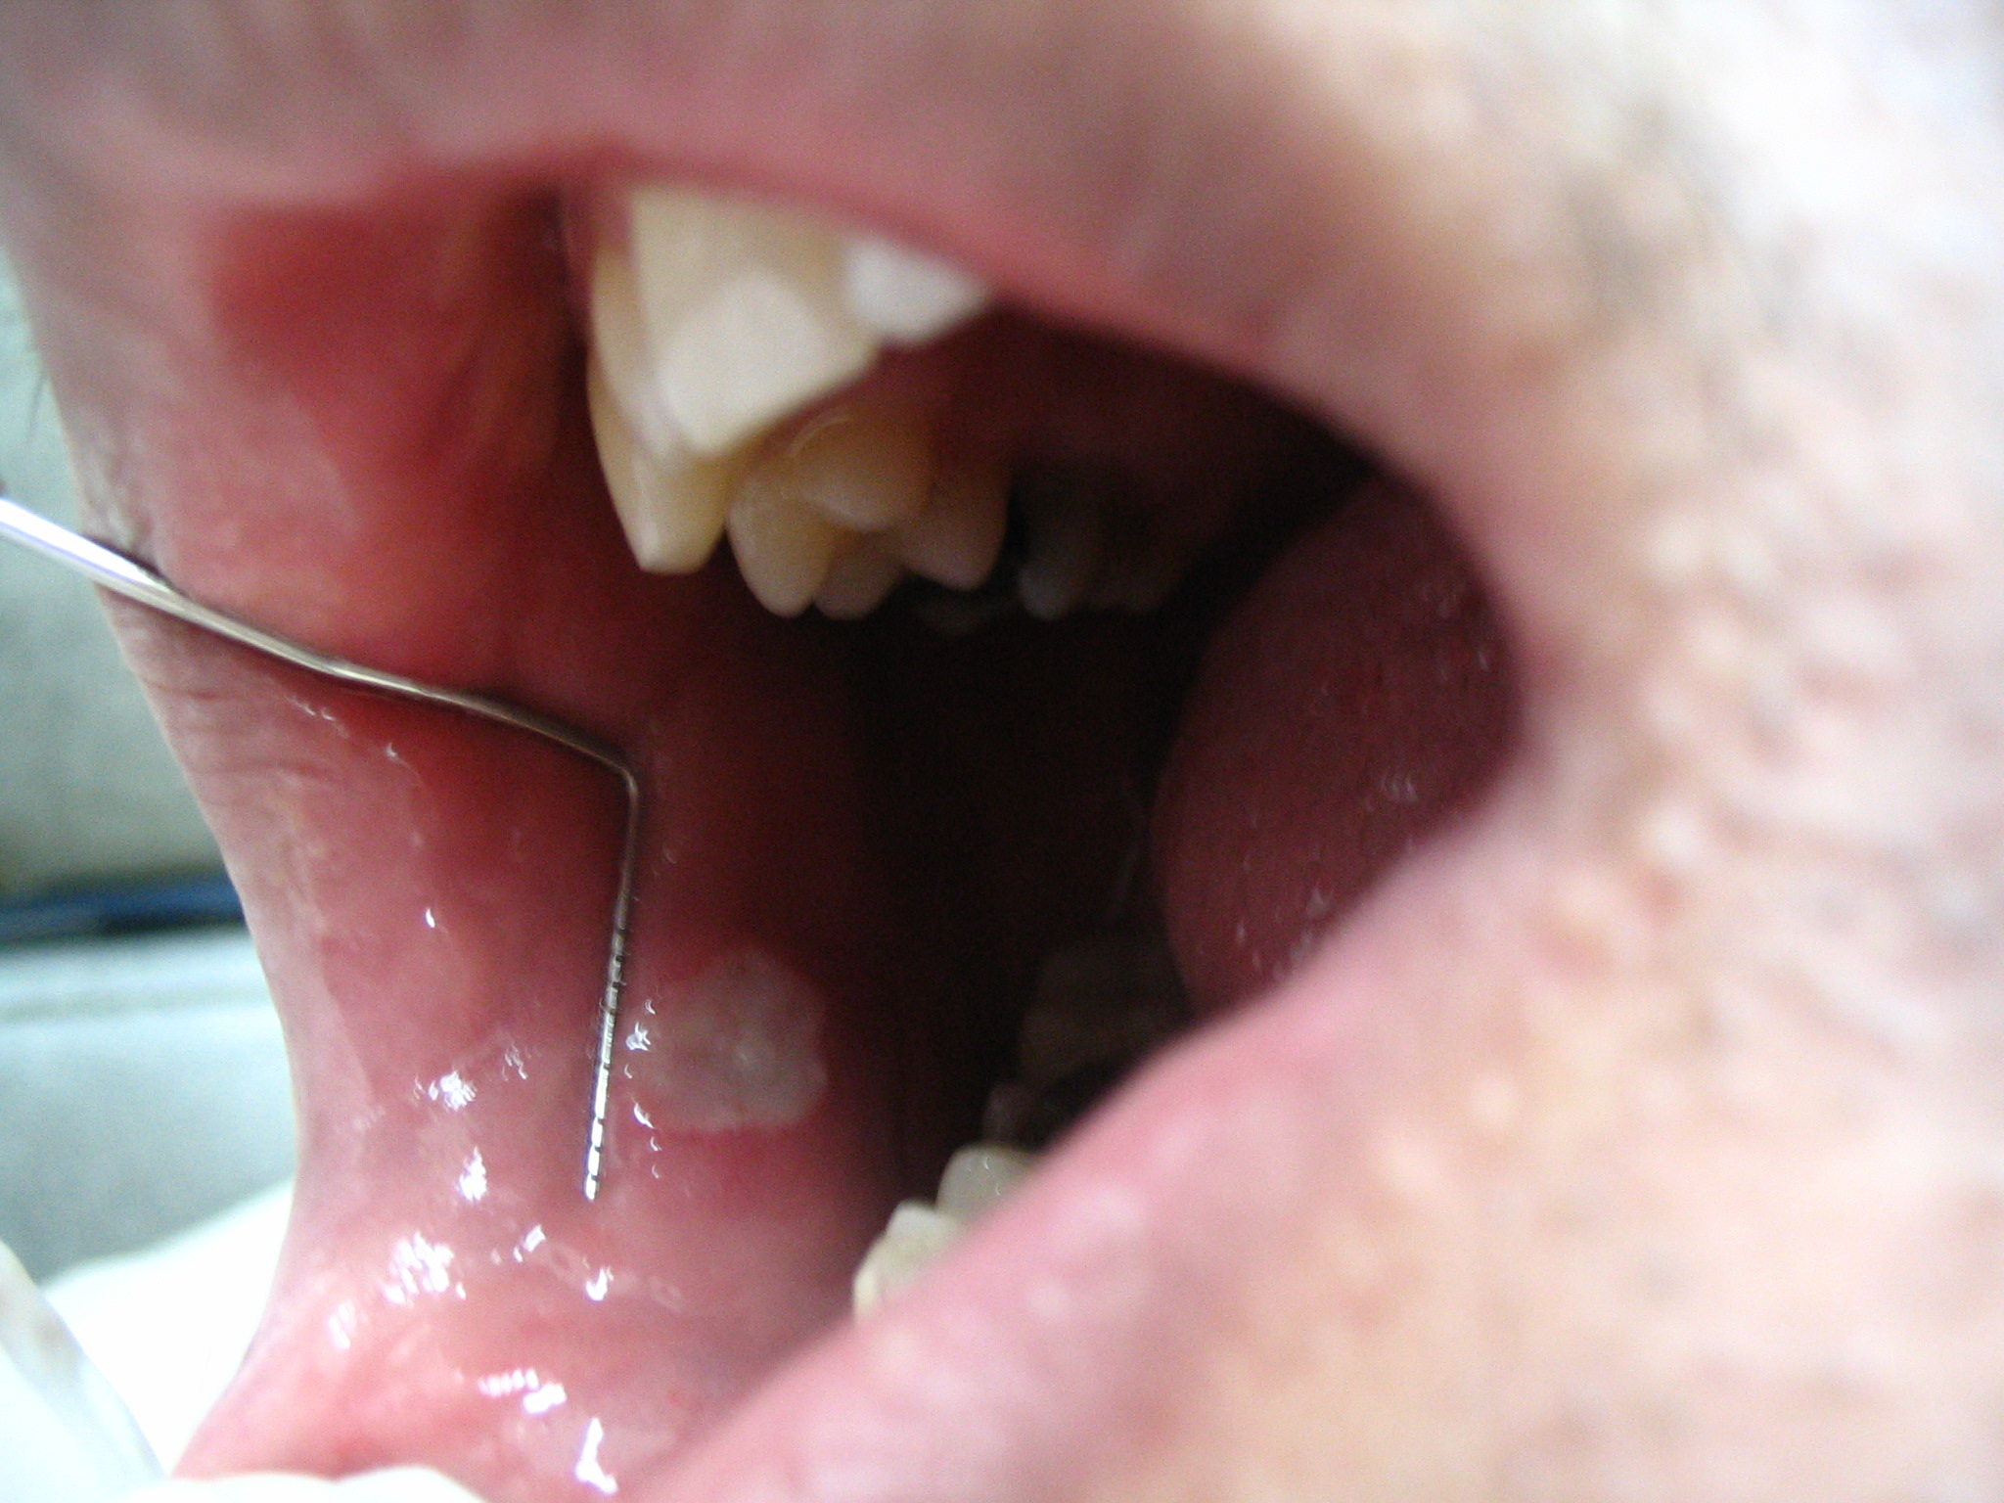

Slide 20
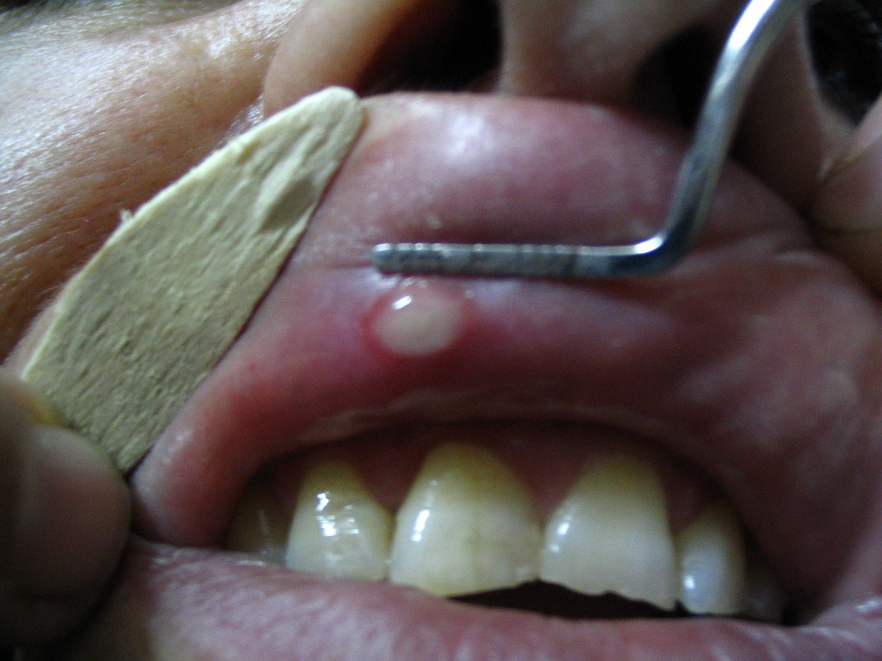

Slide 22
Results

Slide 23
Results
24 patients with MiRAS
6 patients with MaRAS
Immediate, dramatic and sustained pain relief (p-value<0.001)
Accelerate wound healing (p-value<0.05)
No pain during laser therapy
No warmth sensation
No visual effect of damage to oral mucosa
No smoke

Slide 24
Non-contact pain

Slide 25
Contact pain

Slide 26
Wound healing

Slide 27
Powermetery
1 Watt
Gel
2-5 mW
(In the range of LLLT)

Slide 28
In fact by using a transparent gel
with high water content, we can use CO2 laser
as a non ablative, low power laser
(NACLT)
to relieve pain immediately and dramatically, and
accelerate wound healing
in recurrent aphthous stomatitis
without visible side effects.

Slide 29
Articles & Presentations
Zand N, Ataie-Fashtami L, Djavid GE, Fateh M, Alinaghizadeh MR, Fatemi SM, Arbabi-Kalati F. Relieving pain in minor aphthous stomatitis by a single session of non-thermal carbon dioxide laser irradiation. Lasers Med Sci. 2009 Jul; 24(4):515-20.
Zand N, Ataie-Fashtami L, Fateh M, Djavid GE, , Fatemi S, Shirkavand A. Promoting wound healing in minor recurrent aphthous stomatitis by non thermal, Non-Ablative CO2 Laser Therapy. Photomed Laser Surg. 2012
Zand N, Ataie-Fashtami L, Fateh M, Mansouri P, Djavid GE, Fatemi S, Alinaghizadeh M. Analgesic effects of single session of Non-Ablative, CO2 Laser Therapy (NACLT) in major aphthous ulcers (A preliminary study). Lasers in medicine 2010; 6(4): 6-12.
"Non-ablative, CO2 laser Therapy (NACLT): A new approach to relieve pain in oral mucosal lesions" accepted for oral presentation at WALT-2010 (World Association for Laser Therapy) congress, Bergen, Norway, 25-28th September 2010

Slide 30
Articles & Presentations, cont…
CO2 laser reduces pain in a non-ablative manner in minor recurrent aphthous stomatitis. A randomized clinical trial. (oral presentation) Razi hospital , Tehran, Iran, 1386, Zand N, Ataie-Fashtami L, Djavid GE, Fateh M, Alinaghizadeh MR, Fatemi SM, Arbabi-Kalati F.
Non-ablative, CO2 laser Therapy (NACLT): A new approach to relieve pain in oral mucosal lesions. 50th International Annual Congress of The Iranian Dental Association, Tehran, Iran,2010.
Relieving pain and promoting wound healing in minor recurrent aphthous stomatitis by a single session, non-thermal CO2 laser irradiation. The 28th annual conference of the American society for laser in medicine and surgery (ASLMS), April 2008 Florida, USA. (accepted for oral presentation)
CO2 laser reduces pain in minor recurrent aphthous stomatitis: A randomized controlled clinical trial. (accepted for oral presentation in laser Florence 2006 international congress)

Slide 31
Pemphigus vulgaris
Before-after clinical trial

Slide 32
Inclusion Criteria
Established diagnosis of PV based on histological and immunofluorescence findings
Existance of painful oral pemphigus lesions interfering with eating
Continuating the systemic treatment of pemphigus disease.

Slide 33
Exclusion Criteria
Age less than 18 years
Pregnancy
lactation

Slide 34
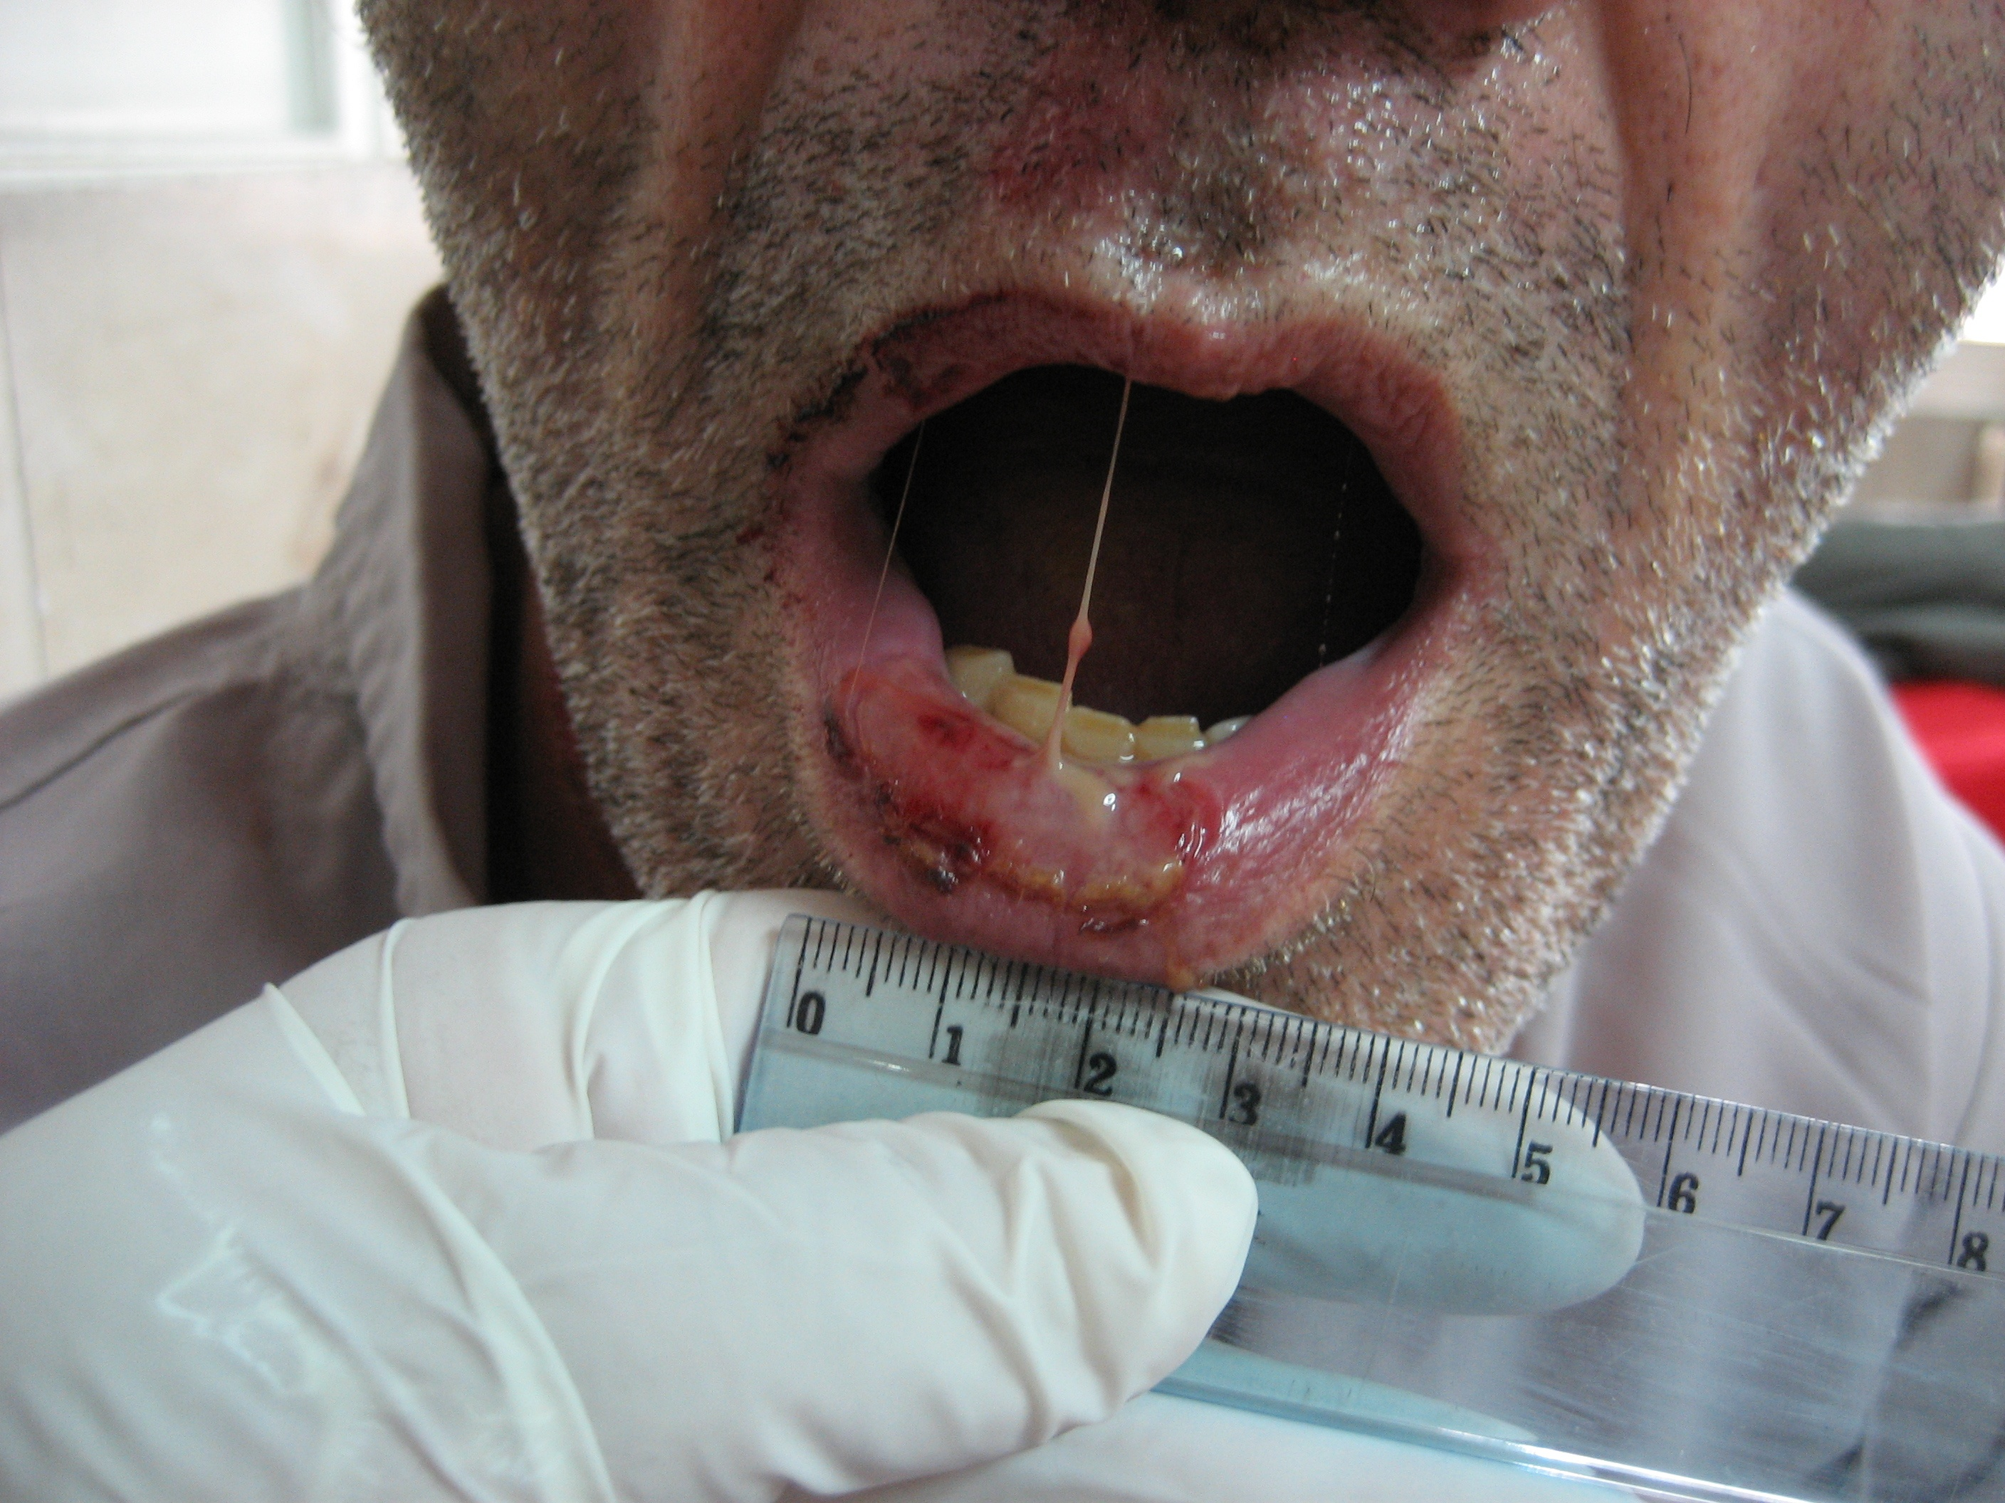
NACLT
Recurrent Aphthous Stomatitis
A randomized controlled clinical
clinical

Slide 35
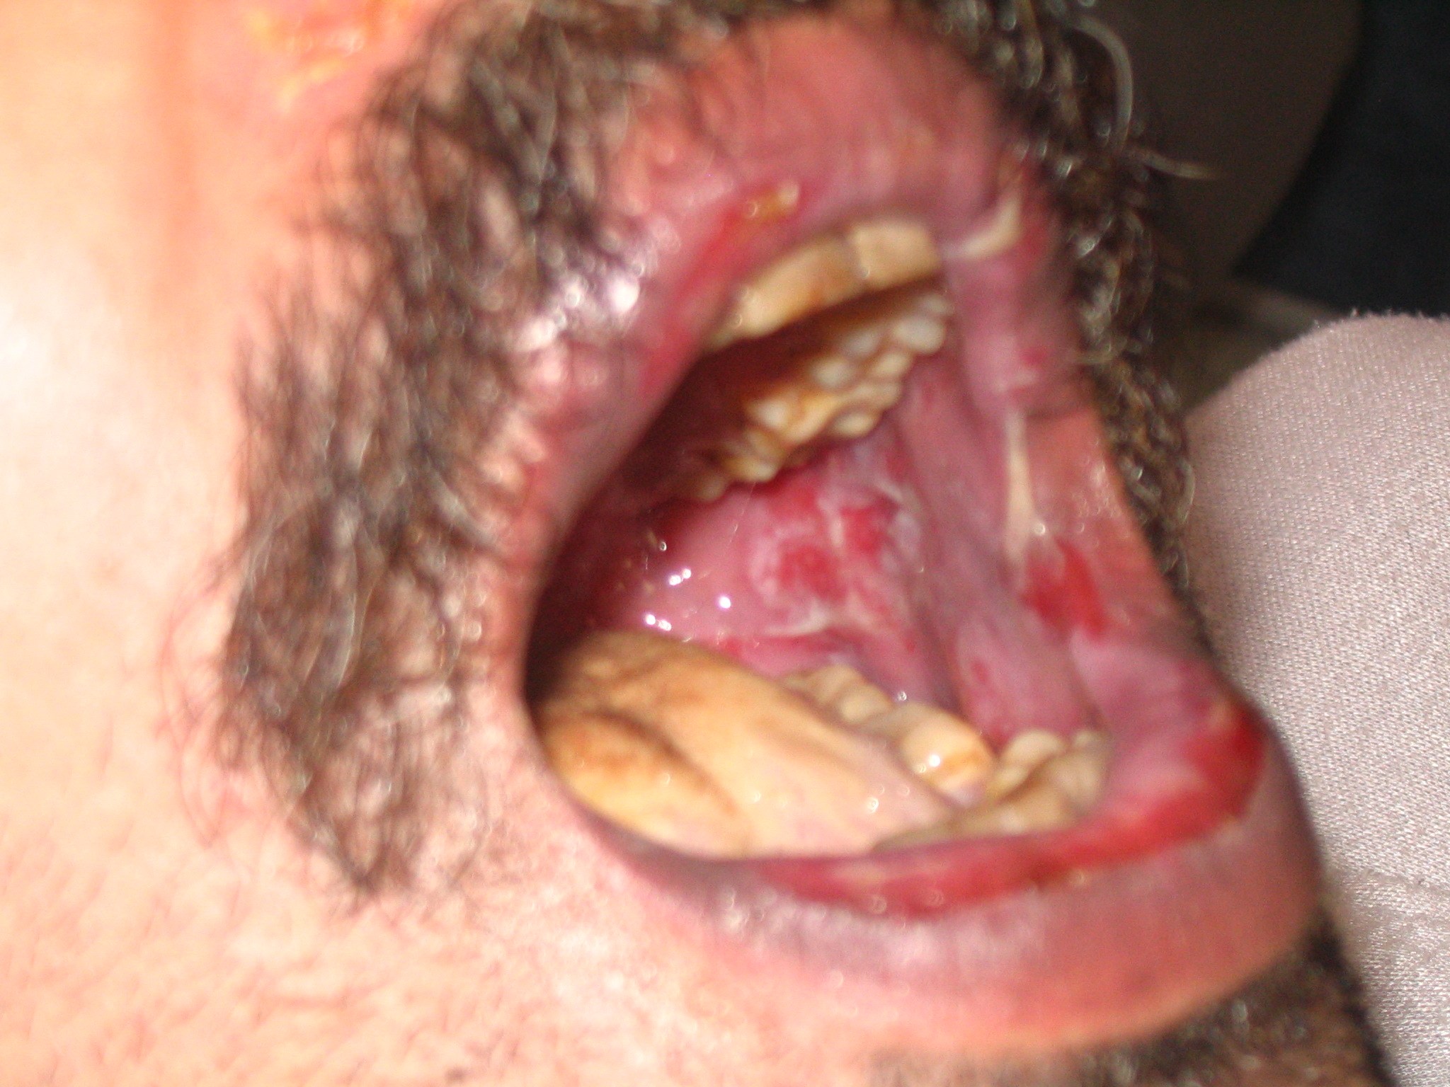

Slide 36
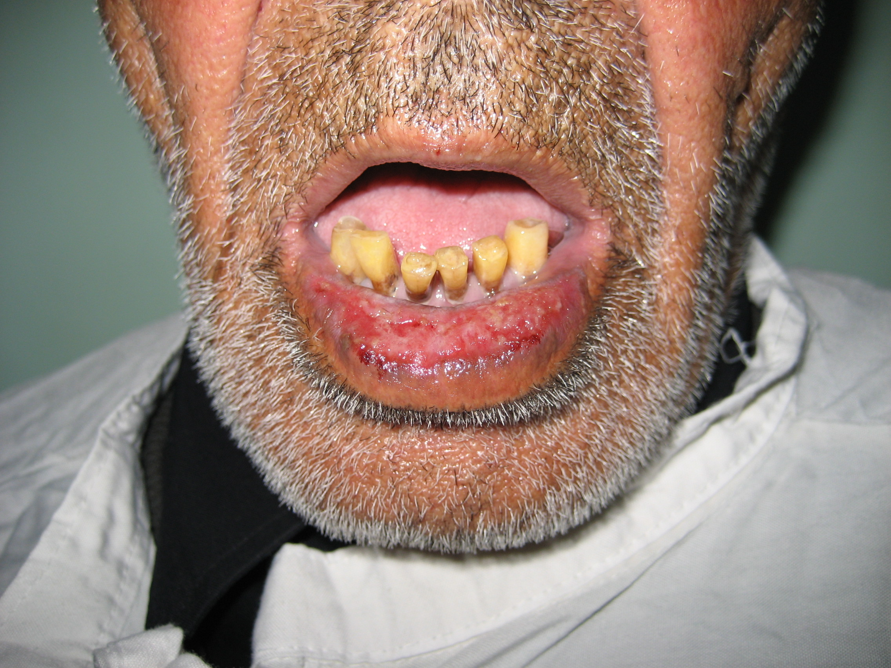

Slide 37
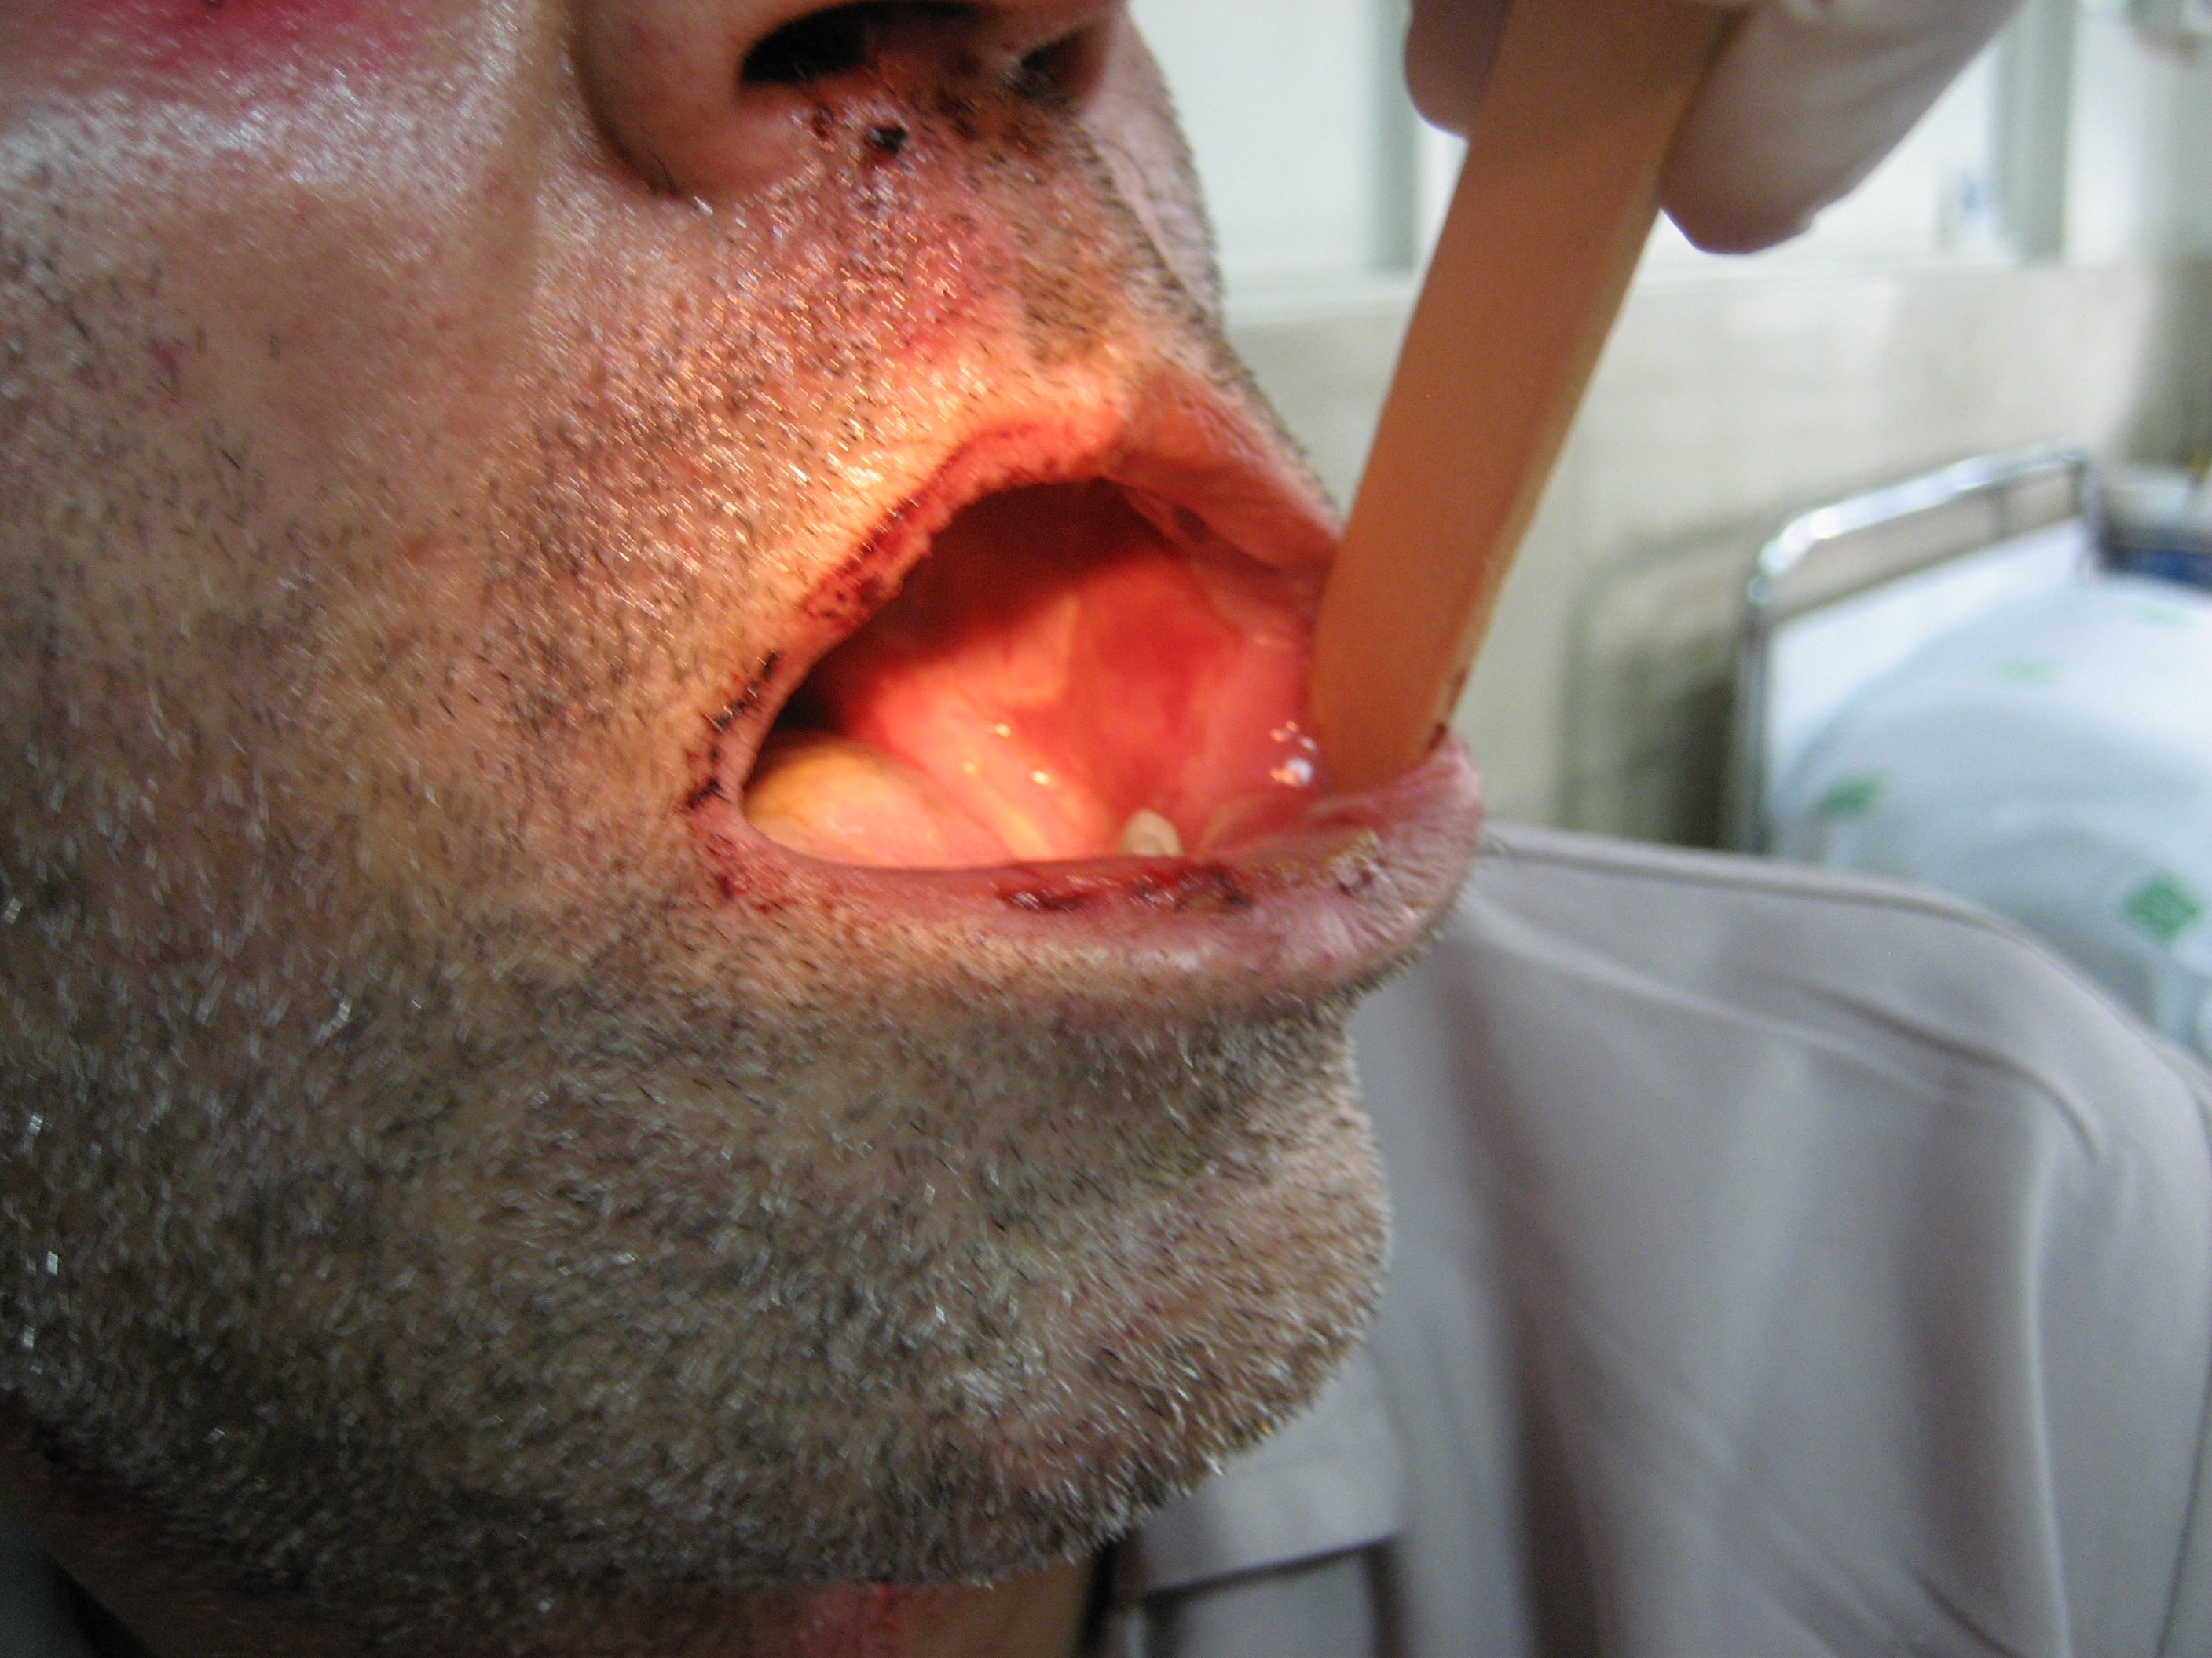

Slide 38
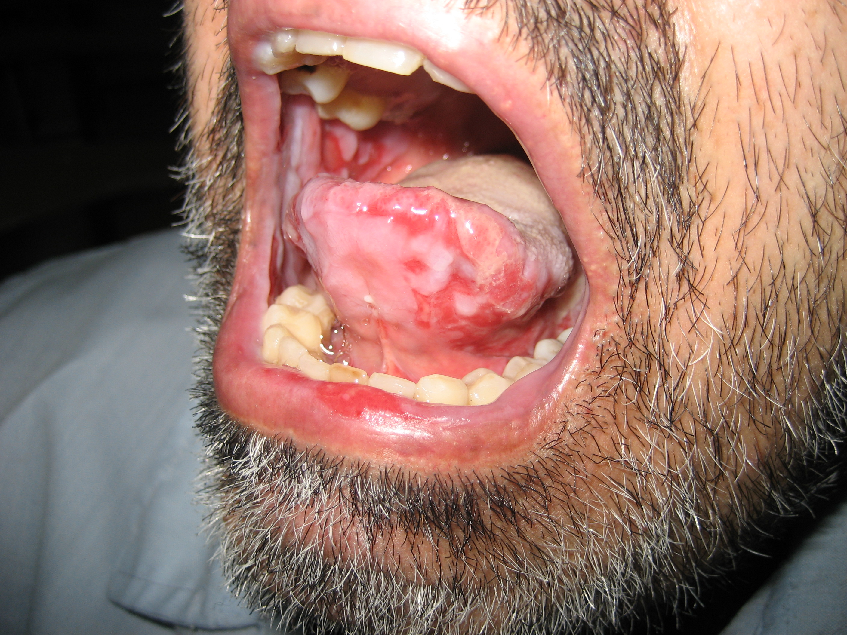
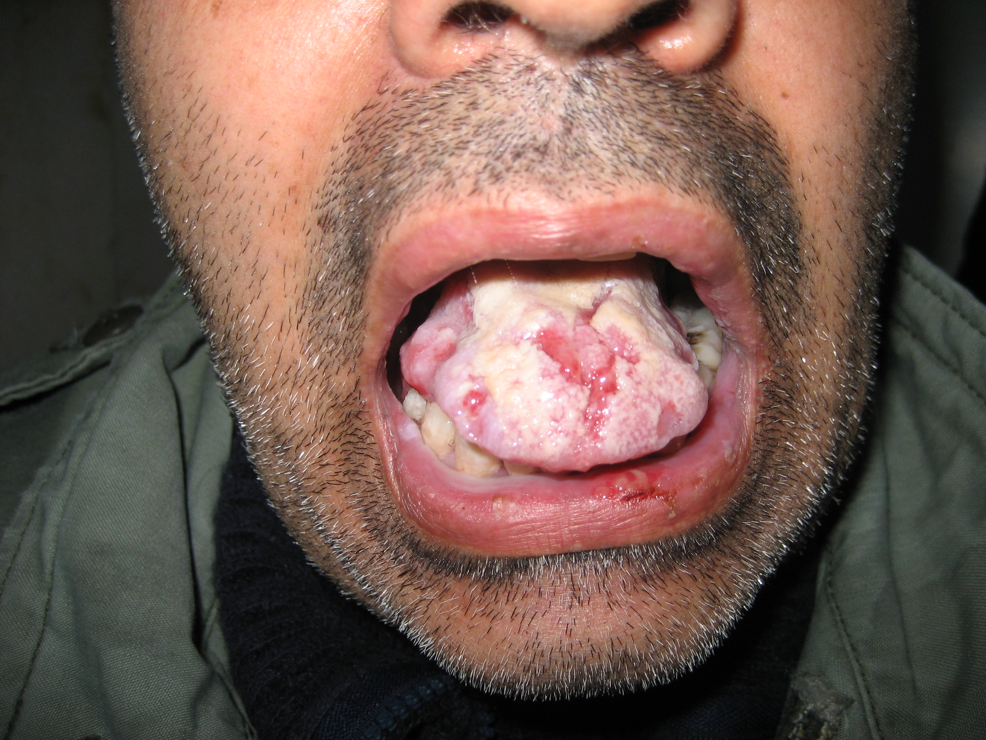

Slide 39
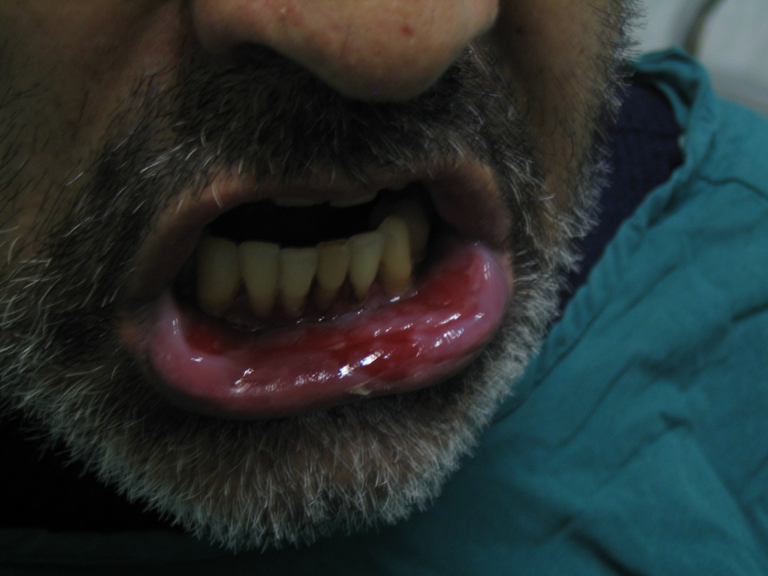

Slide 40
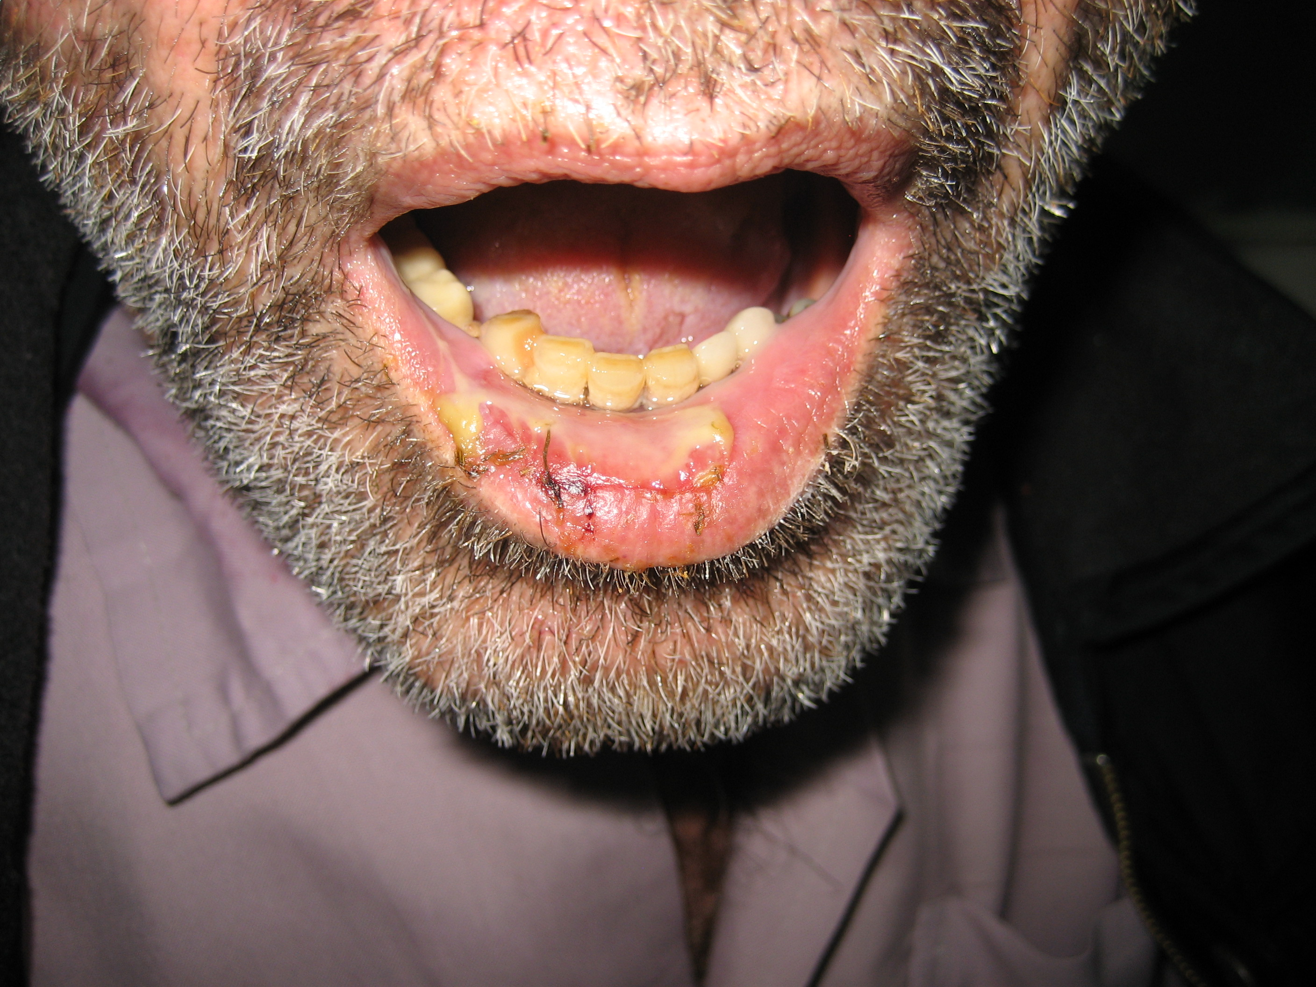

Slide 41
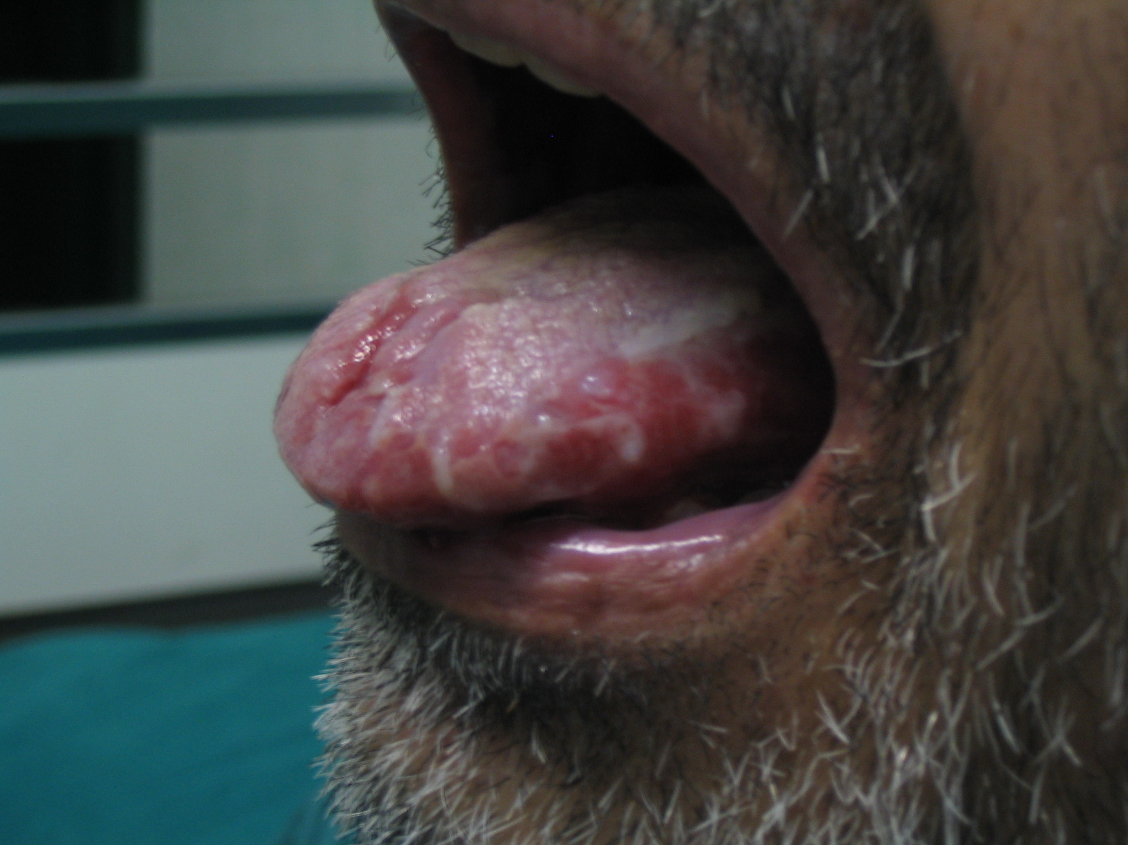

Slide 42
Results
14 patients with 50 areas of painful oral PV
Immediate, dramatic and sustained pain relief (p-value<0.001)
No pain during laser therapy
No visual effect of damage to oral mucosa
No plume formation

Slide 43
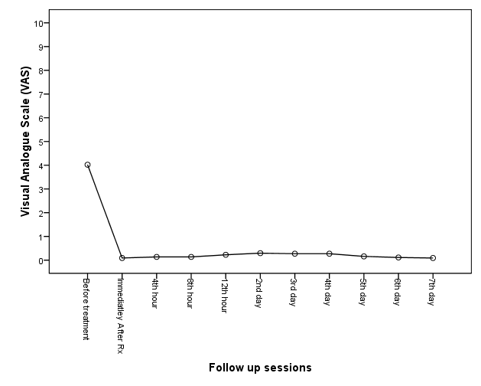
Non-Contact pain

Slide 44
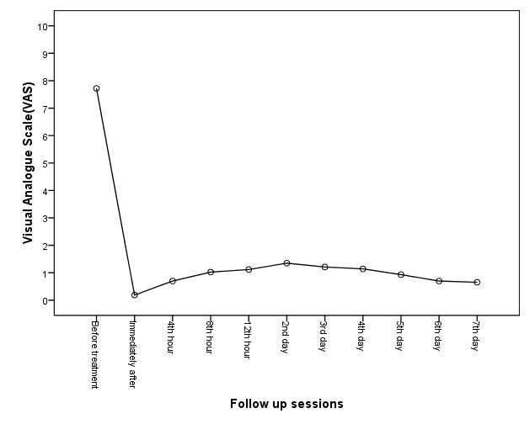
Contact pain

Slide 45
Articles & Presentations
Evaluating the efficacy of non-thermal CO₂ laser therapy (NACLT) to relieve pain in oral lesions of pemphigus vulgaris. Oral presentation in the 29th annual conference of the American society for laser in medicine and surgery (ASLMS), and printed in supplementary ASLMS, Sanfrancisco, USA, 2009 . Zand N., Mansouri P., Ataie-Fashtami L., Fateh M. , Esmaeeli Djavid G., Alinaghizadeh M.
Non-ablative CO2 laser therapy (NACLT): A new approach to relieve pain in oral lesions of pemphigus vulgaris. (Under publish) Zand N., Mansouri P., Fateh M., Rezaie Khiabanloo S., Ataie-Fashtami L., Djavid GE, Safar F., Aghazadeh A., Alinaghizadeh A.
“Evaluating the analgesic effect(s) of single session of Non-ablative, CO2 laser Therapy (NACLT) in painful oral lesions of pemphigus vulgaris”. August 2009. The Iranian society of dermatology conference. August 2009.

Slide 46
Aphthous Ulcers in Behcet’s Disease
Before-after clinical trial
Pilot study

Slide 47
Inclusion criteria
Established diagnosis of BD
Existence of painful oral aphthous ulcers interfering with eating
Continuation of the systemic treatment of BD

Slide 48
Exclusion criteria
Age less than 18 years
Pregnancy
Lactation
Photosensitivity
Taking analgesics before, during, and five days after the procedure
Treatment of the current ulcers with any form of topical medications.

Slide 49
Results
Up to now 4 patients with 5 painful oral aphthous ulcers of Behcet’s disease have completed the trial
Immediate, dramatic and sustained pain relief (p-value<0.001)
No pain during laser therapy
No visual effect of damage to oral mucosa
No plume formation

Slide 51
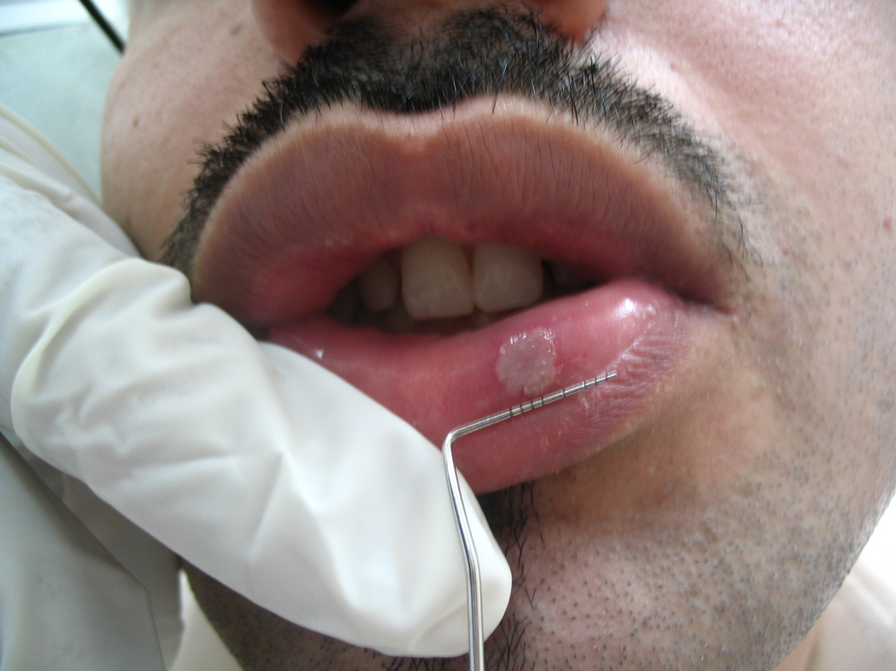

Slide 52
ORAL MUCOSITIS FOLLOWING
BREAST CANCER CHEMOTHERAPY

Slide 53
Study design
Before-after clinical trial
Pilot study

Slide 54
WHO’s Oral Toxicity Scale
World Health Organization’s Oral Toxicity Scale
Severe Mucositis
Grade 1
Grade 2
Grade 3
Grade 4
Soreness ± erythema
Erythema, ulcers; patient can swallow solid food
Ulcers with extensive erythema; patient cannot swallow food
Mucositis to the extent that alimentation is not possible

Slide 55
Results
Up to now 6 patients with painful OM following breast cancer chemotherapy, grade ≤ 3
Immediate, dramatic and sustained pain relief (p-value<0.001)
No pain during laser therapy
No visual effect of damage to oral mucosa
No further neurological complications

Slide 59
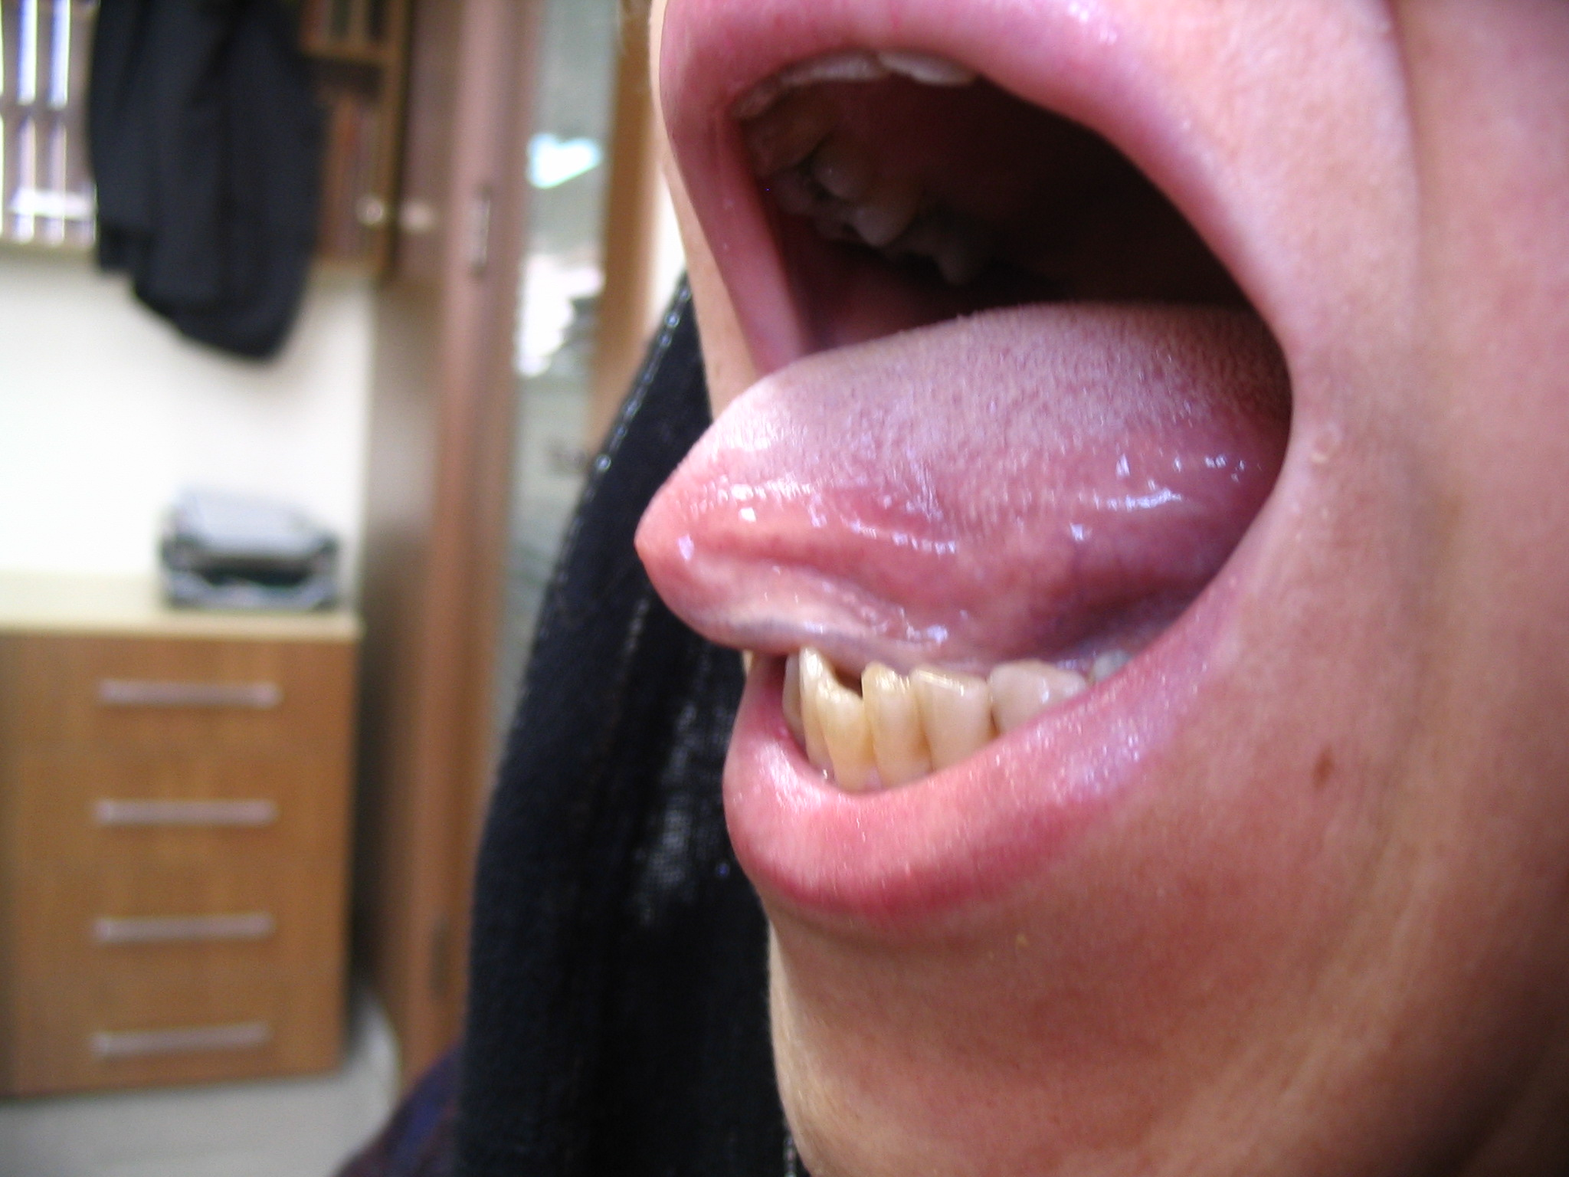

Slide 60
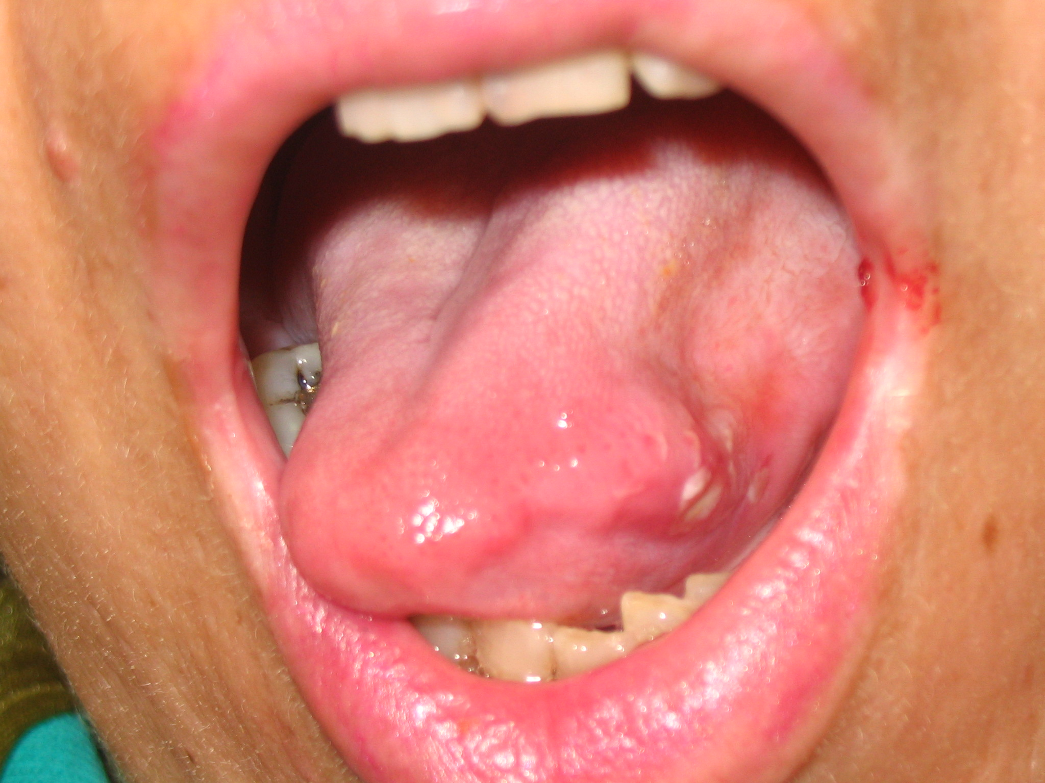

Slide 61
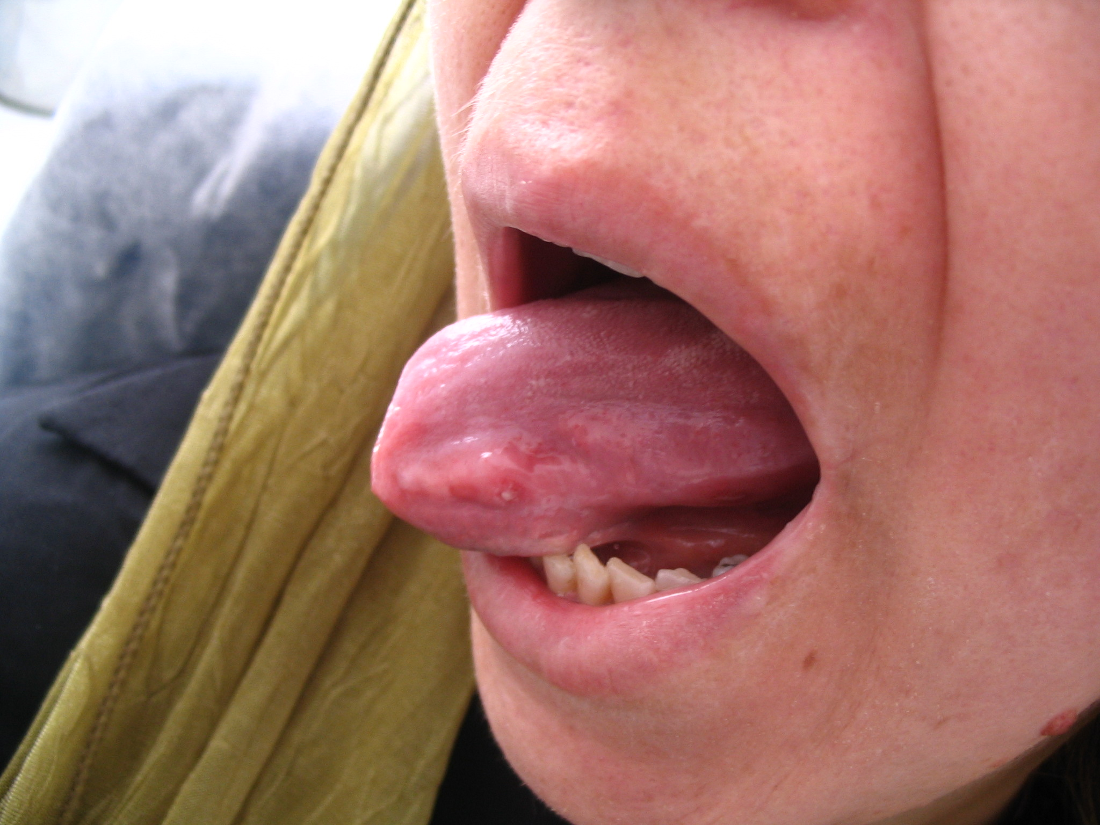

Slide 62
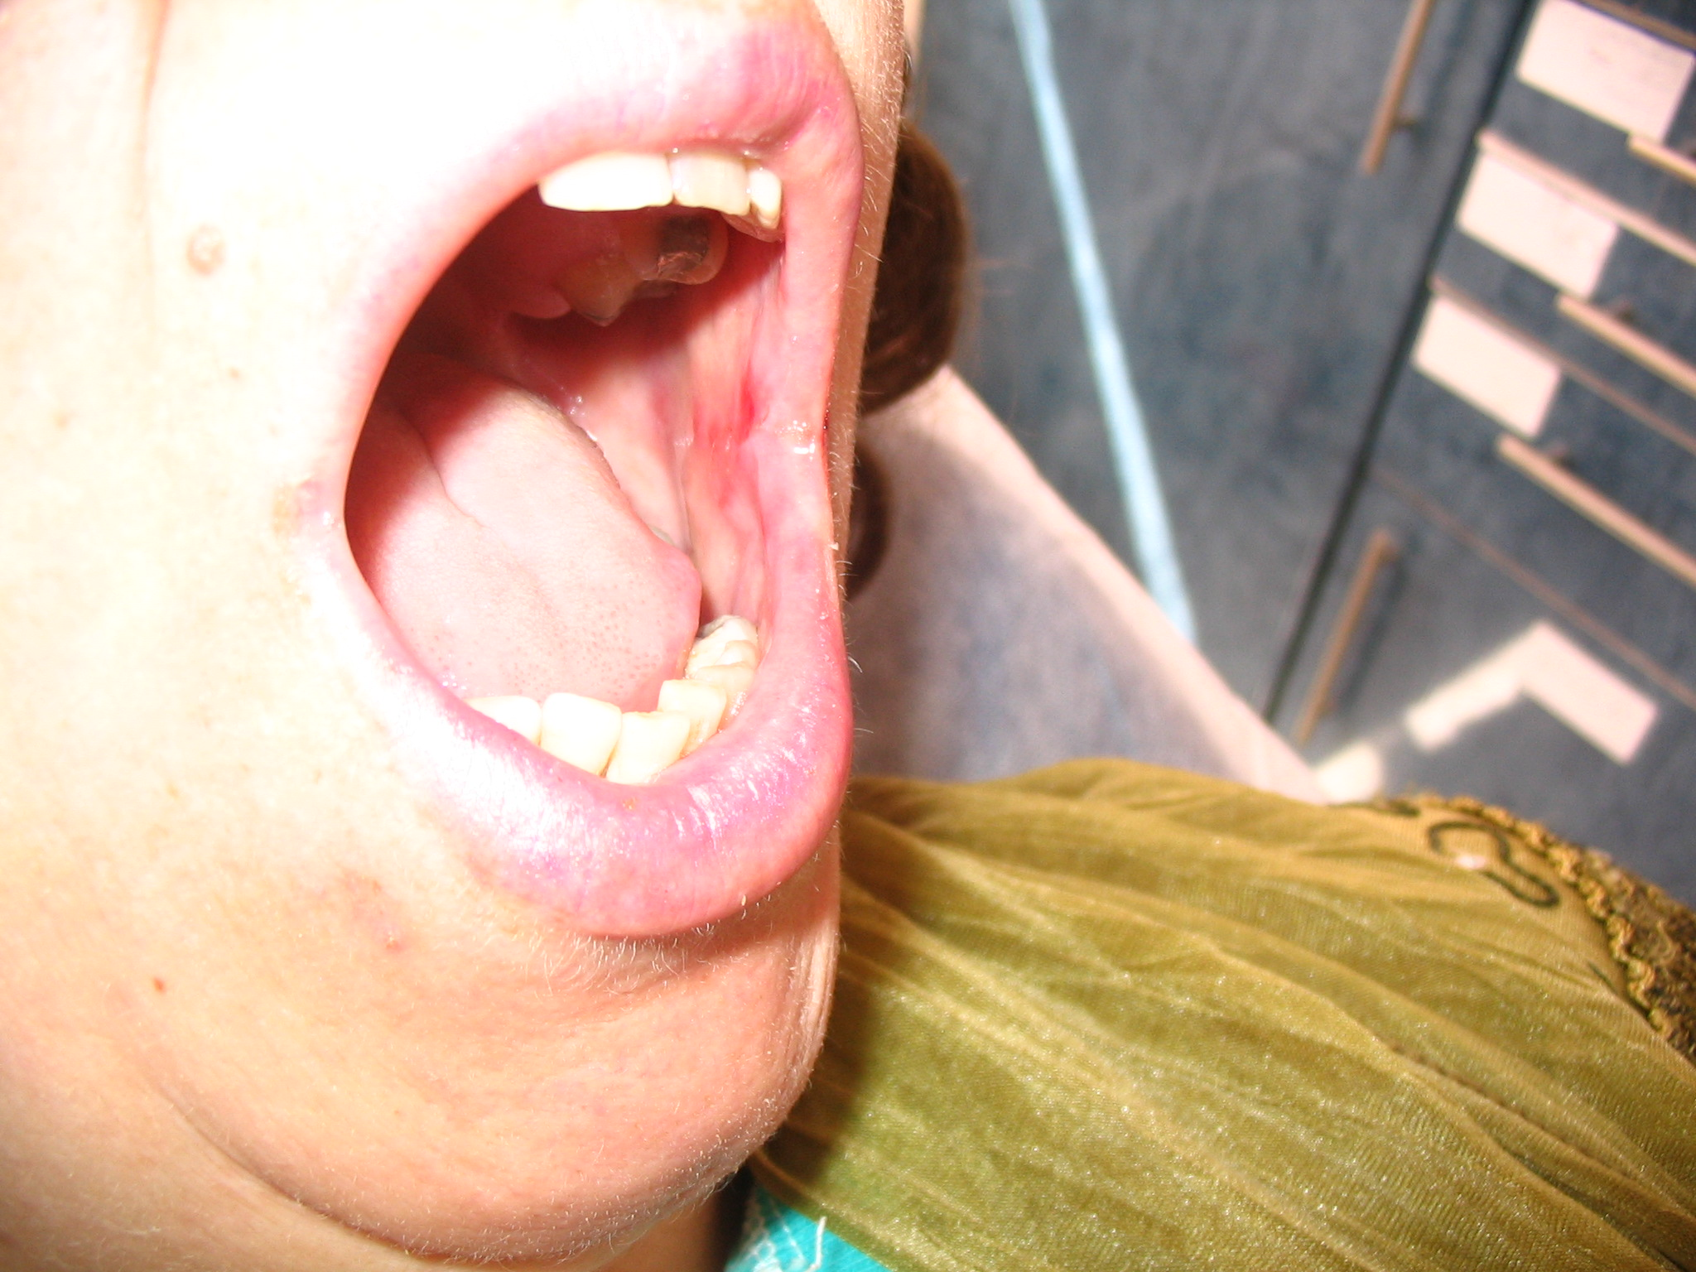

Slide 63
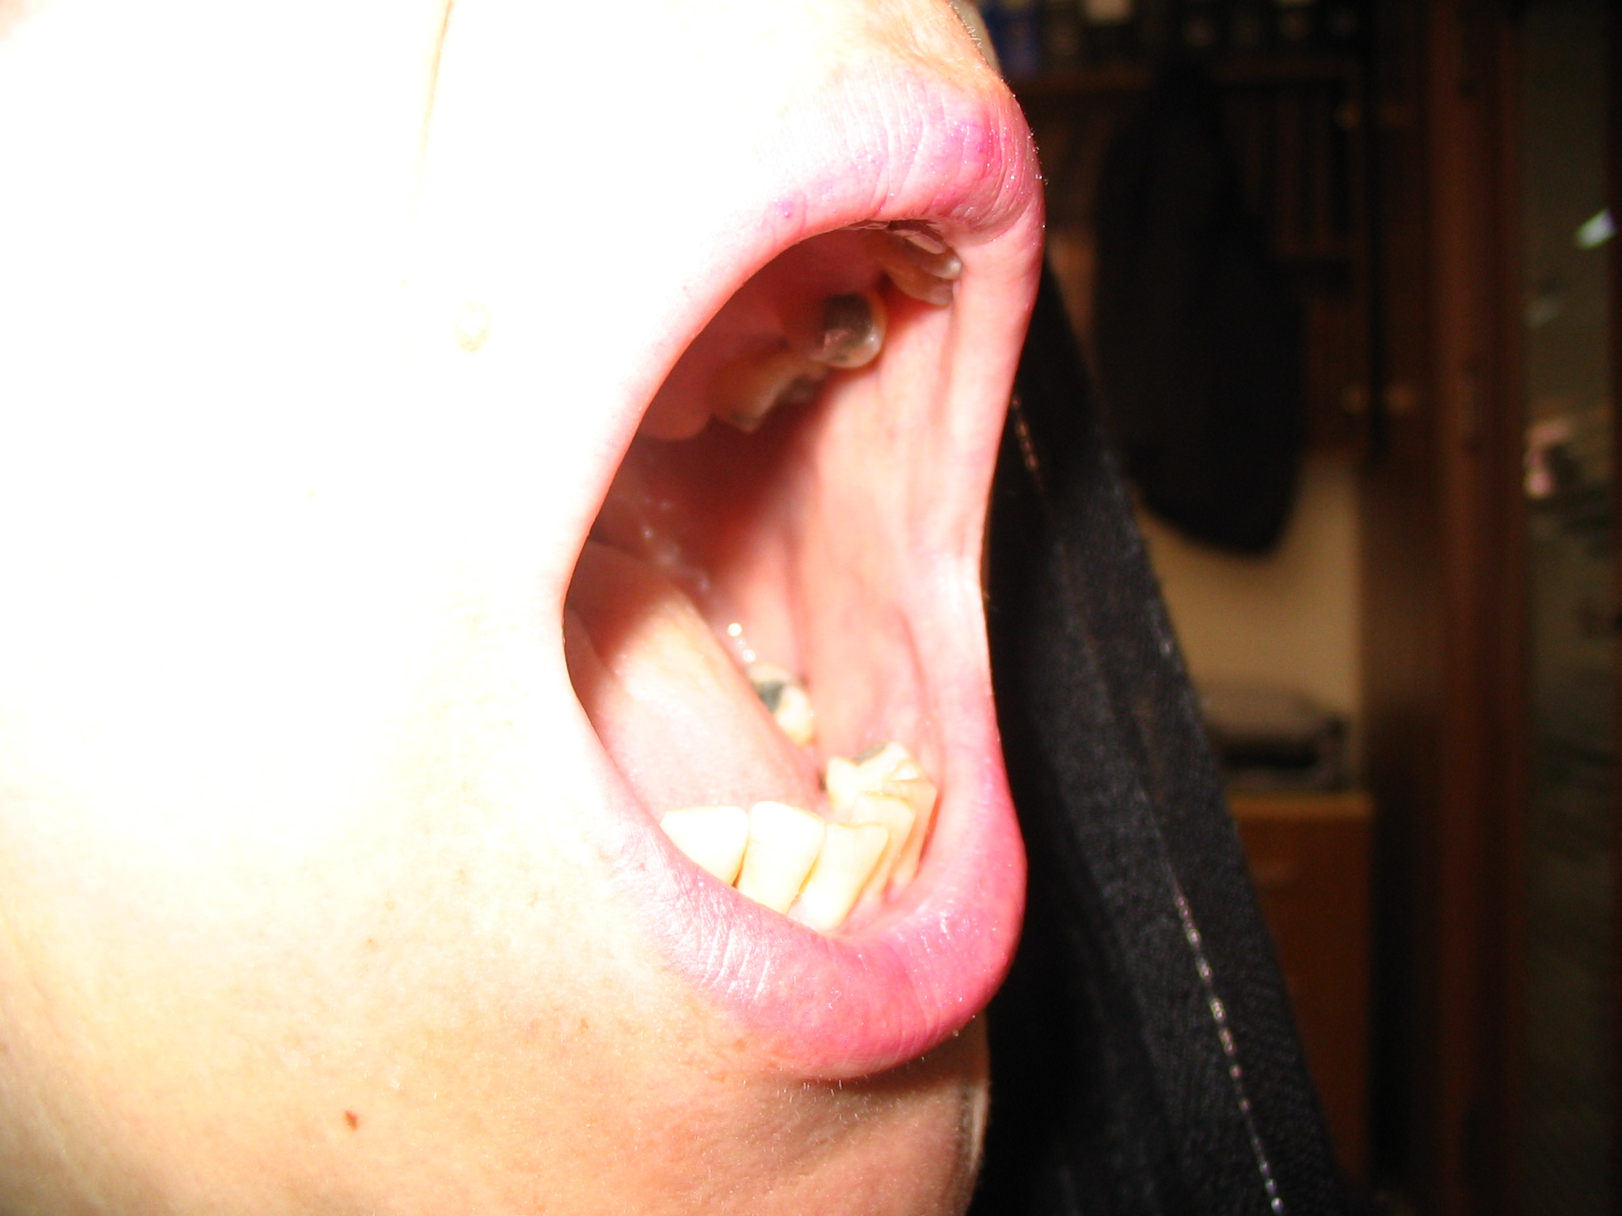

Slide 64
Articles & Presentations
NACLT (Non-ablative CO₂ laser therapy): A new approach to relieve pain in mild to moderate oral mucositis following breast cancer chemotherapy :(a pilot study), Poster presentation, EBCC7, Barcelona, Spain, published in EJC supplements 3, 3, March, 2010.N. Zand, S. Najafi, P. Mansouri, M.Fateh, L. Ataie Fashtami, G. Esmaeeli Djavid, A. Aghazadeh.
Relieving pain in mild/moderate oral mucositis following breast cancer chemotherapy by a single session, non-ablative CO2 laser 10600nm therapy (NACLT). The 4th International Iranian breast cancer congress, Tehran, Iran, March 2009. N. Zand, S.Najafi, P. Mansouri, M.Fateh, L. Ataie Fashtami, G.E Djavid, MR Alinaghizadeh.
“Evaluating the analgesic effect(s) of single session of Non-ablative, CO2 laser Therapy (NACLT) in reducing the pain of mild to moderate chemotherapy-induced oral mucositis”. The 2nd cancer palliative care congress. April 2009.

Slide 65
Case reports

Slide 66
Non-ablative CO2 laser treatment
(NACLT)
Low power laser
treatment
(LLLT)
Single session
Immediate and dramatic
Multi session
Gradual and cumulative

Slide 67
Mechanisms of analgesic effect of NACLT?
May be these mechanisms involved?
Producing physiological changes in neural tissue, like:
Blockage of action potential generation/ conduction of signals in C/ Aδ fibers?
Activation of pain inhibitory pathways?
Producing beta-endorphins and opioid peptides changes?
Producing changes in mediators like substance P, bradykinin, histamin, serotonin, prostaglandins especially PGE2, …?

Slide 69
Future studies...

Slide 70
از توجه شما متشکرم

