Slide 1
IN THE NAME OF GOD

Slide 2
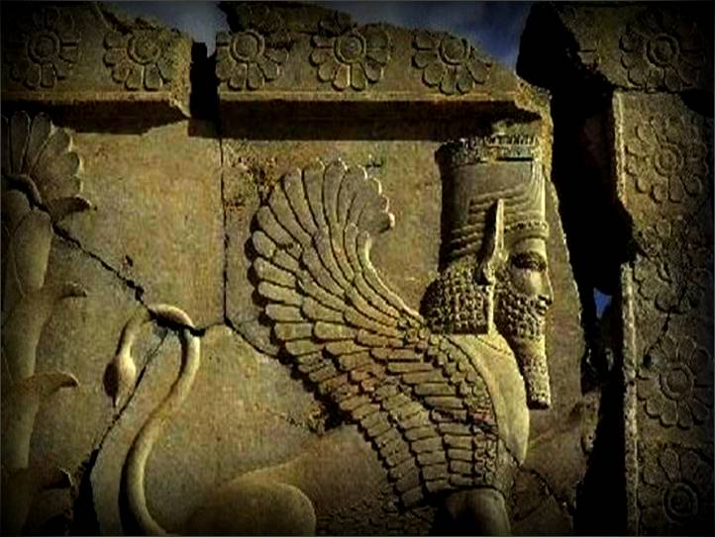
Helping hands are more sacred than hands that pray to the sky
( Cyrus the great )
(

Slide 3
HOW WE SET UP AN ORGAN TRANSPLANTATION CENTER
Seyed Ali . Malekhosseini
Professor of Surgery
Director of Shiraz Transplant Center

Slide 4
History of Organ transplantation in Iran
1st Kidney Tx: 1967(shiraz)
1st Small Bowel Tx: 1992( Tehran-Shahid Beheshti)
1st Deceased donor Liver Tx: 1993(Shiraz)
1st Heart Tx: 1993(Shiraz)
1st Lung Tx: 2000( Tehran- Imam Khomeini)
1st Living donor LTx(LDLT): 1998(Shiraz)
1st Ex situ split LTx (SLT): 2003(Shiraz)
1st Pancreas Tx: 2006(Shiraz)
1st In situ split LTx (SLT): 2007(Shiraz)
1st Multi Visceral Tx: 2010(Shiraz)
1st domino LTx : 2014 (shiraz)

Slide 5
History….(continued)
1989: Religious permission( FATWA) for deceased organ donation
2001: Approval of brain death act by parliament

Slide 6
Imam khomeini’s FATWA ( Religious permission) for deceased organ donation

Slide 7
BARRIERS to set up the transplantation CENTER
Lack of knowledge about the concept of brain death among society
Cultural and religious resistances
Lack of financial support
Shortage of space and equipments
Opposition and disagreement of medical colleagues and university managers
Inadequate experienced surgeons and physicions in the center and across the country
Establishing kidney transplant centers across the country based on living unrelated donation

Slide 8
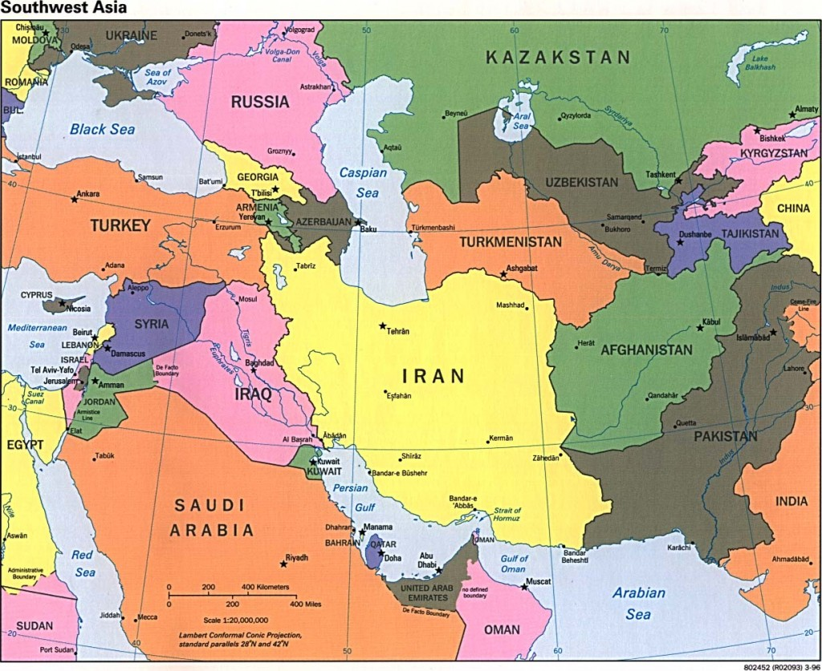
BARRIERS TO SET UP THE TRANSPLANTATION CENTER
Lack of appropriate transportation system in a large country
2000 Km
1800 Km
1500 Km

Slide 9
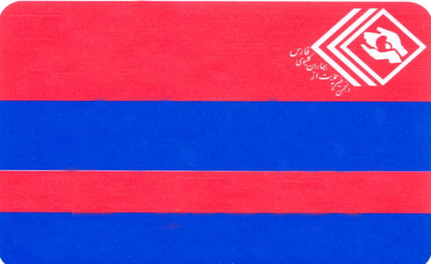
EFFORTS to overcome the barriers
Distribution of organ donation cards in society
(high schools, universities, scientific meetings, barracks, etc….)
ORGAN DONATION CARD
I would like to give “gift of life” to others after my death
Please inform your relatives about your decision
www.farskidney.com

Slide 10
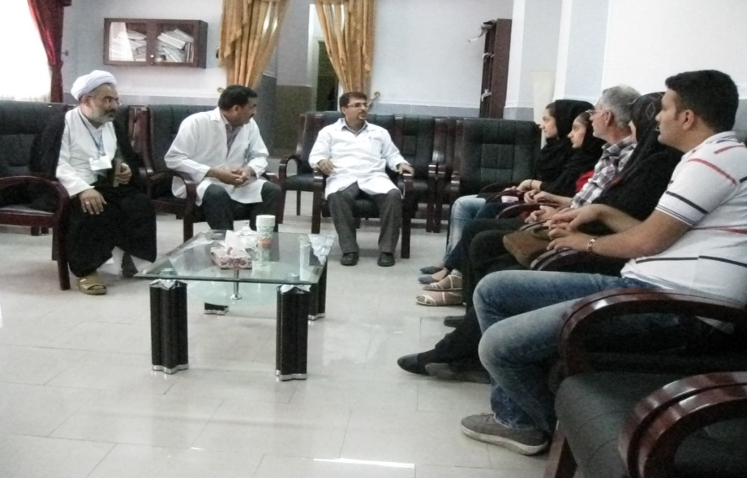
EFFORTS TO OVERCOME THE BARRIERS
Engaging psychiatrics, social workers and clerics in counseling the family of deceased donors to increase the rate of consent

Slide 11
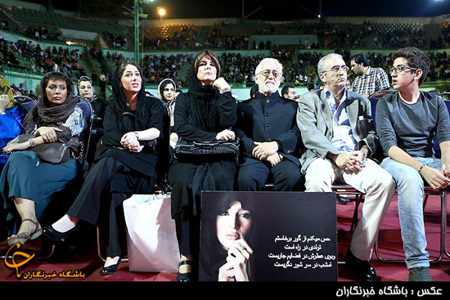
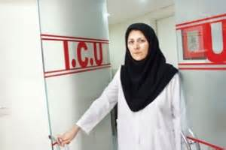
EFFORTS to overcome the barriers
Increasing the knowledge and awareness of society through mass media and seminars and meetings attended by religious authorities
,celebrities and deceased donor families

Slide 12
EFFORTS to overcome the barriers
Founding non-governmental organizations such as The Society of Supporting Kidney and Liver Disease for raising fund

Slide 13
EFFORTS to overcome the barriers
Negotiations with the hospital and university administrators to prepare space and equipment
Negotiation with the government to allocate special budget for the cost of liver transplantation

Slide 14
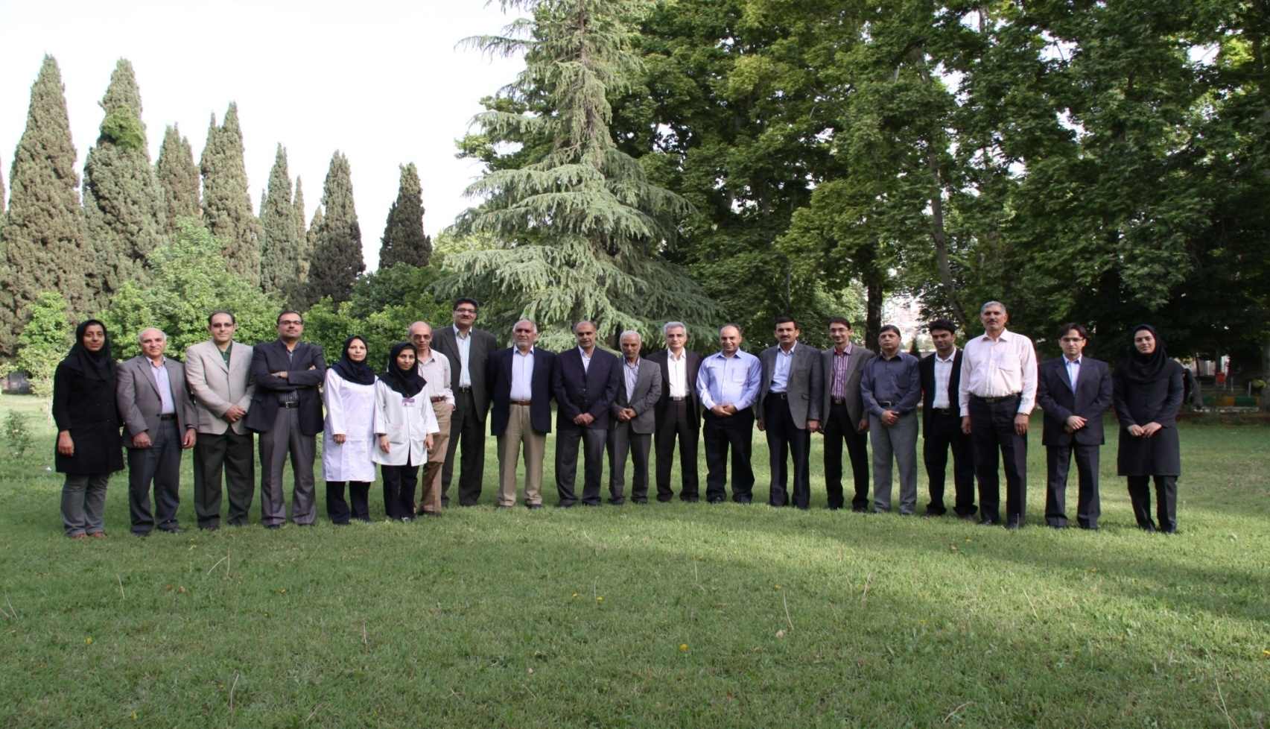
EFFORTS to overcome the barriers
Training transplant staff

Slide 15
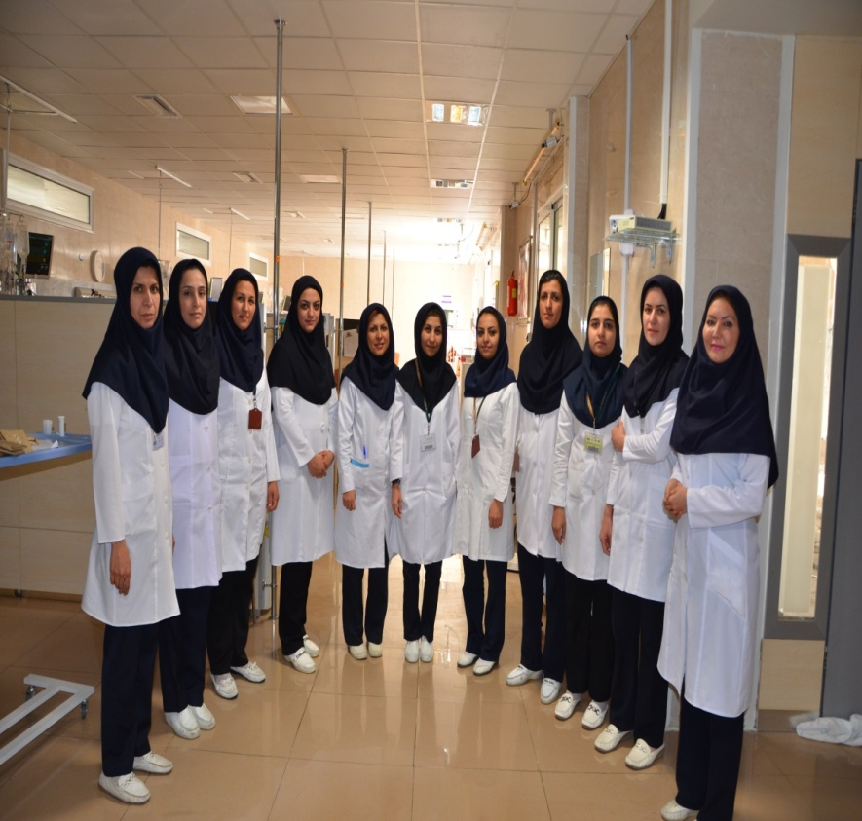
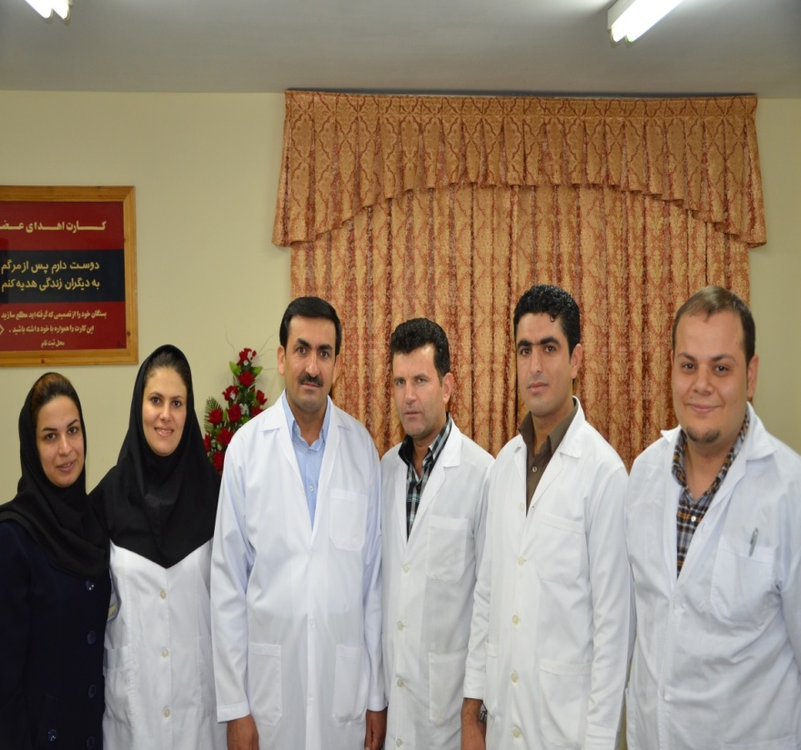
EFFORTS to overcome the barriers
Training nurses and coordinators

Slide 16
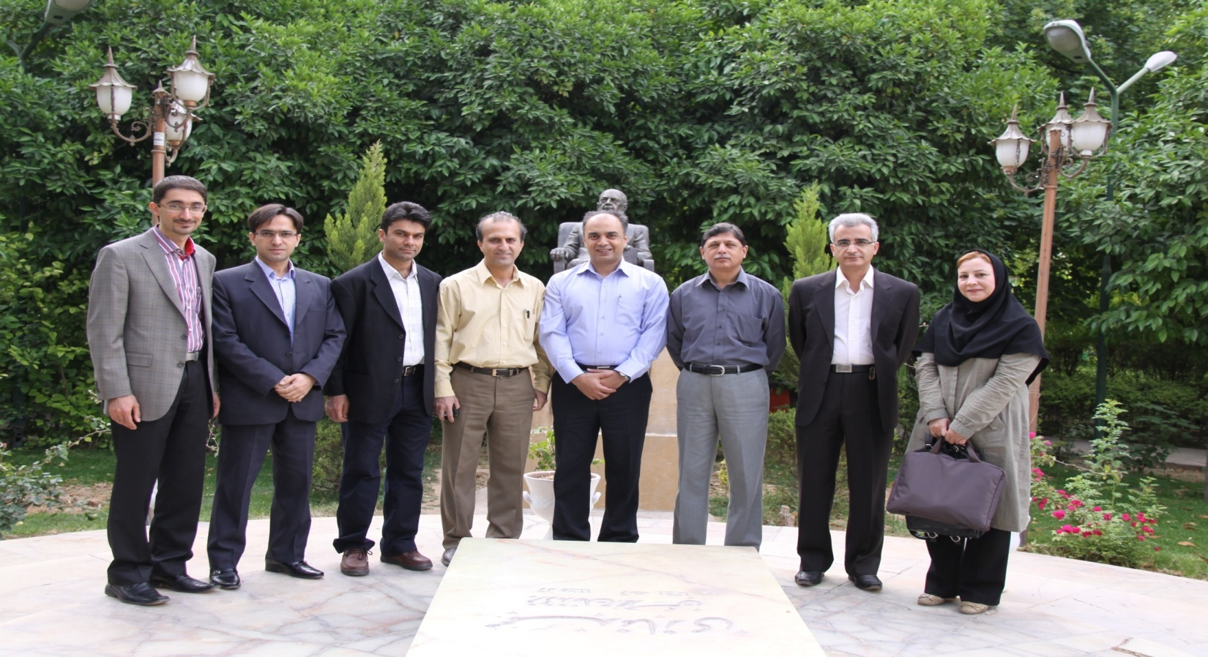
EFFORTS to overcome the barriers
Training of transplant fellows

Slide 17
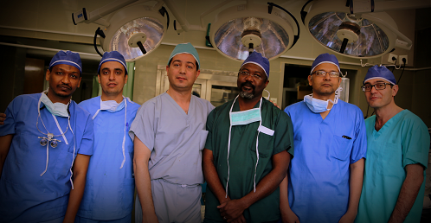
EFFORTS to overcome the barriers
Training of transplant fellows

Slide 18
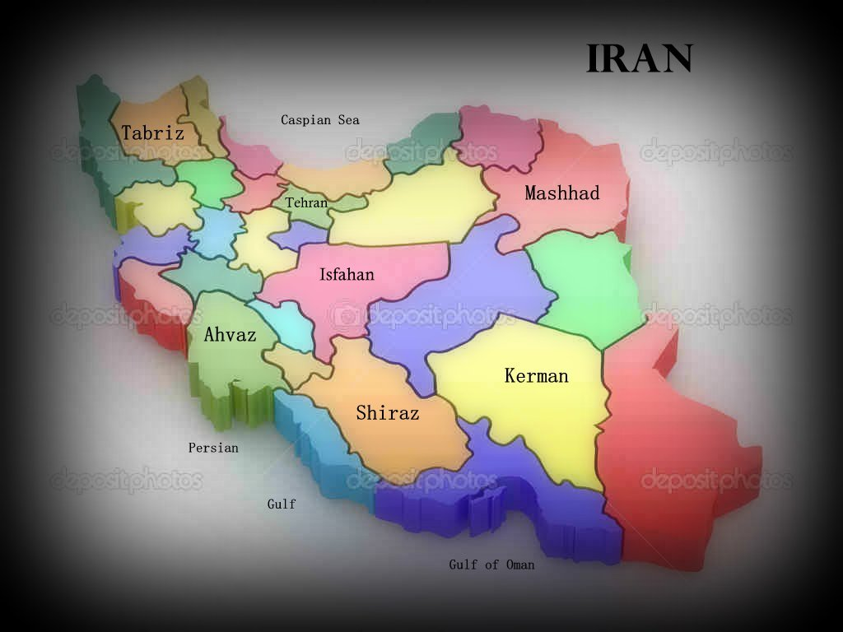
Trained fellows ( surgeon and anesthesiologist ) at the Shiraz Center

Slide 19
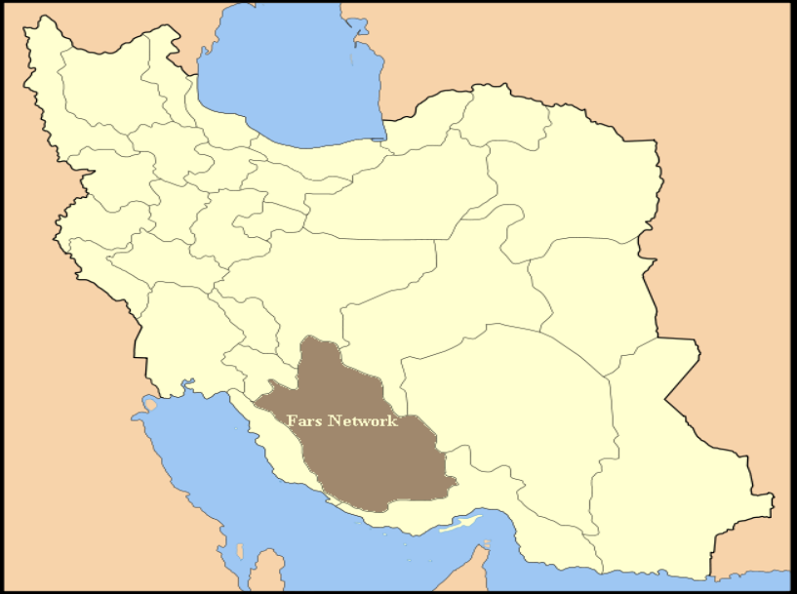
EFFORTS TO OVERCOME THE BARRIERS
Establishing Fars Province network

Slide 20
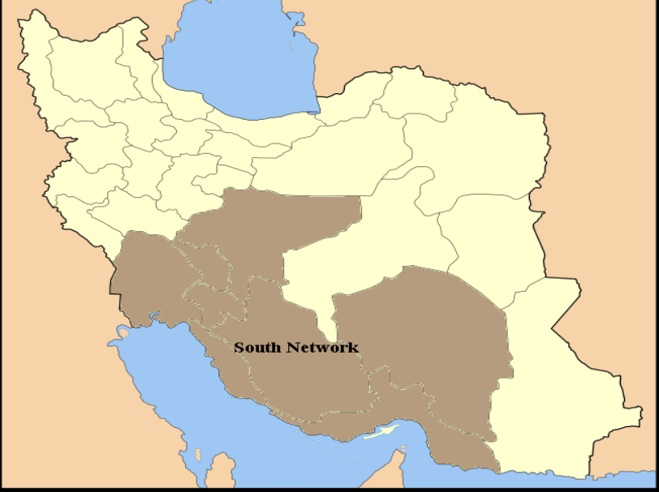
EFFORTS TO OVERCOME THE BARRIERS
Establishing southern network ( in southern and central provinces)

Slide 21
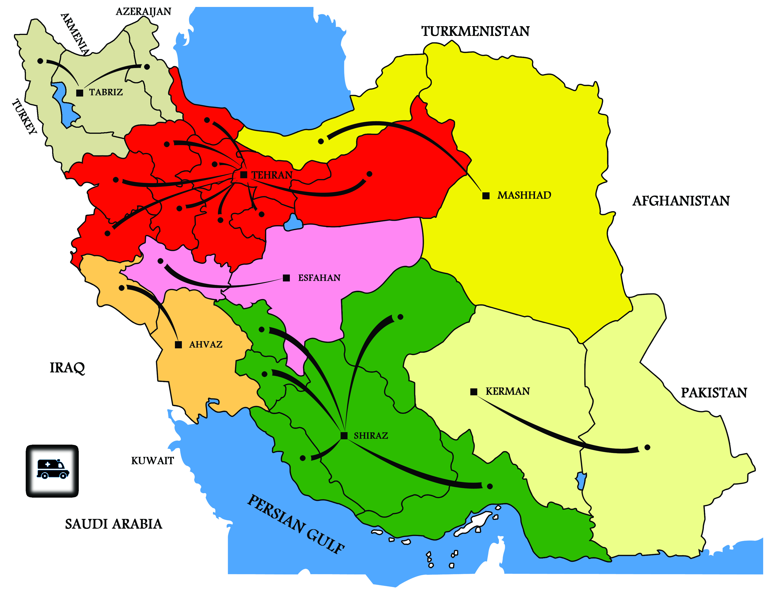
EFFORTS to overcome the barriers
Establishing Iranian network
Dividing the country to 7 transportation zones
Organizing land transport for intra-zone transports

Slide 22
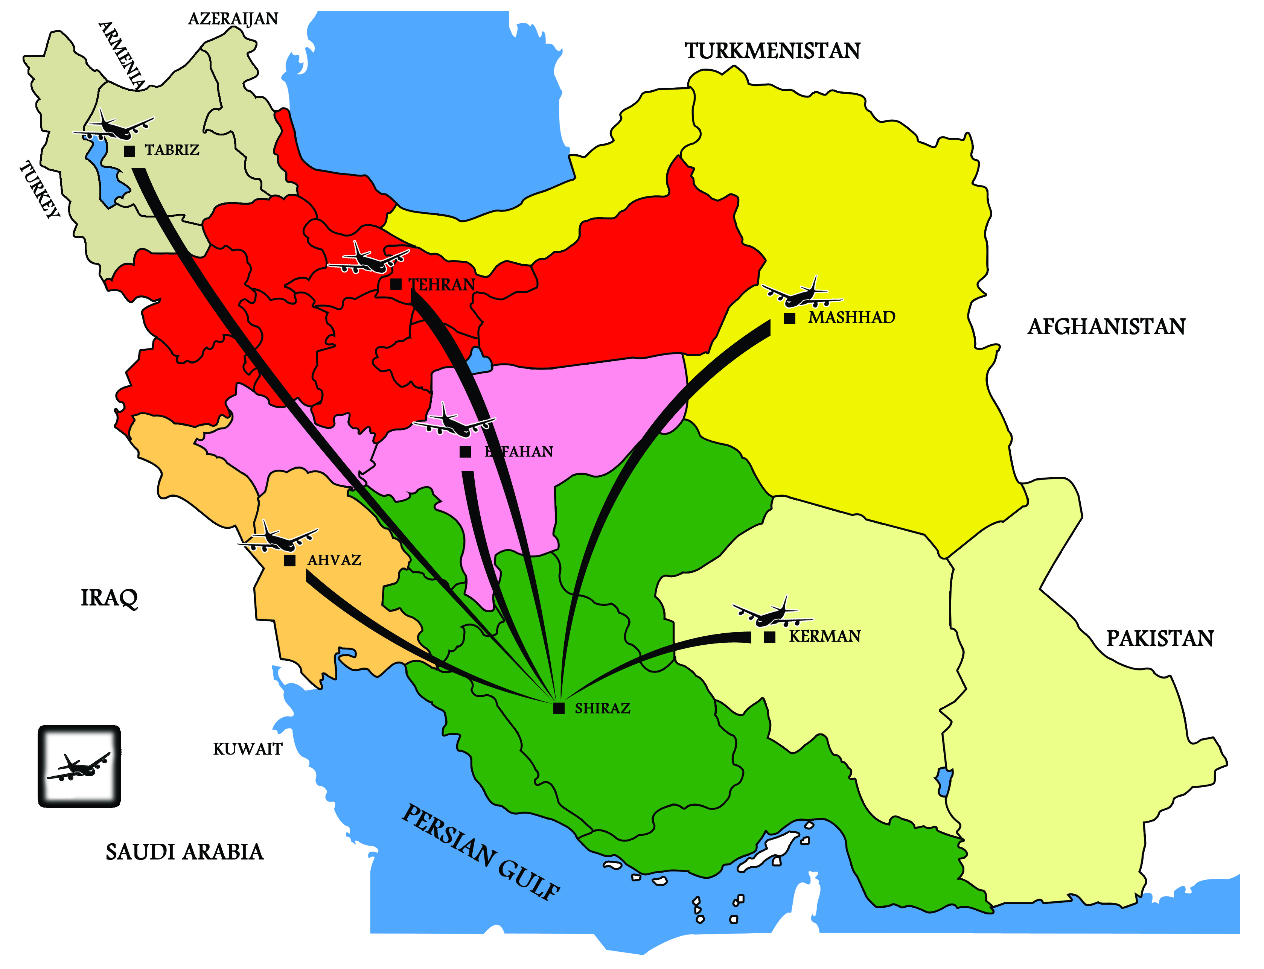
EFFORTS TO OVERCOME THE BARRIERS
Organizing air transport between zones and Shiraz (transplantation center)
Negotiation with domestic airlines to accommodate transportation of transplant procurement teams

Slide 23
EFFORTS to overcome the barriers
Perseverance on deceased organ donation and reluctant to do living unrelated transplantation
2014

Slide 24
Numbers of liver transplantation in IRAN
Shiraz : 2535 cases
Tehran : 336 cases ( Two Centers )
Kerman : 30 cases
Isfahan : 10 cases
Mashhad : 14 cases
Total : 2925 cases

Slide 25
Numbers of Organ Transplantation at Shiraz transplant Center
Kidney: 3308 ( 52% from deceased donor, 48% from living donor )
Liver: 2535
Pancreas: 170
Multi visceral-intestinal: 27

Slide 26
Source of donors in liver TX in shiraz / year
1993-2013
Total : 2535 , deceased donor : 2246, living donor: 289

Slide 27
Source of donors in liver Tx in shiraz / year
1372-1393
Total : 2535 , deceased donor : 2246, living donor: 289

Slide 28
Source of Liver donors

Slide 29
Indications for Liver Tx. in Pediatrics (<18 years, n: 629 )

Slide 30
Indications for Liver Tx. in Adults (≥ 18 years, n: 1906)

Slide 31
Types of Liver transplantation

Slide 32
Living donor liver transplant: Graft Type

Slide 33
One -Year Survival after liver transplantation

Slide 34
The latest approval of IRAN supreme council of organ transplantation:
Prohibition of organ transplantation in private hospitals
Prohibition of organ transplantation for non –Iranian nationals

Slide 35
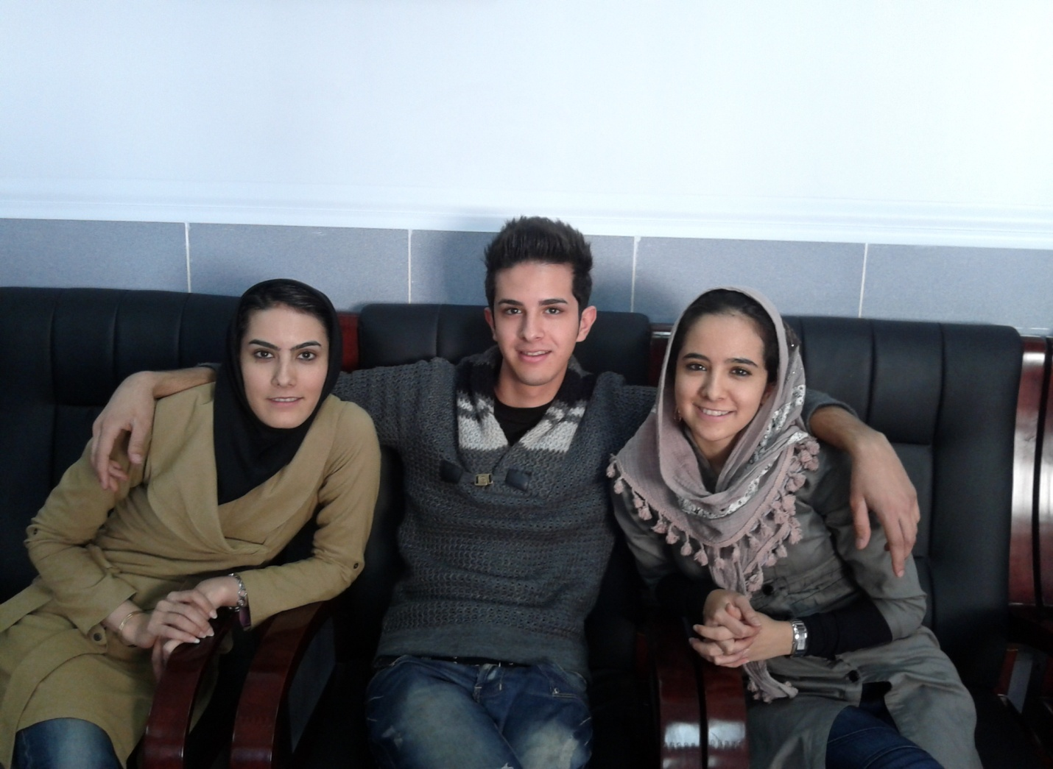
Siblings , cases of Familial Hypercholesterolemia underwent liver transplantation in 3 Months period

Slide 36
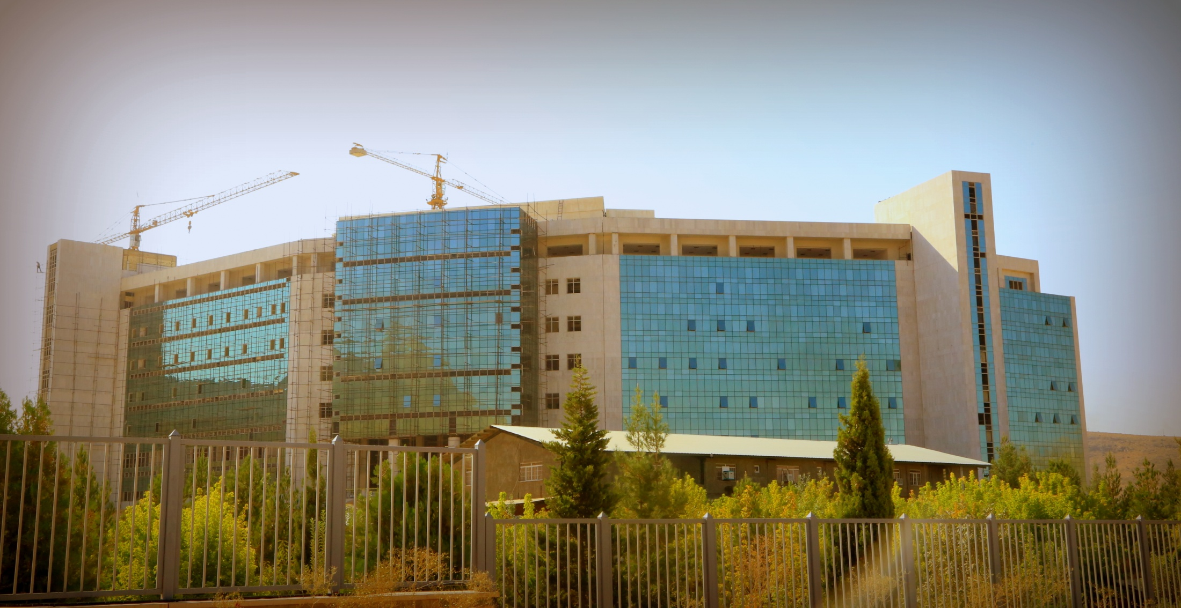
Plans for the future
Founding Abu Ali Sina (Avicena) dialysis center and hospital (charity)

Slide 37
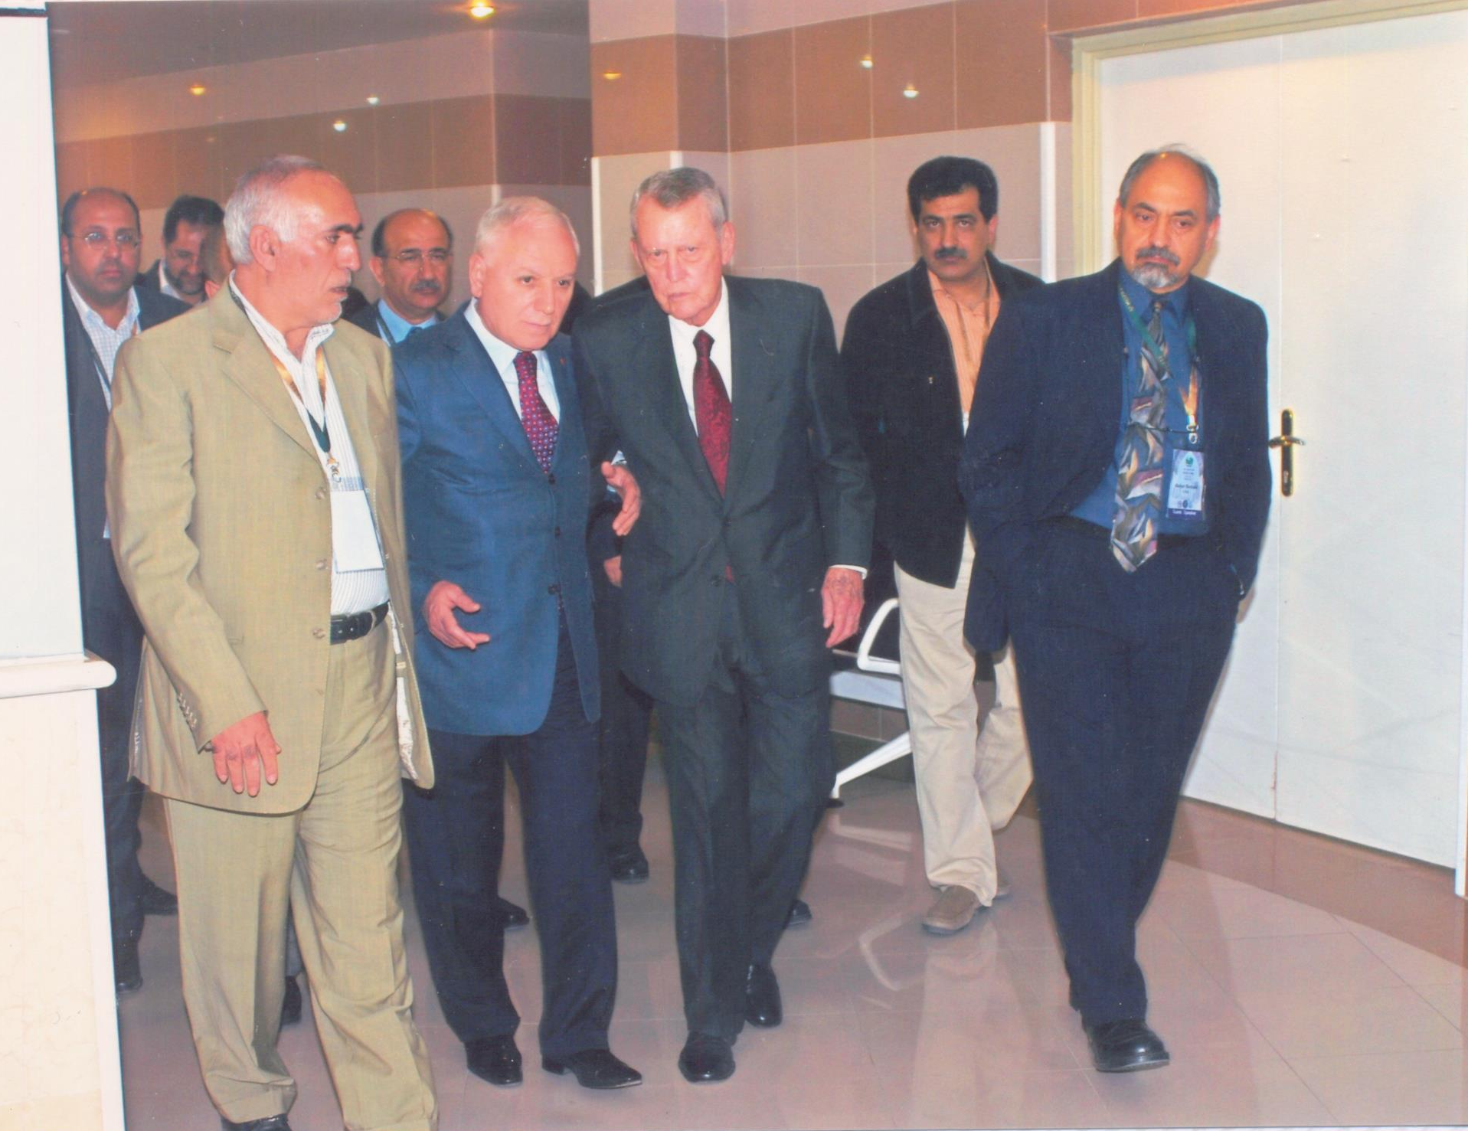

Slide 38
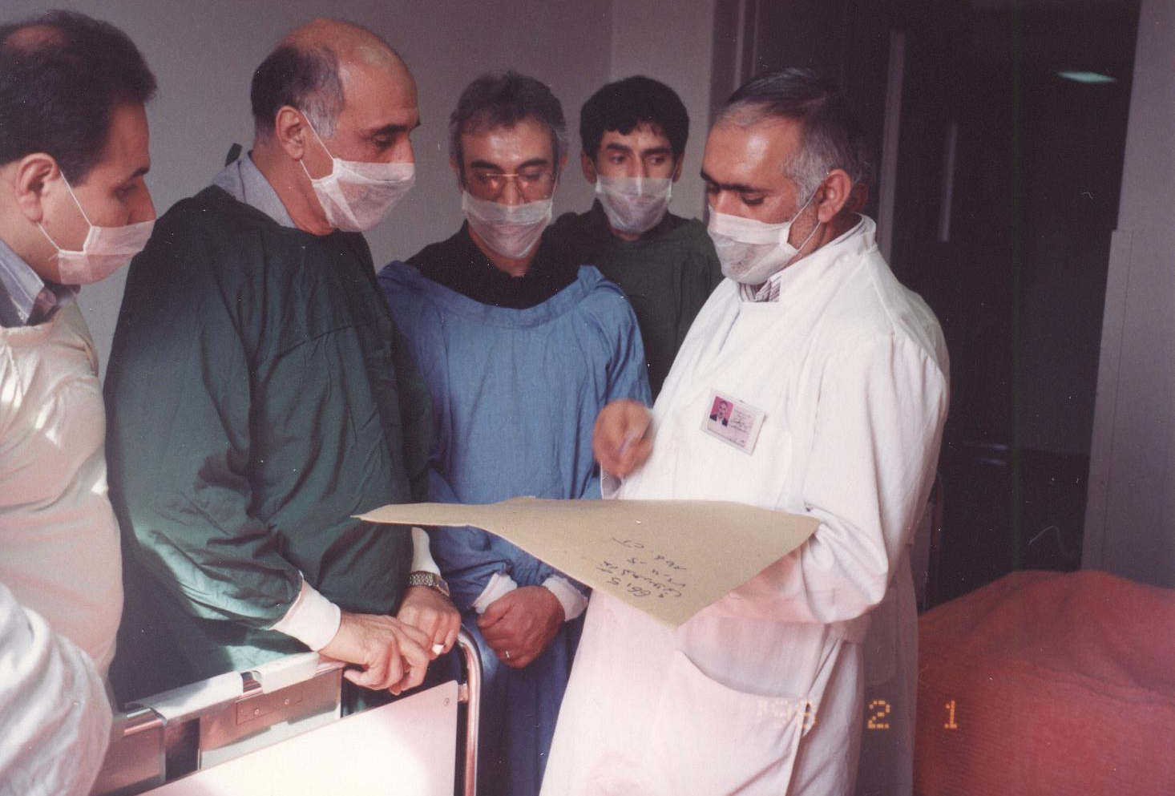

Slide 39
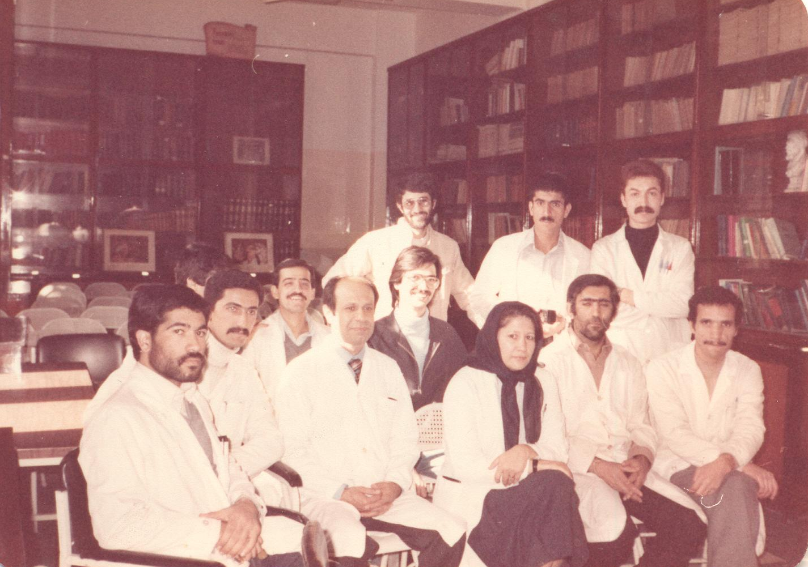

Slide 40
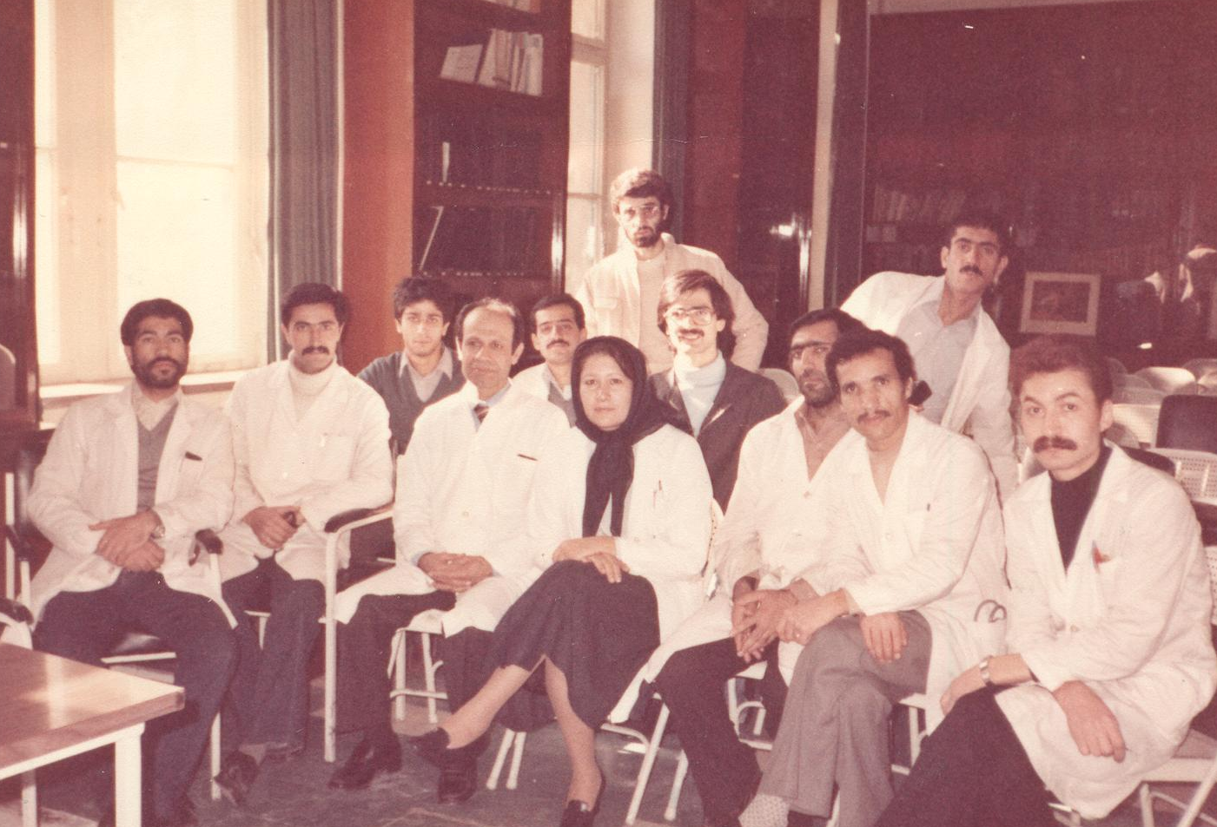

Slide 41
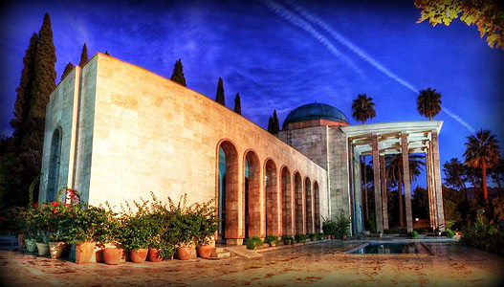
Of one essence is the human race
Thusly has creation put the Base ;
One limb impacted is sufficient
For all others to feel the mace
Sa’adi Shirazi

Slide 42
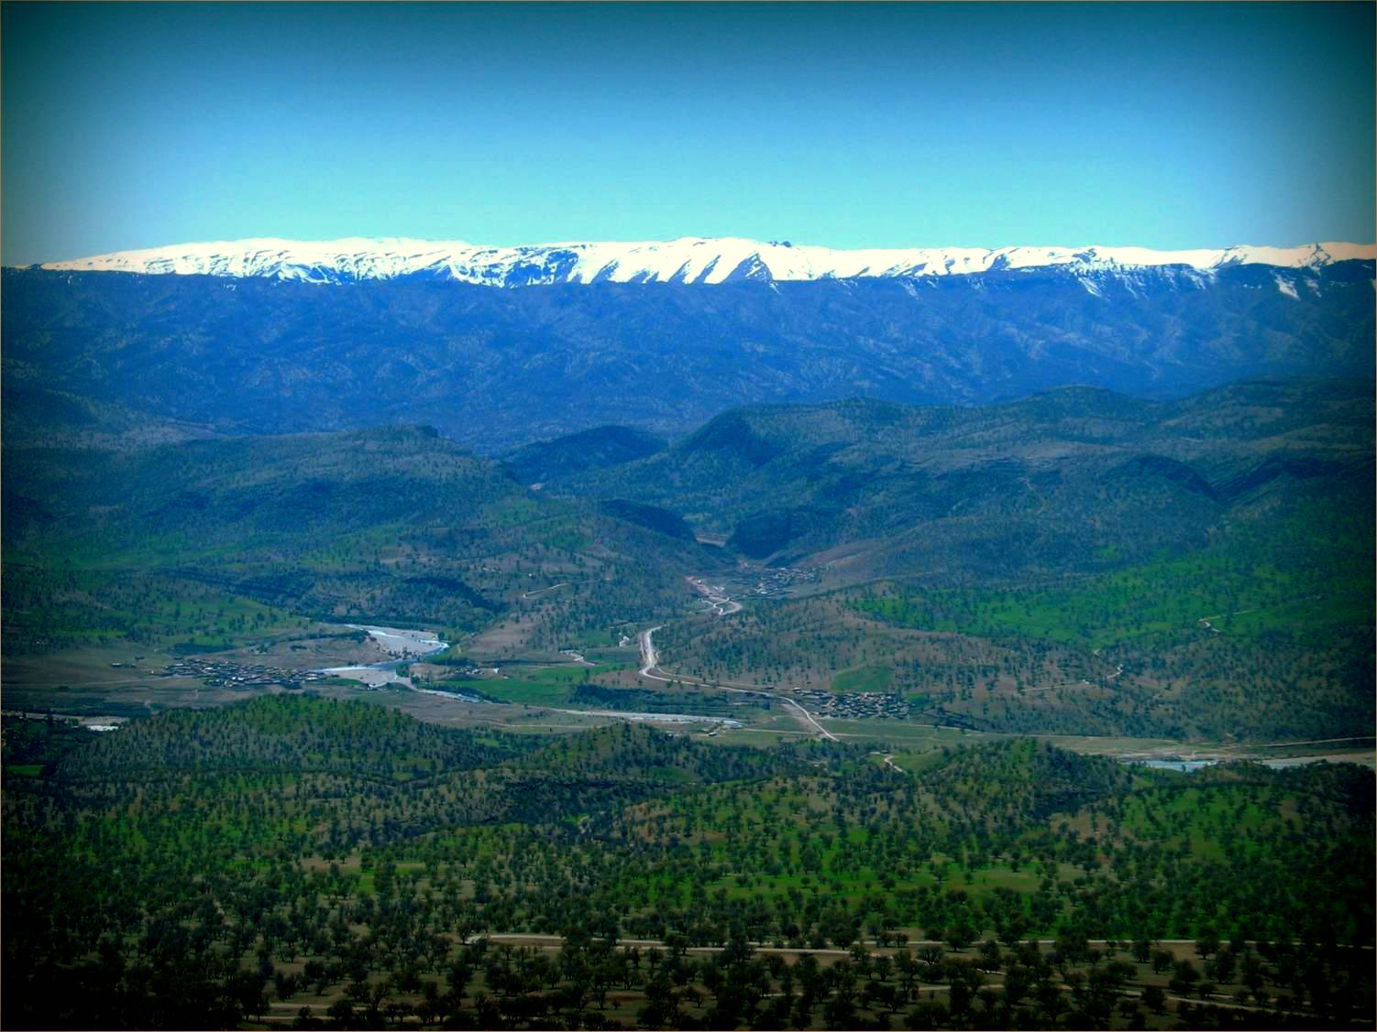
All our successes are indebted to a dedicated tireless team
God bless all.

