Slide 1
Applicability of EMG-based Computerized Classifiers for Discriminating Myogenic & Neurogenic Myopathies A Systematic Review
Eybpoosh M.H.
BSc. of Biomedical engineering
Eybpoosh S.
PhD candidate in Epidemiology

Slide 3
Muscular Disorders
Guillain-Barre Syndrome
Neurogenic
Carpal Tunnel Syndrome
Amyotrophic Lateral Sclerosis
Muscular disorders
Dystrophies (e.g. Duchenne)
Myogenic
Myotonies (Thomsen )

Slide 4
Treatment
Whether the etiology of muscular dysfunction is Myogenic or Neurogenic, therapeutic approaches would be different.
So
The source of defect should be diagnosed accurately

Slide 5
Diagnostic methods
Biopsy
Usually checks if the cause is Myogenic or not
Invasive and expensive for the patient
MRI
Can discriminate Myogenic and Neurogenic myopathies from each other
Is expensive for patient
Non-invasive but usually not completely acceptable and comfortable for the patient
Is expensive for the setting: Requires expensive equipments and expert staffs
The diagnosis process is subjective: Relies on radiologist’s opinion

Slide 6
Diagnostic methods, cont...
EMG based methods
Can discriminate Myogenic and Neurogenic myopathies from each other
Minimally invasive (less than biopsy)
Suites almost all patients’ preferences
Cost and time efficient: More suitable than MRI for resource-limited settings
The diagnosis process is subjective: Relies on expert staff’s interpretation
EMG-based computerized classifiers
The diagnosis process is NOT subjective: it is computerized and automotive

Slide 7
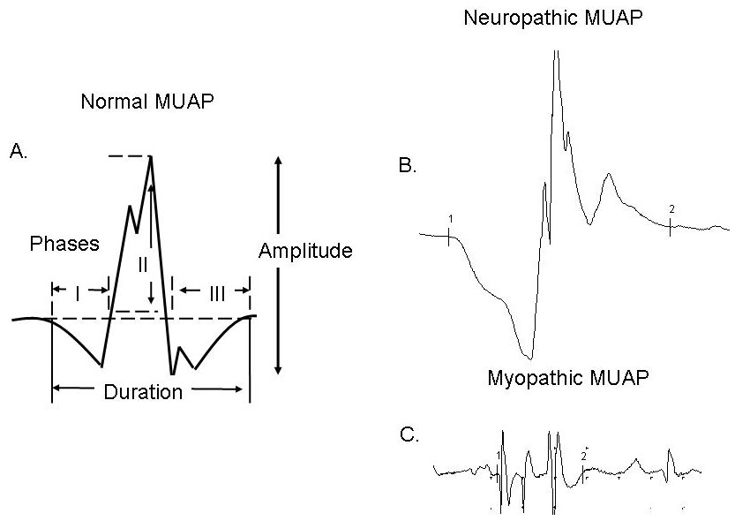

Slide 8
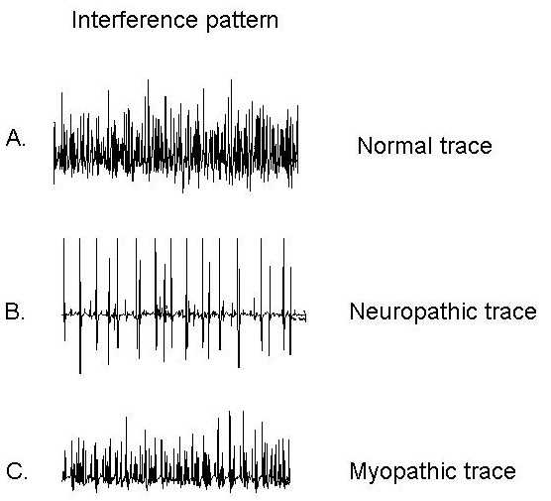

Slide 9
Can EMG-based computerized classifiers be used in practice?
YES
But if they are:
Accurate
Sensitive
Specific
Reliable

Slide 10
The aim of this study
To provide a comprehensive picture about validity & reliability of EMG-based computerized classifiers in detecting source of muscle defect

Slide 11
Methods
Systematic review
PubMed, ScienceDirect, and Cochrane library were searched
January 2000 - 9th April 2014
Eligible articles
Original articles published in peer-reviewed journals
Proposing an EMG-Based computerized classifier
Quality apprisal
QUADAS-2 checklist
Data
Methodological characteristics of the study
Validity indices
Type of classifier

Slide 12
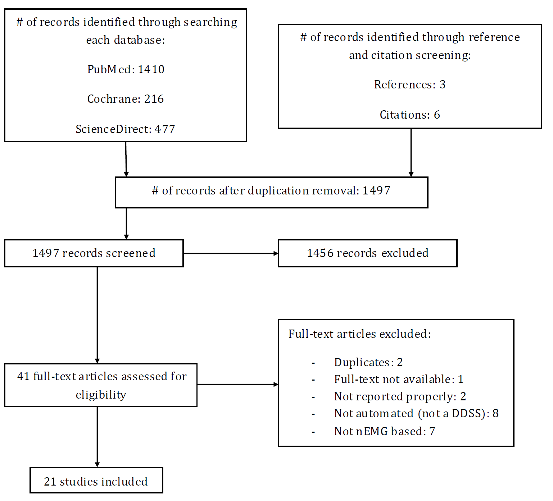
Results

Slide 13
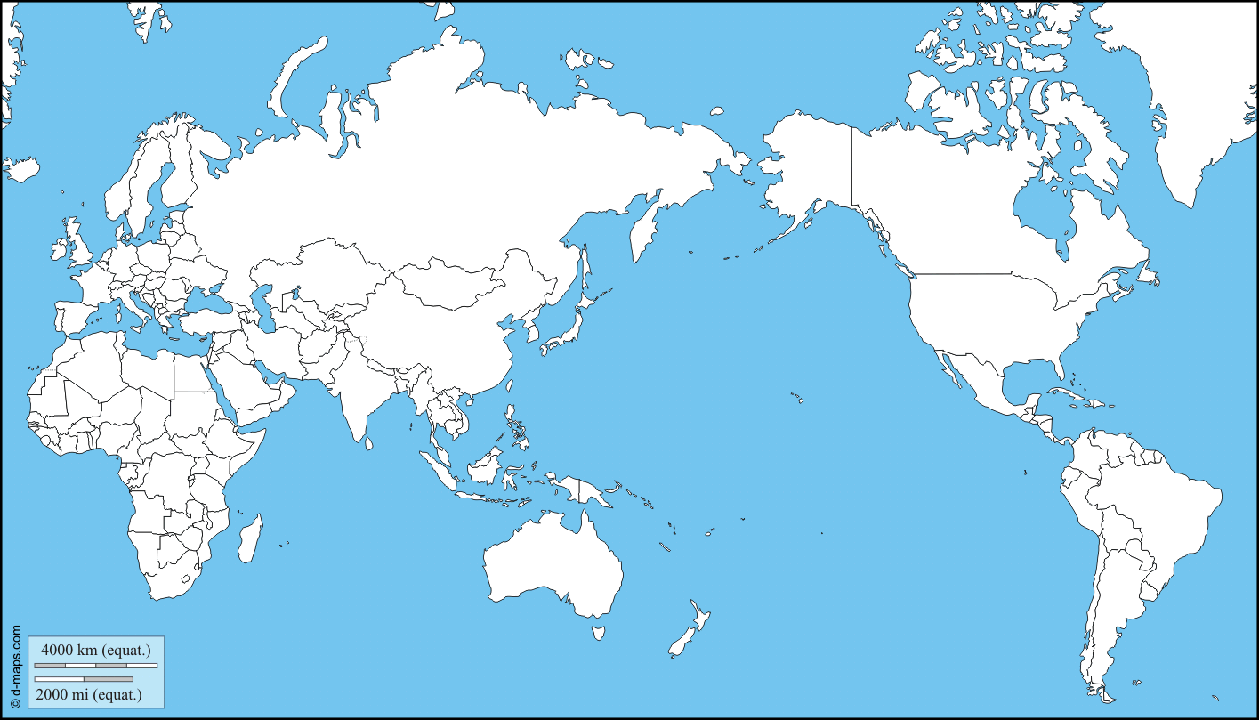
Results , cont...
Turkey: 7
Poland: 3
Cyprus: 3
USA: 2
Canada: 2
China: 2
Iran: 1

Slide 14
Results , cont...
A wide variety of classification algorithms (n= 40) were proposed and tested.
Most were able to classify source of muscle defect into three groups:
Myogenic
Neurogenic
None

Slide 17
Results , cont...
Sensitivity, specificity, and accuracy in all studies were reported.
These indices in correctly diagnosing source of defect in 38 algorithms were at least 0.75 (max= 1.0).
Two other algorithms were
Sensitivity= 0.70, specificity= 0.68, accuracy= 0.72
Sensitivity= NR, specificity= 0.70, accuracy= NR
The algorithms’ replicability was not assessed in some studies.
In reported studies, most algorithms were replicable.

Slide 18
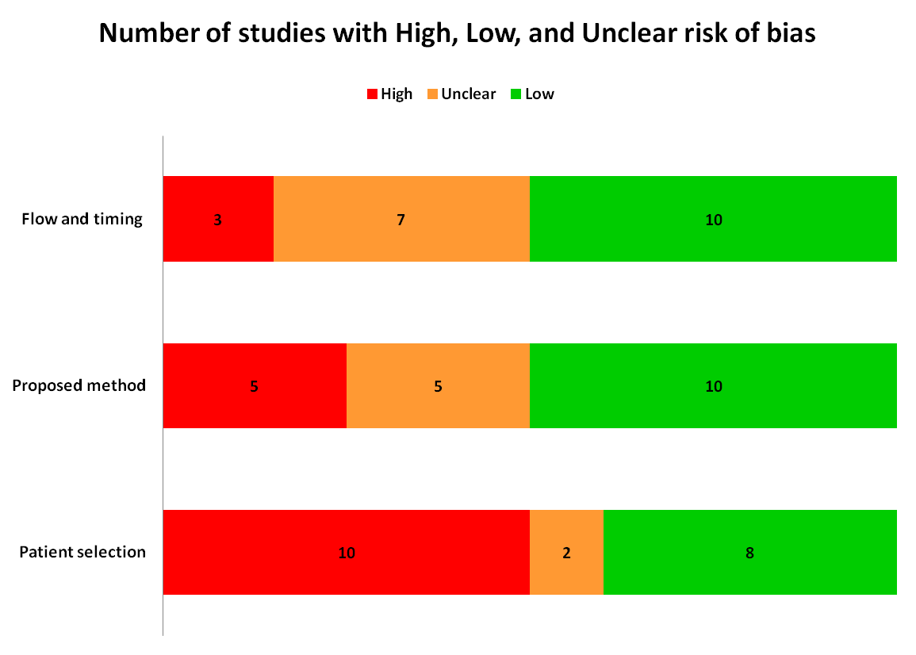
Results , cont...

Slide 19
Patient selection
Did not:
Enroll consecutive or random sample of patients
Avoid case–control designs
Avoid inappropriate exclusions
Hard to diagnosis patients

Slide 20
Flow and Timing
High risk studies did not:
Incorporate appropriate interval between the index test and gold standard.
Include all patients in the analysis.
There was cases of loss to follow up

Slide 21
Proposed method
High risk studies did not:
Interpret index test results without knowledge of the results of the gold standard.

Slide 22
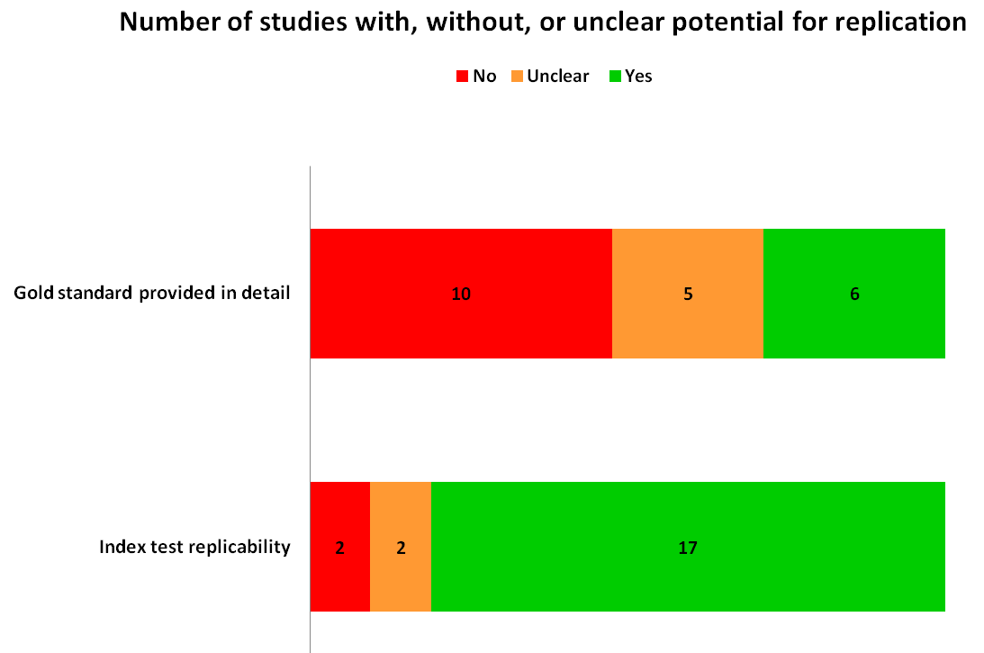
Results , cont...

Slide 23
Conclusion
There are great potential benefits for EMG-based computerized classification algorithms in practice.
Evidences suggest potential for validity and replicability of these algorythms.
However,
Enough rigorous evidence is still required for recommending these methods’ application for clinical practice.
Conducting more methodologically sound studies and comprehensive assessment of validity and reliability of each algorithm is highly recommended.
Methodological details should be reported clearly in the manuscripts.

Slide 25
Contact
E-mail:
M.h.eybpoosh@gmail.com
Tell:
0912-6764051

