Slide 1
شرکت تحقیقاتی بیوفارماسی پارس
PARS BIOPHARMACY RESEARCH CO.

Slide 2
History
Start: 1993
Objective: Transfer of knowledge and technology
between the university and industries.

Slide 3
Field of activities
in-vitro & in-vivo quality control of raw material,
human and veterinary pharmaceutical formulations,
foods, hygienic and cosmetic preparations.
Development of pharmaceutical formulation, nutritional supplements …
Determination of drug residue levels in food.

Slide 4
Product

Slide 5
Importance of Iron
Production of hemoglobin (the molecule in blood that carries oxygen)
Maintaining many body functions, healthy cells, skin, hair, and nails.
Decrease Autism Spectrum Disorder (ASD)

Slide 6
Causes of iron deficiency anemia?
Diets do not include iron-rich foods, Vegetarians, vegans (Iron from vegetables, even those that are iron-rich, is not absorbed as well as iron from meat, poultry, and fish.)
Blood loss: menstruation, particularly heavy menstrual periods, major surgery or physical trauma
Pregnancy & breastfeeding
Gastrointestinal diseases: Celiac disease (sprue), inflammatory bowel diseases (ulcerative colitis, Crohn disease), peptic ulcer, bariatric procedures (especially gastric bypass operations)
Children & teen ages

Slide 7
Signs and Symptoms of Iron-Deficiency Anemia
Symptoms of iron-deficiency anemia are related to decreased oxygen delivery to the entire body:
Being pale or having yellow "sallow" skin
Unexplained fatigue or lack of energy
Shortness of breath or chest pain, especially with activity
Unexplained generalized weakness
Rapid heartbeat
Pounding or "whooshing" in the ears
Headache, especially with activity
Craving for ice or clay - "picophagia"
Sore or smooth tongue
Brittle nails or hair loss

Slide 8
Oral Iron Supplements
Goals: Supply sufficient iron to restore normal iron stores and replenish hemoglobin deficits.
Most commonly available oral preparations:
ferrous sulfate: the least expensive and most commonly used
oral iron supplement.
ferrous gluconate
ferrous fumarate

Slide 9
Problems
Low absorption of iron from supplements
Gastrointestinal side effects: nausea, vomiting, constipation, diarrhea, dark colored stools, and/or abdominal distress
Food and drug interactions: Caffeinated beverages (especially tea), Calcium containing foods and beverages, Calcium supplements, Antacids, H-2 receptor blockers, Proton pump inhibitors

Slide 10
Reason of minerals iron problems
Fe ²⁺
Active ion Food & Drug interaction
Passive transport low absorption

Slide 11
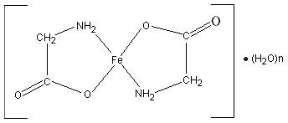
Ferrous Bis-glycinate Chelate

Slide 12
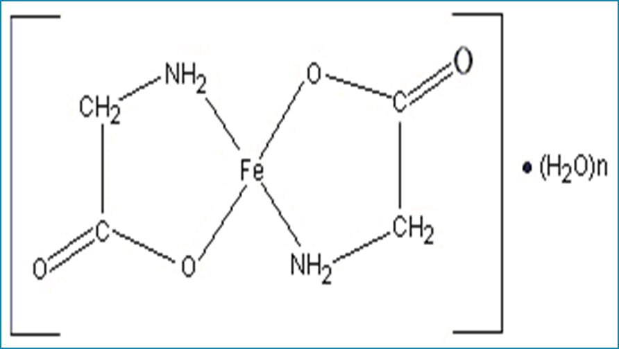
What is Ferrous bisglycinate ?
Ferrous bisglycinate is a chelated form of iron.
With ferrous bisglycinate two molecules of the amino acid glycine are bound covalently to a molecule of iron.

Slide 13
Advantages of Ferro-Shel
superior bioavailability
Superior stability during GI pH
Zero complaints (no food & drug interaction)
Superior tolerability and safety

Slide 14
Mechanism of absorption
In the intestine, ferrous bisglycinate is absorbed intact via the dipeptide pathway, with subsequent hydrolysis into its respective iron and glycine components within the intestinal mucosa.

Slide 15
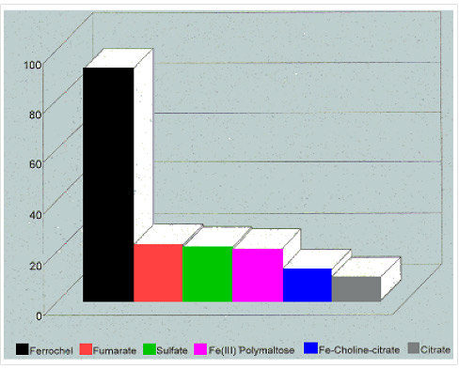

Slide 16
Safety
The LD50 of ferrous bisglycinate = 560mg/kg
(the safest iron available)
It has also been granted GRAS (Generally Regarded As
Safe) status by the FDA

Slide 17
(G R A S)
Generally Recognized as Safe

Slide 18
September 30, 1999
Mr. James Hyde Albion Laboratories, Inc. 101 North Main Clearfield, UT 84015-2243
Re: GRAS Notice No. GRN 000019
Dear Mr. Hyde:
The Food and Drug Administration (FDA) is responding to the notice, dated April 20, 1999, that you submitted in accordance with the agency's proposed regulation, proposed 21 CFR 170.36 (62 FR 18938; April 17, 1997; Substances Generally Recognized as Safe (GRAS)). FDA received the notice on April 22, 1999 and designated it as GRAS Notice No. GRN 000019.
The subject of the notice is ferrous bisglycinate chelate. The notice informs FDA of the view of Albion Laboratories, Inc. (Albion) that ferrous bisglycinate chelate is GRAS, through scientific procedures, for use as a source of dietary iron for food enrichment and fortification purposes.
The notice describes (1) Albion's patented process for the synthesis of ferrous bisglycinate chelate; (2) subchronic toxicity studies in rats, which have been accepted for publication in a peer-reviewed journal; (3) unpublished acute oral toxicity studies in rats; and (4) references to published studies on the bioavailability and efficacy of ferrous bisglycinate chelate in humans. In telephone conversations with representatives of the Office of Premarket Approval, you clarified that dietary exposure to ferrous bisglycinate chelate would be consistent with existing iron supplementation guidelines, which provide for an intake of 18 mg of iron per person per day. The release and dietary exposure to glycine from ferrous bisglycinate chelate given this level of iron supplementation would be approximately 50 mg per person per day.
Based on the information provided by Albion, as well as other information available to FDA, the agency has no questions at this time regarding the conclusion of Albion that ferrous bisglycinate chelate is GRAS under the proposed conditions of use. The agency has not, however, made its own determination regarding the GRAS status of the subject use of ferrous bisglycinate chelate. As always, it is your continuing responsibility to ensure that food ingredients that you market are safe, and are otherwise in compliance with all applicable legal and regulatory requirements.
In accordance with proposed 21 CFR 170.36(f), a copy of this letter, as well as a copy of the information in your notice that conforms to the information in proposed § 170.36(c)(1), is available for public review and copying on the Office of Premarket Approval's homepage on the World Wide Web.

Slide 19
Package
Each tablet of Ferro-Shel® contain:
Ferrous bisglycinate equal to 50mg Fe II
Eack box contain: 30 tablet
Price: 3000 Rls/tablet or 90,000 Rls/box

Slide 20
Contact Us
Tel: +98 21 88956061
Fax: +98 21 88969958
P.O. Box: 14155-7387
E-mail: info@parsbiopharmacy.com
www.parsbiopharmacy.com

