Slide 1
Non pharmacologic Self-care In Hypertension
Dr. F. Ahmadi
Professor Of Nephrology
Nephrology Research Center , TUMS

Slide 2
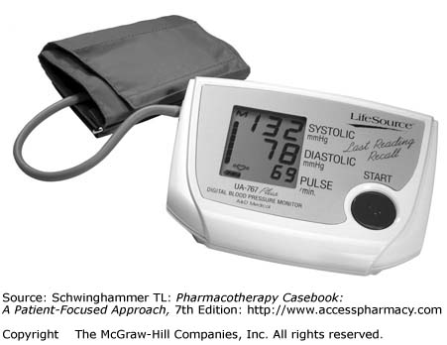
Hypertension Facts:
Affects 1 billion people worldwide
US – about 1 in 3 adults
73 million have hypertension (SBP >140/90)
Number one reason listed for office visits
Causes/contributes to 457,000 admissions per year
A leading cause/contributor to death (MI, stroke, vascular disease)

Slide 3

At Least 65 Million Americans Require
Treatment for Hypertension
Hypertension:
How Big Is the Problem?
Nearly 1 in 3 adults (31%) in the US has hypertension
Fields LE et al. Hypertension. 2004;44:398-404.
Notes:
A recent analysis of National Health and Nutrition Examination Survey (NHANES) data from 1999 to 2000 reported a 3.7% increase in the prevalence of hypertension compared with 1988 to 1994.¹
In a recent study, data from NHANES and the US Census Bureau were used to estimate hypertension burden, prevalence rates, and trends relative to 1988 to 1994 for US adults in 1999 to 2000.² The study found that at least 65 million US adults (nearly 1 in 3 adults, or 31.3%) had hypertension during that time period.²
Assuming continuing trends, the figures would be even higher for 2004.

Slide 4
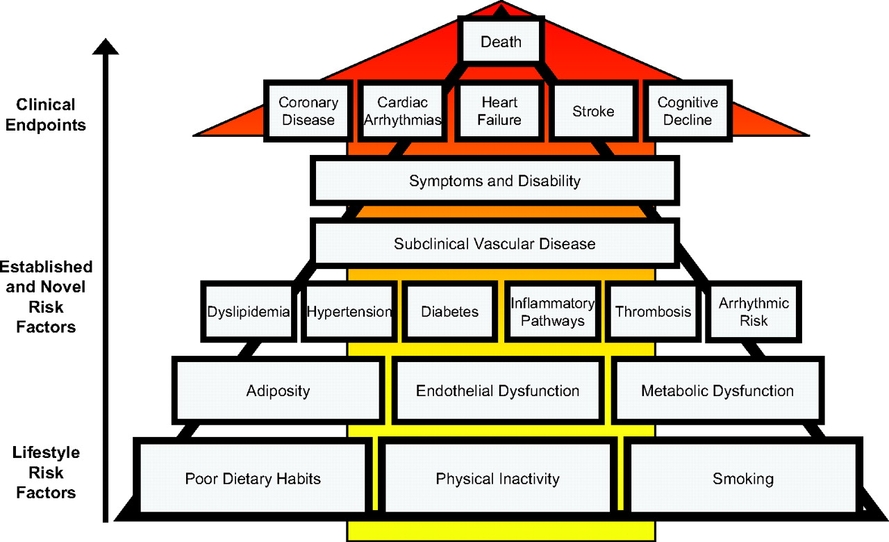

Figure 1. The relations of lifestyle, established and novel risk factors, and cardiovascular disease.
Mozaffarian D et al. Circulation. 2008;117:3031-3038
Copyright © American Heart Association, Inc. All rights reserved.
Notes:
Figure 1. The relations of lifestyle, established and novel risk factors, and cardiovascular disease. Assessment and treatment of dyslipidemia, hypertension, and diabetes are major foci of clinical care, practice guidelines, performance measures, and scientific research. These established cardiovascular risk factors are strongly influenced by lifestyle, including dietary behaviors, physical inactivity, smoking, and adiposity. Adiposity itself is largely a result of poor diet (excess calories) and inactivity. Lifestyle risk factors also influence disease risk via effects on other novel risk factors such as endothelial function, inflammation/oxidative stress, thrombosis/coagulation, arrhythmia, and other pathways. These basic lifestyle habits—poor diet, physical inactivity, and smoking—are thus the most proximal risk factors for cardiovascular disease.

Slide 5
Risk factors you can control
• High blood pressure
• Abnormal cholesterol
•Tobacco use
• Diabetes
• Overweight
• Physical inactivity

Slide 6
Risk factors beyond your control
Age (55 or older for men; 65 or older for women)
Family history of early heart disease (having a father or brother diagnosed with heart disease before age 55 or Diabetes having a mother or sister diagnosed before age 65)

Slide 7
A 5 mmHg population-wide reduction in blood pressure has been estimated to reduce the incidence of coronary events by 9%, strokes by 14% and all-cause mortality by 7%, and would translate into 27,600 lives saved per year in the USA

Slide 8
Hypertension
Lifestyles, Fitness
and Rehabilitation
What Can I Do?
  Loose weight if your overweight
  Get regular physical activity
  Avoid excessive alcohol
  Stop smoking
  Manage your stress

Slide 9

Hypertension
Lifestyles, Fitness
and Rehabilitation
What Can I Do?
  Decrease salt intake
  Eat for heart health
  Discuss the use of oral contraceptives with your doctor
  Discuss the use of some medications your doctor

Slide 10
Hypertension
Lifestyles, Fitness
and Rehabilitation
Ten Commandments for Blood Pressure Control
  Know your blood pressure
    Have it checked regularly
  Know what your weight should be
    Keep it at that level or below
  Don’t use excessive salt in cooking or at meals
    Avoid salty foods
1
2
3

Slide 11
Hypertension
Lifestyles, Fitness
and Rehabilitation
Ten Commandments for Blood Pressure Control
  Eat a low-fat diet
    According to AHA regulations
  Don’t smoke cigarettes
    Or use tobacco products
  Take your medicine exactly as prescribed
    Don’t run out of pills even for a single day
4
5
6

Slide 12
Hypertension
Lifestyles, Fitness
and Rehabilitation
Ten Commandments for Blood Pressure Control
  Keep your appointments with the doctor
  Follow your doctors advice about exercise
  Make certain family members have their blood pressure checked regularly
  Live a normal life in every other way!
7
8
9
10

Slide 13
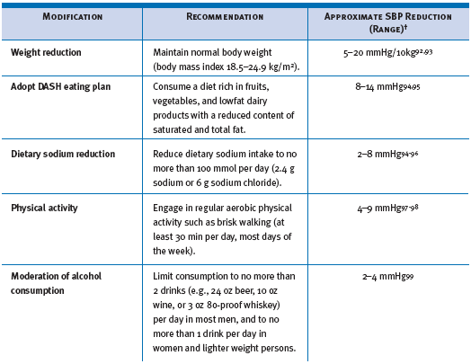
Lifestyle modifications
www.nhlbi.nih.gov

Slide 14
Lifestyle Changes Beneficial in Reducing Weight
Decrease time in sedentary behaviors such as watching television, playing video games, or spending time online.
Increase physical activity such as walking, biking, aerobic dancing, tennis, soccer, basketball, etc.
Decrease portion sizes for meals and snacks.
Reduce portion sizes or frequency of consumption of calorie containing beverages.

Slide 15
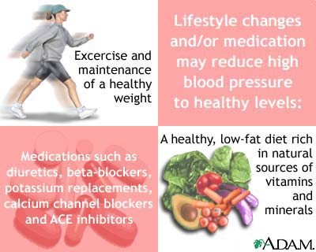

Slide 16
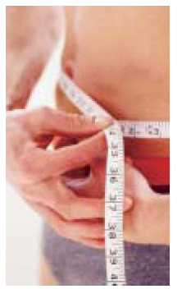
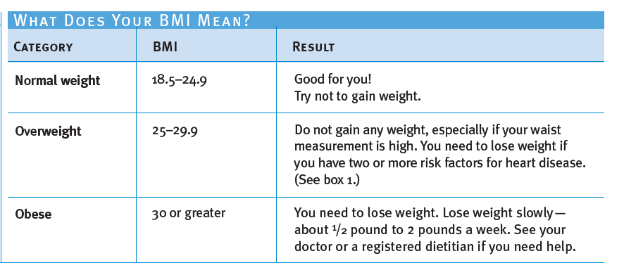

Slide 17

Modification of dietary caloric intake
Obesity is a major public health burden in the USA, affecting 34% adults and 20% adolescents, and is associated with hypertension and multiple other co-morbidities such as diabetes mellitus, coronary heart disease, stroke and obstructive sleep apnea that further increase the risk of cardiovascular disease
More than 65% of individuals with high blood pressure are overweight (BMI ≥25 kg/m2) or obese (BMI ≥30 kg/m2)

Slide 18
Modification of dietary caloric intake
In TOHP I, a 4% reduction in weight was associated with a 2.9/2.3 mmHg reduction in blood pressure over 18 months of observation
In the TOHP II study, a 4 kg reduction in weight was associated with a 2–4 mmHg reduction in blood pressure at 6 months
In the TONE study, with a mean weight loss of 10 lbs (~4.5 kg), about one-third of patients were able to stop antihypertensive medication

Slide 19
Mechanisms of Antihypertensive Effect Of weight Loss
Improvement in Insulin sensitivity
Decrease in sympathetic activity
Decrease in renin-angiotensin-aldostron
Reduction of inflammatory cytokines
Reversal of endothelial dysfunction
Reduction in arterial stiffness

Slide 20


Physical Activity

Slide 21

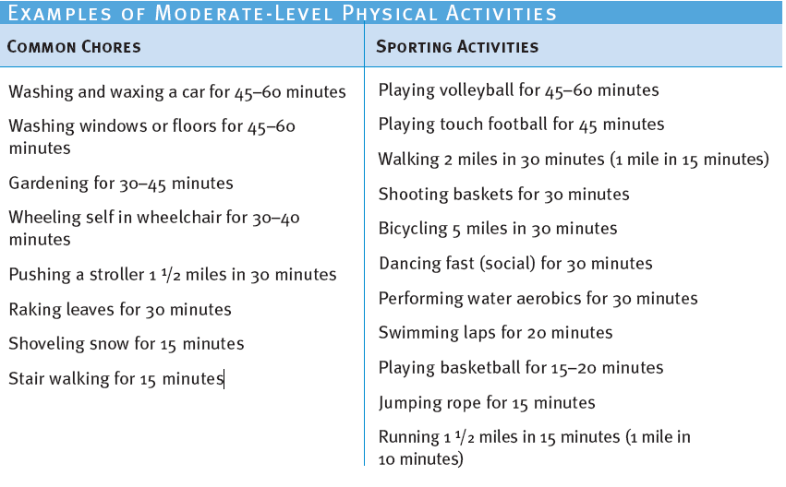

Slide 22
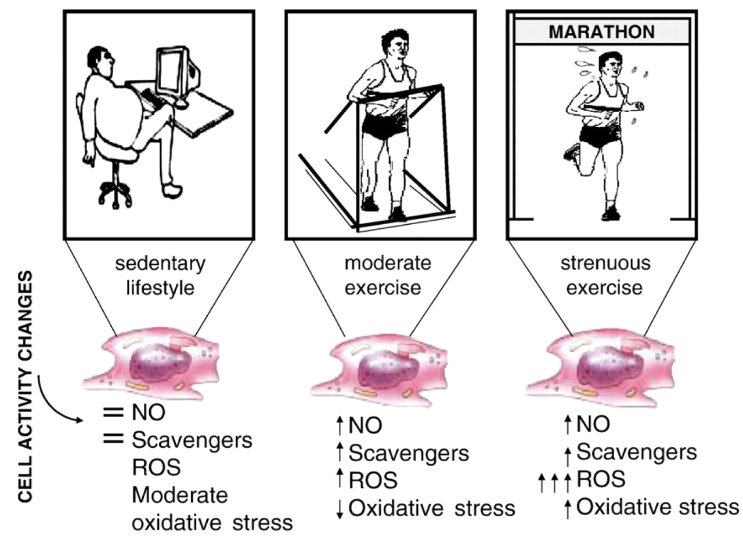

Slide 23
Mechanisms Of Antihypertensive effect of Exercise
Increased endothelium –dependent vasodilatation through NO
Reduced sympathetic activity
Reduced arterial stiffness
Increased insulin sensitivity
Reduced abdominal fat

Slide 24
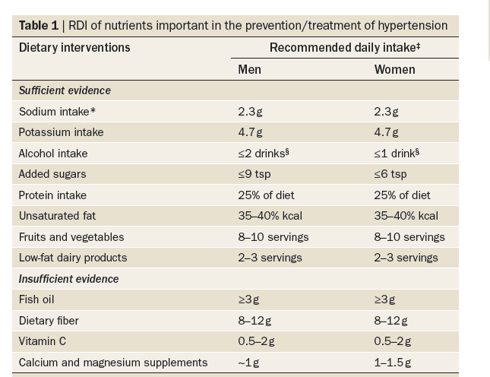

Slide 25
Modification of dietary potassium
In a large meta-analysis of 33 clinical trials, a median increase in urinary potassium excretion by 2 g per day (50 mmol) led to a reduction in blood pressure by 4.4/2.5 mmHg and 1.8/1.0 mmHg in individuals with and without hypertension, respectively
In a subsequent meta-analysis of 27 randomized controlled trials published between 1996 and 2001, a mean increase in potassium intake of 2 g per day was associated with a drop in blood pressure by 3.3/2.1 mmHg, particularly in individuals with hypertension

Slide 26
Modification of dietary potassium
Endothelium-dependent vasodilatation by the ability of potassium to lower intracellular calcium concentration and thereby reduce smooth muscle contraction
potassium deficiency increases the expression of serine/threonine-protein kinase WNK‑1, which might create an imbalance between the activity of the ATP-sensitive inward rectifier potassium channel 1 (KCNJ1) and the epithelial sodium channel, which results in increased sodium retention

Slide 27

DASH Diet
Dietary approaches to Stop Hypertension
As effective as one medication

Slide 28
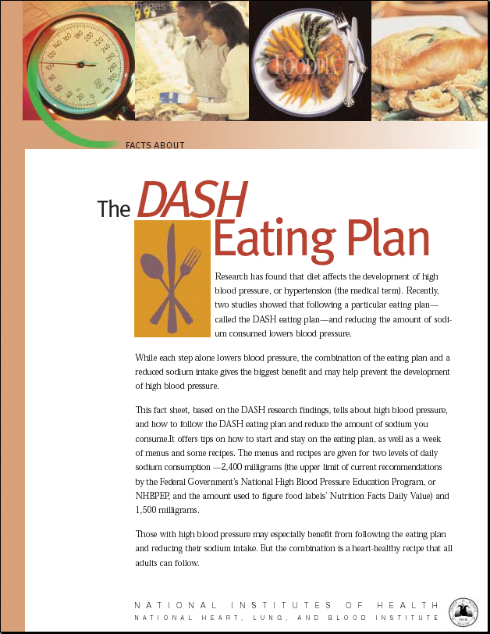

Slide 29
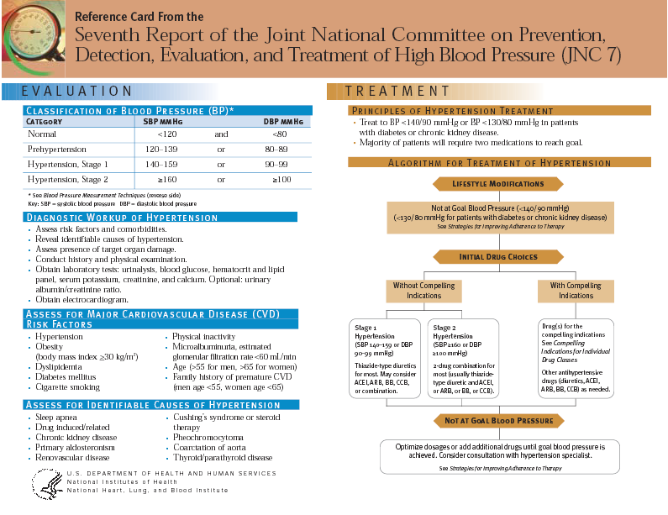
JNC 7 Reference Card

Slide 30
DASH and DASH-like diets
The DASH diet is among the most widely studied dietary recommendations in the management of hypertension. This diet involves an eating plan that is rich in fruit, vegetables and low-fat dairy products, with reduced amounts of cholesterol, total and saturated fat, as well as lean red meat, sweets and sugar-sweetened beverages

Slide 31

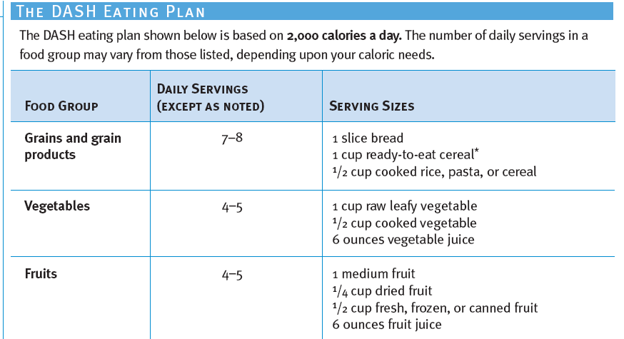

Slide 32
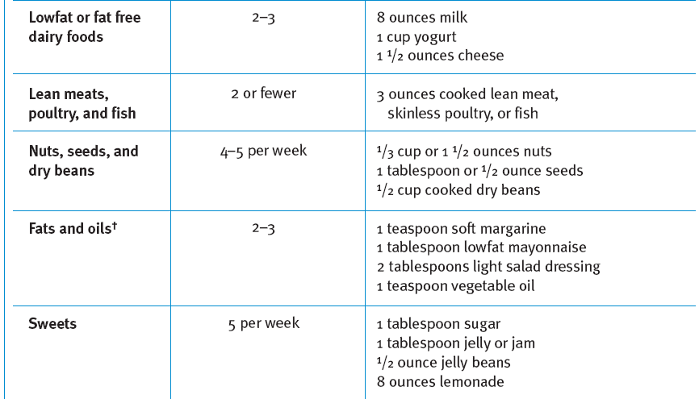

Slide 33
DASH and DASH-like diets
At the end of the study, the DASH diet led to a reduction in blood pressure of 11.4/5.5 mmHg and 3.5/2.1 mmHg in individuals with and without hypertension, respectively, compared with those who consumed a typical American diet

Slide 34
Modification of diet
Modification of diet with vegan sources
Modification of diet with carbohydrates

Slide 35
Modification of diet with carbohydrates
Fructose is the predominant sugar present in these beverages
Although several large cross-sectional and prospective cohort studies have established a causal relationship between sugar-sweetened beverages and the risk of obesity, metabolic syndrome and type 2 diabetes mellitus,87–89 evidence linking consumption of sugar-sweetened beverages and the risk of hypertension have been inconsisten

Slide 36
Modification of diet with carbohydrates
In a cross-sectional analysis collected from NHANES between 2003 and 2006 and involving more than 4,500 adults without a history of hypertension, increased daily fructose intake (≥74 g or an equivalent of 2.5 sugar-sweetened beverages per day) was independently and significantly associated with a greater odds for elevated levels of SBP and a 30% increased risk of a blood pressure >140/90 mmHg

Slide 37
Modification of diet with carbohydrates
In the PREMIER study, which involved 810 adults with prehypertension or stage 1 hypertension, a reduction of just one sugar-sweetened beverage per day resulted in a 1.8/1.1 mmHg reduction in blood pressure over 18 months

Slide 38
Fructose
Activation of the sympathetic nervous system
change in blood pressure to weight gain caused by increased caloric intake
The inverse relationship between consumption of sugar-sweetened beverages and urinary sodium excretion
The role of hyperurecemia in the pathogenesis of fructose-induced hypertension

Slide 39
Hyperuricemia
Increase juxtaglomerular renin production and decrease expression of nitric oxide synthase, causing renal vasoconstriction, sodium retention and increased blood pressure.
Persistent renal vasoconstriction could lead to the development of salt-sensitive hypertension, even after hyperuricemia is corrected
uric acid might induce endothelial and vascular smooth muscle cell proliferation, which could elevate blood pressure

Slide 40
Modification of dietary alcohol consumption
In the INTERSALT study, individuals who drank 300–499 ml alcohol per week or 2.8–4.8 drinks per day had an increase in blood pressure of 2.7/1.6 mmHg.
A large, prospective trial involving 28,000 women and 15,000 men suggested that modest alcohol consumption (one drink per month to five drinks per week) could decrease the risk of hypertension in women, but not in men in whom the risk of hypertension was evident at five drinks per week

Slide 41
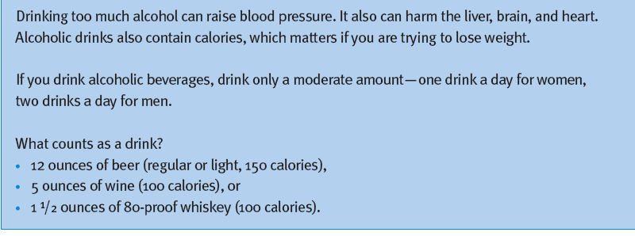
Alcohol

Slide 42
Approaches without evidence for recommendation
The omega‑3 fatty acids in fish oil include eicosapentaenoic acid (EPA), and docosahexaenoic acid (DHA). A systematic review of fish-oil supplements for the prevention and treatment of hypertension in patients with a blood pressure of at least 140/85 mmHg showed that blood pressure was reduced by 2.56/1.47 mmHg in eight studies

Slide 43
Modification of dietary fiber
The water-soluble fiber is mainly derived from fruits and vegetables and has been speculated to help lower blood pressure owing to its ability to increase insulin sensitivity, endothelial function and absorption of minerals such as potassium, calcium and magnesium

Slide 44
Modification of dietary fiber
In a large meta-analysis of 24 trials that included 16 randomized controlled trials and 1,406 individuals, a mean total fiber intake of 11.5 g per day was associated with a nonsignificant reduction in SBP of 1.13 mmHg and modest DBP reduction of 1.26 mmHg. A larger blood-pressure reduction was noted in elderly individuals (1.32/0.67 mmHg), patients with hypertension (2.4/1.8 mmHg) and those with soluble fiber intake (1.32/0.87 mmHg)

Slide 45
Modification of dietary fiber
although total dietary fiber intake of 25–30 g per day is strongly recommended for promoting gastrointestinal and cardiovascular health, the benefits in blood-pressure reduction are at best modest

Slide 46
Modification of dietary calcium and magnesium
In a meta-analysis of 40 clinical trials, ~1 g per day of calcium supplementation was associated with a modest reduction in blood pressure by 1.86/0.99 mmHg, with the improvement being most pronounced in individuals with low calcium intake (≤800 mg per day)
the benefit of calcium and magnesium supplementation in improving blood pressure is very limited and cannot be universally recommended, with the limited exception of individuals who have a low dietary intake of calcium in whom calcium supplementation has shown benefits in blood-pressure control

Slide 47
Modification of dietary vitamin C
observational studies have suggested a beneficial effect of increased serum concentrations of vitamin C or 500–2,000 mg per day of vitamin C supplementation in blood-pressure reduction
However, nine randomized controlled trials have shown inconsistent results. These trials were small, short or not generalizable70 and one study suggested an increase in blood pressure with long-term vitamin C supplementation

Slide 48
Key points
Blood pressure rises with age and the slope of change is influenced by genetic factors as well as environmental and lifestyle factors
Dietary approaches to prevent the age-related change in blood pressure are feasible and should be individualized for different segments of the population based on evidence from observational studies and clinical trials
decrease in dietary sodium and sugar-sweetened beverages, coupled with increased dietary intake of potassium and plant proteins, are the dietary strategies most consistently demonstrated to reduce blood pressure

Slide 49


Remember—You Can Do It!
Maintain a healthy weight
Be physically active
Follow a healthy eating plan
Reduce sodium in your diet
Drink alcohol only in moderation
Take prescribed drugs as directed

Slide 50


