Slide 1
MicroRNAs as novel Biomarkers for Breast Cancer treatment

Slide 2
Presentation by:Fariba Karami
Department of New sciences, Islamic Azad University Tehran Medical Branch, Tehran, Iran
Supervisor:Mahdi Paryan
Department of Research and Development, Production and Research Complex, Pasteur Institute of Iran,Tehran, Iran

Slide 3
MicroRNAs (miRNAs) are a class of small RNA molecules, about ~21 nucleotide (nt) long.
MicroRNA are small non coding RNAs (ncRNAs) that regulate gene expression post transcriptionally.
About 3.0% of human genes encode for miRNAs, and up to 30.0% of human protein coding genes may be regulated by miRNAs.
Currently, more than 2000 unique human mature microRNAs are known.
MicroRNAs play a key role in diverse biological processes including development, cell proliferation, differentiation and apoptosis.
MicroRNAs

Slide 4
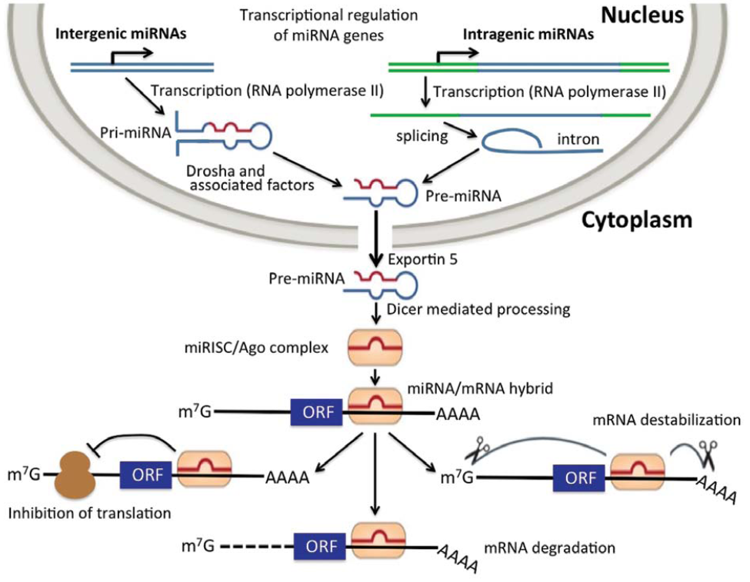
Biogenesis of microRNAs

Slide 5
In cancer, miRNAs function as regulatory molecules, acting as oncogenes or tumor suppressors .
Amplification or over expression of miRNAs can down regulate tumor suppressors or other genes involved in cell differentiation, thereby contributing to tumor formation by stimulating proliferation, angiogenesis and invasion, i.e., they act as oncogenes.
Similarly, miRNAs can down regulate different proteins with oncogenic activity, i.e., they act as tumor suppressors.
miRNAs and cancer

Slide 6
More than half of the miRNAs genes are located in cancer-associated genomic regions or in fragile sites.
The loss of function of a miRNA could be due to several mechanisms, including genomic deletion, mutation, epigenetic silencing, and/or miRNA processing alterations.
On the other hand, miRNAs can act as oncogenic microRNAs by targeting mRNAs encoding tumor suppressor proteins.
miRNAs and cancer (cont..)

Slide 7
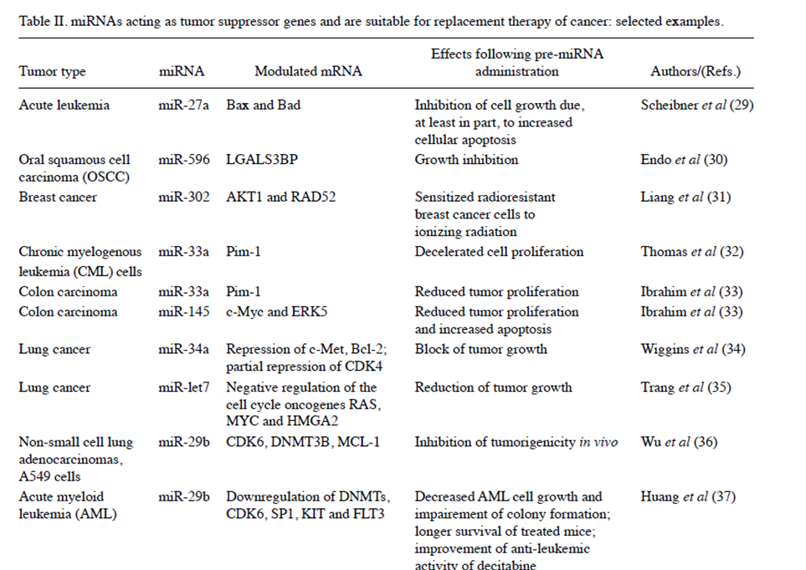

Slide 8
Breast cancer is a complex disease characterized by heterogeneity of genetic alterations.
Genetic and lifestyle/environmental factors are implicated in the aetiology of breast cancer.
According to the American Cancer Society,excluding the cancers of skin, breast cancer is the most common cancer among women, accounting for nearly one in three cancers diagnosed in US women.
Breast cancer is the most commonly diagnosed cancer in women worldwide In Iran, it ranks first among cancers diagnosed in women and is the fifth most common cause of death.
Breast cancer

Slide 9
In the case of breast tumors, several studies have demonstrated a correlation between:
- The expression profile of oncogenic miRNAs (oncomiRs) and tumor suppressor miRNAs; and
the tumorigenic potential of triple-negative [estrogen receptor (ER), progesterone receptor (PR) and Her2/neu] primary breast cancers.
- Among the miRNAs involved in breast cancer, miR-221 plays a crucial role for the following reasons:
i) miR-221 is significantly overexpressed in triple-negative primary breast cancer;
ii) the oncosuppressor p27Kip1, a validated miR-221 target is downregulated in aggressive cancer cell lines; and
iii) the upregulation of a key transcription factor, Slug, appears to be crucial, since it binds to the miR-221/mi-222 promoter and is responsible for the high expression of the miR-221/miR-222 cluster in breast cancer cells.
MicroRNAs in breast tumors

Slide 10
As breast cancer and many other tumors show overall down-regulated miRNAs expression compared to normal tissues, miRNA replacement therapy is intended to restore the levels and functions of down-regulated tumor suppressor-like miRNAs, thereby inhibiting tumor initiation and progression.
Distinct from the single-strand antagomirs(antisense miRNA) , miRNA replacement therapy requires double-stranded miRNAs for functional recruitment to the RNA-induced silencing complex (RISC).
The doubled molecular weight of miRNAs may be a further hurdle to overcome for efficient cellular delivery.
Another big challenge is targeted tumor distribution with minimized uptake by the liver and other organs.
MicroRNA replacement therapy

Slide 11
Theoretically, viral vectors, liposomes, or nanoparticles designed for targeted delivery of siRNA therapeutics may also be appropriate for miRNA encapsulation and delivery.
Experimental miRNA replacement therapies have been tested in many solid tumor models, and these miRNA delivery approaches could possibly be applied to breast cancer treatment.
A few examples are :adenoviral vectors, nanoparticles and lipid-based materials to deliver miRNAs in vivo.
MicroRNA replacement therapy (cont….)

Slide 12
Surgery
Radiotherapy
Chemotherapy
Drugs:Tamoxifen, Estradiol and ….
Therapy effects:
Wide range of side effects
High toxicity
Damging other organs like Hair loss, leukemia, Cells lining the gastrointestinal tract
Not much target
Common treatment of breast cancer

Slide 13
Less toxicity
More efficiency
Targeted
Benefit miRNA replacement therapy

Slide 14
Thank you for your attention

