Slide 1
Effect of Surgical Techniques on End-results
in Cardiovascular Surgery
A 29-year Experiences from 1967 to 1996
H Sadeghi, AA Boulourian, P Ruchat
Department of Cardiovascular Surgery
CHUV
Lausanne

Slide 2
Sternal Incison and closure

Slide 3
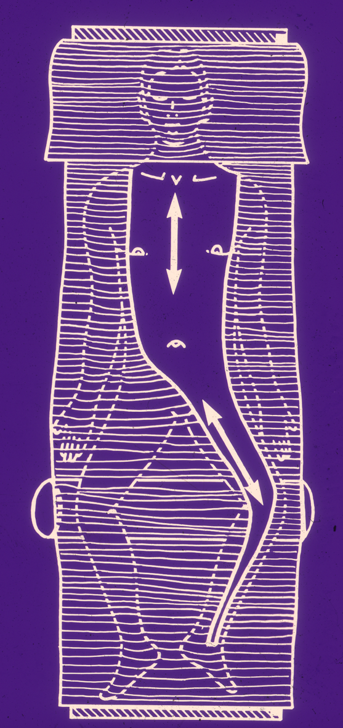

Slide 4
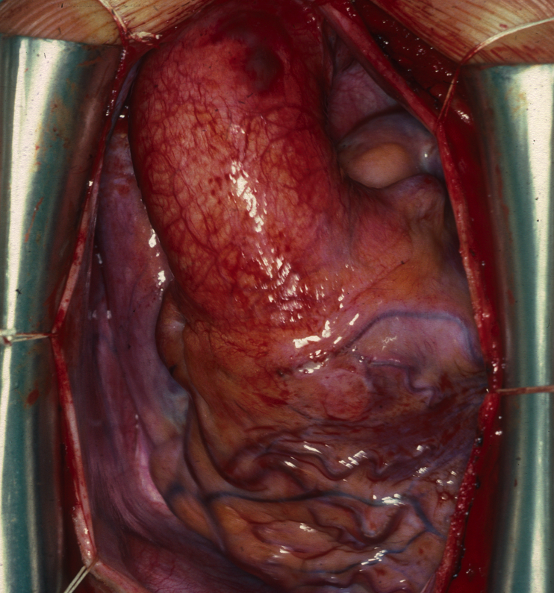

Slide 5
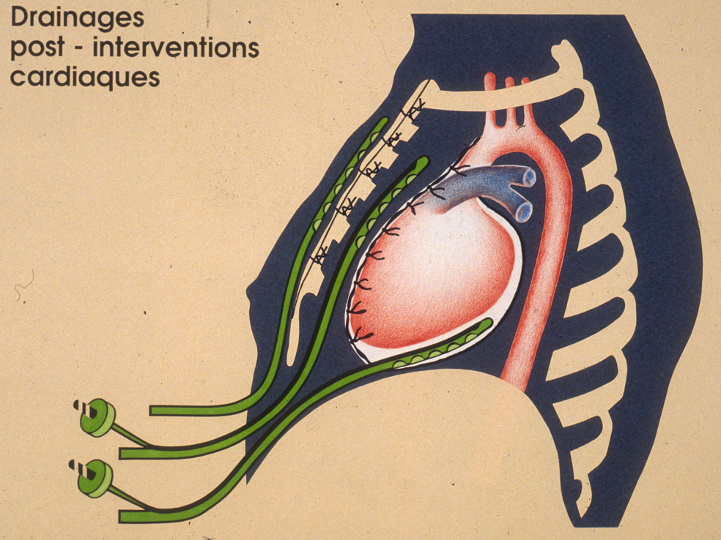
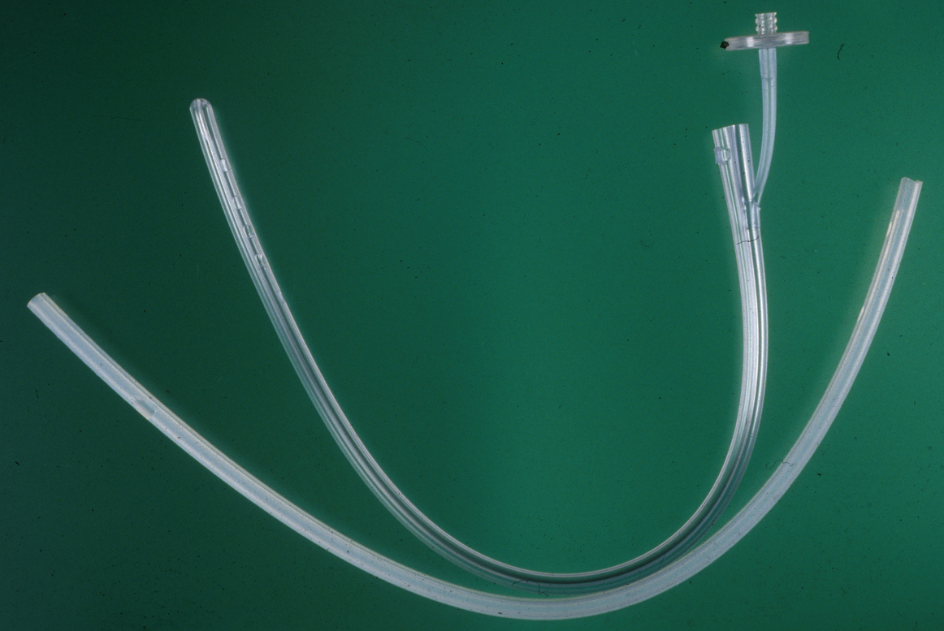
Drainage technique
Blanchard, Hurni et al. EJCTS 1995; 9: 153-7

Slide 6
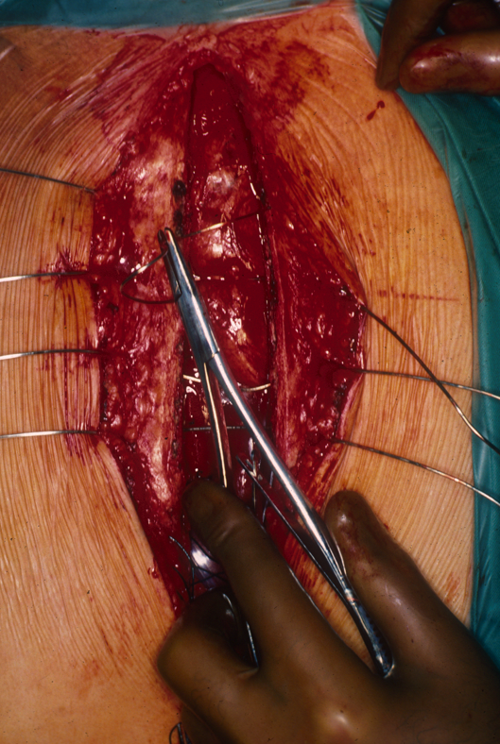
Sternal Closure Technique
Blanchard, Hurni et al. EJCTS 1995; 9: 153-7

Slide 7
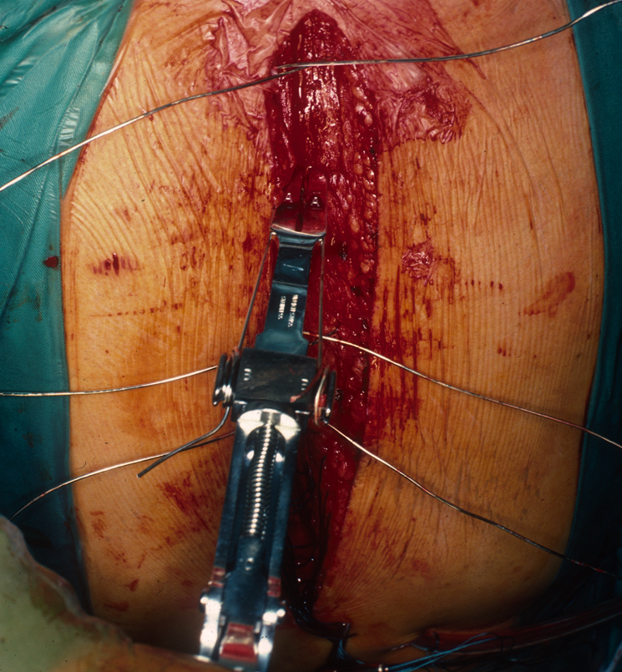
Blanchard, Hurni et al. EJCTS 1995; 9: 153-7

Slide 8
Classical closure of sternal opening

Slide 9
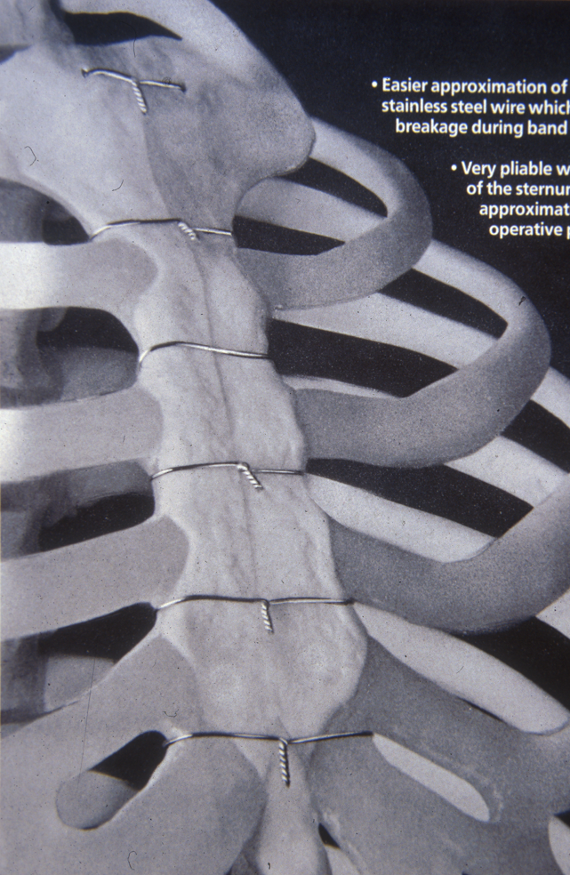
Blanchard, Hurni et al. EJCTS 1995; 9: 153-7

Slide 10
Surgical Site Infection
POST-OP WOUND INFECTIONS ( 4137 Pts 1981-1991)
Deep-sternal infection 6 Pts (1 no bact): 0.145 %
2642 CABG, 1130 VR, 179 CABG + VR, 186 others = 4137 Pts
World literature deep sternal infection: 0.7 - 4 %
Blanchard, Hurni et al. EJCTS 1995; 9: 153-7

Slide 11
Valvular Surgery

Slide 12
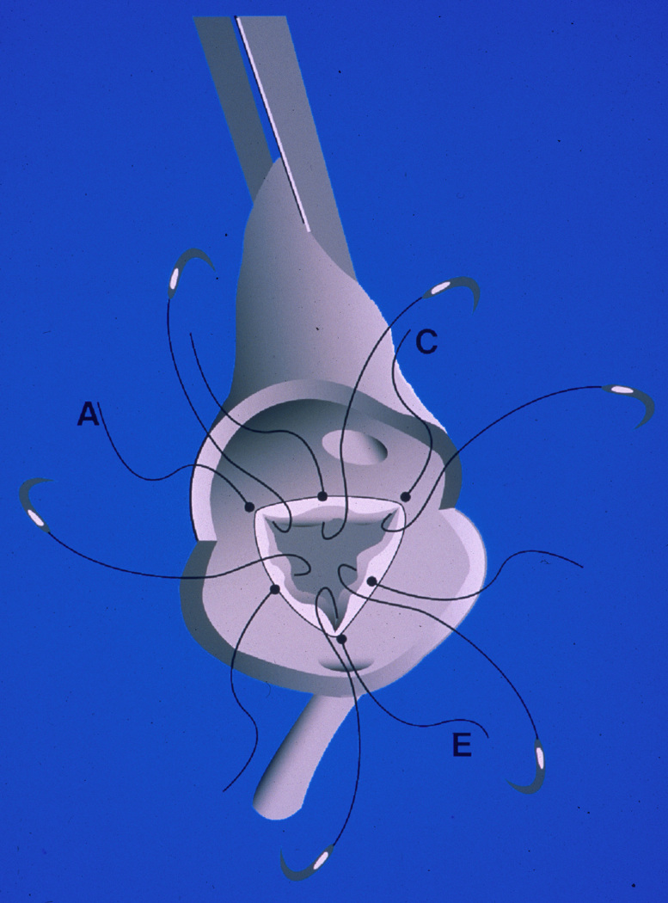
Prosthetic Valve Insertion
Technique
Ruchat et al. Ann Thorac Surg 1998; 65: 859-60

Slide 13
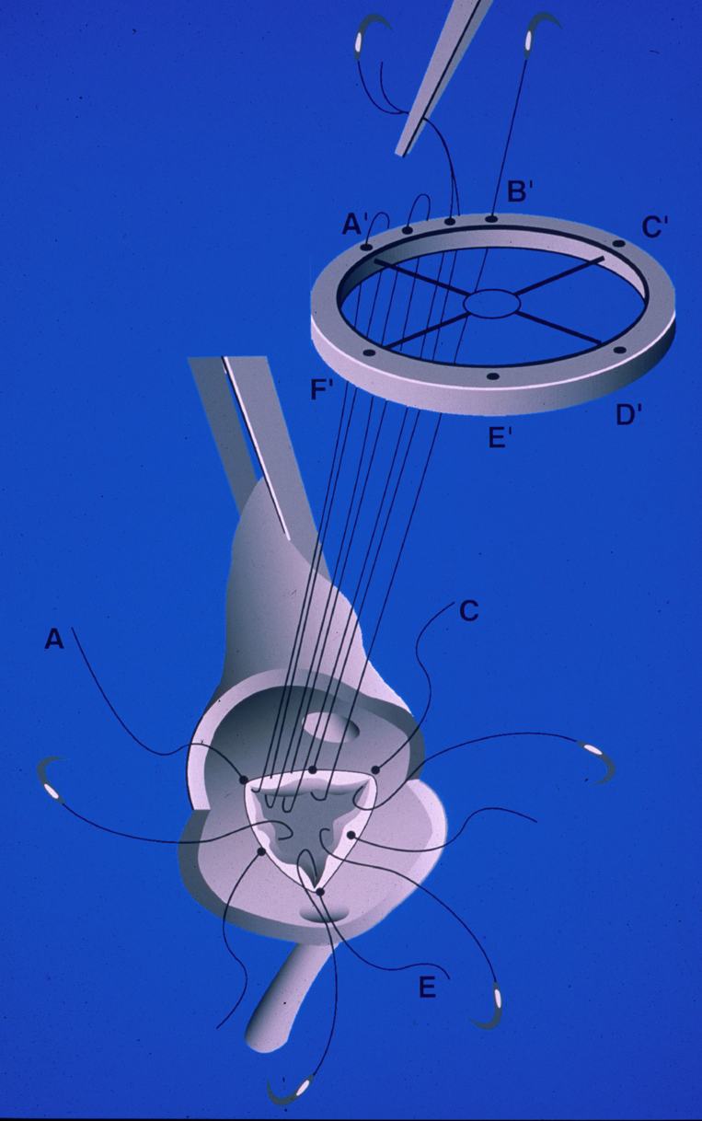
Ruchat et al. Ann Thorac Surg 1998; 65: 859-60

Slide 14
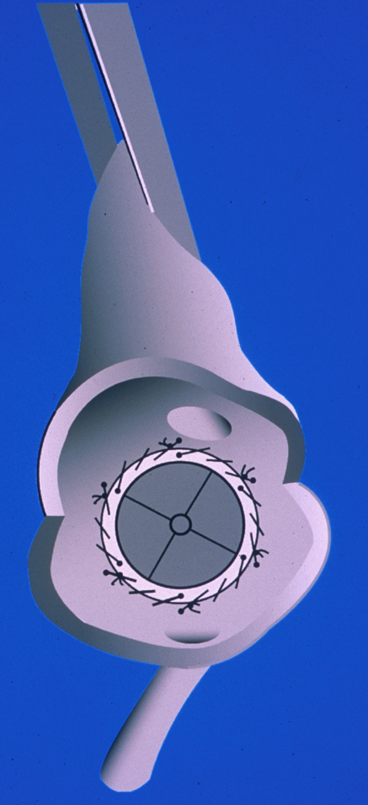
Ruchat et al. Ann Thorac Surg 1998; 65: 859-60

Slide 15
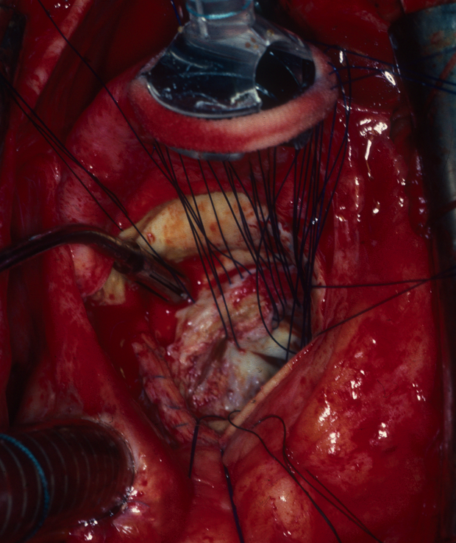

Slide 16
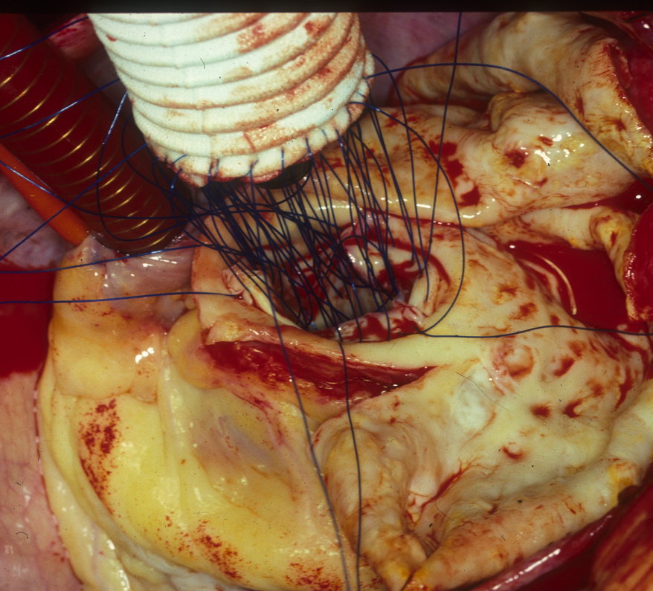

Slide 17
Meta-analysis of Perivalvular Leak
- Debetaz LF, Ruchat P, Hurni M, et al.
St. Jude Medical valve prosthesis: an analysis of long-term outcome and prognostic factors.
J Thorac Cardiovasc Surg 1997;113:134-4.
- Karpuz H, Jeanrenaud X, Hurni M, et al.
Doppler echocardiographic assessment of the new ATS medical prosthetic valve in the aortic position.
Am J Card Imaging 1996;10:254-60.

Slide 18
Meta-analysis of Perivalvular Leak
Lausanne results
Retrospective
prospective
1979-1984
Debétaz et al.
( 3 Pts ) ( St. Jude )
Karpuz et al. 1994-1996
( 0 Pts ) ( ATS )
Total 434 Pts 0.7 %
353 Pts 0.8 %
80
Pts 0.0 %
World literature : perivalvular leak 2 - 4 %

Slide 19
Coronary Artery Bypass
Surgery (CABG)

Slide 20
POLYARTERIOPATHIES
IN CASE OF PERIPH. ART. INSUFF. :
Coronary lesions 50 - 60 %
Cerebral art. lesions 15 - 20 %
CAUSE S OF DEATH :
Coronary 50 - 60 %
CVA 10 - 15 %
Vascular diseases 10 %

Slide 21
POLYARTERIOPATHIES
IN CASE OF CORONARY INSUFF. :
- Cerebral art. lesions 50 - 60 %
Severe 15 %
- Periph. art. lesions 20 %
IN CASE OF CEREBRAL VASC. INSUFF. :
- Coronary lesions 40 %
- Periph. art. lesions 30 %

Slide 22
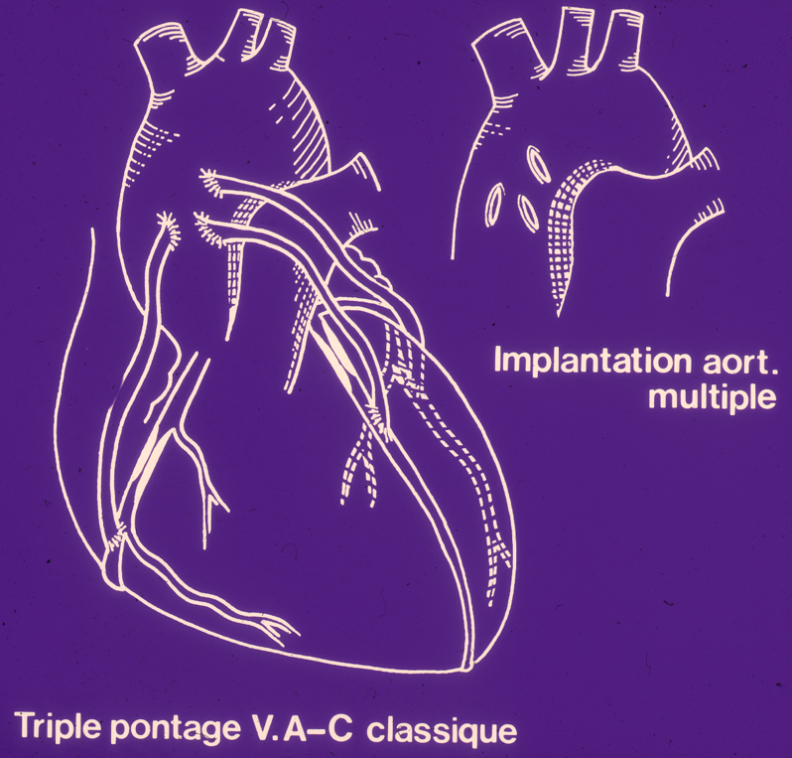
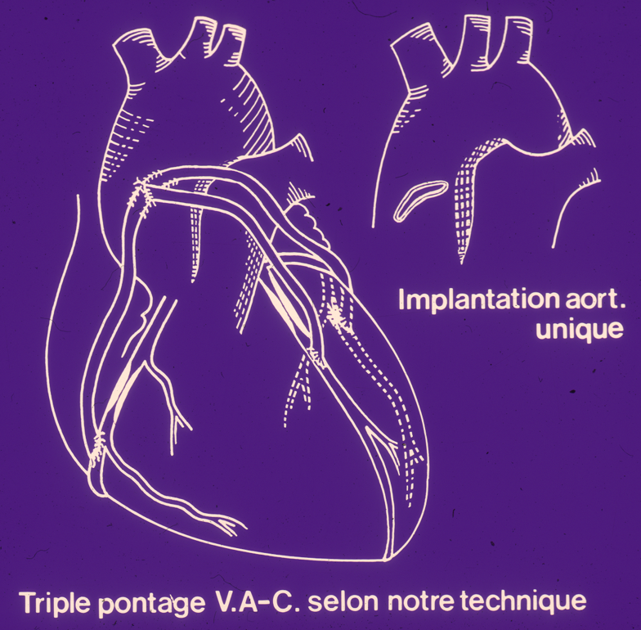
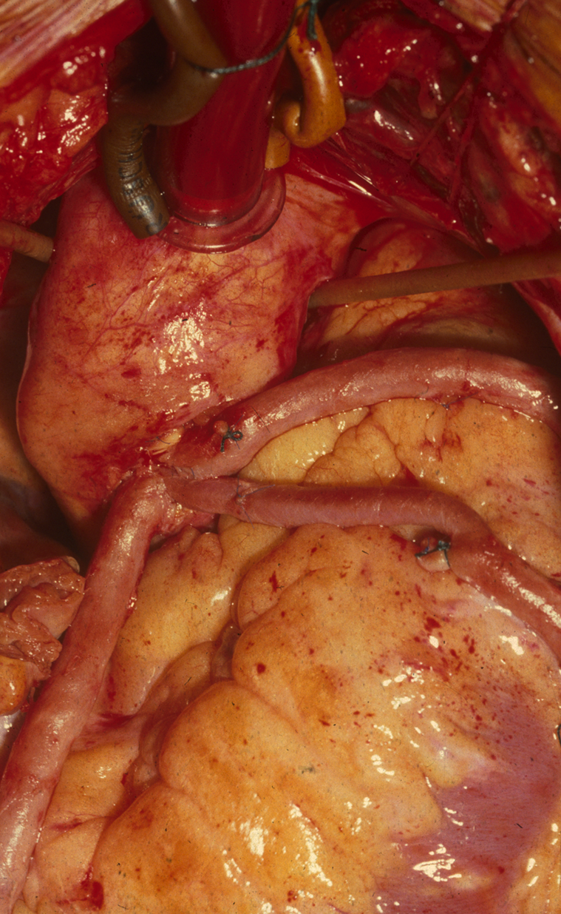
Coronary Surgery Technique

Slide 23
CORONARY SURGERY
SINGLE AORTOTOMY FOR MULTIPLE CABG
( 1978 - 1990 )
2423 Pts ( CABG only, Reops, Unst.ang., LM, early MI, failed PTCA, LVAneur.,Post-necr.
VSD or Mit. Insuf.,AVR, MVR, Ect....)
Op. Mortality ( Global ) 2.3 %
‘‘ ‘‘ ( CABG + EF > 50 % ) 0.5 %
Bleeding from Aortic Anastomosis 0.0 %
Aneur. Dilat. of Aortic Anast. 0.0 %

Slide 24
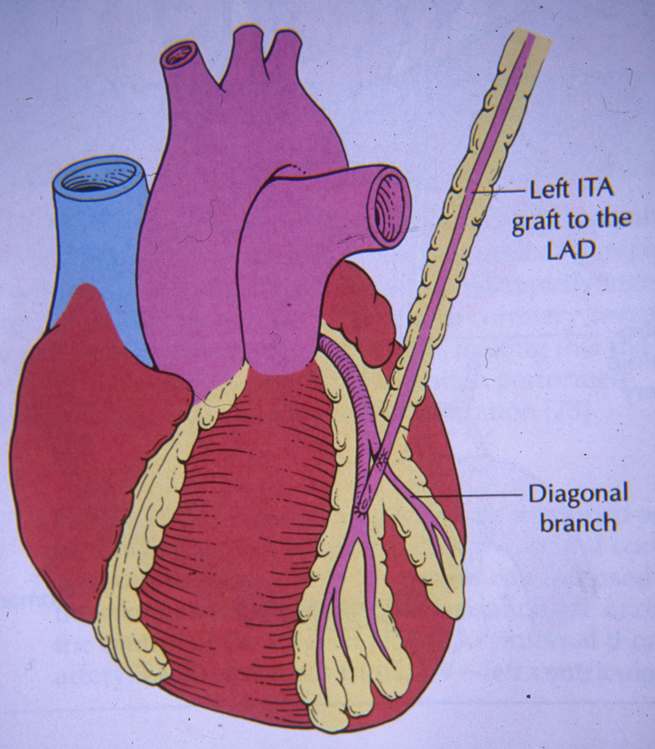
Coronary Surgery Results
Surgery vs Angioplasty (PTCA) for LAD
LAD treated by ITA grafting. Vs PTCA
66 ITA on LAD, prospective
2 deaths at 5yrs ( 3 % )
MI 3 Pts ( 4.5 % )
68 PTCA, prospective
9 deaths at 5yrs ( 13 % )
MI 10 Pts (15 % )
Goy et al. Circulation 1999; 99: 3255-9

Slide 25
Coronary Surgery Results
Stent or Surgery
(SoS)
Prospective multicentric randomized study
CABG or PCI in multivessel disease
At 2-year follow-up :
CABG : 2 % of cardiac death
PCI : 8 % of cardiac death ( Percut. Coron. Interv. )
Lancet 2002; 360: 965-70

Slide 26
Heart Transplantation
(from 1987 to 1995)
Male: 70 patients Female: 10 patients
Age: 31-72 (mean age: 50)
Diagnosis: - Idiopathic cardiomyopathy 46 pts (57.5%)
- Ischemic ,, 32 pts (40.0%)
- Others (valv.) ,, 2 pts ( 2.5%)
Hospital mortality: 3 patients (3.75%)
Hosp. mort. world literature: (8-10%)
Survival at 12 years: 52 patients (65%)

Slide 27
Carotid Endarterectomy
(CEA)

Slide 28
Incidence of Cerebrovascular Disease
1995 CH Population: 7 millions
General Population 1.4 : 1000
55 to 64 yrs 3 : 1000
75 - 84 yrs 15 : 1000
13’000
Strokes/yr ( 0.18 % )
85 % ischemic
15 % hemorragic

Slide 29
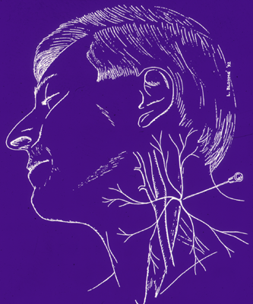
Loco-Regional Anesthesia
Superficial cervical block

Slide 30
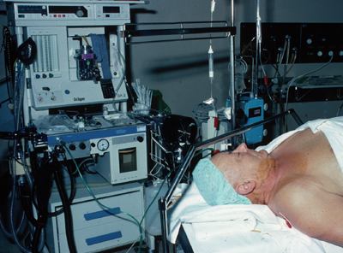
Loco-Regional Anesthesia
1st LRA CEA November 1st 1993

Slide 31
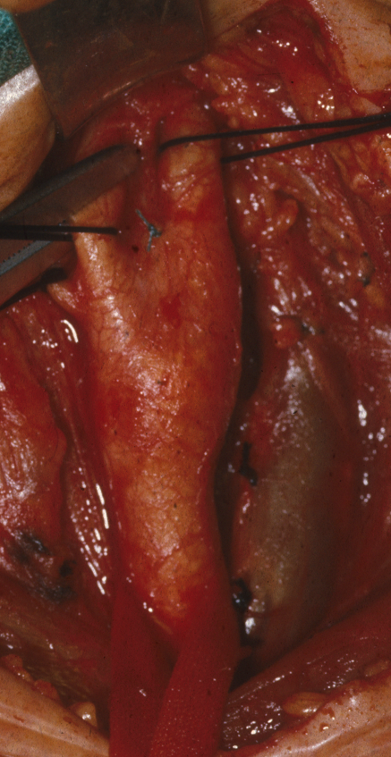
CEA under LRA

Slide 32
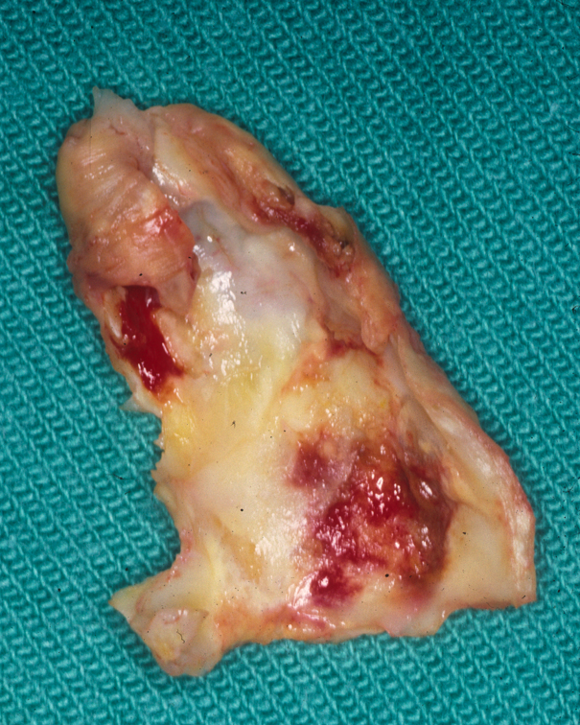
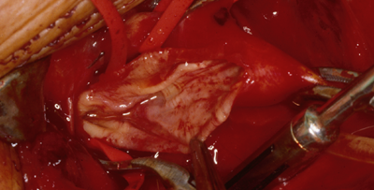
CEA under LRA

Slide 33
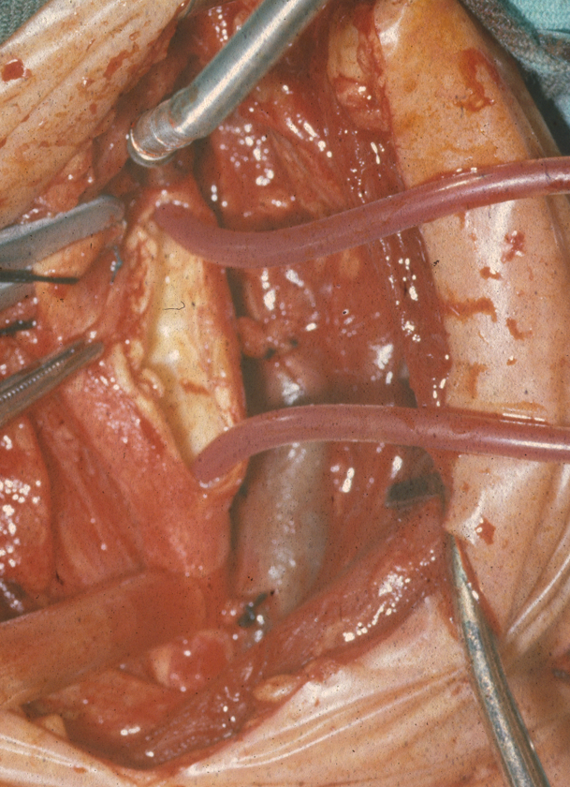
CEA under LRA
Shunting in 1.55 %

Slide 34
CEA with direct 6-0 closure

Slide 35
History of CEA in Lausanne
« Pioneer » time: Groupe I
January 1968 to December 1980
141 CEA
« Perseverance » time: Groupe II
January 1981 to October 31st 1993
276 CEA
« Golden quality » time: Group III
November 1993 to December 31st 2003
903 CEA

Slide 36
Demography
January 1968 to December 2003
1320 Carotid Endarterectomies
964 M (73 %)
356 F (27 %)
Mean Age : 68 yrs (34 - 86)

Slide 37
CEA Incidence
Multicentric studies demonstrating
Superiority of CEA over med ttt
N = 1189

Slide 38
Results
Groupe II Groupe III 276 Pts 903 Pts P
Shunt
Neuro morb
Neuro mort
Total
268 (97 %)
19 (6.9 %)
2 (0.7 %)
21 (7.6 %)
14 (1.55 %)
3 (0.33 %)
1 (0.11 %)
4 (0.44 %)
<.001
<.01

Slide 39
Conclusion
For better surgical results :
Acurate diagnosis
Apropriate surgical indications
Precise surgical technique
Adequate post- operative care

