Slide 1
The Golden Age of Islam with special emphasis on the contributions of Medieval Islamic Physicians to the history of tracheostomy Zahid Hussain Khan ,MD Professor of Anesthesiology &Intensive Care , Tehran Univ. of Medical Sciences, Iran

Slide 2
Fall of the Roman Empire & It`s IMPACT-AD 476
Recurring famines , epidemics
Wars,Sieges & looting
System of knowledge destroyed
Cultural heritage destroyed
Teutonic tribes uprooted values
Vague traces / relies of glorious past

Slide 3
Middle Ages
Moral & material poverty
Chaos & anarchy
Ignorance , superstition,magic
Epidemics/plagues
Decay of scientific & rational approach
Body/soul-conundrum

Slide 4
Dark Ages
Decline of research & reason
Owl – bird of Athena
TAM MARTE
QUAM MINERVA
Long nights & The Alps
Hegels` aphorism

Slide 5
GRAECO-ROMAN PERIOD (AD 529)
AD 529-start of medical tradition
Salerno-forerunner of modern university
Cultural renaissance
Constantinus Africanus (1010-1087)
Haly-ibn Abbas al-Magusi(Liber Regalis)
Ishap.Ibn Sulaiman Ibn. Isac -the Hebreu

Slide 6
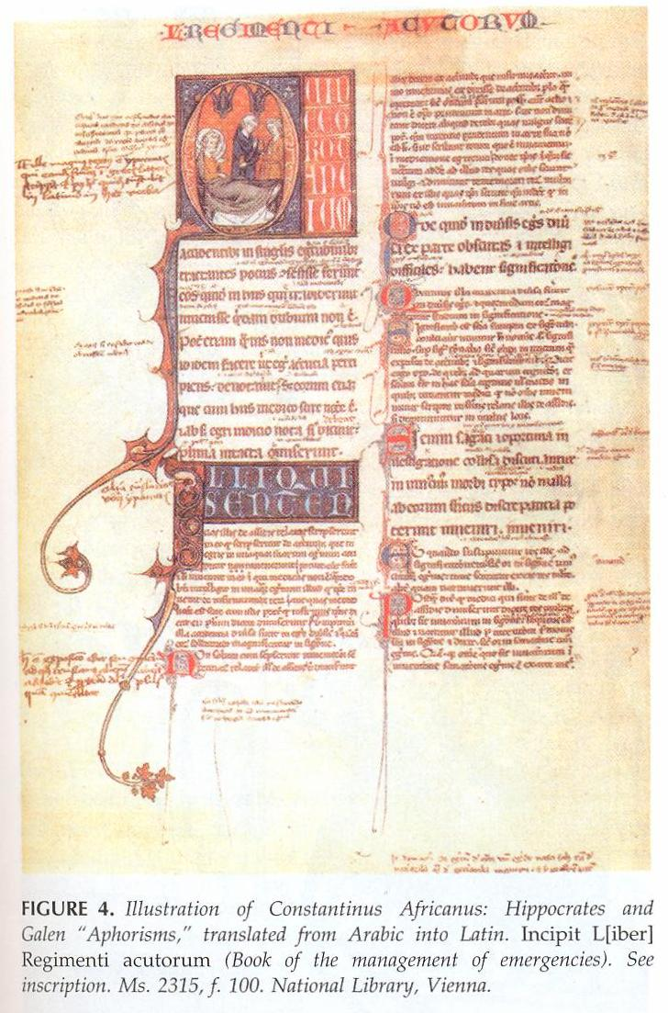
Hunain ibn Ishaq al-kindi (liber Isagogarum)

Slide 7
EDUCATION IN SALERNO
Texts-Liber Isagogarum
Liber Regalis
Basis of medicine –” till 18th” century
“ Essay”,”Sermon & the “Dialogue”
SORATIC DIALOGUE
Medieval question & answer
Clear /concise answer
Easy to recall

Slide 8
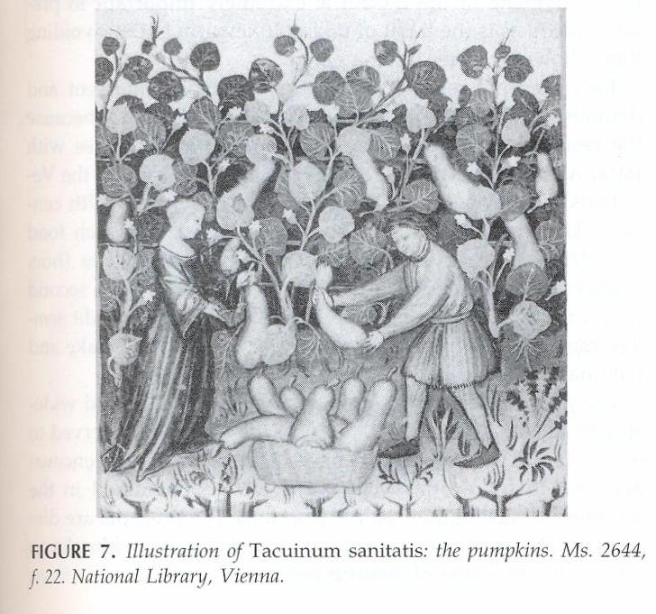

Slide 9
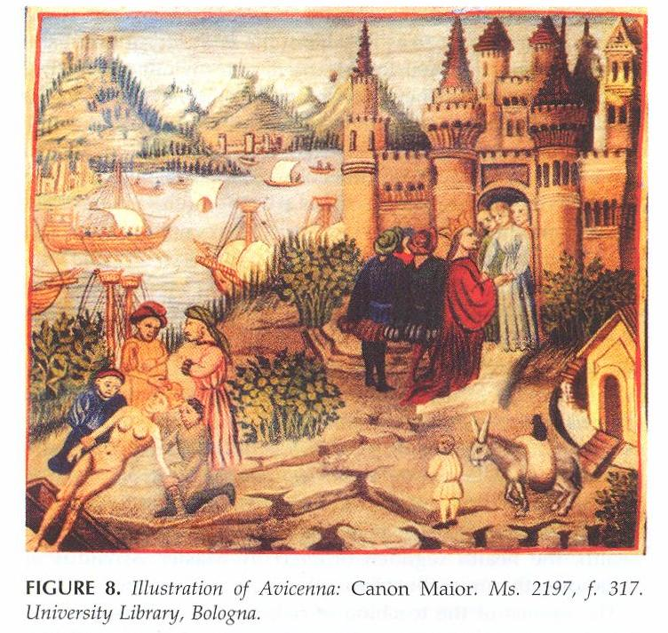
Robert S/O William
Conquerer of Crusade 1

Slide 10
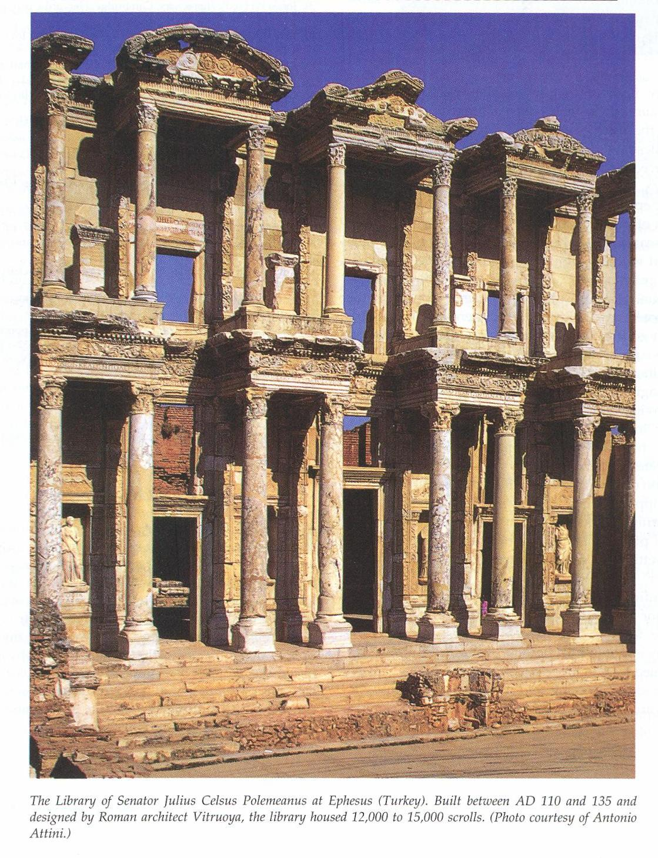

Slide 13
Tracheostomy in the Ancient Past
Controversial procedure
Egyptians-3600 BC
Rig Vida-2000-1000 BC
Ebers Papyrus-1550 BC
Alexander the Great – Homer 1000 BCE
Asclepides (100 BCE)
Antyllus (340 CE)
Paulus of Aegina (625-690 CE)
ISLAMIC GOLDEN AGE (750-1257)

Slide 14
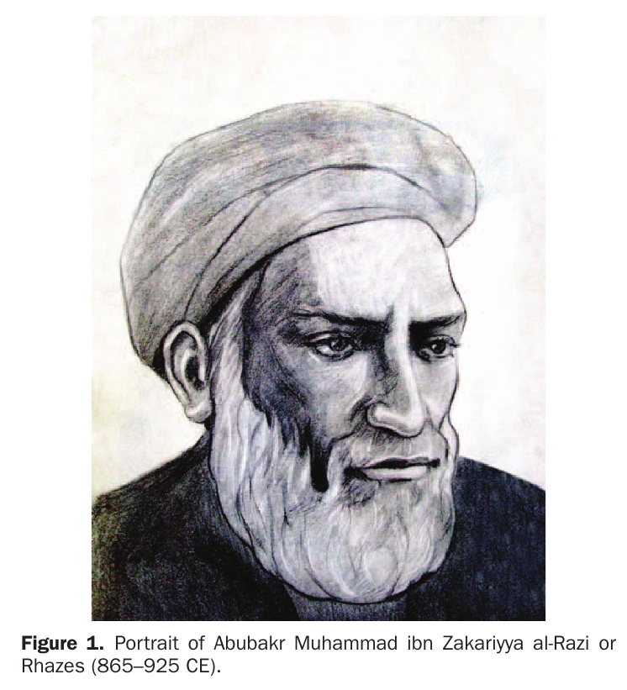
Abubakr Muhammad Ibn Zakariya al-Razi Rhazes (865-925 CE)

Slide 15
RHAZES
Ray – Tehran (865 CE)
Musician
Encyclopedia ( On The Beauty of Music )
Philosophy,Maths.,Literature,Astronomy.Alchemy
Baghdad – al Tabari (807-870 CE)
Al –Muqtadir Hospital – Head
Al-Adudi Hospital
Al-shukuk Ala Jalinus(Doubts about Galen)
>200 books & treatises
Liber Al Mansuri
Liber Continens-24 volumes
Died in Ray – 60 years (925 CE)
August 27 – Pharmacists` Day

Slide 16
Wazir Ahmad Ibn Ismail

Slide 17
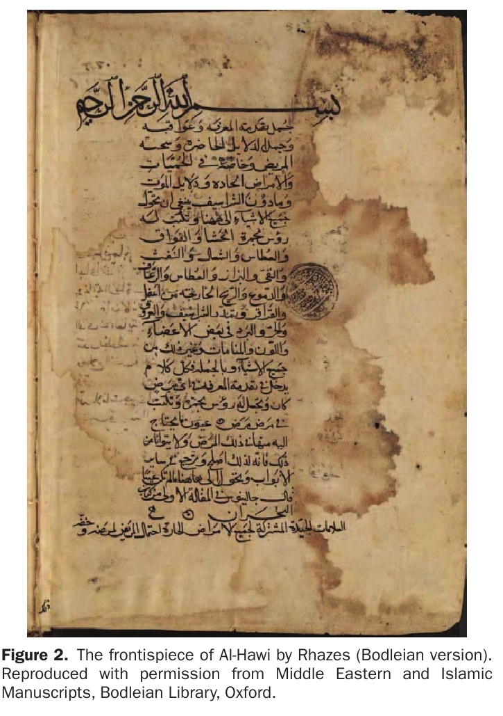
….Procedure
Wazir Ahmad Ibn Ismail

Slide 18
Ali IBN ABBAS MAJUSI,HALY ABBAS (930-994 CE)
Ahwaz
Shaikh Abu Maher Ibn Sayyar(Medicine)
Emir Adud al-dowleh Fana Khusraw
Al – Adudi Hospital
Kitabul Maliki (The Royal Book)-Medical Encyclopedia
The Perfect Book of the Art of Medicine
Critic (Hippocrates , Paul of Aegina,Serapion,Rhazes)
Death (Baghdad or Shiraz)

Slide 20
KAMIL AL-SINNAT AL-TIBBIYA
Pars Practica II&III-Anatomy 1070-1170
Theory of Medicine-10 Discourses
Practical Medicine-10 Discourses
Surgery – 9th Discourse -111 Chapters

Slide 22
ABUL QASIM KHALAF IBN AL-ABBAS AL-ZAHRAWI ALBUCASIS(936-1013CE)
Al-Zahra-Cordoba(Spain)
Personal Physician (Abd-al-Rahman III & Al-Hakam II)
Most Famous Surgeon-Muslim Era
Kitab al-Tasrif-Medical Treatise
30 Chap.200 Illustrations
Latin & Europ.Language Translations
3 books on surgery

Slide 23
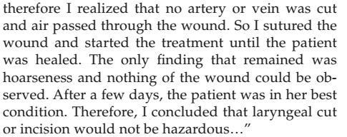
AL-ZAHRAWI`S DESCRIPTION OF TRACHEOSTOMY

Slide 26
ABU ALI HUSAIN IBN ABDULLAH IBN SINA AVICENNA (980-1037 CE)
Afshaneh(Bukhara)-Uzbekistan(Persia)
Aristotle of Islam
Second Doctor
Memorized Quran (8 years)
Logic,Geometry,Maths (10 years)
Cured Nuh ibn Mansure (17 years)
Bukhara-Gorganch (Khwarazmi Kingdom)
Al-Biruni-Great pharmaccist & Polymath.
Vizier-Shams al-Dawla

Slide 27
ABU ALI HUSAIN IBN ABDULLAH IBN SINA AVICENNA (980-1037 CE)
Kitabal-Qawlang(The Treatise on Colic)
Ibn Kakuya`s Conquest of Hamadan
Kitab al-Shifa(Book of Healing)
Died 1037 CE
The Canon of Medicine (Medical Masterpiece)
Nizami`s Tribute
Translations-Latin,Hebrew , German,French,English
Core of Medical Science-13th to 18th Centuries

Slide 28
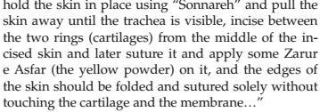

Slide 31
HAKIM ESMAIL JORJANI(1042-1137 CE)
Gorgan-1042 CE
Jurisprudence & Medicine – Abdolqasem Qushairi
Court Physician – Khwarazm Shah Qutb al Din Zakhiriye Khwarazm Shahi (The treasure of Khwarazm Shah)
750000 Word Encyclopedia in Persian
Translated into Arabic,Urdu,Turkish & Hebrew
Al-Aghraz al-Tebbieh (Medical Goals)
Khofieh Alaii
Yadegar _ Memorial
Marve - Death

Slide 34
ABU MARWAN ABD AL-MALIK IBN ZUHR,AVENZOAR-1091-1162 CE
Seville – Spain
Cured Ali Ibn Yusuf Ibn Tashfin (King)-17 years
Court physician
Kitab al-Iqtisad (Book of moderation)
Exile-Morocco
Victory of Almohads over Almorvarides
Court

Slide 35
ABU MARWAN ABD AL-MALIK IBN ZUHR,AVENZOAR-1091-1162 CE
Physician & Vizier (Abd al-Mumin- Founder of Almohad dynasty
Kitab al-Aghdhiya (Book of Ailments)
Met Ahmad Ibn Rushd (Averores 1126-1198 CE)
Book of Facilitation on Therapeutics & Dietetics
Essential textbook of Colliget(Ibn Rushed)
Book of Generalities or Colliget (Ibn Rushd)
Essential Textbook of European Univ`s-18th Century
Father of Experimental Surgery

Slide 40
Trachestomy-Threads & Hooks
Albucasis (Trachestomy unknown in his times)
Jorjani-Aphonia-Pearl of Wisdom
Ibn Zuhr-Feasibility in an Experimental Model
Concept of applying Medicinal pharmacology
Avecenna`s Zarur – e Asfar (The yellow powder)
Ibn Zuhr`s honey & ground cypress nuts

Slide 41
CONCLUSION
Islamic Medicine – Influenced Rise of Europ.Sciences
Medieval Islamic Physicians-Substantial Additions&Modifications
Human dissection-Disapproved
Indespensible role of Anatomy (Albucasis)
Appreciation of God`s Wisdom & Power
(Ibn Rushd&Fakhruddin Razi (1149-1209CE)
Innovative approaches & devices

Slide 47
“May the Heavenly Light always fall on their graves&May their souls lie in impertubable peace” Amen!

Slide 48
“You can`t imagine how much of my health these passions and worries have taken away; And how much of my feeble health shall be usurped and taken away by my UNFINISHED TASKS AND that lie in the deepest recesses of my brain and soul; Awaiting completion and publication” Hussain Khan

Slide 49
“Thank you for your kind attention”

