Slide 1
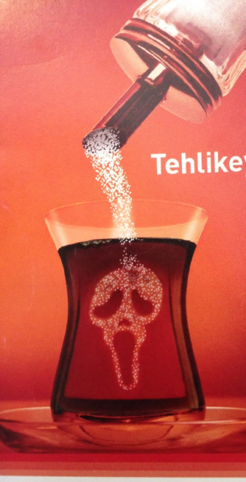
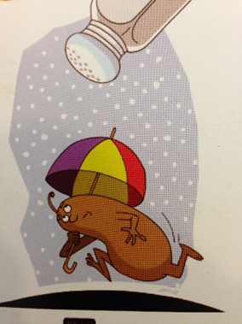
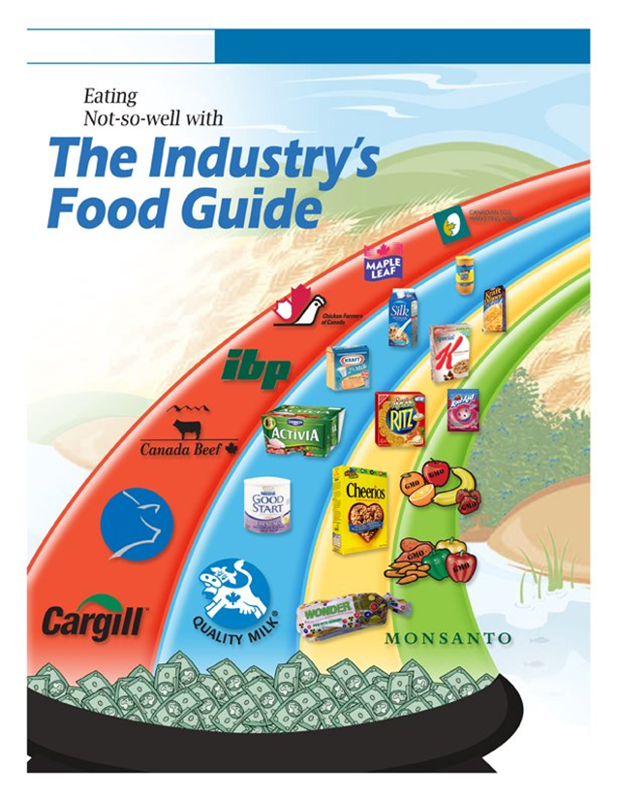
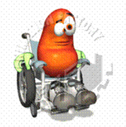
In the name of God
Patient’s Self-care & the role in Diagnosis and Treatment of HTN
Less sugar
Mitra Mahdavi-Mazdeh
Professor of nephrology
Tehran University of Medical Sciences
mmahdavi@tums.ac.ir

Slide 2
The topics that will be covered:
Prevalence and Impact of Hypertension globally and in Iran
How our behaviors are shaped?
Food industries’ lobbying
What shall professionals do? Usage of the similar behavioral science
The role of technology(telemedicine)

Slide 3

80% of NCD deaths occur in low- and middle-income countries.
80% of cardiovascular and diabetes deaths, occurred in low- and middle-income countries
2020: NCD deaths increase 15% globally but 20% in the WHO regions of Africa, South-East Asia and the Eastern Mediterranean

Slide 4
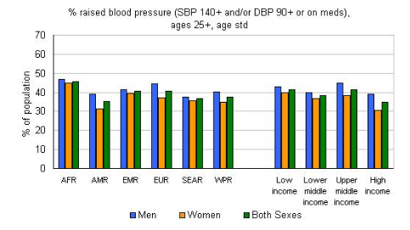

Slide 5
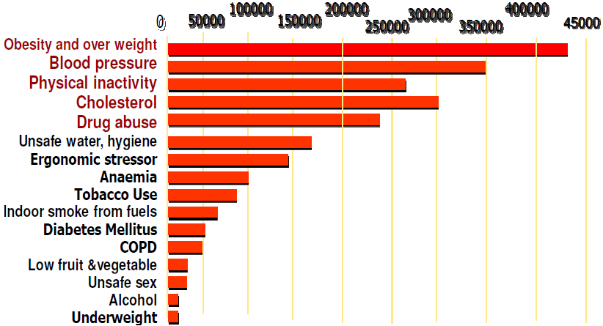
Iran epidemiology:
HTN Prevalence: 25.2% (24.4% to 28.9%)
DM prevalence :
  2005: 7.87% (7.64–8.10)
  2007 :9.19 (8.26–10.11)
  2011:10.63 (9.05–12.21)
3rd national Surveillance (2007) :
  Obesity Prevalence(BMI ≥30 kg/m²): 22.3% (20.2-24.5%)
  Central obesity Prevalence : 53.6% (50.4-56.8%)
Average medical cost per capita of T2DM(2009):
  842.6± 102 USD (8.7% total health care expenditure):
  49% for complications
    cardiovascular disease: 42.3%
    nephropathy :23%
ESRD incidence due to DM increased from 16% in 1997 to 31% in 2006 and HTN ~21%
Burden attributable to 16 leading risk factors in Iran

Slide 6
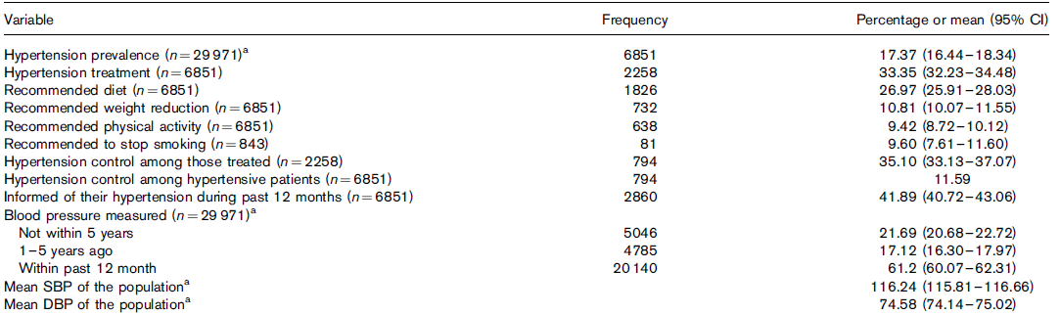
statistics of HTN in 2006 survey

Slide 7

Uncontrolled HTN

Slide 8

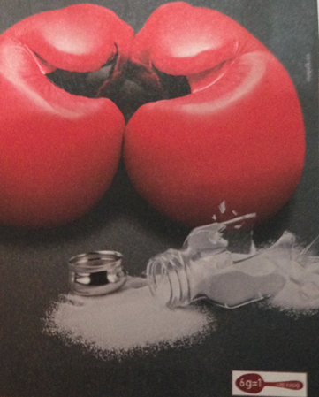
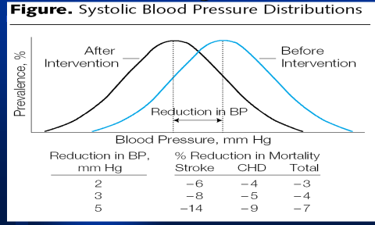
Hypertension Treatment Facts:
Less sugar
Life Style Matters
  Weight Loss (any means)
  Low Na & Calorie Diet
  Exercise
Medications Work
  Compliance
Notes:
Low fat, high fruits/vegetables, and fiber

Slide 9
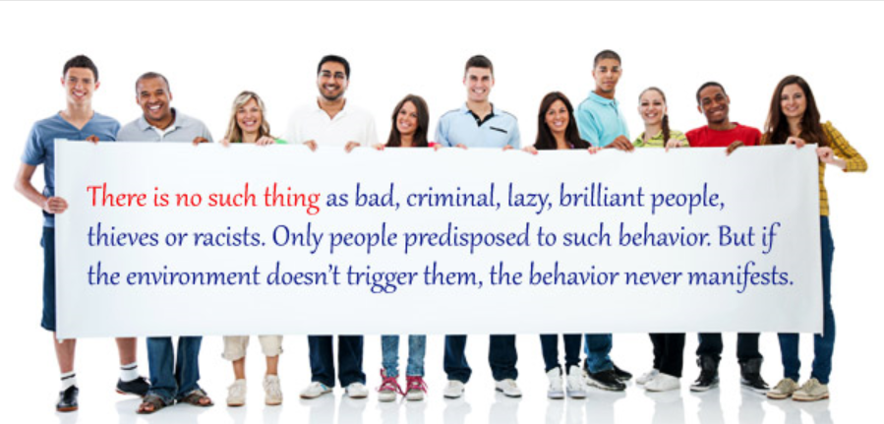
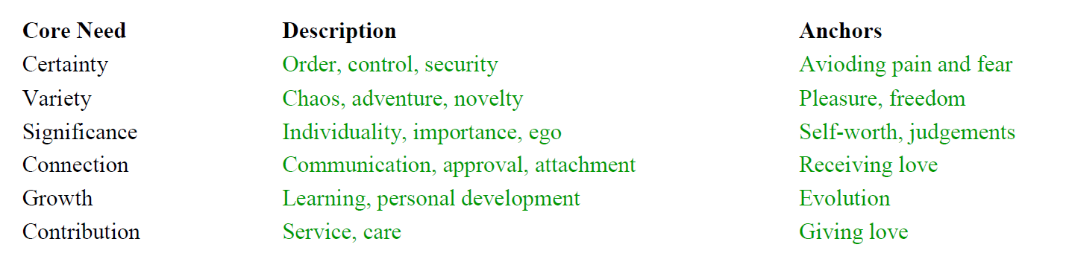
How the Environment Shapes Human Behavior?
Avioding pain and fear
Pleasure, freedom
Self-worth: media,fashion

Slide 10

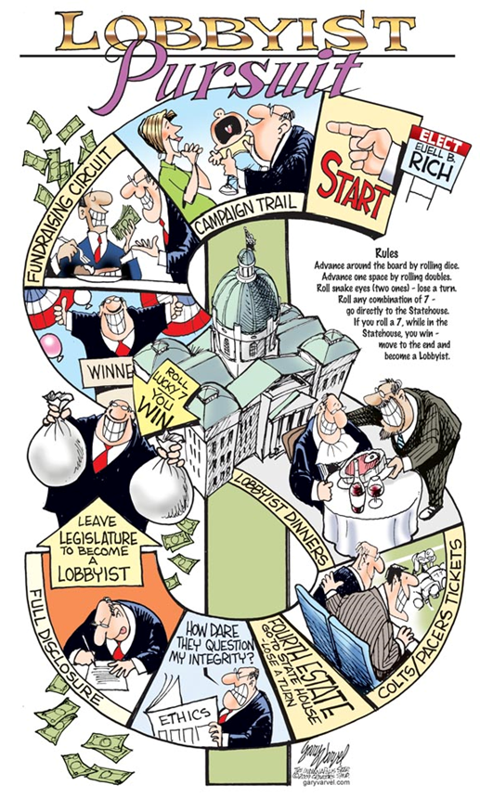

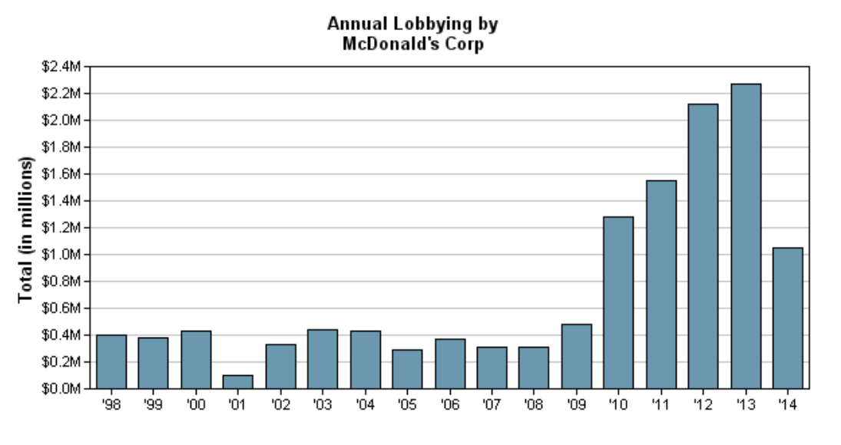
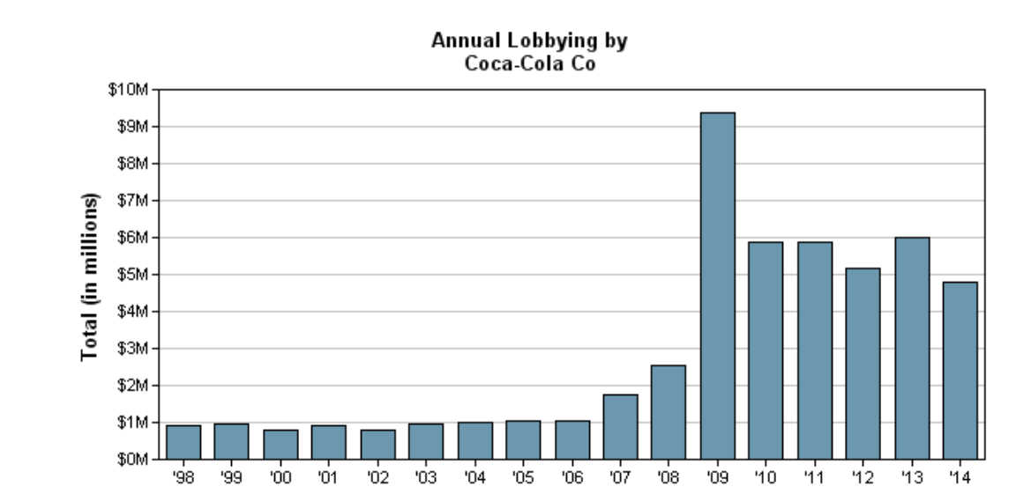
Money spent on lobbying:
Companies like Pepsi, Coca-Cola among others spent 9 million in the 1st season of 2014 alone,almost as much as they spent in all 2013.

Slide 11
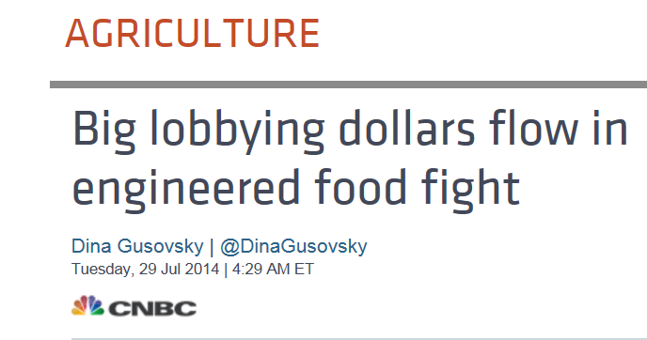
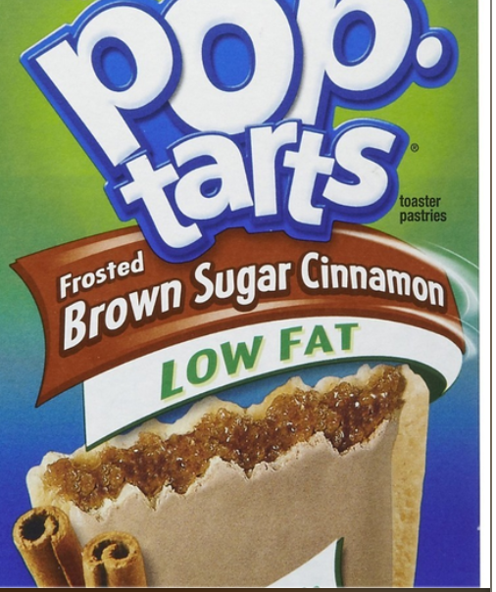


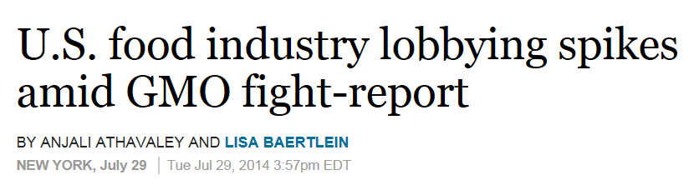

Slide 12
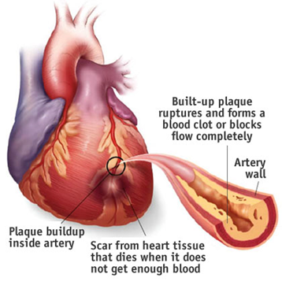
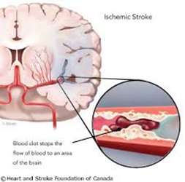

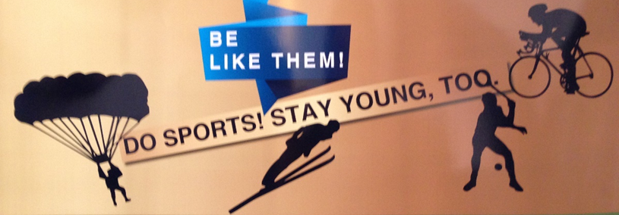
What should professionals do?
Follow the rules of the game to shape behavior to effectively generate the desired habit in life style , maintain it, with the potential to increase its impact
  Avioding pain and fear
  Connection, communication,approval
Ayla Sun

Slide 13
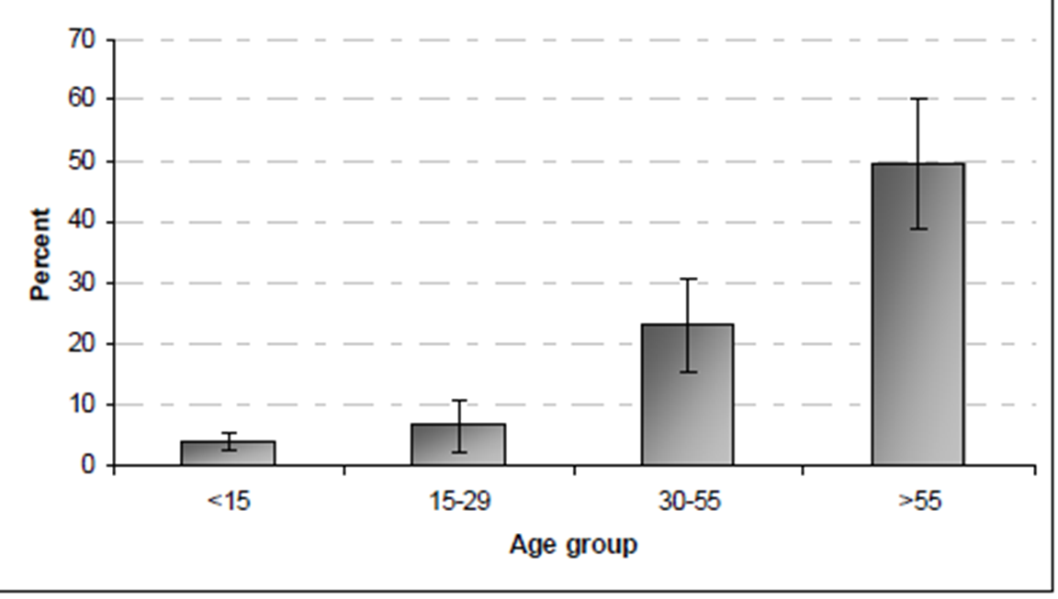
HTN control
Patient Characteristics
TREATMENT ADHERENCE
Perceived
Risks
Cognition
Coping & Stress
Literacy
Comorbidities
Side Effects
The prevalence of HTN in different age groups
(1996- 2005)
Social Environment
Provider Characteristics
Communication
Style
Medication Regimen
Bosworth HB, et al (2006). Am Heart J 149:795-803.l
Bosworth HB & Oddone EZ. (2002). J Nat Med Ass. 94; 236-248
Haghdoost et al: Arch Iranian Med 2008; 11 (4): 444 – 452
Notes:
Approximately 40 percent of the patients had a blood pressure of > or =160/90 mm Hg despite an average of more than six hypertension-related visits per year.
HAS study led to development of a model to explain treatment adherence
EMPHASIZE THAT BOTH PATIENT/PROVIDER

Slide 14
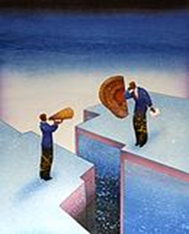

Issues in Patient-Provider Communication
Poor patient-physician communication :
  Physicians do >60% of talking during a visit
    Rarely address psychosocial issues
  Many patients reluctant to express
    Expectations or medication preferences
    Misunderstandings about the regimen
Awareness → belief → change of behavior

Slide 15
Patient Intervention
Use of Telephone/cellphone:
Telephone contact has been shown to be effective in changing patient behavior (Am J Hypertens 1996, Am J Prev Med 2002)
Tend to be more acceptable and convenient than in-person interventions.
61.2 million of Iranians have owned mobile phones in 2014 (http://en.wikipedia.org/wiki/Internet_in_Iran)
May enhance the interventions’ cost-effectiveness, due to reduced intervention costs and reduced visit rates
Notes:
Ex. Nurse inform overweight individuals that losing even a few pounds can have an effect on reducing one’s BP.
In addition, when risk information is conveyed, proportions (e.g., stop smoking results in a reduction of 5 out of 10 people having a stroke”) as opposed to percentages (“if you stop smoking, you have 50% chance of reducing your risk of having a stroke”) will be used. The former presentation method is considered more “person oriented” as opposed to the latter, which is considered more mathematical and more difficult to understand by patients

Slide 16
Nurse Behavioral Intervention vs. None
Secondary Analysis
0.70
RN Behavioral, N=294
0.60
P=0.03
BP Control
No RN ,N=294
0.50
0.40
0
6
12
18
24
Time in Months

Slide 17
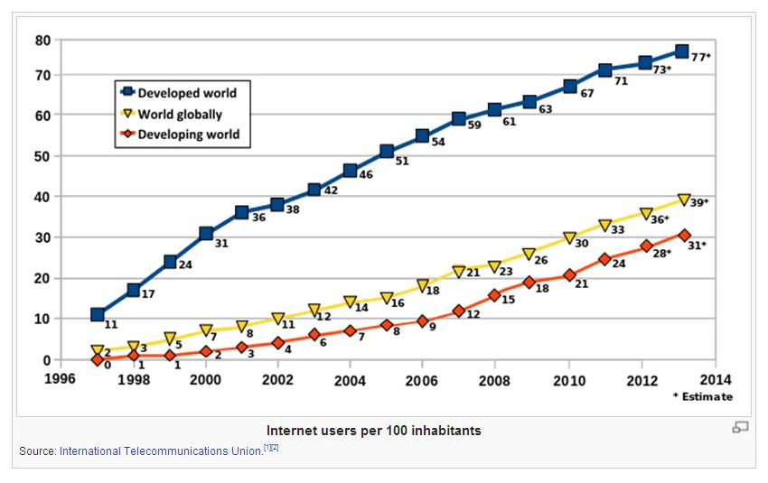
Telecommunication:
mobile phone intervention to increase physical activity efficiently : receiving personalized text messages by short message service (SMS) with relevant educational information and some tangible tips on what to do increased not only the duration of weekly exercise but also its intensity
India: a model of tele-diabetology mobile van equipped with appropriate facilities, and satellite technology to screen diabetes and its complications in addition to deliver necessary medical care to remote villages in southern India

Slide 18


Slide 19
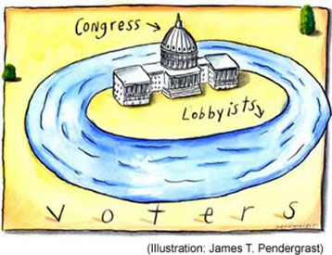
The job of food lobbyists:
Ensure that the government does nothing to impede clients from selling more of their products
Do as much as possible to create a supportive sales environment

