Slide 1
Paving the road to elaborate the genetics of intellectual disabilities
Spring 2003; let’s start at the very beginning,
H. Najmabadi et al, GRC, USWR Tehran, Iran
H. H. Ropers et al, MPIMG Berlin, Germany

Slide 2
Cognitive disorders (CD)
Major medical and socio-economical problem in developed and developing countries.
Account for 8-10% of the total health care expenditure in most European countries
Molecular basis for the majority of patients with an early onset CD remains unknown, which creates an enormous burden to families confronted with such disorder.
Genetic causes of intellectual disability
Chromosomal abnormalities are accounting for >10% of MR.
About 10% X-linked gene defects
10-12% may be due to submicroscopic deletions or duplications, CNVs
60% etiology unknown, autosomal recessive forms, dominant new mutations

Slide 3
Project pipeline
Clinical evaluation
Linkage analysis
Identification of homozygous linkage intervals
Exome sequencing
Detection of homozygous or compound heterozygote variants
Functional studies
Demonstrating the defect of the candidate variant in patients’ cell lines, animal models, etc
Recruitment and selection of families

Slide 4
Recruitment of the families
304 families: three and more affected
557 families additional investigation
234 families: two affected
19 families: sporadic
Total of 955 families
50 Fragile X
398 families in Iran, Mostly sporadic cases or small families
25 Known syndrome
11 karyotype abnormality
27 MCPH genes
Funded by the European Union's Seventh Framework Program under grant agreement number 241995 (GENCODYS)

Slide 5
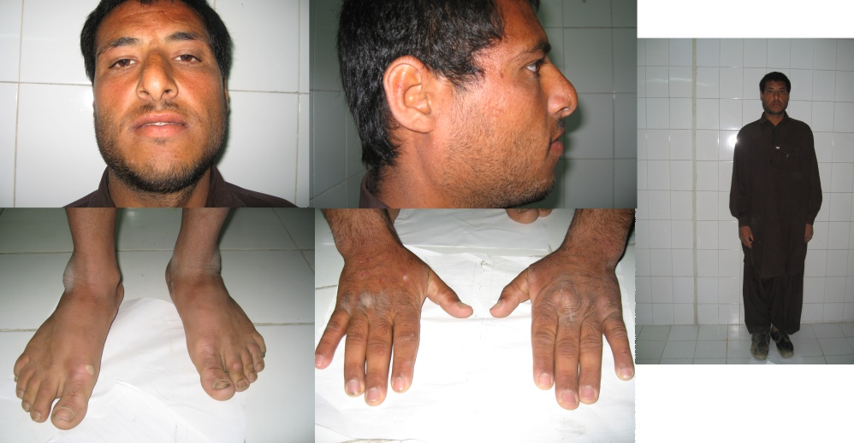
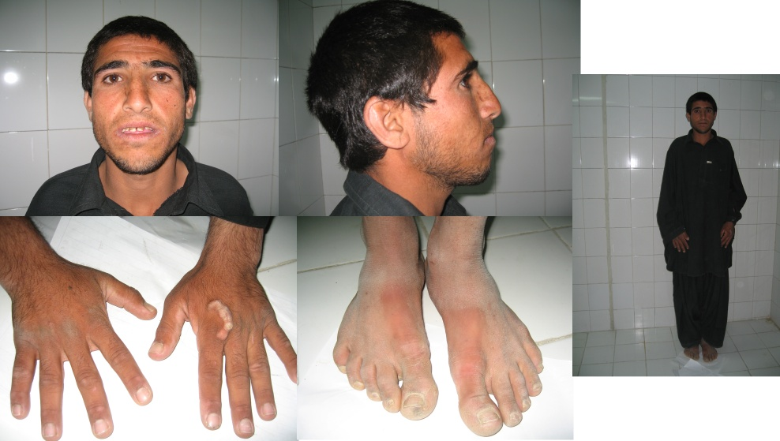
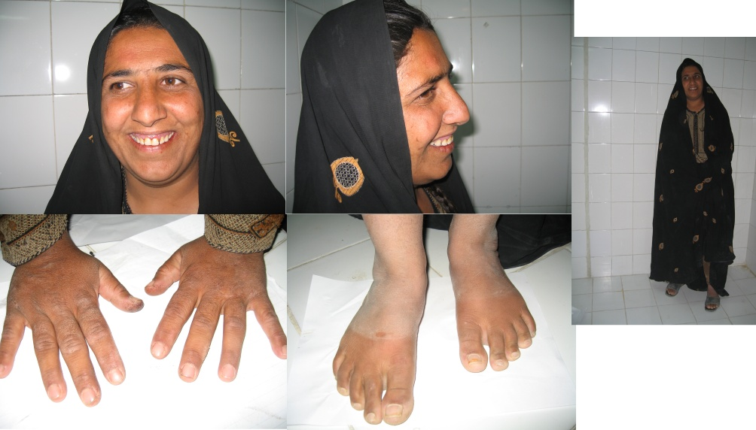
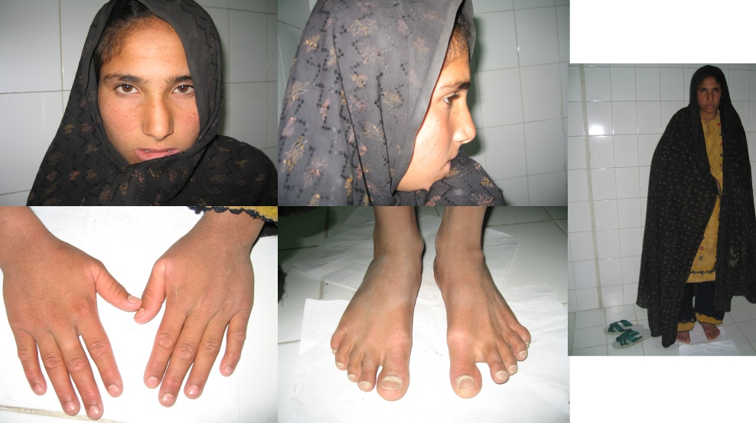
Clinical characterization and documentation of the families

Slide 6
Brain MRI
BMRI for 180 families have been obtained
Microcephaly (60)
Neurologic ( 56)
Ataxia (14)
To help better understand brain function of novel genes (50)

Slide 7
Clinical characterization of the cohort families
(Many Novel syndrome)
clinical
260 families: Autosomal Nonsyndromic ID
557 families
297 families: ID with additional features (syndromic)
145: ID with microcephaly
(Ataxia, Seizure, Myopia, Spasticity, Short stature,….)
35: Known syndromes
10: ID with Congenital cataract
14: ID with Ataxia
5:ID with facial dysmorphism
7:ID & hearing Loss
77: ID and other futures
Funded by the European Union's Seventh Framework Program under grant agreement number 241995 (GENCODYS)

Slide 8
ID/Microcephaly
74 out of 145 microcephalic families showed
Seizure
Spasticity
Short stature
Strabismus
Ataxia
Myopia

Slide 9
ID/congenital cataract
10 families showed ID+ familial Congenital cataract
Two families SRD5A3
One family TAF2
One family CAPN9
One family SURF1
One family: two novel genes in process
One family :RUSC1 (syndromic)
One family: ACO2 (Syndromic )

Slide 10
ID/ataxia
14 families showed ID+ truncal ataxia
One family: ZBTB11
One family: GPAA1
One family: MRPL10
One family: RIPPY10
One family: FAM123
One family: DDX3X
One family: EXOSC5
Two families : two novel candidate (OLA1/GLS),(RAB3GAP1/R3HDM1)
One family: CA8
One family: AK1
Three families: result pending

Slide 11
Initial Screening to Determine the Underline Genetic Defects in ID Families

Slide 12
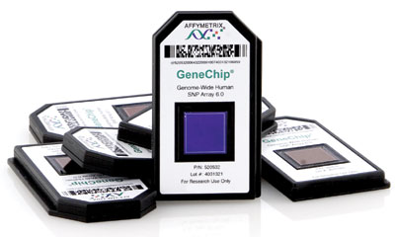
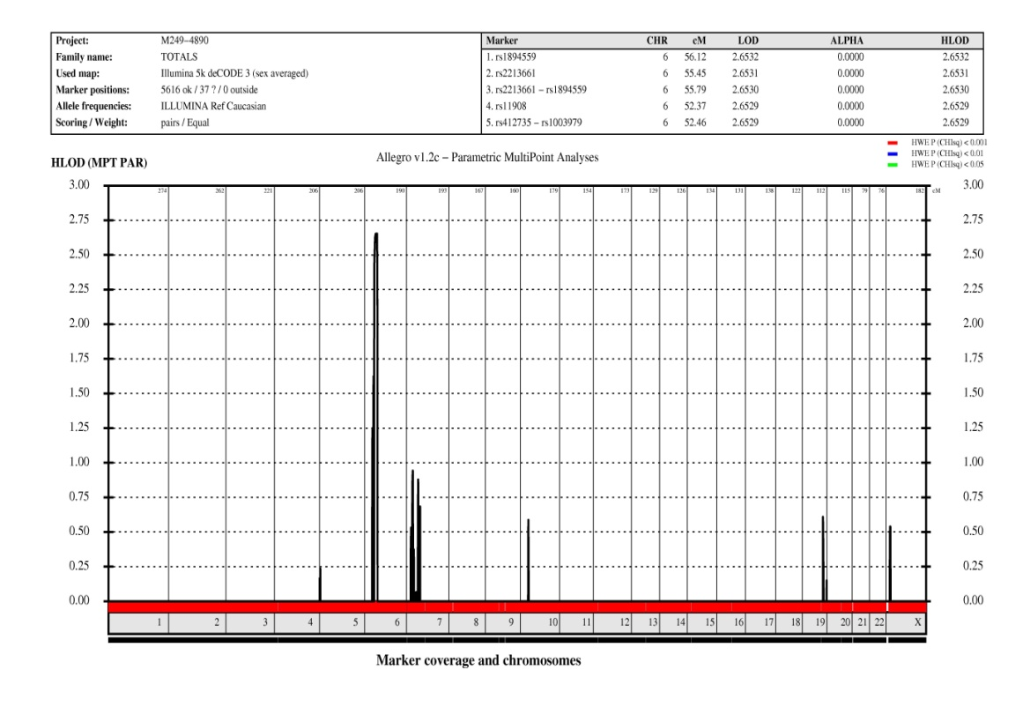
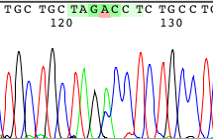
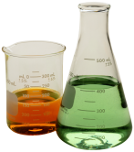
Mapping strategy to identify novel genes in ARID
Genotyping using whole genome
SNP Arrays (10k - 1Mio markers)
Linkage analysis
Homozygosity mapping
Disease locus
LOD Score
Chromosomes 1-X
Mutation screening Functional analyses
Notes:
Dabei gehen wir wie folgt vor: Zunächst führen wir eine Genotypisierung mit genomweit verteilten SNPs durch. Dafür verwenden wir Arrays oder Chips von Affymetrix mit bis zu 1 Mio Marker. Anschließend machen wir eine Kopplungsanalyse und ermitteln damit einen Bereich der mit hoher Wahrscheinlichkeit den gesuchten Gendefekt enthält. Das Ergebnis einer solchen Analyse ist hier dargestellt: auf der X-achse sind die Chromosomen von 1-X nacheinander aufgetragen, auf der Y Achse der sog. LOD-Score, ein Maß für die Wahrscheinlichkeit bei einem Markerort im Genom den Gendefekt zu finden. Wenn wir dann auf die Markerebene gehen sehen wir den homozygoten Bereich wie hier rechts dargestellt.

Slide 13
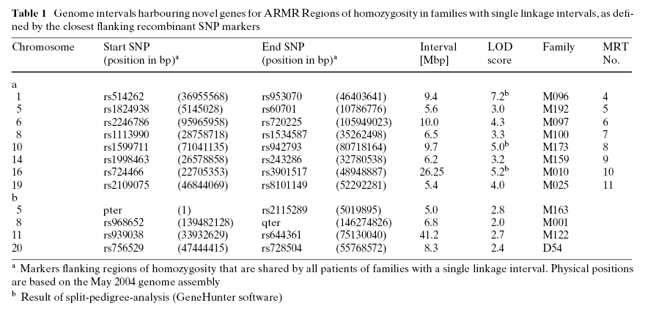
In 2006 Homozygosity mapping for 78 families with NSARMR, 12 families showed single autosomal linkage intervals
8 of these linkage intervals, with LOD scores above 3 represent novel gene loci for NS-ARMR.
Najmabadi H., Hum Genet, 121: 2006

Slide 14
Autosomal Recessive Mental Retardation: Homozygosity Mapping Identifies 27 Single Linkage Intervals, at Least 15 Novel Loci and Several Mutation Hotspots
Kuss et al. 2010 Hum Genet

Slide 15
Identification of novel molecular defects underlying syndromic and non-syndromic ID
Gene | Location | Function | Ethnicity | Reference
GRIK2 | 6q16.3 | Involved in the transmission of light information from the retina to the hypothalamus, Involved in the maturation of microcircuits and network formation in brain areas | Iranian | Motazacker MM et al. Am J Hum Genet 2007; 81: 792–798
TUSC3 | 8p22 | Play a central role in vertebrate embryonic development that cannot be compensated by other putative Mg2+ transporters , required for cellular Mg2+ uptake , catalyzes the transfer of an oligosaccharide chain on nascent proteins, the key step of N-glycosylation | Iranian, French | Garshasbi M et al. Am J Hum Genet 2008; 82, 1158–1164
VLDLR | 9p24 | Play a role at the part of the reelin signaling pathway, which is involved in neuroblast migration in the cerebral cortex and cerebellum | Iranian, Canadian, Turkish | Abbasi Moheb L et al. Euro J Hum Genet 2008; 16: 270–273
TRAPPC9 | 8q24.3 | May be a potential target for modulating the NF-(kappa)B signaling cascade in neuronal pathologies dependent upon abnormal activation of this pathway, enhancer of the cytokine-induced NF-(kappa)B signaling pathway, having an essential function in post mitotic neurons as opposed to neural progenitors | Iranian, Pakistani, Tunisian, Israeli | Mir A at al. Am J Hum Genet 2009; 85: 909-915
SRD5A3 | 4q12 | polyprenol reductase with a crucial role in N-linked protein glycosylation, polyprenol reductase, that is required for converting polyprenol to dolichol, confirming that the reduction of polyprenol is the major pathway for dolichol biosynthesis | Iranian, Emirati, Turkish, Polish | Kahrizi K at al. Euro J Hum Genet 2011;19:115–117
ZC3H14 | 14q31.3 | May contribute to control of gene expression in human cells through binding poly(A) RNA | Iranian | Pak CH et al. PNAS
ST3GAL3 | 1p34.1 | Transfering sialic acid to terminal positions on the carbohydrate groups of glycoproteins and glycolipids , Being key determinants for a variety of cellular recognition processes | Iranian | Kuss AW et al. Submitted to ASHG, 2011
NSUN2 | 5p115.31 | RNA methyltransferase that methylates tRNAs, and possibly RNA polymerase III transcripts., May act downstream of Myc to regulate epidermal cell growth and proliferation | Two Iranian | Abbasi Moheb L et al. Submitted at ESHG 2011
ZNF526 | 19q13.2 | Involved in transcription regulation | Two Iranian | Abbasi Moheb L et al. Submitted at ESHG 2011

Slide 16
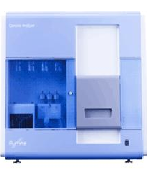
Identification of novel molecular defects using exome enrichment & next generation sequencing
I. Enrichment of genomic segment to be sequenced : Array hybridisation
II. Deep sequencing
Probes for coding sequences in
linkage Interval
Millions of
(paired-end) reads
ACTGGACCTGATTGCCTAAGGTCGATGCATGCATGAGTCC
ACTGGACCTGATTGCCTAAGGTCGATGCATGCATGAGTCC
ACTGGACCTGATTGCCTAAGGTCGATGCATGCATGAGTCC
ACTGGACCTGATTGCCTAAGGTCGATGCATGCATGAGTCC
ACTGGACCTGATTGCCTAAGGTCGATGCATGCATGAGTCC
ACTGGACCTGATTGCCTAAGGTCGATGCATGCATGAGTCC
ACTGGACCTGATTGCCTAAGGTCGATGCATGCATGAGTCC
ACTGGACCTGATTGCCTAAGGTCGATGCATGCATGAGTCC
DNA fragments from coding regions of linkage interval
ACTGGACCTGATTGCCTAAGGTCGATGCATGCATGAGTCC
ACTGGACCTGATTGCCTAAGGTCGATGCATGCATGAGTCC
ACTGGACCTGATTGCCTAAGGTCGATGCATGCATGAGTCC
ACTGGACCTGATTGCCTAAGGTCGATGCATGCATGAGTCC
ACTGGACCTGATTGCCTAAGGTCGATGCATGCATGAGTCC
ACTGGACCTGATTGCCTAAGGTCGATGCATGCATGAGTCC
ACTGGACCTGATTGCCTAAGGTCGATGCATGCATGAGTCC
ACTGGACCTGATTGCCTAAGGTCGATGCATGCATGAGTCC
ACTGGACCTGATTGCCTAAGGTCGATGCATGCATGAGTCC
ACTGGACCTGATTGCCTAAGGTCGATGCATGCATGAGTCC
ACTGGACCTGATTGCCTAAGGTCGATGCATGCATGAGTCC
ACTGGACCTGATTGCCTAAGGTCGATGCATGCATGAGTCC
ACTGGACCTGATTGCCTAAGGTCGATGCATGCATGAGTCC
ACTGGACCTGATTGCCTAAGGTCGATGCATGCATGAGTCC
ACTGGACCTGATTGCCTAAGGTCGATGCATGCATGAGTCC
III. Sequence analysis
AGGTCGATGCATGCATGAGTCC
AGGTCGATGCATGCATGAGTCC
AGGTCGATGCATGCATGAGTCC
AGGTCGATGCATGCATGAGTCC
AGGTCGATGCATGCATGAGTCC
AGGTCGATGCATGCATGAGTCC
of reads unambiguously mapped to the linked region in the human genome
AGGTCGATGCATGCATGAGTCC
AGGTCGATGCATGCATGAGTCC
AGGTCGATGCATGCATGAGTCC
ACTGGACCTGATTGCCTA
AGGTCGATGCATGCATGAGTCC
AGGTCGATGCATGCATGAGTCC
AGGTCGATGCATGCATGAGTCC
AGGTCGATGCATGCATGAGTCC
AGGTCGATGCATGCATGAGTCC
AGGTCGATGCATGCATGAGTCC
AGGTCGATGCATGCATGAGTCC
AGGTCGATGCATGCATGAGTCC
AGGTCGATGCATGCATGAGTCC
ACTGGACCTGATTGCCTA
AGGTCGATGCATGCATGAGTCC
AGGTCGATGCATGCATGAGTCC
AGGTCGATGCATGCATGAGTCC
AGGTCGATGCATGCATGAGTCC
ACTGGACCTGATTGCCTA

Slide 17
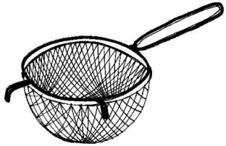
Bioinformatic mutation detection (exons and flanking regions)
(Ten) thousands of
mismatches
“Filter” I
- Homozygosity
- Positional sequence quality
- Depth of sequence coverage at bp position
Few thousand
variants
“Filter” II
Synonymous changes
Several tens of missense or nonsense mutations
“Filter” III
SNP database
189 Individual genomes
200 Danish exomes
Less than three or protein truncating and missense mutations
Notes:
INDELs: (1-3bp) None in 096 and in 319 two in 3’UTRs
Large ones could have been seen by absence of reads, this was not observed.
Individual genomes: at present about 11 in Database (at the time of analysis less)

Slide 18
NGS in 136 families with autosomal recessive ID
27 without any plausible mutation (~20%, not exonic??)
31 with more than one plausible mutation
78 remaining families, of these
26 with single mutations in 23 known ID genes
all but 3 are syndromic
52 with single mutations in 50 novel (candidate) genes
30 of these with non-syndromic ID (4 with ASD)
22 with syndromic ID

Slide 19
Novel candidate genes for autosomal recessive ID
Histones and histone modification, chromatin remodelling, regulation of transcription: 12 genes
ii. Regulation of glutamatergic or dopaminergic neurotransmission: 5 genes
iii. Regulation of translation: 4 genes
iv. Cell cycle control, chromosome alignment: 4 genes
v. Ras/Rho, MAPK pathways: 3 genes
vi. Fatty acid synthesis, fat metabolism: 3 genes
vii.Inositol triphosphate metabolism: 2 genes
viii.Glial cell differentiation and migration: 2 genes
ix. Metabolic defects: 2 genes
x. Others (e.g., ion channels, apoptosis, glycosylation, splicing, protein degradation, unknown): 13 genes

Slide 20
Deep sequencing reveals 50 novel genes for recessive cognitive disorders
Hossein Najmabadi^{1,2}, Hao Hu³, Masoud Garshasbi^{1,3}, Tomasz Zemojtel4, Seyedeh Sedigheh Abedini¹, Wei Chen^{3,5}, Masoumeh Hosseini¹, Farkhondeh Behjati¹, Stefan Haas⁴, Payman Jamali⁶, Agnes Zecha³, Marzieh Mohseni¹, Lucia Puttmann³, Leyla Nouri Vahid¹, Corinna Jensen³, Lia Abbasi Moheb^{1,3}, Melanie Bienek³, Farzaneh Larti¹, Ines Mueller³, Robert Weissmann³,Hossein Darvish¹, Klaus Wrogemann^{3,7}, Valeh Hadavi², Bettina Lipkowitz³, Sahar Esmaeeli-Nieh³, Dagmar Wieczorek⁸, Roxana Kariminejad², Saghar Ghasemi Firouzabadi¹, Monika Cohen⁹, Zohreh Fattahi¹, Imma Rost¹⁰, Faezeh Mojahedi¹¹,Christoph Hertzberg¹², Atefeh Dehghan¹³, Anna Rajab¹⁴, Mohammad Javad Soltani Banavandi¹, Julia Hoffer³, Masoumeh Falah¹, Luciana Musante³, Vera Kalscheuer³, Reinhard Ullmann³, AndreasWalter Kuss^{3†}, Andreas Tzschach³, Kimia Kahrizi¹ & H. Hilger Ropers³
3.Department Human Molecular Genetics, Max Planck Institute for MolecularGenetics,14195Berlin,Germany.
4.Department of Computational Molecular Biology,MaxPlanck Institute forMolecularGenetics,14195Berlin,Germany.
5.Max-Delbrueck-Centrumfur MolekulareMedizin, 13092 Berlin, Germany.
7.Department of Biochemistry andMedical Genetics, University of Manitoba, Winnipeg, Manitoba R3E0J9, Canada.
8.Institut fuer Human genetik, Universitaetsklinikum, 45122 Essen, Germany.
9.Kinderzentrum Muenchen, 81377 Muenchen, Germany.
10.Zentrum fuer Human genetik und Laboratorium smedizin Dr Klein und Dr Rost, 82152 Martinsried, Germany.
12.Kinderneurologie und Sozialpaediatrie, Vivantes-KlinikumNeukolln,12351Berlin,Germany.
14.GeneticsUnit, Ministry ofHealth, DirectorateGeneral ofHealth Affairs,RoyalHospital,Muscat113,Oman. †Present address: Institute for Human Genetics, University Medicine Greifswald & Interfaculty Institute for Genetics and Functional Genomics, Ernst Moritz Arndt University, 17489 Greifswald, Germany
1.Genetics Research Center, University of Social Welfare and Rehabilitation Sciences, 19857 Tehran, Iran.
2.Kariminejad-Najmabadi Pathology & Genetics Centre, 14667 Tehran, Iran.
6.ShahroudWelfare Organization, 36156 Semnan, Iran.
11.Mashhad Medical Genetic Counseling Center, 91767 Mashhad, Iran.
13.YazdWelfareOrganization,89178Yazd, Iran.
Nature 478, 57–63 (6 October 2011)

Slide 21
1st Cohort
Targeted NGS
136 families
21 families with no results
115 families with results
78 families with single candidate gene
78 families with single candidate gene
26 families with known genes (23 genes)
52 families with novel gene (50 genes)

Slide 22
2nd Cohort
Targeted NGS+WES
199 families
94 families with No Candidate gene
81 families with one candidate gene
44 families with known gene (known genes reported in nature paper)
37 families with novel gene (37 gene)
23 families with two or more candidate gene
1 family is in process in MPI after WES reanalysis

Slide 23
Novel and Known Genes (2nd Cohort- families with only one candidate gene)
Known Genes(40 genes in 44 families) |  |  |  | Novel Genes(37 genes in 37 families)
TSEN54 | IL1RAPL2 | SRD5A3 | ASPM | NAA15 | GPR126 | CCNT2 | NFXL1
AP4M1 | NGLY1 | BBS4 | CNTNAP2 | FAM160A2 | CNPY3 | RIPPLY1 | TCF25
AIMP1 | TTN | VLDLR | SUMF1 | PLIN1 | EML3 | ATF7IP | ATP2B3
VPS13B | LARP7 | TRMT1 (2 families) | CAPN10 (2 families) | KLHL33 | RUSC1 | CYP3A4 | IFFO2
ATRX | CDK5RAP2 | ACO2 | PHF8 | PIDD | EXOSC5 | ZFAND2B | ITSN1
L2HGDH | ALDH3A2 | TMEM67 (2 families) | SASS6 | FAM123A | MFSD2A | CEP104 | FSCN1
TRAPPC9 | CACNA1C | GRM1 | AK1 | EZH1 | SNX14 | CDKN2AIP | DHCR24
ANK3 | CYP27A1 | SHANK3 | UBR4 | RDH11 | IPP | CLIP1 | ZBTB11
SLC6A17 | SLC38A5 | TG | ALMS1 | PPP1R3D | DDX3X | NIF3L1 | MRPL10
RAB40AL | ARX | PYCR1 | ALS2 (2 families) | GPAA1

Slide 24
3rd Cohort
WES
101 families
45 families with one candidate gene
26 families with known gene (known genes reported in nature paper)
19 families with novel gene (19 gene)
4 families with two or more candidate gene
51 families with no candidate gene
1 family is still in process

Slide 25
Novel and Known Genes (3rd Cohort- families with only one candidate gene)
Known Genes (18 genes in 26 families) |  |  |  | Novel Genes(19 genes in 19 families)
DYM | BBS9 | FMN2 | VPS13B (3 families) | SP2 | TBRG1 | GCN1L1 | ATP2A1
WDR62 (3 families) | AP4S1 (2 families) | ASNS | PGAP3 | ASB11 | ABCA2 | CEP104 | ITIH6
ERLIN2 | ZNF335 (2 families) | AP4B1 (2 families) | AP4M1 | PAN2 | NAT10 | PTPRD | GPT2
PANK2 | ASPM (2 families) | GMPPA | POMGNT1 | SLC25A23 | HMGCLL1 | CLPTM1 | CDK9
C5orf42 | B3GALNT2 |  |  | TTC5 | NRD1 | WDR31

Slide 26
Autosomal Genes
Known Genes (58 in Total) |  | Novel Genes (91 in Total)
ACO2 ( Chr22) | CA8 ( Chr8) | AIMP1 ( Chr4) | CCNA2 ( Chr4)
AHI1 ( Chr6) | CDK5RAP2 ( Chr9) | ACBD6 ( Chr1) | CCNT2 ( Chr2)
AK1 ( Chr9) | CNTNAP2 ( Chr7) | ADK ( Chr10) | CDKN2AIP ( Chr4)
ALDH3A2 ( Chr17) | COL18A1 ( Chr21) | ADRA2B ( Chr2) | CEP104 ( Chr1)
ALDH5A1 ( Chr6) | CYP27A1 ( Chr2) | ASCC3 ( Chr6) | CLIP1 ( Chr12)
ALMS1 ( Chr2) | EZH1 ( Chr17) | ASCL1 ( Chr12) | CLPTM1( Chr 19)
ALS2 ( Chr2) | FOLR1 ( Chr11) | ATF7IP ( Chr12) | CNKSR1 ( Chr1)
ANK3 ( Chr10) | GPAA1 ( Chr8) | BCAS3 ( Chr17) | COQ5 ( Chr12)
AP4E1 ( Chr1) | GRM1 ( Chr6) | BOD1 ( Chr5) | CYP2A13 ( Chr19)
AP4M1 ( Chr7) | HEMK1 ( Chr3) | C11orf46 ( Chr11)/ ARL14EP | DHCR24 ( Chr1)
BBS2 ( Chr16) | HEXA ( Chr15) | C8orf41 ( Chr8)/ TTI2 | EEF1B2 ( Chr2)
BBS4 ( Chr15) | L2HGDH ( Chr14) | CACNA1C ( Chr12) | ELP2 ( Chr18)
BBS7 ( Chr4) | MCPH1- Microcephalin ( Chr8) | CAPN10 ( Chr2) | ENTPD1 ( Chr10)
BBS9( Chr7) | MCPH2-WDR62( Chr19) | CACNA1G ( Chr7) | ERLIN2 ( Chr8)
CA2 ( Chr8) | MCPH5-ASPM( Chr1) | CASP2 ( Chr7) | EXOSC5 ( Chr19)

Slide 27
Autosomal Genes
Known Genes (58 in Total) |  | Novel Genes (91 in Total)
MCPH6-CENPJ ( Chr13) | SHANK3 ( Chr22) | FAM123A ( Chr13) | KLHL33 ( Chr14)
MED13L ( Chr12) | SLC2A1 ( Chr1) | FAM160A2 ( Chr11) | LAMA1 ( Chr18)
NAGLU ( Chr17) | SIPP1 ( Chr12) | FASN ( Chr17) | LARP7 ( Chr4)
NGLY1 ( Chr3) | SUMF1 ( Chr3) | FRY ( Chr13) | LINS1 ( Chr15)
PDHX ( Chr11) | TRAPPC9 ( Chr8) | GON4L ( Chr1) | MAN1B1 ( Chr9)
PEX6 ( Chr6) | TG ( Chr8) | GPR126 ( Chr6) | MFSD2A ( Chr1)
PGAP3 ( Chr17) | TH ( Chr11) | GRIK2 ( Chr6) | MRPL10 ( Chr17)
PIGT ( Chr20) | TMEM67 ( Chr8) | HIST1H4B ( Chr6) | NAA15 ( Chr4)
PMM2 ( Chr16) | TSEN54 ( Chr17) | IFFO2 ( Chr1) | NDST1 ( Chr5)
PRKCG ( Chr19) | UBR4 ( Chr1) | INPP4A ( Chr2) | NFXL1 ( Chr4)
PRKRA ( Chr2) | VPS13B ( Chr8) | IPP ( Chr1) | NIF3L1 ( Chr2)
PYCR1 ( Chr17) | VRK1 ( Chr14) | ITSN1 ( Chr21) | Nsun2 ( Chr5)
RG9MTD2 ( Chr4) | ZC3H14 ( Chr14) | KDM5A ( Chr12) | PARP1 ( Chr1)
SASS6 ( Chr1) |  | KDM6B ( Chr17) | PECR ( Chr2)
SEL1L ( Chr14) |  | KIF7 ( Chr15) | PIDD ( Chr11)

Slide 28
Autosomal Genes
Novel Genes (91 in Total)
PLIN1 ( Chr15) | TAF2 ( Chr18) | ZFAND2B ( Chr2)
POLR3B ( Chr1) | TCF25 ( Chr16) | TRAPPC9 (chr8)
PPP1R3D ( Chr20) | TMEM135 ( Chr11) | C12orf57 (chr12)
PRMT10 ( Chr4) | TRMT1 ( Chr19) | ZNF526 (chr19)
PRRT2 ( Chr16) | TUSC3 ( Chr8)
RALGDS ( Chr9) | UBR7 ( Chr14)
RDH11 ( Chr14) | VLDLR‌ ( Chr9)
RGS7 ( Chr1) | WARS2 ( Chr1)
RUSC1 ( Chr1) | WBP4 ( Chr13)
SCAPER ( Chr15) | WDR45L ( Chr17)
SLC31A1 ( Chr9) | WDR87( Chr19)
SLC6A17 ( Chr1) | ZBTB11 ( Chr3)
SNX14 (Chr6) | ZBTB40 ( Chr1)
SRD5A3 ( Chr4) | ZCCHC8 ( Chr12)
ST3GAL3 ( Chr1) | ZNF526 ( Chr19)

Slide 29
X-linked Genes
Known Genes (9 in Total) | Novel Genes (4 in Total)
ARX | CLCN4
ARHGEF9 | ATP2B3
ATRX | DDX3X
SLC38A5 | SYLT4
GRIA3
RSK2
RAB40AL
IL1RAPL2
CNKSR2

Slide 30
13 autosomal genes with functions in the mitochondria
Name | Function
ACO2 | Aconitate Hydratase, Mitochondrial
ALDH5A1 | Mitochondrial Succinate Semialdehyde Dehydrogenase
CASP2 | caspase 2,cysteine containing aspartate-specific protease,stored in the mitochondrial intermembrane space and released into cytosol after appropriate apoptotic stimuli,expressed in neural precursor cell
CYP27A1 | Sterol 26-Hydroxylase, Mitochondrial/ This mitochondrial protein oxidizes cholesterol intermediates as part of the bile synthesis pathway.
COQ5 | Ubiquinone Biosynthesis Methyltransferase COQ5, Mitochondrial
HEMK1 | N5-glutamine methyltransferase responsible for the methylation of the GGQ triplet of the mitochondrial translation release factor MTRF1L
L2HGDH | L-2-Hydroxyglutarate Dehydrogenase, Mitochondrial
PDHX | Pyruvate Dehydrogenase Protein X Component, Mitochondrial
PYCR1 | Pyrroline-5-Carboxylate Reductase 1, Mitochondrial
MRPL10 | Mitochondrial Ribosomal Protein L10
PARP1 | Mitochondrial localization of PARP-1 requires interac tion with mitofilin and is involved in the maintenance of mitochondrial DNA int egrity
PECR | Mitochondrial LC-Fatty Acid Beta-Oxidation
WARS2 | Tryptophan TRNA Ligase 2, Mitochondrial

Slide 31
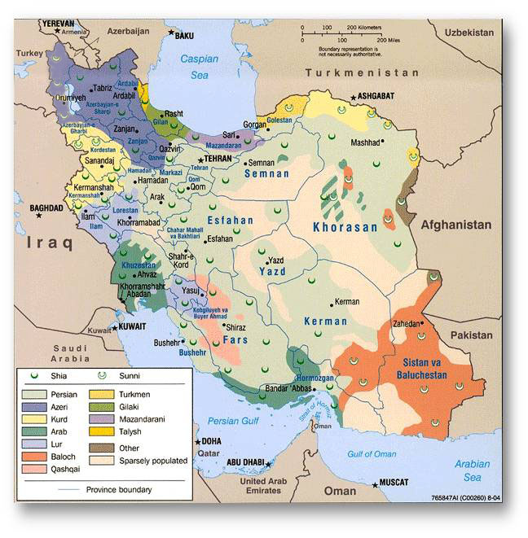
Distribution of novel genes in different ethnic group in Iran
Azeri:9
Torkmen:5
Gilak:1
Mazani:3
Kurd:7
Total:99 genes
Nine genes have been identified in more than one family
Lor:5
Fars:46
Arab:5
Southern:13
Baloch/Zaboli:16
Funded by the European Union's Seventh Framework Program under grant agreement number 241995 (GENCODYS)

Slide 32
Total Families: 436
1st Cohort: 136 families | 2nd Cohort :199 families | 3rd Cohort:101 families
Total families with one candidate gene: 204 (46.7% with one candidate gene)
1st Cohort: 78 families(57.3%) 73 gene | 2nd Cohort : 81 families (40.7%) 77 genes | 3rd Cohort:45 families (44.5%) 37 genes
Total families with one candidate known gene: 96 (47%)
1st Cohort: 26 families (33.3%) 23 genes | 2nd Cohort : 44 families (54.3%) 40 genes | 3rd Cohort: 26 families (57.7%) 18 genes
Total families with one candidate novel gene: 108 (52.9%)
1st Cohort: 52 families (66.7%) 50 genes | 2nd Cohort : 37 families (45.7%) 37 genes | 3rd Cohort: 19 families (42.2%) 19 genes

Slide 33
Total families with one candidate gene: 204 1st Cohort: 78 families 2nd Cohort :81 families 3rd Cohort:45 families

Slide 34
In 2011; Distribution of ARID genes throughout the genome
Investigation of > 200 consanguineous Iranian families
ST3GAL3
GON4L
ACBD6
HIST3H3
ADRA2B
CAPN10
CNKSR1
PARP1
RGS7
INPP4A
PECR
CRBN
ZBTB40
1
2
EEF1B2
3
SRD5A3
CCNA2
NSUN2
HIST1H4B
GRIK2
ASCC3
CASP2
VLDLR
PRMT10
NDST1
4
5
6
7
PRSS12
LARP7
TUSC3
TRAPP9C
VLDLR
C9orf86
ADK
C11orf46
C12orf57
ASCL1
ZC3H14
MAN1B1
ENTPD1
POLR3B
CLIP1
ERLIN2
SLC31A1
RALGDS
FRY
COQ5
UBR7
8
9
10
11
12
13
14
C8orf41
TAF2
TMEM135
KDM5A
ZCCHC8
SCAPER
KIF7
KDM6B
CACNA1G
ELP2
ZNF526
PRRT2
FASN
TRMT1
15
LINS 1
16
17
WDR45L
18
CC2D1A
19
20
21
22
LAMA1
Over 200 new loci, several overlapping (➔common causes?)
Known NS-ID Genes up to 2006
Novel Syndromic ID Genes
Novel NS- ID Genes

Slide 35
In 2014; Distribution of ARID genes throughout the genome
DHCR24
ST3GAL3
ALS2
ZFAND2B
ZBTB11
IPP
GON4L
ACBD6
HIST3H3
ADRA2B
NIF3L1
CAPN10
MFSD2A
CNKSR1
RGS7
INPP4A
CCNT2
PECR
CRBN
ZBTB40
1
RUSC1
2
EEF1B2
3
SLC6A17
PARP1
SRD5A3
CCNA2
NSUN2
HIST1H4B
GRIK2
ASCC3
PDE1C
CASP2
NFXL1
AIMP1
PRMT10
VLDLR
NDST1
GPR126
NAA15
4
5
6
7
PRSS12
LARP7
CDKN2AIP
TUSC3
TRAPP9C
VLDLR
C9orf86
ADK
PIDD
C11orf46
C12orf57
ASCL1
RDH11
ZC3H14
MAN1B1
ENTPD1
POLR3B
CLIP1
KLHL33
ERLIN2
SLC31A1
RALGDS
FRY
ATF7IP
COQ5
UBR7
8
9
10
11
12
13
14
C8orf41
TAF2
FAM160A2
TMEM135
KDM5A
ZCCHC8
SCAPER
KIF7
KDM6B
CACNA1G
ELP2
ZNF526
PPP1R3D
PRRT2
FASN
TRMT1
15
16
17
WDR45L
18
CC2D1A
19
20
21
22
LINS 1
TCF25
LAMA1
EXOSC5
Over 300 new loci, several overlapping
Known NS-ID Genes up to 2006
Novel Syndromic ID Genes
Novel NS- ID Genes
Most current Genes

Slide 36
End of September 2014

Slide 37
Functional assessment of novel ARID genes
Functional category | Gene | Publication
Neurotransmitter receptor | GRIK2 | Motazacker MM et al., 2007
Transmembrane transporter | TUSC3 | Garshasbi M et al., 2008
Cell signaling pathway (neuronal cells differentiation) | TRAPPC9 | Mir A et al., 2009
 | RUSC1 | Ongoing
Protein/ lipid glycosylation | SRD5A3 | Kahrizi K et al., 2011
 | ST3GAL3 | Hu H et al., 2011
RNA binding (influence gene expression) | ZC3H14 | Pak CH et al., 2011
Microtubule binding protein | CLIP1 | Larti F et al., 2014
tRNA methyltransferase | NSUN2 | Abbasi Moheb L et al., 2011
 | TRMT1 | Ongoing
DNA binding (Regulation of transcription ) | ZBTB11 | Ongoing
Protease (apoptosis) | CAPN10 | Ongoing

Slide 38
Drosophila as model organism for learning defects
Functional Validation
50 novel candidate
disease genes
12 families with more than
one candidate
15
no Drosophila
orthologs
35
Drosophila
orthologs
Knockdown of genes of interest
Long and short term memory test
LTM / STM
WP2 Dr. Krystyna Keleman
Research Institute of Molecular Pathology (Vienna)

Slide 39
Functional analysis: summary
LTM deficit | STM deficit
CCNA2 | UBR7
COQ5 | SCAPER
FRY | TMEM135
KDM6B
LARP7
MAN1B1
NDST1
PARP1
SLC31A1
CASP2
FASN
70% of the new ID genes have an ortholog in Drosophila
11 → LTM defect
3 → STM defect
2 → Lethal (POLR3B, TAF2)

Slide 40
Cell Bank
Approximately 90 samples were banked
Cell bank website consists of ID families with genes and phenotypes
www.iran-cellbank.com

Slide 41
ID website www.iran-cellbank.com
Notes:
41

Slide 42
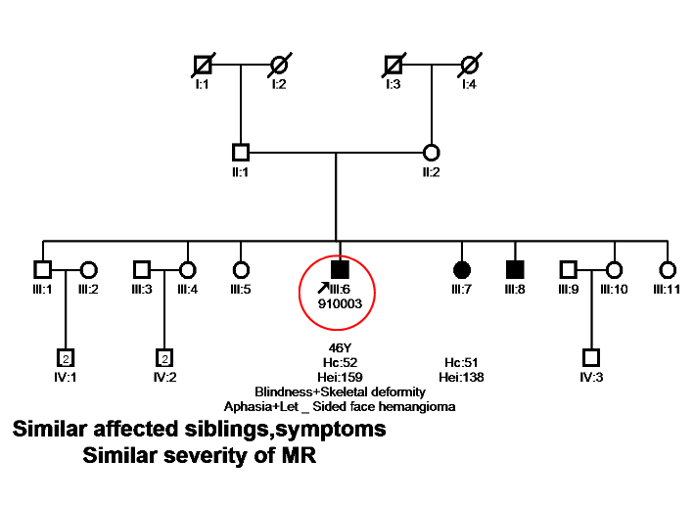
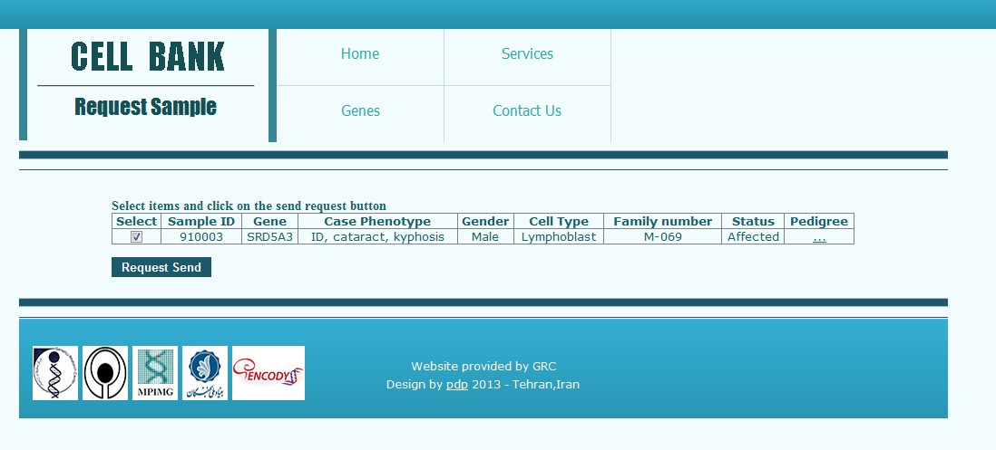

Slide 43
Summary by the end of September 2014
81 known genes in 102 families
106 novel genes out of 123 families
25 novel genes has been reported in 2 or more families (27%)
29 families with two plausible candidate gene
At present time we can offer carrier detection and PND for over 50% of the families.

Slide 44
Out look
Determining the function of the remaining 106 novel genes in brain
Functional analysis of 26 families with two plausible candidate gene
Completing the Whole Genome Sequencing for the reaming families.
Screening sporadic families with consanguinity

Slide 45
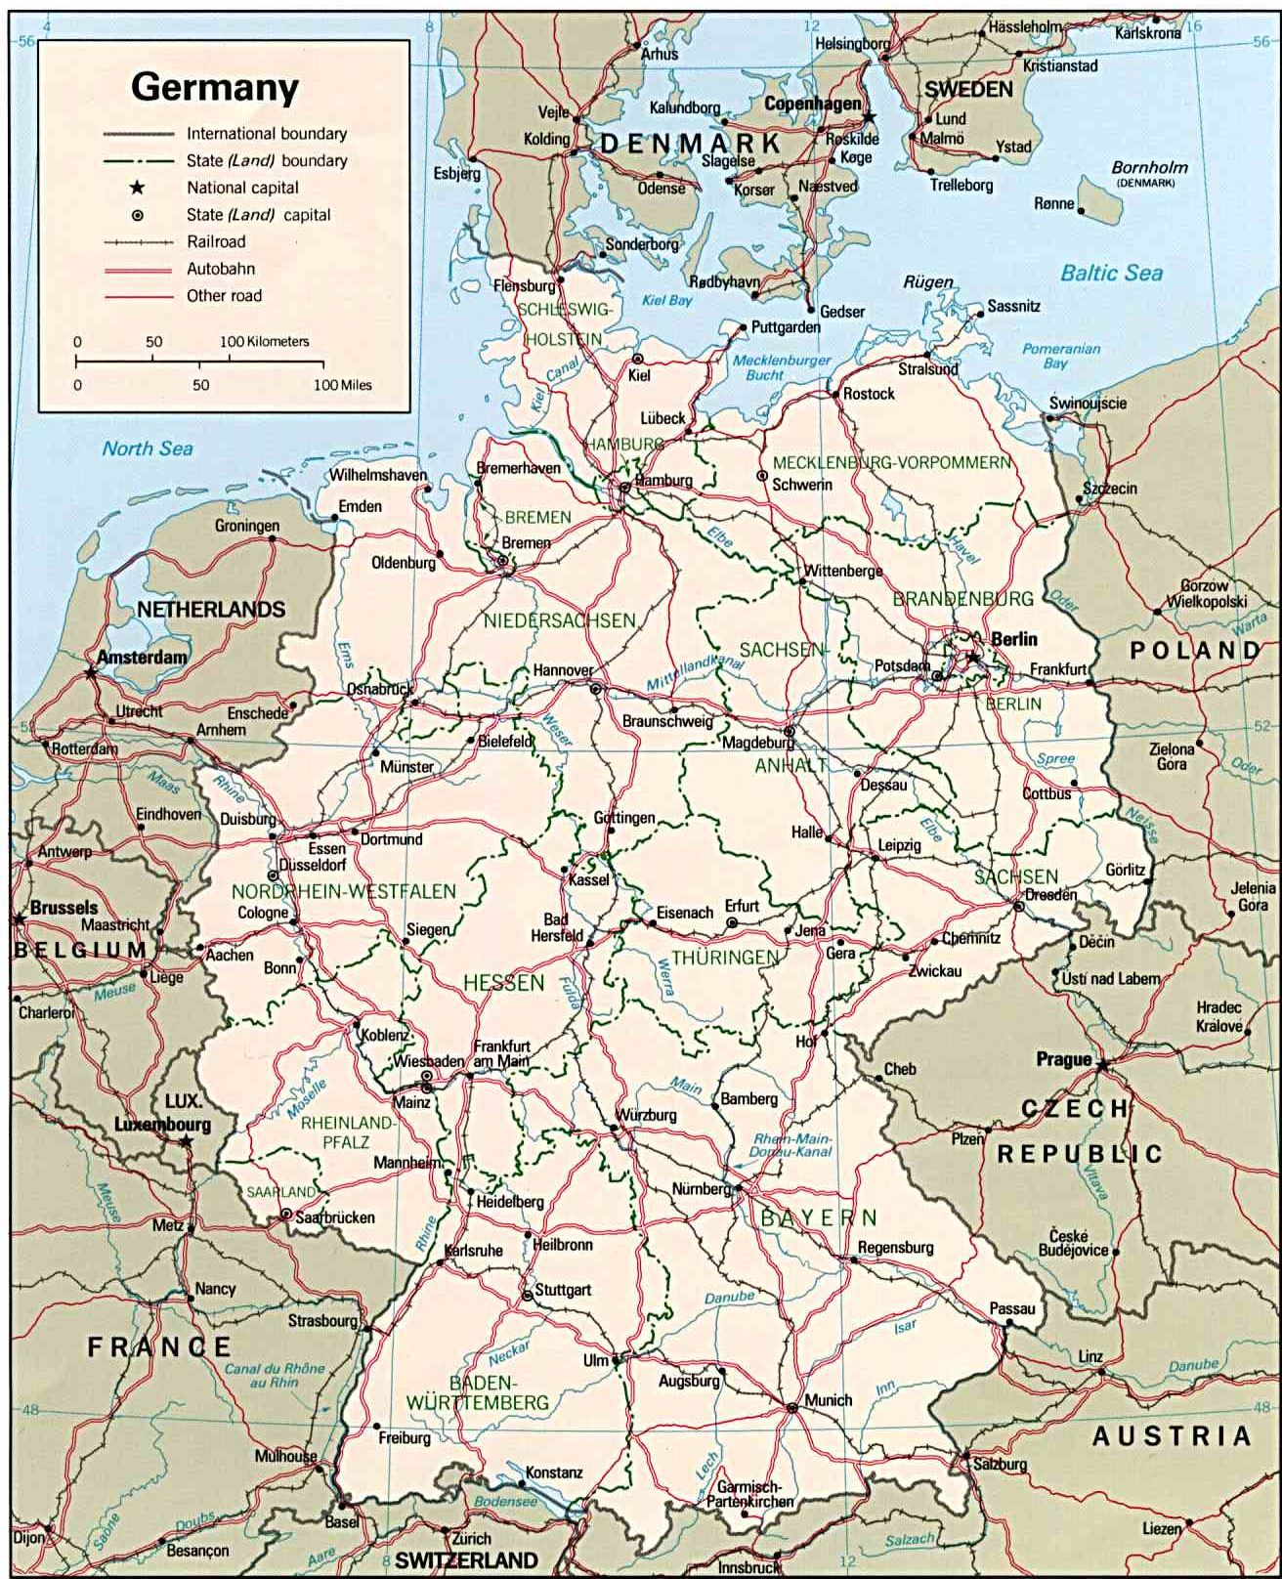
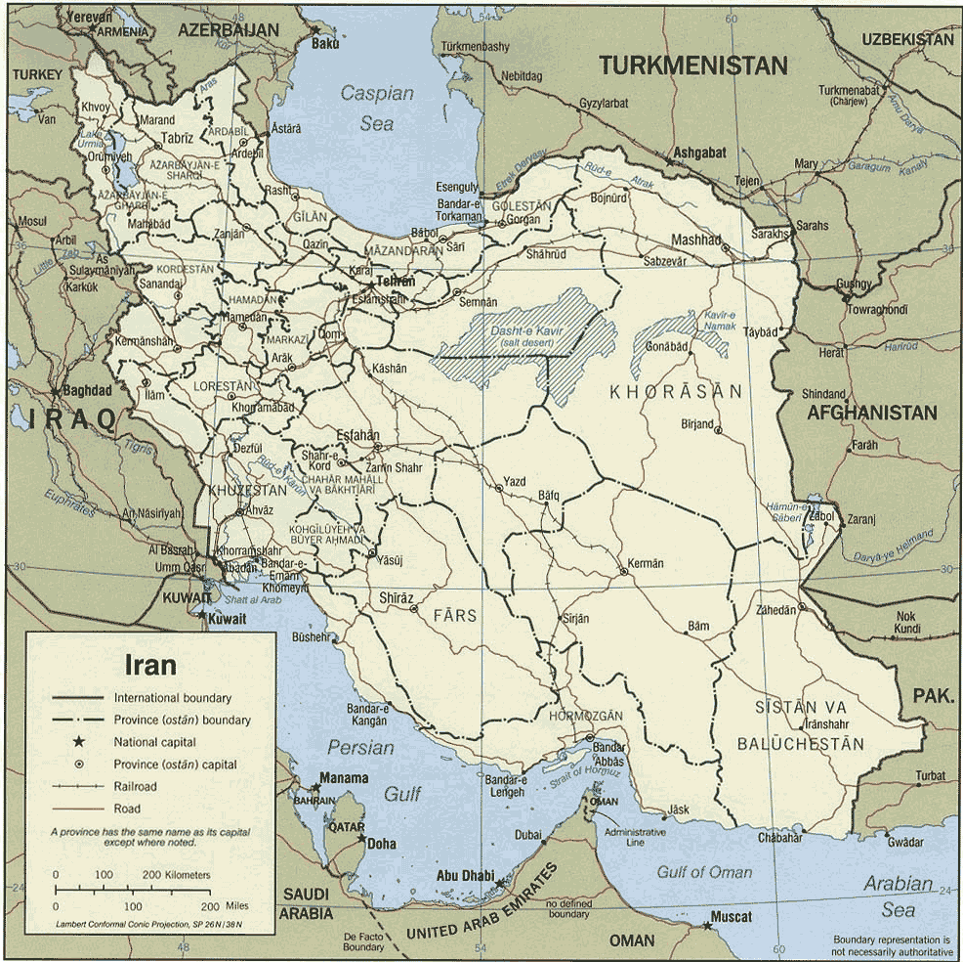
The people
Families and Patients
Prof. Hans Hilger Ropers
Prof. Thomas Wienker
Dr. Andreas Kuss
Dr. Luciana Musante
Dr. Masoud Garshasbi
Dr. Andreas Tzschach
Dr. Cougar Hau Hu
Dr. Tomasz Zemojtel
Dr. Lucia Puttmann
Dr. Vera Kalscheuer
Dr. Reinhard Ullmann
Dr. Chen Wei
MPI, Berlin
Dr. Kimia Kahrizi
Sedigheh Abedini
Masoumeh Hosseini
Dr. Payman Jamali
Marzieh Mohsani
Leyla Nouri
Dr. Farzaneh Larti
Zohreh Fattah
Dr Roxana Kariminejad
Many cooperative Iranian
USWR-GRC, Tehran
IRAN
GERMANY
Mohammad Mahdi Motazacker
Lia Abbasi-Moheb
Sahar Esmaeli Nieh
Kariminejad – Najmabadi Pathology and Genetic Center
Max Planck innovation funds
Iranian national foundation
BMBF MRNET

