Slide 1
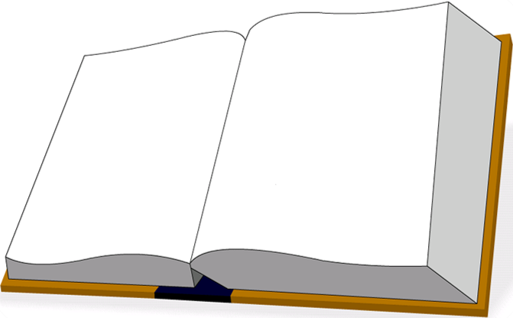
به نام
خالق یکتا

Slide 2
Nanotechnology application in Neuroscience
Opportunities and challenges
Zahmatkesh Maryam, Faridi-Majidi Reza, Ejtemaee-Mehr Shahram
School of Advanced Technologies in Medicine

Slide 3
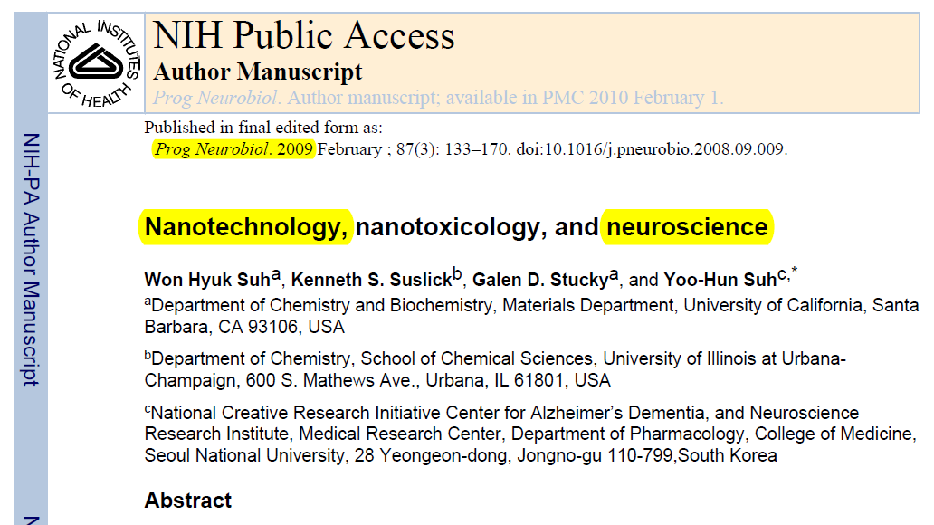
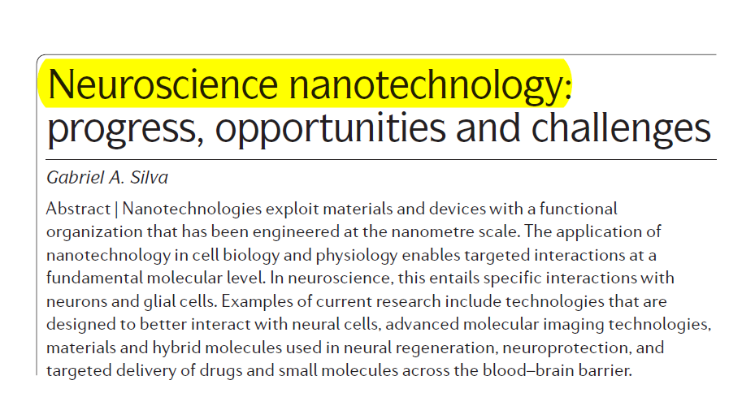
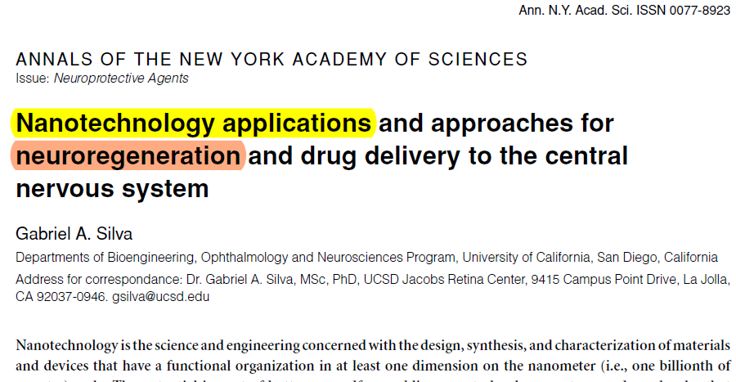
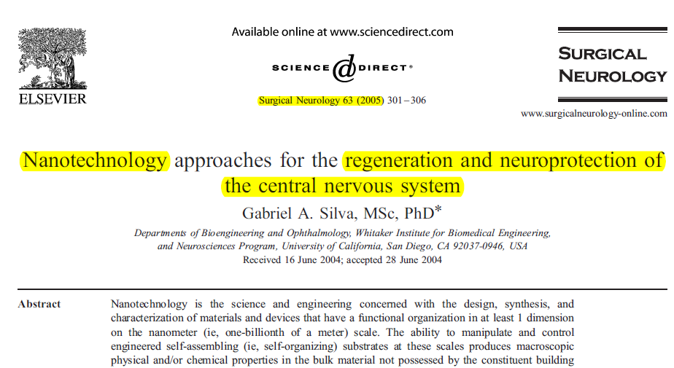

Slide 4
Two key types of nano technology application in neuroscience
Platform nanotechnologies: that can be readily adapted to address neuroscience questions
Tailored nanotechnologies: that are specifically designed to resolve a particular neurobiological issue.

Slide 5
Applications of nanotechnologies in Basic neuroscience
Improved signal detection
Single-particle tracking of target molecules in live cells
Detection of ligand– receptor dynamics in the cell membrane
New tools for studying neuronal signalling processes
Possible of local and systemic toxicity for in vivo applications of Quantum-dot nanotechnology
Gabriel A. Silva. Nature Reviews, Neuroscience. Volume 7, 2006: 65-74.

Slide 6
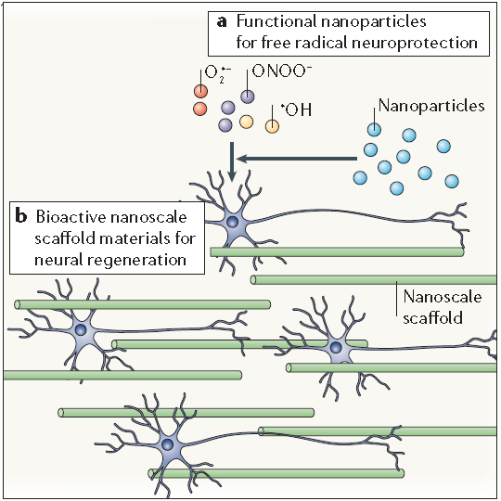
Applications of nanotechnology in clinical neuroscience
Applications of nanotechnology in neuroscience include research aimed at limiting and reversing neuropathological disease states.
Nanoparticles that promote neuroprotection by limiting the effects of free radicals produced following trauma (for example, those produced by CNS secondary injury mechanisms).
Neuroprotective strategies, in particular those that use fullerene derivatives;

Slide 7
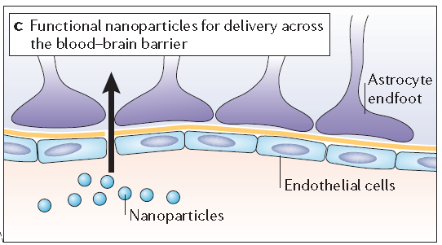
Applications of nanotechnology in clinical neuroscience
Nanoparticles designed to allow the transport of drugs and small molecules across the blood–brain barrier.
Gabriel A. Silva. Nature Reviews, Neuroscience. Volume 7, 2006: 65-74.

Slide 8
Summary of applications of nanotechnology in AD treatment
Neuroprotection
Antioxidant nanotechnology building blocks
Carboxyfullerenes
Hydroxyfullerenes
Antiamyloid
Antioligomeric
Protecting against NMDA-R toxicity
Amyloid aggregates resolubilization
anti-assembly strategy
Anti-amyloid toxicity
Nanogels artificial chaperons
Dendrimers
Hydrated Fulleren
Nanoparticles mediated Thermal energy supply
Dendrimers
Memantine (adamantine nanotechnology building block)
Amir Nazema and G. Ali Mansoorib. Journal of Alzheimer’s Disease 13 (2008) 199–223.

Slide 9
Endogenous Nanoparticles

Slide 10
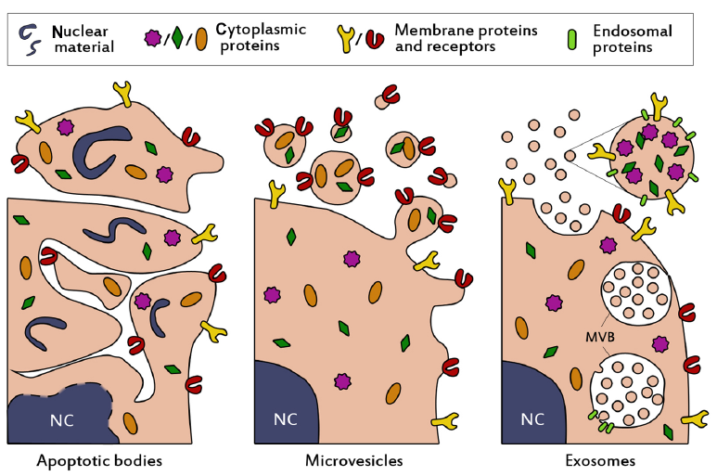
Schematic presentation of the biogenesis and composition of the three main classes of extracellular vesicles
Exosomes are small (40-80 nm), relatively homogenous in size, and may contain (endosomal) proteins involved in their assembly, such as CD9, Alix and TSG101.
Kooijmans S. AA., et al.,International Journal of Nanomedicine 2012:7 1525–1541.

Slide 11
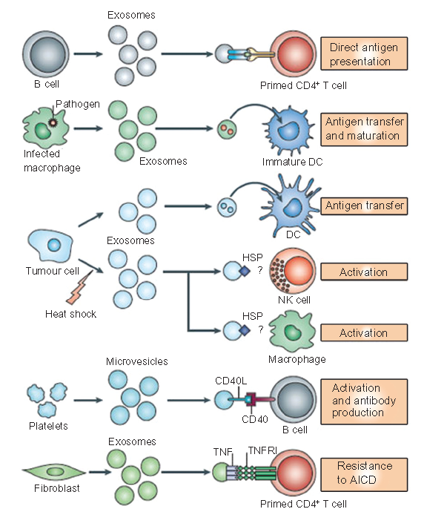
Exosome
They are concentrated carriers of genetic and proteomic information, and thus are believed to play important roles in intercellular communication.
Kooijmans S. AA., et al., International Journal of Nanomedicine 2012:7 1525–1541.

Slide 12
Exosome Mimetics

Slide 13
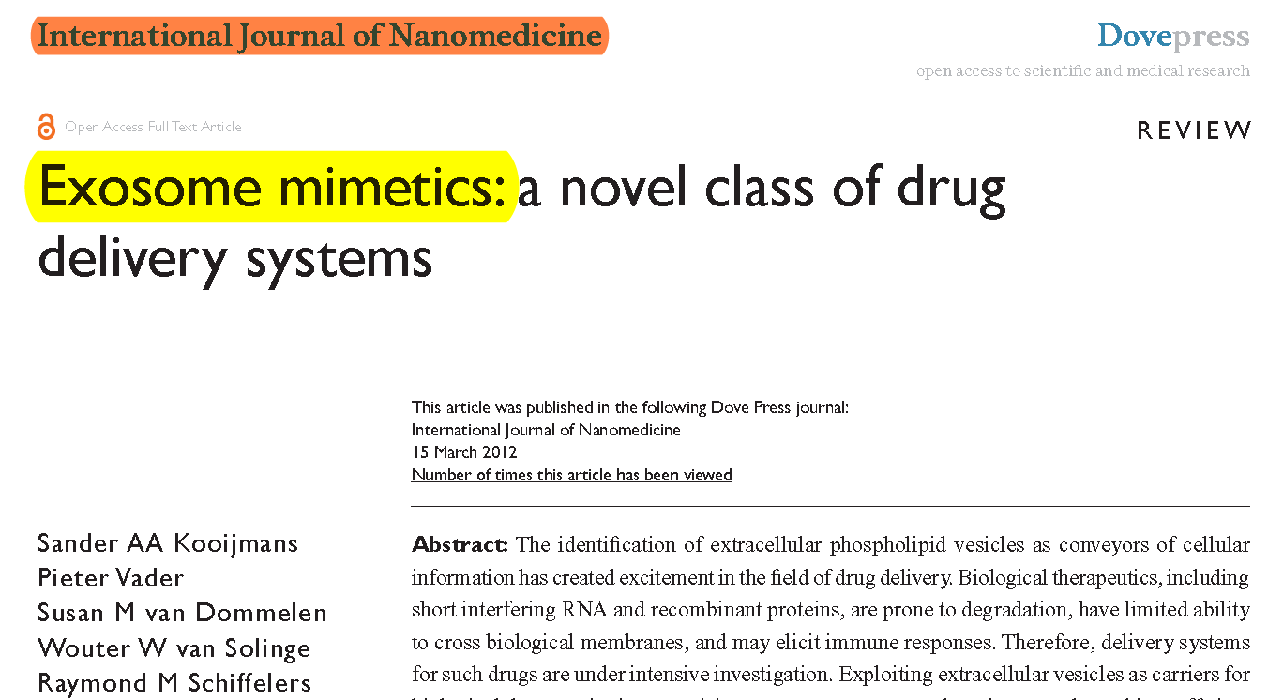

Slide 14
Advantages over conventional drug delivery systems
Virus-based drug delivery systems,
their potential for insertional mutagenesis or oncogenesis, high production costs, and risk of immunogenicity limit their clinical use.
Nonviral drug delivery vehicles, such as cationic polyplexes and lipoplexes, are generally considered to be less immunogenic and mutagenic, but cytotoxicity and low transfection efficiencies in vivo are still major challenges to overcome.
Kooijmans S. AA., et al.,International Journal of Nanomedicine 2012:7 1525–1541.

Slide 15
Exosome mimetics
It is well possible that not all components of exosomes are required for their proper functioning, an alternative strategy would be to mimic these vesicles synthetically.
By assembly of liposomes harboring only crucial components of natural exosomes, functional exosome mimetics may be create.
Kooijmans S. AA., et al.,International Journal of Nanomedicine 2012:7 1525–1541.

Slide 16
Nanotechnology application in Neuroscience
Opportunities and challenges
Zahmatkesh Maryam, Faridi-Majidi Reza, Ejtemaee-Mehr Shahram
School of Advanced Technologies in Medicine

Slide 17
International Journal of Nanomedicine 2007:2(4) 639–649

