Slide 2
Improving Adenovirus Transduction of ASC
Babak Negahdari

Slide 3
AdV & MSCs
Recombinant adenoviruses in gene therapy
MSCs in regenerative medicine, and gene and drug delivery.
Limitation of adenoviral gene transfer in human MSCs

Slide 4
advantages of ASCs
Availability
secretion of pro-angiogenic and anti-apoptotic factor
Immunomodulation
multilineage differentiation capability
similarity to BMSCs
Less post-engraftment differentiation
maintained for long periods
stable population doublings
growth factor secretion
Paracrine mechanisms

Slide 5
Adenovirus advantages
transfer genes into different types of cells.
Application in both humans and animal species
In 28% of 600 gene therapy
replicate at high titers
infecting dividing and non-dividing cells
high range of gene packaging capacity
epichromosomal expression
safety compared to other viral vectors

Slide 6
Goals of research
Increase the adenovirus transduction level of hASC using Valproic Acid (VPA) and determine proper concentration and duration of treatment alone or in combination with ViraDuctin™ adenovirus transduction reagent.

Slide 7
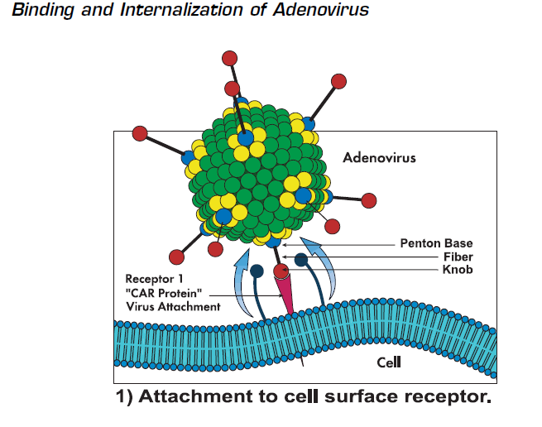

Slide 8
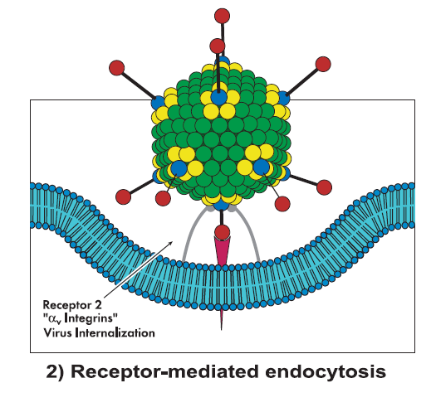
Binding and internalization of Adenovirus

Slide 9
CAR expression & Valproic acid
CAR expression & Valproic acid
XTT test for Valproic acid toxicity on ASC
RNA extraction
Real time PCR by CAR primer
ASC treatment with Val 6h,12h,24h,48h
Treatment dose: 1mM,1.5mM,2mM,3mM,4mM and 5mM

Slide 10
Valproic Acid & XTT test
3 × 10⁴ hASCs were cultivated in each well of flat 96-well plates
Concentrations of 1, 1.5, 2, 3, 4 and 5mM of VPA
hASCs viability evaluated after 12, 24 and 48 hours of VPA treatment by XTT

Slide 11
Valproic acid XTT test
*
*

Slide 12
Effects of VPA on viability of treated hASCs
Exposure to VPA at concentrations above 2mM resulted in cytotoxic effects and these effects were more pronounced in longer exposure periods.
In 48 hrs after exposure, cytotoxic effects were statically significant at 3,4 and 5mM concentration (P value <0.05­­)

Slide 13
VPA and upregulation of CAR mRNA levels
Four potential VPA treatment periods (6, 12, 24 and 48 hrs) and three concentrations of VPA (1, 1.5 and 2mM) were evaluated.
In all durations of VPA treatment, transcriptional upregulation in CAR mRNA levels increased by decreasing concentration from 2mM to 1mM of VPA.

Slide 14
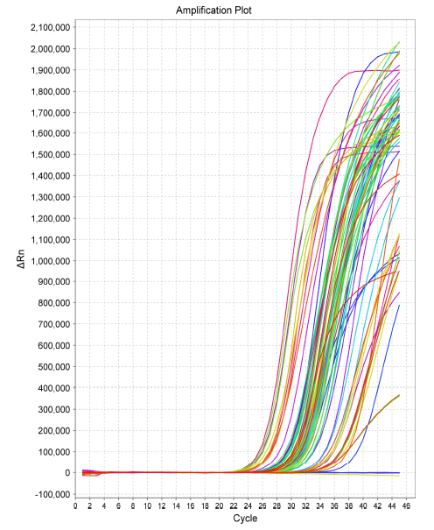
CAR mRNA Real-Time

Slide 15
VPA and upregulation of CAR mRNA levels
Increased exposure period resulted in decreased CAR mRNA levels from 6.8±0.5 folds to 3.1±0.5 folds.
Therefore 1mM VPA concentration was considered as the durable VPA concentration for next experiments.
The highest level of mRNA expression was observed at 6 and 12 hrs post treatment with 1mM of VPA

Slide 16
CAR mRNA expression after VPA treatment in indicated exposure periods and concentrations. Quantitative RT-PCR was used to determine CAR expression. Results were demonstrated as fold increase in expression.
6.5
4.5
6
4
4
2.5
3.2
2.2

Slide 17
Transduction of hASCs following treatment with VPA and ViraDuctinTM by GFP expressing Adenovirus
Transduction rates were evaluated at 12 and 24 hrs post treatment.
hASCs were transduced with Ad5GFP at MOI 10 in the presence or absence of 1mM of VPA for 12 and 24 hrs
GFP expression was evaluated 72hrs post infection. hASCs with low CAR expression level, yielded in 6-7% of GFP expressing cells.
Treatment with VPA for 12 and 24 hrs enhanced the total percentage of transduced cells by 1.4 and 2.6 fold respectively.

Slide 18
Transduction of hASCs following treatment with VPA and ViraDuctinTM by GFP expressing Adenovirus
1mM VPA added to cells and incubated for 24hrs and Ad5GFP/ViraDuctinTM complex applied to cells.
ViraDuctinTM treatment of hASCs resulted in 2.5±0.2 fold increase in transduction rate whereas combination of ViraDuctinTM and VPA afforded a higher level of transduction (3.5±0.5)

Slide 19
Flowcytometric analysis of adenovirus transduction in hASCs treated with VPA and ViraDuctinTM.
*

Slide 20
خدایا چنان کن سرانجام کار توخشنود باشی و ما رستگار

