Slide 1
NEU-LAXOVA SYNDROME IS A HETEROGENEOUS METABOLIC DISORDER CAUSED BY DEFECTS IN ENZYMES OF THE L-SERINE BIOSYNTHESIS PATHWAY
ARIANA KARIMINEJAD
Kariminejad-Najmabadi Pathology & Genetics Center
#2, 4th St. Hasan Seyf St. Sanat Sq. Shahrak Gharb, Tehran Iran
+98-2188363955
arianakariminejad@yahoo.com

Slide 2
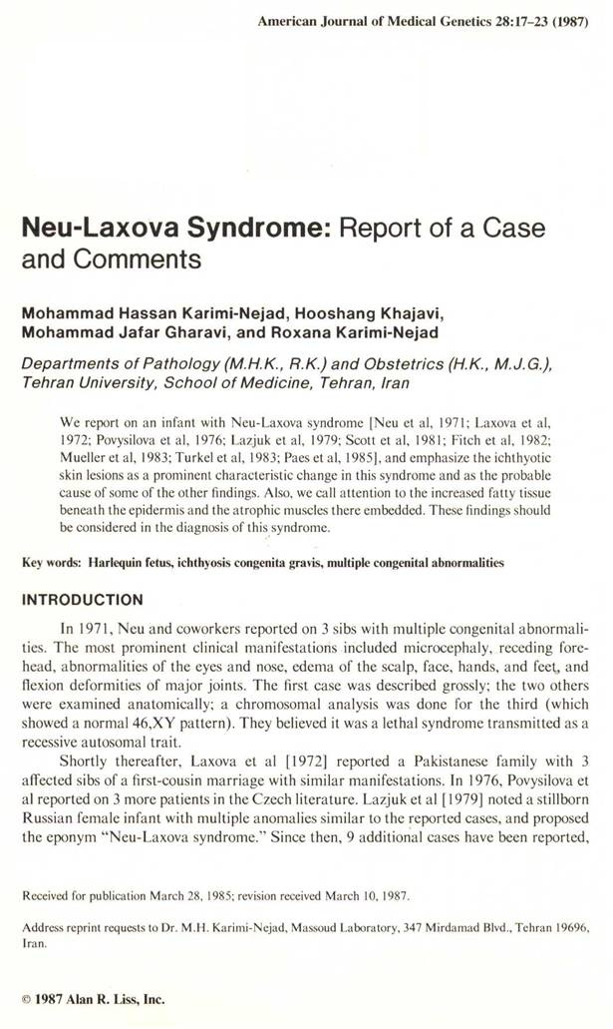
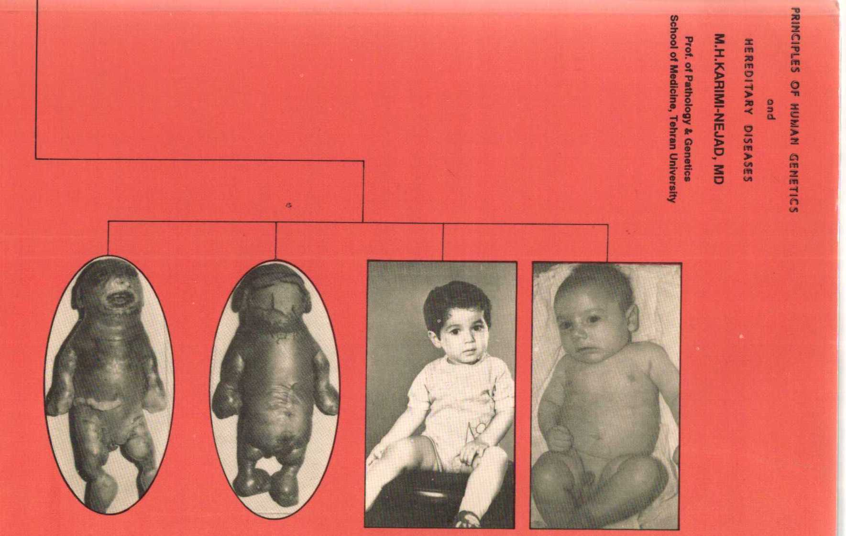
OMIM: Karimi-Nejad et al. (1987) emphasized ichthyotic skin lesions as a prominent characteristic change and called attention to the increased fatty tissue beneath the epidermis and the atrophic muscles embedded therein.

Slide 3
Neu-Laxova syndrome
Neu et al. 1971, Laxova et al. 1972 ≈ 60 cases in the literature
Severe IUGR, no skeletal dysplasia
Microcephaly + brain malforma-tions (lissencephaly type III, cerebellar hypoplasia, and others)
Congenital ichthyosis
Contractures and limb swelling
Occasional facial clefting
Perinatal lethality
Autosomal recessive
Probably a disorder affecting basic mechanisms that are critical for cell proliferation (e.g. cell cycle, division, differentiation)

Slide 4
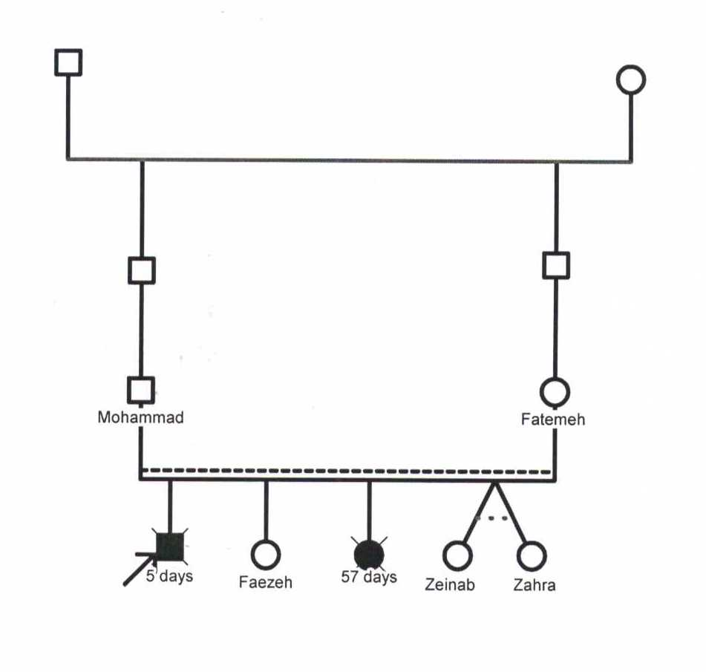
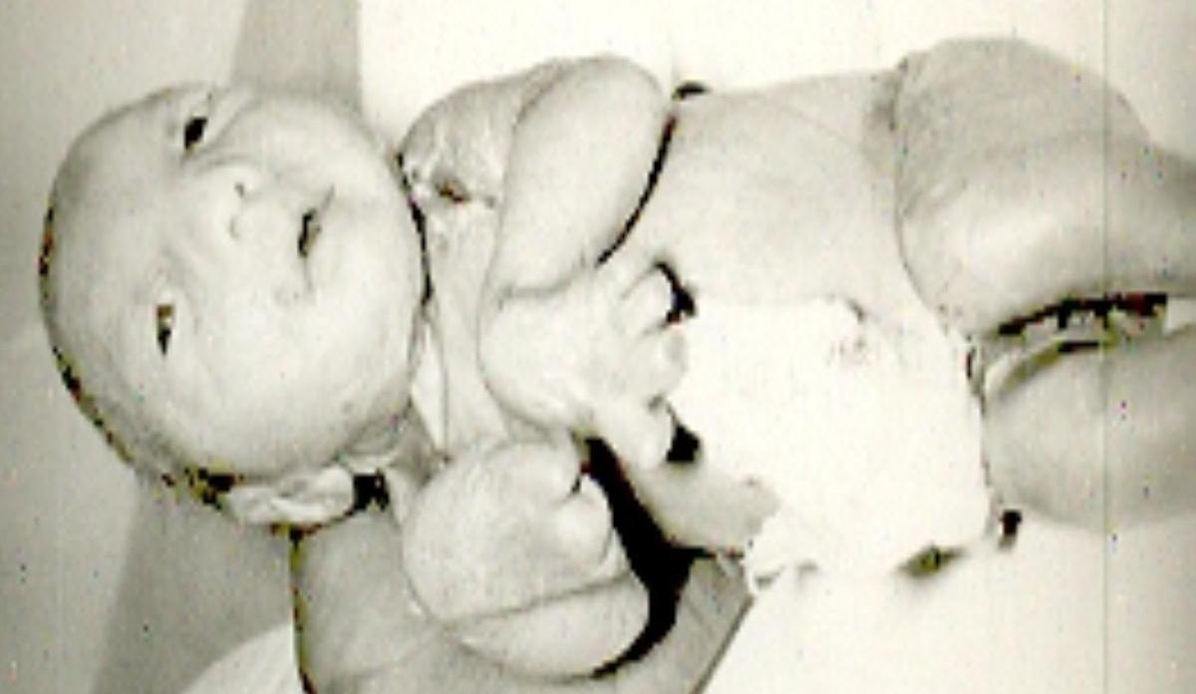
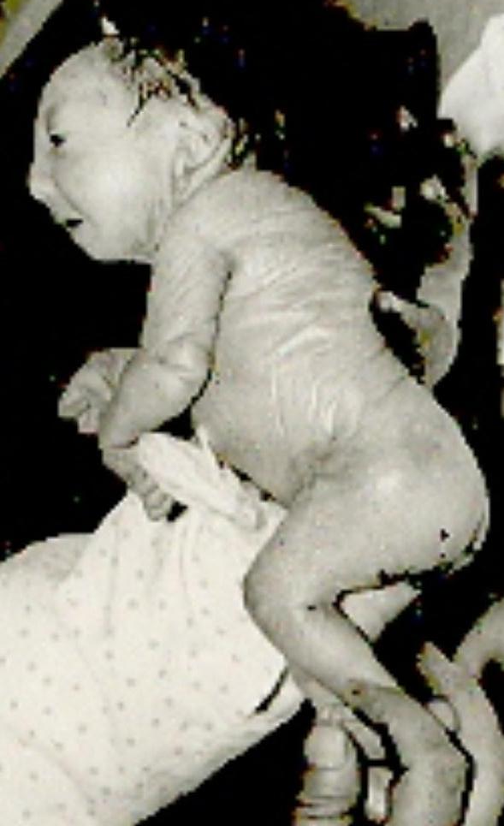
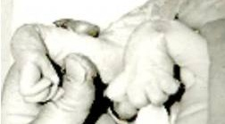
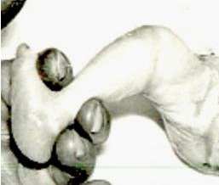
1371 (1992), a female newborn
Referred for chromosomal study
Diagnosis of Neu-Laxova syndrome was made upon physical examination

Slide 5
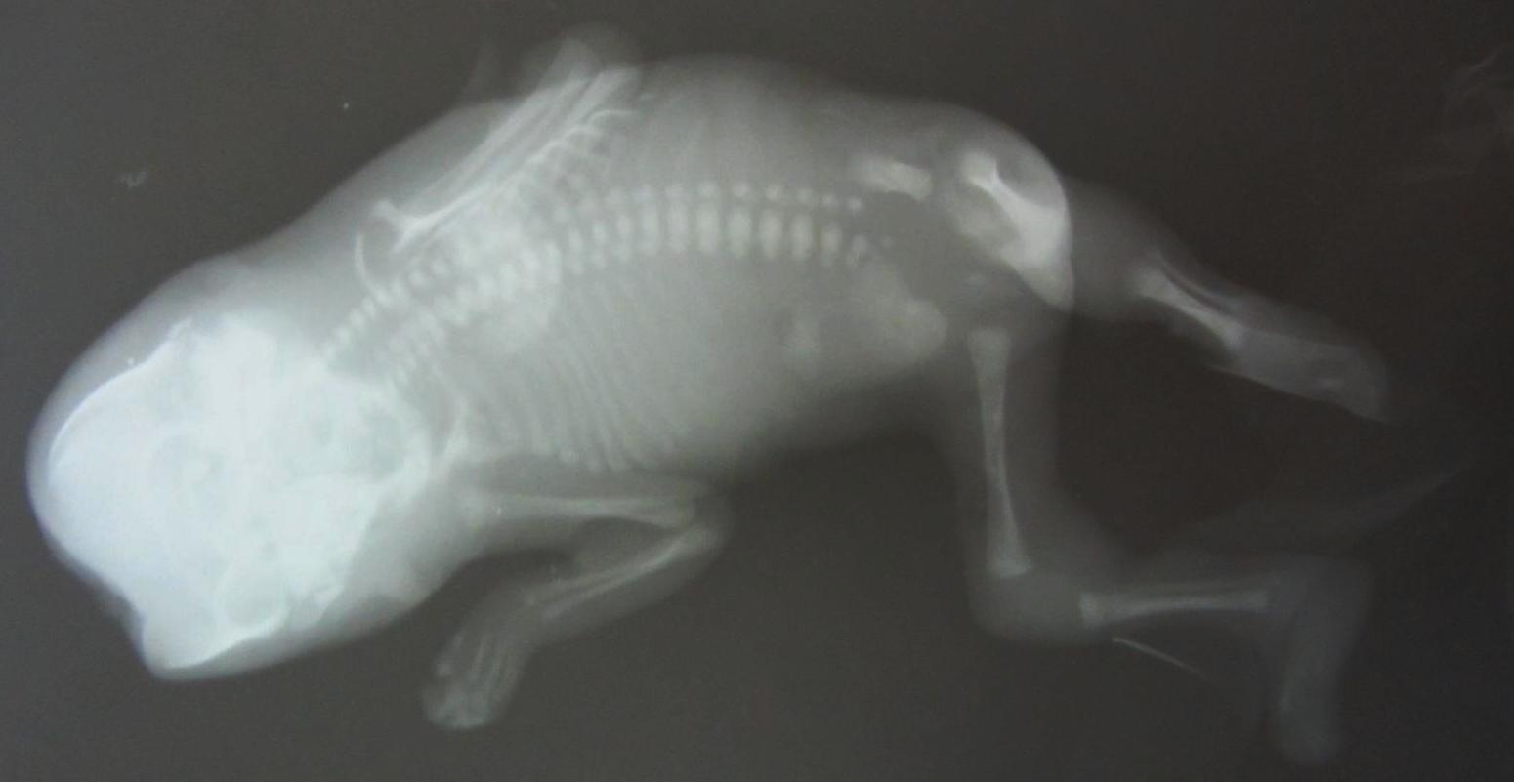
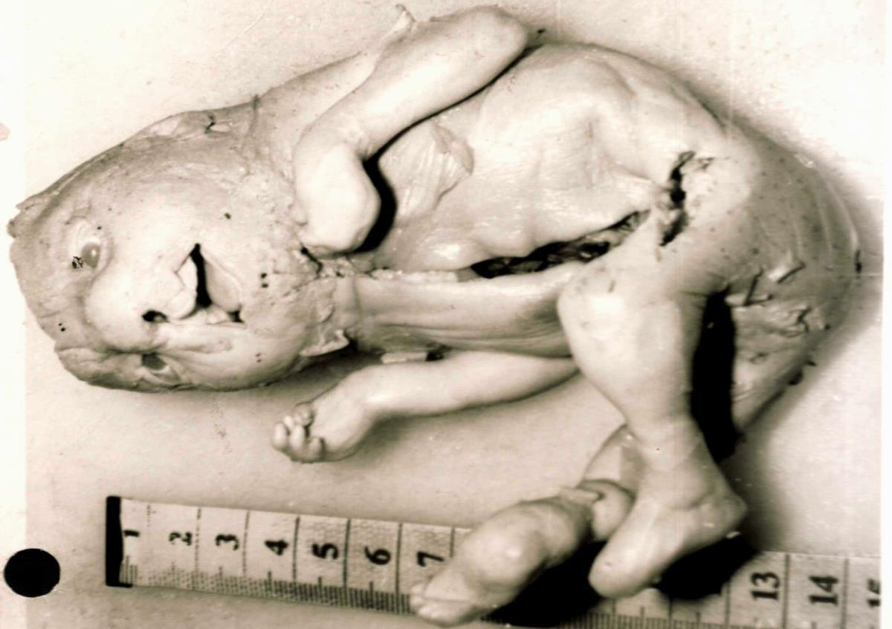
1372, (1993) 8-month-old fetus sent for autopsy examination and Neu-Laxova syndrome was diagnosed

Slide 6
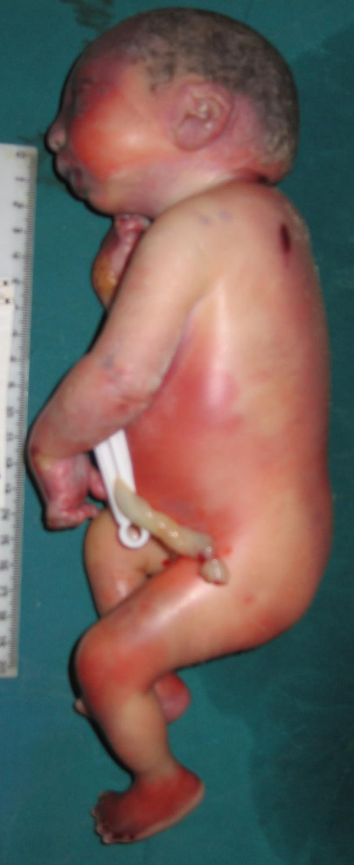
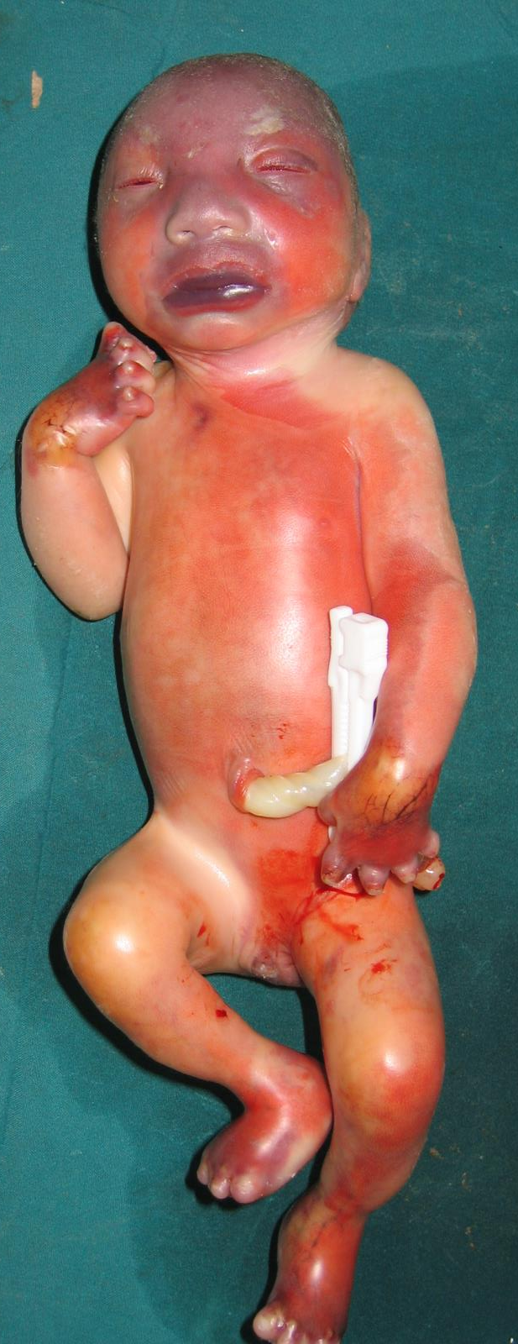
D
D
F
N
1383, (1994) unrelated couple brought 8-month-old fetus for autopsy examination
Neu-Laxova syndrome

Slide 7
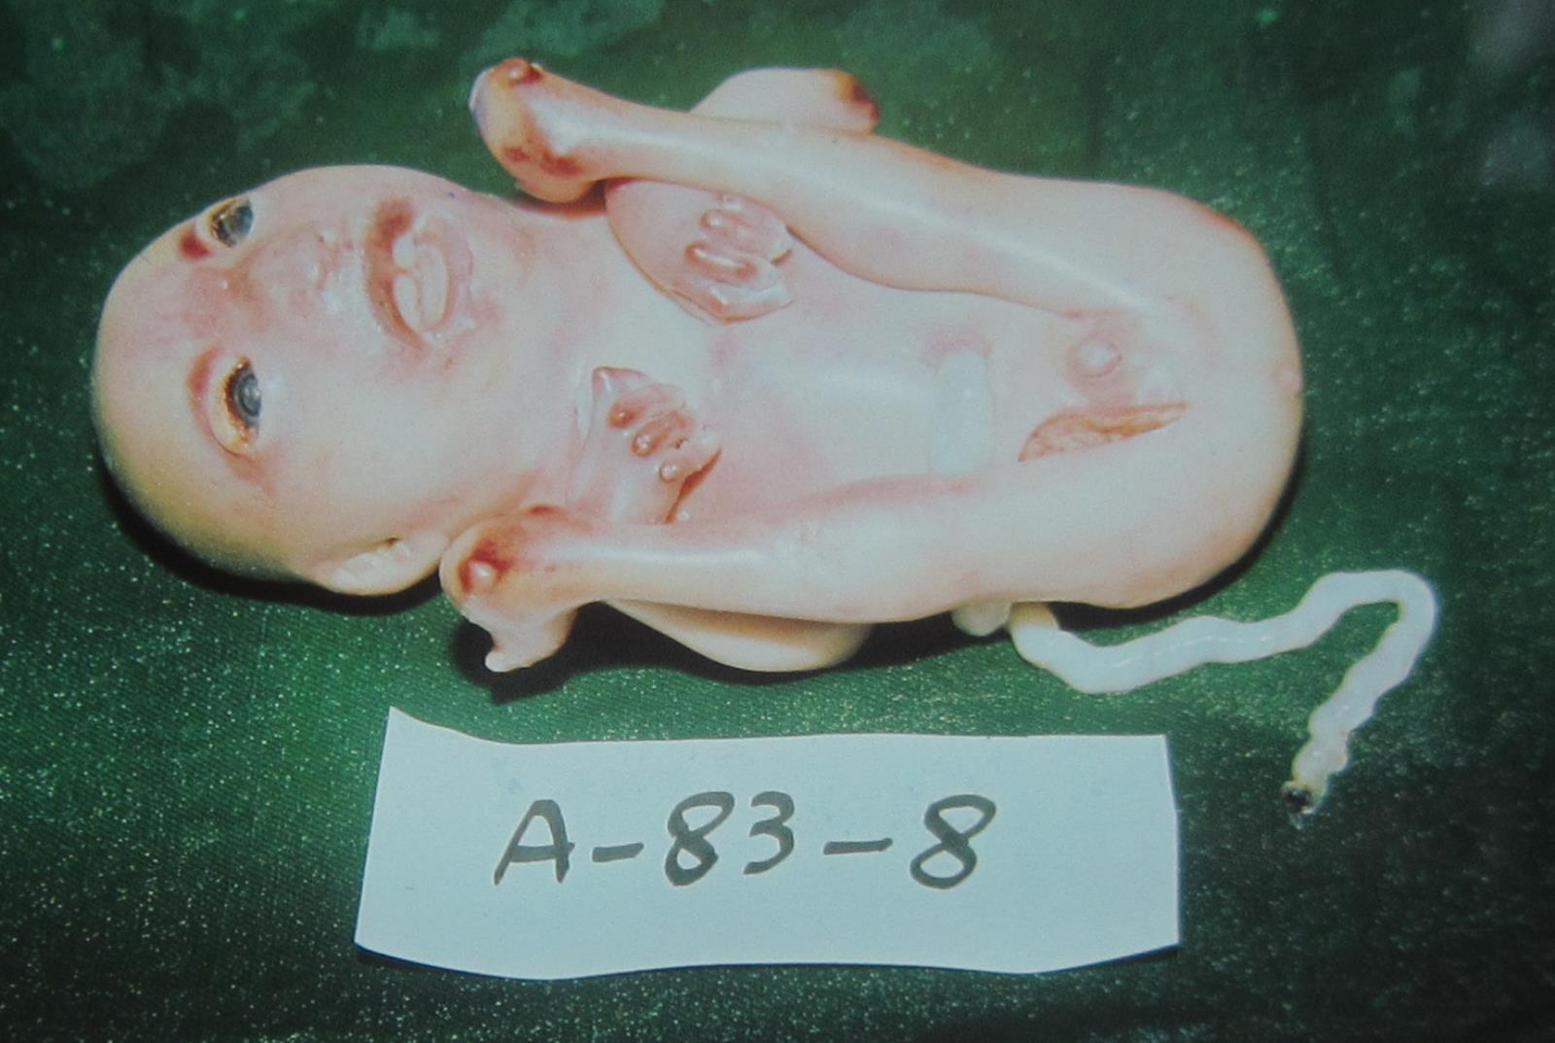
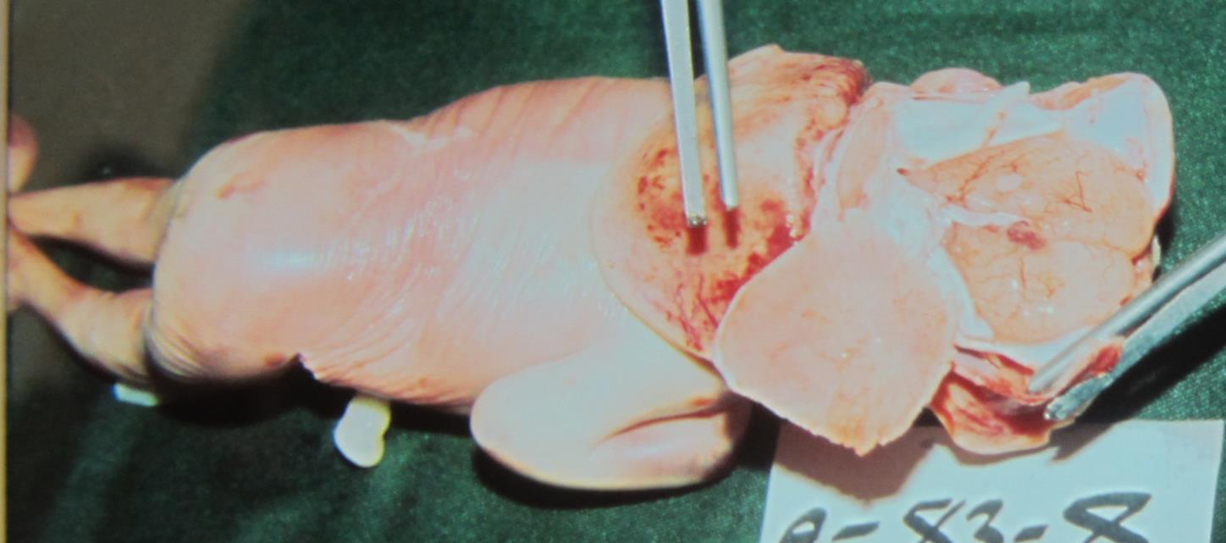
2
2
D
D
D
F
1386, (1997) first cousin couple
Autopsy examination performed at another center with diagnosis of ichthyosis.
Based on findings in autopsy report and pictures made diagnosis of Neu-Laxova syndrome

Slide 8
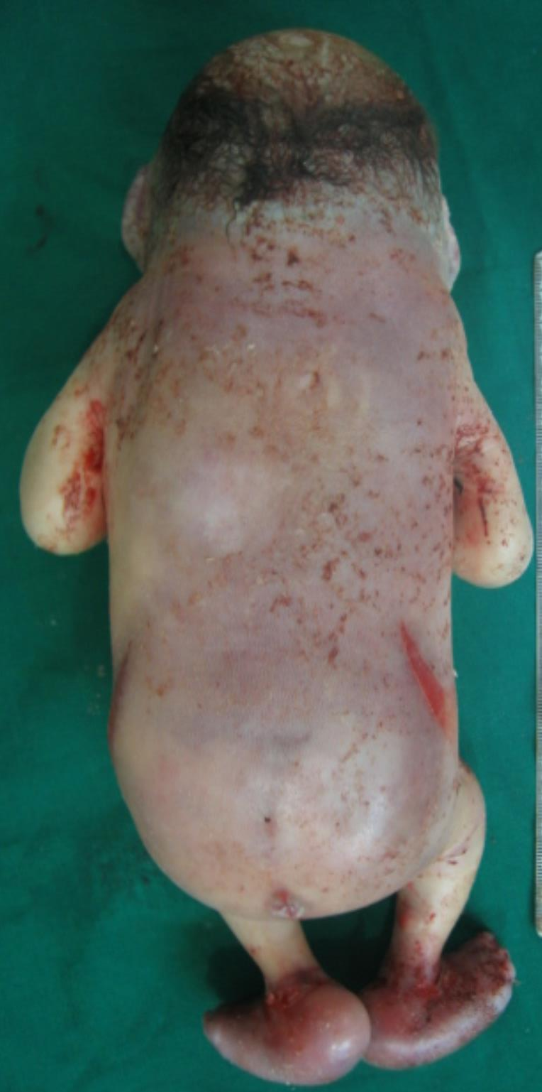
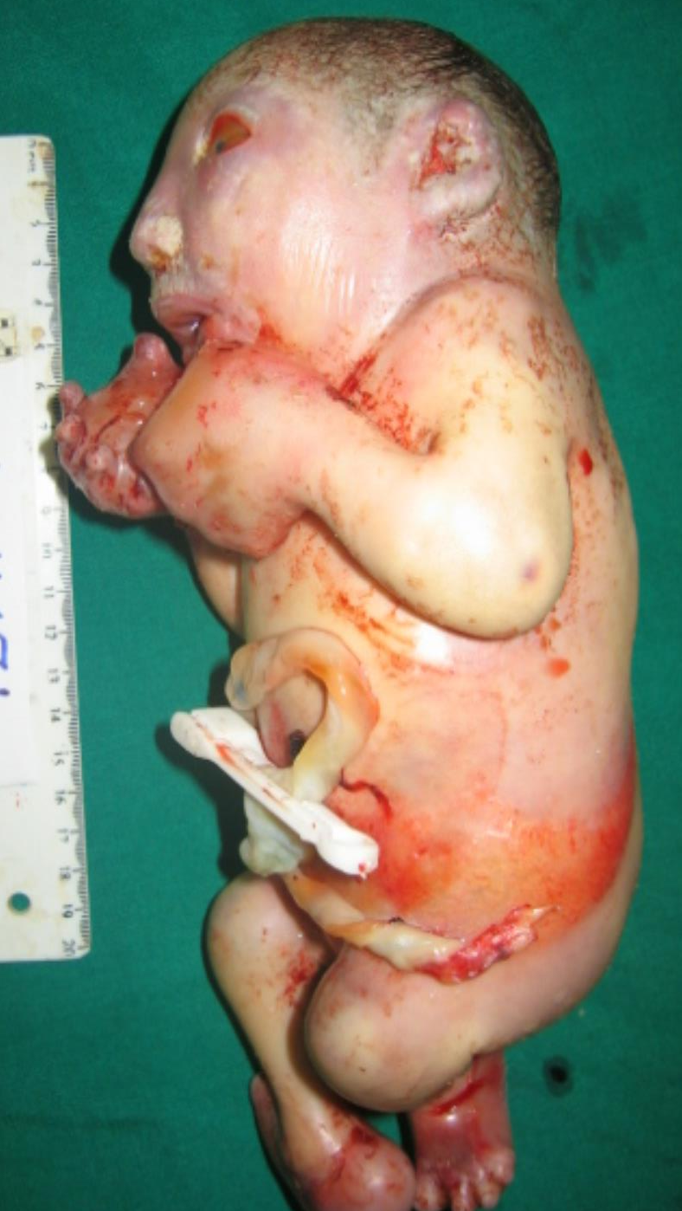
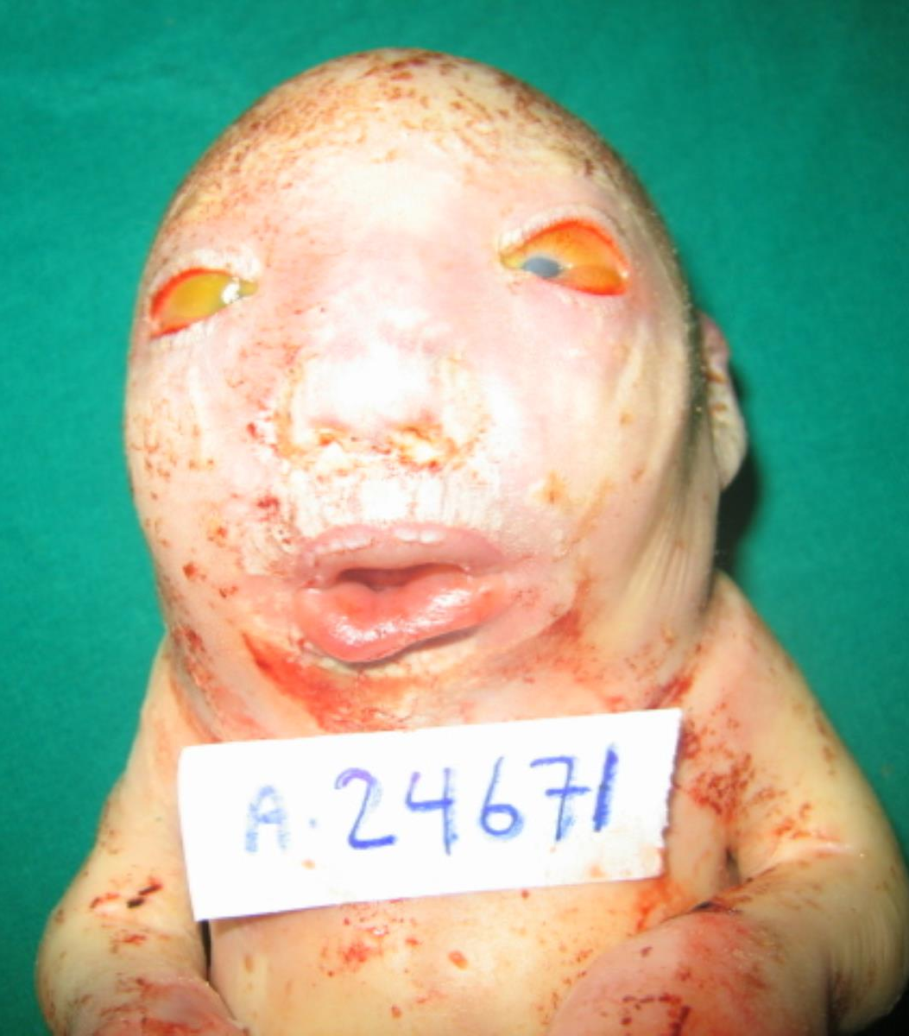
D
D
D
4
2
D
D
D
D
F
N
N
N
1387, (2008) a first cousin couple
33-week-old fetus for autopsy examination
Neu-Laxova syndrome
The sister had two similar cases of IUFD

Slide 9
Neu-Laxova syndrome
Distinct phenotype
AR inheritance + high rate of parental consanguinity
Vague idea about possible pathomechanism
Collect patients
Map locus
Identify gene
Publish

Slide 10
Collecting (started in 2007)
D
D
D
D
N
N
2
2
D
D
N
F
N
D
D
D
D
F
N
N
D
D
D
4
2
4°cousins
D
D
D
D
D
D
D
D
D
D
F
F
N
N
N
N
D
D
N

Slide 11
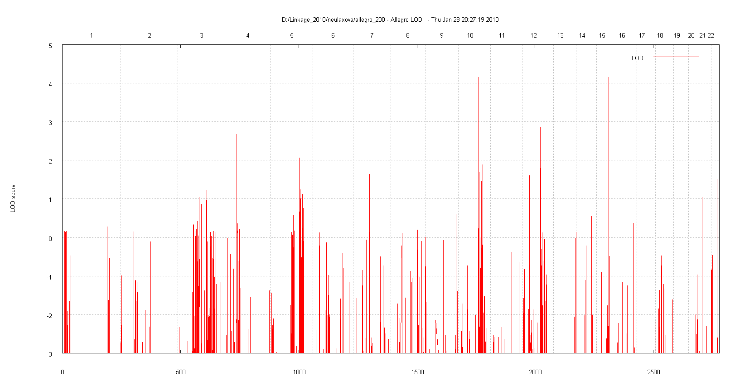
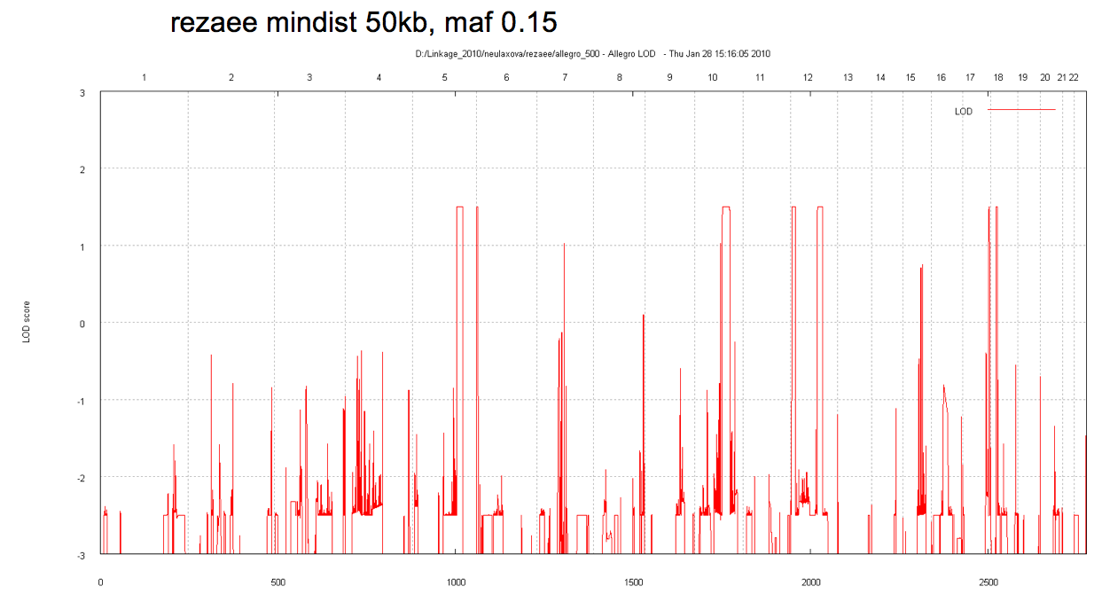
Mapping (done in 2009; A. Janecke)
Probably heterogeneous, no single candidate locus revealed
D
D
D
4
2
D
D
D
D
F
N
N
N

Slide 12
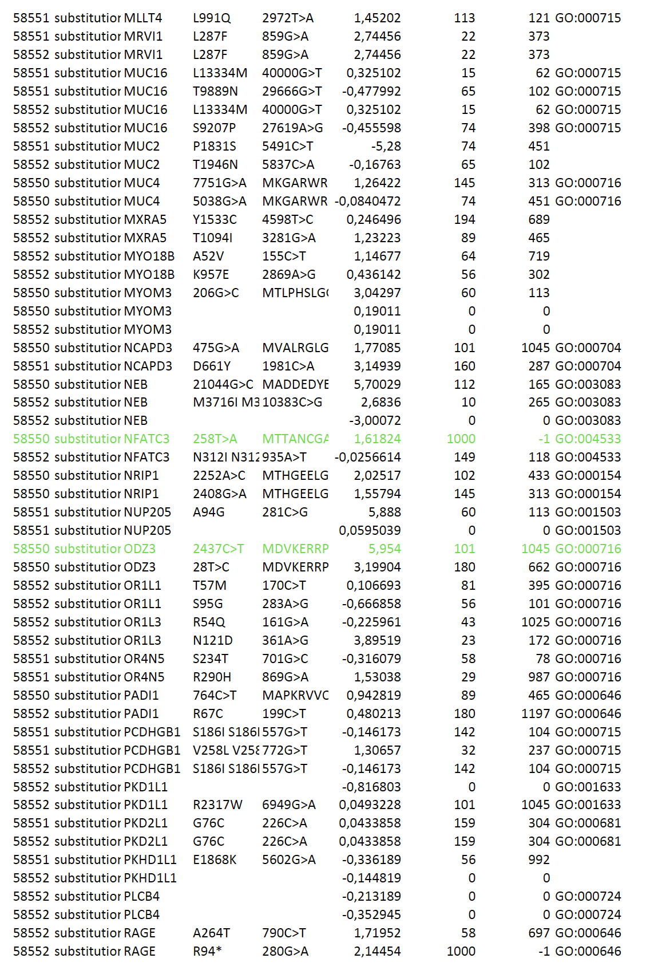
Exome Seq (done in 2011; A. Hoischen)
4°cousins
N
N
D
D
3
6
D
N
N
D
D
N
Multiple variants validated, no obvious causative mutation
2
2
D
D
D
F
D
D
D
N
N
4
2
D
D
D
D
D
F
N
N
N

Slide 13
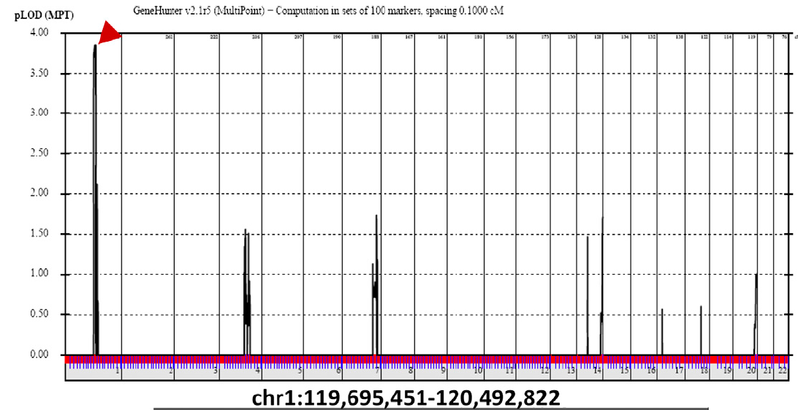
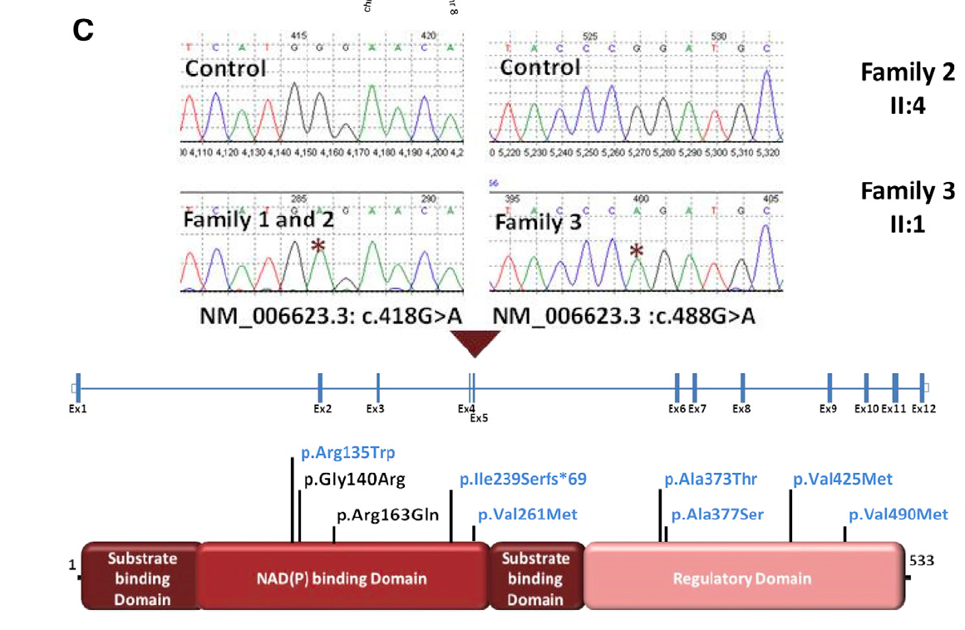

Slide 14
PHGDH – could we have missed it?
PHGDH: c.160C>T (het); p.(R54C)
N
N
Confirmation by Sanger sequencing
D
*
Notes:
Re-analysis of mapping data revealed a homozygous region on chromosome 1 in a consanguineous family overlapping the recently published gene locus of PHGDH . We identified a missense mutation in this family, additionally analysis of the exome of the affected fetus from family 7 showed a heterozygous mutation and a second mutation was identified with high resolution microarray analysis which revealted a smlall intragenic deletion of at least 3 exons.

Slide 15
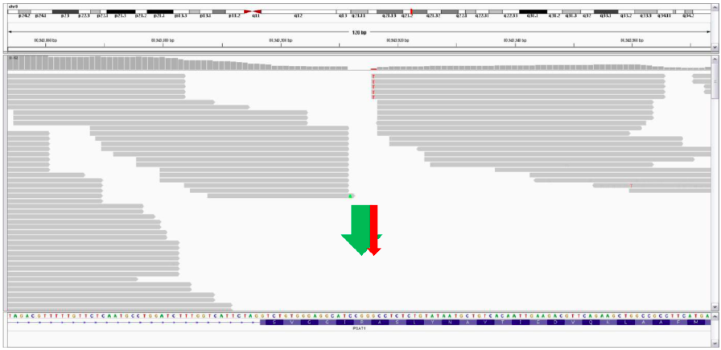
Missed: PSAT1 c.1023_1027delinsAGACCT
called as c.1027G>T
Notes:
Exome sequencing datal allowed uso map regions of homozygosity in the index case from family 1 which was not previously investigated inby array-based mapping. We identified a large homozygous region on choromsome 9 overlapping with homozygous intervals in three other families in which had undergone

Slide 16
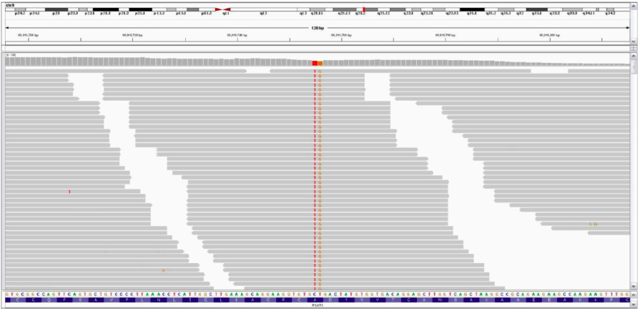
Missed: PSAT1 missense mutation in the proximity of a known SNP
called as rs3739474
not called

Slide 17
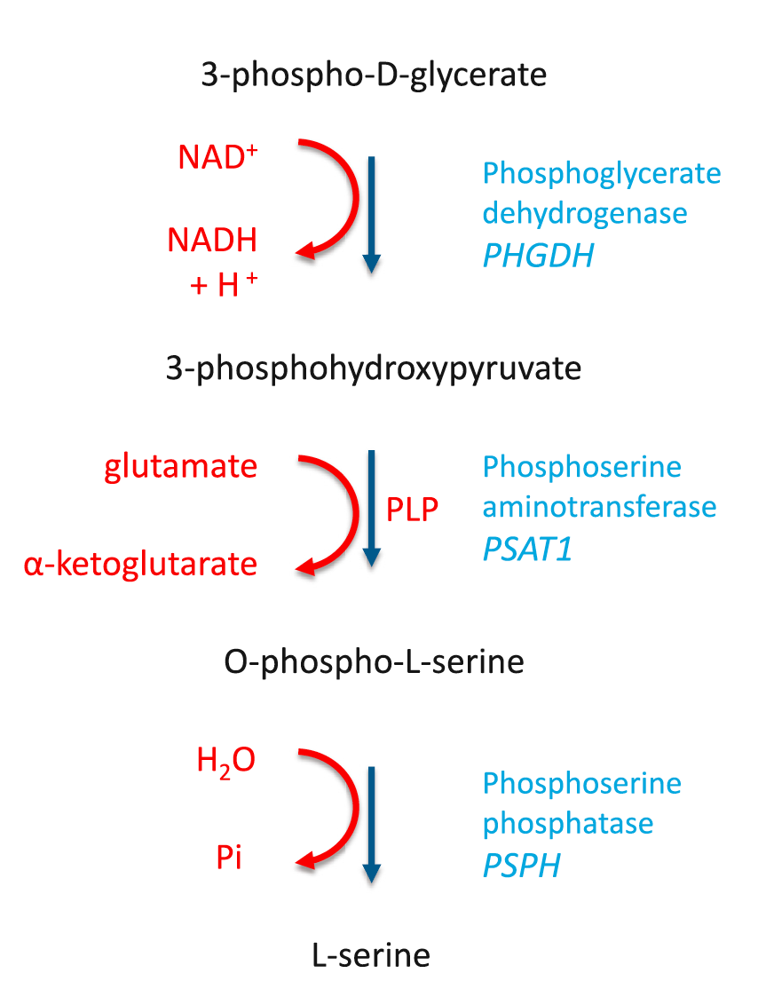
Serine biosynthesis
Enhanced serine biosynthesis:
During embryogenesis, particularly in neuroprogenitor cells
Melanoma and breast cancer cells express high levels of PHGDH
Serine deficiency disorders:
Autosomal recessive
Mutations in PHGDH, PSAT1 or PSPH
Residual enzyme activities 10-25%
Newborns/children: neurological phenotype with psychomotor retardation, microcephaly and seizures
Adults: progressive polyneuropathy
Potentially treatable
One-carbon metabolism nucleotide synthesis

Slide 18
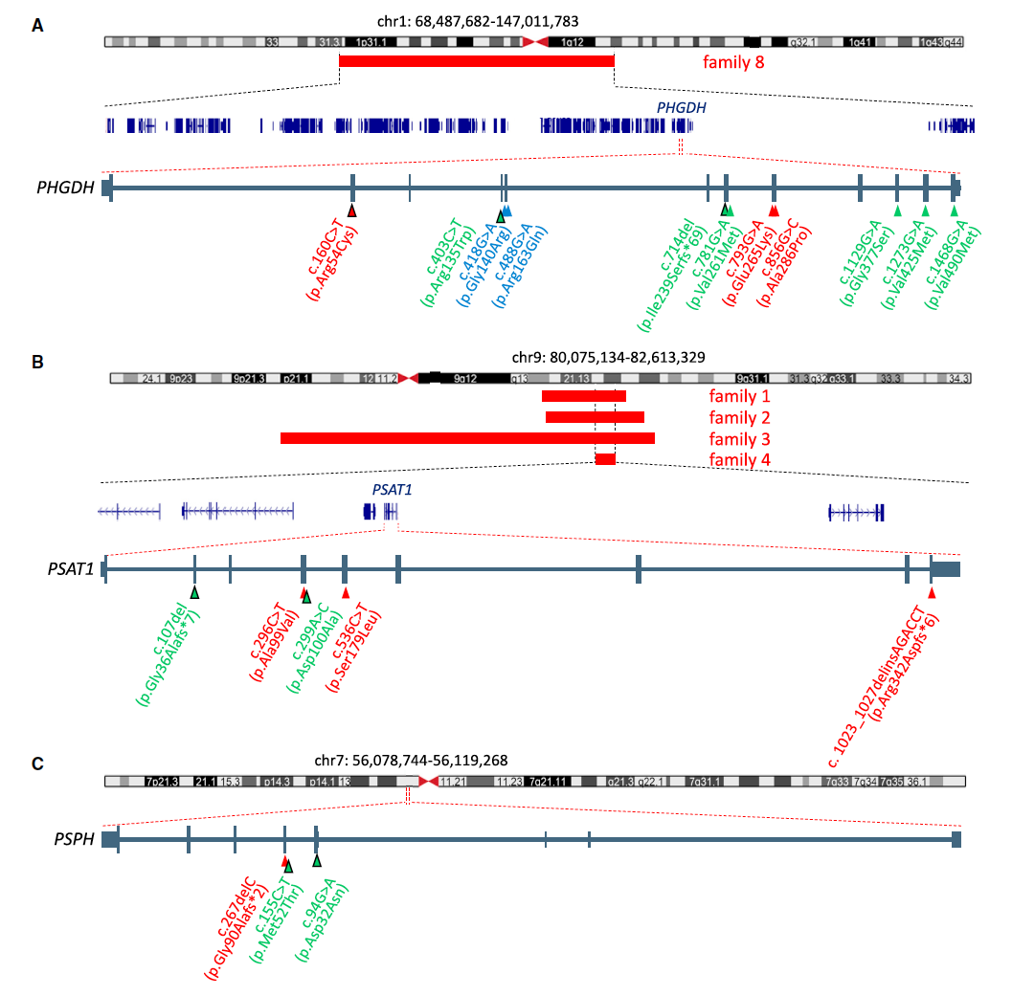
PHGDH:
3 families
PSAT1:
6 families
PSPH:
1 family

Slide 19
Summary of molecular findings
Biallelic mutations in 10 out of 12 families
All mutations novel ones
Mostly missense - except for one frameshift mut. of last exon (PHGDH), one het. 3-exon deletion (PHGDH), one frameshift mut. of next-to-last exon (PSPH)
Mutations probably do not lead to complete absence of the gene product
No functional testing available

Slide 20
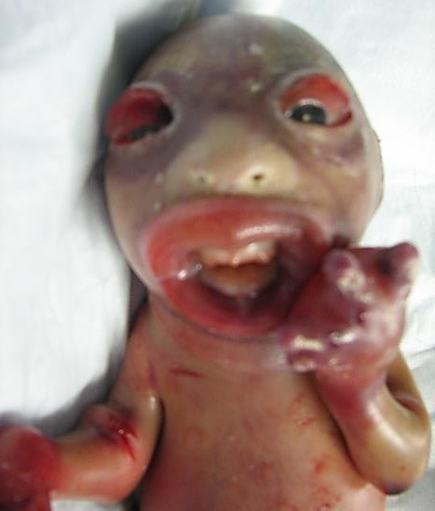
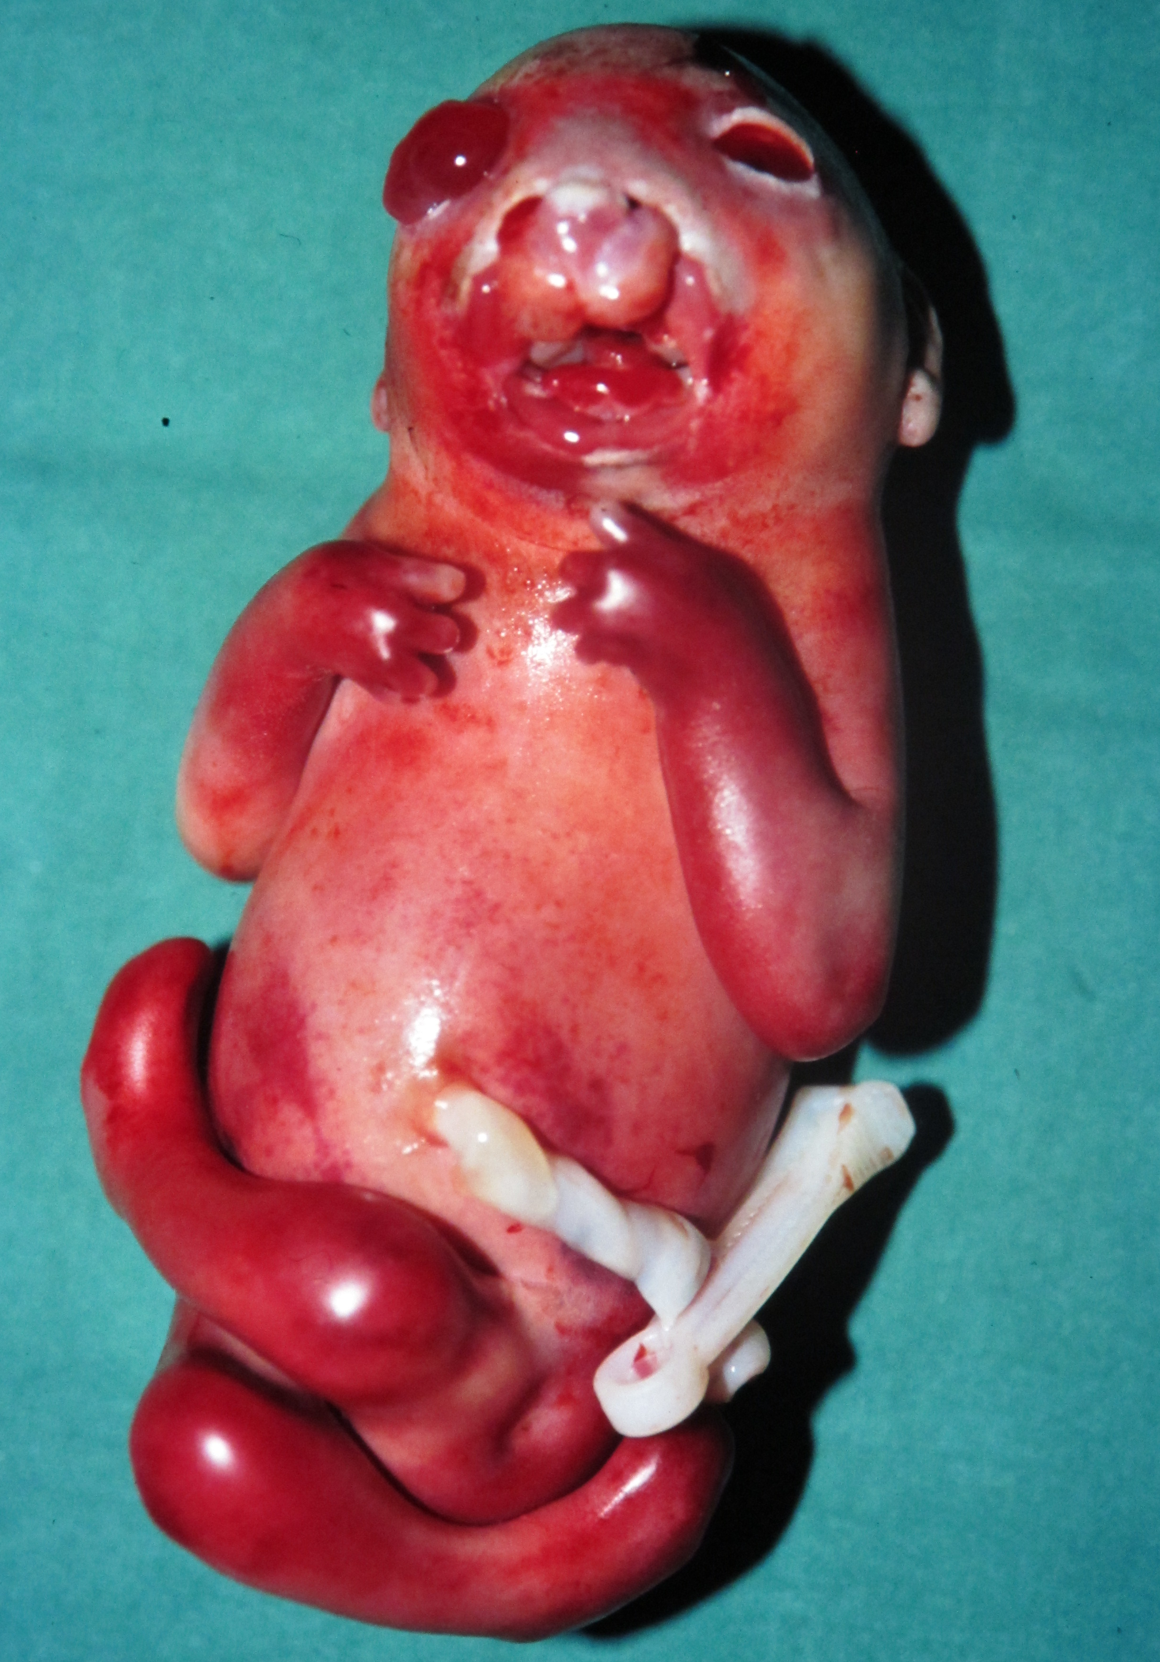
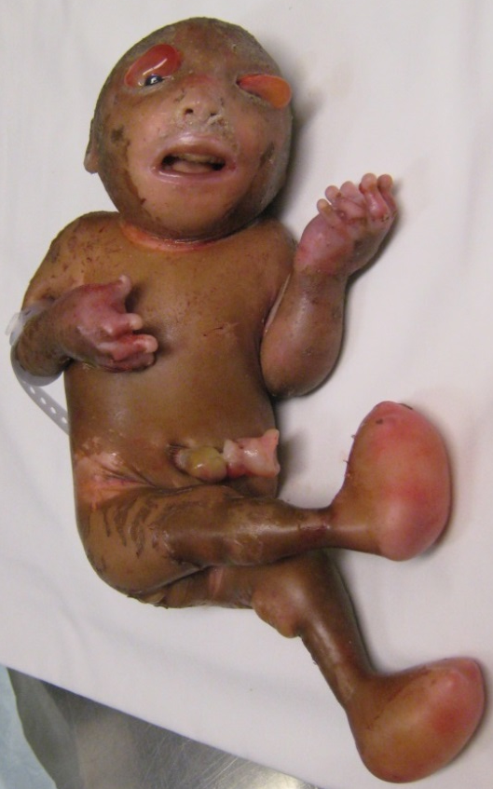
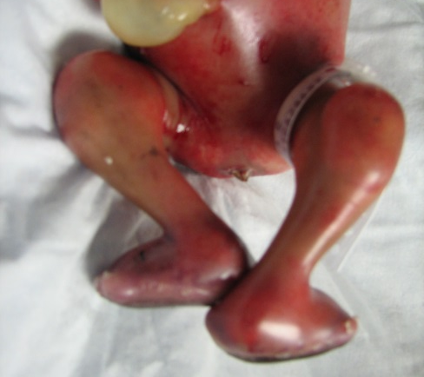
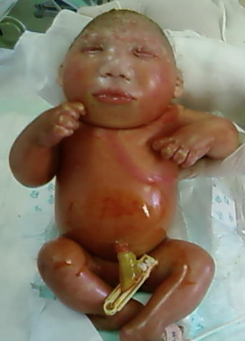
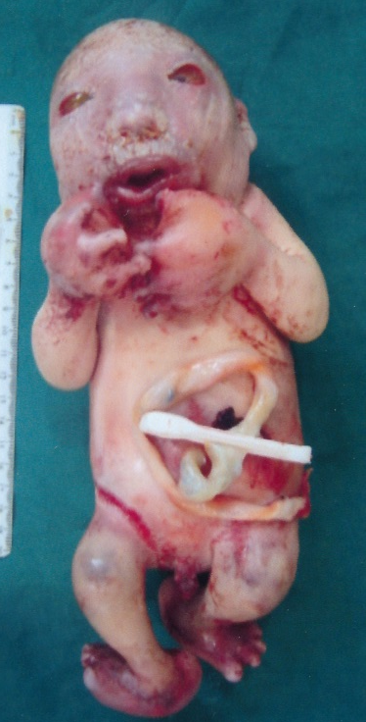
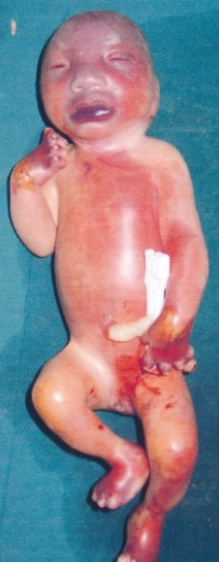
PHGDH: A286P
PHGDH: R54C/del
PSAT1: R342Dfs*6
PSAT1: S179L
PSAT1: A99V
PSAT1: A99V/S179L
PSPH: G90Afs*2

Slide 21
PSAT1: A99V

Slide 22
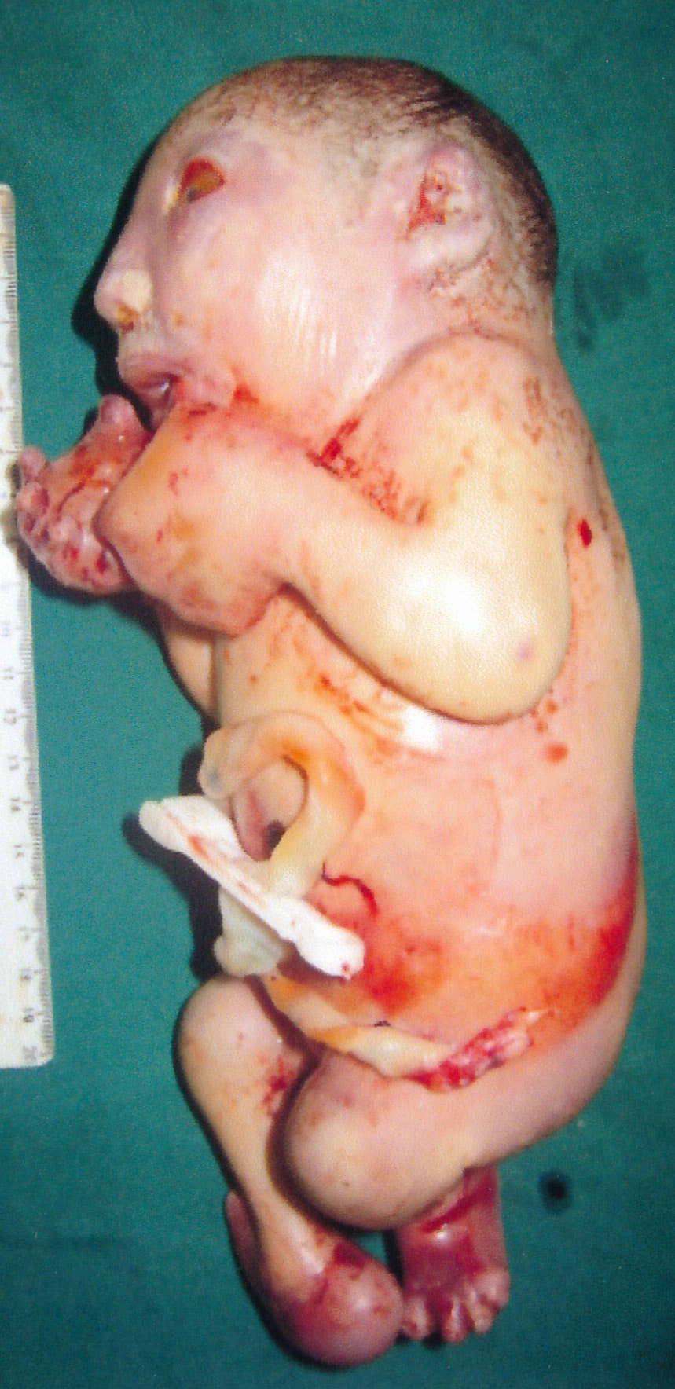
Unsolved
UV PSPH
D
D
D
4
2
D
D
D
D
UV PSPH
F
N
N
N
In the unsolved family the clinical features are completely compatible with Neu-Laxova
Notes:
The clinical features are not milder and not atypical.

Slide 23
Conclusions
NLS is a L-serine biosynthesis disorder
NLS is a disorder of impaired cellular proliferation, thus underscoring the critical role of serine supply in proliferating cells
NLS is (near) the ultimate end within a spectrum of serine deficiency disorders
There is at least one additional gene for NLS which is apparently not in the canonical L-serine biosynthesis pathway
Call for further patients

Slide 24
¹⁷ These authors contributed equally to this work
You can still win in a lost race!
Notes:
Make Ariana Kariminejad

Slide 25
Many thanks to my collaborators
Tehran
Mohamad Hasan Kariminejad
Siavash Ghaderi-Sohi, Payman Goodarzi, Hamidreza Setayesh,
Nijmegen
Magdeburg
Stockholm
Essen
Lübeck
Istanbul
Innsbruck
Fresno
Ottawa
Rocio Acuna-Hidalgo, Maartje van de Vorst, Marloes Steehouwer, Christian Gilissen, Marloes Steehouwer, Rolph Pfundt, Alexander Hoischen
Denny Schanze
Ann Nordgren, Peter Conner, Giedre Grigelioniene, Daniel Nilsson, Magnus Nordenskjöld, Anna Wedell
Dagmar Wieczorek
Gabriele Gillessen-Kaesbach
Hülya Kayserili, Nursel Elcioglu
Birgit Krabichler, Andreas R Janecke
Cynthia Curry
Malcolm G MacKenzie, Kym M Boycott
... and particular thanks to all families for their participation in this study
Notes:
Change the order

